Slide 1
Design of Experiments
Suhwan kim
Department of Statistics
Inha University
March 18, 2022

Slide 2
Chapter3. Analysis of Variance

Slide 3
Contents
Analysis of Variance
Example 3.1
The Analysis of Variance
Analysis of the Fixed Effects Model
Formal Statistical Hypothesis
Decomposition of the Total Sum of Squares
Model Adequacy Checking in the ANOVA
I) Normality → Checking Q-Q plot or Shapiro Test
II) Independence → Checking residual plots
III) Constant variance → Levene’s Test
- Other Important Residual Plots
Practice problem

Slide 4
Analysis of Variance
Example 3.1: Etch Rate Data
4 levels of RF power : (160W, 180W, 200W, 220W)
Replicated 5 times : (1, 2, 3, 4, 5) (runs made in random order)
 | Observations
Power (W)
 | 1 | 2 | 3 | 4 | 5 | Totals | Averages
160 | 575 | 542 | 530 | 539 | 570 | 2756 | 551.2
180 | 565 | 593 | 590 | 579 | 610 | 2937 | 587.4
200 | 600 | 651 | 610 | 637 | 629 | 3127 | 625.4
220 | 725 | 700 | 715 | 685 | 710 | 3535 | 707.0
Design of Experiments

Slide 5
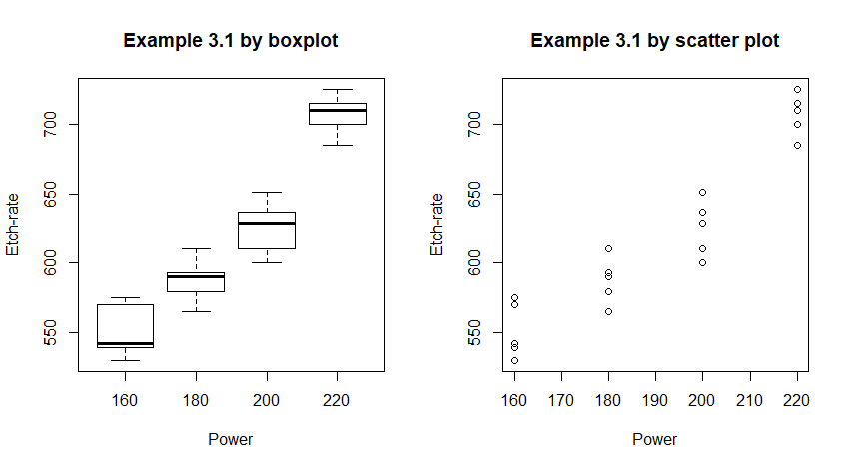
Analysis of Variance
Example 3.1: Etch Rate Data
Design of Experiments

Slide 6

Analysis of Variance
The Analysis of Variance
Completely Randomized Design (CRD)
a levels or treatments
n replicates
Run in random order
There are fixed effects case and the random effects case.
The goal is to test hypotheses about the equality of the $a$ treatment means
(i.e., $H_{0} :μ_{1}=...=μ_{a}$).
Design of Experiments

Slide 7
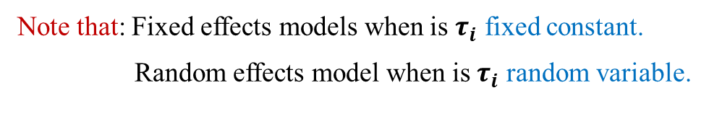

Analysis of Variance
The Analysis of Variance
One-Way ANOVA model
$$y_{ij}=μ+τ_{i}+ε_{ij} \text{is} \text{called} \text{the} \text{effects} \text{model}$$
$$\text{Let} μ_{i}=μ+τ_{i}, \text{then}$$
$$y_{ij}=μ_{i}+ε_{ij} \text{is} \text{called} \text{the} \text{means} \text{model}$$
Note that: Fixed effects models when is $τ_{i}$ fixed constant.
Random effects model when is $τ_{i}$ random variable.
Design of Experiments

Slide 8
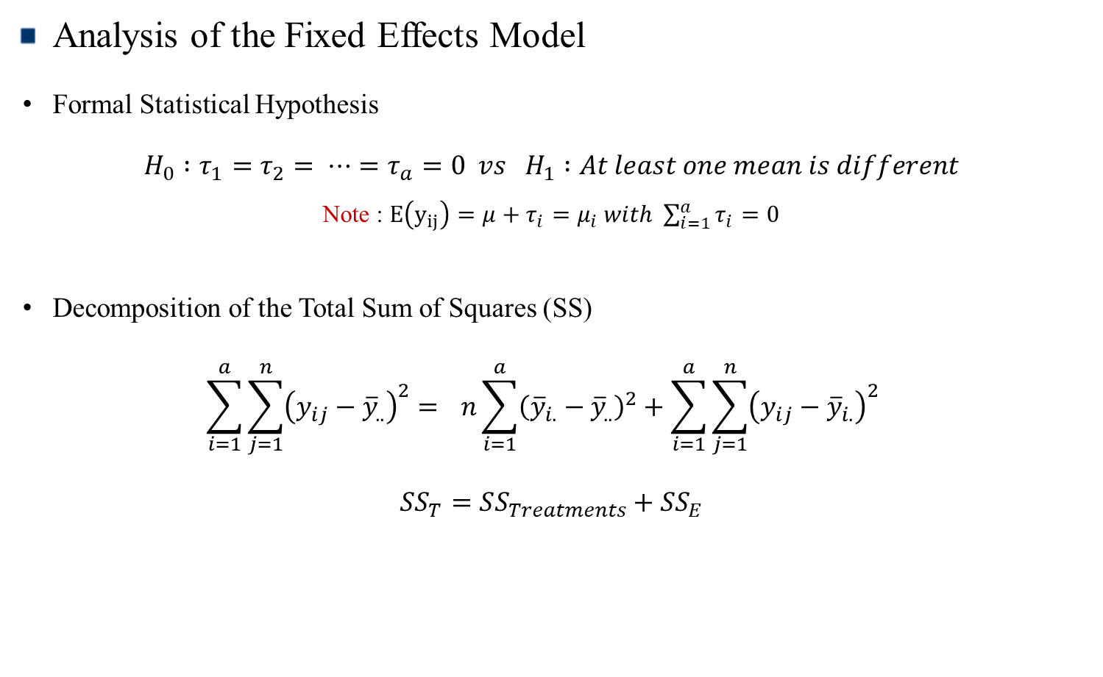
Analysis of Variance
Analysis of the Fixed Effects Model
Formal Statistical Hypothesis
$$H_{0} :τ_{1}=τ_{2}= ⋯=τ_{a}=0 vs H_{1} :At least one mean is different$$
Note : $E\left(y_{ij}\right)=μ+τ_{i}=μ_{i} with \sum_{i=1}^{a}{τ_{i}=0}$
Decomposition of the Total Sum of Squares (SS)
$$\sum_{i=1}^{a}{\sum_{j=1}^{n}{{\left(y_{ij}−{\overline{y}}_{..}\right)}^{2}= } }n\sum_{i=1}^{a}{{\left({\overline{y}}_{i.}−{\overline{y}}_{..}\right)}^{2}+\sum_{i=1}^{a}{\sum_{j=1}^{n}{{\left(y_{ij}−{\overline{y}}_{i.}\right)}^{2} } }}$$
$$SS_{T}=SS_{Treatments}+SS_{E}$$
Design of Experiments

Slide 9
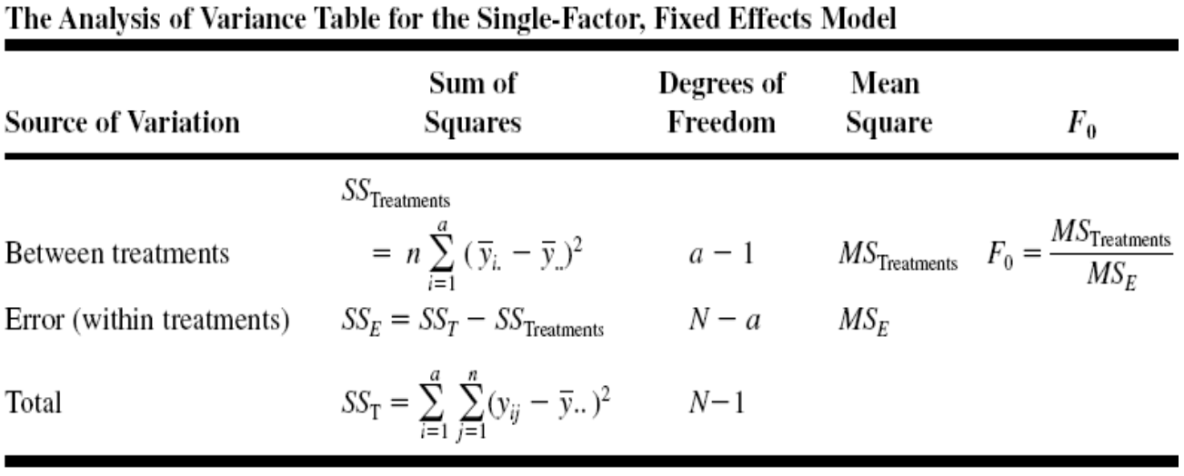
Analysis of Variance
Analysis of Fixed Effect Model
TABLE 3.3
Design of Experiments

Slide 10
Analysis of Variance
Analysis of Fixed Effect Model
Model Adequacy Checking in the ANOVA
I) Normality : Check for the assumption that the distribution of errors is normal.
Q-Q Plot
Shapiro-Wilk test
II) Independence : Check for residual plots.
Design of Experiments

Slide 11
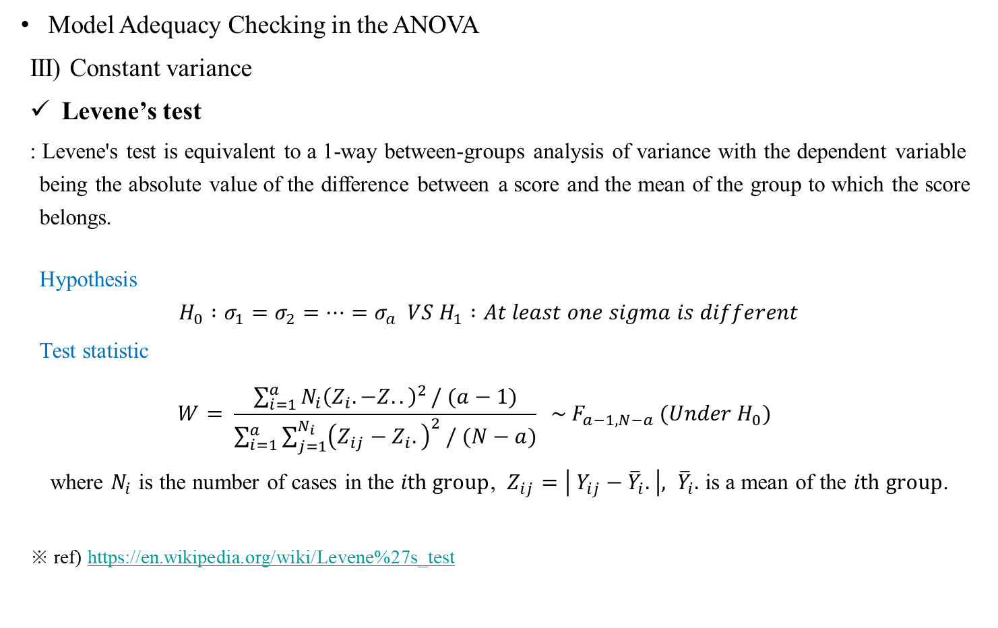
Analysis of Variance
Model Adequacy Checking in the ANOVA
III) Constant variance
Levene’s test
: Levene's test is equivalent to a 1-way between-groups analysis of variance with the dependent variable being the absolute value of the difference between a score and the mean of the group to which the score belongs.
Hypothesis
$$H_{0} :σ_{1}=σ_{2}=⋯=σ_{a} VS H_{1} :At least one sigma is different$$
Test statistic
$$W= \frac{\sum_{i=1}^{a}{N_{i}{\left(Z_{i}. −Z..\right)}^{2}}/ (a−1)}{\sum_{i=1}^{a}{\sum_{j=1}^{N_{i}}{{\left(Z_{ij}−Z_{i}.\right)}^{2} / (N−a)}}} \sim F_{a−1,N−a} (Under H_{0})$$
where $N_{i}$ is the number of cases in the $ith group$, $Z_{ij}=\left| Y_{ij}−{\overline{Y}}_{i}. \right|, {\overline{Y}}_{i}.$ is a mean of the $ith group$.
※ ref) https://en.wikipedia.org/wiki/Levene%27s_test
Design of Experiments

Slide 12
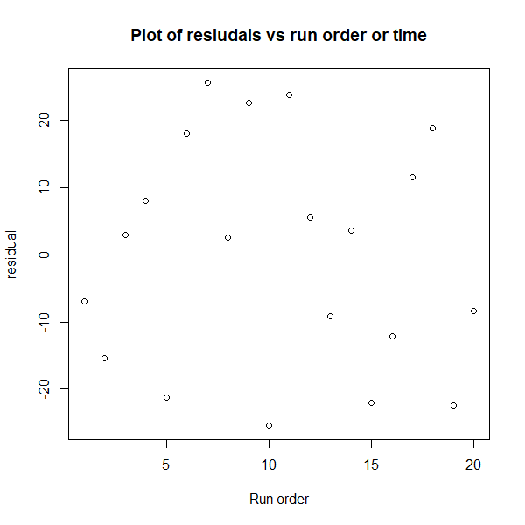
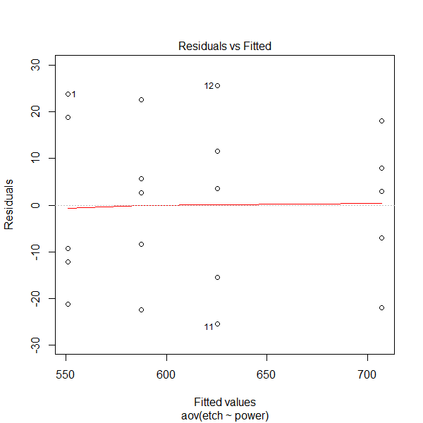
Analysis of Variance
Analysis of Fixed Effect Model
Other Important Residual Plots
Design of Experiments

Slide 13
Practice problem
혼합 기술 | 강도
A | 3135 | 3001 | 2865 | 2890
B | 3210 | 3311 | 2975 | 3150
C | 2815 | 2910 | 2985 | 3050
D | 2619 | 2706 | 2612 | 2765
Q1 : 혼합기술에 대한 Box plot 그려라
Q2 : 혼합기술이 시멘트강도의 영향을 줄 수 있다고 할 수 있는가? 유의수준 0.05로 검정하라.
Q3 : 모델이 적절한지에 대해 평가하라.
Design of Experiments

