Slide 1
Design of Experiments
Suhwan Kim
Department of Statistics
Inha University
March 25, 2022

Slide 2
Chapter3. Analysis of Variance

Slide 3
Contents
Contrasts
Orthogonal Contrasts
Scheffe’s Method
Comparing Pairs of Treatment Means
Fisher Least Significant Difference (LSD) Method
Tukey’s test
Comparing with a control
The random effects model

Slide 4
Analysis of Variance
Example 3.1: Etch Rate Data
4 levels of RF power : (160W, 180W, 200W, 220W)
Replicated 5 times : (1, 2, 3, 4, 5) (runs made in random order)
 | Observations
Power (W)
 | 1 | 2 | 3 | 4 | 5 | Totals | Averages
160 | 575 | 542 | 530 | 539 | 570 | 2756 | 551.2
180 | 565 | 593 | 590 | 579 | 610 | 2937 | 587.4
200 | 600 | 651 | 610 | 637 | 629 | 3127 | 625.4
220 | 725 | 700 | 715 | 685 | 710 | 3535 | 707.0
Design of Experiments

Slide 5
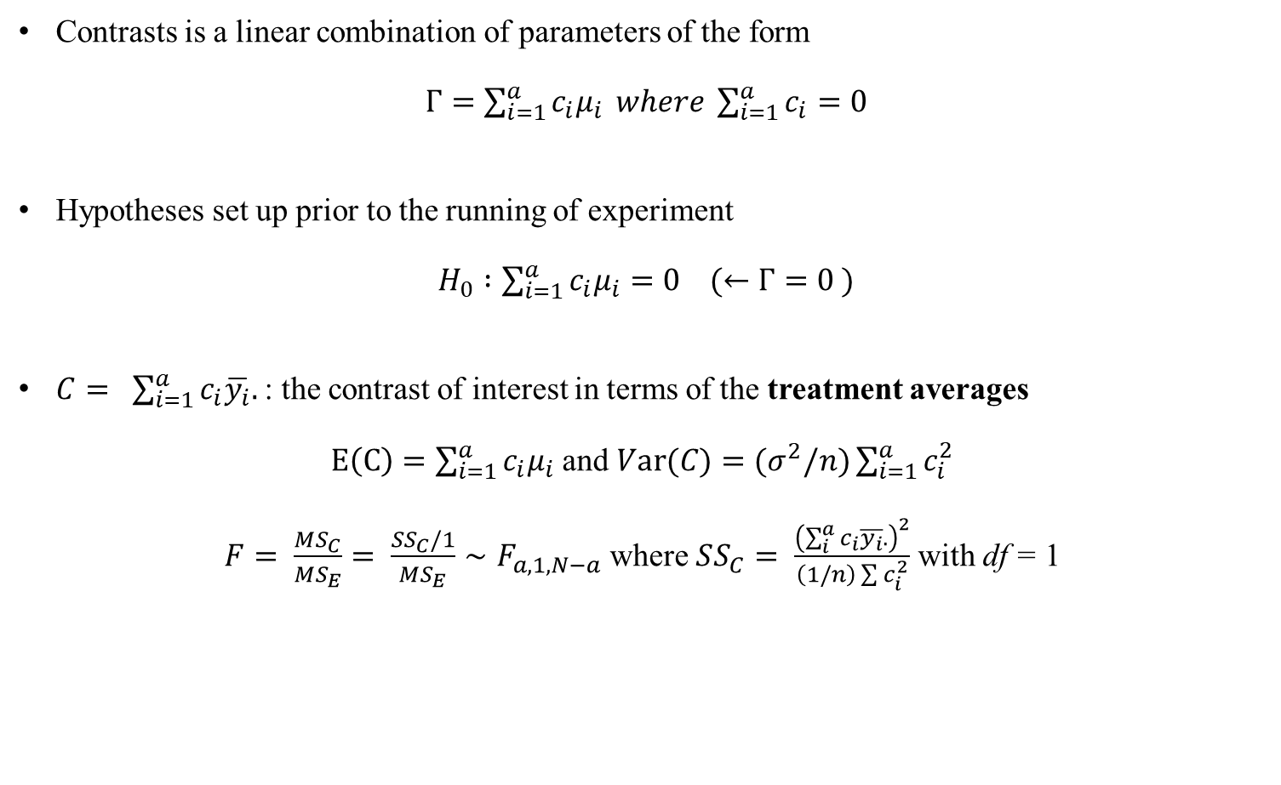
Contrasts
Contrasts is a linear combination of parameters of the form
$Γ=\sum_{i=1}^{a}{c_{i}μ_{i}} where \sum_{i=1}^{a}{c_{i}}=0$
Hypotheses set up prior to the running of experiment
$H_{0} :\sum_{i=1}^{a}{c_{i}μ_{i}}=0 (←Γ=0 )$
$C= \sum_{i=1}^{a}{c_{i}\overline{y_{i}}.}$: the contrast of interest in terms of the treatment averages
$E\left(C\right)=\sum_{i=1}^{a}{c_{i}μ_{i}}$ and $Var(C)=(σ^{2}/n)\sum_{i=1}^{a}{c_{i}^{2}}$
$F= \frac{MS_{C}}{MS_{E}}= \frac{SS_{C}/1}{MS_{E}}∼F_{a,1,N−a}$ where $SS_{C}= \frac{{\left(\sum_{i}^{a}{c_{i}\overline{y_{i}}.}\right)}^{2}}{\left(1/n\right)\sum{c_{i}^{2}}}$ with df = 1
Design of Experiments

Slide 6
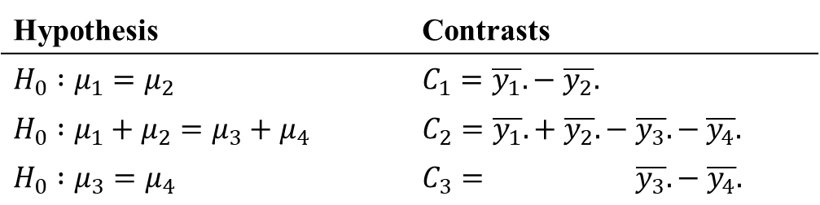

Orthogonal Contrasts
Definition : Two contrasts with coefficients $\{c_{i}\}$ and $\left\{d_{i}\right\}$ are orthogonal if
$\sum_{i=1}^{a}{c_{i}d_{i}}=0$
For a treatments, the set of (a-1) orthogonal contrasts partition the sum of squares
Example 3.6 (Ex 3.1 continued)
Hypothesis | Contrasts
$$H_{0} :μ_{1}=μ_{2}$$ | $$C_{1}=\overline{y_{1}}.− \overline{y_{2}}.$$
$$H_{0} :μ_{1}+μ_{2}=μ_{3}+μ_{4}$$ | $$C_{2}=\overline{y_{1}}.+ \overline{y_{2}}. − \overline{y_{3}}.− \overline{y_{4}}.$$
$$H_{0} :μ_{3}=μ_{4}$$ | $$C_{3}= \overline{y_{3}}.− \overline{y_{4}}.$$
Design of Experiments

Slide 7
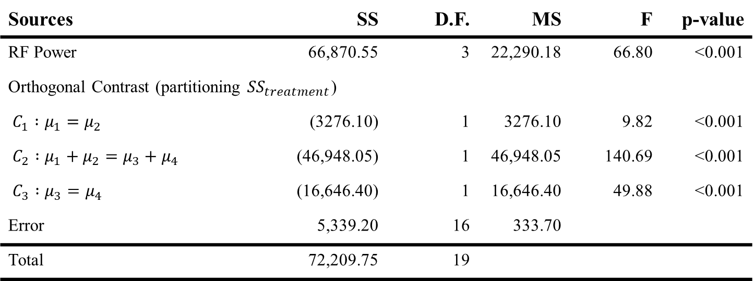
Orthogonal Contrasts
ANOVA Table
Sources | SS | D.F. | MS | F | p-value
RF Power | 66,870.55 | 3 | 22,290.18 | 66.80 | <0.001
Orthogonal Contrast (partitioning ${SS}_{treatment}$)
$C_{1} :μ_{1}=μ_{2}$ | (3276.10) | 1 | 3276.10 | 9.82 | <0.001
$C_{2} :μ_{1}+μ_{2}=μ_{3}+μ_{4}$ | (46,948.05) | 1 | 46,948.05 | 140.69 | <0.001
$C_{3} :μ_{3}=μ_{4}$ | (16,646.40) | 1 | 16,646.40 | 49.88 | <0.001
Error | 5,339.20 | 16 | 333.70
Total | 72,209.75 | 19
Design of Experiments

Slide 8
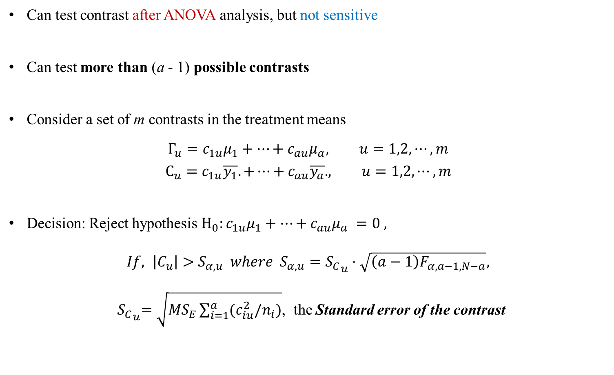
Scheffe’s Method
Can test contrast after ANOVA analysis, but not sensitive
Can test more than (a - 1) possible contrasts
Consider a set of m contrasts in the treatment means
$$Γ_{u}=c_{1u}μ_{1}+⋯+c_{au}μ_{a}, u=1,2, ⋯, m$$
$$C_{u}=c_{1u}\overline{y_{1}}. +⋯+c_{au}\overline{y_{a}}. , u=1,2,⋯, m$$
Decision: Reject hypothesis $H_{0}:c_{1u}μ_{1}+⋯+c_{au}μ_{a} =0 ,$
$If, \left|C_{u}\right|>S_{α,u} where$ $S_{α,u}={S_{C}}_{u}⋅\sqrt{\left(a−1\right)F_{α,a−1,N−a}},$
${ S_{C}}_{u}=\sqrt{MS_{E}\sum_{i=1}^{a}{(c_{iu}^{2}/n_{i})}}$, the Standard error of the contrast
Design of Experiments

Slide 9
Comparing Pairs of Treatment Means
May wish to compare only pairs of means
Scheffe’s method can be applied but not the most sensitive
Frequently, want to determine which means differ by testing the differences between all pairs of treatment means
Design of Experiments

Slide 10
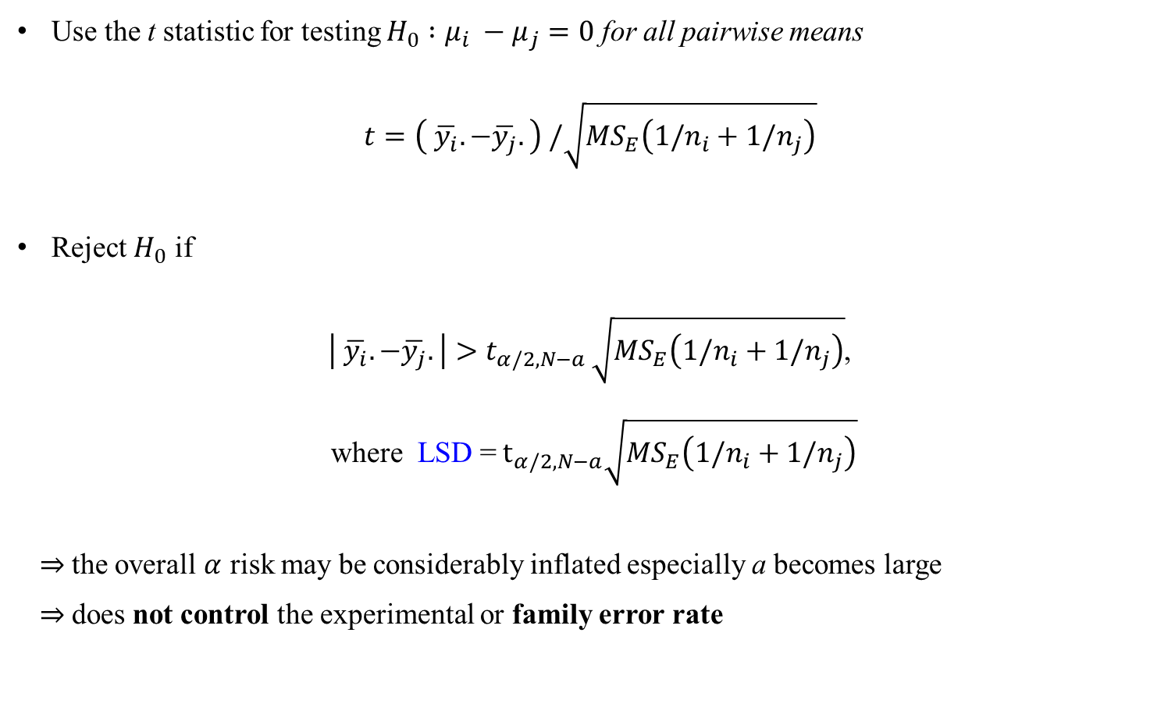
Fisher Least Significant Difference (LSD) Method
Use the t statistic for testing $H_{0} :μ_{i} −μ_{j}=0$ for all pairwise means
$t=\left( \overline{y_{i}}. −\overline{y_{j}}.\right) /\sqrt{MS_{E}\left(1/n_{i}+1/n_{j}\right)}$
Reject $H_{0}$ if
$\left| \overline{y_{i}}. −\overline{y_{j}}.\right|>t_{α/2,N−a }\sqrt{MS_{E}\left(1/n_{i}+1/n_{j}\right)}$,
where LSD =${ t}_{α/2,N−a}\sqrt{MS_{E}\left(1/n_{i}+1/n_{j}\right)}$
⇒ the overall $α$ risk may be considerably inflated especially a becomes large
⇒ does not control the experimental or family error rate
Design of Experiments

Slide 11
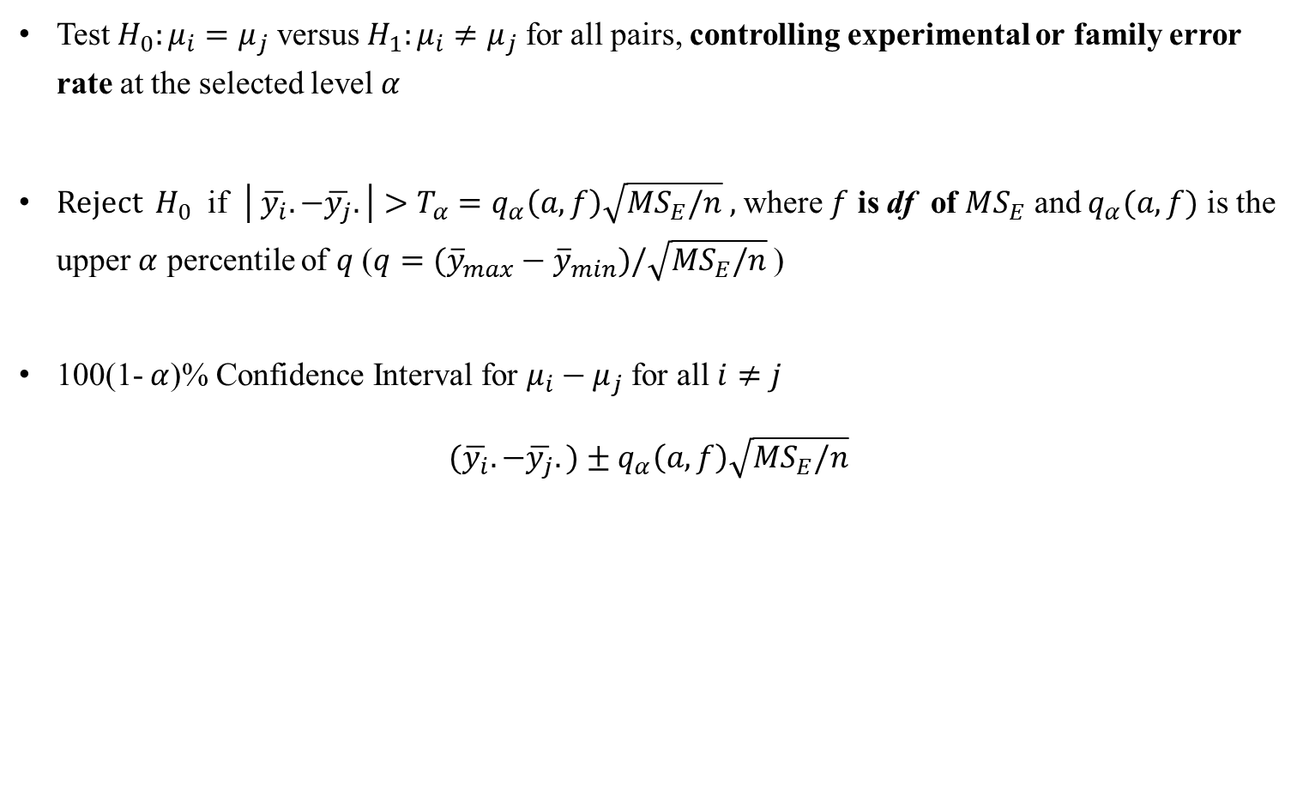
Tukey’s Test
Test $H_{0}:μ_{i}=μ_{j}$ versus $H_{1}:μ_{i}≠μ_{j}$ for all pairs, controlling experimental or family error rate at the selected level $α$
Reject ${ H}_{0}$ if $\left| \overline{y_{i}}. −\overline{y_{j}}.\right|>T_{α}=q_{α}\left(a,f\right)\sqrt{MS_{E}/n} ,$ where $f$ is df of $MS_{E}$ and $q_{α}(a,f)$ is the upper $α$ percentile of $q$ ($q=({\overline{y}}_{max}−{\overline{y}}_{min})/\sqrt{MS_{E}/n}$ )
100(1- $α$)% Confidence Interval for $μ_{i}−μ_{j}$ for all $i≠j$
$(\overline{y_{i}}. −\overline{y_{j}}.)±q_{α}\left(a,f\right)\sqrt{MS_{E}/n}$
Design of Experiments

Slide 12
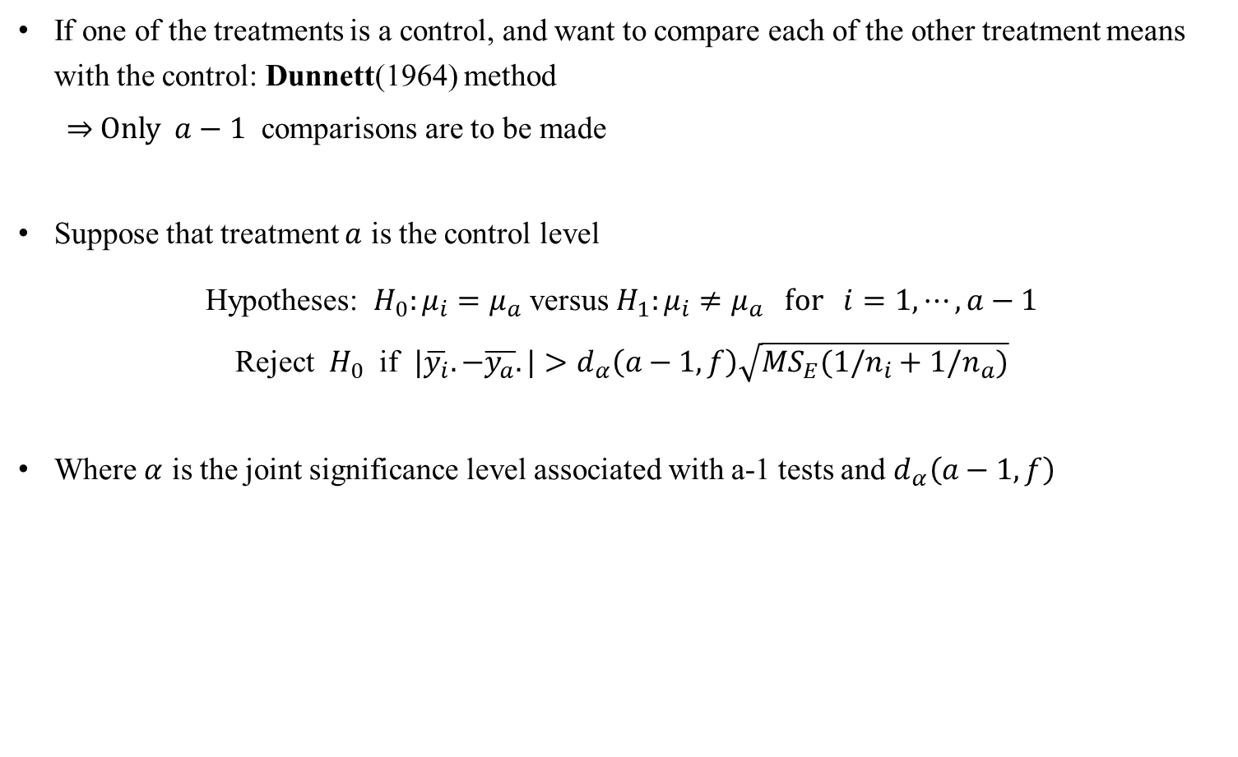
Comparing Treatment Means with a Control
If one of the treatments is a control, and want to compare each of the other treatment means with the control: Dunnett(1964) method
⇒ Only $a−1$ comparisons are to be made
Suppose that treatment $a$ is the control level
Hypotheses: $H_{0}:μ_{i}=μ_{a}$ versus $H_{1}:μ_{i}≠μ_{a} for i=1,⋯,a−1$
Reject ${ H}_{0}$ if $|\overline{y_{i}}.−\overline{y_{a}}.|>d_{α}\left(a−1,f\right)\sqrt{MS_{E}(1/n_{i}+1/n_{a})}$
Where $α$ is the joint significance level associated with a-1 tests and $d_{α}\left(a−1,f\right)$
Design of Experiments

Slide 13

The Random Effects Model
There are a large number of possible levels for the factor
The experimenter chooses $a$ of these levels at random
Model:
$$y_{ij}=μ+τ_{i}+ε_{ij}, i=1,2,⋯,a ; j=1,2,⋯,n$$
Where both $τ_{i}$ and $ε_{ij}$ are random and independent
Assumptions:
$τ_{i}\sim IN(0,σ_{τ}^{2})$ and $ε_{ij}\sim IN(0,σ^{2})$ with ${τ_{i}⊥ε}_{ij}$
Note that ${Var(y}_{ij})=σ_{τ}^{2}+σ^{2}$ (Variance Components)
Design of Experiments

Slide 14

The Random Effects Model
Hypotheses:
$$H_{O}:σ_{τ}^{2}=0 versus H_{1}:σ_{τ}^{2}>0$$
Estimating the model parameters
$$E\left[MS_{treatment}\right]=σ^{2}+nσ_{τ}^{2} and E\left[MS_{E}\right]=σ^{2}$$
⇒ ${\hat{σ}}^{2}=MS_{E}, {{\hat{σ}}_{τ}}^{2}=\frac{MS_{treatment}−MS_{E}}{n}$
Design of Experiments

Slide 15
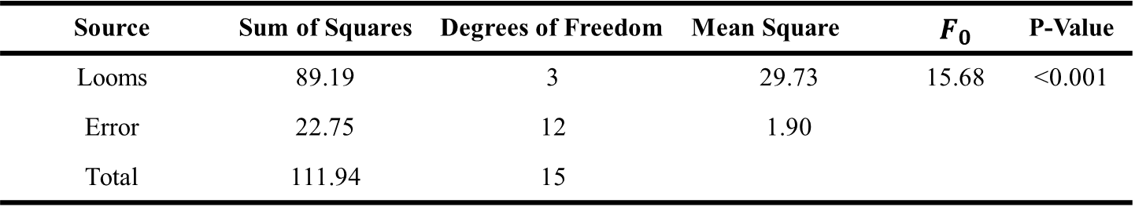
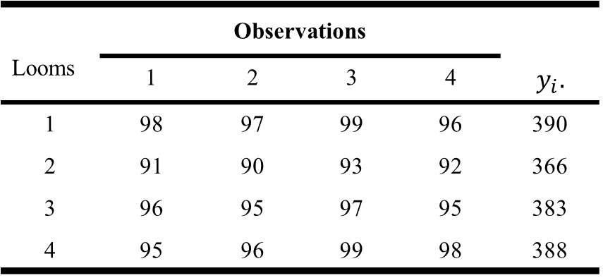
The Random Effects Model
Strength data for example 3.11
ANOVA Table
 | Observations
Looms
 | 1 | 2 | 3 | 4 | $$y_{i}.$$
1 | 98 | 97 | 99 | 96 | 390
2 | 91 | 90 | 93 | 92 | 366
3 | 96 | 95 | 97 | 95 | 383
4 | 95 | 96 | 99 | 98 | 388
Source | Sum of Squares | Degrees of Freedom | Mean Square | $$F_{0}$$ | P-Value
Looms | 89.19 | 3 | 29.73 | 15.68 | <0.001
Error | 22.75 | 12 | 1.90
Total | 111.94 | 15
Design of Experiments

Slide 16

The Random Effects Model
${{\hat{σ}}_{τ}}^{2}=\frac{29.73 −1.90}{4}=6.96$ and ${\hat{σ}}_{y}^{2}={\hat{σ}}^{2}+{\hat{σ}}_{τ}^{2}=1.90+6.96=8.86$
Confidence interval for the error variance:
$\frac{\left(N−a\right)MS_{E}}{χ_{α/2,N−a}^{2}}≤σ^{2}≤\frac{\left(N−a\right)MS_{E}}{χ_{1−\left(α/2\right),N−a}^{2}}$
Design of Experiments

Slide 17
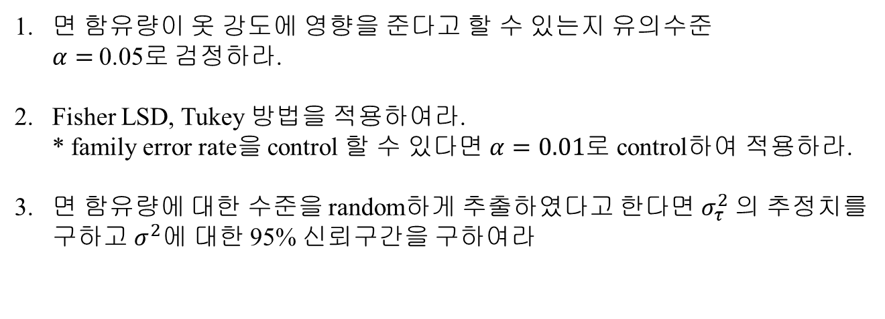
Exercise
면 함유량 | 관찰값
 | 1 | 2 | 3 | 4 | 5
15 | 7 | 7 | 15 | 11 | 9
20 | 12 | 17 | 12 | 18 | 18
25 | 14 | 19 | 19 | 18 | 18
30 | 19 | 25 | 22 | 19 | 23
35 | 7 | 10 | 11 | 15 | 11
Table1 : 옷 개발을 위한 면 함유량에 따른 옷 강도
면 함유량이 옷 강도에 영향을 준다고 할 수 있는지 유의수준 $α=$0.05로 검정하라.
Fisher LSD, Tukey 방법을 적용하여라. * family error rate을 control 할 수 있다면 $α=0.01$로 control하여 적용하라.
면 함유량에 대한 수준을 random하게 추출하였다고 한다면 $σ_{τ}^{2}$의 추정치를 구하고 $σ^{2}에$ 대한 95% 신뢰구간을 구하여라
Design of Experiments

