Slide 1
Design of Experiments
Suhwan Kim
Department of Statistics
Inha University
April 1, 2022

Slide 2
Chapter4. Experiments with Blocking Factors

Slide 3
Contents
The Randomized Complete Block Design (RCBD)
The Blocking Principle
Statistical Analysis of the RCBD
Analysis of Variance for a RCBD
Some Other Aspects of RCBD
Random Treatments and/or Blocks
Estimating Missing Values
The Latin Square Design

Slide 4
The Randomized Complete Block Design (RCBD)
The Blocking Principle
A nuisance factor is a factor that probably has some effect on the response, but it’s of no interest.
Blocking is a technique for dealing with nuisance factors
If the nuisance variable is known and controllable
→ Use blocking, Randomized Complete Block Design (RCBD)
If the factor is known and uncontrollable
→ Use analysis of covariance
If the factor is unknown and uncontrollable (a “lurking” variable)
→ Randomization balances out its impact across the experiment
Design of Experiments

Slide 5
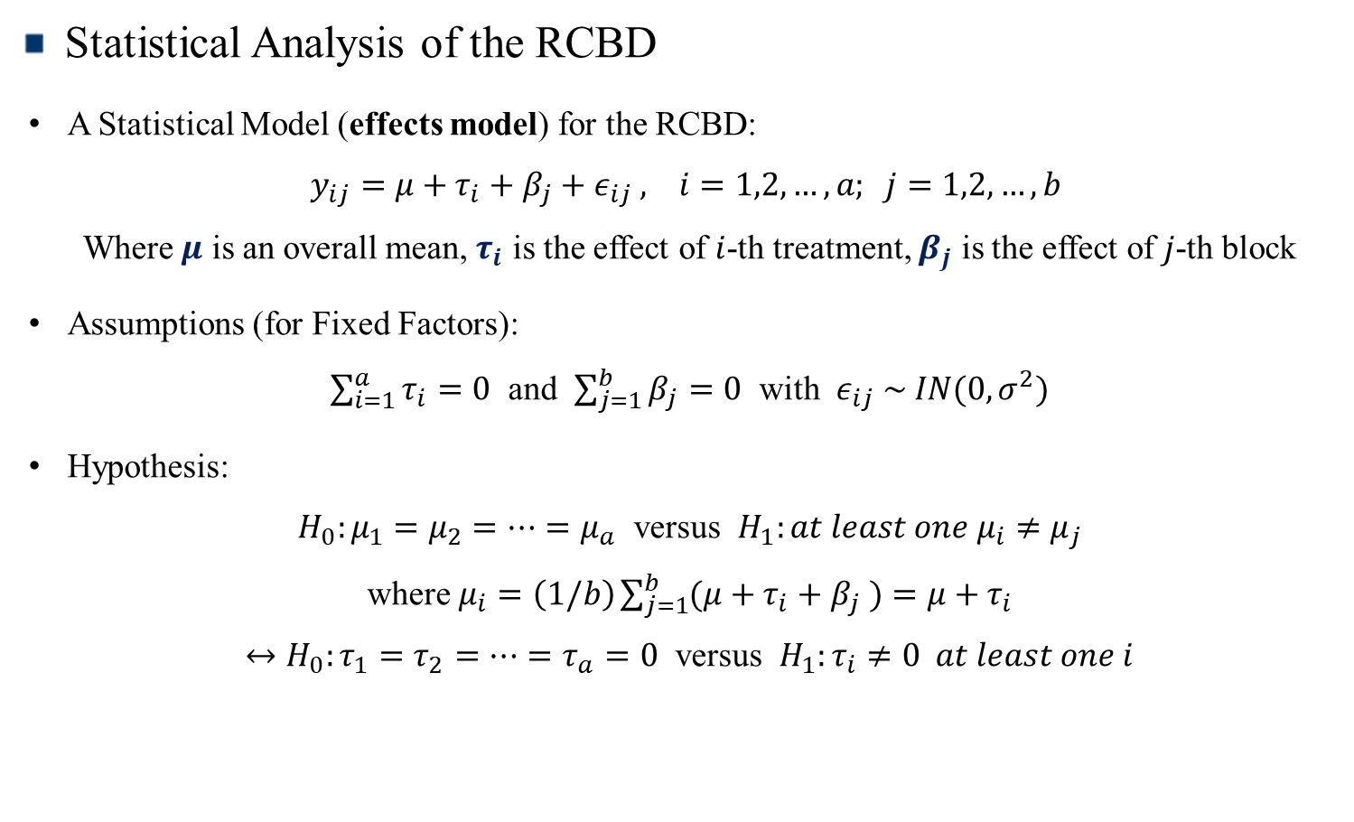
The Randomized Complete Block Design (RCBD)
Statistical Analysis of the RCBD
A Statistical Model (effects model) for the RCBD:
$y_{ij}=μ+τ_{i}+β_{j}+ε_{ij} , i=1,2,…,a; j=1,2,…,b$
Where $μ$ is an overall mean, $τ_{i}$ is the effect of $i$-th treatment, $β_{j}$ is the effect of $j$-th block
Assumptions (for Fixed Factors):
$\sum_{i=1}^{a}{τ_{i}}=0$ and $\sum_{j=1}^{b}{β_{j}}=0$ with $ε_{ij} \sim IN(0,σ^{2})$
Hypothesis:
$H_{0}:μ_{1}=μ_{2}=…=μ_{a}$ versus $H_{1}:at least one μ_{i}≠μ_{j}$
where $μ_{i}=\left(1/b\right)\sum_{j=1}^{b}{(μ+τ_{i}}+β_{j} )=μ+τ_{i}$
$↔H_{0}:τ_{1}=τ_{2}=…=τ_{a}=0$ versus $H_{1}:τ_{i}≠0 at least one i$
Design of Experiments

Slide 6
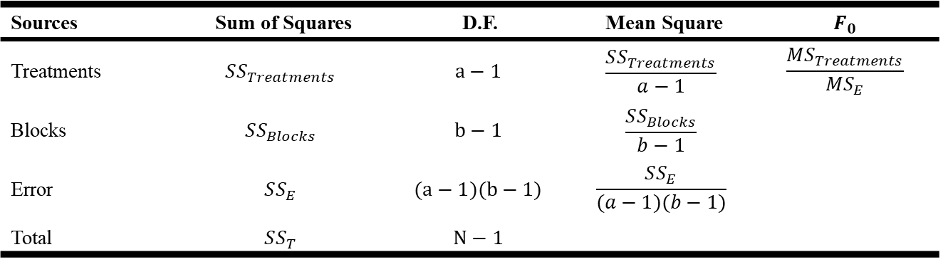

The Randomized Complete Block Design (RCBD)
Analysis of Variance for a RCBD
ANOVA Table
Testing Hypotheses
Test Static: $F_{0}=\frac{MS_{Treatments}}{MS_{E}}\sim F_{a−1,(a−1)(b−1)}$ under $H_{0} (τ_{1}=…=τ_{a})$
→ Reject $H_{0}$ if $F_{0}>F_{α,a−1,(a−1)(b−1)}$
Sources | Sum of Squares | D.F. | Mean Square | $$F_{0}$$
Treatments | $$SS_{Treatments}$$ | $$a−1$$ | $$\frac{SS_{Treatments}}{a−1}$$ | $$\frac{MS_{Treatments}}{MS_{E}}$$
Blocks | $$SS_{Blocks}$$ | $$b−1$$ | $$\frac{SS_{Blocks}}{b−1}$$
Error | $$SS_{E}$$ | $$(a−1)(b−1)$$ | $$\frac{SS_{E}}{(a−1)(b−1)}$$
Total | $$SS_{T}$$ | $$N−1$$
Design of Experiments

Slide 7
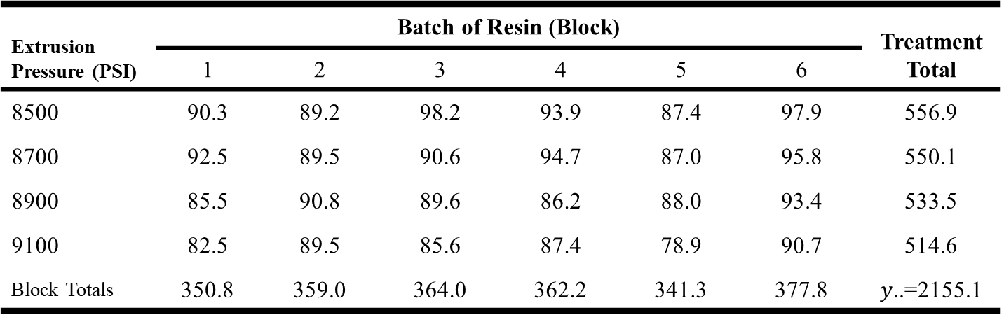
The Randomized Complete Block Design (RCBD)
Example 4.1
4 levels of Extrusion Pressure (PSI) : (8500, 8700, 8900, 9100)
6 levels of Batch of Resin : (1, 2, 3, 4, 5, 6)
Conduct a RCBD, assign all 4 pressures to each of the 6 batches of resin
Extrusion Pressure (PSI) | Batch of Resin (Block) |  |  |  |  |  | Treatment Total
 | 1 | 2 | 3 | 4 | 5 | 6
8500 | 90.3 | 89.2 | 98.2 | 93.9 | 87.4 | 97.9 | 556.9
8700 | 92.5 | 89.5 | 90.6 | 94.7 | 87.0 | 95.8 | 550.1
8900 | 85.5 | 90.8 | 89.6 | 86.2 | 88.0 | 93.4 | 533.5
9100 | 82.5 | 89.5 | 85.6 | 87.4 | 78.9 | 90.7 | 514.6
Block Totals | 350.8 | 359.0 | 364.0 | 362.2 | 341.3 | 377.8 | $y$..=2155.1
Design of Experiments

Slide 8
The Randomized Complete Block Design (RCBD)
tapply
Use when you want to see the sum of treatment and block
tapply(x, index, sum(x))
Extrusion Pressure (PSI) | Batch of Resin (Block) |  |  |  |  |  | Treatment Total
 | 1 | 2 | 3 | 4 | 5 | 6
8500 | 90.3 | 89.2 | 98.2 | 93.9 | 87.4 | 97.9 | 556.9
8700 | 92.5 | 89.5 | 90.6 | 94.7 | 87.0 | 95.8 | 550.1
8900 | 85.5 | 90.8 | 89.6 | 86.2 | 88.0 | 93.4 | 533.5
9100 | 82.5 | 89.5 | 85.6 | 87.4 | 78.9 | 90.7 | 514.6
Block Totals | 350.8 | 359.0 | 364.0 | 362.2 | 341.3 | 377.8 | $y$..=2155.1
Design of Experiments

Slide 9
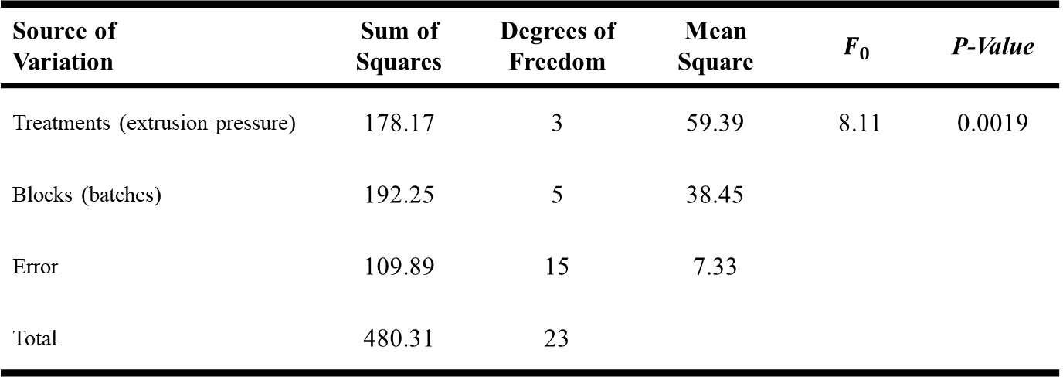

The Randomized Complete Block Design (RCBD)
ANOVA Table
→ Reject $H_{0}$ (note that no test for block effects)
Source of Variation | Sum of Squares | Degrees of Freedom | Mean Square | $$F_{0}$$ | P-Value
Treatments (extrusion pressure) | 178.17 | 3 | 59.39 | 8.11 | 0.0019
Blocks (batches) | 192.25 | 5 | 38.45
Error | 109.89 | 15 | 7.33
Total | 480.31 | 23
Design of Experiments

Slide 10
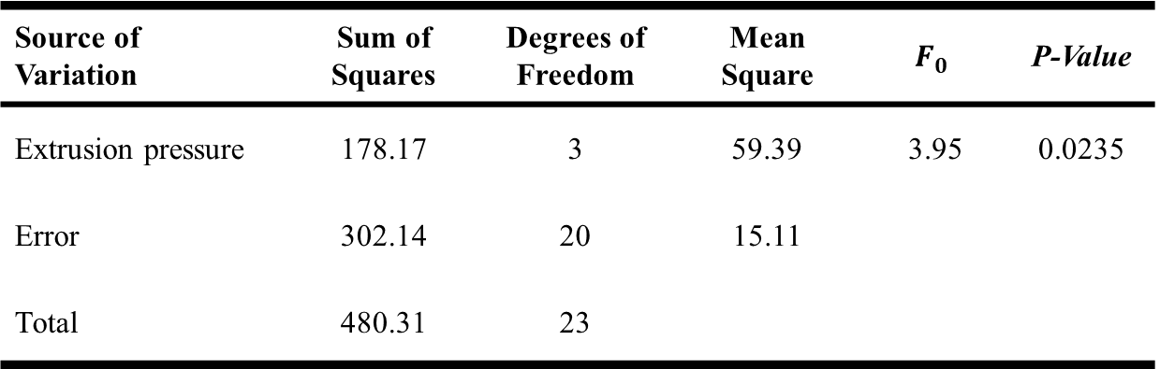

The Randomized Complete Block Design (RCBD)
Some Other Aspects of RCBD
ANOVA Table (Run by a CRD, $n=b=6$, by chance)
→ $H_{0}$ is reject from both ANOVA
→ but ${\hat{σ}}^{2}$ decreases when blocking factor is considered (15.11 →7.33)
Source of Variation | Sum of Squares | Degrees of Freedom | Mean Square | $$F_{0}$$ | P-Value
Extrusion pressure | 178.17 | 3 | 59.39 | 3.95 | 0.0235
Error | 302.14 | 20 | 15.11
Total | 480.31 | 23
Design of Experiments

Slide 11
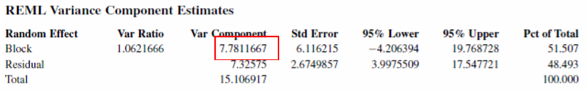
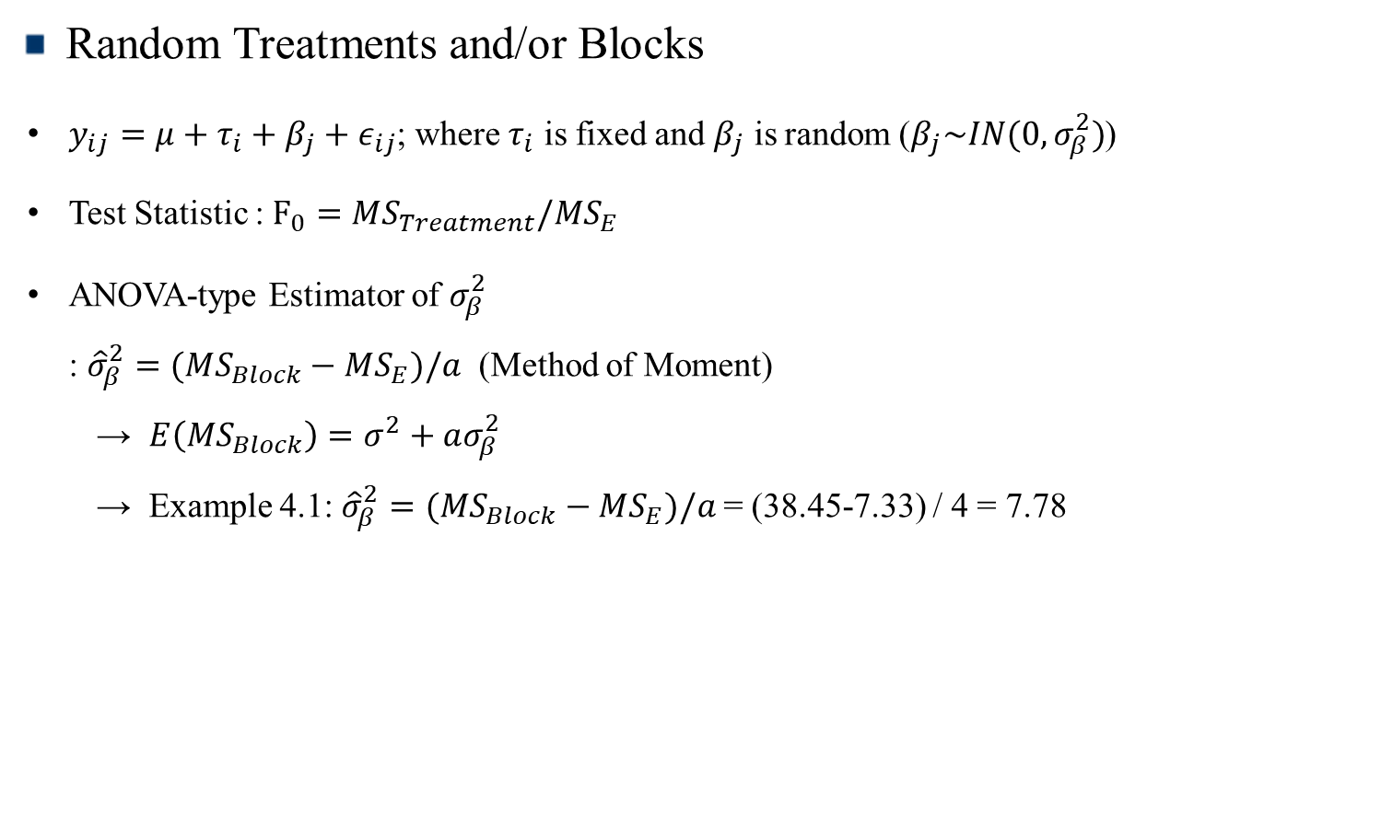
The Randomized Complete Block Design (RCBD)
Random Treatments and/or Blocks
$y_{ij}=μ+τ_{i}+β_{j}+ε_{ij}$; where $τ_{i}$ is fixed and $β_{j}$ is random ($β_{j}\sim IN(0,σ_{β}^{2})$)
Test Statistic : $F_{0}=MS_{Treatment}/MS_{E}$
ANOVA-type Estimator of $σ_{β}^{2}$
: ${\hat{σ}}_{β}^{2}=(MS_{Block}−MS_{E})/a$ (Method of Moment)
→ $E\left(MS_{Block}\right)=σ^{2}+aσ_{β}^{2}$
→ Example 4.1: ${\hat{σ}}_{β}^{2}=(MS_{Block}−MS_{E})/a$ = (38.45-7.33) / 4 = 7.78
Design of Experiments

Slide 12
The Latin Square Design
The Latin Square Design
These designs are used to simultaneously control two sources of nuisance variability
A significant assumption is that the three factors do not interact
If this assumption is violated, the Latin square design will not produce valid results
Design of Experiments

Slide 13
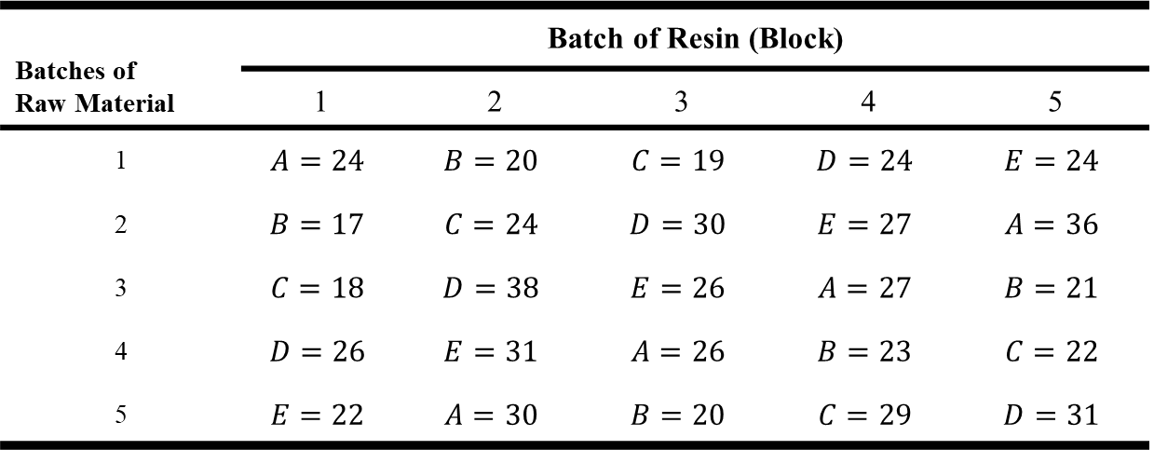

The Latin Square Design
The Rocket Propellant Problem – A Latin Square Design
Treatment: 5 formulations of a rocket propellant (A, B, C, D, E)
Two Block Factors with 5 levels (Operators; Batches of raw material)
$5×5$ Latin Square Design
Batches of Raw Material | Batch of Resin (Block)
 | 1 | 2 | 3 | 4 | 5
1 | $$A=24$$ | $$B=20$$ | $$C=19$$ | $$D=24$$ | $$E=24$$
2 | $$B=17$$ | $$C=24$$ | $$D=30$$ | $$E=27$$ | $$A=36$$
3 | $$C=18$$ | $$D=38$$ | $$E=26$$ | $$A=27$$ | $$B=21$$
4 | $$D=26$$ | $$E=31$$ | $$A=26$$ | $$B=23$$ | $$C=22$$
5 | $$E=22$$ | $$A=30$$ | $$B=20$$ | $$C=29$$ | $$D=31$$
Design of Experiments

Slide 14
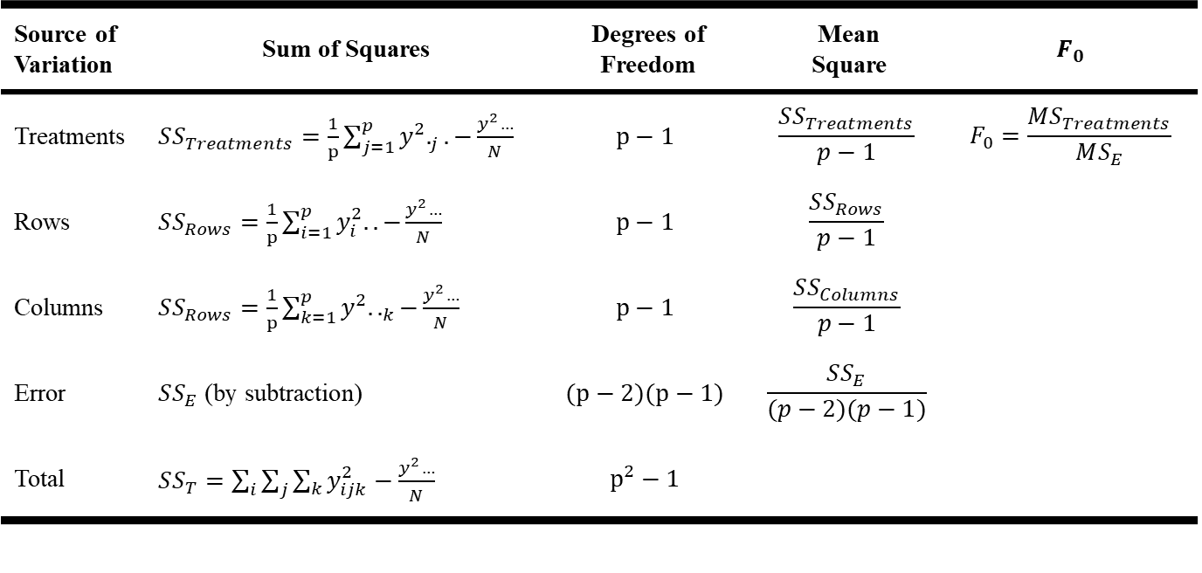

The Latin Square Design
Statistical Analysis
→ Model: $y_{ijk}=μ+α_{i}+τ_{j}+β_{k}+ε_{ijk} (i, j, k=1,…,p)$
→ The statistical analysis (ANOVA) is much like the analysis for the RCBD
Source of Variation | Sum of Squares | Degrees of Freedom | Mean Square | $$F_{0}$$
Treatments | $SS_{Treatments}=\frac{1}{p}\sum_{j=1}^{p}{y^{2}._{j}.−}\frac{y^{2}…}{N}$ | $$p−1$$ | $$\frac{SS_{Treatments}}{p−1}$$ | $$F_{0}=\frac{MS_{Treatments}}{MS_{E}}$$
Rows | $SS_{Rows}=\frac{1}{p}\sum_{i=1}^{p}{y_{i}^{2}.. −}\frac{y^{2}…}{N}$ | $$p−1$$ | $$\frac{SS_{Rows}}{p−1}$$
Columns | $SS_{Rows}=\frac{1}{p}\sum_{k=1}^{p}{y^{2}.._{k}−}\frac{y^{2}…}{N}$ | $$p−1$$ | $$\frac{SS_{Columns}}{p−1}$$
Error | $SS_{E}$ (by subtraction) | $$(p−2)(p−1)$$ | $$\frac{SS_{E}}{(p−2)(p−1)}$$
Total | $SS_{T}=\sum_{i}{\sum_{j}{\sum_{k}{y_{ijk}^{2}}}−\frac{y^{2}…}{N}}$ | $$p^{2}−1$$
Design of Experiments

Slide 15
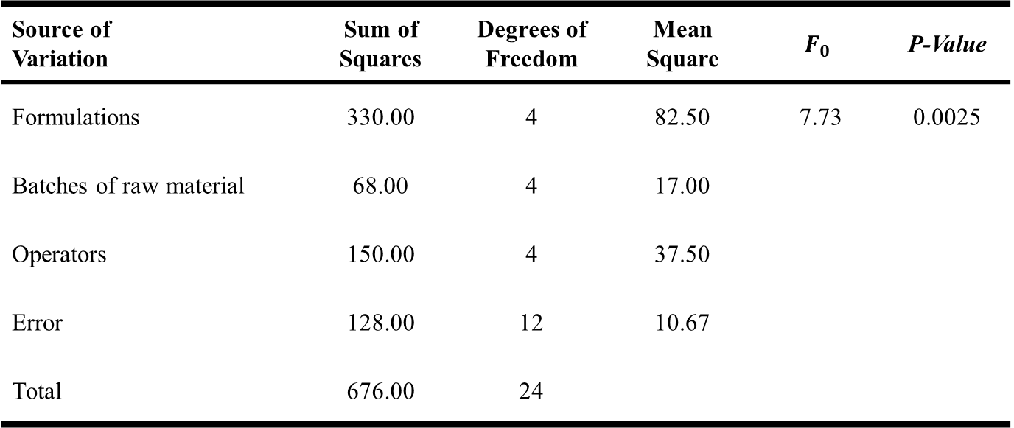
The Latin Square Design
ANOVA Table
Source of Variation | Sum of Squares | Degrees of Freedom | Mean Square | $$F_{0}$$ | P-Value
Formulations | 330.00 | 4 | 82.50 | 7.73 | 0.0025
Batches of raw material | 68.00 | 4 | 17.00
Operators | 150.00 | 4 | 37.50
Error | 128.00 | 12 | 10.67
Total | 676.00 | 24
Design of Experiments

Slide 16
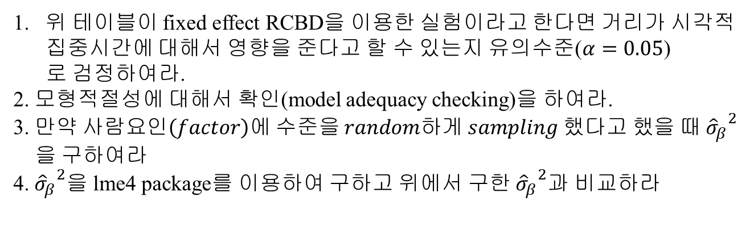
Excerise
거리에 따른 시각적 집중시간에 대한 실험
 | 사람
거리 | 1 | 2 | 3 | 4 | 5
4 | 10 | 6 | 6 | 6 | 6
6 | 7 | 6 | 6 | 1 | 6
8 | 5 | 3 | 3 | 2 | 5
10 | 6 | 4 | 4 | 2 | 3
위 테이블이 fixed effect RCBD을 이용한 실험이라고 한다면 거리가 시각적
집중시간에 대해서 영향을 준다고 할 수 있는지 유의수준($α=0.05$)
로 검정하여라.
2. 모형적절성에 대해서 확인(model adequacy checking)을 하여라.
3. 만$약 사람요인\left(factor\right)에 수준을 random하게 sampling 했다고 했을 때 {{\hat{σ}}_{β}}^{2}$
을 구하여라 4. ${{\hat{σ}}_{β}}^{2}$을 lme4 package를 이용하여 구하고 위에서 구한 ${{\hat{σ}}_{β}}^{2}$과 비교하라
Design of Experiments

Slide 17
Excerise
생산 공학자가 조립방법(A, B, C, D) 컬러 텔레비전 부품의 조립시간에 대한 실험 (Latin square design)
 | 조작자
조립순서 | 1 | 2 | 3 | 4
1 | C = 10 | D = 14 | A = 7 | B = 8
2 | B = 7 | C = 18 | D = 11 | A = 8
3 | A = 5 | B = 10 | C = 11 | D = 9
4 | D = 10 | A = 10 | B = 12 | C = 14
위 실험결과를 통해 조립방법이 텔레비전 조립시간에 영향을 주는지
유의수준 0.05로 검정하라.
Design of Experiments

