Slide 1
Design of Experiments
Suhwan Kim
Department of Statistics
Inha University
April 7, 2022

Slide 2
Contents
The Randomized Complete Block Design (RCBD)
Estimating Missing Values
Balanced Incomplete Block Design (BIBD)
Basic Definitions and Principles
Some Basic Definitions
Two-Factor Factorial Design
Example 5.1: The Battery Life Experiment
The General Two-Factor Factorial Experiment
Analysis of Variance Table
The Battery Design Experiment
The Assumption of No Interaction

Slide 3
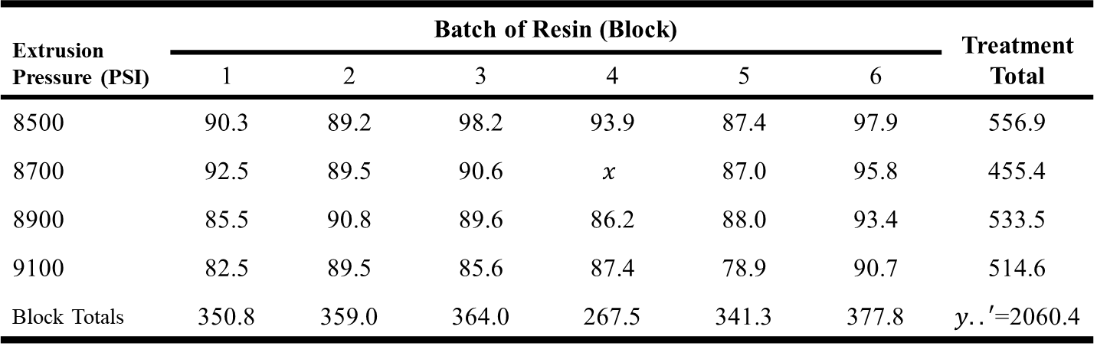

The Randomized Complete Block Design (RCBD)
Estimating Missing Values
Estimating the missing observation $x$ so that it will have a minimum contribution to the error sum of squares
Extrusion Pressure (PSI) | Batch of Resin (Block) |  |  |  |  |  | Treatment Total
 | 1 | 2 | 3 | 4 | 5 | 6
8500 | 90.3 | 89.2 | 98.2 | 93.9 | 87.4 | 97.9 | 556.9
8700 | 92.5 | 89.5 | 90.6 | $$x$$ | 87.0 | 95.8 | 455.4
8900 | 85.5 | 90.8 | 89.6 | 86.2 | 88.0 | 93.4 | 533.5
9100 | 82.5 | 89.5 | 85.6 | 87.4 | 78.9 | 90.7 | 514.6
Block Totals | 350.8 | 359.0 | 364.0 | 267.5 | 341.3 | 377.8 | $y..′$=2060.4
Design of Experiments

Slide 4
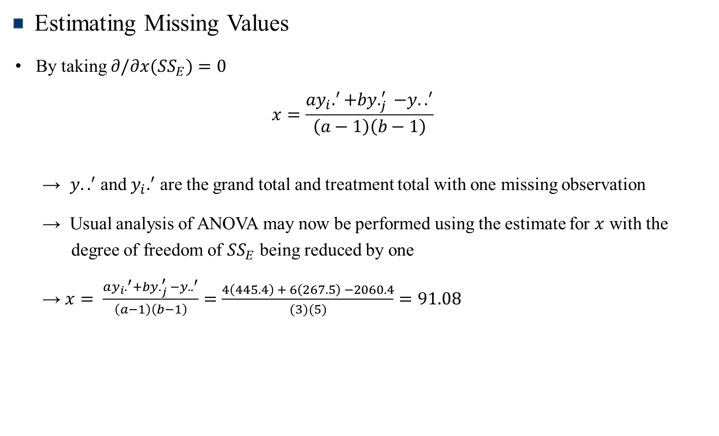
The Randomized Complete Block Design (RCBD)
Estimating Missing Values
By taking $∂/∂x(SS_{E})$ $=0$
$$x=\frac{ay_{i}.^{′}+by._{j}^{′} −y..^{′}}{\left(a−1\right)\left(b−1\right)}$$
→ $y..^{′}$ and $y_{i}.^{′}$ are the grand total and treatment total with one missing observation
→ Usual analysis of ANOVA may now be performed using the estimate for $x$ with the degree of freedom of $SS_{E}$ being reduced by one
→ $x= \frac{ay_{i}.^{′}+by._{j}^{′} −y..^{′}}{\left(a−1\right)\left(b−1\right)}=\frac{4\left(445.4\right) + 6\left(267.5\right) −2060.4}{(3)(5)}=91.08$
Design of Experiments

Slide 5
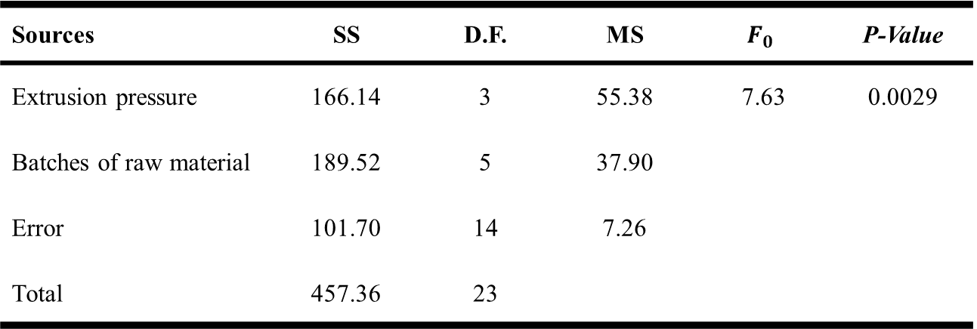
The Randomized Complete Block Design (RCBD)
Estimating Missing Values
ANOVA Table
Sources | SS | D.F. | MS | $$F_{0}$$ | P-Value
Extrusion pressure | 166.14 | 3 | 55.38 | 7.63 | 0.0029
Batches of raw material | 189.52 | 5 | 37.90
Error | 101.70 | 14 | 7.26
Total | 457.36 | 23
Design of Experiments

Slide 6
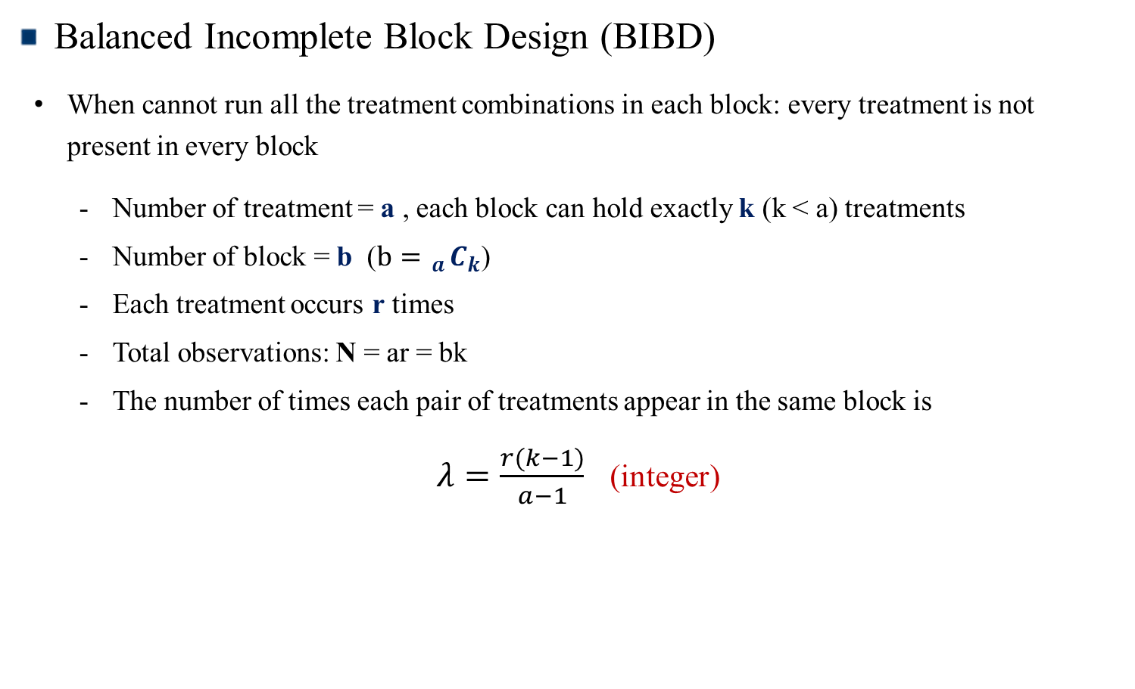
Balanced Incomplete Block Design (BIBD)
Balanced Incomplete Block Design (BIBD)
When cannot run all the treatment combinations in each block: every treatment is not present in every block
Number of treatment = a , each block can hold exactly k (k < a) treatments
Number of block = b ($b= _{a}C_{k}$)
Each treatment occurs r times
Total observations: N = ar = bk
The number of times each pair of treatments appear in the same block is
$λ=\frac{r(k−1)}{a−1}$ (integer)
Design of Experiments

Slide 7
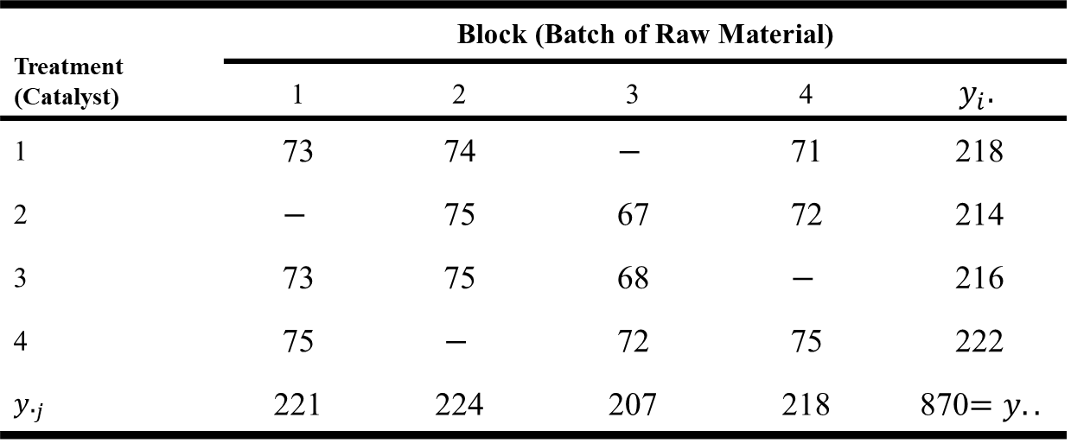
Balanced Incomplete Block Design (BIBD)
Example (TABLE 4.22)
Balanced Incomplete Block Design for Catalyst Experiment
Treatment (Catalyst) | Block (Batch of Raw Material)
 | 1 | 2 | 3 | 4 | $$y_{i}.$$
1 | 73 | 74 | $$−$$ | 71 | 218
2 | $$−$$ | 75 | 67 | 72 | 214
3 | 73 | 75 | 68 | $$−$$ | 216
4 | 75 | $$−$$ | 72 | 75 | 222
$y._{j}$ | 221 | 224 | 207 | 218 | 870$=y..$
Design of Experiments

Slide 8
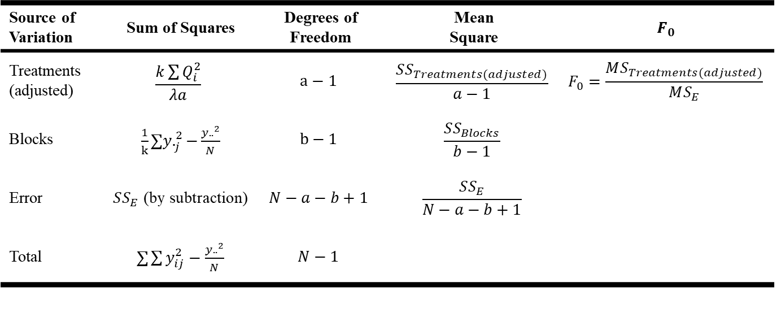

Balanced Incomplete Block Design (BIBD)
ANOVA (MODEL: $y_{ij}=μ+τ_{i}+β_{j}+ε_{ij}$)
→ $SS_{Treatments(adjusted)}=$ $k\sum{Q_{i}^{2}}/(λa)$ , where $Q_{i}=y_{i}.−\sum_{j=1}^{b}{\frac{n_{ij}y._{j}}{k}}$.
($n_{ij}=1$ if treatment $i$ appears in the $j$-th block, 0 otherwise)
→ $SS_{T}=SS_{Treat(adjusted)}+SS_{Block}+SS_{E}$
Source of Variation | Sum of Squares | Degrees of Freedom | Mean Square | $$F_{0}$$
Treatments (adjusted) | $$\frac{k\sum{Q_{i}^{2}}}{λa}$$ | $$a−1$$ | $$\frac{SS_{Treatments(adjusted)}}{a−1}$$ | $$F_{0}=\frac{MS_{Treatments(adjusted)}}{MS_{E}}$$
Blocks | $\frac{1}{k}∑y._{j}^{2}−\frac{y..^{2}}{N}$ | $$b−1$$ | $$\frac{SS_{Blocks}}{b−1}$$
Error | $SS_{E}$ (by subtraction) | $$N−a−b+1$$ | $$\frac{SS_{E}}{N−a−b+1}$$
Total | $∑\sum{y_{ij}^{2}−\frac{y..^{2}}{N}}$ | $$N−1$$
Design of Experiments

Slide 9
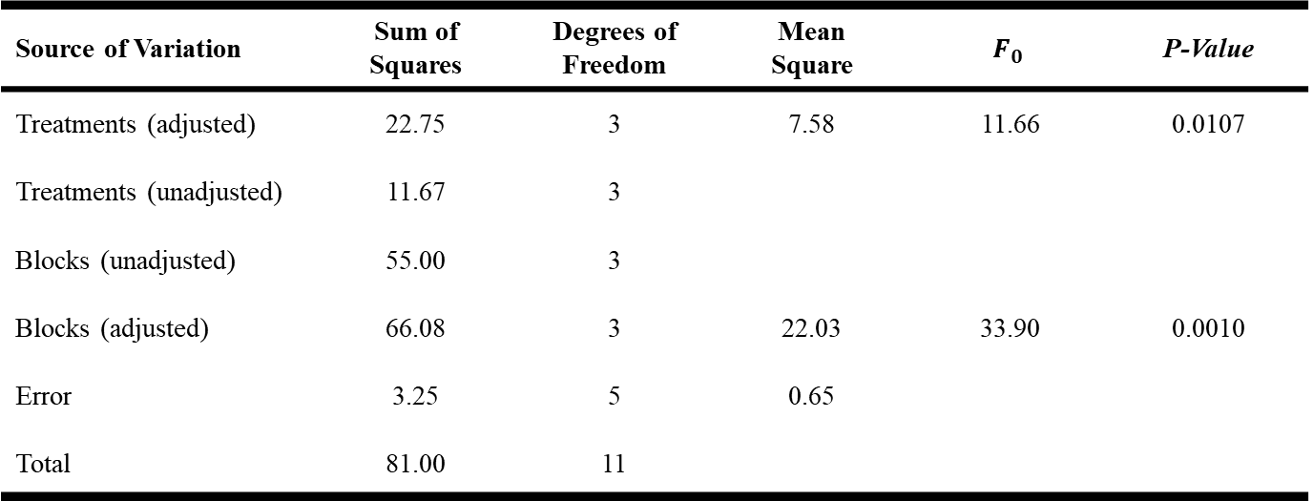

Balanced Incomplete Block Design (BIBD)
ANOVA Table
→ Note that $SS_{T}≠SS_{Treat(adjusted)}+SS_{Block(adjusted)}+SS_{E}$
← Treatments and blocks are not orthogonal anymore
Source of Variation | Sum of Squares | Degrees of Freedom | Mean Square | $$F_{0}$$ | P-Value
Treatments (adjusted) | 22.75 | 3 | 7.58 | 11.66 | 0.0107
Treatments (unadjusted) | 11.67 | 3
Blocks (unadjusted) | 55.00 | 3
Blocks (adjusted) | 66.08 | 3 | 22.03 | 33.90 | 0.0010
Error | 3.25 | 5 | 0.65
Total | 81.00 | 11
Design of Experiments

Slide 10
Chapter 5. Factorial Experiments

Slide 11
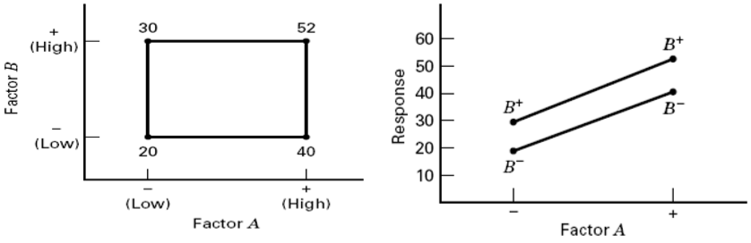
Basic Definitions and Principles
Some Basic Definitions
Factorial Designs
: Most efficient in studying the effects of two or more factors
Definition of a factor (main) effect
: The change in the mean response when the factor is changed from low to high
Design of Experiments

Slide 12

Basic Definitions and Principles
Main Effect
$$A={\overline{y}}_{A^{+}}−{\overline{y}}_{A^{−}}=\frac{40+52}{2}−\frac{20+30}{2}=21$$
$$B={\overline{y}}_{B^{+}}−{\overline{y}}_{B^{−}}=\frac{30+52}{2}−\frac{20+40}{2}=11$$
Interaction Effect
: Difference in mean response between the levels of one factor is not the same at all levels of the other factors
$$AB=\frac{52+20}{2}−\frac{30+40}{2}=1$$
Design of Experiments

Slide 13

Two-Factor Factorial Design
Example 5.1: The Battery Life Experiment
$A=$ Material type; $B=$ Temperature (note: A is a qualitative variable)
$3^{2}$-factorial design
Material Type | Temperature (⁰F)
 | 15 |  | 70 |  | 125
1 | 130 | 155 | 34 | 40 | 20 | 70
 | 74 | 180 | 80 | 75 | 82 | 58
2 | 150 | 188 | 136 | 122 | 25 | 70
 | 159 | 126 | 106 | 115 | 58 | 45
3 | 138 | 110 | 174 | 120 | 96 | 104
 | 168 | 160 | 150 | 139 | 82 | 60
Design of Experiments

Slide 14
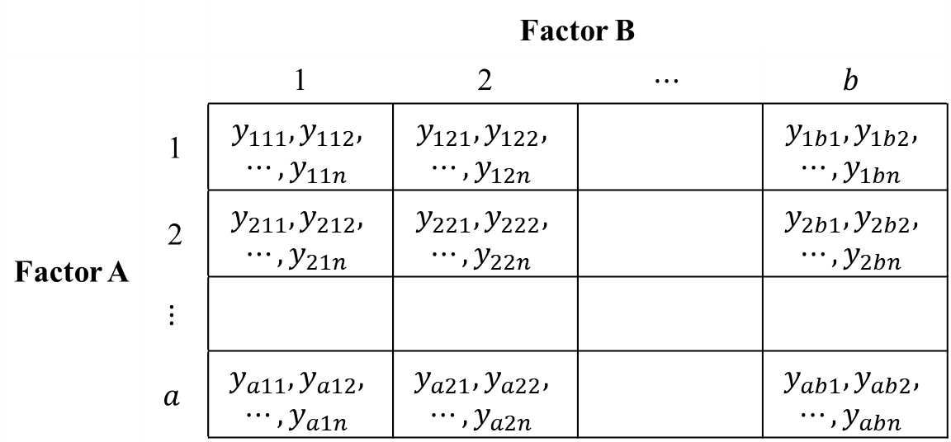

Two-Factor Factorial Design
The General Two-Factor Factorial Experiment
General Arrangement for a Two-Factor Factorial Design
→ $a$ levels of factor $A$; $b$ levels of factor $B$; $n$ replicates
Note: This is a completely randomized design
 |  | Factor B
 |  | 1 | 2 | $$⋯$$ | $$b$$
Factor A | 1 | $$y_{111}, y_{112},$$ $$⋯, y_{11n}$$ | $$y_{121}, y_{122},$$ $$⋯, y_{12n}$$ |  | $$y_{1b1}, y_{1b2},$$ $$⋯, y_{1bn}$$
 | 2 | $$y_{211}, y_{212},$$ $$⋯, y_{21n}$$ | $$y_{221}, y_{222},$$ $$⋯, y_{22n}$$ |  | $$y_{2b1}, y_{2b2},$$ $$⋯, y_{2bn}$$
 | $$⋮$$
 | $$a$$ | $$y_{a11}, y_{a12},$$ $$⋯, y_{a1n}$$ | $$y_{a21}, y_{a22},$$ $$⋯, y_{a2n}$$ |  | $$y_{ab1}, y_{ab2},$$ $$⋯, y_{abn}$$
Design of Experiments

Slide 15
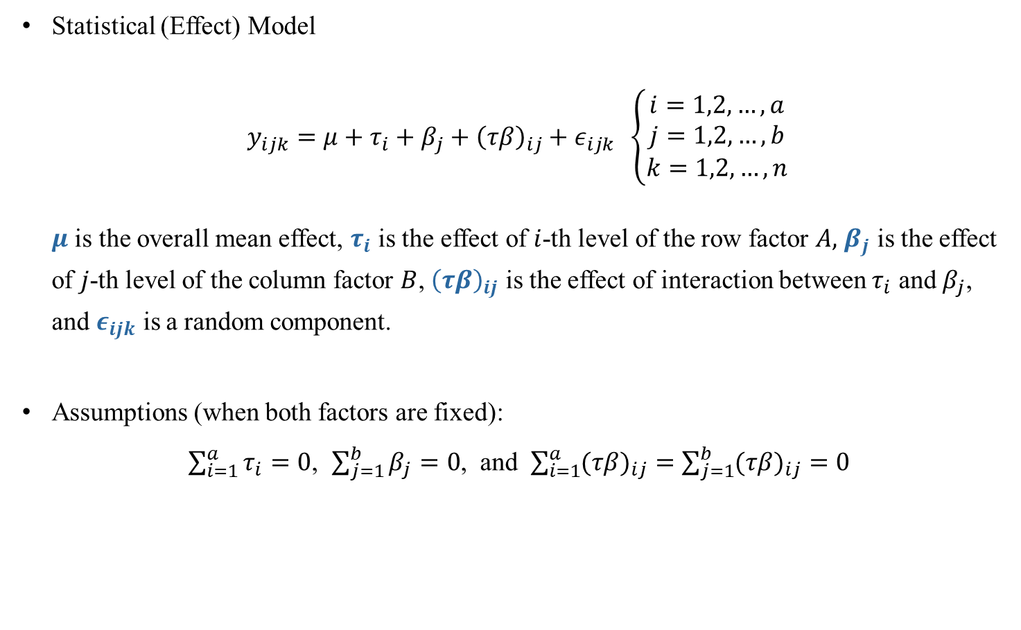
Two-Factor Factorial Design
Statistical (Effect) Model
$y_{ijk}=μ+τ_{i}+β_{j}+{\left(τβ\right)}_{ij}+ε_{ijk} \left\{\begin{aligned}i=1,2,…,a \\ j=1,2,…,b \\ k=1,2,…,n\end{aligned}\right.$
$μ$ is the overall mean effect, $τ_{i}$ is the effect of $i$-th level of the row factor $A,$ $β_{j}$ is the effect of $j$-th level of the column factor $B$, ${\left(τβ\right)}_{ij}$ is the effect of interaction between $τ_{i}$ and $β_{j}$, and $ε_{ijk}$ is a random component.
Assumptions (when both factors are fixed):
$\sum_{i=1}^{a}{τ_{i}}=0$, $\sum_{j=1}^{b}{β_{j}}=0$, and $\sum_{i=1}^{a}{{(τβ)}_{ij}}=\sum_{j=1}^{b}{{(τβ)}_{ij}}=0$
Design of Experiments

Slide 16

Two-Factor Factorial Design
Hypotheses
i) $H_{0}:τ_{1}=τ_{2}=…=τ_{a}=0$ versus $H_{1}: at least one τ_{i}≠0$
ii) $H_{0}:β_{1}=β_{2}=…=β_{b}=0$ versus $H_{1}: at least one β_{j}≠0$
iii) $H_{0}:{(τβ)}_{ij}=0$ for all $i, j$ versus $H_{1}: at least one {(τβ)}_{ij}≠0$
Design of Experiments

Slide 17
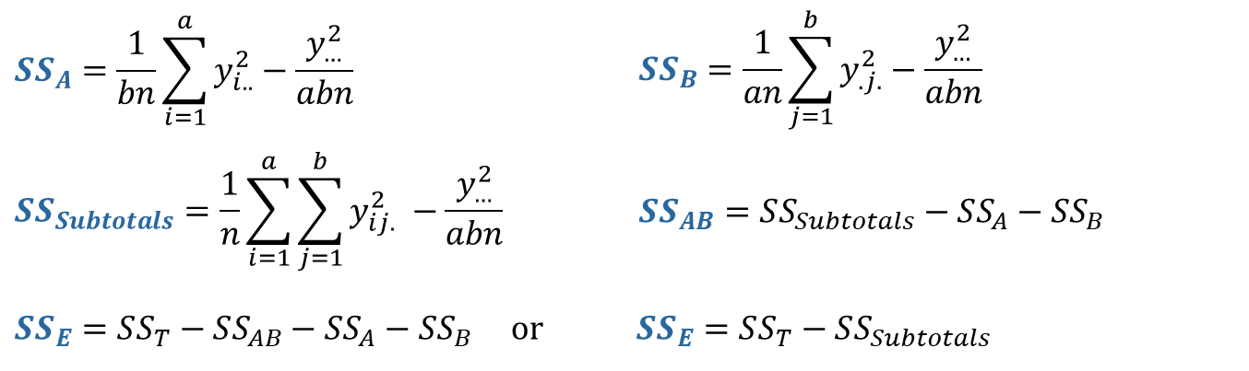

Two-Factor Factorial Design
Analysis of Variance Table
Sum of Squares Decomposition
$$SS_{T}=SS_{A}+SS_{B}+SS_{AB}+SS_{E}$$
$$df : abn−1=\left(a−1\right)+\left(b−1\right)+\left(a−1\right)\left(b−1\right)+ab(n−1)$$
Working Formula
$$SS_{A}=\frac{1}{bn}\sum_{i=1}^{a}{y_{i..}^{2}}−\frac{y_{…}^{2}}{abn}$$ | $$SS_{B}=\frac{1}{an}\sum_{j=1}^{b}{y_{.j.}^{2}}−\frac{y_{…}^{2}}{abn}$$
$$SS_{Subtotals}=\frac{1}{n}\sum_{i=1}^{a}{\sum_{j=1}^{b}{y_{ij.}^{2}} }−\frac{y_{…}^{2}}{abn}$$ | $$SS_{AB}=SS_{Subtotals}−SS_{A}−SS_{B}$$
$SS_{E}=SS_{T}−SS_{AB}−SS_{A}−SS_{B}$ or $SS_{E}=SS_{T}−SS_{Subtotals}$
Design of Experiments

Slide 18


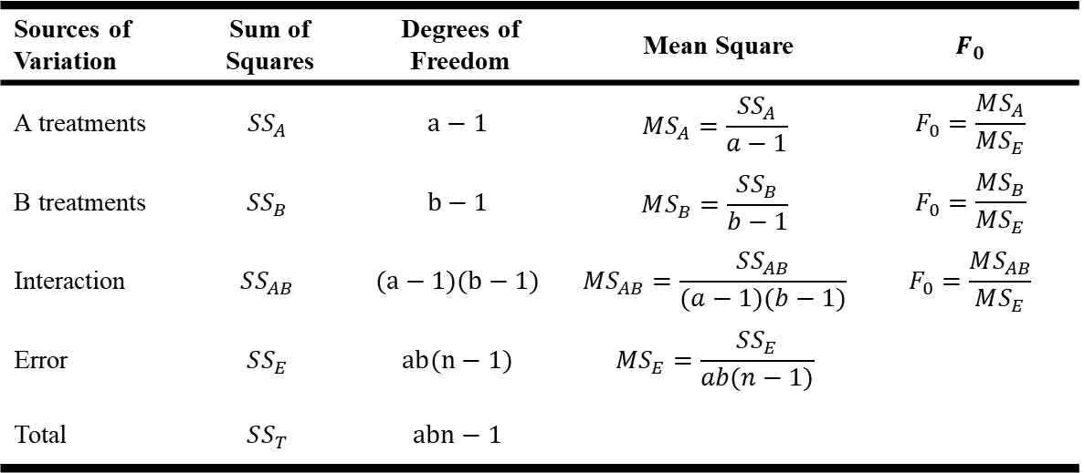
Two-Factor Factorial Design
ANOVA Table (Fixed Effect Case)
Sources of Variation | Sum of Squares | Degrees of Freedom | Mean Square | $$F_{0}$$
A treatments | $$SS_{A}$$ | $$a−1$$ | $$MS_{A}=\frac{SS_{A}}{a−1}$$ | $$F_{0}=\frac{MS_{A}}{MS_{E}}$$
B treatments | $$SS_{B}$$ | $$b−1$$ | $$MS_{B}=\frac{SS_{B}}{b−1}$$ | $$F_{0}=\frac{MS_{B}}{MS_{E}}$$
Interaction | $$SS_{AB}$$ | $$(a−1)(b−1)$$ | $$MS_{AB}=\frac{SS_{AB}}{(a−1)(b−1)}$$ | $$F_{0}=\frac{MS_{AB}}{MS_{E}}$$
Error | $$SS_{E}$$ | $$ab(n−1)$$ | $$MS_{E}=\frac{SS_{E}}{ab(n−1)}$$
Total | $$SS_{T}$$ | $$abn−1$$
Expected Mean Squares
$$E\left[MS_{A}\right]=σ^{2}+bnΣ_{i=1}^{a}τ_{i}^{2}/(a−1)$$
$$E\left[MS_{B}\right]=σ^{2}+anΣ_{i=1}^{b}β_{j}^{2}/(b−1)$$
$E\left[MS_{AB}\right]=σ^{2}+nΣ_{i=1}^{a}Σ_{j=1}^{b}{\left(τβ\right)}_{ij}^{2}/\left\{\left(a−1\right)\left(b−1\right)\right\}$ with $E\left[MS_{E}\right]=σ^{2}$
Design of Experiments

Slide 19
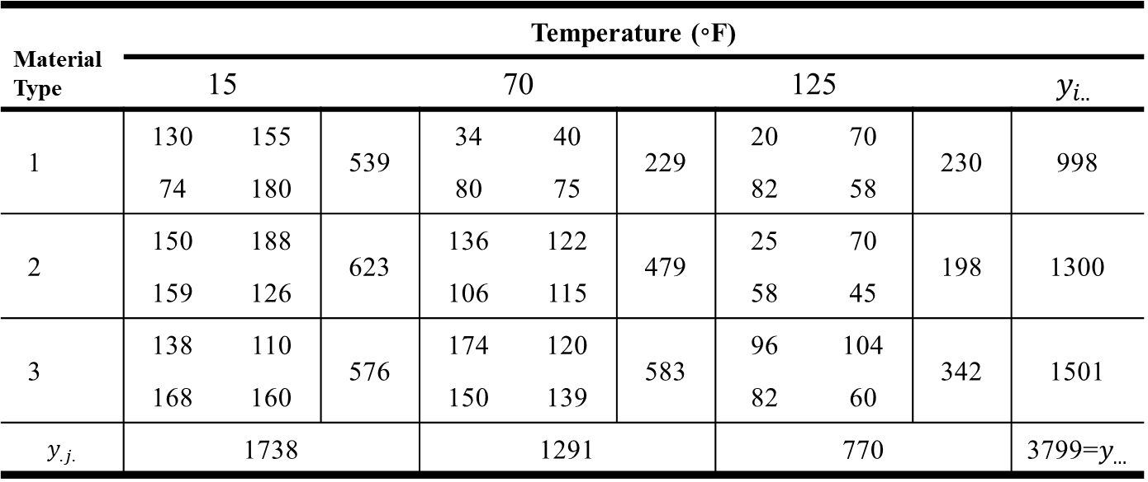
Two-Factor Factorial Design
The Battery Design Experiment
Data: TABLE 5.4 (a=3, b=3, n=4)
Material Type | Temperature (◦F)
 | 15 |  |  | 70 |  |  | 125 |  |  | $$y_{i..}$$
1 | 130 | 155 | 539 | 34 | 40 | 229 | 20 | 70 | 230 | 998
 | 74 | 180 |  | 80 | 75 |  | 82 | 58
2 | 150 | 188 | 623 | 136 | 122 | 479 | 25 | 70 | 198 | 1300
 | 159 | 126 |  | 106 | 115 |  | 58 | 45
3 | 138 | 110 | 576 | 174 | 120 | 583 | 96 | 104 | 342 | 1501
 | 168 | 160 |  | 150 | 139 |  | 82 | 60
$$y_{.j.}$$ | 1738 |  |  | 1291 |  |  | 770 |  |  | 3799=$y_{…}$
Design of Experiments

Slide 20
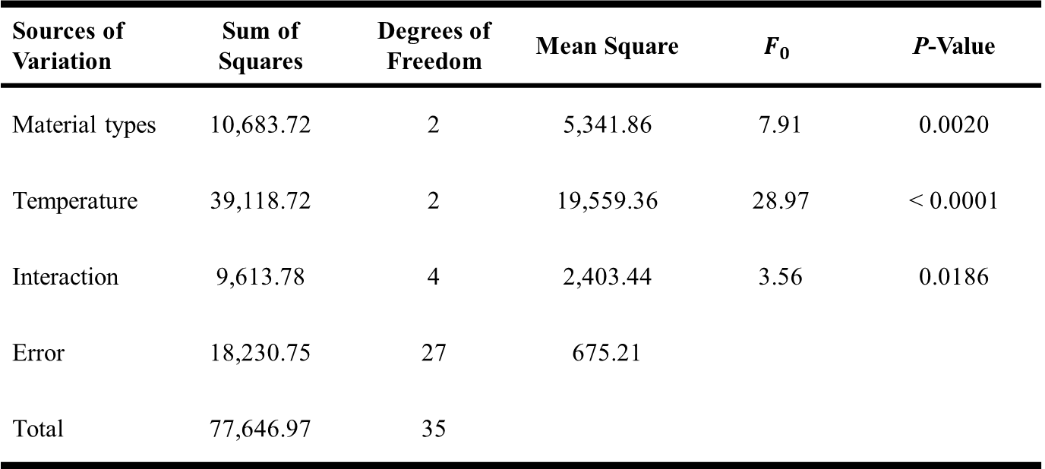
Two-Factor Factorial Design
ANOVA Table
Sources of Variation | Sum of Squares | Degrees of Freedom | Mean Square | $$F_{0}$$ | P-Value
Material types | 10,683.72 | 2 | 5,341.86 | 7.91 | 0.0020
Temperature | 39,118.72 | 2 | 19,559.36 | 28.97 | < 0.0001
Interaction | 9,613.78 | 4 | 2,403.44 | 3.56 | 0.0186
Error | 18,230.75 | 27 | 675.21
Total | 77,646.97 | 35
Design of Experiments

Slide 21
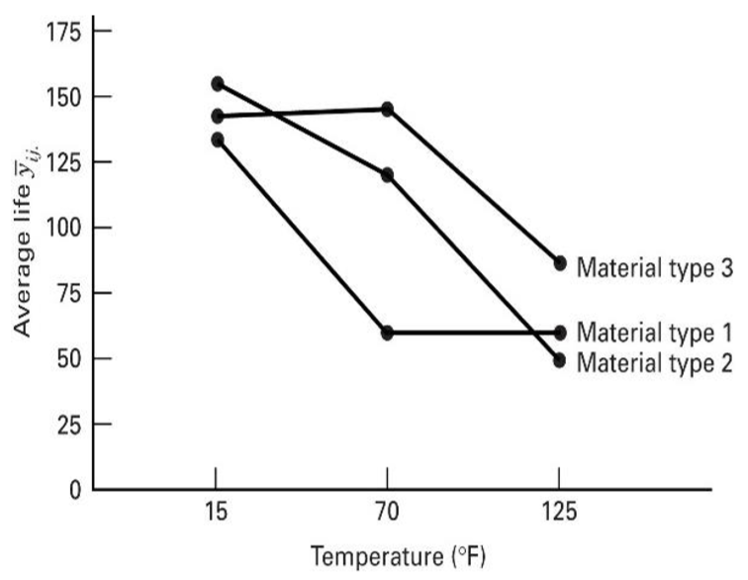
Two-Factor Factorial Design
Interaction Plot
Design of Experiments

Slide 22
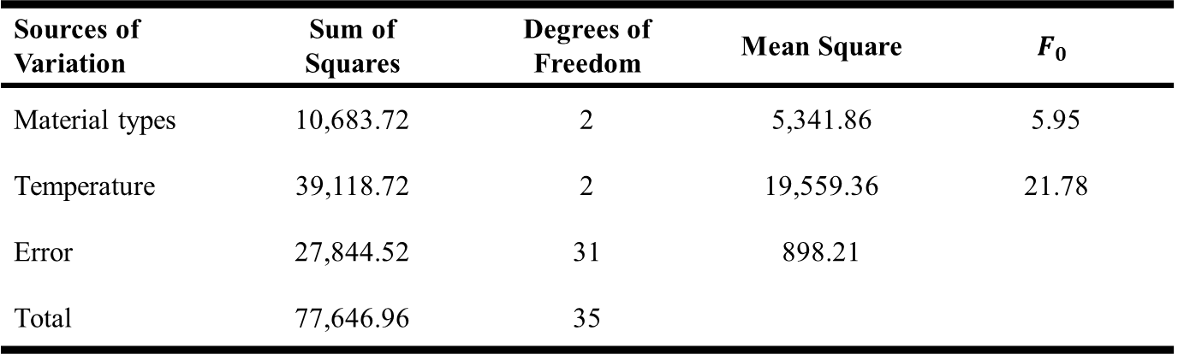

Two-Factor Factorial Design
The Assumption of No Interaction
Model
$$y_{ijk}=μ+τ_{i}+β_{j}+ε_{ijk} \left\{\begin{aligned}i=1,2,…,a \\ j=1,2,…,b \\ k=1,2,…,n\end{aligned}\right.$$
ANOVA Table
Sources of Variation | Sum of Squares | Degrees of Freedom | Mean Square | $$F_{0}$$
Material types | 10,683.72 | 2 | 5,341.86 | 5.95
Temperature | 39,118.72 | 2 | 19,559.36 | 21.78
Error | 27,844.52 | 31 | 898.21
Total | 77,646.96 | 35
Design of Experiments

