Slide 1
Design of Experiments
Suhwan Kim
Department of Statistics
Inha University
April 15, 2022

Slide 2
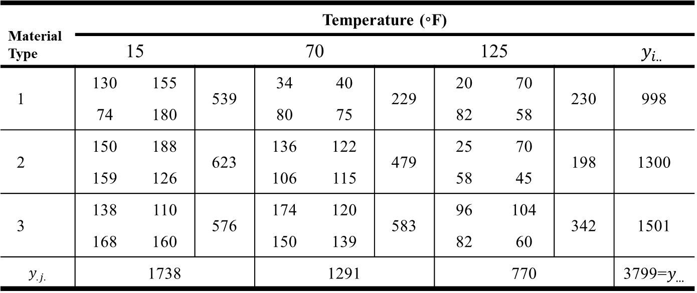
Two-Factor Factorial Design
The Battery Design Experiment
Data: TABLE 5.4 (a=3, b=3, n=4)
Material Type | Temperature (◦F)
 | 15 |  |  | 70 |  |  | 125 |  |  | $$y_{i..}$$
1 | 130 | 155 | 539 | 34 | 40 | 229 | 20 | 70 | 230 | 998
 | 74 | 180 |  | 80 | 75 |  | 82 | 58
2 | 150 | 188 | 623 | 136 | 122 | 479 | 25 | 70 | 198 | 1300
 | 159 | 126 |  | 106 | 115 |  | 58 | 45
3 | 138 | 110 | 576 | 174 | 120 | 583 | 96 | 104 | 342 | 1501
 | 168 | 160 |  | 150 | 139 |  | 82 | 60
$$y_{.j.}$$ | 1738 |  |  | 1291 |  |  | 770 |  |  | 3799=$y_{…}$
Design of Experiments

Slide 3
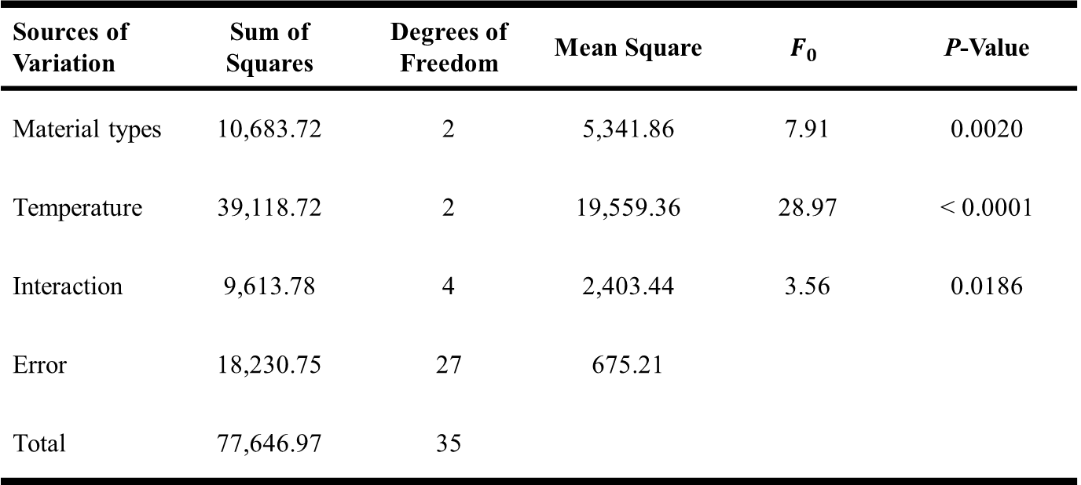
Two-Factor Factorial Design
ANOVA Table
Sources of Variation | Sum of Squares | Degrees of Freedom | Mean Square | $$F_{0}$$ | P-Value
Material types | 10,683.72 | 2 | 5,341.86 | 7.91 | 0.0020
Temperature | 39,118.72 | 2 | 19,559.36 | 28.97 | < 0.0001
Interaction | 9,613.78 | 4 | 2,403.44 | 3.56 | 0.0186
Error | 18,230.75 | 27 | 675.21
Total | 77,646.97 | 35
Design of Experiments

Slide 4
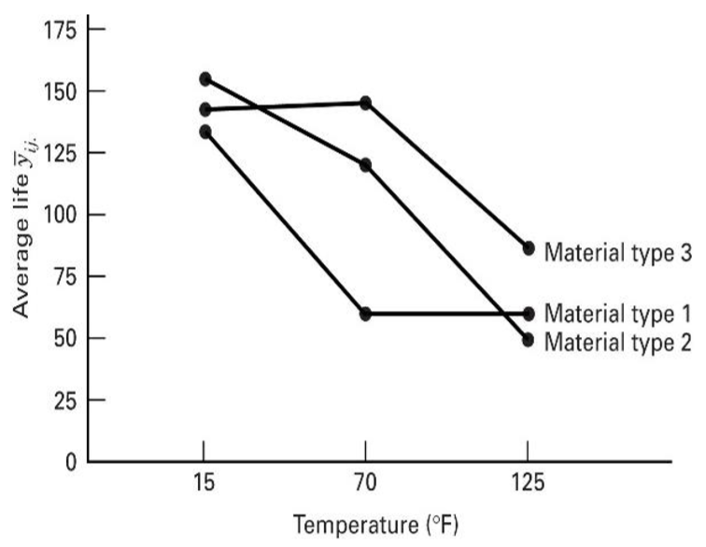
Two-Factor Factorial Design
Interaction Plot
Design of Experiments

Slide 5
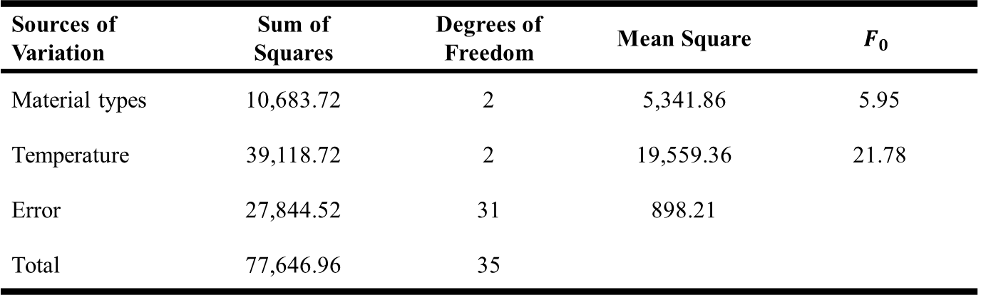

Two-Factor Factorial Design
The Assumption of No Interaction
Model
$$y_{ijk}=μ+τ_{i}+β_{j}+ε_{ijk} \left\{\begin{aligned}i=1,2,…,a \\ j=1,2,…,b \\ k=1,2,…,n\end{aligned}\right.$$
ANOVA Table
Sources of Variation | Sum of Squares | Degrees of Freedom | Mean Square | $$F_{0}$$
Material types | 10,683.72 | 2 | 5,341.86 | 5.95
Temperature | 39,118.72 | 2 | 19,559.36 | 21.78
Error | 27,844.52 | 31 | 898.21
Total | 77,646.96 | 35
Design of Experiments

Slide 6
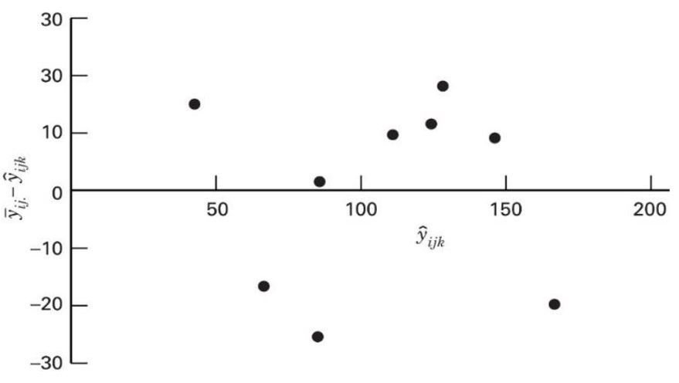

Two-Factor Factorial Design
Residual Plot $({\overline{y}}_{ij.}−{\hat{y}}_{ijk})$ versus ${\hat{y}}_{ijk}$
← Pattern: residuals move from positive to negative to positive to negative again
Design of Experiments

Slide 7
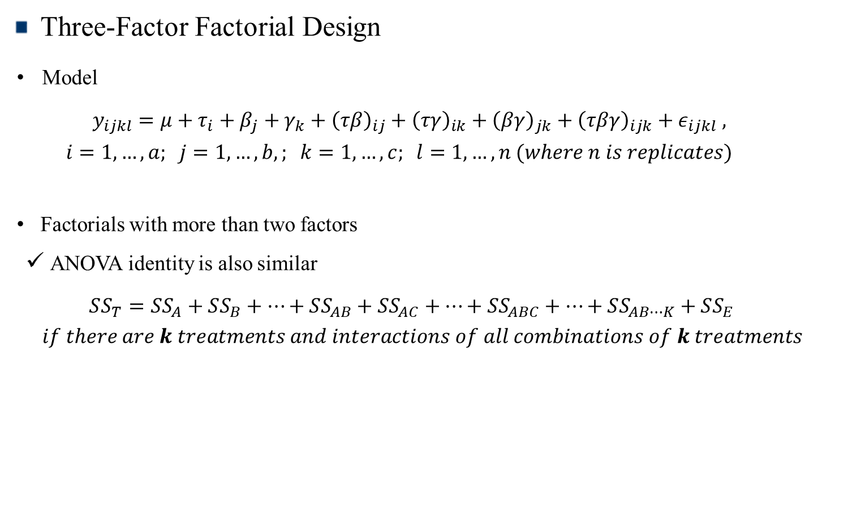
The General Factorial Design
Three-Factor Factorial Design
Model
$$y_{ijkl}=μ+τ_{i}+β_{j}+γ_{k}+{\left(τβ\right)}_{ij}+{\left(τγ\right)}_{ik}+{\left(βγ\right)}_{jk}+{\left(τβγ\right)}_{ijk}+ε_{ijkl} ,$$
$$i=1,…,a; j=1,…,b,; k=1,…,c; l=1,…,n (where n is replicates)$$
Factorials with more than two factors
ANOVA identity is also similar
$$SS_{T}=SS_{A}+SS_{B}+⋯+SS_{AB}+SS_{AC}+⋯+SS_{ABC}+⋯+SS_{AB⋯K}+SS_{E}$$
$$if there are k treatments and interactions of all combinations of k treatments$$
Design of Experiments

Slide 8
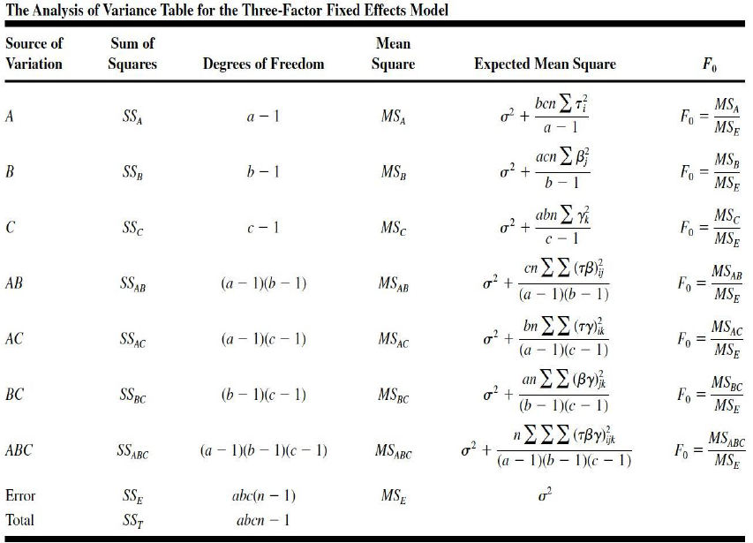
The General Factorial Design
ANOVA Table (Three–Factor Factorial Design)
Design of Experiments

Slide 9
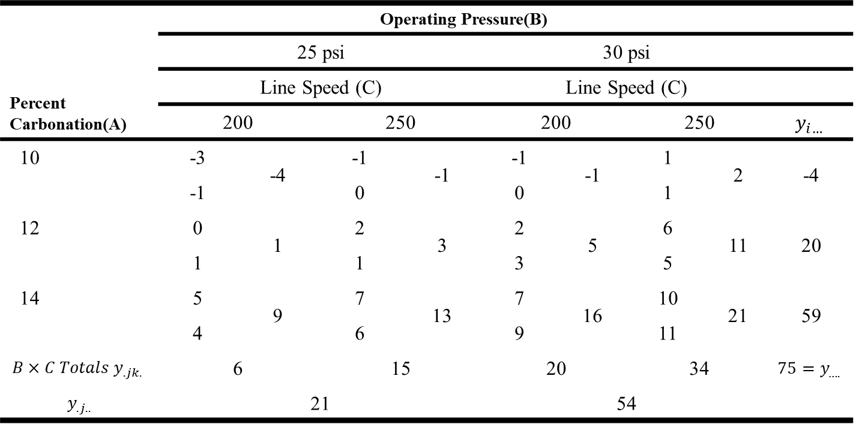
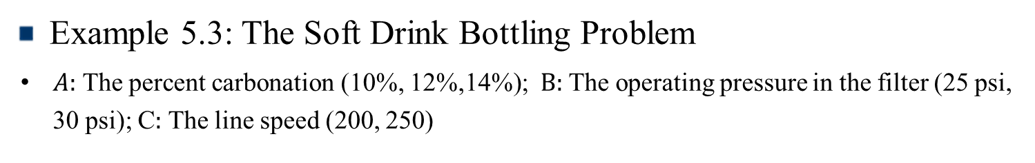
The General Factorial Design
Example 5.3: The Soft Drink Bottling Problem
$A:$ The percent carbonation (10%, 12%,14%); $B:$ The operating pressure in the filter (25 psi, 30 psi); C$:$ The line speed (200, 250)
Percent Carbonation(A) | Operating Pressure(B)
 | 25 psi |  |  |  | 30 psi
 | Line Speed (C) |  |  |  | Line Speed (C)
 | 200 |  | 250 |  | 200 |  | 250 |  | $$y_{i…}$$
10 | -3 | -4 | -1 | -1 | -1 | -1 | 1 | 2 | -4
 | -1 |  | 0 |  | 0 |  | 1
12 | 0 | 1 | 2 | 3 | 2 | 5 | 6 | 11 | 20
 | 1 |  | 1 |  | 3 |  | 5
14 | 5 | 9 | 7 | 13 | 7 | 16 | 10 | 21 | 59
 | 4 |  | 6 |  | 9 |  | 11
$$B×C Totals y_{.jk.}$$ | 6 |  | 15 |  | 20 |  | 34 |  | $$75=y_{….}$$
$$y_{.j..}$$ | 21 |  |  |  | 54
Design of Experiments

Slide 10
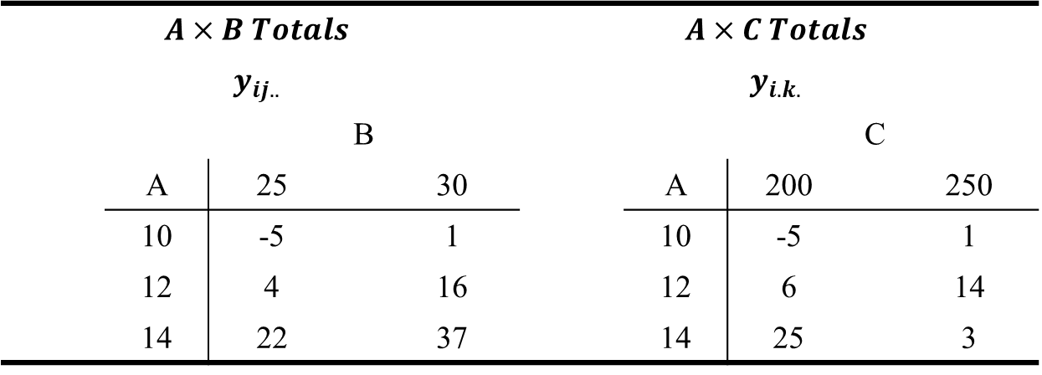
The General Factorial Design
Example 5.3: The Soft Drink Bottling Problem (Continue)
$$A×B Totals$$ |  |  |  |  | $$A×C Totals$$
$$y_{ij..}$$ |  |  |  |  | $$y_{i.k.}$$
 |  | B |  |  |  |  |  | C
 | A | 25 |  | 30 |  | A | 200 |  | 250
 | 10 | -5 |  | 1 |  | 10 | -5 |  | 1
 | 12 | 4 |  | 16 |  | 12 | 6 |  | 14
 | 14 | 22 |  | 37 |  | 14 | 25 |  | 3
Design of Experiments

Slide 11
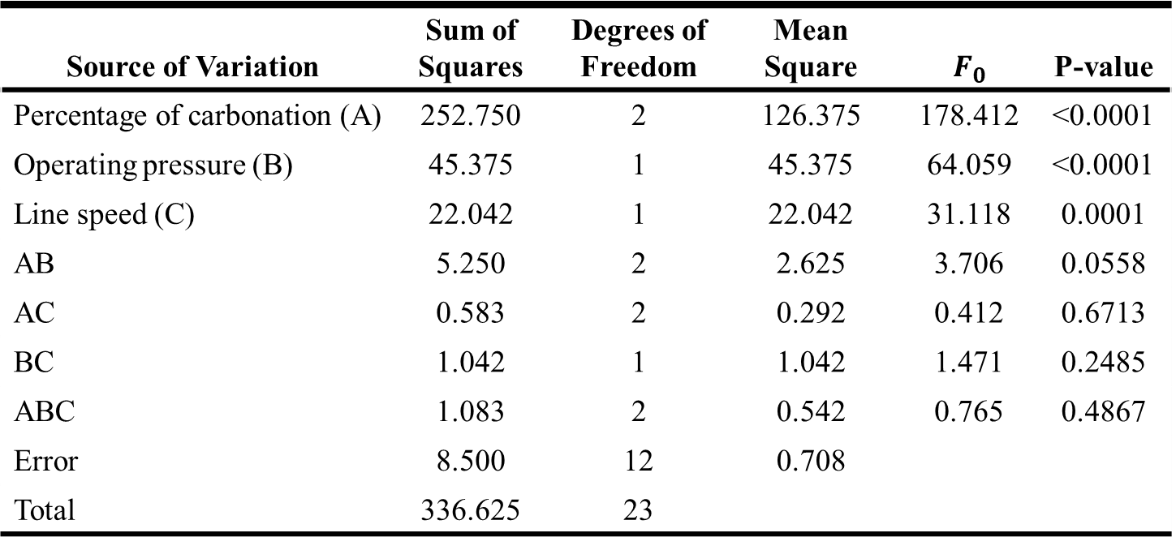
The General Factorial Design
ANOVA Table for Example 5.3
Source of Variation | Sum of Squares | Degrees of Freedom | Mean Square | $$F_{0}$$ | P-value
Percentage of carbonation (A) | 252.750 | 2 | 126.375 | 178.412 | <0.0001
Operating pressure (B) | 45.375 | 1 | 45.375 | 64.059 | <0.0001
Line speed (C) | 22.042 | 1 | 22.042 | 31.118 | 0.0001
AB | 5.250 | 2 | 2.625 | 3.706 | 0.0558
AC | 0.583 | 2 | 0.292 | 0.412 | 0.6713
BC | 1.042 | 1 | 1.042 | 1.471 | 0.2485
ABC | 1.083 | 2 | 0.542 | 0.765 | 0.4867
Error | 8.500 | 12 | 0.708
Total | 336.625 | 23
Design of Experiments

Slide 12
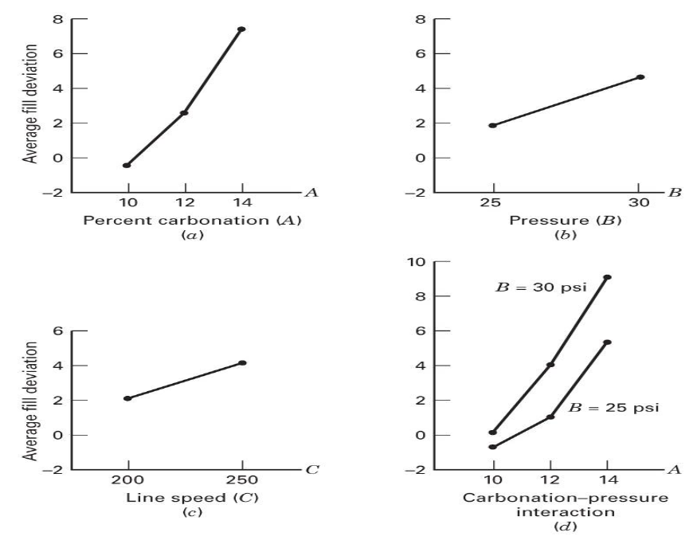
The General Factorial Design
Main effects and Interaction Plot
Design of Experiments

