Slide 1
Design of Experiments
Suhwan Kim
Department of Statistics
Inha University
April 29, 2022

Slide 2
Chapter 5. Factorial Experiments (Part 2)

Slide 3
Contents
Fitting Response Curves and Surfaces
Quantitative and Qualitative Factors
Example 5.4 (Ex 5.1 Battery Life Experiment)

Slide 4
Fitting Response Curves and Surfaces
Quantitative and Qualitative Factors
The basic ANOVA procedure treats every factor as if it were qualitative
This can be accounted for in the analysis to produce regression models for quantitative factors at each level of the qualitative factors
These response curves and/or response surfaces are often a considerable aid in practical interpretation of the results
Design of Experiments

Slide 5
Fitting Response Curves and Surfaces
Example 5.4 (EX 5.1 Battery Life Experiment continued)
Material Type | Temperature (⁰F)
 | 15 |  | 70 |  | 125
1 | 130 | 155 | 34 | 40 | 20 | 70
 | 74 | 180 | 80 | 75 | 82 | 58
2 | 150 | 188 | 136 | 122 | 25 | 70
 | 159 | 126 | 106 | 115 | 58 | 45
3 | 138 | 110 | 174 | 120 | 96 | 104
 | 168 | 160 | 150 | 139 | 82 | 60
Design of Experiments

Slide 6
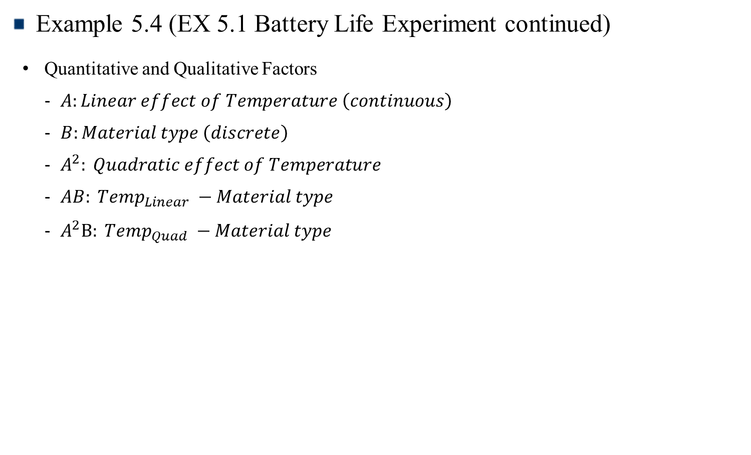
Fitting Response Curves and Surfaces
Example 5.4 (EX 5.1 Battery Life Experiment continued)
Quantitative and Qualitative Factors
$A:Linear effect of Temperature \left(continuous\right)$
$B:Material type \left(discrete\right)$
$A^{2}: Quadratic effect of Temperature$
$AB: Temp_{Linear} −Material type$
$A^{2}B: Temp_{Quad} −Material type$
Design of Experiments

Slide 7
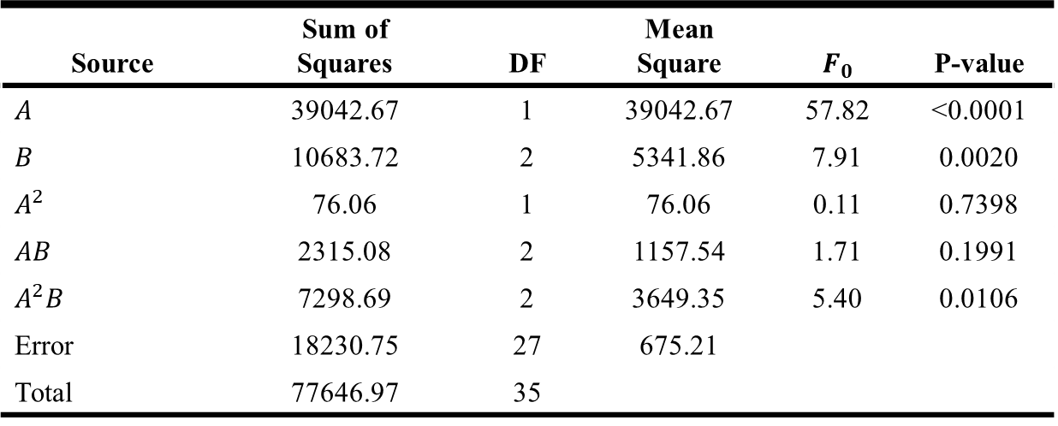
Fitting Response Curves and Surfaces
ANOVA for Response Surface Reduced Cubic Model
Source | Sum of Squares | DF | Mean Square | $$F_{0}$$ | P-value
$A$ | 39042.67 | 1 | 39042.67 | 57.82 | <0.0001
$B$ | 10683.72 | 2 | 5341.86 | 7.91 | 0.0020
$A^{2}$ | 76.06 | 1 | 76.06 | 0.11 | 0.7398
$AB$ | 2315.08 | 2 | 1157.54 | 1.71 | 0.1991
$A^{2}B$ | 7298.69 | 2 | 3649.35 | 5.40 | 0.0106
Error | 18230.75 | 27 | 675.21
Total | 77646.97 | 35
Design of Experiments

Slide 8

Fitting Response Curves and Surfaces
Regression Model Summary of Results
Material type 1
$$Life=169.3801 −2.4886∗Temp+0.0129∗Temp^{2}$$
Material type 2
$$Life=159.6240−0.1790∗Temp+0.4163∗Temp^{2}$$
Material type 3
$$Life=132.7624−0.8926∗Temp+0.4322∗Temp^{2}$$
Design of Experiments

Slide 9
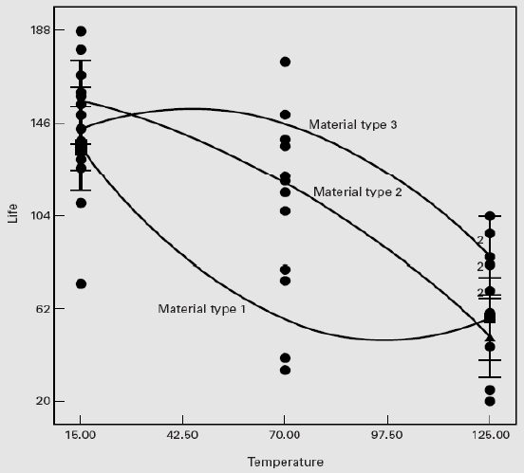
Fitting Response Curves and Surfaces
Regression Model Summary of Results
Predicted life as a function of temperature for the three material types
Design of Experiments

Slide 10
Chapter 6. Two-Level Factorial Experiments (Part 1)

Slide 11
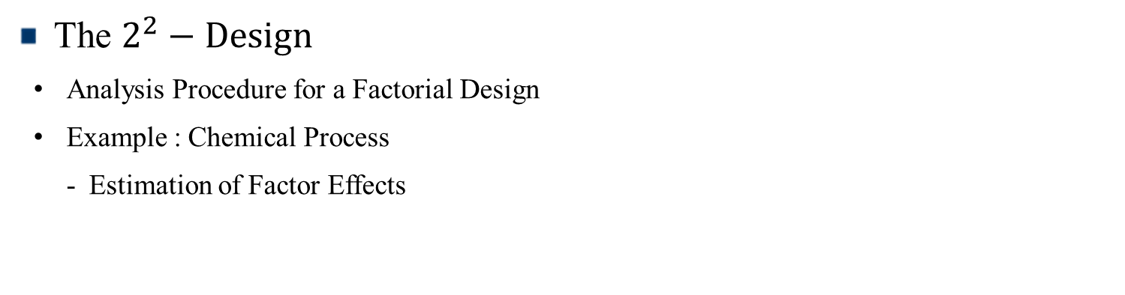
Contents
Introduction
The $2^{2}−Design$
Analysis Procedure for a Factorial Design
Example : Chemical Process
Estimation of Factor Effects

Slide 12
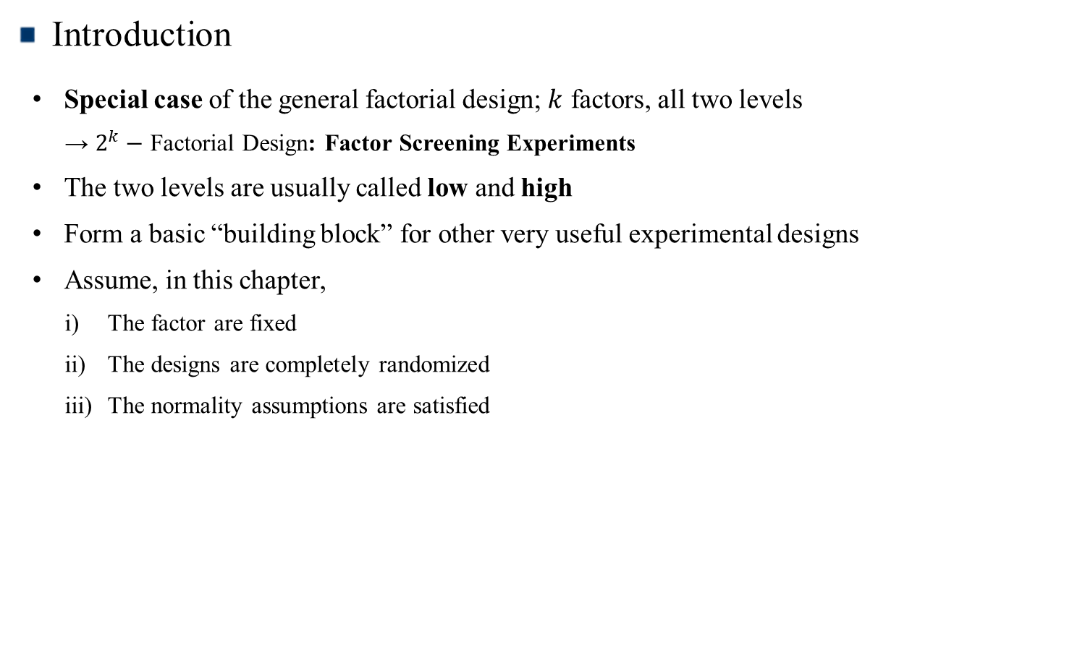
Introduction
Introduction
Special case of the general factorial design; $k$ factors, all two levels
→ $2^{k}−$ Factorial Design: Factor Screening Experiments
The two levels are usually called low and high
Form a basic “building block” for other very useful experimental designs
Assume, in this chapter,
The factor are fixed
The designs are completely randomized
The normality assumptions are satisfied
Design of Experiments

Slide 13
The $2^{2}−$ Design
Analysis Procedure for a Factorial Design
Estimate factor effects
Formulate model
With replication, use full model
With an un-replicated design, use normal probability plots
Statistical testing (ANOVA)
Refine the model
Analyze residuals (graphical)
Interpret results
Design of Experiments

Slide 14
The $2^{2}−$ Design
Example : Chemical Process
Two-factors (A and B) with two levels
where A = reactant concentration, B = catalyst amount; y = recovery
Factor |  | Treatment Combination | Replicate
A | B |  | I | II | III | Total
- | - | A low, B low | 28 | 25 | 27 | 80
+ | - | A high, B low | 36 | 32 | 32 | 100
- | + | A low, B high | 18 | 19 | 23 | 60
+ | + | A high, B high | 31 | 30 | 29 | 90
Design of Experiments

Slide 15
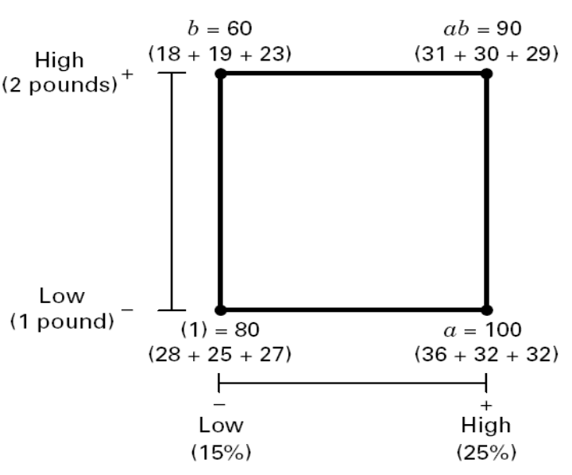
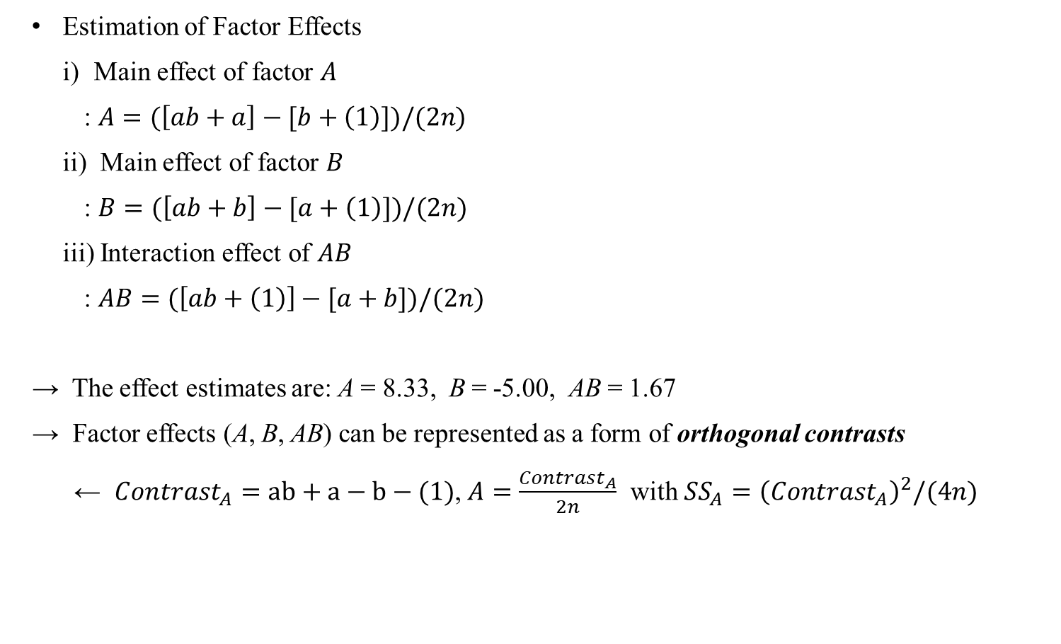
The $2^{2}−$ Design
Estimation of Factor Effects
Main effect of factor $A$
: $A=(\left[ab+a\right]−[b+\left(1\right)])/(2n)$
ii) Main effect of factor $B$
: $B=(\left[ab+b\right]−[a+\left(1\right)])/(2n)$
iii) Interaction effect of $AB$
: $AB=(\left[ab+\left(1\right)\right]−[a+b])/(2n)$
→ The effect estimates are: A = 8.33, B = -5.00, AB = 1.67
→ Factor effects (A, B, AB) can be represented as a form of orthogonal contrasts
← $Contrast_{A}=ab+a−b−(1)$, $A=\frac{Contrast_{A}}{2n}$ with $SS_{A}={\left(Contrast_{A}\right)}^{2}/(4n)$
B
A
Design of Experiments

