Slide 1
Configuring ConnxtMD Automation

Slide 2
Things you’ll need beforehand.
Internet Explorer Version 8
Java 8, which is to already be put in your Path environmental variable.
Eclipse IDE

Slide 3
Download Selenium (remember location)
Go to https://selenium-release.storage.googleapis.com/index.html
Pick a version of Selenium you want to download.
Download the IEDriverServer and selenium-server.
Store them in a location that you can remember.

Slide 4
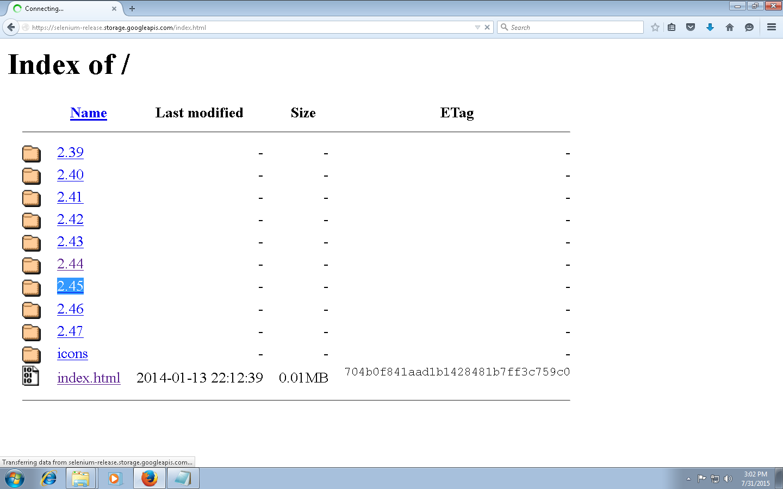
Picking a version of selenium

Slide 5
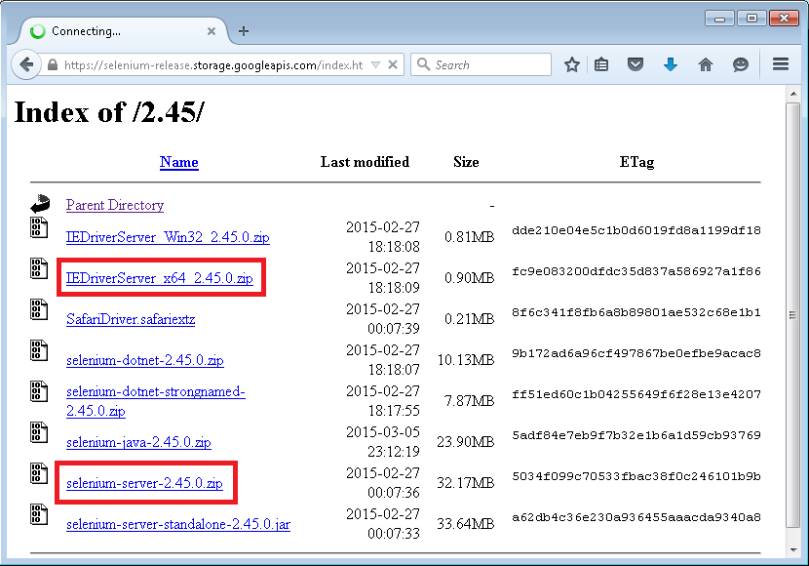
Downloading Selenium

Slide 6
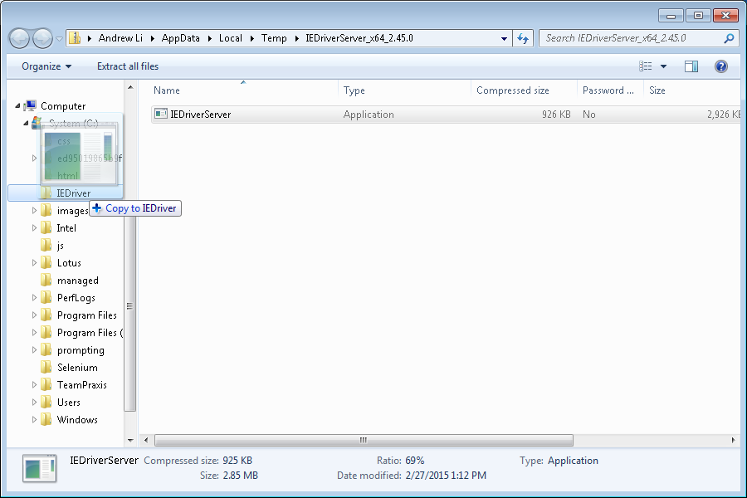
Storing the IE driver in a reasonable location

Slide 7
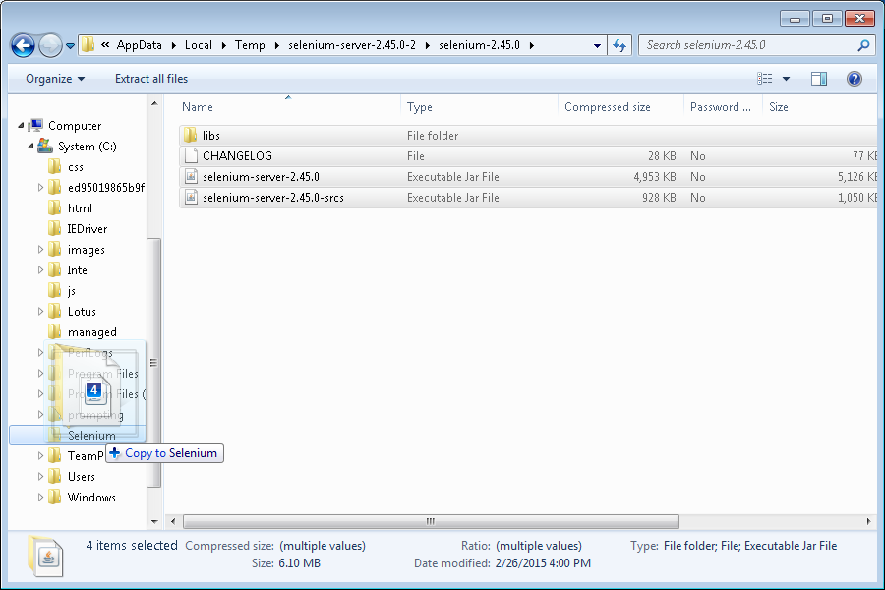
Storing the selenium server files in a reasonable location

Slide 8
Download the folder ConnxtMD
You need access to the private repository https://github.com/TeamPraxisLLC/gumbo
Open the zip file.
Go into Andrew_Summer2015 and move the ConnxtMD folder into your computer.

Slide 9
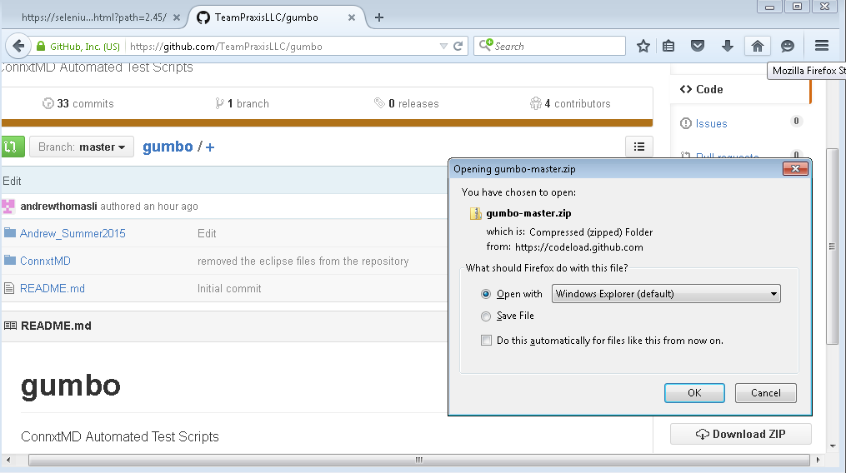
Downloading the zip

Slide 10
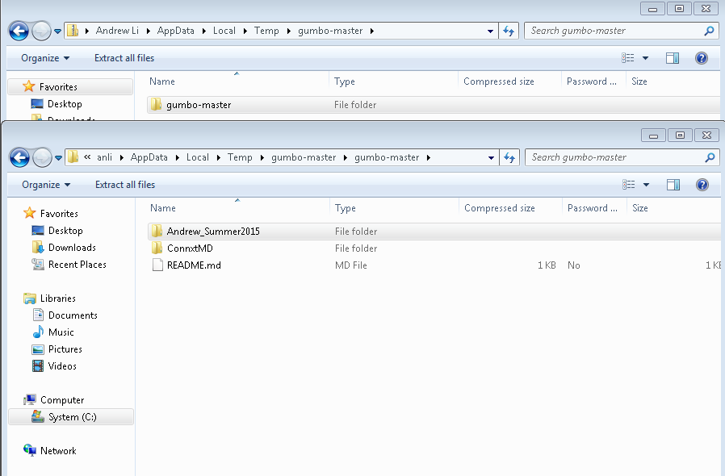
Opening Andrew_Summer2015 Open gumbo-master, then open Andrew_Summer2015

Slide 11
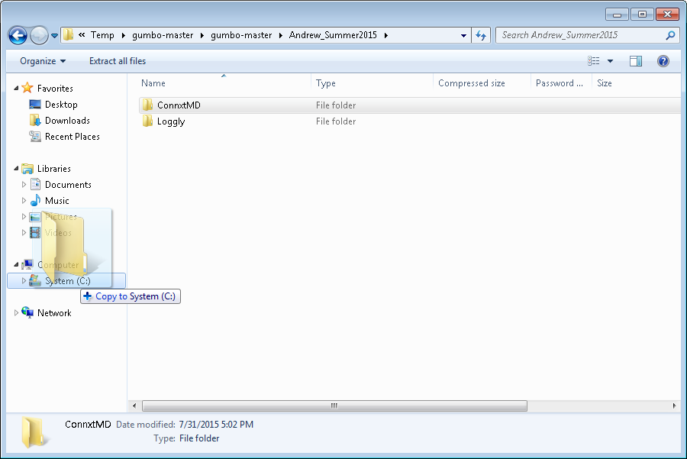
Move the folder ConnxtMD to Computer

Slide 12
Open up eclipse
If you haven’t done so already, download eclipse.
Open eclipse and select the folder that you moved onto your computer as your workspace.

Slide 13
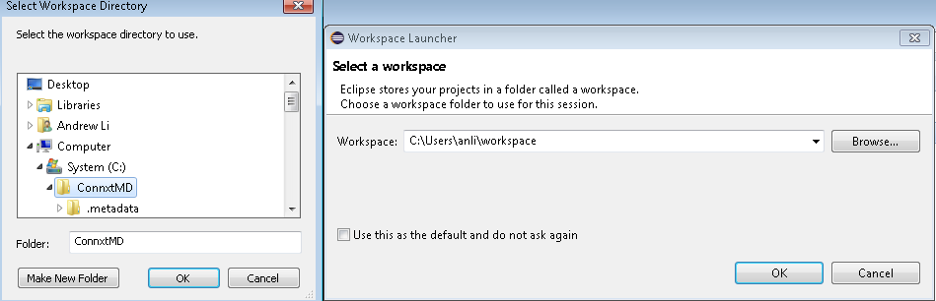
Selecting the workspace

Slide 14
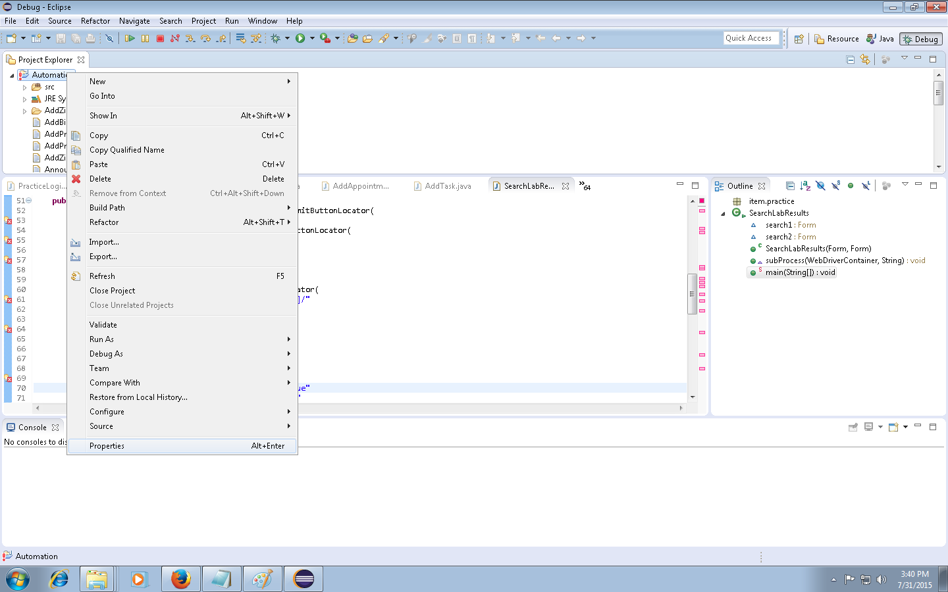
Right click the existing project and click properties

Slide 15
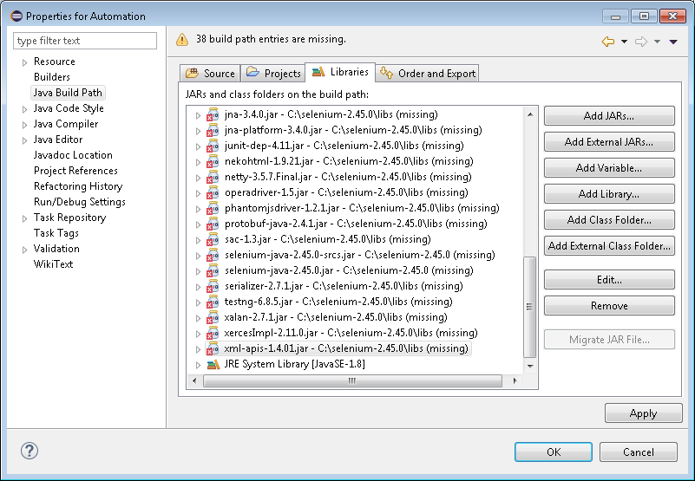
Go to Java Build Path and go to the libraries tab, then remove all jars except the JRE System Library

Slide 16
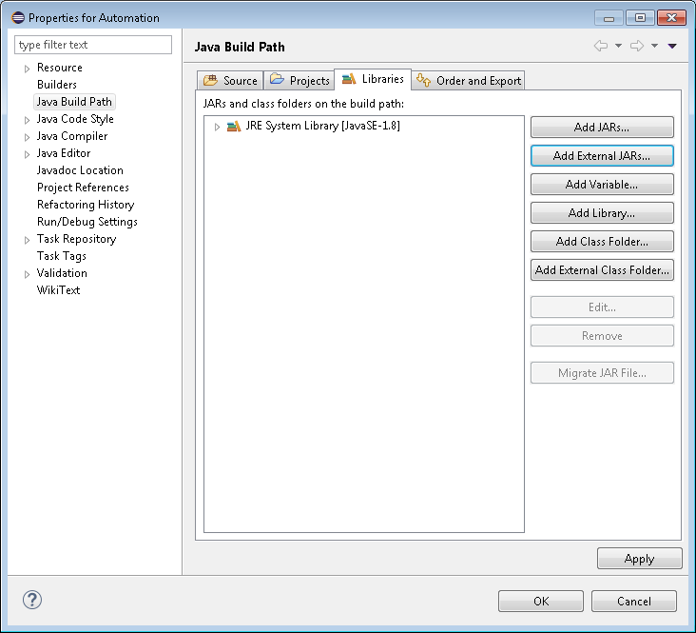
Click on Add External JARs

Slide 17
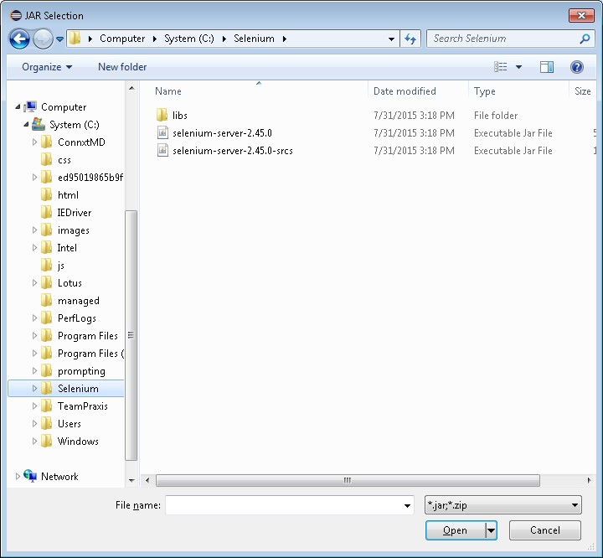
Go to the folder you moved your selenium-server files to.

Slide 18
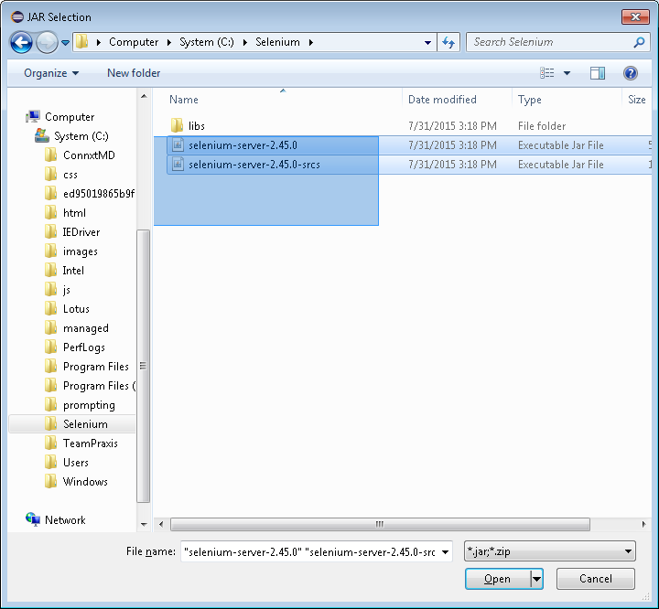
Select both of the jar files

Slide 19
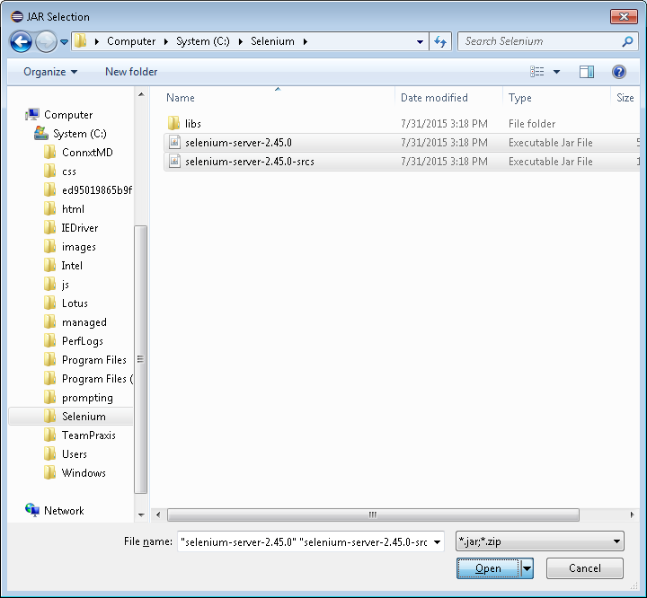
Once selected, press open

Slide 20
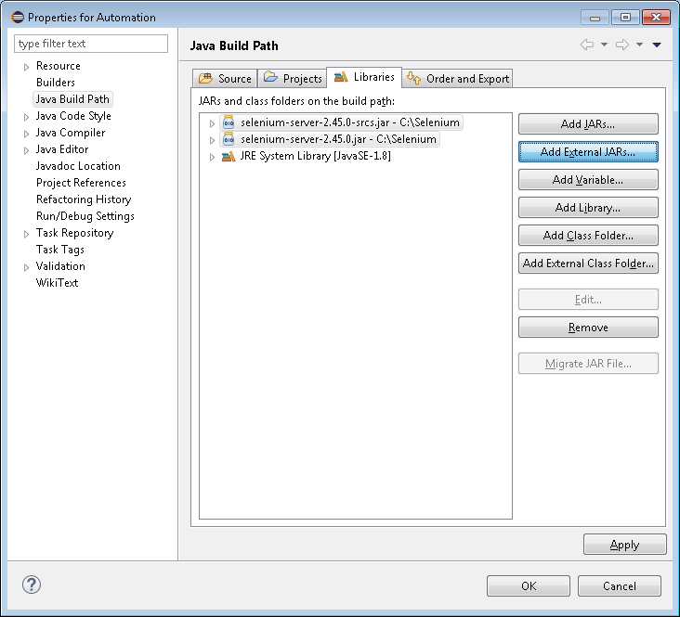
Click Add External Jars again

Slide 21
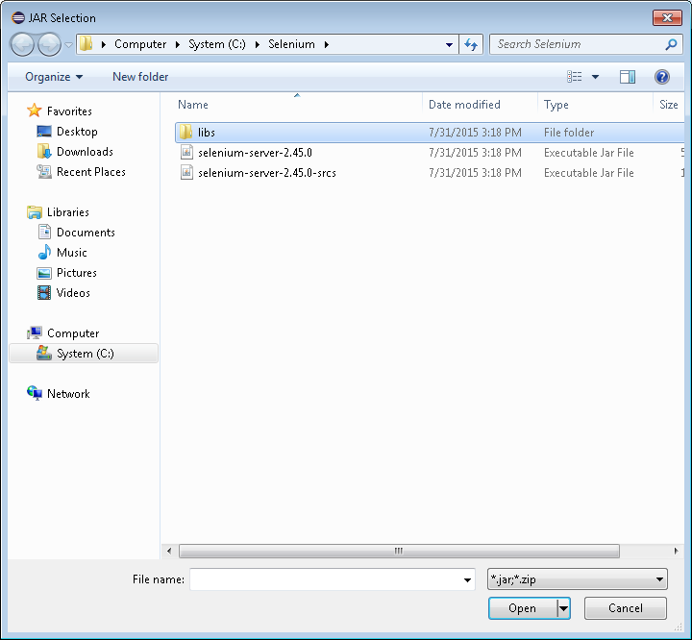
Go into the libs folder

Slide 22
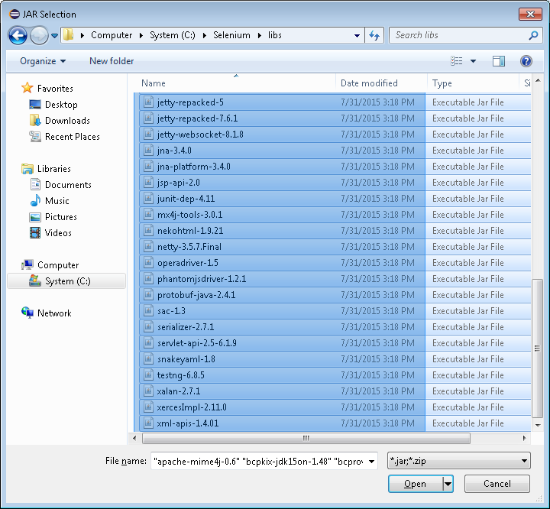
Select all of the jar files

Slide 23
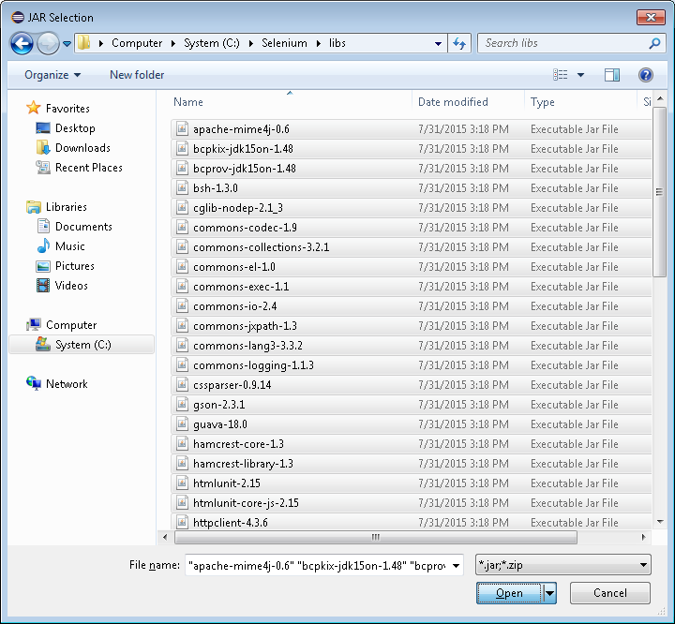
Click “Open”

Slide 24
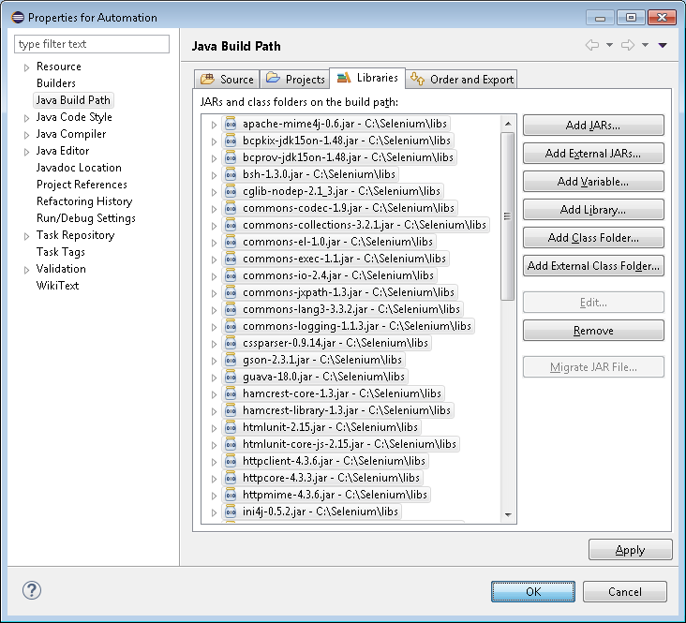
Click OK

Slide 25
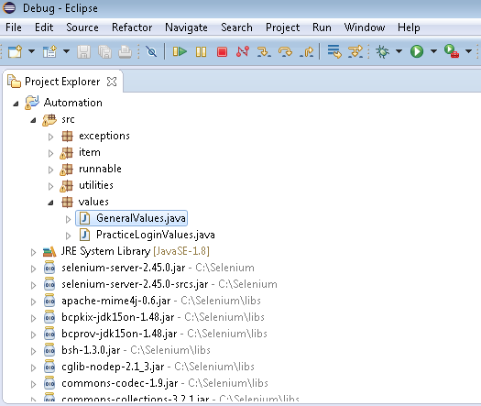
In Package Explorer, open Automation (Project) >> src folder (source) >> values (package) >> GeneralValues.java (class)

Slide 26
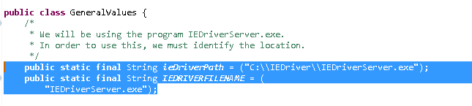
Make sure the program knows the location of the IE Driver!!!
IMPORTANT: Make sure the constant ieDriverPath matches the absolute path of the IE Driver App, and make sure the constant called IEDRIVERFILENAME matches the name of the IE Driver App. You downloaded the IE Driver Server at the same time you downloaded selenium. Backslashes for paths should be replaced with two backslashes. Don’t forget to save.

