Slide 1
Configuring Loggly Automation

Slide 2
Things you’ll need beforehand.
Firefox
Java 8, which is to already be put in your Path environmental variable.
Eclipse IDE

Slide 3
Download Selenium (remember location)
Go to https://selenium-release.storage.googleapis.com/index.html
Pick a version of Selenium you want to download.
Download the selenium-server.
Store it in a location that you can remember.

Slide 4
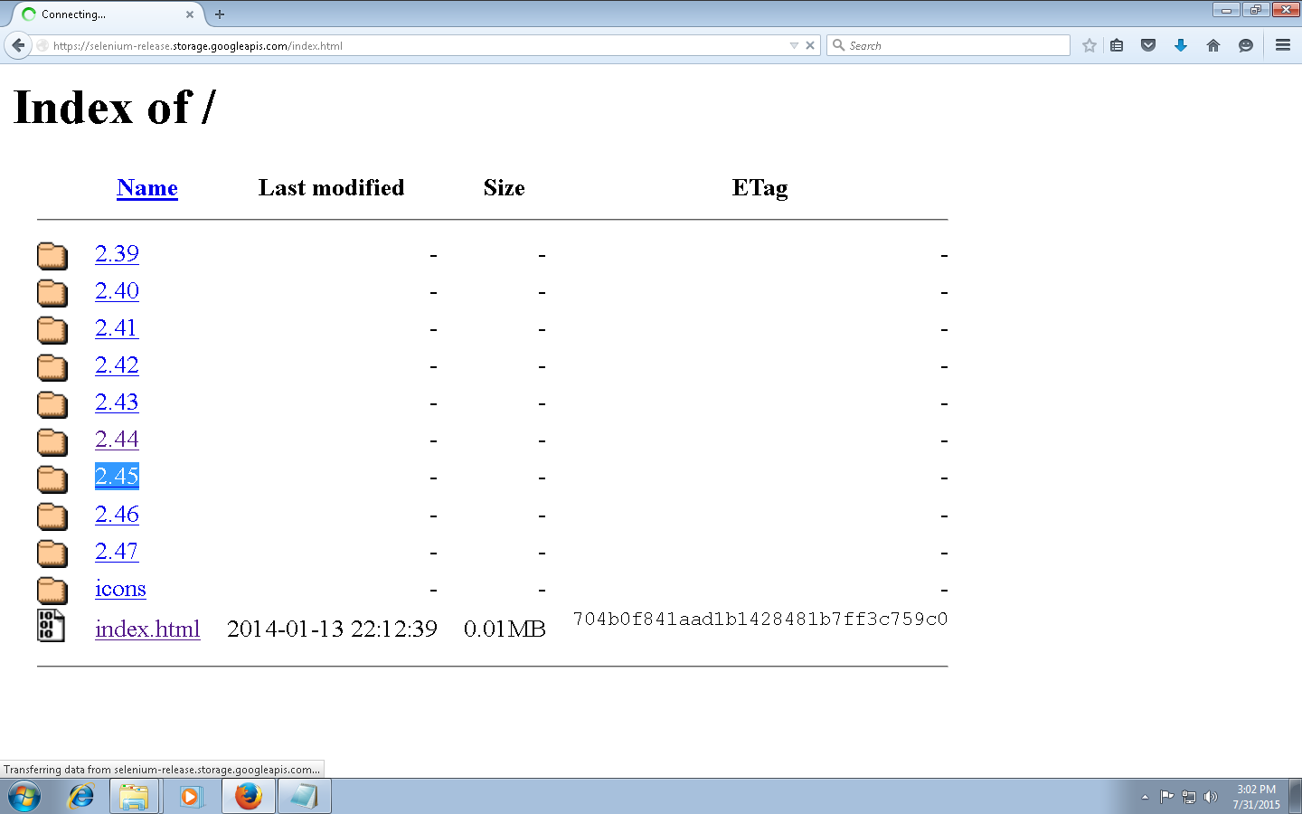
Picking a version of selenium

Slide 5
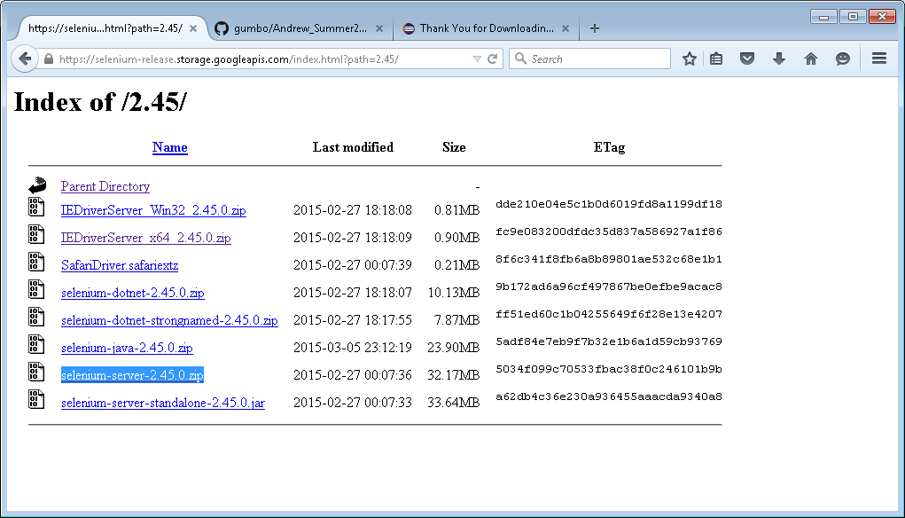
Downloading Selenium

Slide 6
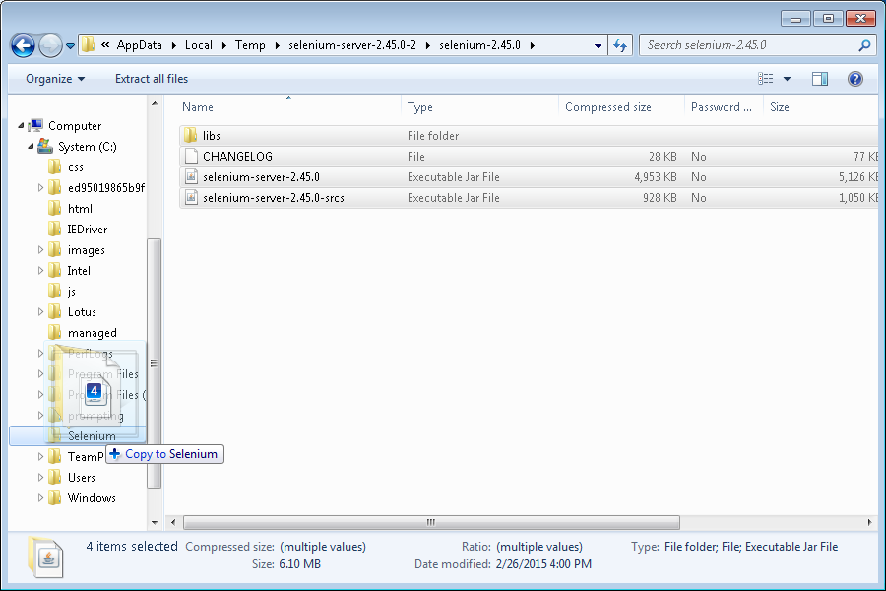
Storing the selenium server files in a reasonable location

Slide 7
Download the folder Loggly
You need access to the private repository https://github.com/TeamPraxisLLC/gumbo
Open the zip file.
Go into Andrew_Summer2015 and move the Loggly folder into your computer.

Slide 8
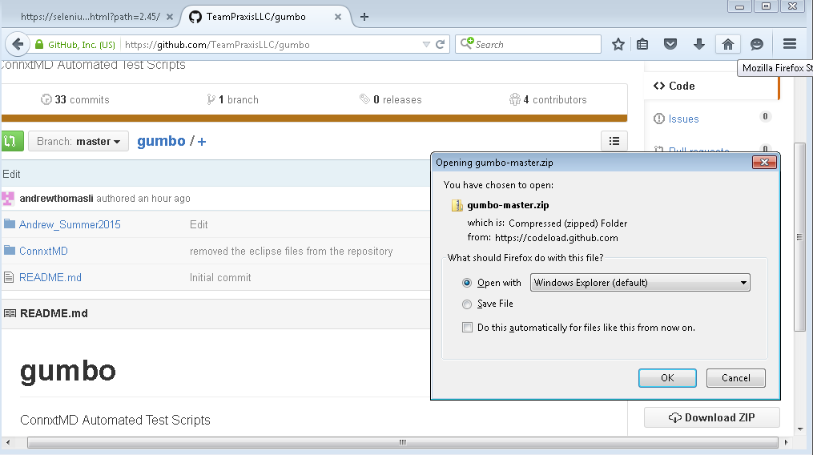
Downloading the zip

Slide 9
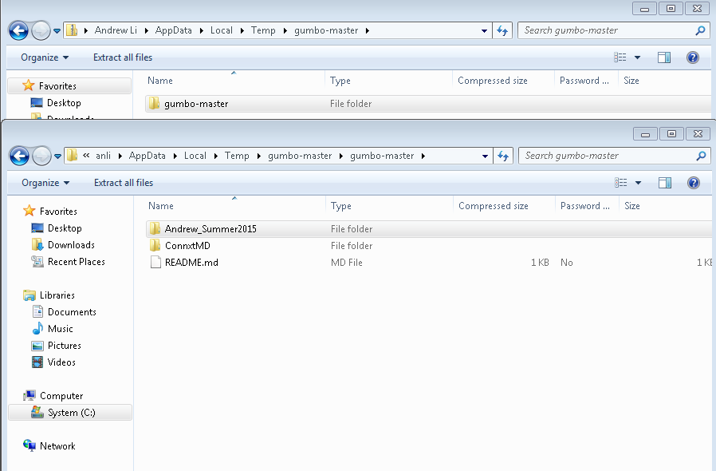
Opening Andrew_Summer2015 Open gumbo-master, then open Andrew_Summer2015

Slide 10
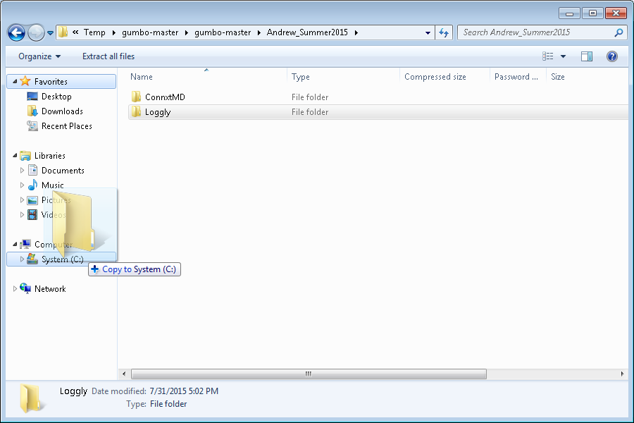
Move the folder ConnxtMD to Computer

Slide 11
Open up eclipse
If you haven’t done so already, download eclipse.
Open eclipse and select the folder that you moved onto your computer as your workspace.

Slide 12
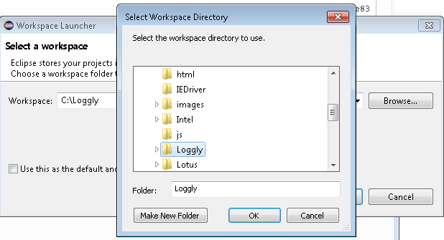
Selecting the workspace

Slide 13
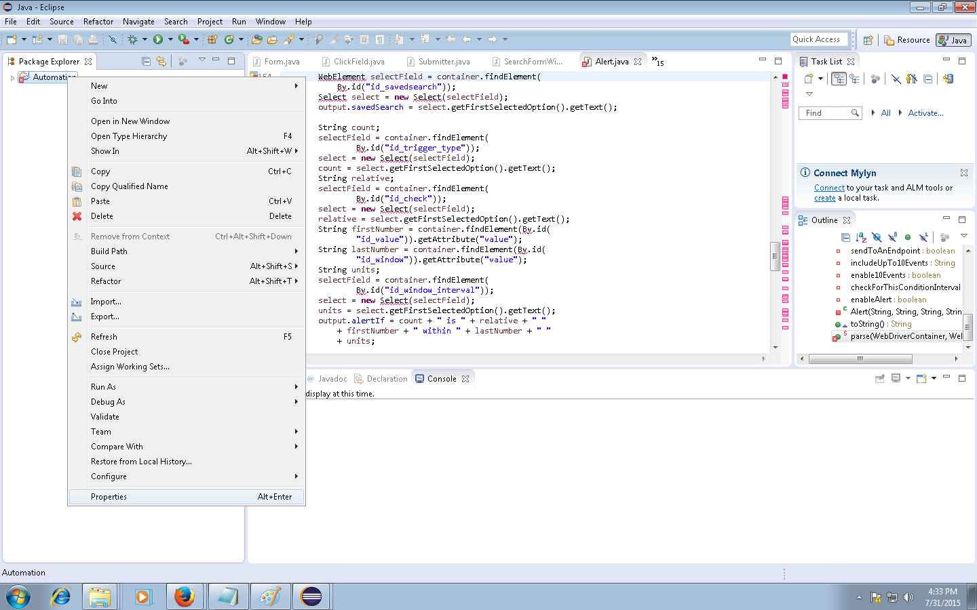
Right click the existing project and click properties

Slide 14
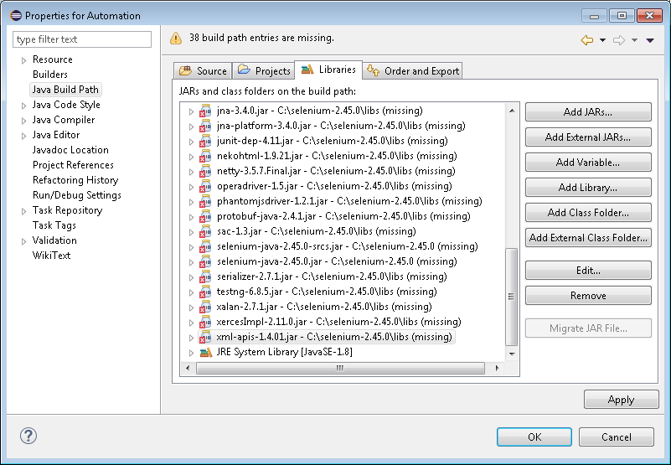
Go to Java Build Path and go to the libraries tab, then remove all jars except the JRE System Library

Slide 15
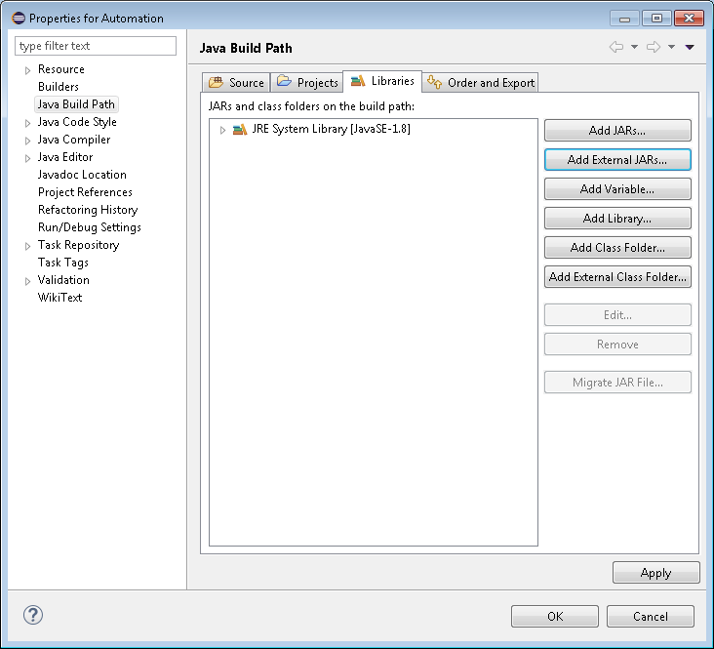
Click on Add External JARs

Slide 16
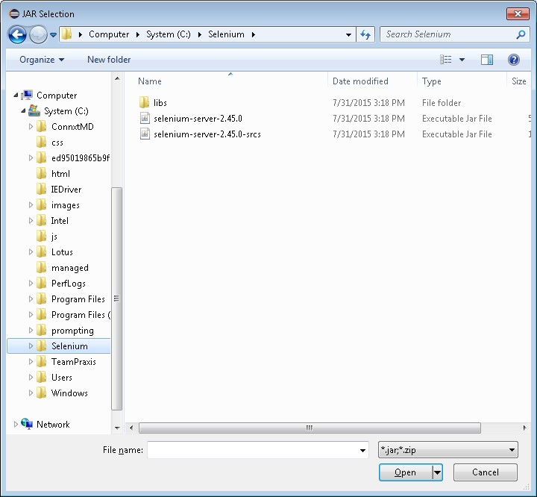
Go to the folder you moved your selenium-server files to.

Slide 17
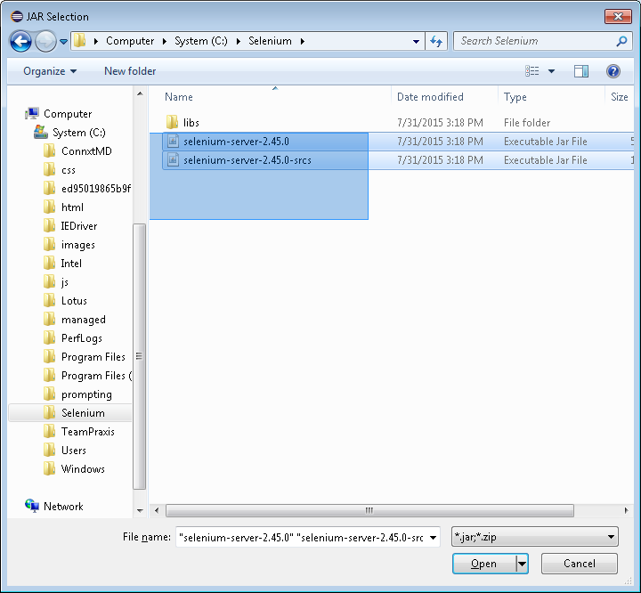
Select both of the jar files

Slide 18
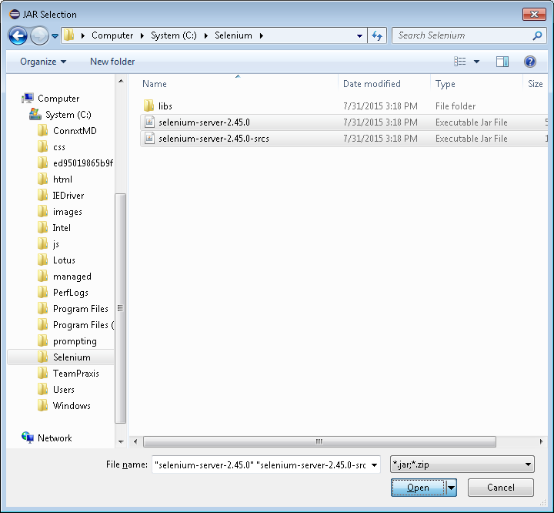
Once selected, press open

Slide 19
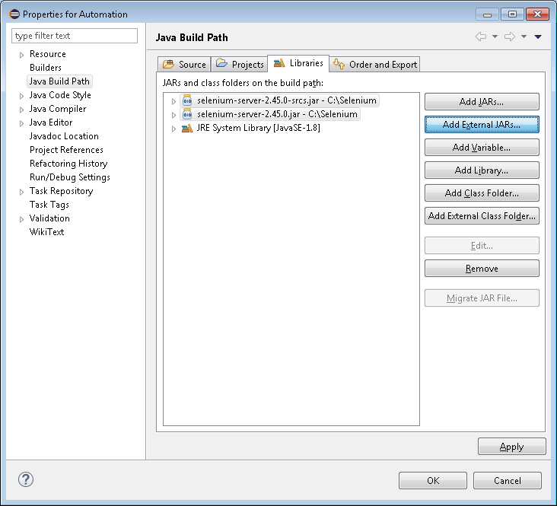
Click Add External Jars again

Slide 20
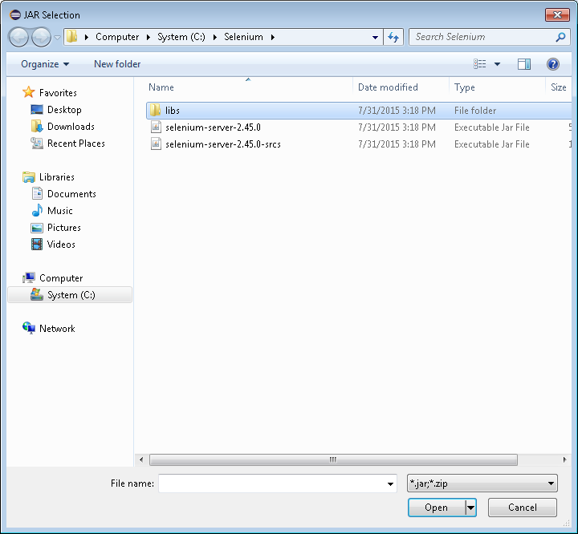
Go into the libs folder

Slide 21
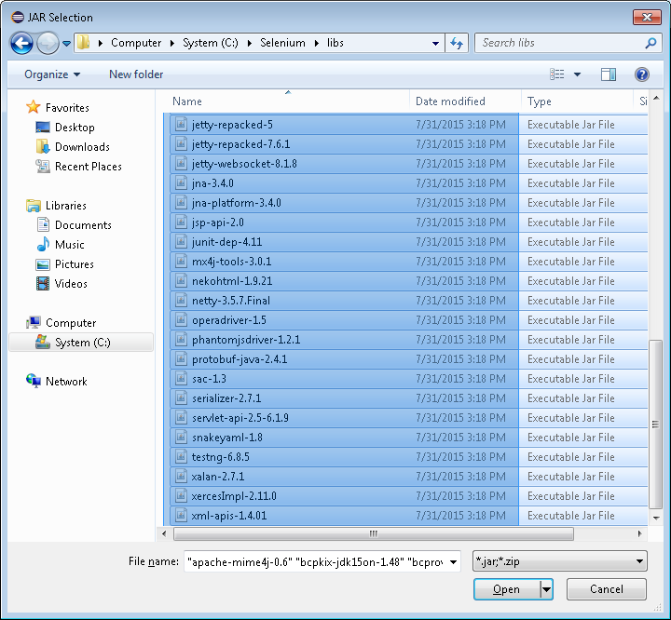
Select all of the jar files

Slide 22
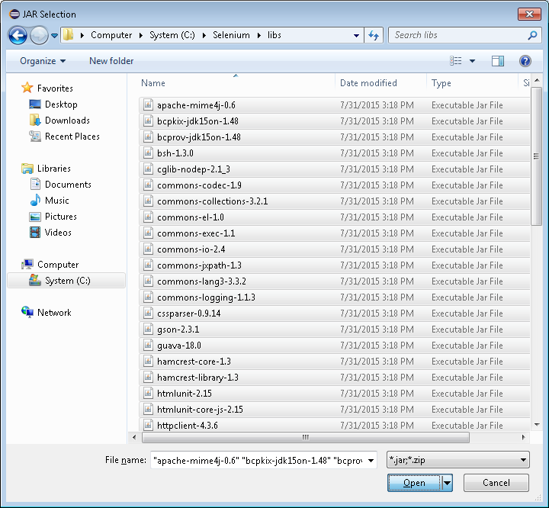
Click “Open”

Slide 23
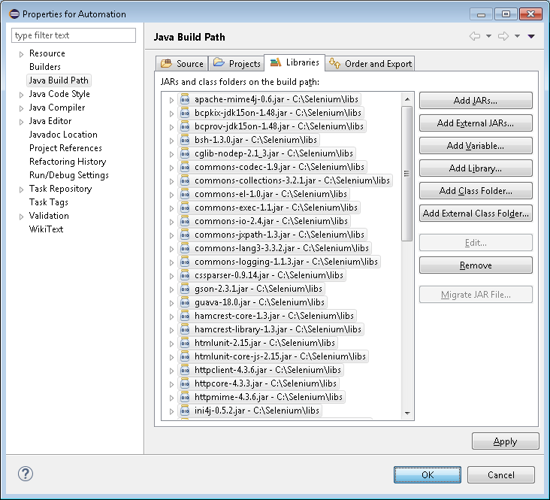
Click OK

