Slide 1
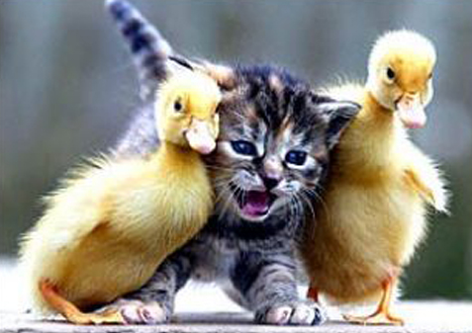
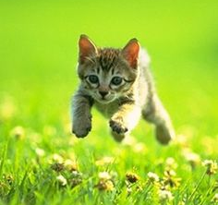
Alright, let’s do this.
Each block will contain a series of images with the same category and concept. You will also be told whether the image is positive (embodies the category) or negative (does NOT embody the category). Your job will be to determine whether each image suitably embodies the description in the instructions.
Example: Cat + Between [positive] Press < (left) if GOOD, press > (right) if BAD.
<
>
<
>

