Slide 1
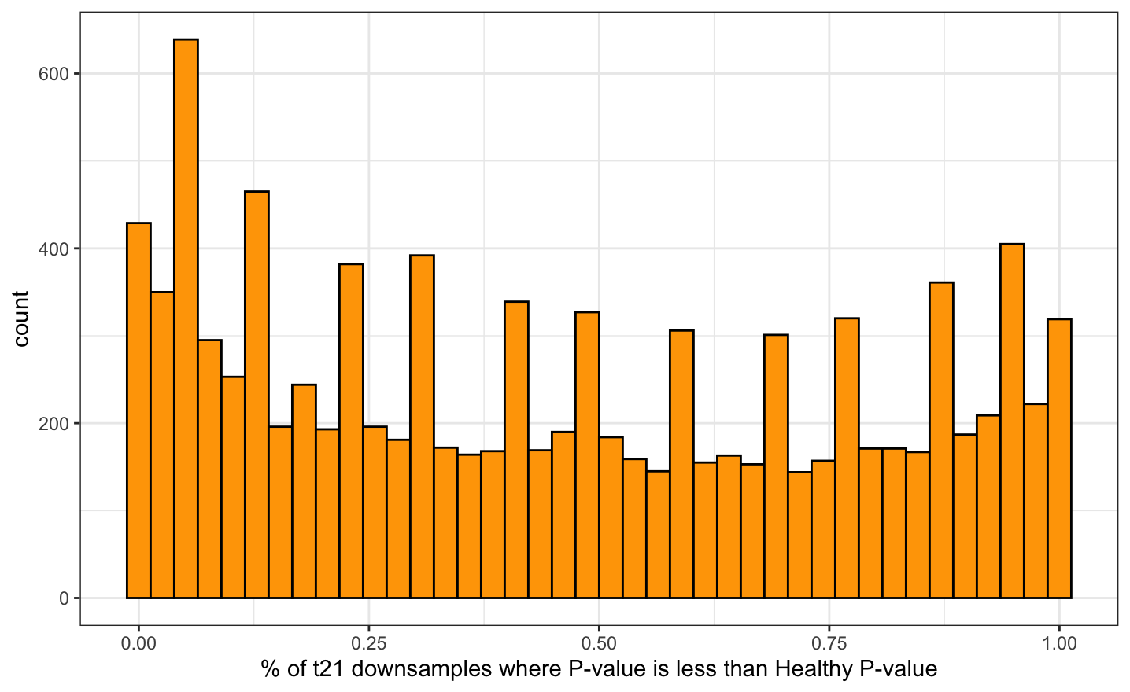
Generally there is a skew towards t21 liver v femur having more significant p values than healthy liver v femur
(histogram across all genes)

Slide 2
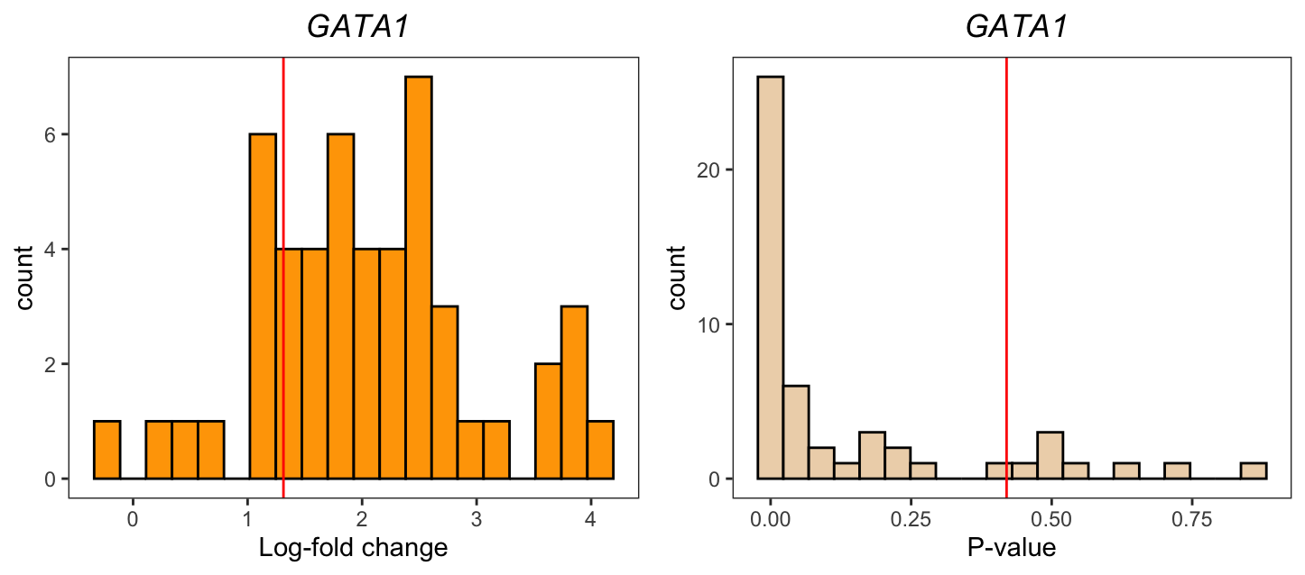
Same type of plots as over slack

Slide 3
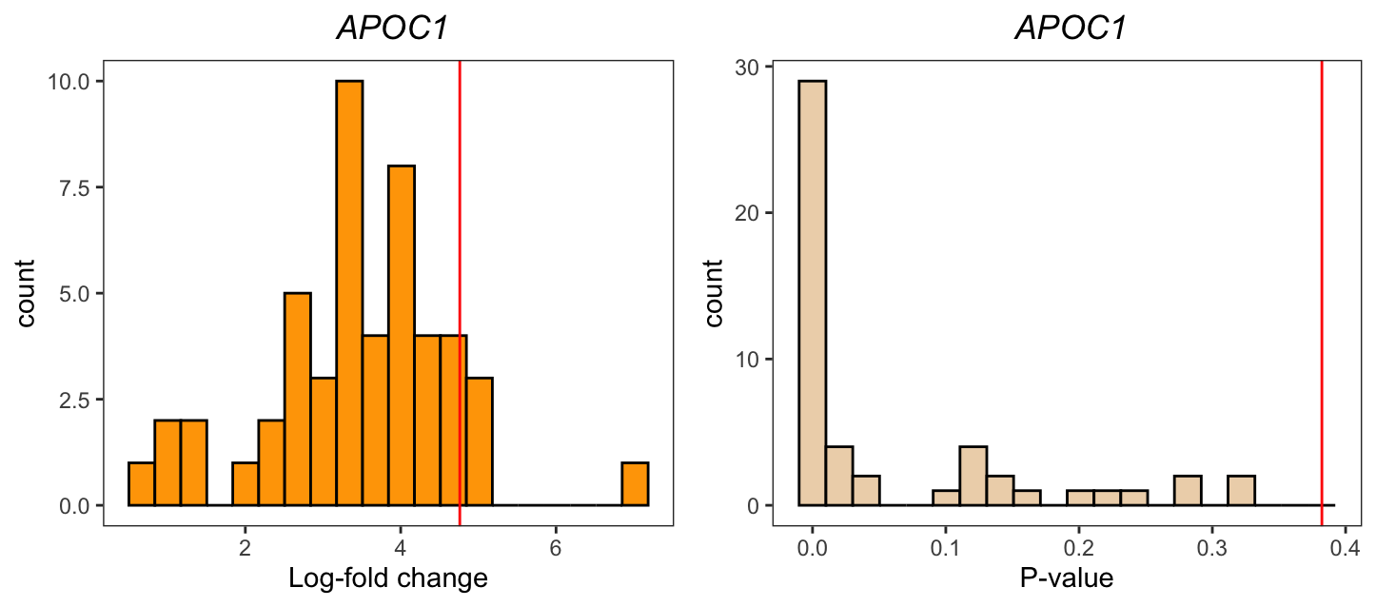
Same type of plots as over slack

Slide 4
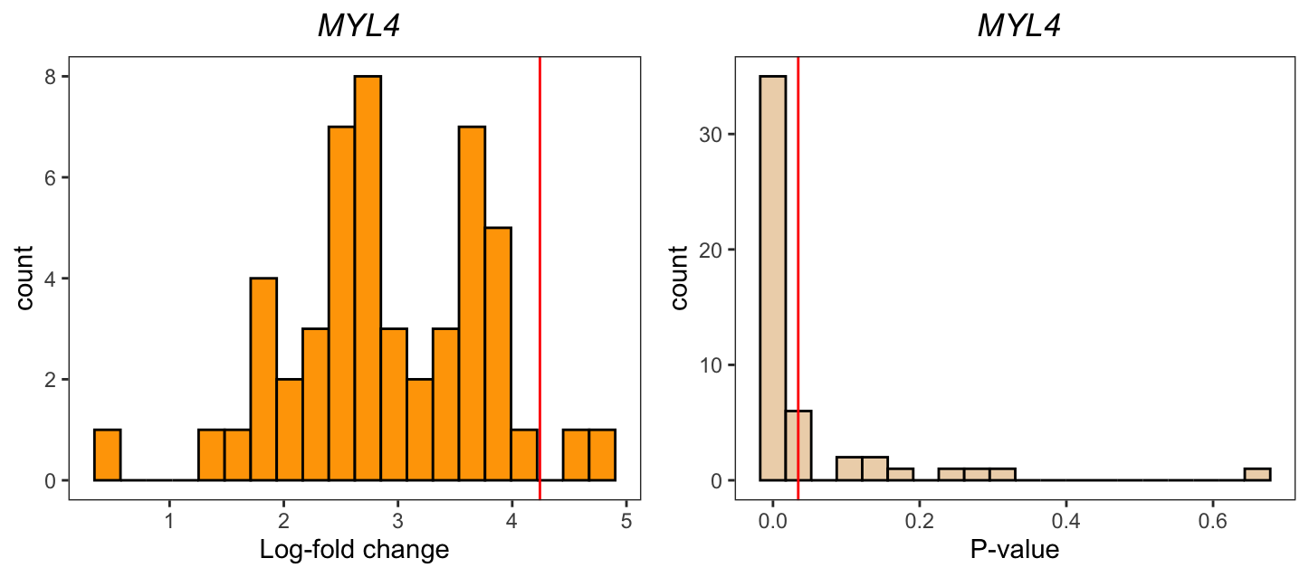
Same type of plots as over slack

Slide 5
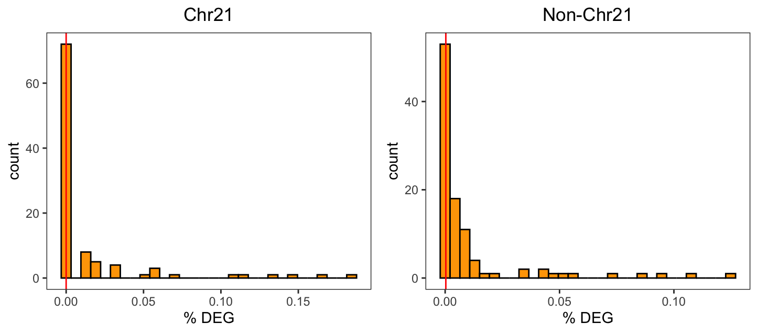
Same type of plots as over slack
28% t21 downsamples have more DEG than healthy
(most are also 0)
68% t21 downsamples have more DEG than healthy

Slide 6
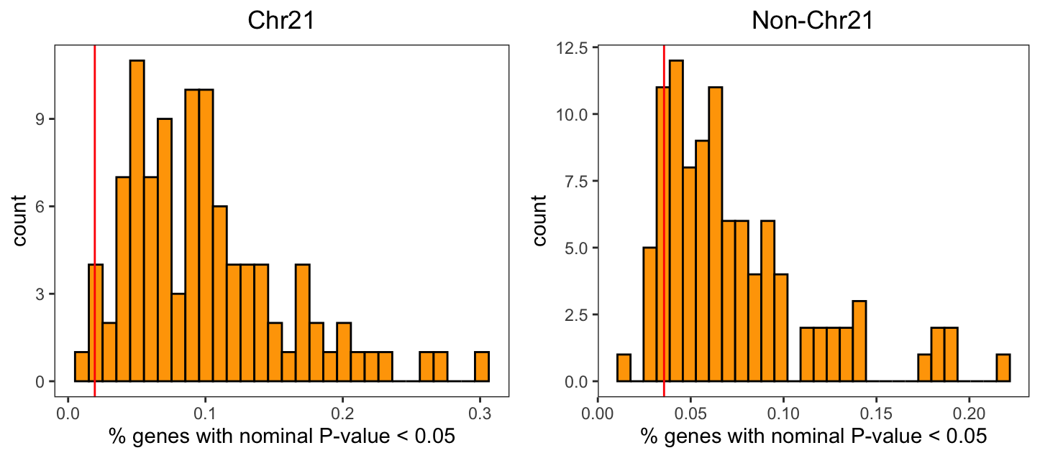
95% t21 downsamples have more P < 0.05 genes than healthy
90% t21 downsamples have more P < 0.05 genes than healthy

Slide 7

Something funky is going on, in that the t21 downsamples have less logFC than the full data
(I thought it would be centered around the same value)
Here, blue is t21 logFC and red is healthy logFC

Slide 8
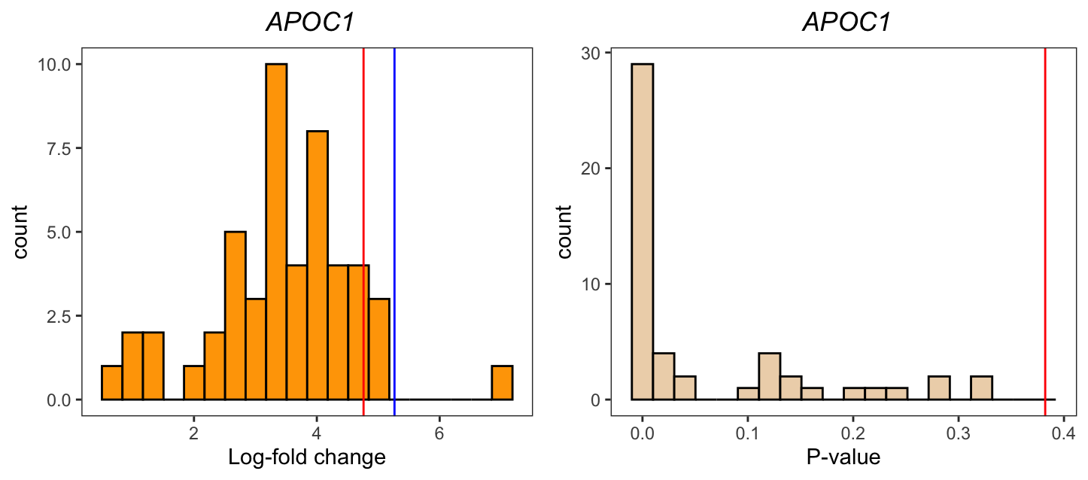

Slide 9


