Slide 1
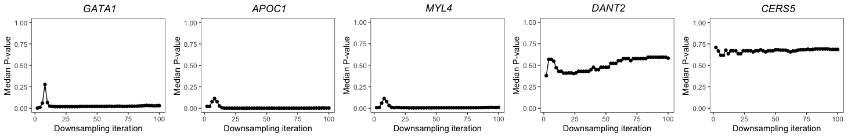
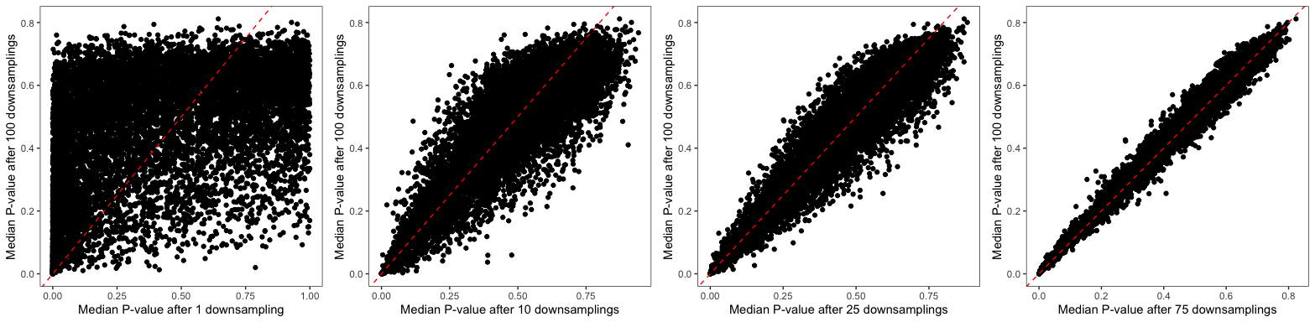

Slide 2
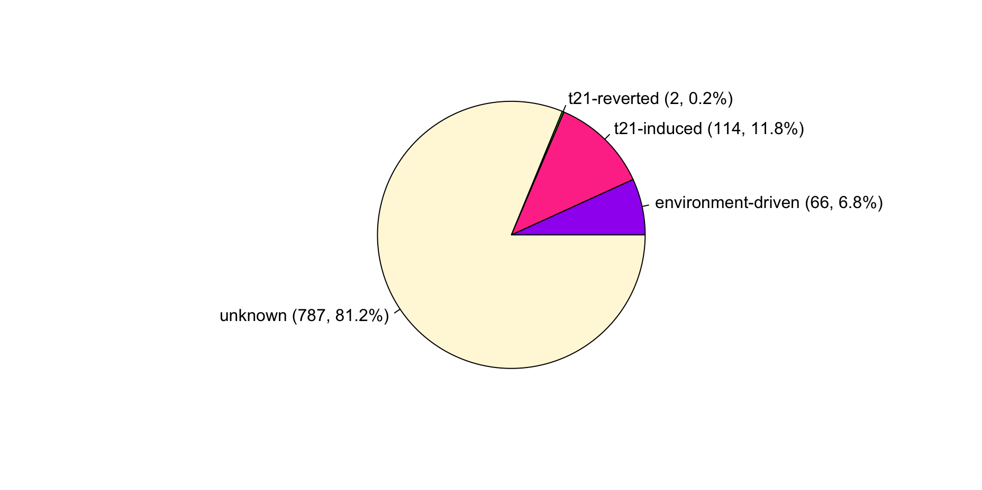
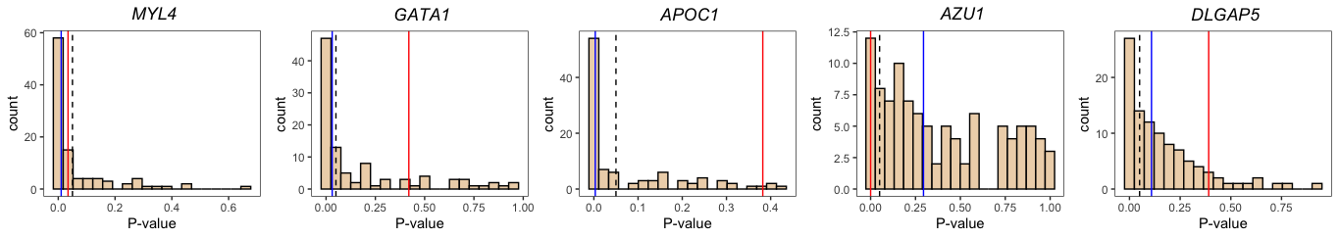
Environment-driven = adj FDR < 0.05 in either T21 or H & unadj P < 0.05 in the other
T21-induced = adj FDR < 0.05 & median T21 downsample P < 0.05 & H unadj P > 0.05
T21-reverted = adj H FDR < 0.05 & unadj T21 P > 0.05
Unknown = adj T21 FDR < 0.05 but median T21 downsample P > 0.05
Environment-driven
T21-induced
T21-reverted
Unknown
(FDR < 0.05 in full t21 dataset)

Slide 3
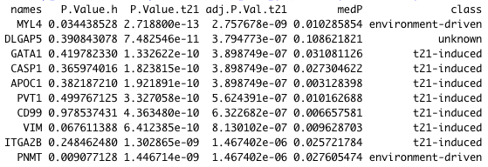
Top t21: liver vs femur hits

Slide 4
3 chromosome 21 genes that are labeled as “t21-induced”
"BTG3" "C21orf58" "MRPL39”
BTG3 seems to be the most interesting one here (which has higher expression in t21 liver than t21 femur)

Slide 5
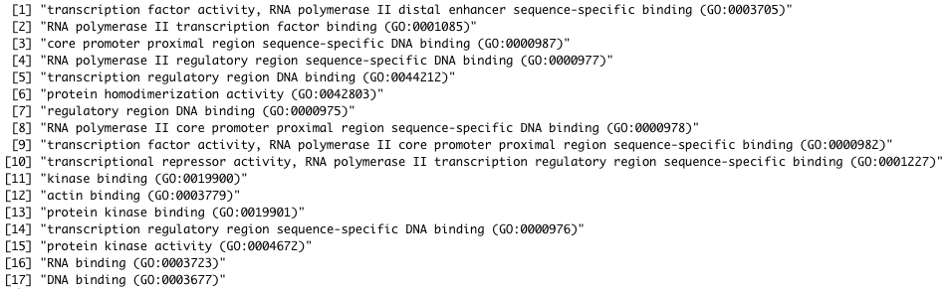
GO molecular functions enriched in “t21-induced” gene set

Slide 6
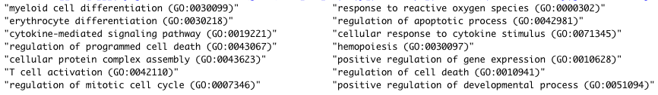
GO biological processes enriched in “t21-induced” gene set

Slide 7
ENCODE and ChEA transcription factors whose targets are enriched in “t21-induced” gene set
"GATA1 CHEA" "RUNX1 CHEA" "IRF8 CHEA" "GATA2 CHEA"
GATA1 targets in the t21-induced gene set list:
PPP1R15A;TFRC;ZBTB16;C21ORF58;LY86;SLC40A1;DAPP1;LDLRAD4;FOS;FOXO3;GATA1;KLF1;ANKRD9;TMEM107;PIM1;MEF2D;GPR146

Slide 8
Results are robust to removing chr 21 genes

Slide 9
Repeating with 66 genes from the “environment-driven” gene set
Molecular functions (GO)
Biological processes (GO)
[1] "tubulin binding (GO:0015631)"
[2] "ubiquitin protein ligase binding (GO:0031625)"
[3] "ubiquitin-like protein ligase binding (GO:0044389)"
[4] "protein homodimerization activity (GO:0042803)"
[5] "sequence-specific DNA binding (GO:0043565)"
[6] "metal ion binding (GO:0046872)"
[7] "DNA binding (GO:0003677)"
[1] "regulation of cell cycle (GO:0051726)" "metaphase plate congression (GO:0051310)"
[3] "regulation of DNA binding (GO:0051101)" "mitotic spindle organization (GO:0007052)"
[5] "spindle assembly (GO:0051225)" "response to cytokine (GO:0034097)"
ENCODE and ChEA transcription factors whose targets are enriched in “t21-induced” gene set
[1] "E2F4 ENCODE" "SIN3A ENCODE" "E2F1 CHEA" "ESR1 CHEA" "NFYA ENCODE" "RUNX1 CHEA"
[7] "GATA1 CHEA" "SP1 ENCODE"
GATA1 targets in the environment-driven gene set list:
PNMT;NEK6;LPCAT3;BCL2;BLVRB;HES1;IL6R;SLC18A2

