Slide 1
Analysis updated

Slide 2
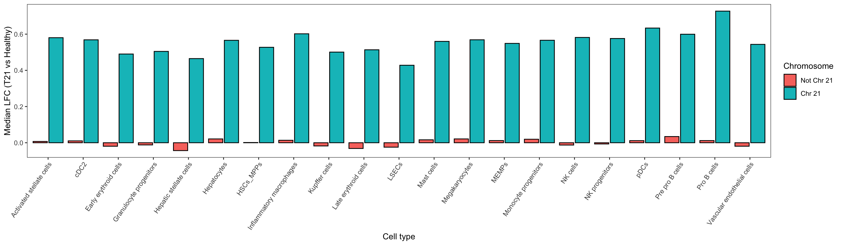
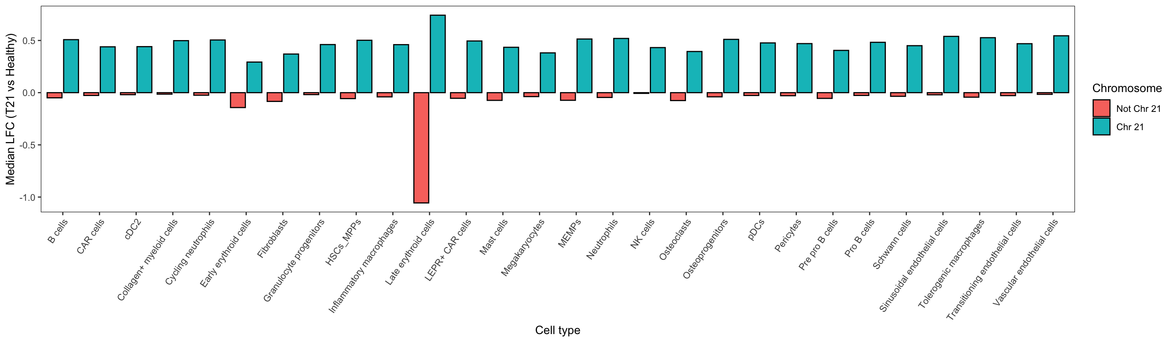
Increased expression across chr 21 genes
Liver
Femur

Slide 3
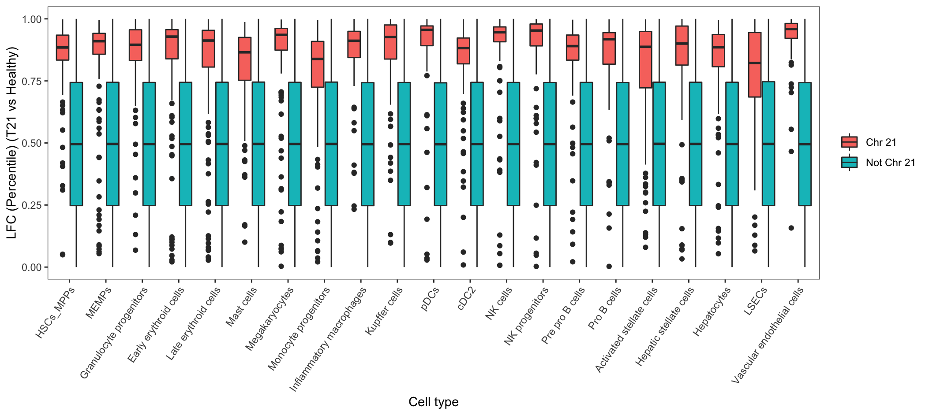
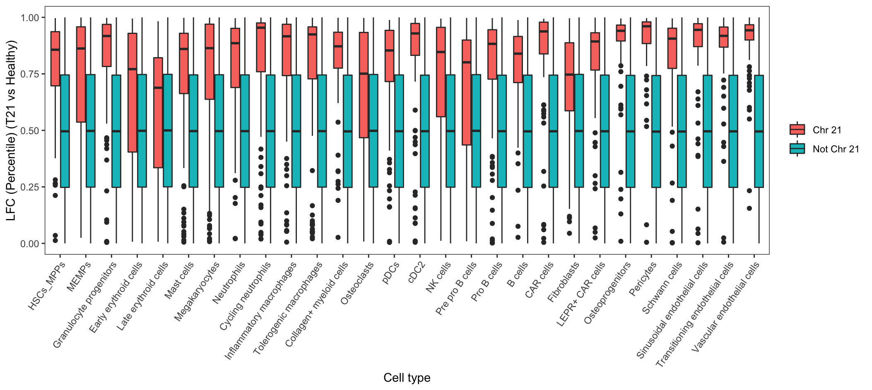
Increased expression across chr 21 genes
Liver
Femur

Slide 4
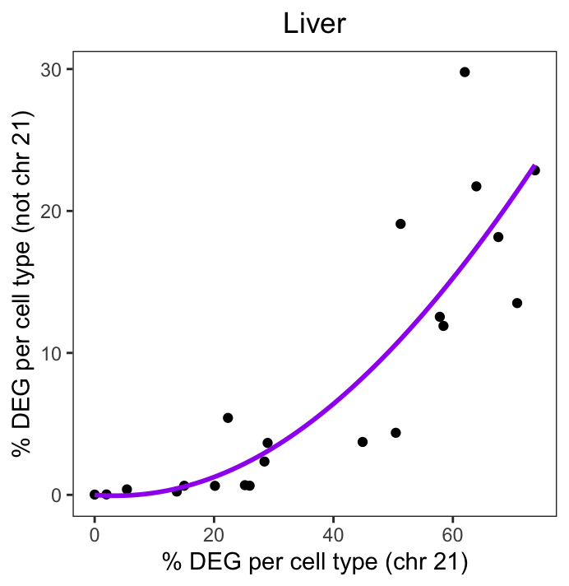
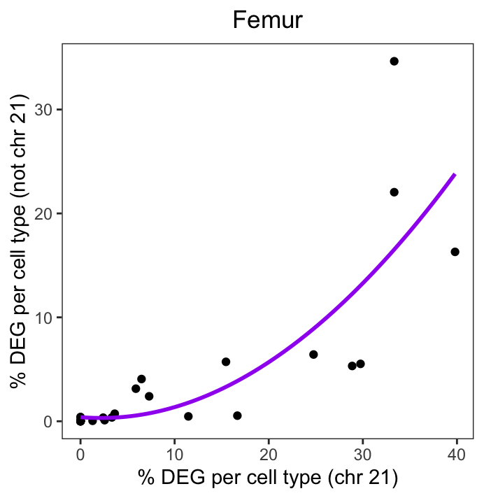
Exponential relationship between chr 21 dysregulation and non-chr21 dysregulation (T21 v Healthy)

Slide 5
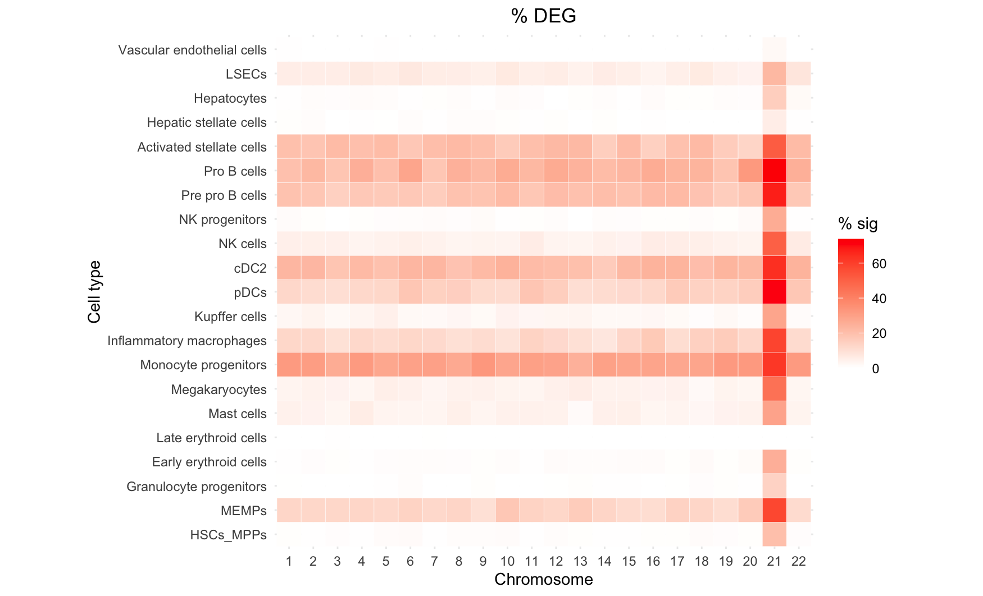
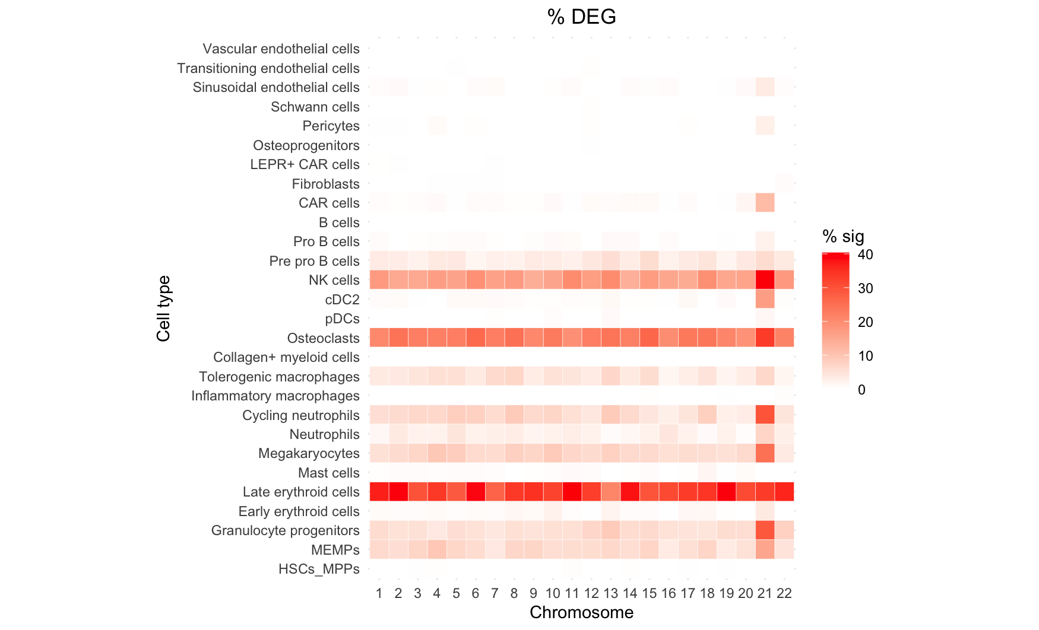
Differences in number of significant DEGs across cell types and between liver and femur environments
Liver
Femur

Slide 6
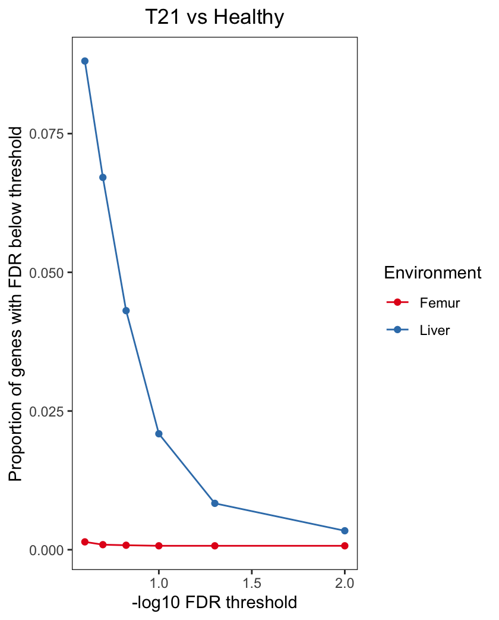
Example: For HSCs, many more T21 v Healthy DEGs found in Liver compared to Femur

Slide 7
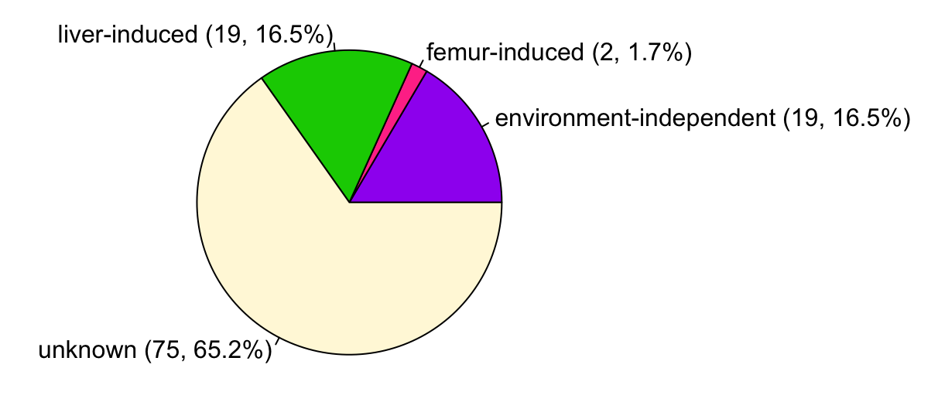
Conducted DEG analysis between:
T21 liver and healthy liver samples
T21 femur and healthy femur samples
Classified significant DEGs as:
Liver-induced
Liver-specific changes in T21 dysregulation
Femur-induced
Femur-specific changes in T21 dysregulation
(3) Environment-independent
T21 dysregulation observed in both femur and liver environments
(4) Unknown
T21 dysregulation observed (in liver), but unclear whether dysregulation is driven by the liver environment or if it is environment-independent
Results:
40 of 115 DEGs (34.8%) could be assigned as liver-induced, femur-induced, or environment-independent T21 dysregulation.
Methods/Specific Details:
Environment-independent = adj FDR < 0.05 in either femur or liver & unadj P < 0.05 in the other environment
Liver-induced = liver adj FDR < 0.05 & median liver downsample unadj P < 0.05 & femur unadj P > 0.05
Femur-induced = femur adj FDR < 0.05 & liver unadj P > 0.05
Unknown = adj FDR < 0.05 in liver, but median liver downsample P > 0.05 & femur unadj P > 0.05 (e.g. are we underpowered?)

Slide 8
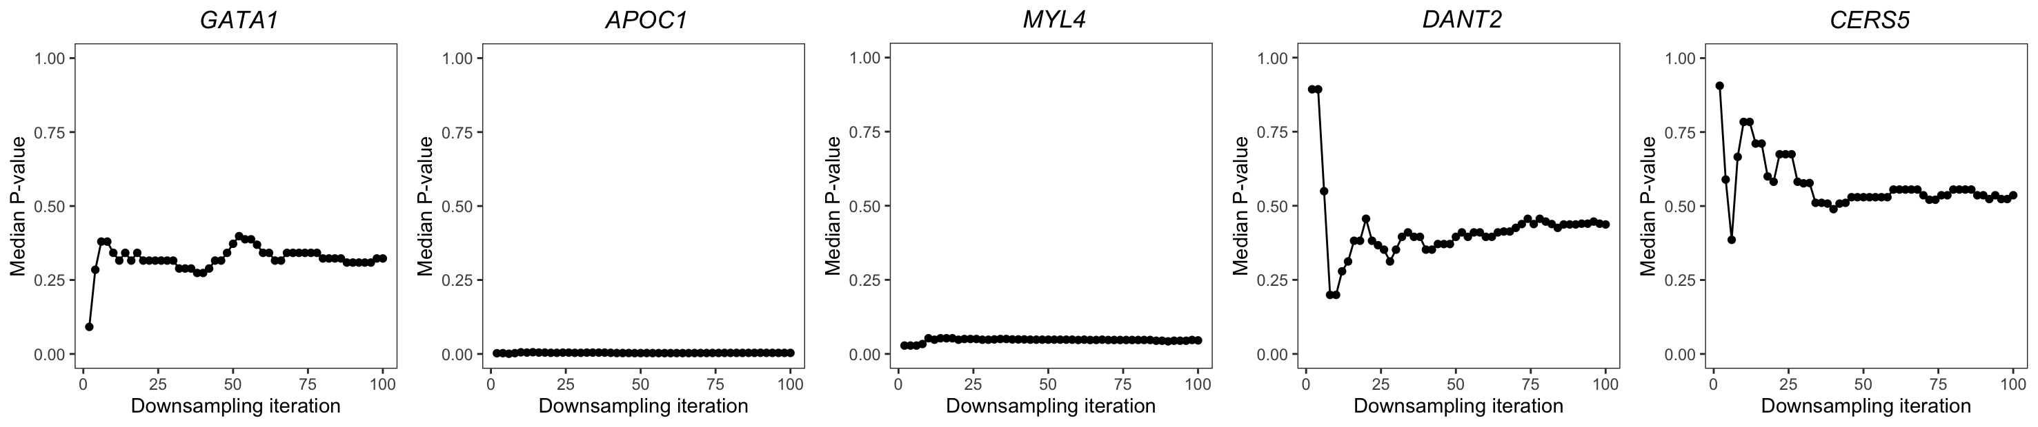
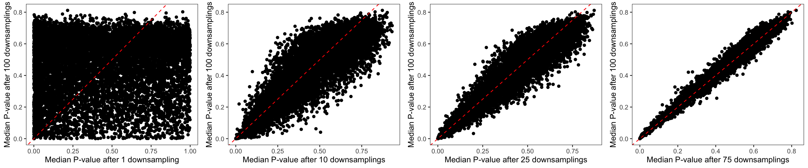
Down-sampling in liver (T21 v Healthy DE analysis):

Slide 9
19 liver-induced T21 genes
Downregulated in t21:
[1] "ACTG1" "EIF3D" "HLA-DMA" "HLA-DPA1" "HLA-DRA" "HLA-DRB1" "HNRNPA1" "HSD17B11" "MARCKS"
[10] "MFAP4" "RGS19" "TKT" "TYROBP" "VIM"
Enrichment: (FDR<0.1)
MF: [1] "MHC class II receptor activity (GO:0032395)" "MHC class II protein complex binding (GO:0023026)"
BP:
[1] "peptide antigen assembly with MHC protein complex (GO:0002501)"
[2] "antigen processing and presentation of exogenous peptide antigen via MHC class II (GO:0019886)"
[3] "antigen processing and presentation of peptide antigen via MHC class II (GO:0002495)"
[4] "antigen processing and presentation of exogenous peptide antigen (GO:0002478)"
[5] "positive regulation of leukocyte mediated cytotoxicity (GO:0001912)"
[6] "interferon-gamma-mediated signaling pathway (GO:0060333)"
[7] "cellular response to interferon-gamma (GO:0071346)"
[8] "T cell receptor signaling pathway (GO:0050852)"
[9] "regulation of immune response (GO:0050776)"
[10] "antigen receptor-mediated signaling pathway (GO:0050851)"
[11] "positive regulation of gene expression (GO:0010628)"
[12] "cytokine-mediated signaling pathway (GO:0019221)"
[13] "supramolecular fiber organization (GO:0097435)"
TF set: N/A
Upregulated in t21:
[1] "C21orf58" "PRMT2" "PTPRD" "SON" "YBEY"
Enrichment: (FDR < 0.1)
MF: N/A
BP: N/A
TF set: "TAF1 ENCODE” (SON;PRMT2;YBEY;C21ORF58) and "PML ENCODE” (SON;PRMT2;C21ORF58)

Slide 10
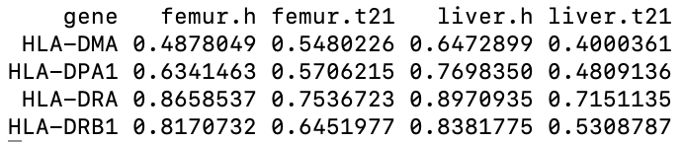
What proportion of cells express the downregulated HLA genes?

Slide 11
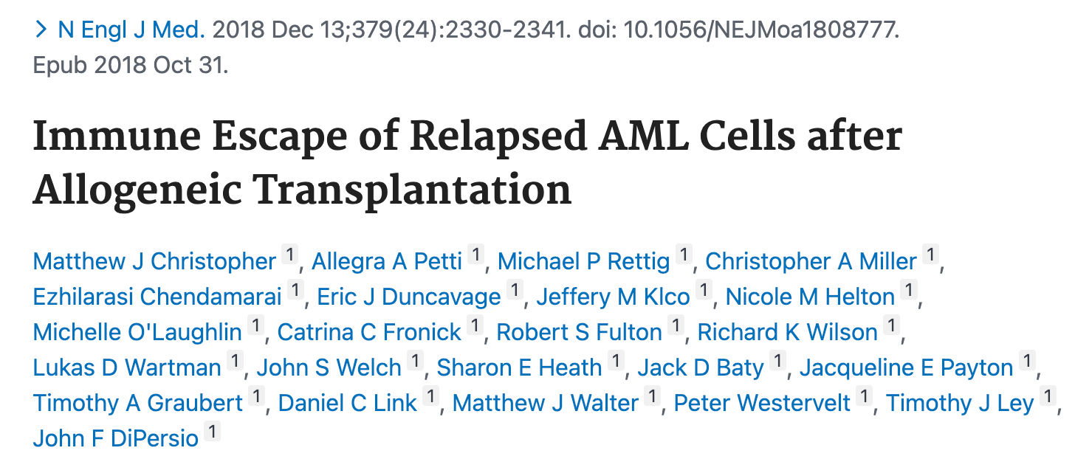
Potentially relevant paper
https://pubmed.ncbi.nlm.nih.gov/30380364/
RNA sequencing of samples obtained at relapse after transplantation revealed dysregulation of pathways involved in adaptive and innate immunity, including down-regulation of major histocompatibility complex (MHC) class II genes (HLA-DPA1, HLA-DPB1, HLA-DQB1, and HLA-DRB1)

Slide 12
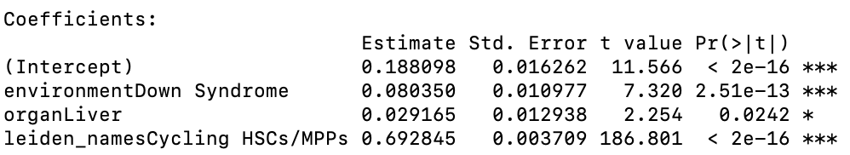
Cell cycle analysis
Methods:
Linear probability model assessing the probability of cell cycle in G2 or S phase (not in G1)
Jointly model the effect of T21, environment (Liver v Femur), and HSC/MPP vs Cycling HSC/MPP cluster
Results:
8.0% increase in T21 cells compared to healthy
2.9% increase in Liver compared to Femur
69.3% increase in cycling HSCs vs HSCs

