Slide 1
Analysis updated

Slide 2
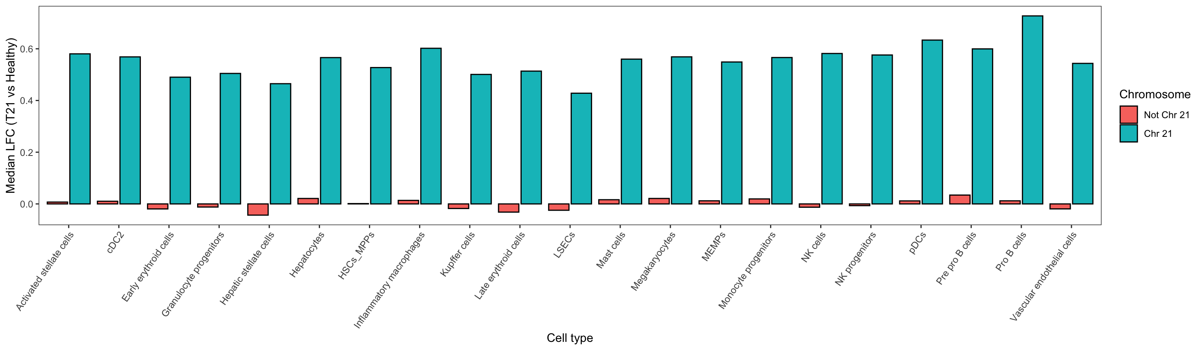
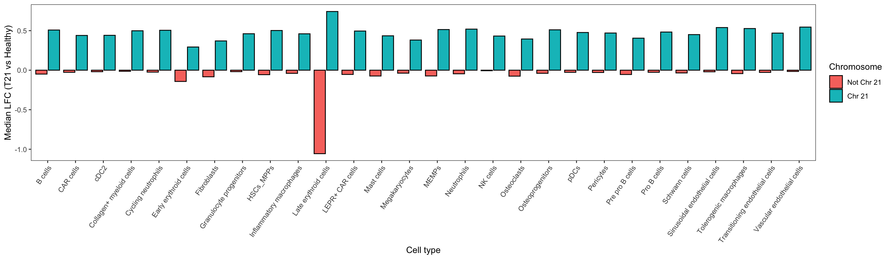
Increased expression across chr 21 genes
Liver
Femur

Slide 3
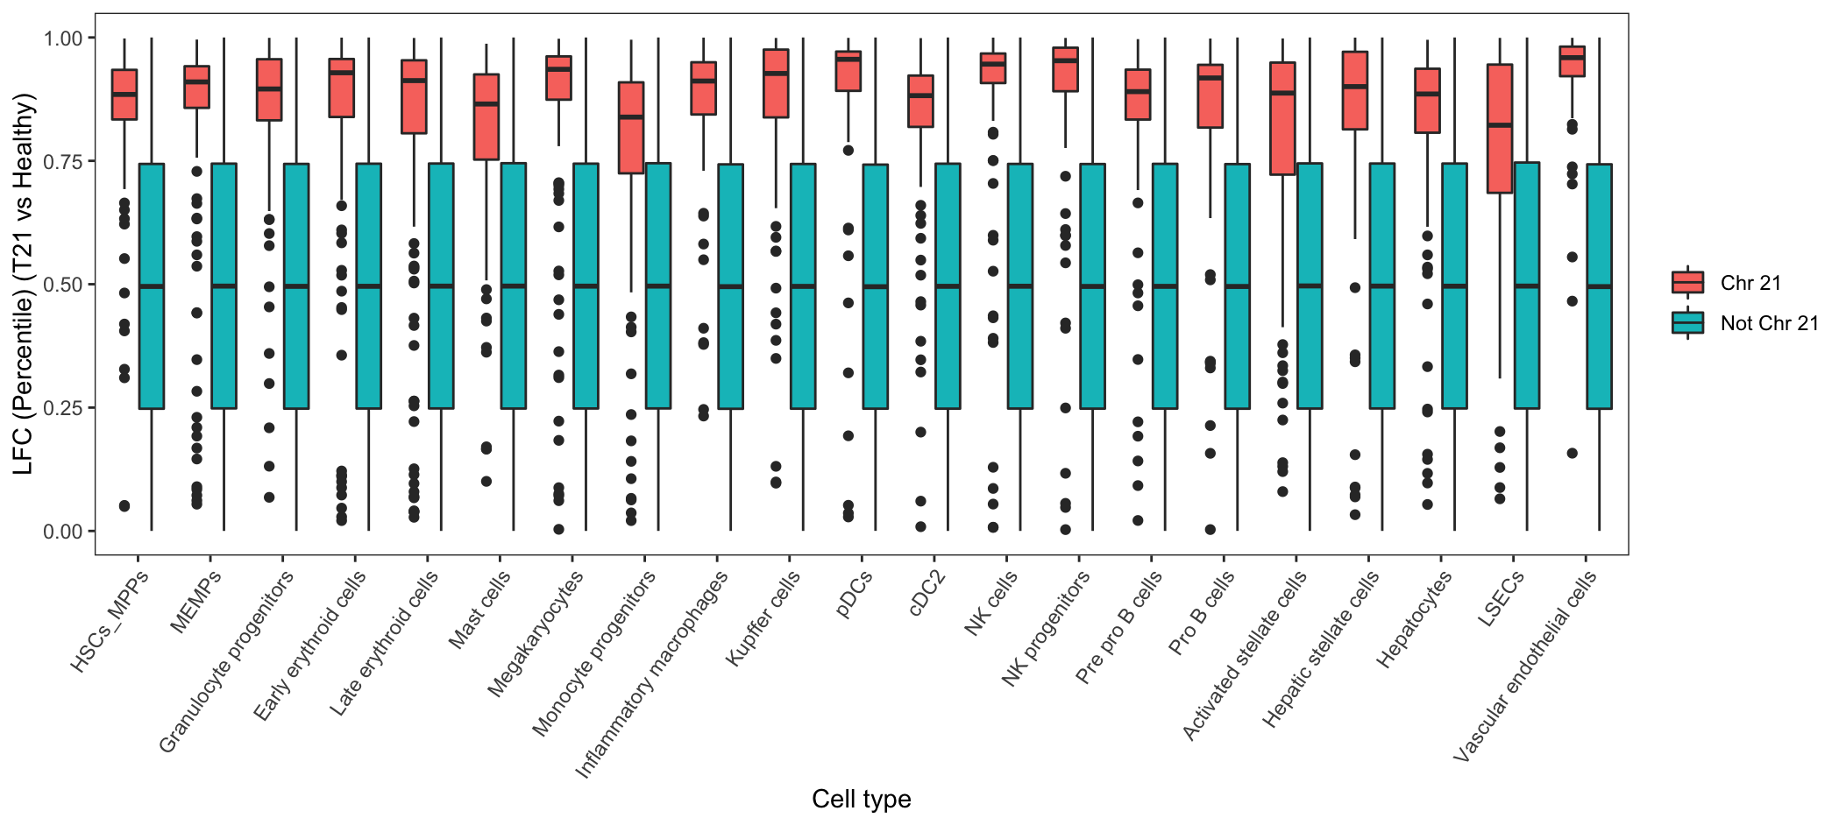
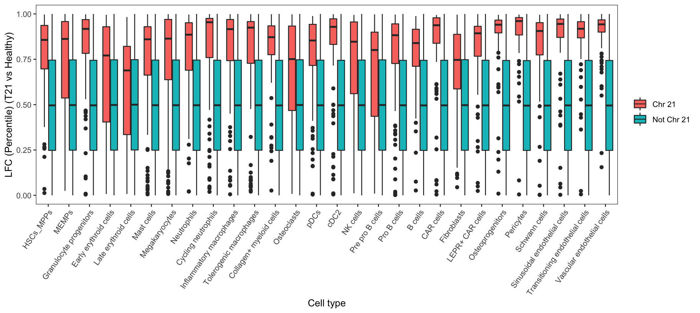
Increased expression across chr 21 genes
Liver
Femur

Slide 4
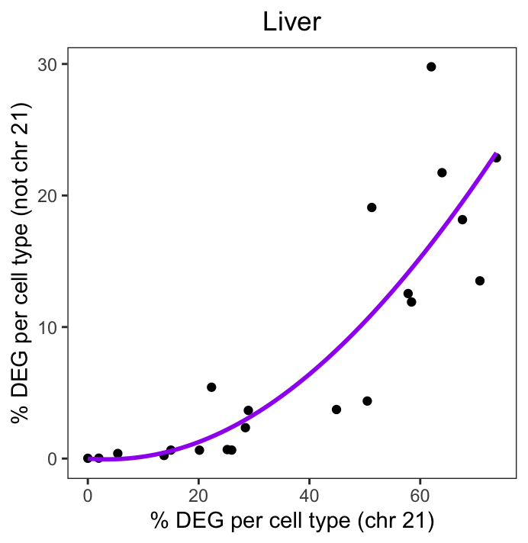
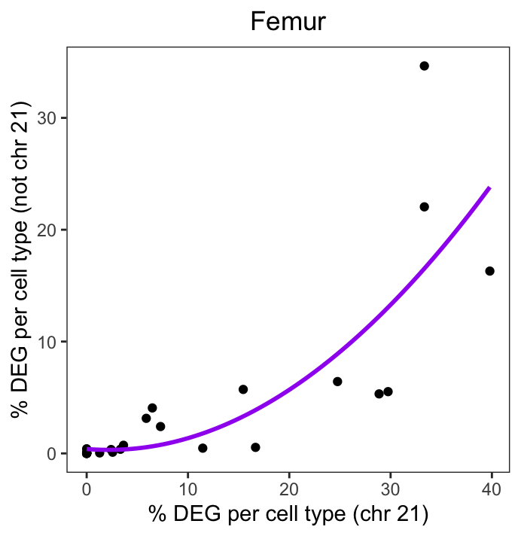
Exponential relationship between chr 21 dysregulation and non-chr21 dysregulation (T21 v Healthy)

Slide 5
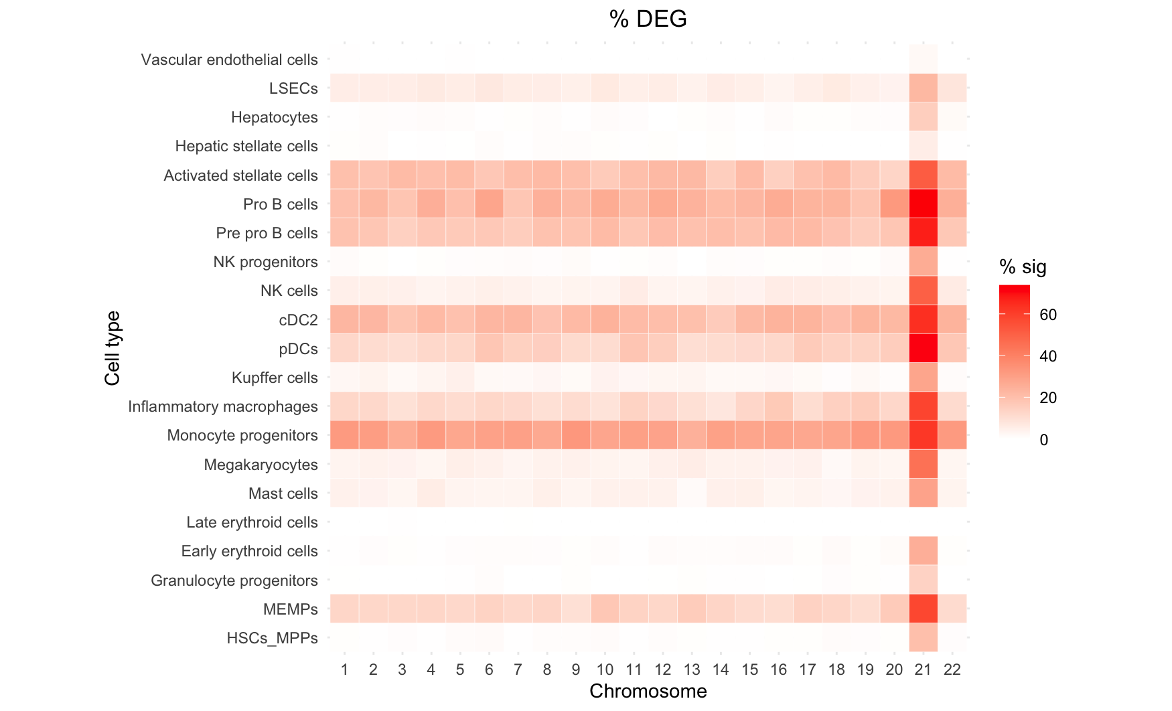
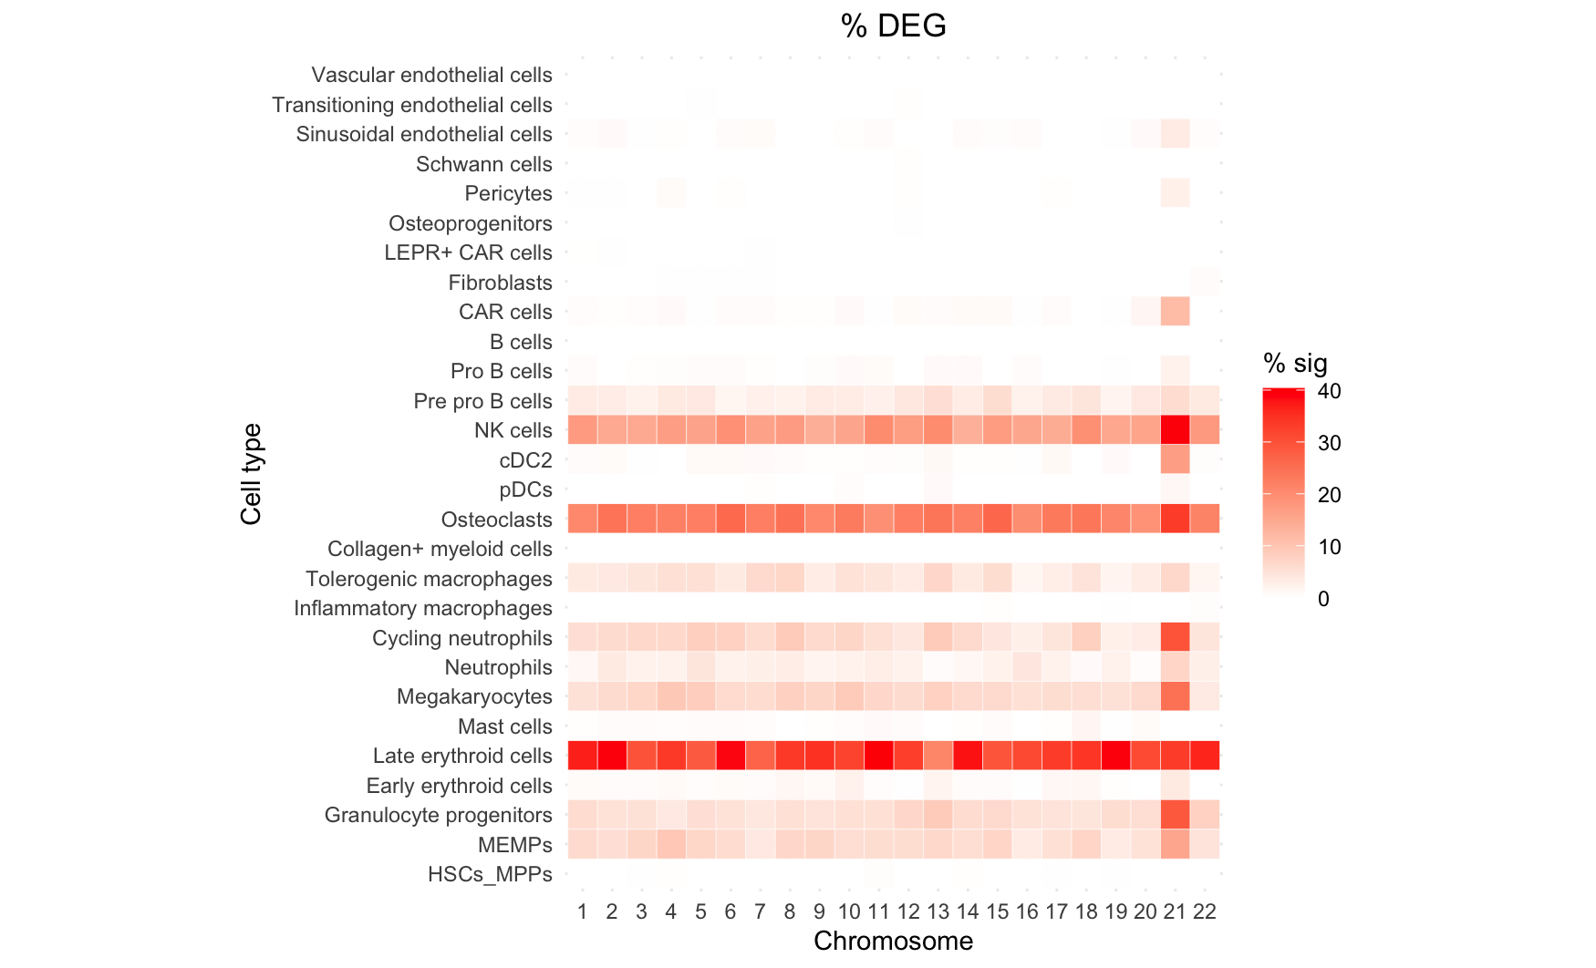
Differences in number of significant DEGs across cell types and between liver and femur environments
Liver
Femur

Slide 6
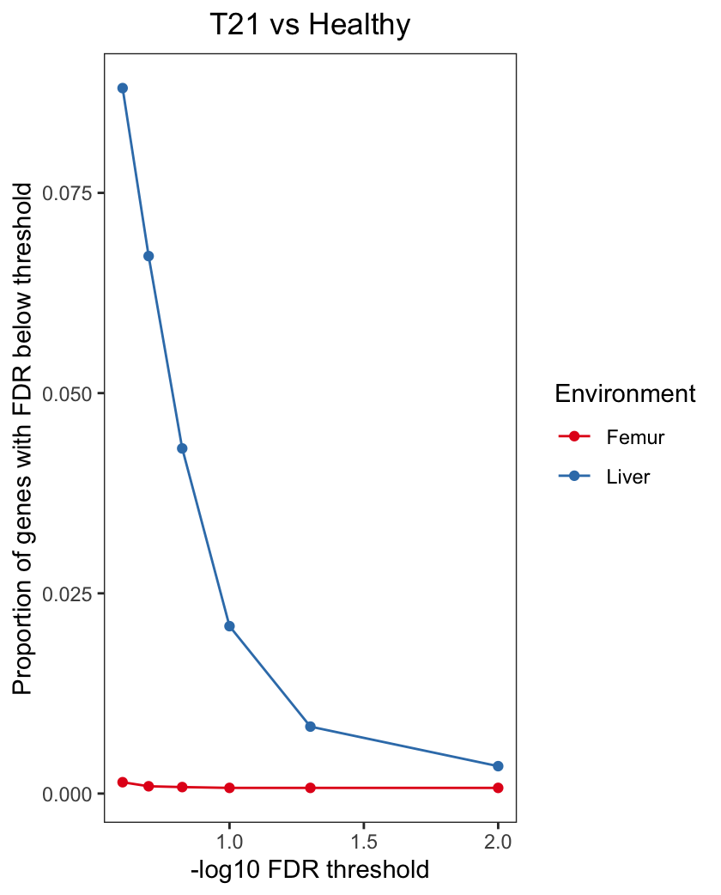
Example: For HSCs, many more T21 v Healthy DEGs found in Liver compared to Femur

Slide 7
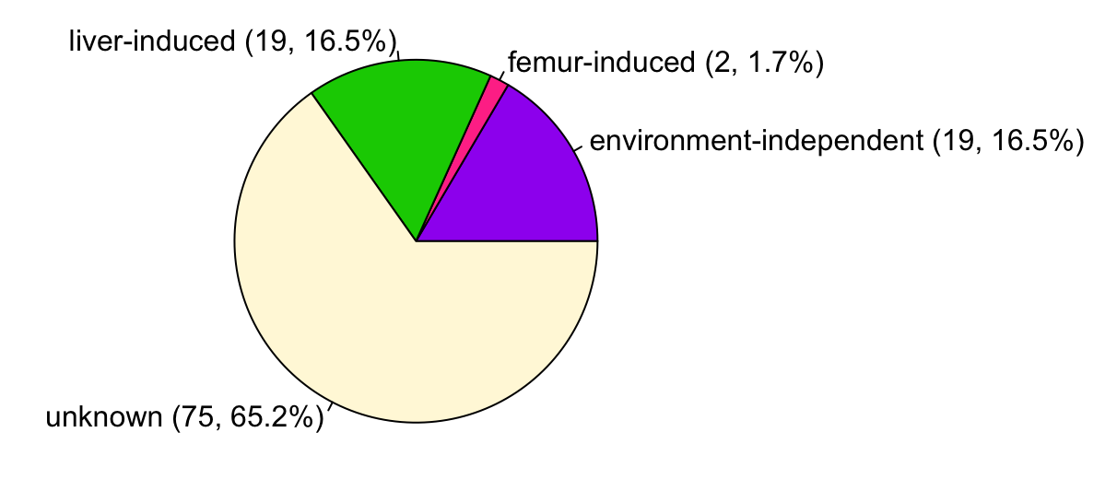
Conducted DEG analysis between:
T21 liver and healthy liver samples
T21 femur and healthy femur samples
Classified significant DEGs as:
Liver-induced
Liver-specific changes in T21 dysregulation
Femur-induced
Femur-specific changes in T21 dysregulation
(3) Environment-independent
T21 dysregulation observed in both femur and liver environments
(4) Unknown
T21 dysregulation observed (in liver), but unclear whether dysregulation is driven by the liver environment or if it is environment-independent
Results:
40 of 115 DEGs (34.8%) could be assigned as liver-induced, femur-induced, or environment-independent T21 dysregulation.
Methods/Specific Details:
Environment-independent = adj FDR < 0.05 in either femur or liver & unadj P < 0.05 in the other environment
Liver-induced = liver adj FDR < 0.05 & median liver downsample unadj P < 0.05 & femur unadj P > 0.05
Femur-induced = femur adj FDR < 0.05 & liver unadj P > 0.05
Unknown = adj FDR < 0.05 in liver, but median liver downsample P > 0.05 & femur unadj P > 0.05 (e.g. are we underpowered?)

Slide 8
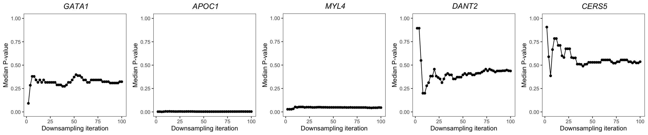
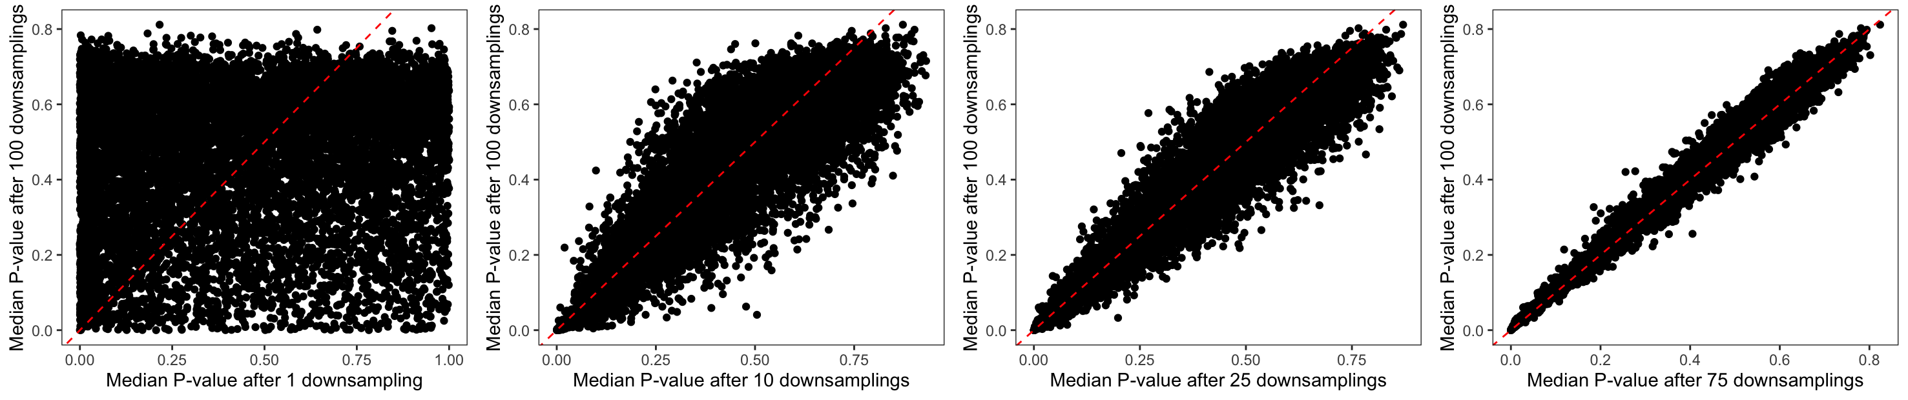
Down-sampling in liver (T21 v Healthy DE analysis):

Slide 9
19 liver-induced T21 genes
Downregulated in t21:
[1] "ACTG1" "EIF3D" "HLA-DMA" "HLA-DPA1" "HLA-DRA" "HLA-DRB1" "HNRNPA1" "HSD17B11" "MARCKS"
[10] "MFAP4" "RGS19" "TKT" "TYROBP" "VIM"
Enrichment: (FDR<0.1)
MF: [1] "MHC class II receptor activity (GO:0032395)" "MHC class II protein complex binding (GO:0023026)"
BP:
[1] "peptide antigen assembly with MHC protein complex (GO:0002501)"
[2] "antigen processing and presentation of exogenous peptide antigen via MHC class II (GO:0019886)"
[3] "antigen processing and presentation of peptide antigen via MHC class II (GO:0002495)"
[4] "antigen processing and presentation of exogenous peptide antigen (GO:0002478)"
[5] "positive regulation of leukocyte mediated cytotoxicity (GO:0001912)"
[6] "interferon-gamma-mediated signaling pathway (GO:0060333)"
[7] "cellular response to interferon-gamma (GO:0071346)"
[8] "T cell receptor signaling pathway (GO:0050852)"
[9] "regulation of immune response (GO:0050776)"
[10] "antigen receptor-mediated signaling pathway (GO:0050851)"
[11] "positive regulation of gene expression (GO:0010628)"
[12] "cytokine-mediated signaling pathway (GO:0019221)"
[13] "supramolecular fiber organization (GO:0097435)"
TF set: N/A
Upregulated in t21:
[1] "C21orf58" "PRMT2" "PTPRD" "SON" "YBEY"
Enrichment: (FDR < 0.1)
MF: N/A
BP: N/A
TF set: "TAF1 ENCODE” (SON;PRMT2;YBEY;C21ORF58) and "PML ENCODE” (SON;PRMT2;C21ORF58)

Slide 10
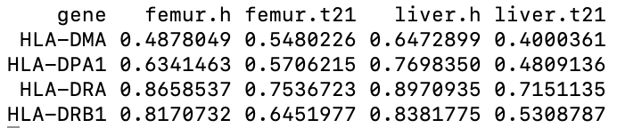
What proportion of cells express the downregulated HLA genes?

Slide 11

Potentially relevant paper
https://pubmed.ncbi.nlm.nih.gov/30380364/
RNA sequencing of samples obtained at relapse after transplantation revealed dysregulation of pathways involved in adaptive and innate immunity, including down-regulation of major histocompatibility complex (MHC) class II genes (HLA-DPA1, HLA-DPB1, HLA-DQB1, and HLA-DRB1)

Slide 12
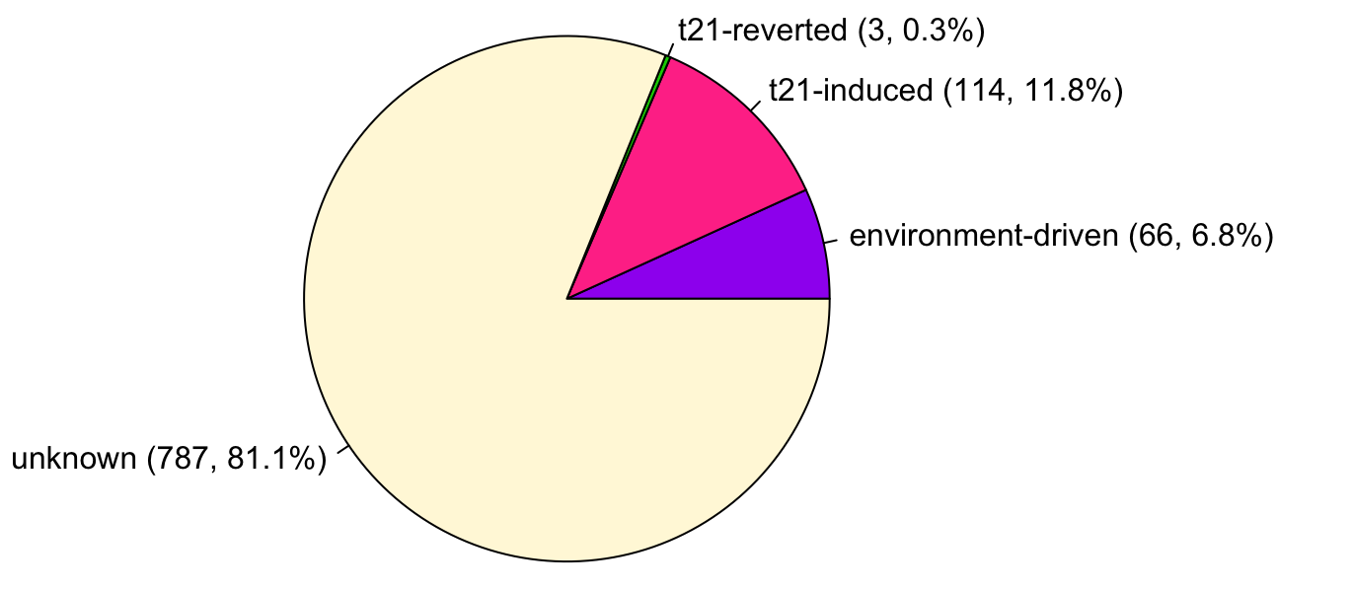
Conducted DEG analysis between:
T21 liver and T21 femur samples
Healthy liver and healthy femur samples
Classified significant DEGs as:
Environment-driven
Expression differences found in T21 and healthy
T21-induced
T21-induced differences in femur v liver
T21-reverted
No t21 differences in femur v liver, only healthy
(4) Unknown
Differences observed in T21 samples, but unclear whether healthy cells also exhibit these differences
Results:
183 of 970 DEGs (18.9%) could be assigned as T21-induced, T21-reverted, or environment-driven.
Methods/Specific Details:
Environment-independent = adj FDR < 0.05 in either T21 or healthy & unadj P < 0.05 in the other analysis
Liver-induced = T21 adj FDR < 0.05 & median T21 downsample unadj P < 0.05 & healthy unadj P > 0.05
Femur-induced = healthy adj FDR < 0.05 & T21 unadj P > 0.05
Unknown = adj FDR < 0.05 in T21, but median T21 downsample P > 0.05 & healthy unadj P > 0.05 (e.g. are we underpowered?)

Slide 13
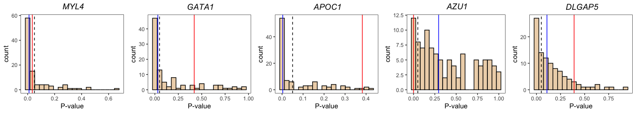
Environment-driven
T21-induced
T21-reverted
Unknown

Slide 14
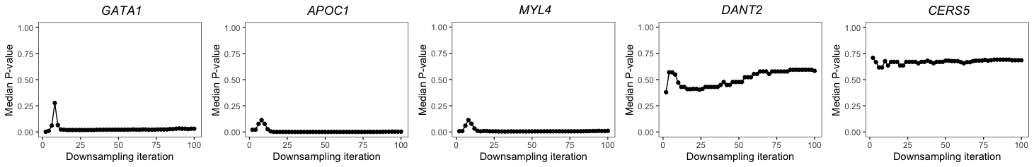
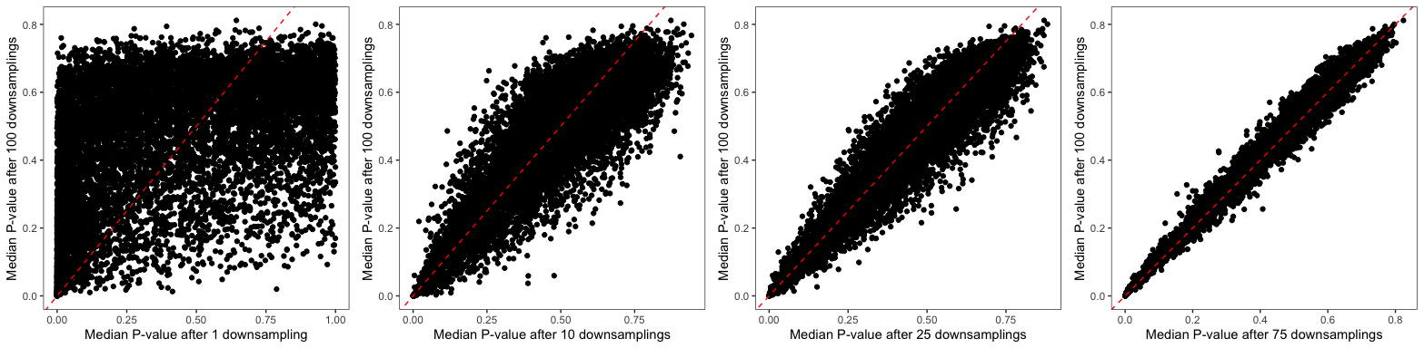

Slide 15
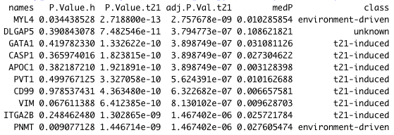
Top t21: liver vs femur hits

Slide 16
3 chromosome 21 genes that are labeled as “t21-induced”
"BTG3" "C21orf58" "MRPL39”
BTG3 seems to be the most interesting one here (which has higher expression in t21 liver than t21 femur)

Slide 17
Next performed enrichment analyses
To be consistent w t21 v healthy analysis, I subset to gene sets with FDR < 0.1 and at least 3 or more genes contained within the gene set
I am also using the 2021 GO sets, compared to the previous analyses used 2018 GO sets.

Slide 18
Gene sets for t21-induced genes upregulated in the liver

Slide 19
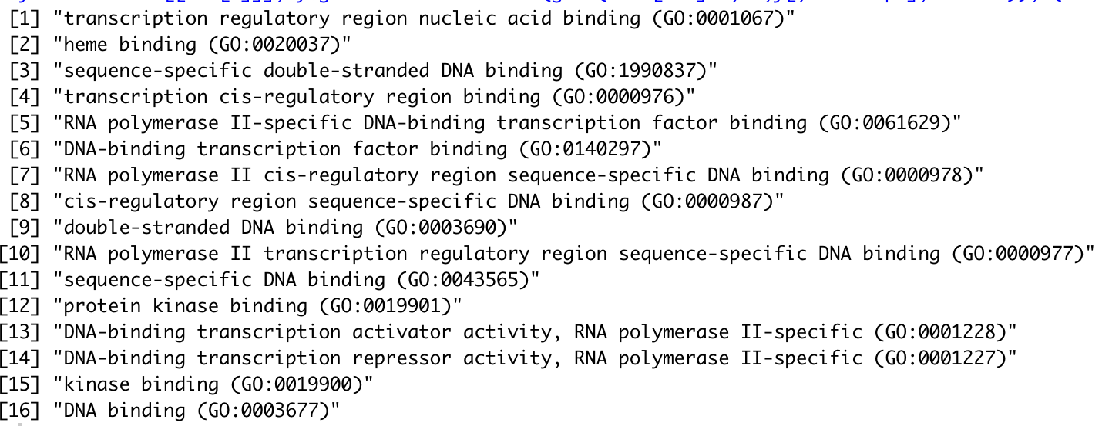
GO molecular functions enriched in “t21-induced” gene set

Slide 20
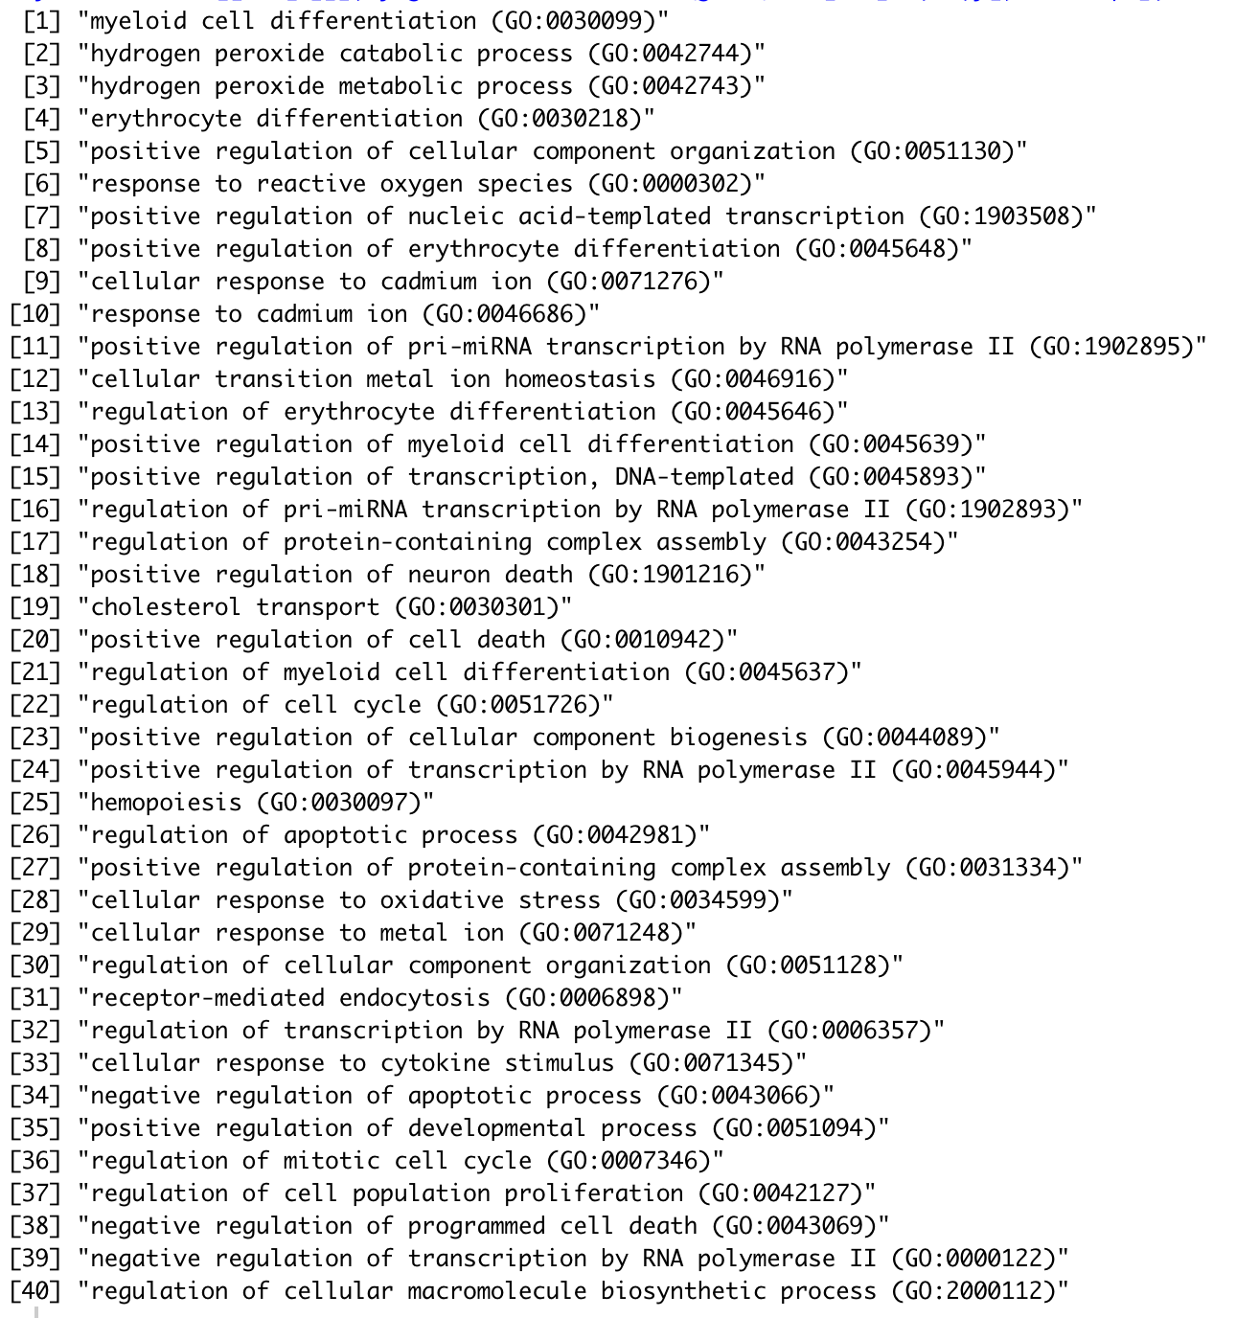
GO biological processes enriched in “t21-induced” gene set

Slide 21
ENCODE and ChEA transcription factors whose targets are enriched in “t21-induced” gene set
(ordered by significance)

Slide 22
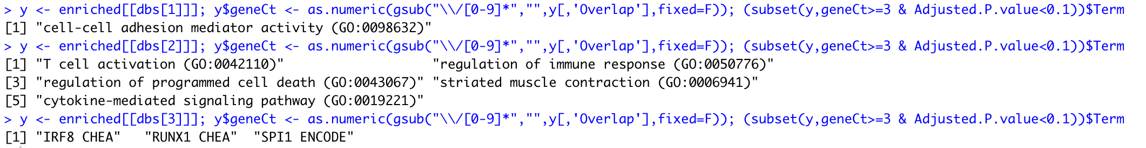
Gene sets for t21-induced genes downregulated in the liver
BP
MF
TF targets

Slide 23
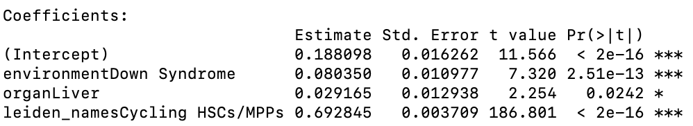
Cell cycle analysis
Methods:
Linear probability model assessing the probability of cell cycle in G2 or S phase (not in G1)
Jointly model the effect of T21, environment (Liver v Femur), and HSC/MPP vs Cycling HSC/MPP cluster
Results:
8.0% increase in T21 cells compared to healthy
2.9% increase in Liver compared to Femur
69.3% increase in cycling HSCs vs HSCs

