Slide 1
Right Sizing Classic AUTOSAR for Real-World Automotive ECUs
Omar Alshabibi, Principal Product Manager – ETAS
ewNA26 • [Sep 23rd] • [Room / 9]

Slide 2

What We’ll Cover
Session agenda – replace with your talk’s outline
01
Introduction
02
Classic AUTOSAR Overview
03
Integration and AUTOSAR Sizing Challenges
04
Proposed Solution - Practical Tips for Code Generation
05
ETAS RTA-CAR Solution
06
Key Takeaways - Q&A
2

Slide 3
SECTION 03
Practical tips for designers & integrators
Tips to reduce memory usage and leverage our efficient code generation
3
ewNA26

Slide 4
Complexity in automotive software development
Brief History of Automotive Software
Now
  90% innovation in vehicle development
  EE accounts for 40% vehicle development costs
  50-75% development costs of an ECU are SW
Use of Software in Automotive
Ever increasing amount of distributed, networked functionality in software…
Emission control
Safety (active/passive)
Software
2000
  Many SW functions
  In vehicle networks predominate
1990
  Growth of infotainment
  SW widely used for engine & chassis control
Hardware
1970
  Mechanical
  EE for engine control
No common architectural standard …
  …so every company invented its own solutions…
  …and everyone thinks theirs is “the best”
?
Why did the complexity grow?
How do we manage complexity?

Slide 5

A Consortium, a Standard, an Architectural model…or what??? Everything!
What is AUTOSAR?
AUTOSAR (AUTomotive Open System ARchitecture) is an open and standardized automotive software architecture, jointly developed by automobile manufacturers, suppliers and tool developers.
AUTOSAR aims to improve complexity management of highly integrated E/E architectures through an increased reuse and exchangeability of SW modules between OEMs and suppliers.
Latest Autosar release has 13,620 pages of documentation
Notes:
AUTOSAR=global partnership of leading companies in the automotive and software industry to develop and establish the standardized software framework and open E/E system architecture for intelligent mobility
Scopo: semplificare il debug, aumentare il riutilizzo di componeneti sw, consentire la collaborazione definendo uno std per l’interfacciamento tra I componeneti sw

Slide 6





Why the automotive industry needs middleware
AUTOSAR Middleware
Powertrain
Electrification
ADAS
OEMs Applications
OEMs Applications
Interface and unlocking HW Potential
Standard Middleware Solution
Middleware
MCAL
MCAL
Hardware
Hardware
Notes:
Before we kick off the challenges of smaller MCU devices and the best software fit for it, let me highlight the needs for a middleware
Why the auto industry needs a middleware? Evolution of E/E architecture and complexity of ECUs from
Unlocking the potential of the underlying HW capabilities with a common software solution that can be reused from one ECU to another with less re-investment

Slide 7
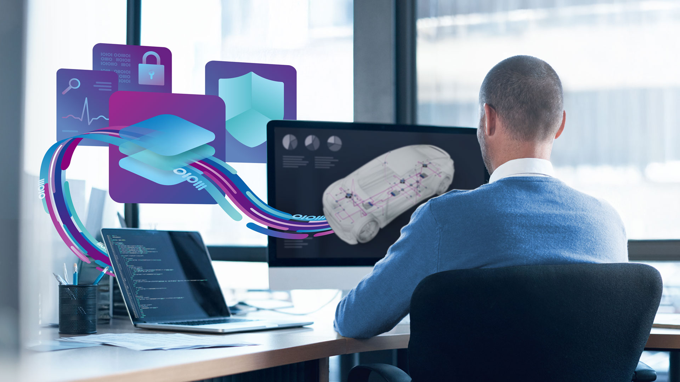




Problem and Solution
AUTOSAR Middleware
What problem does AUTOSAR solve?
Reusability and portability via unified SW stack
Accelerates development and integration efforts
Compliant, scalable and compatible SW stack
Notes:
Robust and scalable platforms: Providing highly reliable and flexible software foundations for both high-performance microprocessors and resource-constrained microcontrollers. Accelerates development and ensures future-proof architectures across diverse automotive domains.
Integrated safety and security: Engineered with comprehensive mechanisms and adherence to industry standards (ISO 26262, ISO/SAE 21434) from design to deployment. Enables the creation of safe and secure ECUs, meeting stringent automotive regulations and protecting against evolving threats.
AUTOSAR compliance and real-time performance: Offering a production-proven AUTOSAR stack for standardization, modularity, and deterministic real-time execution in embedded systems. Simplifies integration, optimizes resource utilization, and guarantees predictable behavior for critical automotive functions.

Slide 8
SECTION 02
Automotive ECU Integration Reality
AUTOSAR Challenges
8
ewNA26

Slide 9

The ECU Integration Reality
Complexity vs. HW Constraints
Common Friction Points
Automotive software content is growing exponentially, yet production cost pressures keep microcontroller margins extremely tight.
Configuration depth explosion: Managing thousands of parameters is highly prone to human error.
Linker overflows: Adding a single minor feature late in integration triggers memory limits.
Unoptimized communication: Default generic routing structures consume bloated stack and flash.
THE MCU COST PENALTY
Upgrading adds €0.30 - €0.80 / unit
Across 2+ million vehicles, this represents millions in lost margin.

Slide 10
Why is AUTOSAR Assumed "Too Big"?
1. Unspecialized Generic BSW
2. Flexibility-First Generators
Standard implementations use heavy generic BSW modules designed to handle every theoretical use case rather than specializing for the target ECU.
Many code generation tools prioritize universal compliance and run-time flexibility over aggressive, footprint-optimized compiler-level output.
3. Poor Default Configurations
4. Unnecessary Heavy Features
Default settings often ship with unnecessarily large buffers (e.g., DcmDslBuffer, PduRTxBuffer) and redundant OS tasks that eat up valuable RAM.
Enabling heavy features like inter-ECU synchronous client-server calls or full diagnostic event memory when simple static interfaces suffice.

Slide 11
Can AUTOSAR fit into small devices?
AUTOSAR Challenges
11
ewNA26

Slide 12

A Right-Sized Approach
The Sizing Philosophy
"AUTOSAR's real value emerges when the implementation is thoughtfully scoped, optimized, and aligned tightly to the ECU's actual functional needs."
Core Engineering Principles
Strict Scope Optimization
Disable and prune every optional sub-module and service not required by OEM specifications.
Static Parameter Tuning
Aggressively minimize default buffer sizes and limit the number of active OsTasks.
Hardware-Aligned Code Gen
Configure generation tools to eliminate runtime conditionals in favor of static compiler optims.
GOAL
Reduce software configuration depth while guaranteeing absolute determinism, safety, and AUTOSAR compliance.

Slide 13




Can AUTOSAR fit into small devices?
Device selection
AUTOSAR
Architecture is known.
Even with complexity challenges, benefits provide significant advantages.
MCU Sizing
Define ECU functionality.
Estimate footprint.
Select a microcontroller.
Caution
“AUTOSAR is scary…”
“To be safe, we should select a bigger MCU.”
Cost Pressure
"These MCUs are expensive"...
“MCU cost savings must require a different solution.”
Notes:
This example might resonate with people who have worked on “green-field” projects or teams new to AUTOSAR.
1. Either internal or external factors decided that AUTOSAR benefits outweigh the challenges”
2. So you go ahead, and begin sizing the MCU, looking at application software from previous projects for example, adding AUTOSAR headroom.
3. Concern around AUTOSAR leads to selection of a bigger MCU”, 2-4 MB or something similar.
4. If the cost of the MCU is questioned or an issue, which we increasingly see, its assumed that a different software approach is needed

Slide 14
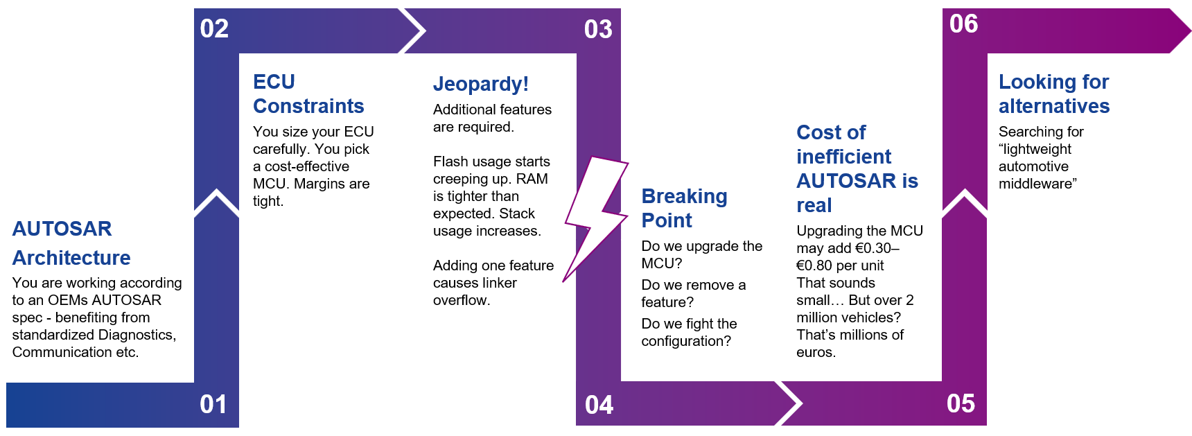
Jeopardy during development
Can AUTOSAR fit into small devices?
Notes:
This example might resonate with people who have worked with AUTOSAR for a longer time, for example on a platform basis. Is a common story that leads people to think alternatives are needed
You’re using AUTOSAR because its already well established, its part of the OEM-Tier 1 relationship/eco-system. Rely on ECU extracts, AUTOSAR Application Software etc.
You might choose what you think is the right MCU for the project, but scope can change
Features are added by the project, this causes Flash and RAM usage to increase, CPU load and Stack usage increases. Eventually it all becomes too much
You are faced with the difficult questions
Upgrading has cost implications, alternatively fighting the configuration might be challenging if design decisions are already made
Finally, might think that alternative middleware is needed
This is the topic we want to explore today, and show you that with RTA-CAR you can avoid many of these problems and successfully use lightweight middleware in resource constrained microcontrollers

Slide 15
What is the root cause of these challenges?
Can AUTOSAR fit into small devices?
Why is there an assumption in the industry that AUTOSAR is “too big” for small MCUs?
Assumptions
“AUTOSAR needs MCUs with MBs of Flash.”
“Smaller, cheaper MCUs require a different solution.”
Experiences and History
Past experiences
Shared stories
These inform our thoughts going into new projects
Root Cause of these experiences
AUTOSAR implementations that are not optimized
AUTOSAR projects with poor design choices and configuration
Notes:
So if we want to think about what is the right solution to these problems, we need to understand the root cause, later in the webinar we want to show you have we have worked to overcome them
Why is there this assumption in the industry that AUTOSAR is “too big” for small MCUs?
So starting with the thought patterns that we have identified from before…
These basically come from past experiences and shared stories – either you or someone you know or have worked with before has had difficultly with AUTOSAR and found it to be overbearing, heavyweight, complicated. These then lead to the thought patterns we have discussed.
But what was it that caused these negative experiences… we will explore these in the next slide.

Slide 16

What is the root cause of these challenges?
Can AUTOSAR fit into small devices?
Root causes
1. AUTOSAR implementations that are not optimized
  Generic BSW modules which cannot be specialized
  Generators that prioritize flexibility over size
  Sub-optimal implementation of AUTOSAR features
2. AUTOSAR projects with poor default design choices & configuration
  Extended OS tasks, or simply too many OS tasks
  Unnecessary features enabled
  Use of features that are intrinsically slow or big by their nature (e.g. inter-ECU synchronous client-server)
  High impact options lost in the mass of configuration
  (DcmDslBuffer, PduRTxBuffer, DemBswErrorBufferSize)
Notes:
Later in the webinar we are going to look at both of these topics.
Regarding the Poor ATUOSAR implementation – we will look at how RTA-CAR has been developed to produce very lightweight output with code generators.
Regarding AUTOSAR challenges, we will show how our low-footprint Starter Kits and Practical Tips can help you overcome these challenges and deploy RTA-CAR onto smaller devbices.

Slide 17
SECTION 04
Automotive ECU Integration Reality
AUTOSAR Challenges
17
ewNA26

Slide 18

Practical Integration Tips
Deliver as Source, Not Objects
Streamline Task Mapping
Object code delivery prevents the RTE code generator from performing inter-module compile-time inlining and dead-code pruning. Always compile from source.
Avoid placing periodic and sporadic runnables in separate tasks. Map highly active, communicating runnable to the same task to minimize scheduler context switches.
Right-Size Buffers Explicitly
Statically Manage Variants
Never trust default stack configuration templates. Audit and reduce parameters like PduRTxBuffer and DemBswErrorBufferSize to save massive RAM blocks.
Avoid post-build runtime variant selection. Use compile-time pre-processor variations to completely strip out inactive variants from the final binary image.

Slide 19



Code Generation
Practical tips for designers & integrators
Source Code Delivery
Delivery as Object Code kills RTE optimizations
Basic Tasks
Avoid wait point triggers
Avoid periodic and sporadic runnable in the same Task
Minimize inter-task communication
Map communicating entities to the same task if possible
Use “pure” servers
For intra-ECU Client/Server implement servers as re-entrant code, mark as executable concurrently
Notes:
Souce Code Delivery
As opposed to object code delivery - often the default but think is it realy necessary, can it be avoided to save footprint?
Basic Tasks
Explain why basic tasks are expensive
RTE has to decide what type of task based on the ECU configuration it is given. Main topics are:
–Avoid wake up of wait point triggers
–Do not map periodic and sporadic runnable entities to the same task
Map communicating entities to the same task if possible
–Allows optimization based on Runnable Entity execution sequence
Try to make servers “pure” servers on same ECU -> optimises as a direct function call, avoids extended tasks

Slide 20


Configuration
Practical tips for designers & integrators
Think carefully about buffer sizes
PduRTxBuffer
PduRRbTpBufferPool
DemMaxNumberEvent…
PduR Unicasting
PduR can be optimized if Pdus only have a single destination – avoid routing to multiple destinations
Variant Handling
Use build time variant management to avoid runtime selection of variation
DID vs DTC Diagnostics
ECU diagnostic using data identifiers instead of full diagnostic fault management with DTCs can save lots of flash
Notes:
There are a number of buffer size choices to be made, particularly in
If all messages have a single destination, Pdu router only needs to support unicasting mode, the routing logic can be very simple simple and the memory required for routing tables is minimised - this results in both CPU and Flash size improvements.
Avoid
GLIWA worked with one of the world biggest OEMs and combined two controllers into one by optimizing CPU load and memory, -> in other words only by making better AUTOSAR design choices.

Slide 21

SECTION 05
ETAS RTA-CAR Solution
Efficient AUTOSAR Solution
21
ewNA26

Slide 22
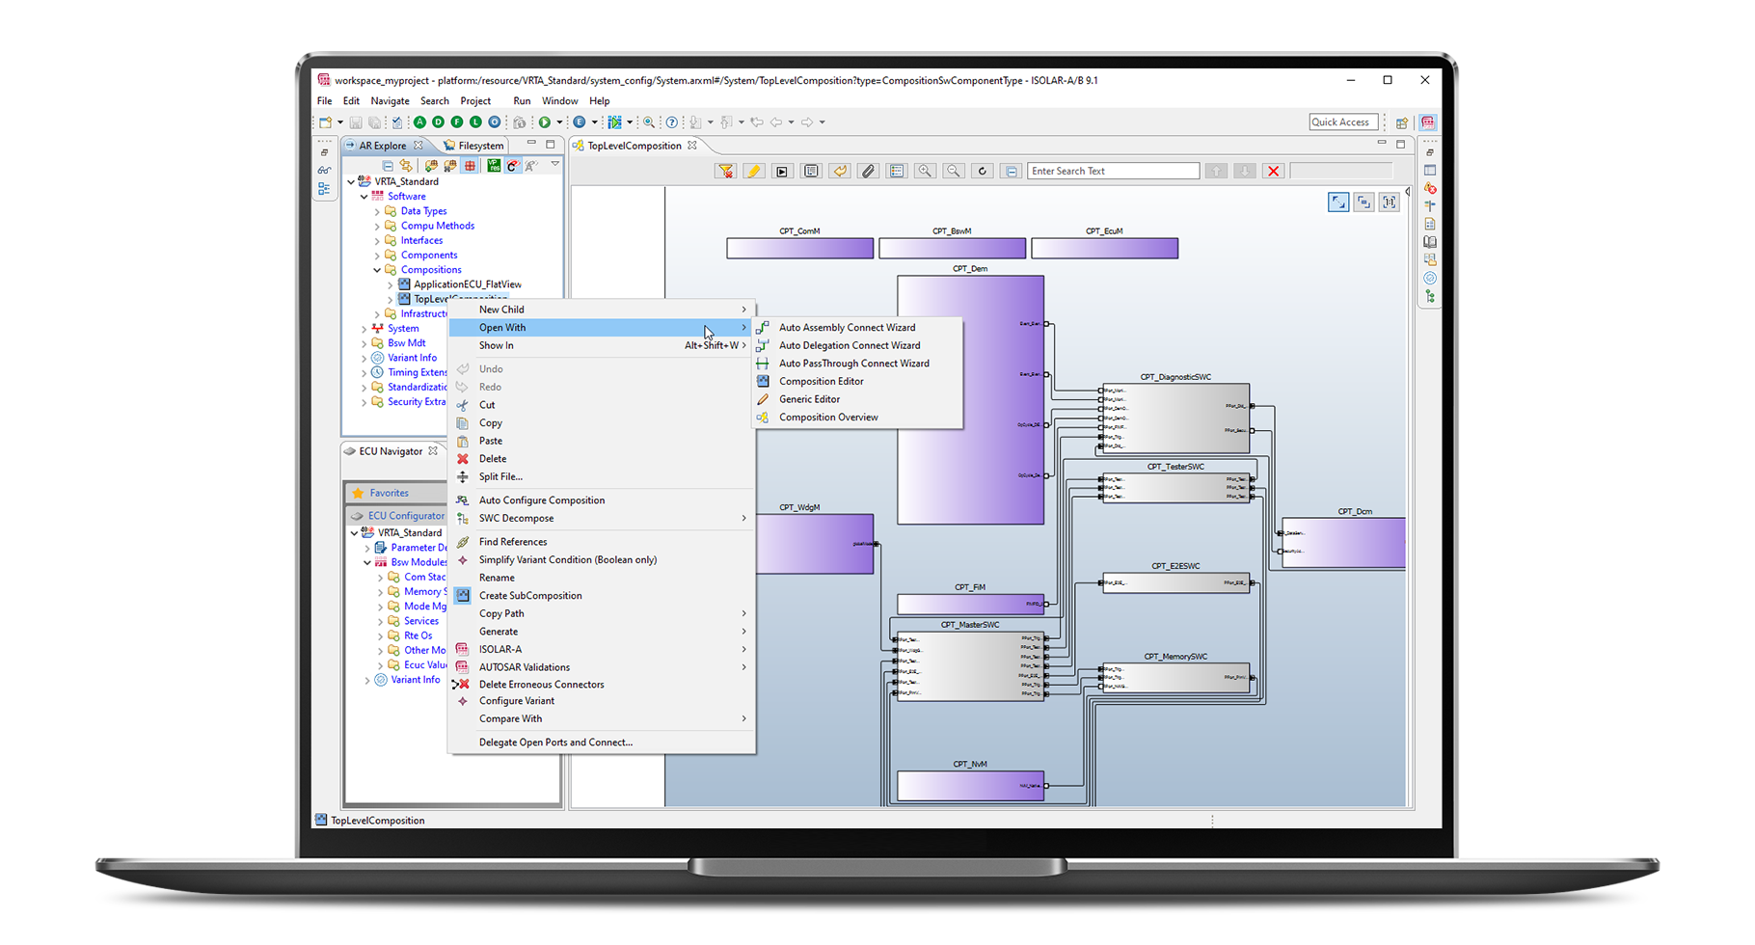

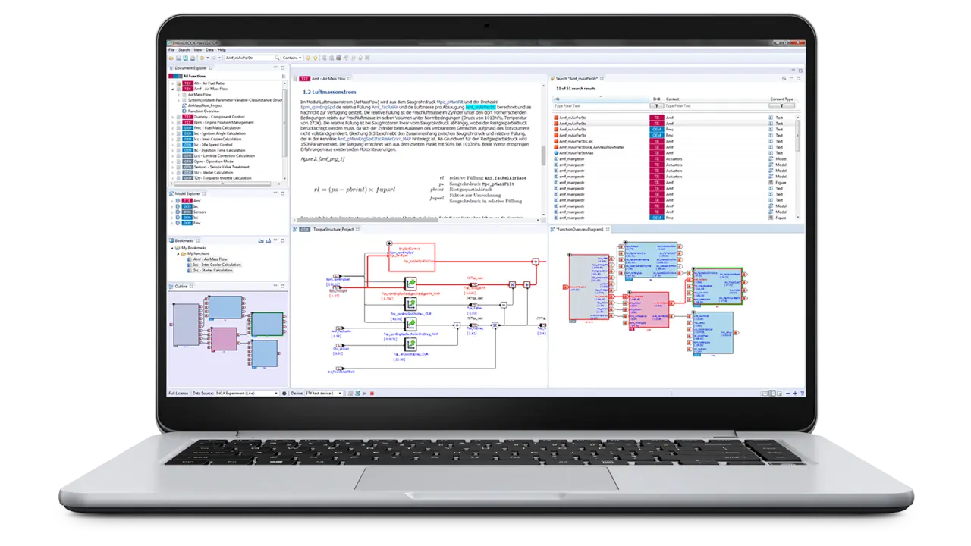
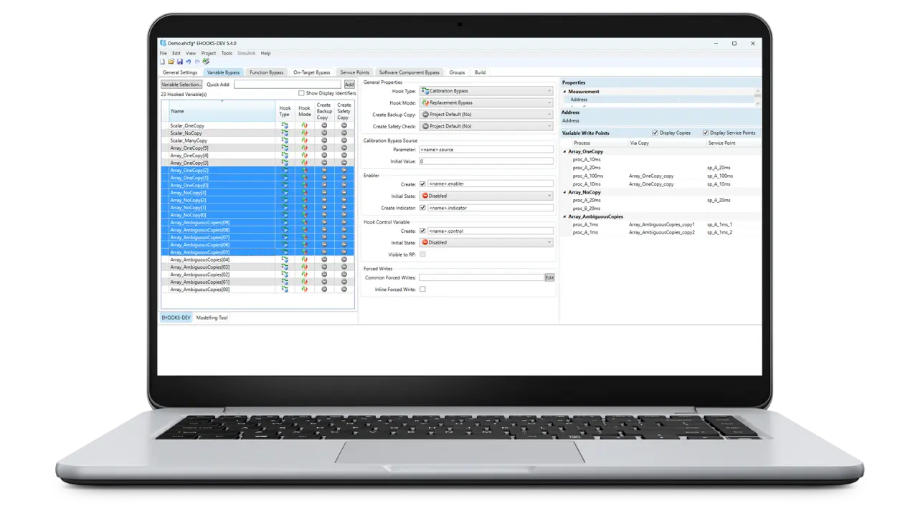
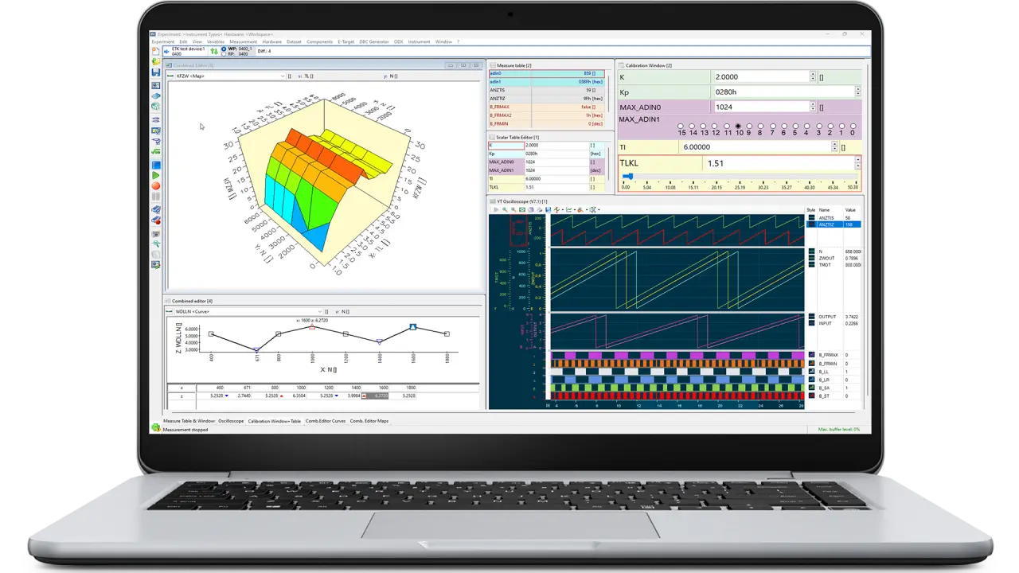
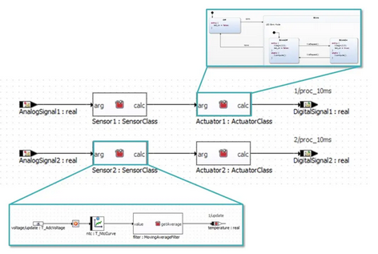
Reliable, safe and secure AUTOSAR solution for microcontrollers
RTA-CAR Solution
RTA-CAR is a highly scalable, feature-rich AUTOSAR software platform solution designed to streamline ECU application development and deployment for OEMs and Tier 1 suppliers, improving time-to-market and operational efficiency
ISOLAR A/B
AUTOSAR configuration and code generation tool
AUTOSAR
Application Software
ISOLAR-A/-B
Development Tools
Vehicle Software Platform Suite
– Classic AUTOSAR Profile
RTA-CAR FSQP
Functional Safety
RTA Code Generator Tools
AUTOSAR Modules (RTA-BSW, -OS, and -RTE)
Classic Platform
RTA-RTE
CAN
RTA-BSW
RTA-CAR
ETH
ETHSEC
FRAY
LIN
J1939
SEC
RTA-
FBL
RTA-OS
Security
Hardware Security Module (HSM) firmware and/or software-based cryptographic library
3rd party MCAL
CycurHSM
CycurSoC
RTA-HVR / RTA-LWHVR
Microcontroller / SoC
ETAS Products / Solutions
Third-Party Products / Solutions
Add-on Components
& OEMs Extensions
Add-on components for specific use cases (e.g. additional protocol stacks, hypervisors, functional safety, charge communication stack)
OEM-specific solutions including Flash Bootloader (FBLs), custom modules, etc.
ECU Hardware

Slide 23
SECTION 06
Key Takeaways
Efficient AUTOSAR Solution
23
ewNA26

Slide 24

Right-Sizing: Strategic Takeaways
AUTOSAR Can Fit
The Path to Success
The assumption that Classic AUTOSAR requires massive, multi-megabyte microcontrollers is outdated.
Leverage Optimizations Early: Implement RTA-OS's single-stack and RTA-RTE’s Api inlining right from the prototype phase.
When configured carefully and backed by an optimizing platform like ETAS RTA-CAR, standard-compliant AUTOSAR easily fits into highly cost-effective, smaller devices.
Avoid Architecture Bloat: Rigorously scope and disable unnecessary standard services to maintain wide hardware safety margins.
Deploy AUTOSAR Kits Earlier: Start from validated footprint-optimized blueprints instead of empty, standard generic configurations.
Key Business Value
High Standards • Compact Footprint • Lower Unit Cost

Slide 25
Thank You
Questions? Let’s connect.
Omar Alshabibi
Omar.alshabibi@etas.com
25
ewNA26

