Slide 1
Project 2: Thermal Systems Solar House
Drew Pang and Kelly Stellmacher

Slide 2
Question:
What thickness of insulation in a solar house in Columbus, Ohio during Winter would maintain a minimum internal temperature over time?
Notes:
Drew

Slide 3
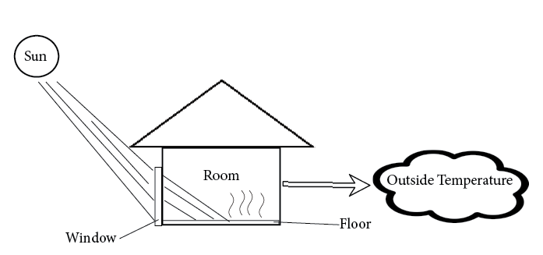
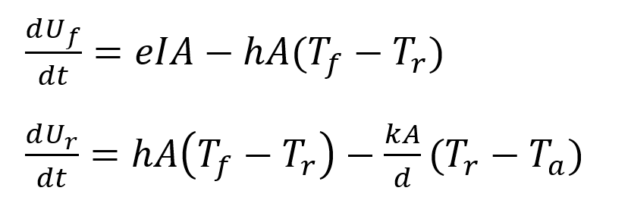
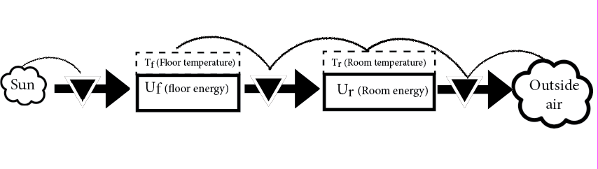
Model:
Schematic:
Equations:
Stock and Flow Diagram:
Notes:
Kelly

Slide 4
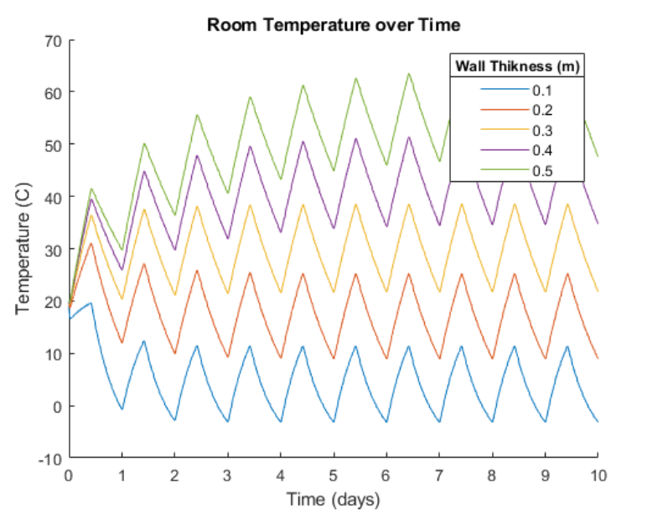
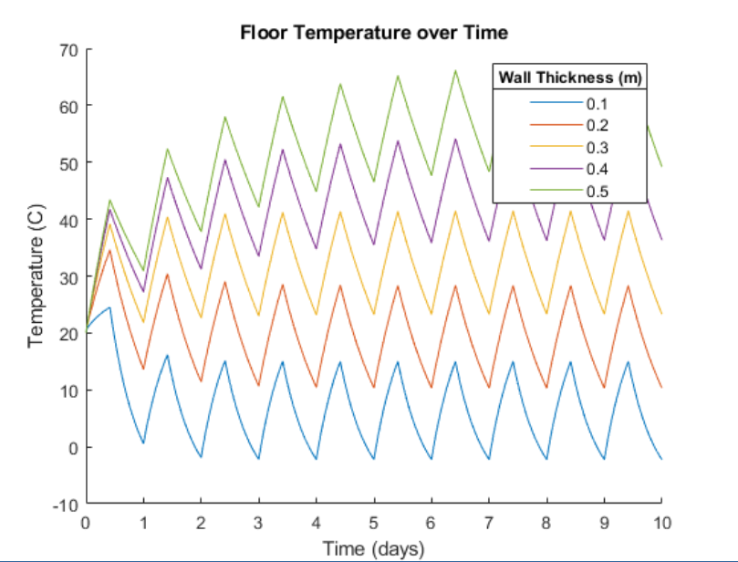
Results:
Figure 1: Floor
Figure 2: Room
Parameter sweep wall thickness 0.1m-0.5m
Blue(1.0m) - too cold
Green (0.5m), purple(0.4m), yellow(0.3m) – too hot
Red (0.2m) is optimal --- high of ~28 low of ~12
Notes:
Drew

Slide 5
Interpretation
Answer to question:
0.2m wall thickness is optimal for a solar house in Columbus Winter
Applications:
Architecture
Sustainability
Notes:
Kelly

Slide 6
Thank you!

