Slide 1
Project 2: Thermal Systems Solar House
Drew Pang and Kelly Stellmacher

Slide 2
Question:
What thickness of insulation in a solar house in Columbus, Ohio during Winter would maintain a minimum internal temperature over time?

Slide 3
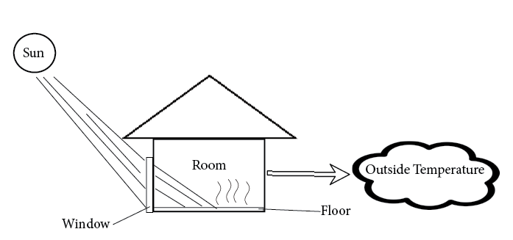
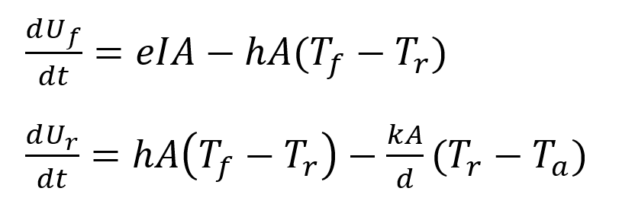
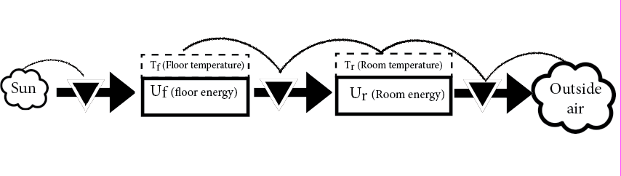
Model:
Schematic:
Equations:
Stock and Flow Diagram:

Slide 4
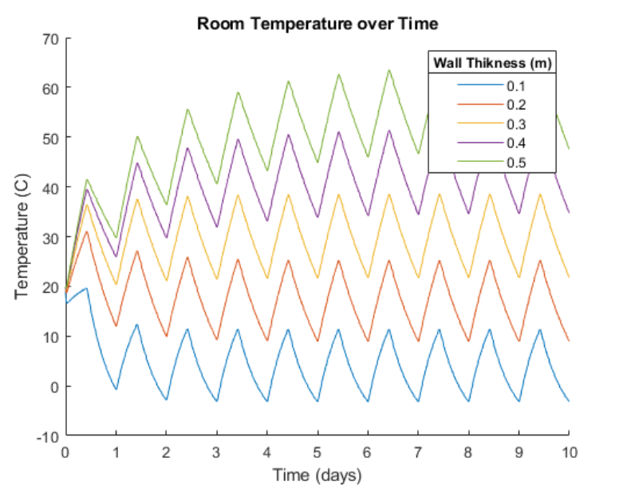
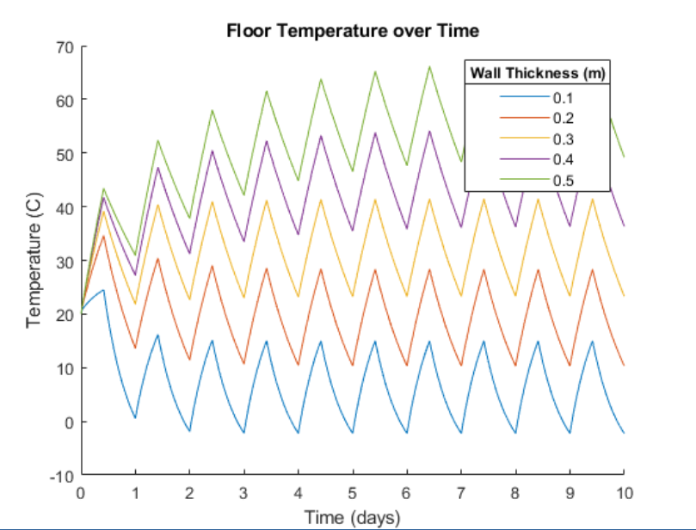
Results:

Slide 5
Interpretation

Slide 6
Thank you!

