Slide 1

Green Pace
Security Policy Presentation
Developer: Drew Pepin

Slide 2

OVERVIEW: DEFENSE IN DEPTH
The model below illustrates our methods of defense for secure coding. We use this model as we develop to maintain proper practices.

Slide 3
THREATS MATRIX
Secure coding standards help the developer understand how vulnerable their code is. This grid depicts different levels of vulnerabilities and how likely they are to be an issue.
Likely Threats that are likely to occur | Priority Standard with high relevancy
Low priority Standard with low relevancy | Unlikely Rare threats that are unlikely to occur

Slide 4
10 PRINCIPLES
Validate Input Data
Heed Complier Warnings
Architect and design for security policies
Keep it simple
Default deny
Adhere to the Principle of Least Privilage
Sanitize data sent to other systems
Practice defense in depth
Use effective quality assurance techniques
Adopt a secure coding standard

Slide 5
CODING STANDARDS
Do not cast an out of range enumeration value
Use valid references, pointers, and iterators to reference elements of a container
Do not attempt to create a std::string from a null pointer
Do not store already owned pointer value in an unrelated smart pointer
Properly deallocate dynamically allocated resources
Use a static assertion to test the value of a constant expression
Handle all exceptions thrown before main() begins executing
Do not alternatively input and output from a file stream without an intervening positioning call
Do not invoke virtual functions from constructors or destructors
Value returning functions must return a value from all exit paths

Slide 6
ENCRYPTION POLICIES
Encryption in rest – Encryption at rest is designed to prevent the attacker from accessing the unencrypted data by ensuring the data is encrypted when on the disk. If an attacker obtains a hard drive with encrypted data but not encryption keys, the attacker must defeat the encryption to read data.
Encryption at flight - Process of encrypting data while the data is being transmitted. In some applications, such as remote application, data may be unencrypted while it is at rest on drive arrays, but encrypted while it is being transmitted for protection.
Encryption in use - Compromising data in use enables access to encrypted data at rest and data in motion. For example, someone with access to random access memory can parse that memory to locate encryption key for data at rest. Once they have the key, they can decrypt data at rest.

Slide 7
TRIPLE-A POLICIES
Authentication – The process where the user is being confirmed as someone who has access to the system. Can include user login and password information for the user to be able to access parts of the system. Some newer methods use 2 step authentication or multi tier authentication.
Authorization - Level of access that a user has within the system. Can include if the user can read, create, delete, or modify files within the database. Can also lead to access whether a user can add or delete files and users within the system.
Accounting – Process of monitoring what a user is doing with their level of access to the system. This will keep track of what databases are accessed, what was done during access, and what user accessed the system.

Slide 8
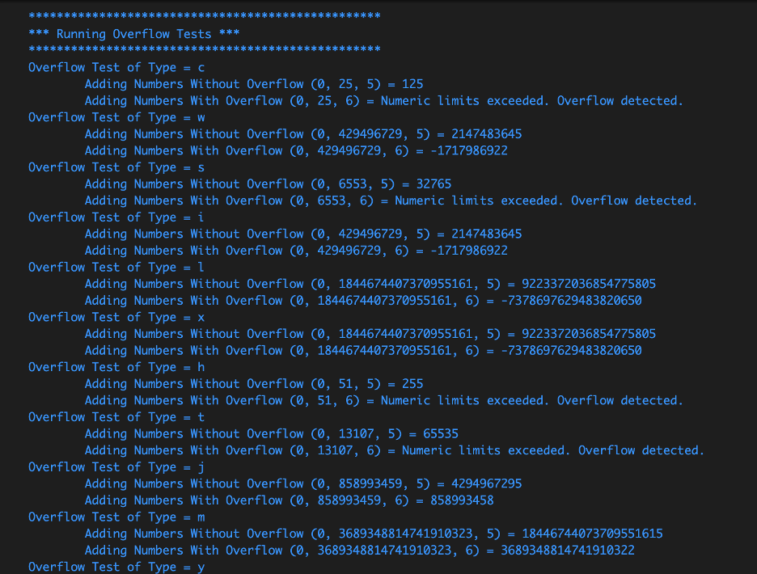
Unit Testing
Testing should be done frequently during development to ensure secure code with no bugs. The example shown is overflow testing

Slide 9

AUTOMATION SUMMARY

Slide 10
TOOLS
DevSecOps Pipeline – A secure coding method that has a full circle approach to enforcing a policy that has an infrastructure built on efficiently keeping code secure. DevSecOps is a good starting point for secure coding, but the developers should use defense in depth techniques, and ensure frequent testing during the development process to catch security flaws early and often.

Slide 11
RISKS AND BENEFITS
Act Now Security Approach – This approach with secure coding involves test driven development. The programmers will be testing their code almost daily, to ensure they catch security issues or bugs as they develop. This prevents issues from piling up, or being lost in the code that could be more detailed as time goes on. The one downside to this approach is longer development time and more resources used.
Wait Security Approach - This approach is where the developer waits until security issues are presented and tackles them then. Issues can stack up this way. Results in quicker development overall.

Slide 12
RECOMMENDATIONS
In order to maintain secure coding and development using our policy, the development team must stay up to date with the latest security threats. Also understanding the motives behind security attacks can help the development team realize potential security flaws in their code.

Slide 13
CONCLUSIONS
In conclusion, the principles and standards discussed in this presentation will be used to ensure secure coding is the standard amongst our development team. Making sure we use defense in depth, as well as using a layered security approach, we will implement safe and consistent coding practices during our development.

Slide 14
REFERENCES
Secure coding practices: Digital security guide: Safeonline.ng : Digital Security Guide. Digital Security Guide | Safeonline.ng. (2018, March 12). Retrieved April 23, 2023, from https://safeonline.ng/web-developers/secure-coding-practices/
Sei External Wiki Home. SEI External Wiki Home - Homepage - Confluence. (n.d.). Retrieved April 23, 2023, from https://wiki.sei.cmu.edu/confluence/display/HOME/SEI+External+Wiki+Home

