Slide 1

REAL OR FAKE?
Predicting fake Instagram accounts using Machine Learning

Slide 2
What is a fake Instagram account?
Fake accounts are bot-generated accounts that mimic the appearance and function of a real account.
Computer bot-generated accounts are against Instagram policies.
Social influencers make money based on the number of followers which can incentivize people to artificially inflate their number of followers.
There are companies that sell “followers” that help people gain a larger following.
Bot-generated accounts share similar features.

Slide 3
Fake Accounts and Instagram’s Response
Fake accounts are considered problematic with both Instagram, their users and companies that invest marketing money on the platform.
Instagram has actively used Machine Learning to identify and remove bot-generated accounts which became known as “the purge.”
The first publicized “purge” happened in 2014. Rapper Ma$e dropped 1.5 million followers, from over 1.6 million to just 272,000 overnight.

Slide 4
Kaggle Dataset Features (n=576)
Profile picture (Yes/No)
Ratio of numbers to total length username
Fullname Words
Ratio of numbers to total length fullname
Name equals username (Yes/No)
Description length
External URL linked (Yes/No)
Set as Private (Yes/No)
Number of Posts
Number of Followers
Number of Follows

Slide 5
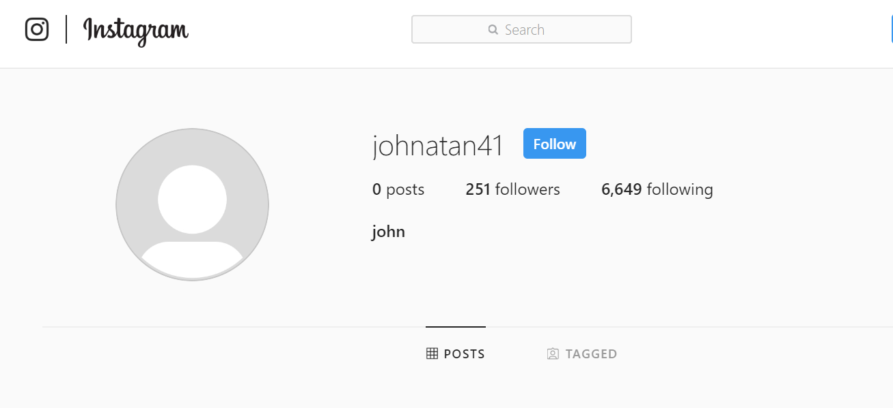
FAKE
No profile picture
No posts
Imbalance of following and followers

Slide 6
Machine Learning to Predict Fake Accounts
Binary Classification Problem
Machine Learning Method
Logistic Regression
Ridge
Lasso
Random Forest
Feature Engineering
Removed low-importance features
Log function to minimize outliers
K-Folds Cross Validation

Slide 7
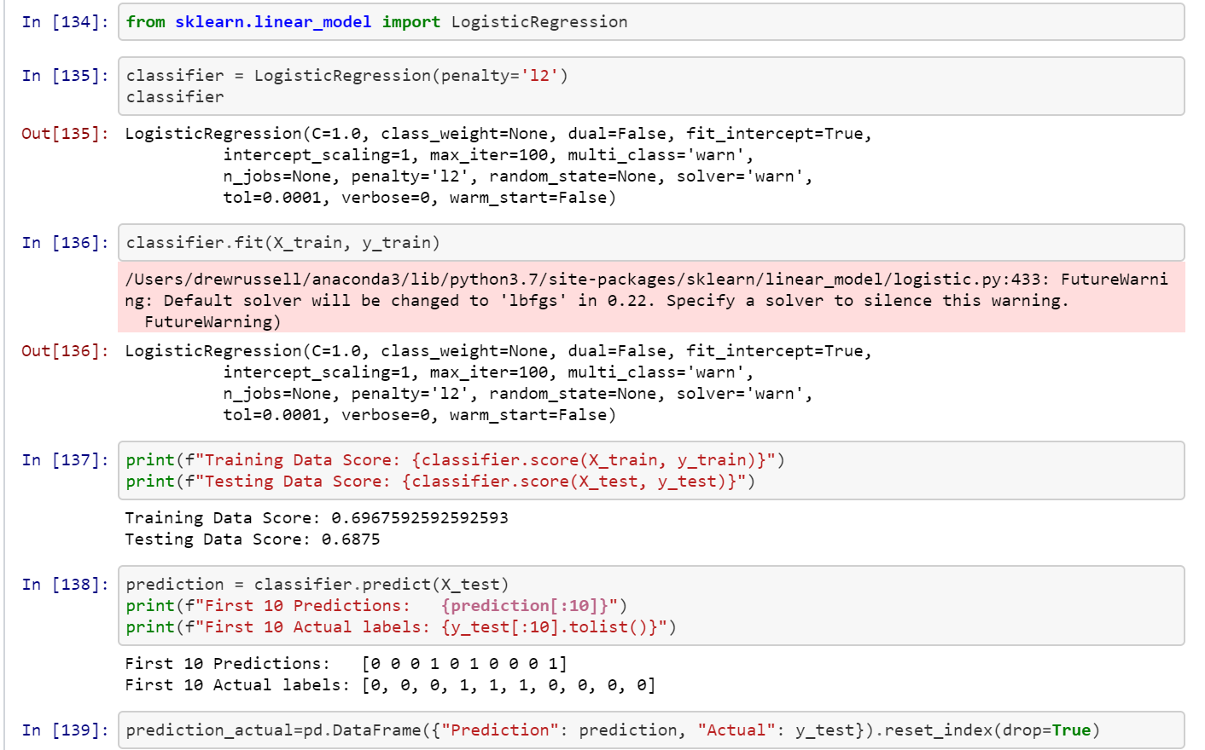
Linear Regression: Ridge

Slide 8
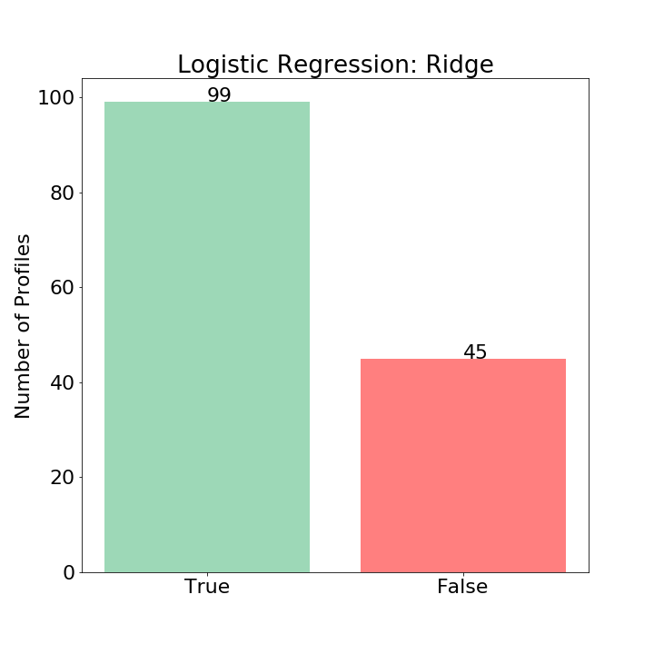

Slide 9
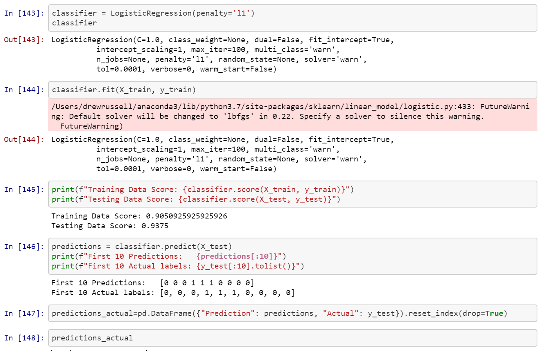
Linear Regression: Lasso

Slide 10
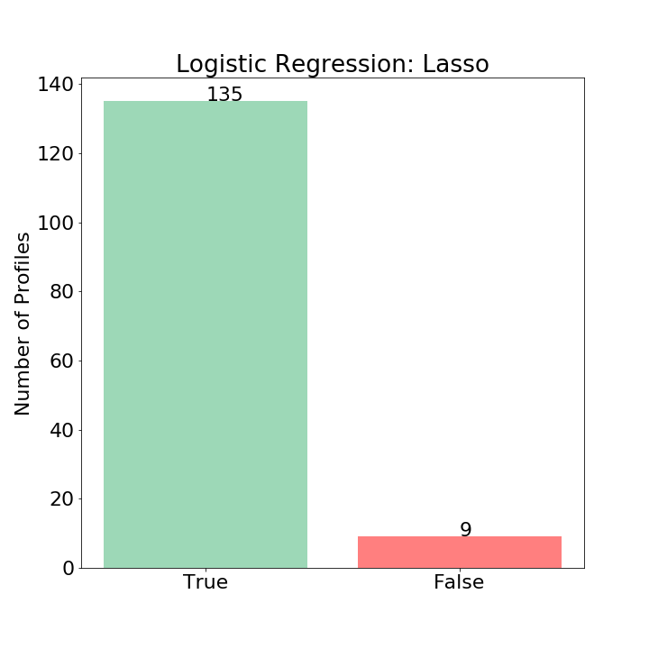

Slide 11
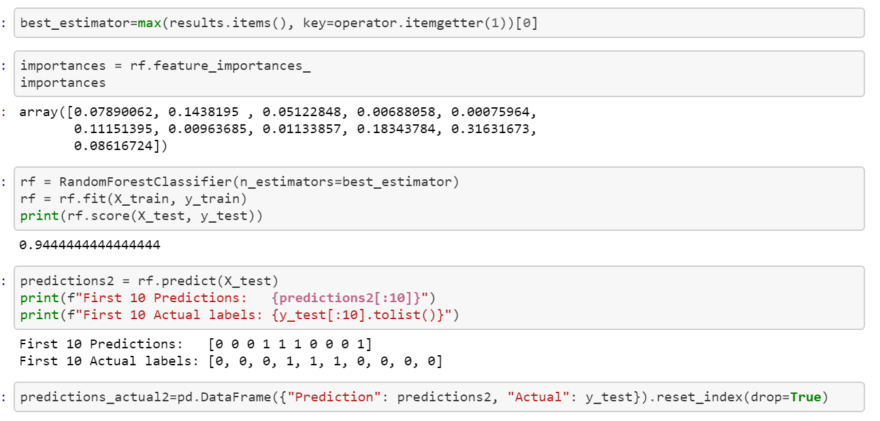
Random Forest (11 Features)

Slide 12
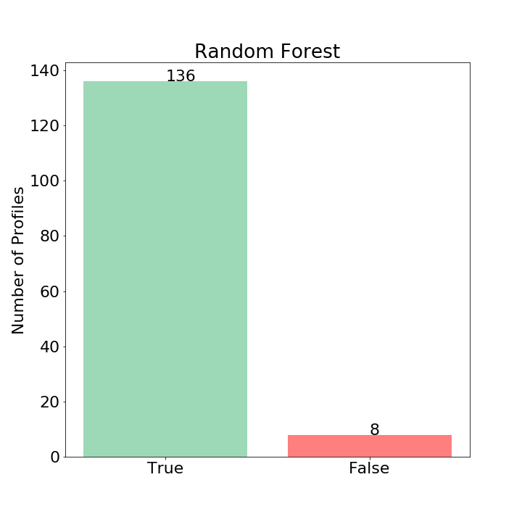

Slide 13
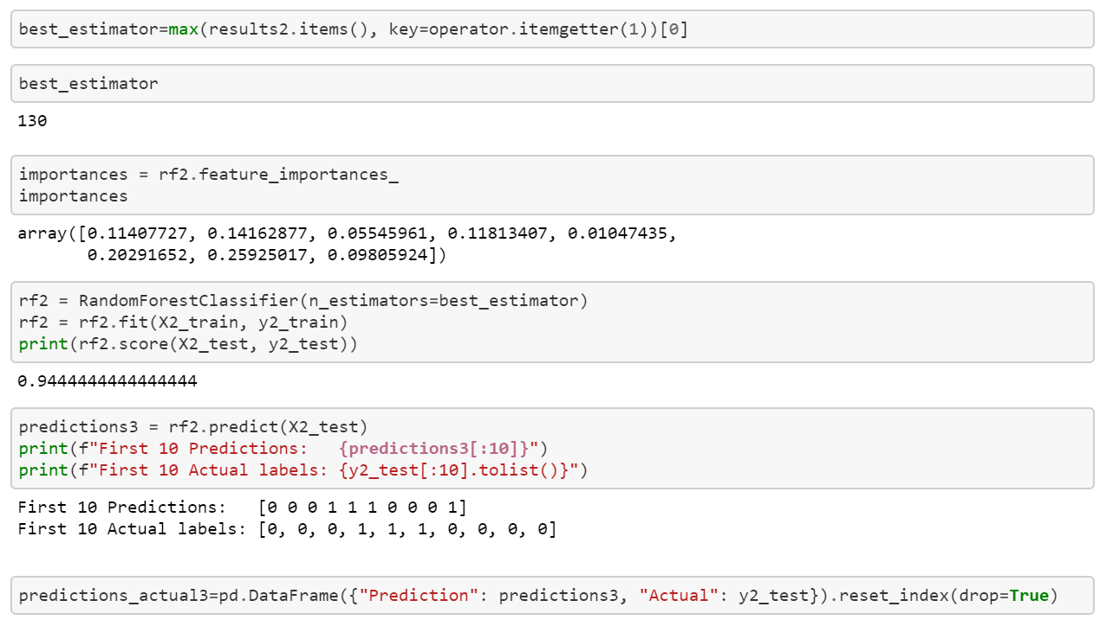
Random Forest (8 Features)

Slide 14
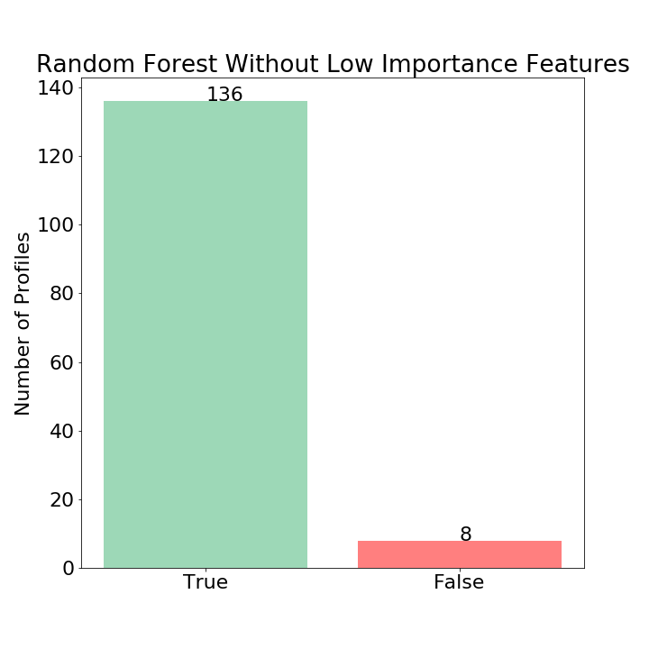

Slide 15
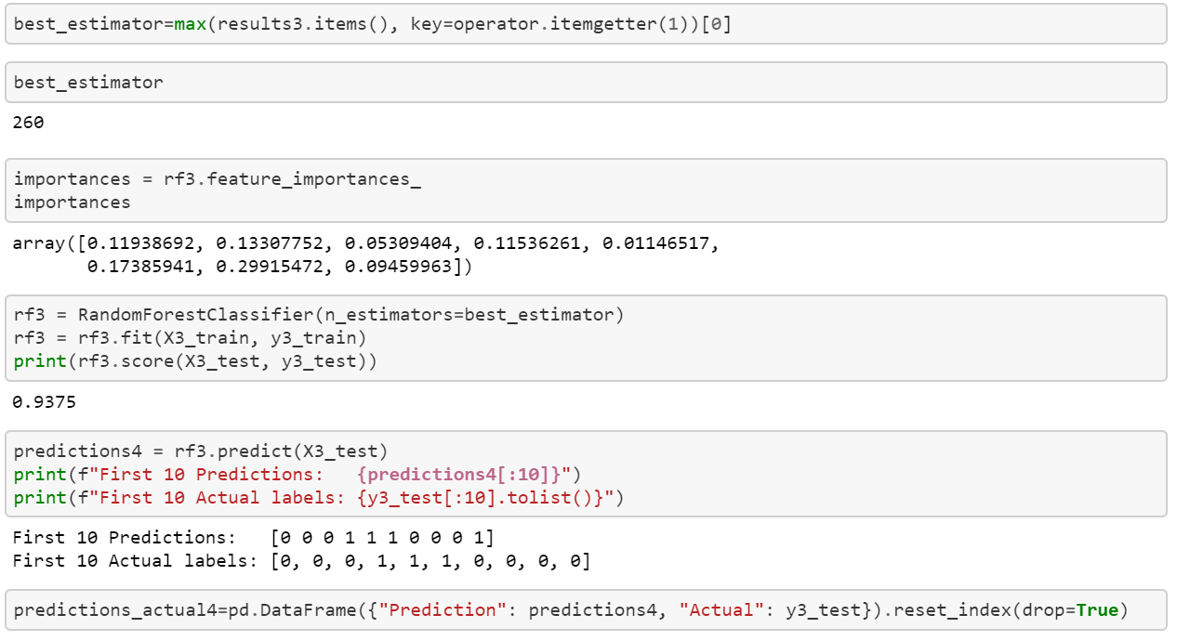
Random Forest (Log Function)

Slide 16
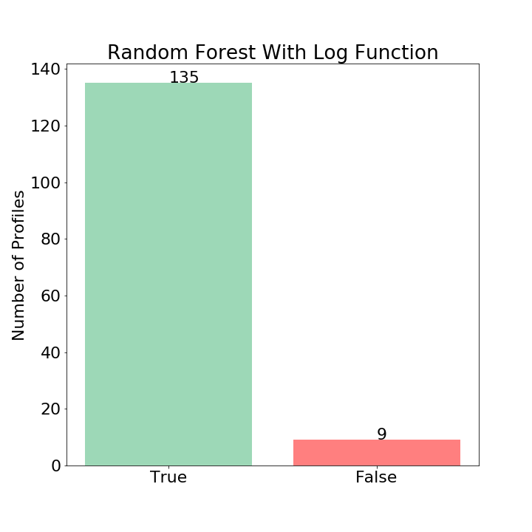

Slide 17
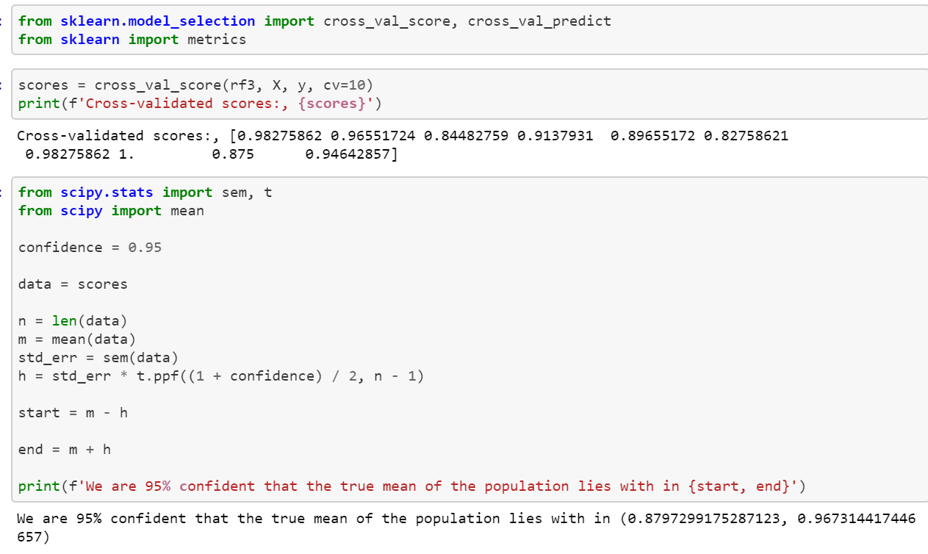
K-Folds Cross Validation

Slide 18
Summary of Model Performance
Linear Regression: Ridge (68.8%)
Linear Regression: Lasso (93.8%)
Random Forest: 11 Features (94.4%)
Random Forest: 8 Features (94.4%)
Random Forest: 8 Features w/Log (93.8%)
K-Folds Cross Validation (88.0% - 96.7%)

Slide 19
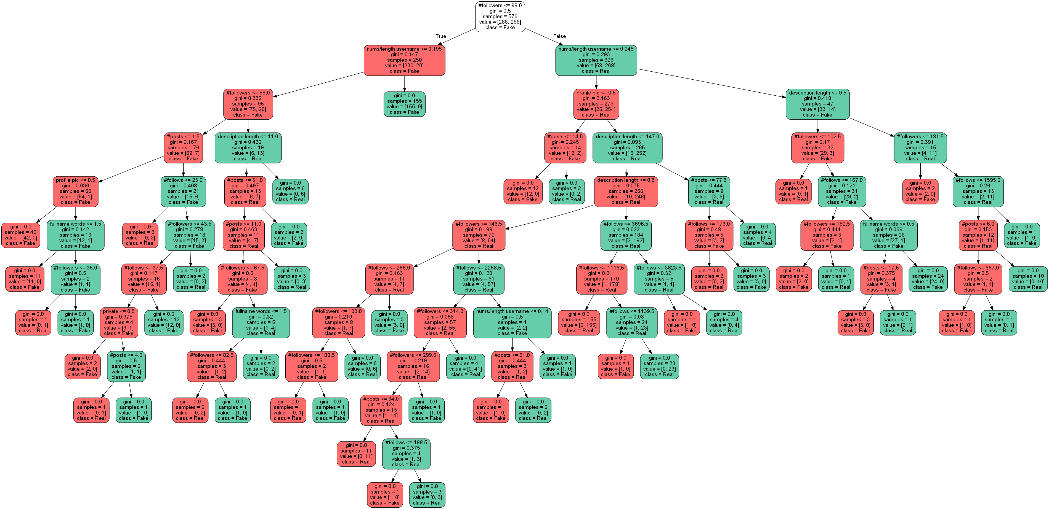

Slide 20
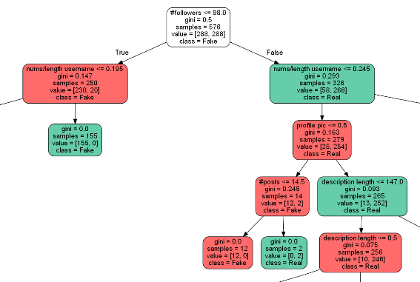
Random Forest Decision Tree

Slide 21



Summary Discussion

Slide 22
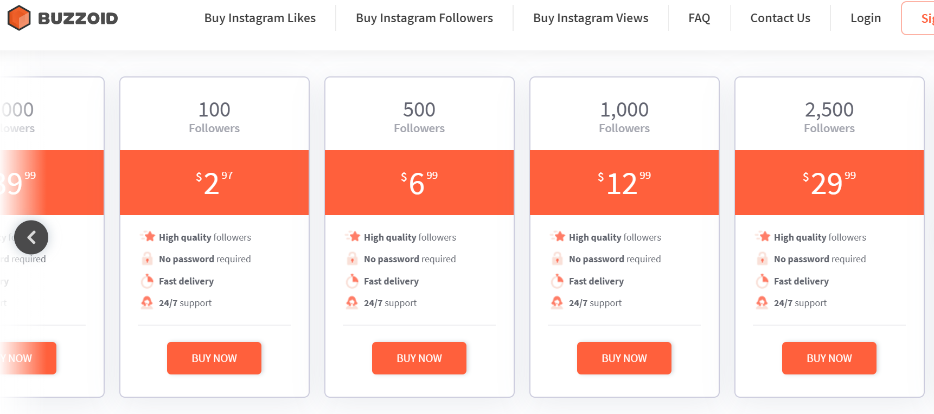
In Case You are Curious…Buying Instagram Followers

