Slide 1
Population structure
Allele frequency differences between groups of individuals organized by space and ecology. Members of a population are more genetically similar to one another than they are to members of another population.

Slide 2
Population structure
Allele frequency differences between groups of individuals organized by space and ecology. Members of a population are more genetically similar to one another than they are to members of another population.
In population genetics, we often ask:
How are populations related?
Does geographic distance predict genetic distance?
Are populations structured based on environment/ecological variables?
Pop 1
Pop 3
Pop 2

Slide 3
Population structure
Allele frequency differences between groups of individuals organized by space and ecology. Members of a population are more genetically similar to one another than they are to members of another population.
In population genetics, we often ask:
How are populations related?
Does geographic distance predict genetic distance?
Are populations structured based on environment/ecological variables?
Pop 1
Pop 3
Pop 2

Slide 4
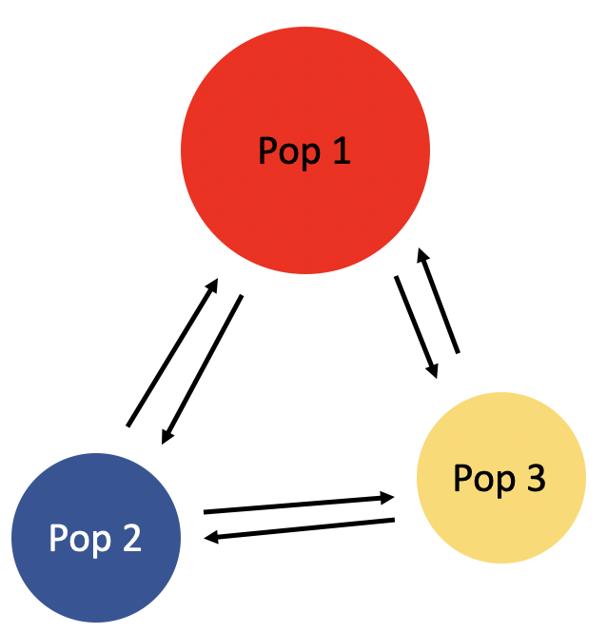

Relative genetic differentiation (Fst)
Compare the average pairwise differences ($π$) between populations and within populations
Many variations on how to estimate Fst
Weir & Cockerham’s (1984) formula accounts for unequal population sampling
All seek to estimate how different populations are if we account for diversity within their gene pools

Slide 5
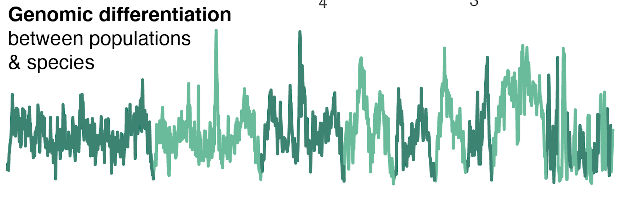
Fst can vary across the genome
Differences in gene flow, natural selection, and recombination rate can impact Fst estimates in different regions of the genome

Slide 6
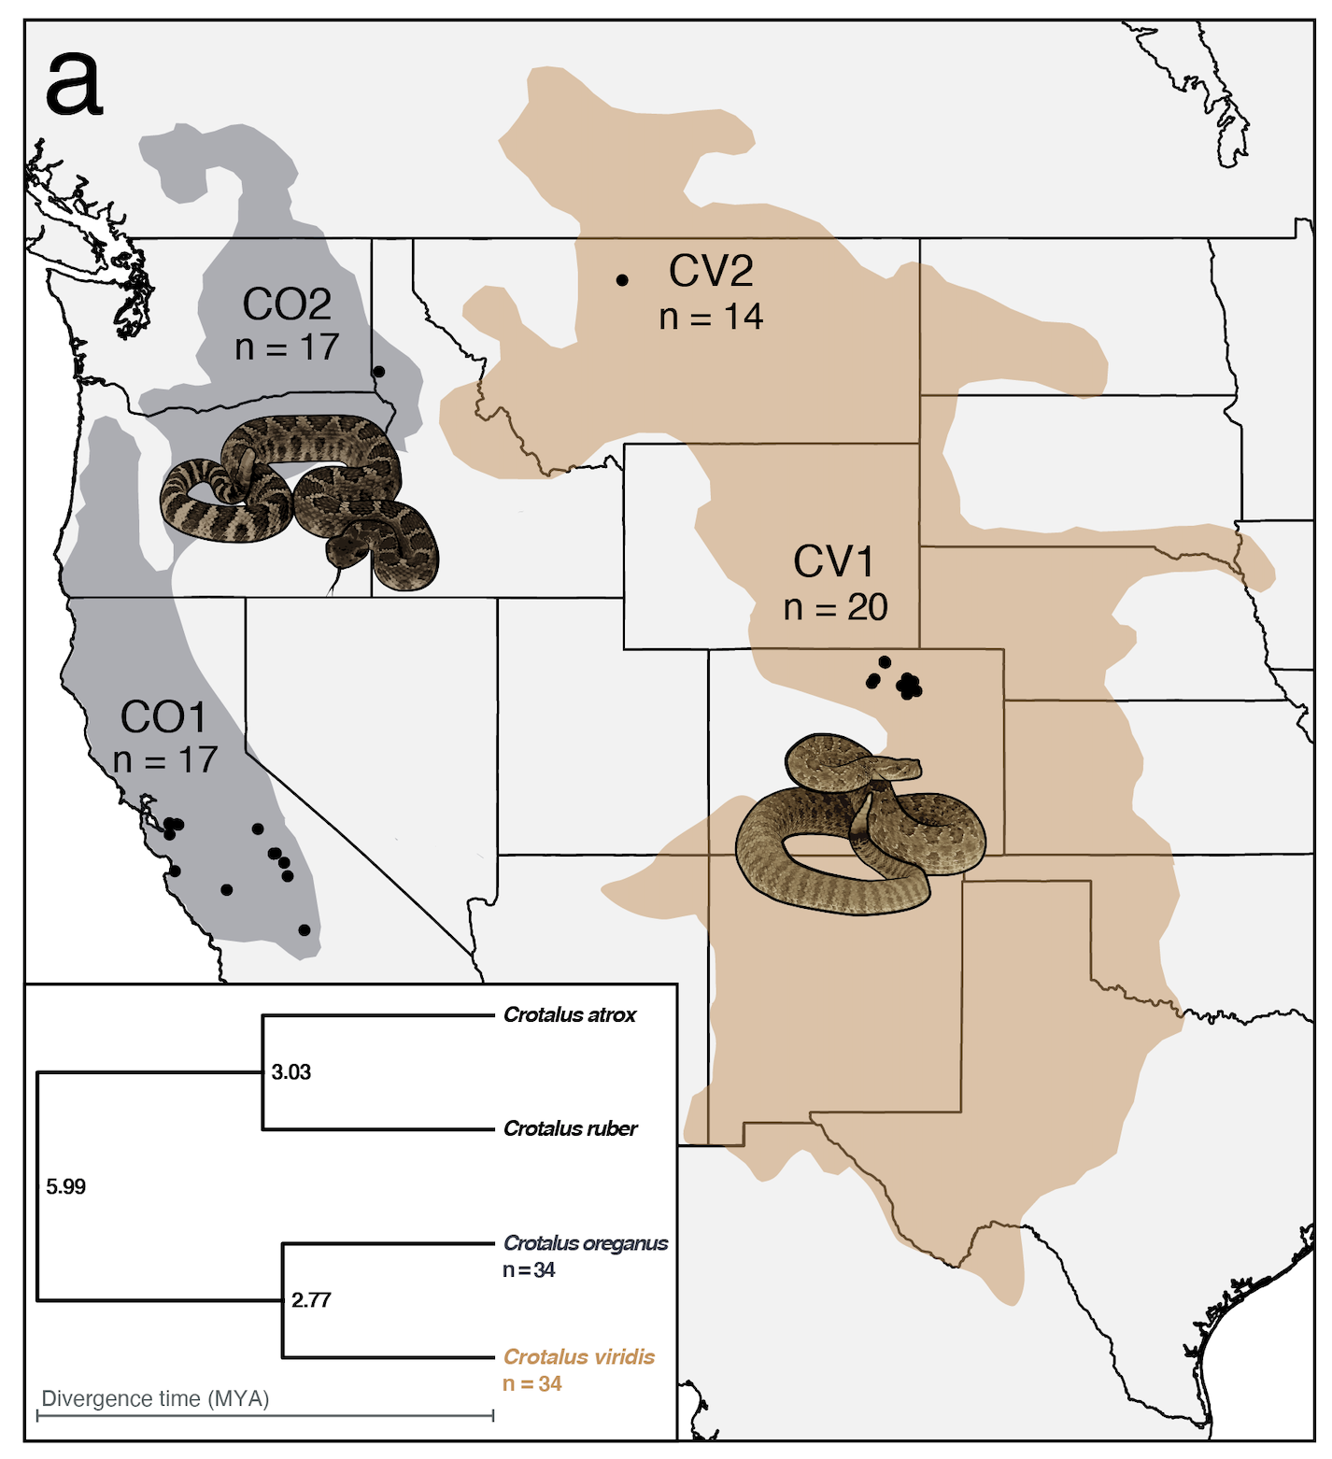
Today’s activity: examining population structure in rattlesnakes using Fst
Study species
Prairie rattlesnake (Crotalus viridis)
Northern Pacific rattlesnake (C. oreganus)
Western diamondback (C. atrox) and red diamondback (C. ruber)
More distant relatives
Questions:
How are populations structured?
How does differentiation vary across genomic regions?
https://github.com/drewschield/EvoGenomics_PopStructure

