Slide 1
Towards Performance Portability in Earth-System Modelling with GOcean.
Andrew Porter, Rupert Ford & Mike Ashworth (STFC Daresbury Laboratory)
Graham Riley (University of Manchester)
Manish Modani
(STFC Hartree Centre)

Slide 2
Contents
Motivation (the GungHo Project)
The GOcean Project
Separation of Concerns (PSyKAl)
Application of PSyKAl to shallow-water models
Performance Impact of PSyKAl
Serial
OpenMP
GPU
Summary

Slide 3
GungHo – What and Why?
GungHo is a UK Met Office/NERC project aiming to research, design and develop a new dynamical core suitable for operational, global and regional, weather and climate simulation
Computer architectures are in a state of flux with a variety of competing technologies
GungHo is developing code for a computer that does not yet exist
Many cores, accelerators (PCIe or socket), FPGAs…
How can we produce maintainable, scientifically-correct code that will perform well on a range of future architectures?

Slide 4
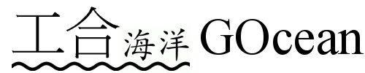
NERC funded, 03/2014 – 02/2015
Collaboration between NOC and STFC
Investigate the feasibility of applying technology from the GungHo project to ocean modelling
Extend the developing GungHo infrastructure to support finite difference on regular, lat-lon grids

Slide 5
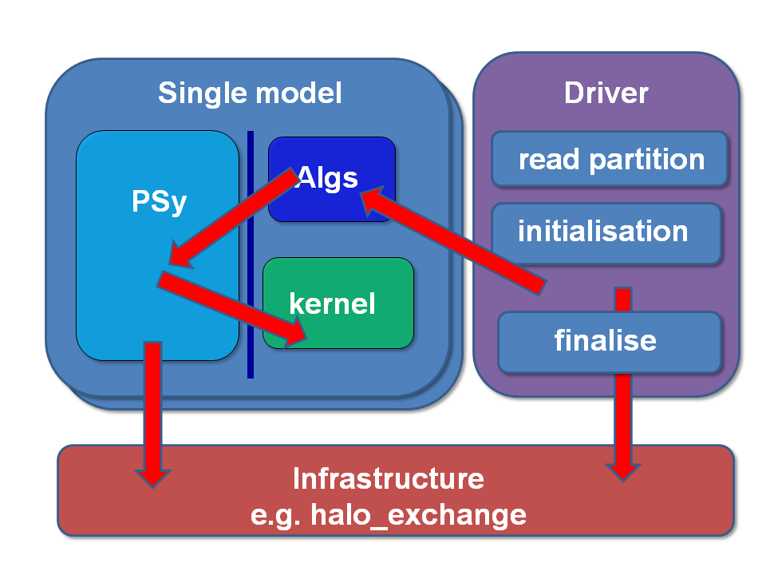
Separation of Concerns in GungHo

Slide 6
The Parallel System, Kernel, Algorithm (PSyKAl) Approach…
Oceanographer writes the algorithm (top) and kernel (bottom) layers, following certain rules
no need to worry about relative indexing of various fields
no need to worry about parallelism (algorithm layer deals with logically global field quantities)
A code-generation system (PSyclone) generates the PSy middle layer
glues the algorithm and kernels together
incorporates all code related to parallelism

Slide 7
Two shallow-water codes…
We have applied the PSyKAl approach to two codes:
‘Shallow’ originally written by Swarztrauber, NCAR
‘NEMOLite2D’ 2D, free-surface part of NEMO extracted by NOC
Both use Finite Difference on Arakawa C grid
But there are important differences:
Boundary conditions (bi-periodic vs. forced/closed)
Relative indexing of variables on the grid
Understanding and expressing these differences is essential for correct code generation

Slide 8
Two benchmarks…
Have re-structured both Shallow and NEMOLite2D following PSyKAl separation of concerns
Manually optimise Shallow while obeying PSyKAl rules
Serial benchmark
Manually optimise NEMOLite2D and implement OpenMP parallelisation
Parallel benchmark
These benchmarks have also been supplied to vendors (IBM, NVIDIA) for them to optimise for their hardware while obeying PSyKAl rules

Slide 9
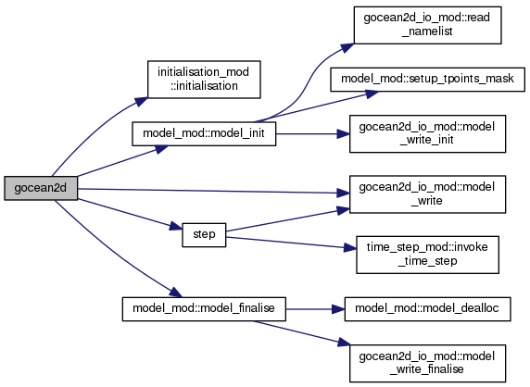
NEMOLite2D - structure

Slide 10
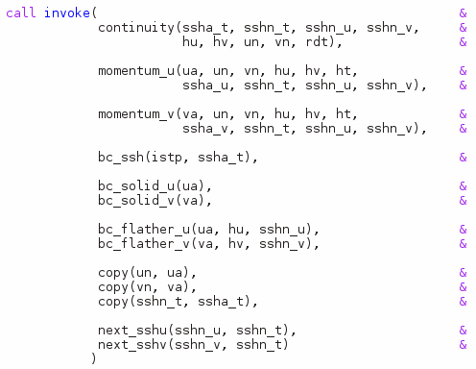
Body of time-stepping loop consists of kernel calls:

Slide 11
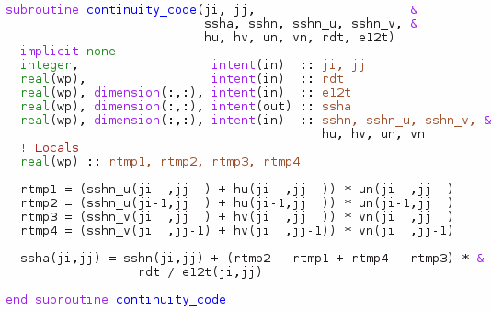
A kernel looks like:

Slide 12
A kernel operates on a single grid-point
A kernel looks like:

Slide 13
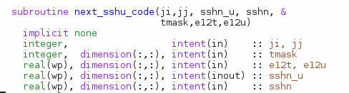

Kernel meta-data
Kernels make use of several grid-related quantities, e.g. area of cell around a T point, T-point mask etc.
The algorithm layer should not/cannot supply these:

Slide 14
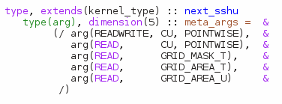
Extend meta-data to specify what quantities a kernel requires from the infrastructure:
PSyclone then supplies these quantities from the generated middle layer

Slide 15
What about performance?

Slide 16
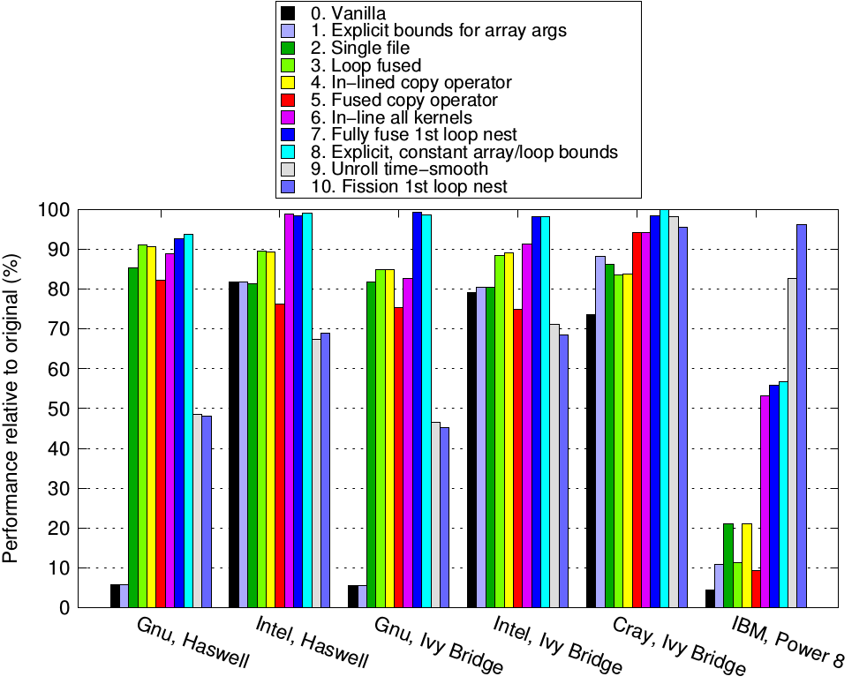
Shallow optimisation stages (serial)
(256 x 256 case)

Slide 17
Gnu cannot optimise across separate source files

Slide 18
Loop fusion not always beneficial

Slide 19
Kernel source in-lining important for all except Cray

Slide 20
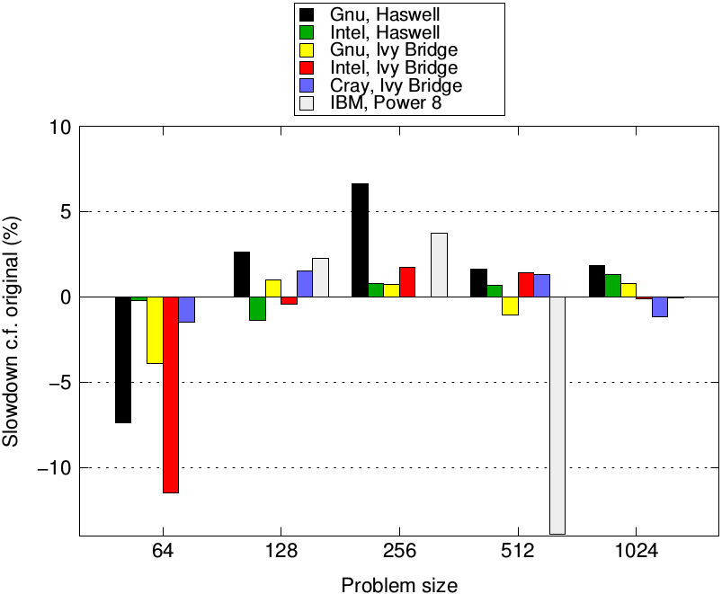
Summary for Shallow (serial)

Slide 21
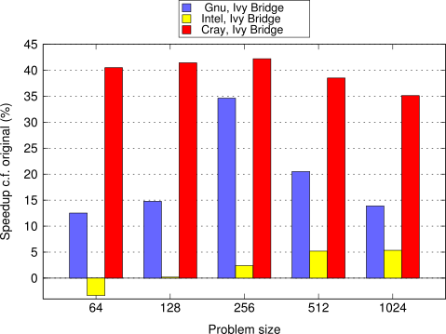
Second benchmark: NEMOLite2D (serial)

Slide 22
Performance with OpenMP

Slide 23
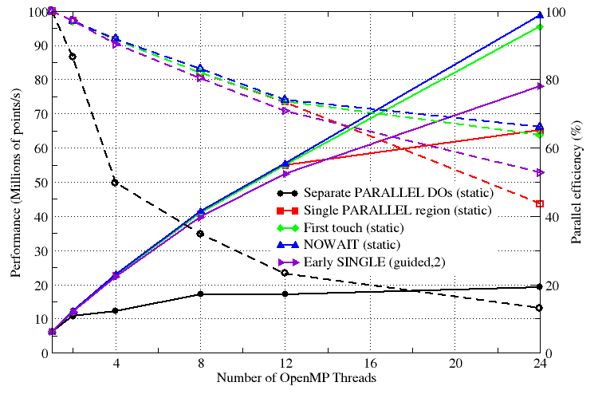
NEMOLite2D, OpenMP optimisation stages
(256 x 256 case, Intel v.14)

Slide 24
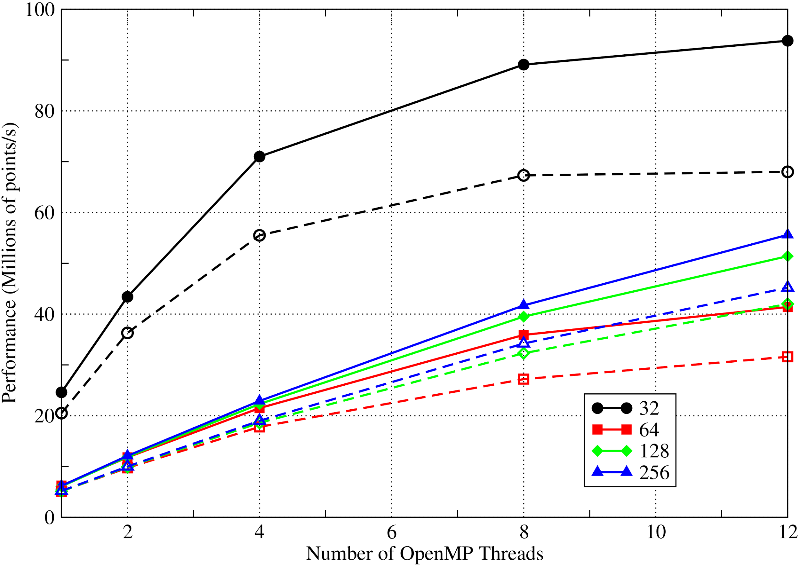
NEMOLite2D, OpenMP
Solid lines – manual OpenMP
Dashed lines – PSyclone-generated
Notes:
Intel compiler, single socket of Ivy Bridge

Slide 25
NEMOLite2D, OpenMP
Solid lines – manual OpenMP
Dashed lines – PSyclone-generated
Mainly due to lack of kernel-inlining in generated code
Notes:
Intel compiler, single socket of Ivy Bridge

Slide 26
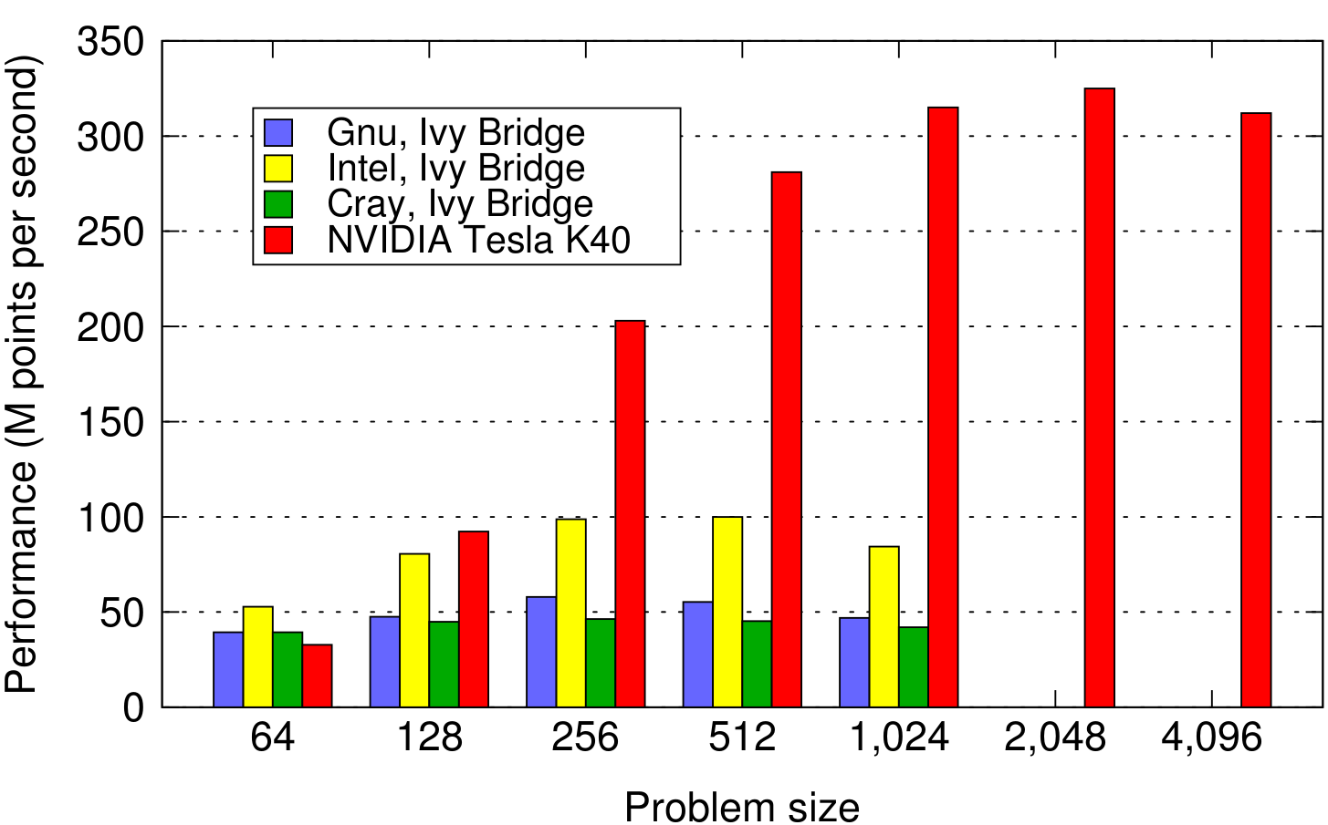
NEMOLite2D, GPU
GPU results courtesy of Jeremy Appleyard, NVIDIA

Slide 27
Next steps…
Compilers are complex!
Recovering performance is not straightforward
More transformations required (e.g. in-lining of kernel code for Gnu and Intel)
Currently not exploring the optimisation space
Only attempting to recover original code structure
Three dimensions
Current test cases are two-dimensional
Full models are a mixture of 2D and 3D…
NOC working on introducing some 3D aspects to NEMOLite

Slide 28
Summary I
Separation of Concerns: Introduces flexibility needed to achieve performance on different architectures
potentially enables e.g. OpenMP or OpenACC to be used, depending on target hardware
No need to modify source code containing the Natural Science (Algorithm and Kernel layers)
Optimal code structure is both system- and compiler-dependent

Slide 29
Summary II
Framework now supports two distinct shallow-water models
Code generation
Support for loop fusion and OpenMP transformations (parallel, parallel do and do)
Work continuing on PSyclone in the GungHo project
More OpenMP support (loop colouring)
Distributed memory support (MPI)
Support for OpenACC

Slide 30
Thank you!

Slide 31
Extras…

Slide 32
Compilers and CPUs
 | Gnu | Intel | Cray | IBM
Intel Haswell (E5-1620 v2) | 4.9.3 | 14.0.0
Intel Ivy Bridge (E5-2697) | 4.9.1 | 14.0.1.106 | 8.3.3
IBM Power 8 |  |  |  | 15.1.2 (Linux)

Slide 33
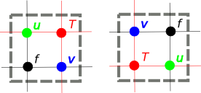
Offset choice
A developer can choose how the different grid-point types are indexed relative to T
shallow defines {u,v,f} points to the South and West of the T point to have same (i,j) index while NEMO uses those to the North and East:
We call this choice the ‘offset’ of the grids
Specified in kernel meta-data

Slide 34
Middle layer is generated…
! ** Start of time loop **
DO ncycle=1,itmax
! COMPUTE CAPITAL U, CAPITAL V, Z, H
call invoke(compute_cu_type(CU, P, U), &
compute_cv_type(CV, P, V), &
compute_z_type(z, P, U, V), &
compute_h_type(h, P, U, V) )

Slide 35
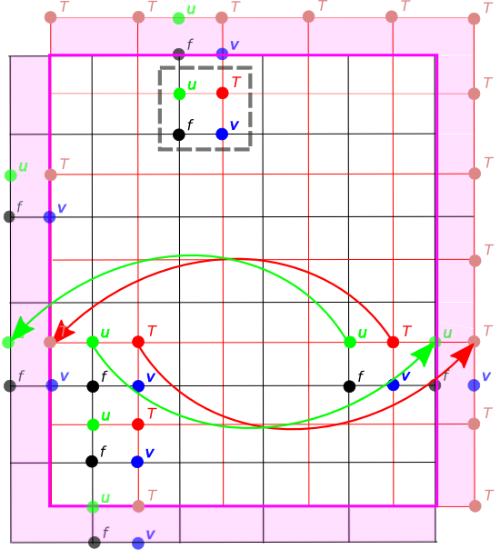
SW offset with Periodic Boundaries
Grid points with same (i,j)
Data movement for PBC update
Boundary region
External/boundary grid points
Notes:
N.B. only actually need one of the two E/W halos and one of the two N/S halos, depending on the field.

Slide 36
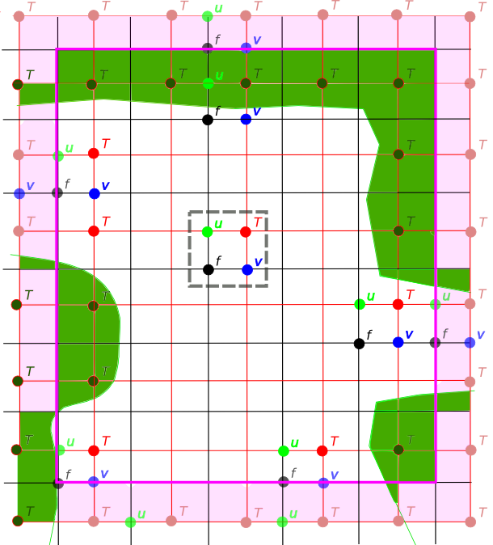
SW offset with open and closed boundaries
User defines domain in terms of T points
Definition includes the boundary points
Serial implementation doesn’t need halos

Slide 37
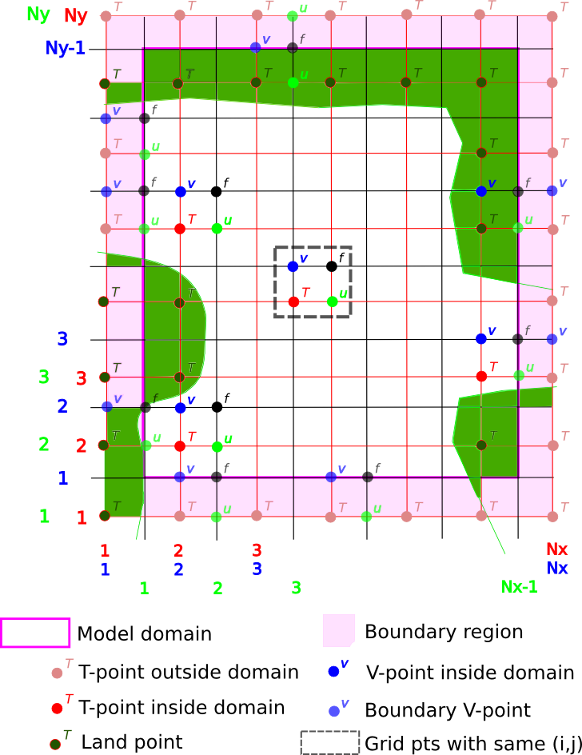
NE offset with in-place boundary conditions

Slide 38
Code generation to the rescue…
PSyclone currently has rudimentary support for loop-fusion (and the addition of OpenMP)
e.g. for the time-smoothing section of the code where all 3 loops have same bounds:
DO j=1,SIZE(uold,2)
DO i=1,SIZE(uold,1)
CALL tsmooth_code(i,j,u…)
DO i=1,SIZE(vold,1)
DO j=1,SIZE(vold,2)
CALL tsmooth_code(i,j,v…)
DO i=1,SIZE(pold,1)
DO j=1,SIZE(pold,2)
CALL tsmooth_code(i,j,p…)
DO j=1, SIZE(uold, 2)
DO i=1, SIZE(uold, 1)
CALL tsmooth_code(i,j,u…)
CALL tsmooth_code(i,j,v…)
CALL tsmooth_code(i,j,p…)
END DO
END DO

Slide 39
