Slide 1
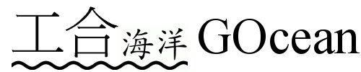
An update…
Andrew Porter, Rupert Ford & Graham Riley STFC
Hedong Liu & Jason Holt NOC

Slide 2
Project Overview
NERC funded, 03/2014 – 02/2015
Collaboration between NOC and STFC
Existing NEMO code structure needs updating
20 yrs old and MPI only, vertical level index last
Investigate the feasibility of applying the GungHo approach to ocean modelling
Ocean models can avoid pole problem
put poles over land; can retain a lat-lon grid
Look to extend the developing Gung-Ho infrastructure to support finite difference on lat-lon grids

Slide 3
The Plan…
Obtain finite-difference, shallow-water model(s)
Re-structure following PSyKAl approach
Extend kernel meta-data to capture necessary information
Finite difference, lat-lon, direct-addressed
Extend PSyclone to generate the Parallel System (middle layer)
Support for multi/many-core/GPU etc. but not MPI
Investigate performance implications and feedback to PSyclone
Feedback to the NEMO system team

Slide 4
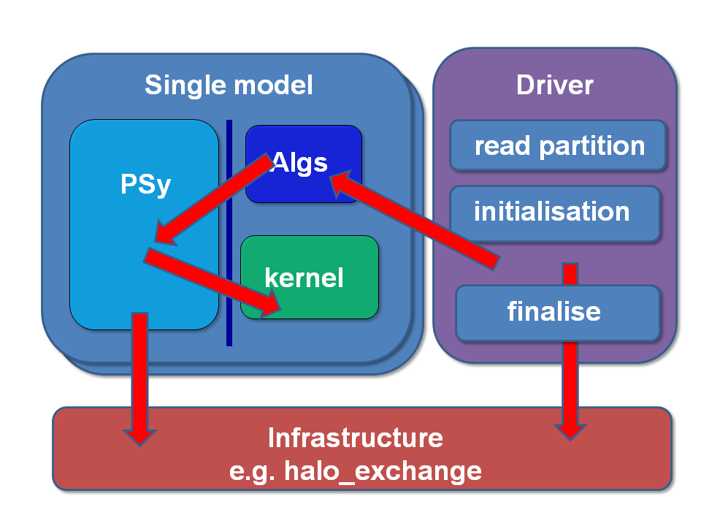
Separation of Concerns in Gung-Ho (recap)

Slide 5
The Parallel System, Kernel, Algorithm (PSyKAl) Approach…
Oceanographer writes the algorithm and kernel layers, following certain rules
no need to worry about relative indexing of various fields
no need to worry about parallelism
A code-generation system (PSyclone) generates the PSy middle layer
glues the algorithm and kernels together
incorporates all code related to parallelism

Slide 6
Two shallow-water codes…
We are applying PSyKAl approach to two codes:
‘shallow:’ originally written by Swarztrauber, NCAR
‘NEMOLite2D:’ 2D, free surface part of NEMO extracted by NOC
Both use Finite Difference on Arakawa C grid
But there are important differences:
Boundary conditions (periodic vs. forced/closed)
Relative indexing of variables on the grid
Understanding and expressing these differences is essential for correct code generation

Slide 7
Placing variables...
Variable placement for the Staggered Arakawa C-grid with NEMO indexing convention:
v(i,j)
f(i,j)
T: scalars (density, salinity etc.)
u,v: velocity components
f: vorticity
u(i-1,j)
T(i,j)
u(i,j)
v(i,j-1)

Slide 8
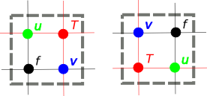
Offset choice
A developer can choose how the different grid-point types are indexed relative to T
shallow defines {u,v,f} points to the South and West of the T point to have same (i,j) index while NEMO uses those to the North and East:
We call this choice the ‘offset’ of the grids
Specified in kernel meta-data

Slide 9
PSyKAl-ification...
Take shallow-water code, e.g.:
DO ncycle=1,itmax ! Time-stepping loop
! COMPUTE CAPITAL U, CAPITAL V, Z AND H
DO J=1,N
DO I=1,M
CU(I+1,J) = & .5*(P(I+1,J)+P(I,J))*U(I+1,J)
CV(I,J+1) = & .5*(P(I,J+1)+P(I,J))*V(I,J+1)
...
END DO
END DO

Slide 10
Construct (point-wise) kernels, e.g.:
SUBROUTINE compute_cu_code(i, j, & cu, p, u)
INTEGER, INTENT(in) :: i, j
REAL(wp), INTENT(in) :: p(:,:), u(:,:)
REAL(wp), INTENT(inout):: cu(:,:)
CU(I,J) = .5*(P(I,J)+P(I-1,J))*U(I,J)
END SUBROUTINE compute_cu_code

Slide 11
Re-structure following Gung-Ho rules (all computation must be done in a kernel):
Time-stepping loop at algorithm level becomes….
DO ncycle=1,itmax ! Time-stepping loop
! COMPUTE CAPITAL U, CAPITAL V, Z AND H
CALL compute_cu(CU, P, U)
CALL compute_cv(CV, P, V)
...
CALL invoke(compute_cu(CU, P, V), & compute_cv(CV, P, V), & ...)

Slide 12
Translation/generation…
PROGRAM shallow
USE psy_shallow, ONLY: invoke_0
…
! ** Start of time loop **
DO ncycle=1,itmax
! COMPUTE CAPITAL U, CAPITAL V, Z, H
CALL invoke_0(cu, p, u, cv, v, z, h)

Slide 13
SUBROUTINE invoke_0(cu_1,p,u,cv_1,v,z,h)
USE compute_cv_mod, ONLY: compute_cv_code
USE compute_cu_mod, ONLY: compute_cu_code
USE topology_mod, ONLY: cu, cv
REAL,intent(inout),dimension(:,:) :: cu_1,p,u,cv_1,v,z,h
DO i=cu%istart,cu%istop
DO j=cu%jstart,cu%jstop
CALL compute_cu_code(i, j, cu_1, p, u)
END DO
END DO
DO i=cv%istart,cv%istop
DO j=cv%jstart,cv%jstop
CALL compute_cv_code(i, j, cv_1, p, v)
…

Slide 14
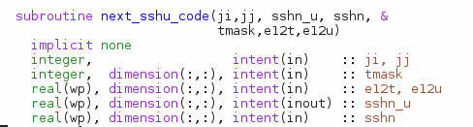

Kernel meta-data
Kernels make use of several grid-related quantities, e.g. area of cell around a T point, T-point mask etc.
The algorithm layer should not/cannot supply these:

Slide 15
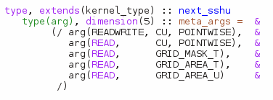
Extend meta-data to specify what quantities a kernel requires from the infrastructure:
PSyclone must then supply these quantities from the generated middle layer (e.g. by accessing a grid objected pointed to by a field object)

Slide 16
What about performance?
Some timings for 2000 time steps of 128x128 domain on a single core:
Compiler: | Gnu 4.8.2 | Intel 14.0.0 | Cray 8.2.6 | Intel 14.0.1
CPU: | Xeon E5-1620 v3, 3.7 GHz (Haswell) | Xeon E5-1620 v3, 3.7 GHz (Haswell) | Xeon E5-2697, 2.7 GHz (Ivy Bridge) | Xeon E5-2697, 2.7 GHz (Ivy Bridge)
Original*: | 0.37 | 0.37 | 0.29 | 0.40
Manual, vanilla†: | 6.30 | 0.42 | 0.41 | 0.49
Manual, opt’d‡: | 0.53 | 0.39 | 0.31 | 0.43
* Unmodified shallow code
† Manual PSyKAl version
‡ As † but with middle layer optimised
Notes:
Timings obtained from running interactively on nodes so subject to some noise.

Slide 17
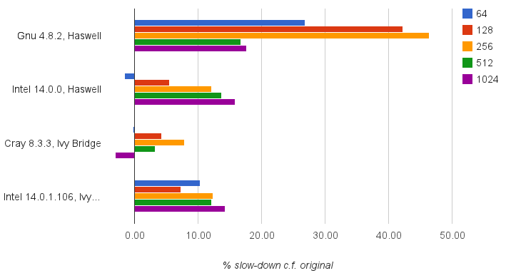
All compilers are not created equal
Performance of best (so far) PSyKAl version compared to original, unmodified ‘shallow’:

Slide 18
Next steps…
Supply vendors (IBM, NVIDIA) with original and PSyKAl’ised versions and let them optimise
Use lessons learned to continue to improve PSyclone
Gain fuller understanding of cost (if any) of introducing layered structure
Currently not exploring the optimisation space
Only attempting to recover original code structure
Three dimensions
Current test cases are two-dimensional
Full models are a mixture of 2D and 3D…
NOC working on introducing some 3D aspects to NEMOLite

Slide 19
Summary I
Separation of Concerns: A practical approach to marrying the requirements of oceanographers with the requirements for performance in the (pre-) exascale era.
Introduces flexibility needed to achieve performance on different architectures
potentially enables e.g. OpenMP or OpenACC to be used, depending on target hardware
Very dependent on middle layer to retrieve the performance that we’ve thrown out

Slide 20
Summary II
Framework now supports two distinct shallow-water models
Basic code generation functional
Support for loop fusion and OpenMP transformations
Working in collaboration with hardware vendors to understand what loses us performance and how to regain it
Potential to explore optimisation space that has been opened by the flexibility provided by code transformation & generation

Slide 21
Extras…

Slide 22
Middle layer is generated…
! ** Start of time loop **
DO ncycle=1,itmax
! COMPUTE CAPITAL U, CAPITAL V, Z, H
call invoke(compute_cu_type(CU, P, U), &
compute_cv_type(CV, P, V), &
compute_z_type(z, P, U, V), &
compute_h_type(h, P, U, V) )

Slide 23
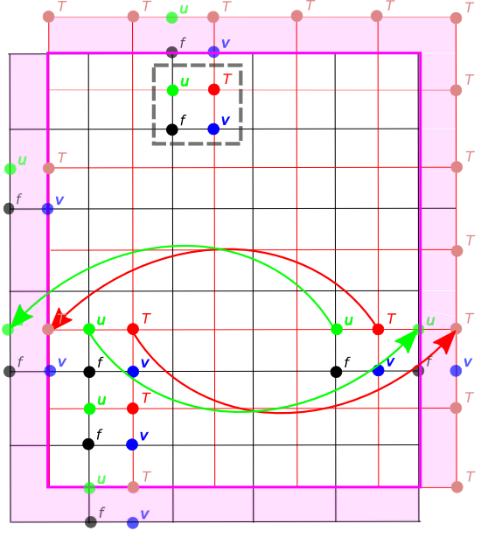
SW offset with Periodic Boundaries
Grid points with same (i,j)
Data movement for PBC update
Boundary region
External/boundary grid points
Notes:
N.B. only actually need one of the two E/W halos and one of the two N/S halos, depending on the field.

Slide 24
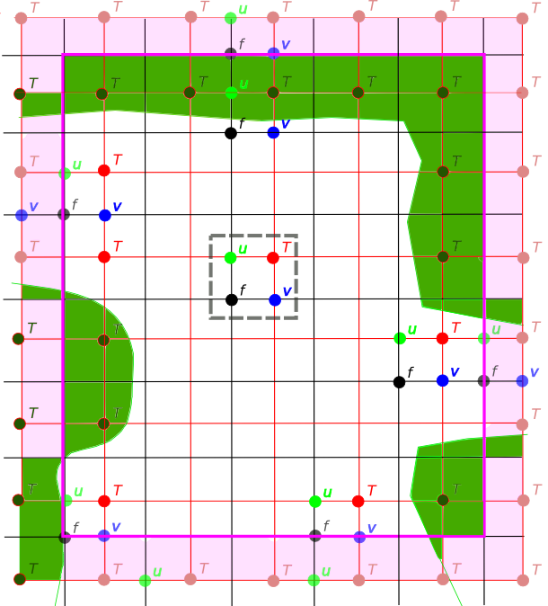
SW offset with open and closed boundaries
User defines domain in terms of T points
Definition includes the boundary points
Serial implementation doesn’t need halos

Slide 25
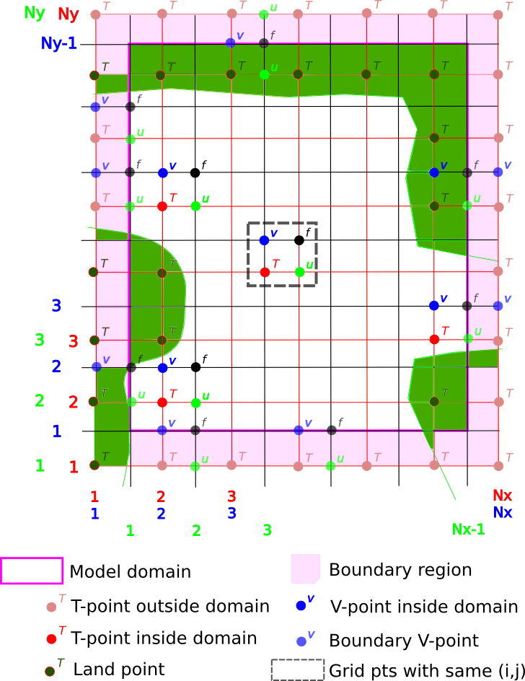
NE offset with in-place boundary conditions

Slide 26
Code generation to the rescue…
PSyclone currently has rudimentary support for loop-fusion (and the addition of OpenMP)
e.g. for the time-smoothing section of the code where all 3 loops have same bounds:
DO j=1,SIZE(uold,2)
DO i=1,SIZE(uold,1)
CALL tsmooth_code(i,j,u…)
DO i=1,SIZE(vold,1)
DO j=1,SIZE(vold,2)
CALL tsmooth_code(i,j,v…)
DO i=1,SIZE(pold,1)
DO j=1,SIZE(pold,2)
CALL tsmooth_code(i,j,p…)
DO j=1, SIZE(uold, 2)
DO i=1, SIZE(uold, 1)
CALL tsmooth_code(i,j,u…)
CALL tsmooth_code(i,j,v…)
CALL tsmooth_code(i,j,p…)
END DO
END DO

