Slide 1

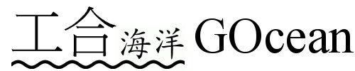
“G-Ocean:2D” Project
Gocean:2D team

Slide 2
About “Gocean:2D” project
Towards a next-generation ocean model in the GungHo framwork: 2D test cases (Funded by NERC in 2014)
Work team
Jason Holt (PI), Adrian New, Hedong Liu (NOC)
Mike Ashworth, Graham Riley, Rupert Ford, Andrew Porter (STFC Scientific Computing Department)
Project partners
John Thuburn (University of Exeter), Nigel Wood, John Siddorn (MetOffice), Colin Cotter, David Ham (Imperial Colloege)

Slide 3
Objectives
Develop a 2D ocean model in GungHo’s framework
Similarities between atmosphere and ocean dynamic systems
Facing the same challenges (scalability, ease of use, maintenance, future-proofing), so share the same routes to overcome them.
Start from 2D because of the funding support strength (orders difference compared with GungHo’s).
Run a set of test cases (idealised and realistic)
To evaluate/optimise/prove the framework and its components.
To compare with other existing approaches on accuracy, computational efficiency, and scalability.
Introduce/disseminate GungHo framework in ocean modelling community
A revolutionary model programming approach to enhance the next generation ocean modelling.
Extend GungHo’s fruitfulness beyond atmosphere.

Slide 4
Where are we now? Model building
Extract 2D part from NEMO v3.6
Indirect addressing
Direct addressing
Design and build Algs and Kernel
PSy taken over from GungHo, creation of new bits if it is not general enough for both GungHo and GOcean.

Slide 5
Extract a 2D model from NEMO v3.6
Follow NEMO’s FD/FV discretisation (Orthognal quad C- grid)
Vector invariant form of advection term
Energy and enstrophy conserving discretisation of Coriolis’ term
Quadratic bottom friction term
Solid (slip/noslip) and open boundary conditon (clamped SSH and Flather V)
Prediction-Correction explicit time stepping (AB-AM)
Two versions: Direct addressing and Indirect addressing

Slide 6
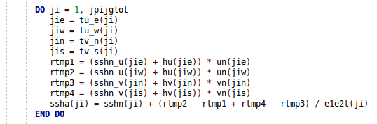
Indirect Addressing
Recode the code in a new way
Fit for GungHo’s framework, but
Mesh Topological information is not enough for FD/FV method. Some geometory/orientation information must be added in.
So, function spaces change with Mesh Topo.

Slide 7
Direct Addressing
Model extraction only needs some insignificant modifications and re-organisations.
Efficient implicit mesh topo and function spaces
But this does not fit in the generality of GungHo recommended data model
We are investigate to extending GungHo to support this
AP, RF, GR have already started this work

Slide 8
Of Grids and Spaces...
Staggered Arakawa C-grid with NEMO indexing convention:
v(i,j)
Finite-difference equivalent of FE spaces?
T: scalars (density, salinity etc.)
u,v: velocity components
f: vorticity
f(i,j)
u(i-1,j)
T(i,j)
u(i,j)
v(i,j-1)

Slide 9
The beginning
Take shallow-water code, e.g.:
DO ncycle=1,itmax
! COMPUTE CAPITAL U, CAPITAL V, Z AND H
DO J=1,N
DO I=1,M
CU(I+1,J) = & .5*(P(I+1,J)+P(I,J))*U(I+1,J)
CV(I,J+1) = & .5*(P(I,J+1)+P(I,J))*V(I,J+1)
...
END DO
END DO

Slide 10
The middle
Re-structure following Gung-Ho rules...
DO ncycle=1,itmax
! COMPUTE CAPITAL U, CAPITAL V, Z AND H
CALL compute_cu(CU, P, U)
CALL compute_cv(CV, P, V)
...
CALL invoke(compute_cu(CU, P, V), compute_cv(CV, P, V), ...)

Slide 11
The end?
Generate (point-wise?) kernels, e.g.:
SUBROUTINE compute_cu_code(i, j, & cu, p, u)
INTEGER, INTENT(in) :: i, j
REAL(wp), INTENT(in) :: p(:,:), u(:,:)
REAL(wp), INTENT(out):: cu(:,:)
CU(I,J) = .5*(P(I,J)+P(I-1,J))*U(I,J)
END SUBROUTINE compute_cu_code

Slide 12
Concerns about direct addressing
Introduces flexibility needed to achieve performance on different architectures
e.g. potentially enables index ordering to be swapped depending on target hardware
Very dependent on middle layer to retrieve the performance that we’ve thrown out
Need new/extended meta-data to capture dependencies of fields on a C-grid
how do these relate to the FE spaces?

Slide 13
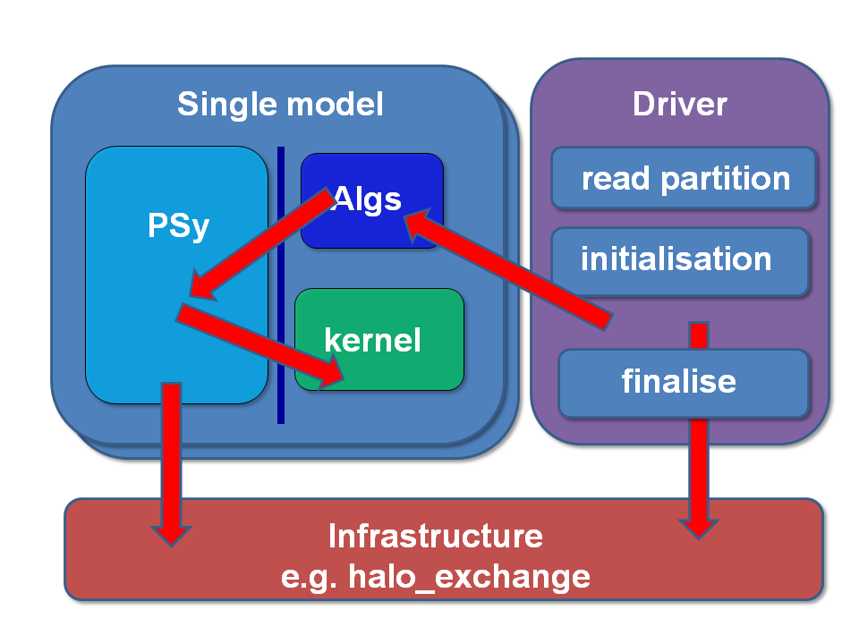
Next Step
Design Algs, Kernel and PSy blocks for Gocean

Slide 14
Issues
Design of Function Spaces for FD/FV method for different type of methods (advection schemes, Coriolis’ scheme, boundary conditions)
Efficiently separate Algs and Kernel while let PSy take its role.
Mesh Topology and Function Spaces are different in FD and FV
Direct addressing capability
Fareness for the comparison between Direct addressing and indirect addressing in a 2D model.

Slide 15
Thank you for your attention

