Slide 1
Overall Pipeline
Front End
Back End
Feature Detection
Feature Matching
Homography
(Rigid Transform)
Estimation w/ RANSAC
Homography to Odometry
Write to g2o
Estimate World Coordinate
Propose Cross Links
Optimize g2o

Slide 2
Feature Detection Pipeline
Feature Detection Pipeline
Detect Features
Radial Non-Max Suppression
Extract Feature Descriptors
Tile Image
Combine all tiles
…
Detect Features
Radial Non-Max Suppression
Extract Feature Descriptors

Slide 3
Feature Matching Pipeline
Extract Features and Descriptors from Image 1
knnMatch(k=2)
Lowe Ratio Test
Extract Features and Descriptors from Image 2

Slide 4
Perform first pass
Crosslink Proposition
Meets
thresholds
Meets
thresholds
Check dx,dy < THRESHOLDS
Compute H
Check H Projection
Propose Link!
Given two
images…
Fails to
find H
Outside
thresholds
Outside
thresholds
Mark No Link!

Slide 5
Intuition of Lowe Ratio Test
Distance of K=2 Best Matches for a Given Feature
Distance between features
Feature 1
Feature 2

Slide 6
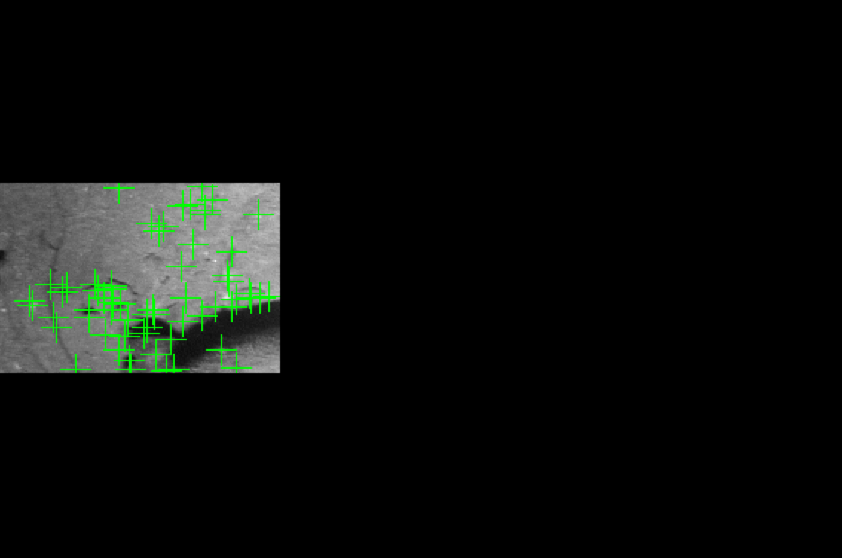
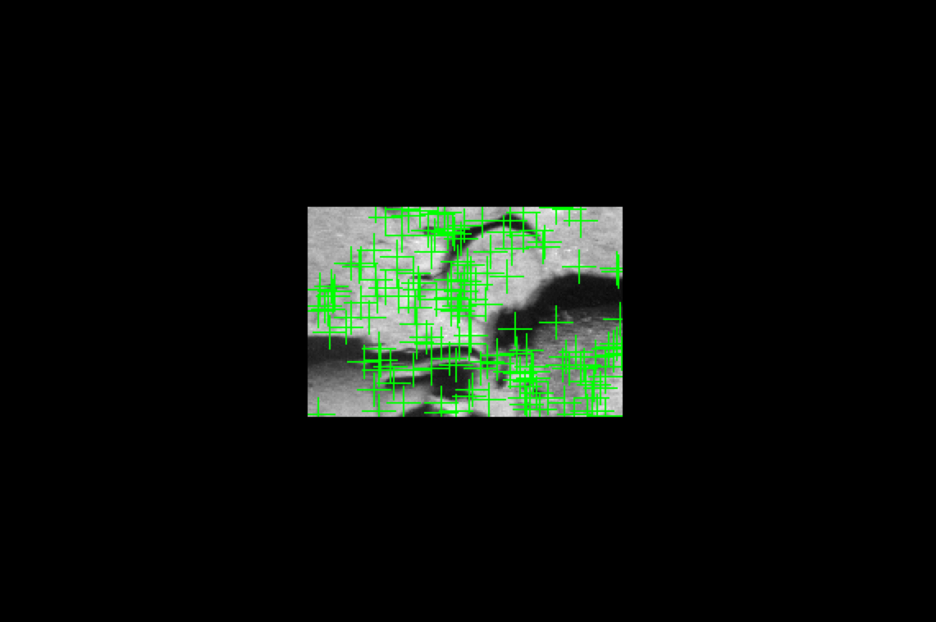
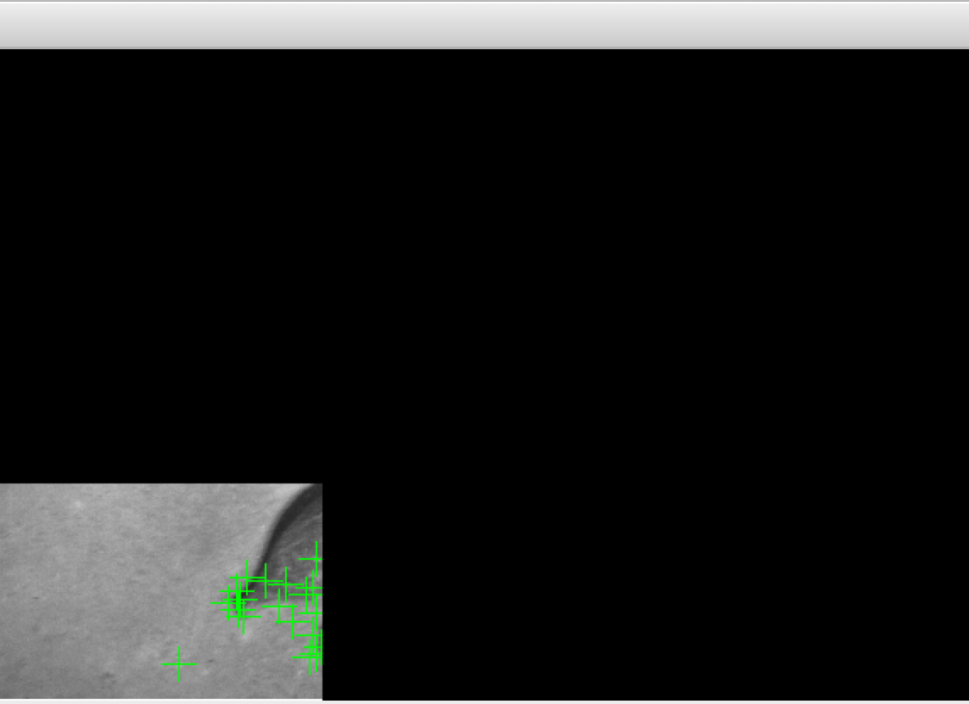
Tiling helps ensure a more uniform feature displacement
around the image.

Slide 7
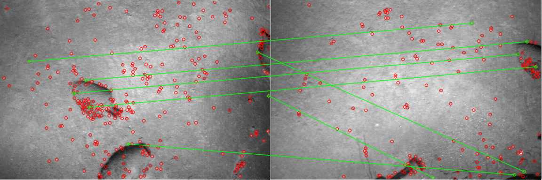
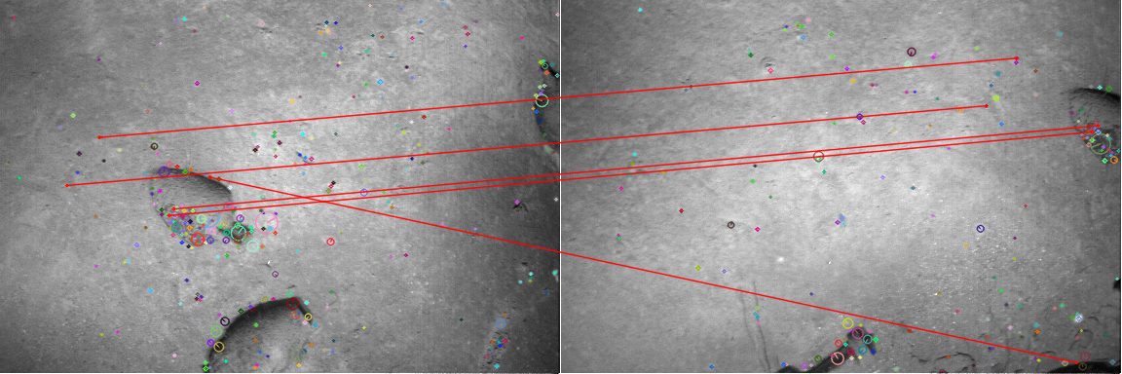
Kept by RANSAC
Eliminated by RANSAC

