Slide 1
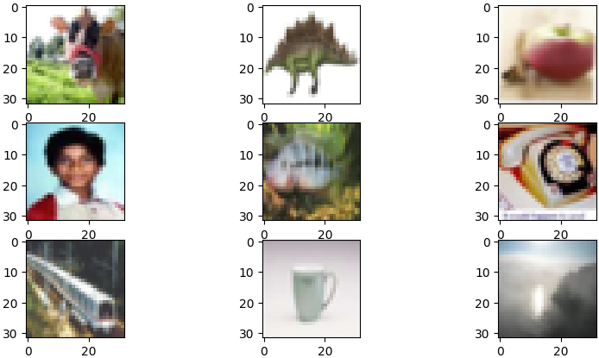
Real-World Object Recognition
Team ByteMe
ITAI 1378: Computer Vision
April 09, 2024

Slide 2
Introduction
Focus: Develop, fine-tune, and evaluate an image classification deep learning model from a dataset comprising various labeled categories
Goal: Leverage convolutional neural networks (CNNs) to achieve high accuracy in image classification while exploring the impact of different hyperparameters

Slide 3
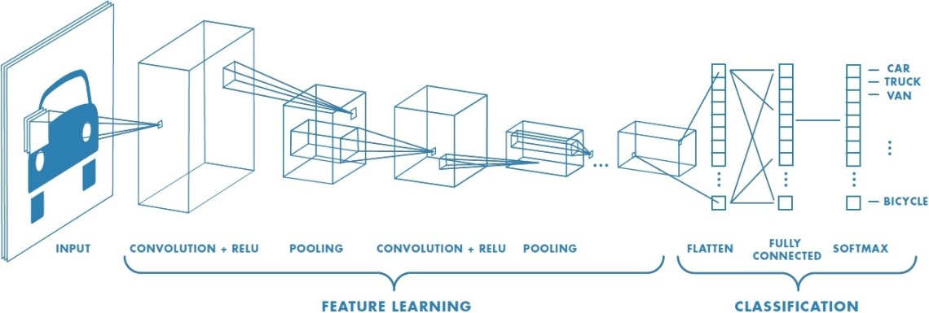
Convolutional Neural Network
This Photo by Unknown author is licensed under CC BY.

Slide 4
Methodology
Data Preprocessing
Model Architecture
Dataset: CIFAR-100 (10,000 images of 32x32 pixels across 100 classes)
Images normalized and resized to 224x224 pixels
Train/test split: 80/20
Data Augmentation: (rotation, dimensions shift, shear and zoom range, and horizontal flip)
Convolutional Layer (32 filters, 3x3 kernel) with ReLU activation
MaxPooling Layer (2x2 pool size)
Dropout Layer (0.5 dropout rate)
Regularization L2
Fully Connected Layer (128 units) with ReLU activation

Slide 5
Methodology (cont.)
Training the Model
Evaluation Metrics
Base Model = ResNet50
Optimizer: Adam
Loss Function: Cross entropy
Learning Rates tested: 0.01, 0.005, 0.001, and 0.0001
Batch size: 32
Epochs: 50
Confusion Matrix (accuracy, precision, recall, F1-score) for true/false positive and negatives

Slide 6
Results
Highest accuracy of 92% with a learning rate of 0.001
Learning rate of 0.0001 resulted in slower convergence
Learning rate of 0.01 led to instability in training dynamics
The Confusion Matrix indicated excellent recognition for some classes (e.g., cats and dogs) but showed some misclassifications between similar categories (e.g., trucks and cars)

Slide 7
Discussions
The balanced learning rate helped in achieving stable and effective training results
Misclassifications noted from the confusion matrix were primarily between visually similar classes, suggesting potential improvements in feature extraction layers or the need for more nuanced training strategies (Jones)
Although trucks and cars were sometimes misclassified, they fall under the same "vehicles" superclass

Slide 8
Further Exploration and Recommendation
Data Augmentation: Implementing different rotations, flips, and color adjustments to introduce more variability
Model Ensembling: Combining predictions from multiple models to improve accuracy

Slide 9
Conclusion
The project successfully demonstrates the high accuracy of CNNs in image classification tasks on a diverse dataset
Different hyperparameter combinations will result in different model's capabilities and accuracy
Continuous improvements and adaptations are essential to tackle the nuances of real-world data effectively

Slide 10
References
Henry, Matthew, and Step Guide. “7 Best Techniques To Improve The Accuracy of CNN W/O Overfitting.” Hargurjeet, 26 May 2021, https://gurjeet333.medium.com/7-best-techniques-to-improve-the-accuracy-of-cnn-w-o-overfitting-6db06467182f. Accessed 13 April 2024.
Jones, Edward. “Build your own deep learning classification model in Keras.” Towards Data Science, 2020, https://towardsdatascience.com/build-your-own-deep-learning-classification-model-in-keras-511f647980d6. Accessed 13 April 2024.
Krizhevsky, Alex. “Learning Multiple Layers of Features from Tiny Images,.” CIFAR-10 and CIFAR-100 datasets, 2009, https://www.cs.toronto.edu/~kriz/cifar.html. Accessed 13 April 2024.

