Slide 1

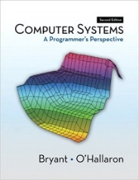
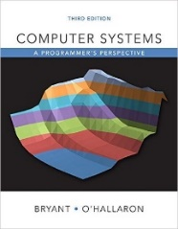
System Level Programming
Unit 12 Catch and Catch-Aware Programming
李靓 (Li Jing) lijing712@scu.edu.cn
School of Computer Science / Software Engineering

Slide 2
Catch and Catch-Aware Programming
Cache implementation
Cache miss rate
Locality optimization

Slide 3
Cache implementation
Read “Cache implementation.doc”, and fill the blank on the table
Please submit
“Cache implementation.doc”

Slide 4
Cache miss rate
Read “cache miss rate.html” and answer the questions in “cache_miss.doc” with necessary figures and analysis
Please submit
“cache_miss.doc”

Slide 5
Locality optimization
Read the instructions in “image process.html”
A cache simulation program with image processing
Modify files rotate.c and smooth.c
Your job is to optimize locality
Spatial or temporal
The program itself will
Check the correctness
Output the speed improvement

Slide 6
Locality optimization
Please submit
The modified source file “rotate.c” and “smooth.c”
“locality_optimization.doc”
Short description of the reason why you change the code this way
Show your result with figure of running output

