Slide 1

System Level Programming
Software College of SCU
四川大学软件学院 赵辉
Email: zhaohui@scu.edu.cn
Website: http://swjx.scu.edu.cn/moodle/
Tel：13348989866

Slide 2
Lab 10. Performance Measurement
Practice1 Multiple choice question
Practice2 Lab10-1 Optimizing Program Performance Analysis
Practice3 Lab10-2 Optimizing Program Performance

Slide 3
Practice1 Multiple choice question
Due：time on moodle

Slide 4
Practice2 Lab10-1 Optimizing Program Performance Analysis
This practice is from 4.2.2 of “ssd6.chm”
  A so-called trigram
  Just like a simple expert system

Slide 5
Practice2 Lab10-1 Optimizing Program Performance Analysis
This practice is from 4.2.2 of “ssd6.chm”
  E.g.: it is given the following input string.
  The trigrams are: (just like its knowledge database)
    [This is an], [is an example.], [an example. The], [example. The bird], [The bird is], [bird is an], [is an eagle], [an eagle. The], [eagle. The boy], [The boy is], [boy is an], [is an expert.], [and expert. This], and [expert. This is].
  Then you can give it a string such as [boy is]
    It can output string according to its trigrams
This is an example. The bird is an eagle. The boy is an expert

Slide 6
Practice2 Lab10-1 Optimizing Program Performance Analysis
This practice is from 4.2.2 of “ssd6.chm”
  The program starts with real English text.
    life.txt
  It reads all sequences of three consecutive words. And store them into trigrams
  The output is initialized with two words.
    The output is then extended by looking at the last two words, finding trigrams that start with these two words, and then picking one of the trigrams to provide a third word.

Slide 7
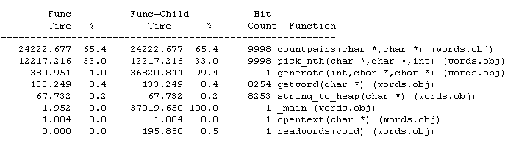
Practice2 Lab10-1 Optimizing Program Performance Analysis
There two version, words.cpp and words3.cpp
  The latter is faster
    Words.cpp
This function is spending most of time.

Slide 8
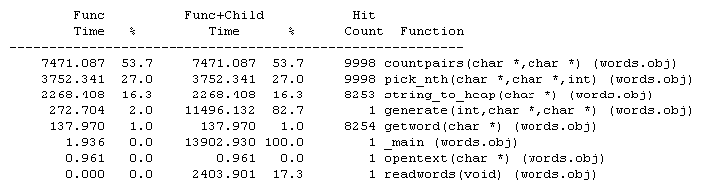
Practice2 Lab10-1 Optimizing Program Performance Analysis
There two version, words.cpp and words3.cpp
  The latter is faster
    Words3.cpp

Slide 9
Practice2 Lab10-1 Optimizing Program Performance Analysis
Analysis the two version’s source code
  To learn how the latter version optimize the performance
Then writing down your founding by answering the following questions, necessary figure is suggested
  The data structure difference between them
  The operation difference between them, that is what optimizing skill are used
    Describe each function that is changed
    文件1/2： trigram.doc

Slide 10
Practice3 Lab10-2 Optimizing Program Performance
Read the requirements on the Moodle site
Then Optimizing the program given, until it fulfill the requirement
  Profiling Tools of VC IDE will be used
  文件2/2：replacements.rar
    Your modified substitute.cpp
    description file substitute.doc
      a clear but concise description of what you observed before optimization. It should be substantiated by an empirical evidence of the profiler output.
      the bottlenecks you noticed
      the actions you took to address the bottlenecks, and the improvements you observed (again substantiated by empirical evidence)
      reasons for why you did NOT attempt to optimize any more than you did.

Slide 11
Sum up
  本次Lab需要完成的提交：学号_姓名_week10.rar ：
    文件1/2：trigram.doc
    文件2/2：replacements.rar
      Your modified substitute.cpp
      description file substitute.doc
  Upload to module @week10
  Due： time on moodle

