Slide 1

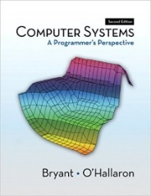
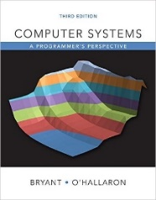
System Level Programming
Unit 11 Optimizing Program Performance
李靓 (Li Jing) lijing712@scu.edu.cn
School of Computer Science / Software Engineering

Slide 2
Optimizing Program Performance
10.1 Introduction of optimizing program
10.2 The Golden Rules of optimization
10.3 Optimizing compilers
10.4 Example of optimizing program
10.5 General optimization techniques [self study]

Slide 3
10.1 Introduction of optimizing program
Procedure of developing a program
Professional programmers is more concerned to make programs easy to write, debug and maintain
Slow but correct
To make it faster
Is speed the most important concern while writing program?

Slide 4
10.1 Introduction of optimizing program
It is often better to use a simple but slow algorithm
Fast programs | Slow but correct programs
Compute right answers faster | Usually take much more time to develop
 | Speed improvements < X2 are barely noticeable to users in an interactive setting
 | Improvements in speed can be obtained by waiting for the next generation hardware

Slide 5
10.1 Introduction of optimizing program
Procedure of developing a program
Slow but correct
Optimize at multiple levels
Modeling - Algorithm
Coding - Procedures
Compiling – Low level
Execution – Hardware
…
To make it faster

Slide 6
Optimizing Program Performance
10.1 Introduction of optimizing program
10.2 The Golden Rules of optimization
10.3 Optimizing compilers
10.4 Example of optimizing program
10.5 General optimization techniques [self study]

Slide 7
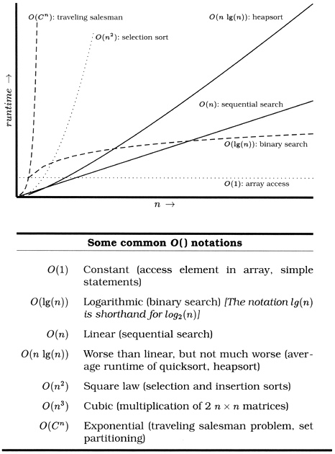
10.2 The Golden Rules of optimization
Good algorithms rule
The best and most important way of optimizing a program is using good algorithms
Worse than linear
But not much worse
Exponential
Square law
Linear
Logarithmic
Constant

Slide 8
10.2 The Golden Rules of optimization
Good algorithms rule
The best and most important way of optimizing a program is using good algorithms

Slide 9
10.2 The Golden Rules of optimization
Asymptotic complexity (时间复杂度) is not always an appropriate metric of efficiency
Low-level optimization

Slide 10
Optimizing Program Performance
10.1 Introduction of optimizing program
10.2 The Golden Rules of optimization
10.3 Optimizing compilers
10.4 Example of optimizing program
10.5 General optimization techniques [self study]

Slide 11
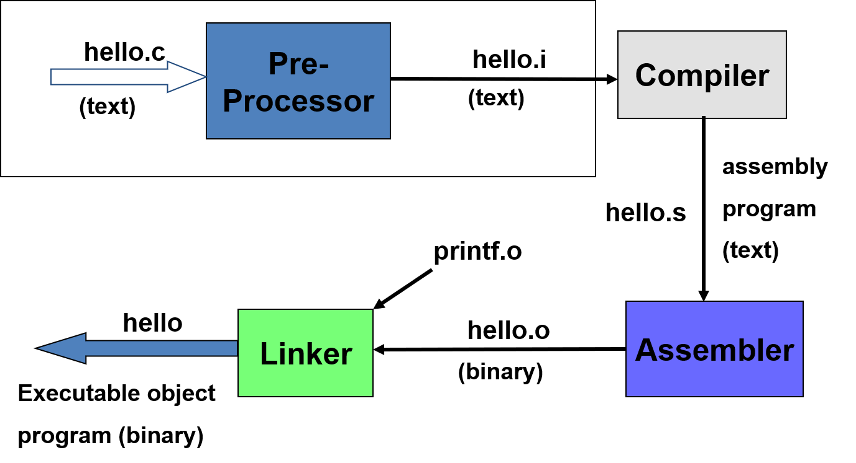
10.3 Optimizing compilers

Slide 12
10.3 Optimizing compilers
Capabilities of optimizing compilers
Provide efficient mapping of program to machine
Register allocation 寄存器分配
hello.i
Compiler
hello.o
(binary)
(text)
a
b
y
x
c

Slide 13
10.3 Optimizing compilers
Capabilities of optimizing compilers
Provide efficient mapping of program to machine
Code selection and ordering 编译器重排序
Eliminating minor inefficiencies
hello.i
Compiler
hello.o
(binary)
(text)
for (i=0; i<10; i++)
k = i;
for (i=0; i<10; i++);
k = i;
k = 10;

Slide 14
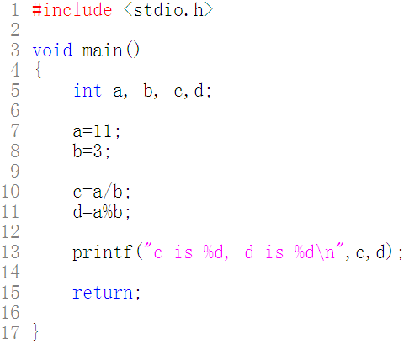
10.3 Optimizing compilers

Slide 15
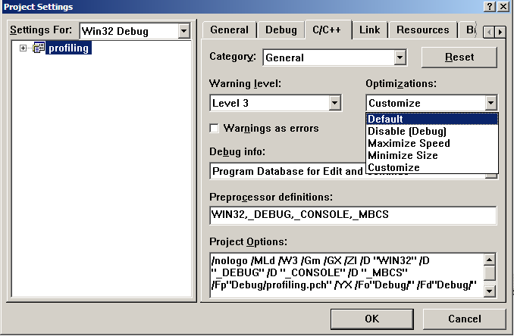
10.3 Optimizing compilers

Slide 16
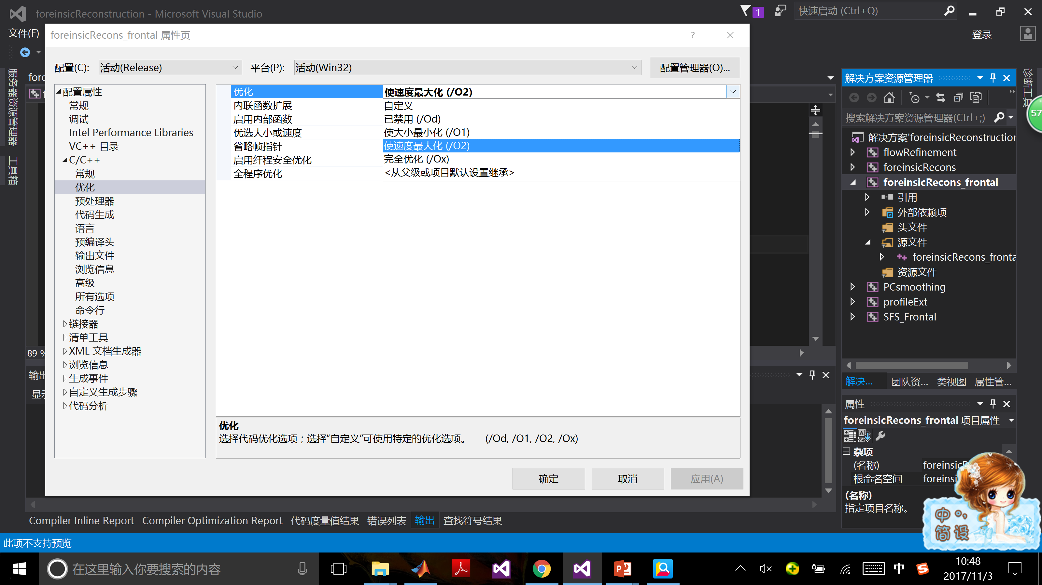
10.3 Optimizing compilers

Slide 17
10.3 Optimizing compilers
Limitation of optimizing compilers
Compilers have difficulty overcoming “optimization blockers(妨碍优化的因素)”
Potential memory aliasing
存储器别名使用
Potential procedure side-effects
函数副作用

Slide 18
10.3 Optimizing compilers
Memory aliasing
编译器必需假设不同的指针可能会指向存储器的同一位置，造成了妨碍优化的因素。
1 void twiddle1(int *xp, int *yp)
2 {
3 *xp += *yp;
4 *xp += *yp;
5 }
6
7 void twiddle2(int *xp, int *yp)
8 {
9 *xp += 2* *yp;
10 }
Q1: Which one is more efficient?
Q2：Does the twiddle1 have the same behavior as twiddle2?
Q3: If xp and yp are equal, what are the results?

Slide 19
10.3 Optimizing compilers
Procedure side-effects
编译器不会判断一个函数是否有副作用，它会假设最糟的情况，并保持所有的函数调用不变
1 int f(int);
2
3 int func1(x) {
4 return f(x) + f(x) + f(x) + f(x);
5 }
6
7 int func2(x) {
8 return 4*f(x);
9 }
Q1: Which one is efficient?
Q2: Do they have same result?
Q3: What are the results if the following code for f is:
1 int counter = 0;
2
3 int f(int x) {
4 return counter++;
5 }
f() will modify the global variable which causes side-effect.

Slide 20
Optimizing Program Performance
10.1 Introduction of optimizing program
10.2 The Golden Rules of optimization
10.3 Optimizing compilers
10.4 Example of optimizing program
10.5 General optimization techniques [self study]

Slide 21
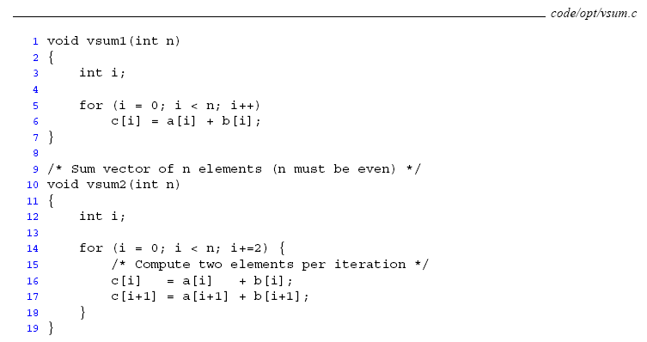
10.4 Example of optimizing program
Expressing program performance

Slide 22
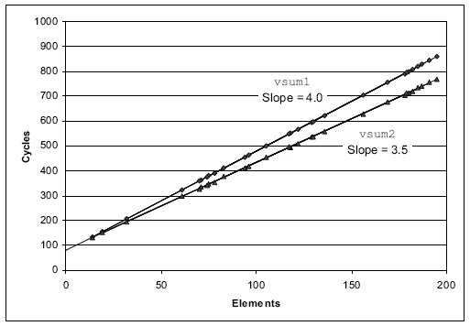
10.4 Example of optimizing program
vsum1: 80 + 4.0n
vsum2: 83.5 + 3.5n
Cycles Per Element (CPE)
每元素的周期数

Slide 23
10.4 Example of optimizing program
In this example, we will see a program of vector
Data structure
Some functions
combine() for optimization
combine1(): without optimization
combine2(): eliminating loop inefficiencies
combine3(): reducing procedure calls
combine4(): eliminating unneeded memory references

Slide 24
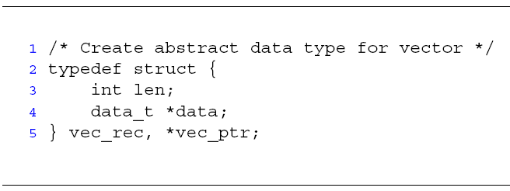
10.4 Example of optimizing program
length
0
1
2
length–1
data
• • •
Read the code in the folder of “vector code of csapp 5.3”

Slide 25
10.4 Example of optimizing program

Slide 26
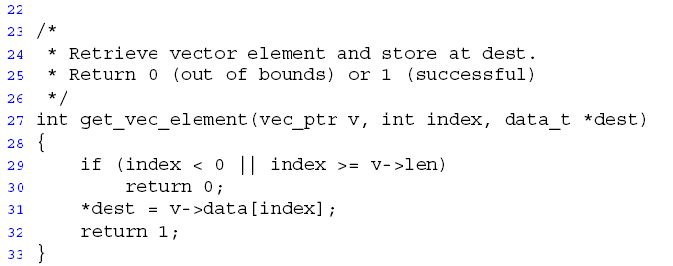
10.4 Example of optimizing program

Slide 27
10.4 Example of optimizing program
Function combine1()
Compute sum of all elements of v
Store result at destination location
void combine1(vec_ptr v, int *dest)
{
int i;
*dest = 0;
for (i = 0; i < vec_length(v); i++) {
int val;
get_vec_element(v, i, &val);
*dest += val;
}
}
CPE(每元素的周期数): 31.25

Slide 28
10.4 Example of optimizing program
Code motion / 代码移动
Move call to vec_length() out of inner loop
Value doesn’t change | Constant time
void combine2(vec_ptr v, int *dest) {
int i;
int length = vec_length(v);
*dest = 0;
for (i = 0; i < length; i++) {
int val;
get_vec_element(v, i, &val);
*dest += val;
}
}
CPE: 20.66

Slide 29
10.4 Example of optimizing program
Code motion example #2
Convert string to lower case
T(n) = O(n^2)
void lower1(char *s)
{
int i;
for (i = 0; i < strlen(s); i++)
if (s[i] >= 'A' && s[i] <= 'Z')
s[i] -= ('A' - 'a');
}
size_t strlen(const char* s) {
int length = 0;
while (*s != ‘\0’) {
s++; length++;
}
return length;
}

Slide 30
10.4 Example of optimizing program
Time quadruples (4倍) when double string length

Slide 31
10.4 Example of optimizing program
Move call to strlen outside of loop
Value doesn’t change
Code motion
void lower2(char *s) {
int i;
int len = strlen(s);
for (i = 0; i < len; i++)
if (s[i] >= 'A' && s[i] <= 'Z')
s[i] -= ('A' - 'a');
}

Slide 32
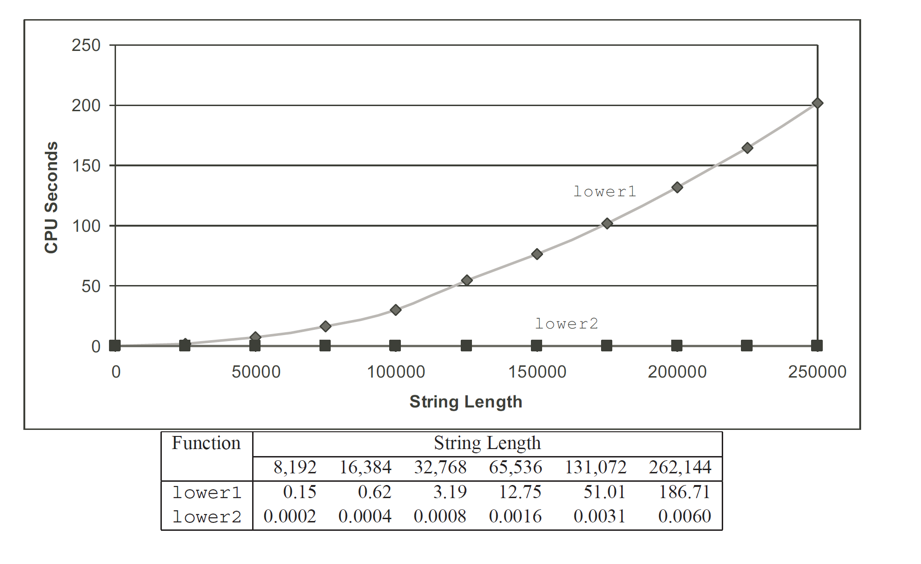
10.4 Example of optimizing program
Lower1() – time doubles when double string length
Lower2() – linear performance

Slide 33
10.4 Example of optimizing program
Reduction in procedure call / 减少过程调用
Procedure calls are expensive
void combine2(vec_ptr v, int *dest) {
int i;
int length = vec_length(v);
*dest = 0;
for (i = 0; i < length; i++) {
int val;
get_vec_element(v, i, &val);
*dest += val;
}
}
Avoid procedure call to retrieve each vector element
How?

Slide 34
10.4 Example of optimizing program
Reduction in procedure call / 减少过程调用
combine2()()Check boundary + assign
Get pointer to start of array before loop
Within loop just do pointer reference
for (i=0; i<length; i++) {
get_vec_element(v, i, &val);
… }
// data_t * start;
for (i=0; i<length; i++) {
val = start[i];
… }

Slide 35
10.4 Example of optimizing program
Reduction in procedure call / 减少过程调用
int* get_vec_start(vec_ptr v) {
return v->data;
}
void combine3(vec_ptr v, int *dest) {
int i;
int length = vec_length(v);
int *data = get_vec_start(v);
*dest = 0;
for (i = 0; i < length; i++) {
*dest += data[i];
}
CPE: 6.00
Drawback?
Not as clear in terms of data abstraction

Slide 36
10.4 Example of optimizing program
Overview *dest += data[i];
*dest += data[i];
00401159 8B 55 0C mov edx,dword ptr [ebp+0Ch] // edx = dest
0040115C 8B 02 mov eax,dword ptr [edx] // eax = [edx] = [dest]
0040115E 8B 4D FC mov ecx,dword ptr [ebp-4] // ecx = i
00401161 8B 55 F4 mov edx,dword ptr [ebp-0Ch] // edx = data
00401164 03 04 8A add eax,dword ptr [edx+ecx*4] // eax = eax + data[i]
00401167 8B 4D 0C mov ecx,dword ptr [ebp+0Ch] // ecx = dest
0040116A 89 01 mov dword ptr [ecx],eax // [ecx] = [dest] = eax

Slide 37
10.4 Example of optimizing program
Eliminate unneeded memory references / 消除不必要的存储器引用
Memory references are expensive
Avoid memory read/write
Local variable is held in register
Don’t need to store in destination until end
void combine4(vec_ptr v, int *dest) {
…
int sum = 0;
for (i = 0; i < length; i++)
sum += data[i];
*dest = sum;
}

Slide 38
10.4 Example of optimizing program
Eliminate unneeded memory references / 消除不必要的存储器引用
void combine4(vec_ptr v, int *dest) {
int i;
int length = vec_length(v);
int *data = get_vec_start(v);
int sum = 0;
for (i = 0; i < length; i++)
sum += data[i];
*dest = sum;
}
CPE: 2.00

Slide 39
10.4 Example of optimizing program
Assembly code after optimization
sum += data[i];
004011D7 8B 4D FC mov ecx,dword ptr [ebp-4] // ecx = i
004011DA 8B 55 F4 mov edx,dword ptr [ebp-0Ch] // edx = data
004011DD 8B 45 F0 mov eax,dword ptr [ebp-10h] // eax = sum
004011E0 03 04 8A add eax,dword ptr [edx+ecx*4] // eax = eax +data[i]
004011E3 89 45 F0 mov dword ptr [ebp-10h],eax // sum = eax

Slide 40
Optimizing Program Performance
10.1 Introduction of optimizing program
10.2 The Golden Rules of optimization
10.3 Optimizing compilers
10.4 Example of optimizing program
10.5 General optimization techniques [self study]

Slide 41
10.5 General optimization techniques
The clicking optimizations

Slide 42
10.5 General optimization techniques
The Clicking Optimizations
Faster Mathematics
Faster Loops
Avoiding Expression Repetitions
Using Assembly
Using register
Integers
Pointer Dereferencing
Avoiding Temporary Variables
String Comparisons
Pre vs. Post Increment/Decrement
Call by Value vs. Call by Reference
Don't Reallocate, But Reuse
Use switch() instead of if...else...
Early loop breaking
Other Suggestions

Slide 43
Summary
Attribute of a program
optimality
slowly but surely
short and sweet
efficiency
too little, too late
quick but dirty

