Slide 1
System Level Programming
Software College of SCU
四川大学软件学院 左航
Email: 2380588@qq.com
Notes:
Move to unit 4 and discuss some issues about Structured Data Representation.

Slide 2
Unit 4. Structured Data Representation
4.0 Review
4.1 Pointers
4.2 Array
4.3 String
4.4 Structure and Union
4.5 Alignment
201001V1.1
Notes:
Here are the topics today, with which you are already very familiar. All these topics have close relationship with memory.

Slide 3
4.0 Review (1/6)
Memory Address
  All data is stored in memory.
  Memory is a sequence of bytes that is numbered, starting with 0x. That number is the address.
    Think of memory as a single one-dimensional array
  In general, neither the name nor the type of the variables survive this translation done by compiler. (important)编译后无变量名和类型
0xffff ffff
0xffff fffe
0xffff fffd
0xffff fffc
0xffff fffb
……
0x0000 0002
0x0000 0001
0x0000 0000
201001V1.1
Notes:
The machine code that the CPU executes are identified only by their number. These numbers are called "addresses.“
Compilers take care of translating the operations our programs perform on variables into operations performed on addresses. In general, neither the name nor the type of the variables survive this translation.
当数据分布其上时，是不连续的

Slide 4
4.0 Review (2/6)
Are variables allocated consecutive on memory?
//Addresses.cpp
#include <stdio.h>
char globalchar1;
char globalchar2 = 'g';
int globalint1;
int globalint2 = 9;
char globalchar3;
int main (int argc, char * argv[ ])
{
char localchar1;
char localchar2 = 'l';;
int localint1;
int localint2 = 1;
char localchar3;
printf("Globals: '%c'(%d) '%c'(%d) %d %d '%c'(%d)\n",
globalchar1, globalchar1, globalchar2, globalchar2, globalint1, globalint2,
globalchar3, globalchar3);
printfLocals: '%c'(%d) '%c'(%d) %d %d '%c'(%d)\n",
localchar1, localchar1,
localchar2, localchar2,
localint1, localint2,
localchar3, localchar3);
return 0;
}
201001V1.1
Notes:
Variables’ Memory Allocation.
Global (access by all sub-routines)
Local (only to its routine)
(谭浩强书：生存期和作用域）

Slide 5
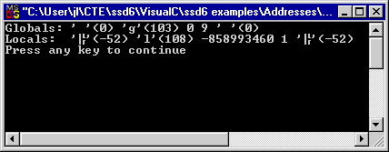
4.0 Review (3/6)
Why the Output:
  It would appear
    the uninitialized global variables seem to be somehow initialized to zero
    but that the same is not true of local variables.
The 2’s complement of -52 is 0XCC.
201001V1.1
Notes:
Now first focus on globals:
1.the first two outputs,a space character and an integer 0. come from the uninitialized character variable. And the result indicates the value of this variable is zero.
2. The following two outputs, a character g and an integer 103, come from the initialized character variable
3. The 0 here is the output of the uninitialized interger.
the output indicates that Read first line.
Move to the second line of locals:
1. the first two outputs,an unkown character and a negative integer -52. come from the uninitialized character variable.
2. The fifth one is the output of an uninitialized integer.
If we convert these negative numbers to hexadecimal, we will find that the content in those memory units are 0xCC. Why?
Let’s move to the disassembly window and see what have happened.
As mentioned in last week, when a new function is called, some space is allocated for it on stack, and with these four instructions, data 0xCC will be filled in. and that’s why we find negative integers or cc in those uninitialized memory units.
let's reach to the conclusion again. read lines.
we focus on another aspect of this program the addresses of variables. are these variables allocated consecutively on memory?

Slide 6
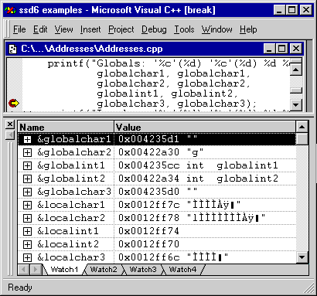
4.0 Review (4/6)
Pay attention to the addresses
201001V1.1
Notes:
First, pay attention to the addresses of initialized global variables whose name containing even numbers, now compare them with the addresses of the other three uninitialized variables. Are they stored in consecutive addresses? They aren’t, because the last four bytes of the addresses are different. Then focus on the addresses with red underlines. The addresses are not designated in the same order as in the declaration and two characters variables are compacted together.
When refer to the local variables the situation is totally different. All local variables are word aligned and allocated on memory in the same order as they are declared.

Slide 7
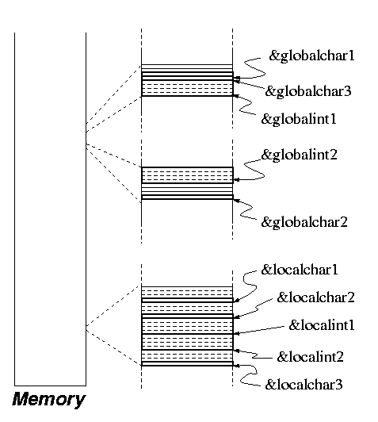
4.0 Review (5/6)
Global vs. Local Variables
  all the local variables are clustered together.
  of the global variables,
    those that are initialized when declared are in one cluster,
    those that are not initialized are in another.
High
uninitialized
initialized
Low
201001V1.1
201001V1.1
Notes:
Why has the compiler picked these addresses for these variables? Does the pattern reveal anything about how the compiler works? Is this pattern present in all programs?
Observe that the addresses are clustered in three groups, as shown in the figure.
Note that all the local variables are clustered together.
Note also that, of the global variables, those that are initialized when declared are in one cluster,
and that those that are not initialized are in another.
Generally, We can draw two conclusions. Here is the first one.
all the local variables are clustered together. Global variables are treated as two different clusters according to the initialization.

Slide 8
4.0 Review (6/6)
We can notice that ints take 4 bytes and that chars take only one.
  Because each byte of memory is independently addressable, one int will "use up" 4 addresses, whereas a char only needs one.
The compiler may choose to pack data less densely（密集地） than it might.
  You can see this in the figure, where it is obvious that out of some 4-byte blocks, only one of the bytes is used.
201001V1.1
Notes:
Here is the second conclusion we get. The compiler may choose to pack data less densely（密集地） than it might, and it differs in global variables and local variables.

Slide 9
Unit 4. Structured Data Representation
4.0 Review
4.1 Pointers
4.2 Array
4.3 String
4.4 Structure and Union
4.5 Alignment
201001V1.1

Slide 10
4.1 Pointers (1/16)
C gives the programmers the freedom to do just about anything.
  Using pointer
  It subverts（搅乱） the clean abstractions programming languages usually provide.
  Pointer variable (pointer): variable that holds an address
  int* intptr;
201001V1.1
Notes:
Originally, c is designed to develop an operating system. And pointer makes C more powerful in manipulating memory. By pointer, programmer can nearly do anything they want, but on the other side, it subverts the clean abstractions programming languages usually provide.

Slide 11
4.1 Pointers (2/16)
Pointers occupy 4 bytes on a 32-bit platform.
Pointer arithmetic operation
  ‘& ‘ takes the address of its operand.
  ‘*’ dereferences a pointer
201001V1.1
Notes:
The location where we store an address takes up 4 bytes on a 32-bit platform despite its type and the pointer itself have an address.

Slide 12
4.1 Pointers (3/16)
0xFFFFFFFF
Assignment:
char* p;
char c = ‘a’:
p = &c;
0x00
0x12
p
0xff
0x0012ff44
0x40
The statement
will indirectly rewrite the value of variable c from ‘a’ to ‘w’.
*
0x0012ff40
w
*p = ‘w’;
a
0x00000000
Address
Data
201001V1.1
Memory
Notes:
The location where we store an address takes up 4 bytes on a 32-bit platform despite its type and the pointer itself have an address.
We declare a char variable and a char pointer variable, then the by the address operator , p is set to point to c.
The first declaration statement makes the compiler allocate one byte and its address is 12345 here. The second declaration statement makes the compiler allocate four bytes for p and its address is 654321. You should notice that compiler will not automatically allocate memory for what the pointer points to.
P is redirected through the asterisk operator to variable c and rewrite the value from ‘a’ to ‘w’.
The asterisk is an operator that redirects the operation from the pointer variable to a data variable.

Slide 13
4.1 Pointers (4/16)
Notes:
  1. The declaration of a pointer makes the compiler allocate memory to hold the pointer's value (an address), but that the compiler will not automatically allocate memory for that which the pointer points to.
      p at 0x0012ff44, not the memory at 0x0012ff40.
  2. Through ‘&’ and ‘*’ operators, a C programmer can make two variable names refer to the same location in memory.
      An assignment to one of the variables will change the value of the other (important)
201001V1.1
Notes:
指针定义指令只是获得了4个字节用于存放指针的值，即指针指向的某个地址
指针定义指令不会附带分配指针指向的某个地址的内存空间

Slide 14
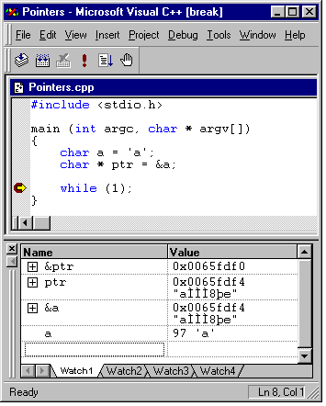
4.1 Pointers (5/16)
We will verify the memory allocation of variables in “watch” window of VC IDE using the following file.
变量x:它的内容；
表达式&x,x的地址
201001V1.1
Notes:
We can see the values and addresses of variable a and ptr in the watch window. And the address of prt is f0 and the content in it is the address of variable a. here comes one question.

Slide 15
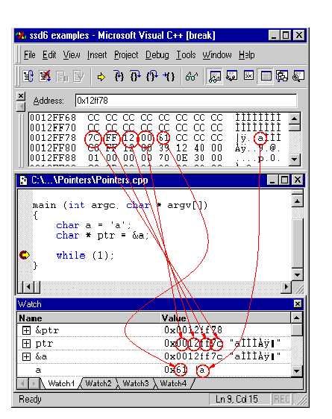
4.1 Pointers(11/16)
Little-endian byte ordering
Point to location 0x0012FF7C
Value is 0x61 = ‘a’
201001V1.1
Notes:
Byte ordering Meaning
big-endian The most significant byte is on the left end of a word.
little-endian The most significant byte is on the right end of a word.

Slide 16
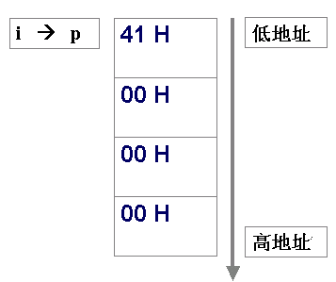
4.1 Pointers (7/16)
What if the data at 0x123456 is actually allocated as the result of a declaration like int Variable?
int i =0x41;
char* p;
p = (char *) &i;
0x123456
What is the value of *p?
201001V1.1
Notes:
Answer: 41h
Here are 3 statements and the question is what is the value of *p? The third assignment try to store the address of an integer variable into a character pointer throught a type casting. Since variable p is a character pointer, by dereferencing it we can only read one byte from the address it points to. And the value of *p is 41h.

Slide 17
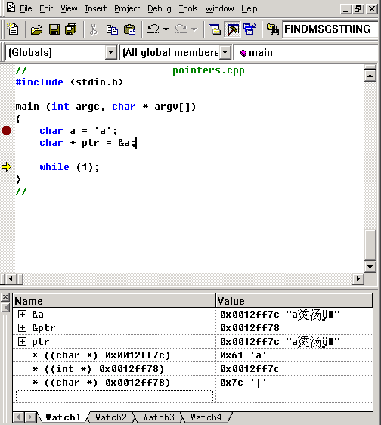
4.1 Pointers (8/16)
* ((char *) 0x0012ff7c)
* ((int *) 0x0012ff78)
* ((char*) 0x0012ff78)
201001V1.1
Notes:
Here are another 3 examples. In the first expression, the address 7c is cast to a character pointer and then dereferenced , the value of the expression is the content stored in the byte located by address 7c. By casting and dereference a pointer, we can read an integer as if it were a character, and four characters as if they were an integer.

Slide 18
4.1 Pointers (9/16)
“Read an integer as if it were a character“, is this possible at all?
  The answer is: Yes
  Reason: The real machine has no notion of integers or characters, it only knows about bits and bytes.
  Conclusion: you should already realize that a character can be read as an integer, and vice versa, because they are both represented with raw bits in the hardware.
201001V1.1
Notes:
Why is this possible, read… and that’s why encoding is important.

Slide 19
4.1 Pointers (10/16)
Encoding
  It dictates which bit sequence represents which integer, and which bit sequence represents which character.
  In other word, Encoding specifies the mapping of values to bit patterns, but it also specifies how many bits a particular type requires.
  It depends on the computer and the encodings we use .
The compiler does this job and takes care of these details for us.
201001V1.1
Notes:
1）
2）
3）

Slide 20
4.1 Pointers (11/16)
Pointer Arithmetic
  Integers can be added to or subtracted from pointers using the operators +, -, +=, -=, ++and --
  One pointer can be subtracted from another by using the subtraction operator –
  By adding n, we get a value in memory location n elements away.
    语法含义的一致性：下一个/上一个元素
    编译器进行翻译,具体偏移多少：指针类型相关
      原因：compiler能够得到指针类型的信息
201001V1.1
Notes:
When n is added to a pointer, then the compiler computes the offset by multiplying n by the size of the type the pointer pointing and then adding the offset to the value of the pointer.

Slide 21
4.1 Pointers (12/16)
start = (int)(*(((char *) &dummy)));
stride = (int)(*(((char *) &dummy) + 1));
0x12ff77 | 0x01
0x12ff76 | 0x02
0x12ff75 | 0x03
0x12ff74 | 0x04
int dummy
201001V1.1
Notes:
This piece of codes are taken from practice 3 in our decoding lab. Suppose dummy is an integer variable, and by casting and dereference its address, we read the content in the byte located by 74. then we convert the value we just read from char to int and assign it to an integer variable start. Now the value of start is 4.
In the second assignment expression, after type casting, the address is added by 1, and increased to 75. read one byte from this address, that is 3 and assign ti to stride. After these two statements are executed, start is 4 and stride is 3.

Slide 22
4.1 Pointers (13/16)
int key1,key2;
process_keys12(&key1, &key2);
void process_keys12 (int * pkey1, int * pkey2)
{
*((int *) (pkey1 + *pkey1)) = *pkey2;
}
0
0
0
3
key1 | 0
 | 0
 | 0
 | 2
key2 | 0
 | 0
 | 0
 | 3
0x0012ff70
201001V1.1
Notes:
This piece of codes are taken from the same program. We call a function in The third line and pass two addresses of integers. We can see in the function parameter list, two addresses are received and saved in two pointers. Note the statement in the body, what’s its function?
The value of right expression of the assignment is the value stored in key2, which is 3.
The operand on the left part is more complex. First dereference pointer pkey1, and we get the value in key1, which is 2. add 2 to the address held in pkey1 and the address will be increased to 12ff78, since each integer takes up 4 bytes. Then store the value of key2 to the four bytes pointed by 12ff78.
This program actually illustrate how to access adjacent memory units through the address of a local variable.

Slide 23
4.1 Pointers (14/16)
Advantages
  You can do almost anything with them
    Pointers allow you to implement sharing without copying i.e. pass by reference vs. pass by copying
    Pointers allow us to use dynamic memory allocation
Disadvantages
  You can do almost anything with them.
    You must manage all the memory
201001V1.1
Notes:
If you love him, send him to New York, cause it’s the heaven.
If you hate him, send him to New York, cause it’s the hell.

Slide 24
4.1 Pointer (15/16)
Function Pointer
  An Example
    void (*foo)(int);
    To declare a pointer to function, we code it as if it were a prototype definition, with the function pointer in parentheses.
  Explanation
    In this example, foo is a pointer to a function taking one argument, an integer, and returning void.
    It's as if you're declaring a function called "*foo", which takes an int and returns void; now, if *foo is a function, then foo must be a pointer to a function.
201001V1.1
Notes:
Since Functions in a program occupy memory, we can define pointers to function variables and store their addresses. Read.

Slide 25
4.1 Pointer (16/16)
Using a Function Pointer
#include <stdio.h>
void my_int_func(int x) {
printf( "%d\n", x );
}
int main() {
void (*foo)(int);
foo = &my_int_func;
/*call my_int_func (note that you do not need to write (*foo)(2) ) */
foo( 2 );
/* but if you want to, you may */
(*foo)( 2 );
return 0;
}
201001V1.1
Notes:
Here is an example of how to call function by points. We have two options. The first option is call by the pointer directly with the actual parameter in parentheses. And the second option is to call by dereferencing the pointer.

Slide 26
Unit 4. Structured Data Representation
4.0 Review
4.1 Pointers
4.2 Array
4.3 String
4.4 Structure and Union
4.5 Alignment
201001V1.1

Slide 27
4.2 Arrays(1/12)
0xffff ffff
0x0012 ffff 0x0012 fffe 0x0012 fffd 0x0012 fffc | a
0x0012 fffb 0x0012 fffa 0x0012 fff9 0x0012 fff8 | Myarray[2]
0x0012 fff7 0x0012 fff6 0x0012 fff5 0x0012 fff4 | Myarray[1]
0x0012 fff3.. 0x0012 fff0 | Myarray[0]
0x0012 ffef.. 0x0012 ffec | f
……
0x0000 0001
0x0000 0000
Examples：
  The compiler arranges array elements adjacent to one another in memory in increasing order
  int a;
  int myarray[3];
  float f;
low
high
201001V1.1
Notes:
Consider an array of integers in this picture, where each integer is a 4-byte word: int myarray[5];
if the address of myarray is 1000, then the address of myarray[0] is also 1000, the address of myarray[1] is 1004, the address of myarray[2] is 1008, and the address of myarray[n] is 1000 + 4 * n, for any value of n.

Slide 28
4.2 Arrays(2/12)
Array VS Pointer：An array in C and C++ is ordinarily synonymous(同义的 ) with a pointer to the first element of the array
  myarray + N = &(myarray[N])
  myarray[N] = *(myarray + N)
Pointer’s Bound check : none
201001V1.1
Notes:
So these two expressions are equivalents in representing the address of element N. and these two are equivalents in representing the value of element n, for any value of n.
C and C++ do not check whether an array index is out of bounds. In fact, the array bounds are not stored anywhere in memory, so there is not even enough information to check whether an index is out of bounds.

Slide 29
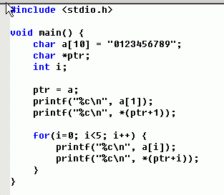
4.2 Arrays(3/12)
Quiz 2.1-1
201001V1.1
Notes:
Here is an program to verify that these two expressions work the same way in accessing each element of an array.

Slide 30
4.2 Arrays(5/12)
intArray + 7
charArray + 7
7*4=28 bytes
7 bytes
intArray
charArray
char charArray[10]
int intArray[10]
201001V1.1
Notes:
Consider these two arrays with different data types, even the same numbers are added to the addresses of the array, the offsets are different.
Each element in chararray takes up 1 byte, the offset is 7. Each element in intarray takes up 4 bytes, so the offset is 28 as a result of multiplying 4 to 7.
Then after the addition, the address of chararray will be increased by 7, and after the the address of intarray will be increased by 28

Slide 31
4.2 Arrays(6/12)
What’s the output of the following program?
main()
{
int a[5]={1,2,3,4,5};
int *ptr=(int *)(&a+1);
printf(“%d,%d”,*(a+1),*(ptr-1));
}
&a and a are different in meaning, but same in value
output：2,5
&a+1, 1*size of a
201001V1.1
Notes:
汇编码上查看结果就是&A+1已经在编译过程中直接按-20折算了地址，没有具体折算过程
&a是数组指针，其类型为 int (*)[5];
而指针加1要根据指针类型加上一定的值，不同类型的指针+1之后增加的大小不同。
a是长度为5的int数组指针，所以要加 5*sizeof(int)
所以ptr实际是a[5]
但是prt与(&a+1)类型是不一样的(这点很重要)
所以prt-1只会减去sizeof(int*)
a,&a的地址是一样的，但意思不一样
a是数组首地址，也就是a[0]的地址，&a是对象（数组）首地址，
a+1是数组下一元素的地址，即a[1],&a+1是下一个对象的地址，即a[5].

Slide 32
4.2 Arrays(7/12)
Arrays of Multi-Byte Types
int intArray[10]
0
0
0
0
intArray[2] = 3
0
3
0
intArray[1] = 2
0
0
2
0
0
intArray[0] = 1
0
intArray = 0x00123456
1
(int *)((char *)intArray + 7);
201001V1.1
Notes:
Here is an other example, we cast the intarray to a char pointer and increase it by 7. then we cast the pointer again from char to int pointer and now it points to this new location. if we dereference the address we will read these four bytes from memory.

Slide 33
4.2 Arrays(8/12)
char array vs int array in alignment
#include <stdio.h>
void main()
{
int nfirstint = 0;
char carr[10]="hello";
int narr[10]={0,1,2,3,4};
while(1);
}
nfirstint | 0x0012ff7c
…padding | 2 bytes
carr[9] | 0x0012ff79
….
carr[1] | 0x0012ff71
carr[0] | 0x0012ff70
narr[9] | 0x0012ff6c
….
narr[1] | 0x0012ff4c
narr[0] | 0x0012ff48
201001V1.1
Notes:
Here is the alignment issue about arrays. Here we define two arrays and the addresses of each element is on the table. It’s easy to find that the arrays are also word aligned, and we get 2 bytes padding here, since the character array only takes up 10 bytes.

Slide 34
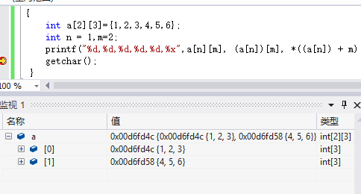
4.2 Arrays(9/12)
2-Dimensional Array
  E.g. long a[2][3];
  This declares an array with 2 elements, each of which is an array of 3 elements, so it looks like this in memory:
a[n][m] == (a[n])[m] == *((a[n]) + m) ?= *((a + n*3) + m)
    In this example, 3 is the number of elements in a single row of the two-dimensional array.
a[0][0]
a[0][1]
a[0][2]
a[1][0]
a[1][1]
a[1][2]
！=
201001V1.1
Notes:
Let’s move to the 2-dimensional array. This statement declares …read. And a two-dimensional array in c is an array of one-dimensional arrays. And the first three expressions are equivalents.
代码见文件夹demo, a +n,这里的n已经是指n个一行了，也就是3*sizeof（int）=12，所以当n=1,m=2时，我们得到的是a的地址增加60（即（1*3+2）*sizeof（int））；
a+1和*（a+1）的值相同，但含义不同，*（a+1）根据下一页ppt的理解，已经是对应元素了，这时*(a+1)+n的n指加上n个整型，而a+1+n，依然加上n行。
注意&a[0]和a[0]的值一样，所以*((a + n*3) + m)和(a + n*3) + m的值一样

Slide 35
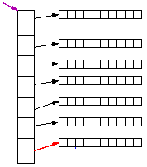

4.2 Arrays(10/12)
Multi-Dimensional Arrays – pointer of pointer
0
array2[6][2]
= *(*(array2 + 6) +2)
= ‘a’
1
2
3
4
5
6
0
1
2
201001V1.1
Notes:
The name of the array is a pointer constant to the first element of the array. In this case however, the first element is another array.
When we dereference the array name, we don’t get one integer, we get an array of integers. In other words, the dereference of the array name of a two-dimensional array is a pointer to a one-dimensional array. If we want to get the pointer to the seventh one-dimensional array, we should dereference the array name plus 6 as a whole. further more, in order to get the third element in the seventh one-dimensional array, we should add 2 to the first dereference expression, and dereference them as a whole again. Ok this complex pointer notation is equivalent to the index syntax arra2[6][2].

Slide 36
4.2 Arrays(11/12)
int md[3][4];
for (int i = 0; i < 3; i++)
for (int j = 0; j < 4; j++)
*(md + i*4 + j) = 0;//compiler error：left operand must be l-value (convert int to int[3])
    i=0,j= 0, *md =0;
for (int i = 0; i < 3; i++)
for (int j = 0; j < 4; j++)
*(*(md+ i) + j) = 0;//right
201001V1.1
Notes:
This expression will cause a compiler error which says the left operand must be l-value. Why? Let’s Assume i and j are both equal to 0, so the offset is 0. the dereference of the array name of a two-dimensional array is a pointer to a one-dimensional array. And the address of one-dimensional array is allocated by the compiler, which means it is a constant value and can not be changed. So the intention to alter it will cause an compiler error. An lvalue expression is used to receiving a value and the rvalue expression used to supply a value.
Md是一个指针数组，数组的每个元素是一个一维数组的地址，这个地址是静态值，由编译器分配，语法上不允许对其进行修改。可以通过强制类型转换或者2次反应用来纠正。

Slide 37
4.2 Arrays(12/12)
Expression of 2-D Array
for (int i = 0; i < 3; i++)
for (int j = 0; j < 4; j++)
md[i][j] = 0;
for (int i = 0; i < 3; i++)
for (int j = 0; j < 4; j++)
*((int*)(md) + i*4 + j) = 0;
201001V1.1
Notes:
Let’s Assume i and j are both equal to 0 too.
In the second statements, we cast the array name, md, to an integer pointer. by doing so, we treat md as an one-dimensional array, and the dereference of an array name of a one-dimensional array is the first element of the array. So this expression is correct.
store 0 into the element. (int*)强制将一个指针数组的地址转换为整型变量的指针，这样才可以访问变量，下页中由于没有做这个转换就导致错误

Slide 38
Unit 4. Structured Data Representation
4.0 Review
4.1 Pointers
4.2 Array
4.3 String
4.4 Structure and Union
4.5 Alignment
201001V1.1

Slide 39
4.3 String(1/12)
In C, there is no string type.
A string is an array of chars terminated by the character `\0' (also known as the null character)
Standard string library:
  char *strcat (char *dest, char *src)
  char *strcpy( char *dest, char *src );
  int strcmp(char *string1, char *string2 );
  int strlen (char *s)
  char *strchr (char *s, char c)
  …
201001V1.1

Slide 40
4.3 String(2/12)
char* strchr(char* str,char ch);
function: 找出str指向的字符串中第一次出现字符ch的位置
return value: 返回指向该位置的指针,如找不到,则返回空指针
arguments: str-待搜索的字符串，ch-查找的字符
When ch means space key
  There is a program called strchr.cpp which can do the work of taking some input and breaking it down into words . (根据空格来分割字符串成一系列单词 )
201001V1.1
Notes:
1）
2）
3）

Slide 41
4.3 String(3/12)
An array of character is terminated by a null character (0x00)
char a[4] = “Hi?”;
a[0] = H;
a[1] = I;
a[2] =?;
a[3] = 0x00
Incorrect declaration:
char a[3] = “Hi?”;
as 0x00 is missing
201001V1.1

Slide 42
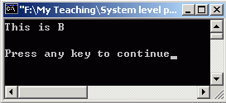
4.3 String(4/12)
// Demonstrate ArrayStorage.cpp
#include <stdio.h>
void Initialize (char * a, char * b) {
a[0] = 'T'; a[1] = 'h'; a[2] = 'i';
a[3] = 's'; a[4] = ' '; a[5] = 'i'; a[6] = 's';
a[7] = ' '; a[8] = 'A'; a[9] = '\0';
b = a;
b[8] = 'B';
}
#define ARRAY_SIZE 10
char a[ARRAY_SIZE];
char b[ARRAY_SIZE];
int main(int argc, char * argv[]) {
Initialize(a, b);
printf("%s\n%s\n", a, b);
return 0;
}
201001V1.1
Notes:
Read the program and analyze why the output of string b is empty. After we assign the value of a to b, these two pointers point to the same memory location. So b[8] and a[8] represent the same element of the array. That’s why the output of array a is “this is B”.

Slide 43
4.3 String(5/12)
address | Global Varaibles
Addr of a 0x00402000
Addr of b 0x0040200C
mem segment
address | Value of Paras (function Initialize )
Addr of a 0x0012ff20 | 0x00402000
Addr of b 0x0012ff24 | 0x0040200c
mem segment
This is A
This is B
0x00402000
201001V1.1

Slide 44
Quiz2.1-2
Quiz2.1-3
Quiz2.1-3
201001V1.1

Slide 45
4.3 String(9/12)
#include <stdio.h>
#include <stdlib.h>
void getmemory(char *p)
{
p=(char *) malloc(100);
strcpy(p,”hello world”);
}
int main( )
{
char *str=NULL;
getmemory(str);
printf(“%s/n”,str);
free(str);
return 0;
}
201001V1.1
Notes:
VS2012未崩溃。

Slide 46
4.3 String(10/12)
address |  | value
0030FF10 | str | NULL
0030F110 | p
003F000
栈
NULL
003F000
堆
H
e
llo world…
201001V1.1

Slide 47
4.3 String(11/12)
What’s the output of following program?
void GetMemory(char **p,int num)
{ *p=(char *)malloc(num); }
int main()
{
char *str=NULL;
GetMemory(&str,100);
strcpy(str,”hello”);
free(str);
if(str!=NULL)
strcpy(str,”world”);
printf(“\n str is %s”,str);
}
str is world
201001V1.1
Notes:
VS2012未崩溃。

Slide 48
4.3 String(12/12)
address |  | value
0030FF10 | str | NULL
0030F110 | p
003F000
*P ---003F000
栈
0030FF10
堆
H
e
llo world…
201001V1.1

Slide 49
Unit 4. Structured Data Representation
4.0 Review
4.1 Pointers
4.2 Array
4.3 String
4.4 Structure and Union
4.5 Alignment
201001V1.1

Slide 50
4.4 Structure and Union (1/7)
Structures(Records) store a collection of arbitrary elements that are accessed by name
  结构体:数据的组合
Records are declared using the struct keyword in C or C++
201001V1.1

Slide 51
4.4 Structure and Union (2/7)
Defining new Types
typedef struct person_tag
{
int alter;
char *name;
struct person_tag *next;
} person_typ;
person_typ v1, v2, v3;
… and later:
v1.alter = 26;
Now we need not to specifiy “struct” all the time when defining variables.
We can also directly define types which are pointers to structs.
201001V1.1
Notes:
We can also use key word “typedet” to define an equivalent to the structure. Now we need …read item 1.

Slide 52
4.4 Structure and Union (3/7)
Memory Layout of Structs
  RULE 1:
    The alignment of a struct is the same as the largest alignment of its elements
  RULE 2:
    The size of a struct is a multiple of its alignment
typedef struct algntest
{
char a,b;
double d;
int i;
}as;
sizeof(as)
24
Vs2017 x86，x64 一样
201001V1.1
Notes:
Here are rules about structure alignment.
CPU+OS+IDE，有些资料说32位下是20位，但是在vs2017的x86，X64下均为24.

Slide 53
4.4 Structure and Union (4/7)
Union联合体 is a data structure which represents only one of the component in the declaration.
  The memory allocated for a union variable is determined by the largest component in the union.
Compared with struct
  struct S{
char c;
int i[2];//int i; --size16
double v;
};
union U{
char c;
int i[2];
double v;
};
Type | &c &i &v | Sizeof
Struct | 0 4 0（16） | 24
Union | 0 0 0 | 8
201001V1.1
Notes:
V 的地址是在i的后续增加，并按8对齐，如果i是4567,89ab，v不会在c上，而是到10上对齐
Read
Here is the comparison of memory allocation between structure and union. These two definitions consist the same components, but the sizeof structure is 20 bytes, since each member variable is aligned by word. And the sizeof of union is 8 which is exactly the size of the largest component in it.

Slide 54
4.4 Structure and Union (5/7)
E.g.,
  This hair contains either the wears_wig component or the color component but not both.
  The memory content of the union variable hair depends on which component is referenced.
typedef union{
int wears_wig;
char color[20];
} hair_t;
hait_t hair；
201001V1.1
Notes:
Here we define a union and name it hair_t. The size of this union is 20 bytes, read.

Slide 55
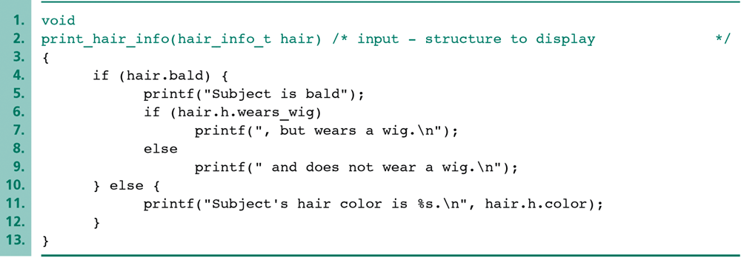
4.4 Structure and Union (6/7)
A Function Using a Union Structure
typedef struct {
int bald;
hair_t h;
} hair_info_t;
hair_info_t hair；
Use the wears_wig component.
Use the color component.
201001V1.1
Notes:
Here is an example about using union and structure. We define a structure who contains a union as its component.
We use the two –way selection, if…else statement, to print the information of somebody’s hair. If the someone is bald, the wears_wig component is active and can be referenced, otherwise, the color component is active and referenced, but not both.

Slide 56
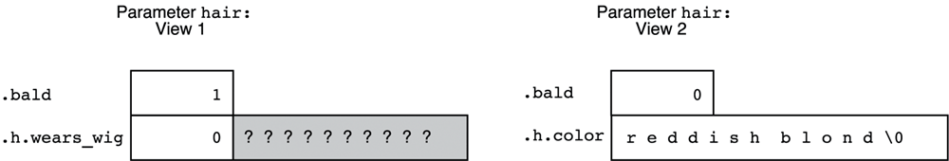
4.4 Structure and Union (7/7)
Referencing the correct union component is the programmer’s responsibility.
The wears_wig component is referenced.
The color component is referenced.
201001V1.1
Notes:
The memory units of a union variable is taken up by either one of the component at a time during execution.
Remember that …

Slide 57
Unit 4. Structured Data Representation
4.0 Review
4.1 Pointers
4.2 Array
4.3 String
4.4 Structure and Union
4.5 Alignment
201001V1.1

Slide 58
4.5 Alignment(1/7)
What is Alignment ?
  compilers often try to align data to word boundaries or even double-word boundaries
  Padding
    some inserted meaningless bytes between the end of the last data structure and the start of the next
  The same to stack and heap
Why
  increases the system's performance due to the way the CPU handles memory.
201001V1.1

Slide 59
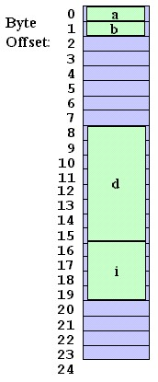
4.5 Alignment(2/7)
Example Struct Memory Layout
You can see a few bytes are missing between b and d
struct mystruct {
char a, b;
double d;
int i;
};
201001V1.1
Notes:
This is an example of Structure memory layout. the compiler is trying to place the 8-byte member d on a boundary that is a multiple of eight bytes. So read

Slide 60
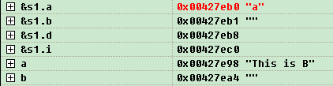
4.5 Alignment(3/7)
struct S{
char a, b;
double d;
int i;
}s1;
#define ARRAY_SIZE 10
char a[ARRAY_SIZE];
char b[ARRAY_SIZE];
201001V1.1
Notes:
VS2012Release d下对齐8,debug下d没有对齐
This is a picture of the watch window, and you can verify the memory layout of structure component and global variable. You can find padding in both cases.

Slide 61
4.5 Alignment(4/7)
Why "wasting" space?
  access to multiple-byte data like d is faster if the data is aligned on natural hardware boundaries
Alignment的两个表现: (x86 as example)
  struct itself will start on maximum of ( an 4-byte boundary or size boundary of its largest component)
    通常为4或者是比4大的成员的size，比如有double时为8；
  the structure must have a length that is a multiple of the size of its largest component
201001V1.1
Notes:
Demo中有演示程序，改变结构体中变量定义顺序，先大尺寸再小尺寸就可以缩小size
只含3个char的结构体cs，size是3
typedef struct algntest
{double d;char a,b;int i;char c;}as; 在debug占4个8byte，但在release无论是否优化下占2个8byte

Slide 62
4.5 Alignment(5/7)
typedef struct algntestc
{
//int i;
//double d;
char a, b;
char c;
}cs;
sizeof(cs): 3, 8, 16
//只有char，则size是3；只有char+int，size是8；只有char+double，size是16
201001V1.1
Notes:
Demo中有演示程序，改变结构体中变量定义顺序，先大尺寸再小尺寸就可以缩小size
只含3个char的结构体cs，size是3
typedef struct algntest
{double d;char a,b;int i;char c;}as; 在debug占4个8byte，但在release无论是否优化下占2个8byte

Slide 63
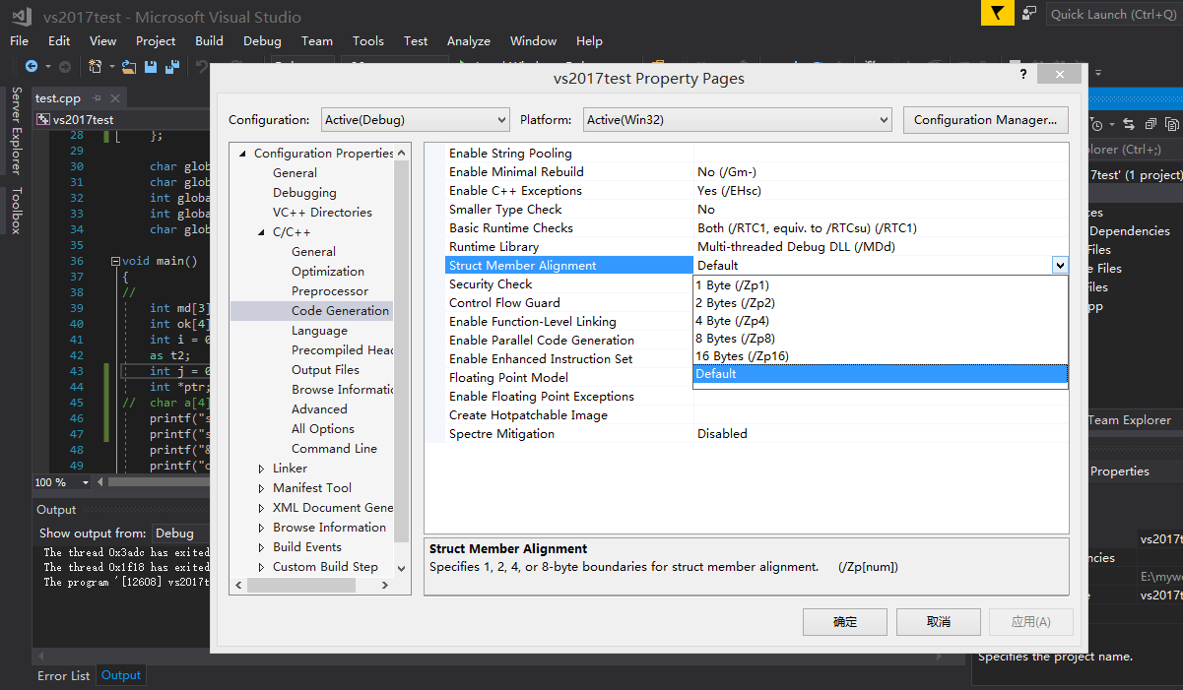
4.5 Alignment(6/7)
Alignment Issue with Visual C++
  Need “Rebuild All”
201001V1.1
Notes:
You can even specify how the compiler should align data in Visual C++'s Project Settings under the Compiler Code Generation dialog box:
Here, the alignment is set to 1 Byte, which means the compiler will packs the fields in the struct with no padding, resulting in a struct of length 14 bytes rather than 24.

Slide 64
4.5 Alignment(7/7)
After recofiguration in release version
struct S{
char a, b;
double d;
int i;
}s1;
#define ARRAY_SIZE 10
char a[ARRAY_SIZE];
char b[ARRAY_SIZE];
int main(int argc, char * argv[])
{
printf("%x %x %x %x %x %x",&s1.a,&s1.b,&s1.d,&s1.i,a,b);
}
Debug version won’t
be effected.
201001V1.1
Notes:
This setting only works in release version. As you can see on the console output, the member of the structure is one-byte aligned and the global variable still word aligned, since the setting only has effect on structure members.
A距s.a 有12个字节，b距a12个字节

