Slide 1
System Level Programming
Software College of SCU
四川大学软件学院 左航
Email: hangz2007@hotmail.com
Course website: http://swjx.scu.edu.cn/moodle/

Slide 2
Unit 6. Memory Layout and Allocation
6.1 Several Uses of Memory
6.2 Memory Bugs
6.3 Garbage Collection
201001V1.1

Slide 3
6.1 Several Uses of Memory
SSD6 3.1
6.1.1 Memory Management
6.1.2 Static Allocation
6.1.3 Dynamic Allocation
6.1.4 Memory Allocation Algorithm
  CSAPP9.9
6.1.5 Program Memory Layout
201001V1.1

Slide 4
6.1.1 Memory Management(1/1)
Variable lifetimes correspond to one of three memory allocation mechanisms:
  Static: Absolute address retained throughout program’s execution
  Stack: Allocated & deallocated in last-in, first-out order, with function calls and returns
  Heap: Allocated and deallocated at arbitrary times according to user’s requirements.
Stack and heap is used for dynamic allocation
201001V1.1

Slide 5
6.1 Several Uses of Memory
6.1.1 Memory Management
6.1.2 Static Allocation
6.1.3 Dynamic Allocation
6.1.4 Memory Allocation Algorithm
6.1.5 Program Memory Layout
201001V1.1

Slide 6
6.1.2 Static Allocation(1/13)
The word static refers to things that happen at compile time and link time when the program is constructed. (not load or execute)
For example, you can define a global variable
char a[9] =“12345678”; //assign 9 bytes for array a
The compiler will assign 9 bytes during compilation.
  cannot change while running.
  only changed when modifying source code.
201001V1.1

Slide 7
6.1.2 Static Allocation(2/13)
Static Allocation of Variables
  all global variables, regardless of whether or not they have been declared as static;
  local variables explicitly declared to be static.
  explicit constants (including strings, sets, etc)
201001V1.1

Slide 8
6.1.2 Static Allocation(3/13)
Statically allocated variables have their storage allocated and initialized before main starts running and are not deallocated until main has terminated.
Statically allocated local variables are only visible within the function in which they are declared, but they are not re-initialized on every call to the function .
201001V1.1

Slide 9
6.1.2 Static Allocation(4/13)
int my_var[128]; // a statically allocated variable
static bool my_var_initialized = false; //static declaration
int my_fn(int x) {
static int a = 5; // static local variable
if (my_var_initialized) return;
my_var_initialized = true;
for (int i = 0; i < 128; i++)
my_var[i] = 0;
}
functions declared in other files cannot access my_var_initialized
variable a is statically allocated and only visible within the function
201001V1.1

Slide 10
6.1.2 Static Allocation(5/13)
The following program has three different kinds of statically allocated variable.
The program is built from three source files. There is a header file ...
/* foo.h */
void foo(void);
201001V1.1

Slide 11
6.1.2 Static Allocation(6/13)
/* foo.c */
#include <stdio.h>
#include "foo.h“
/* Tell compiler evil_glob is defined in another .c file. */
extern int evil_glob;
void foo(void) {
int on_stack = 100;
static int not_on_stack = 200;
evil_glob--;
on_stack++;
not_on_stack++;
printf("In foo ...\n");
printf(" value of on_stack: %d\n", on_stack);
printf(" value of not_on_stack: %d\n", not_on_stack); }
201001V1.1

Slide 12
6.1.2 Static Allocation(7/13)
/* main.c */
#include <stdio.h>
#include "foo.h"
int evil_glob = 999; /* accessible from all .c files */
static int good_glob = 333; /* private to this .c file */
int main(void) {
evil_glob--;
good_glob++;
foo();
foo();
printf("At end, evil_glob is %d and good_glob is %d.\n",
evil_glob, good_glob);
return 0;
}
201001V1.1

Slide 13
6.1.2 Static Allocation(8/13)
Result
In foo ...
value of on_stack: 101
value of not_on_stack: 201
In foo ...
value of on_stack: 101
value of not_on_stack: 202
At end, evil_glob is 996 and good_glob is 334.
201001V1.1

Slide 14
6.1.2 Static Allocation(9/13)
String constants (except those used as initializers for variables of type array of char) are statically allocated.
In most expressions a string constant generates a pointer to the first char in the string
#include <stdio.h>
int main(void) {
char s[] = "cat";
const char *p = "rat";
printf("%s chases %s\n", s, p); //num of para for printf
return 0;
}
201001V1.1
Notes:
C99编译器要求加const

Slide 15
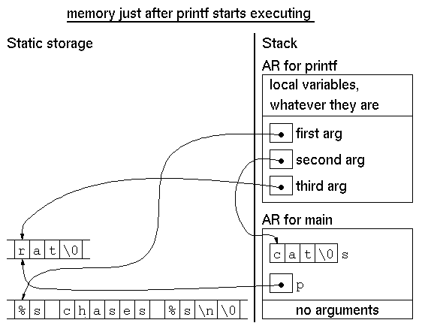
6.1.2 Static Allocation(10/13)
201001V1.1
Notes:
AR: active record

Slide 16
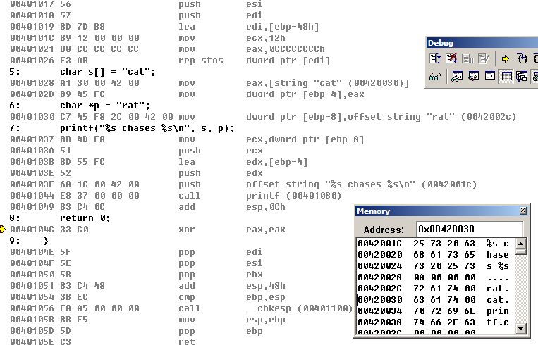
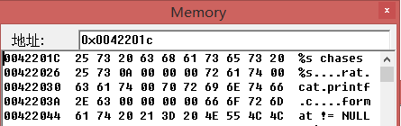
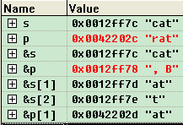
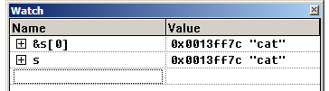
6.1.2 Static Allocation(11/13)
201001V1.1
Notes:
注意图片上的地址有差异，非一次运行内容

Slide 17
6.1.2 Static Allocation(12/13)
Limitations of static allocation
  Naming gets to be a problem
  Not fit for run time memory allocation
    E.g. memory allocate according to user input
    Recursive procedures递归 are impossible.
  Static allocation reserves memory for the duration of the program, but only used temporarily.
201001V1.1

Slide 18
6.1.2 Static Allocation(13/13)
int a=1;
int b=2;
int *p1;
int *const p2=&a;
const int *p3=&b;
const int* const p4=NULL;
p1=&a;*p1=2;
p1=&b;*p1=3;
p2=&b;//compiler error
*p2=5;
p3=&a;
*p3=5;//compiler error
*p4=5;//compiler error
p4=&b; //compiler error
201001V1.1

Slide 19
6.1 Several Uses of Memory
6.1.1 Memory Management
6.1.2 Static Allocation
6.1.3 Dynamic Allocation
6.1.4 Memory Allocation Algorithm
6.1.5 Program Memory Layout
201001V1.1

Slide 20
6.1.3 Dynamic Allocation
6.1.3.1 Dynamic Memory Allocation Concept
6.1.3.2 Stack Allocation
6.1.3.3 Heap Allocation
201001V1.1

Slide 21
6.1.3.1 Dynamic Memory Allocation Concept(1/1)
Dynamic memory allocation is the allocation of memory storage during the runtime of program.
  This is in contrast to static memory allocation, which has a fixed duration.
201001V1.1

Slide 22
6.1.3 Dynamic Allocation
6.1.3.1 Dynamic Memory Allocation Concept
6.1.3.2 Stack Allocation
6.1.3.3 Heap Allocation
201001V1.1

Slide 23
6.1.3.2 Stack Allocation(1/10)
It is the most common form of dynamic allocation.
Allocated & deallocated in last-in, first-out order, with functions calls and returns
It is a standard feature of modern programming languages, including C and C++, as stacks support recursion.
201001V1.1

Slide 24
6.1.3.2 Stack Allocation(2/10)
IA32 Stack
  Region of memory managed with stack discipline
  Grows toward lower addresses
  Register EBP indicates highest stack address
  Register ESP indicates lowest stack address
    address of top element
Stack “Bottom”
Increasing
Addresses
Stack Grows
Down
Stack
Pointer
ESP
Stack “Top”
201001V1.1

Slide 25
6.1.3.2 Stack Allocation(3/10)
Pushing
  push Src
    Fetch operand at Src
    Decrement esp by 4
    Write operand at address given by ESP
Stack “Bottom”
Increasing
Addresses
Stack Grows
Down
Stack
Pointer
ESP
-4
Stack “Top”
201001V1.1

Slide 26
6.1.3.2 Stack Allocation(4/10)
Popping
  pop Dest
    Read operand at address given by ESP
    Increment esp by 4
    Write to Dest
Stack “Bottom”
Increasing
Addresses
Stack
Pointer
ESP
Stack Grows
Down
+4
Stack “Top”
201001V1.1

Slide 27
6.1.3.2 Stack Allocation(5/10)
Original stack
After push eax
After pop edx
0x110
0x110
0x110
0x10c
0x10c
0x10c
0x108
123
0x108
123
0x108
123
0x104
213
0x104
eax
213
eax
213
eax
213
edx
555
edx
555
edx
555
213
esp
0x108
esp
0x108
0x104
esp
0x104
0x108
201001V1.1

Slide 28
6.1.3.2 Stack Allocation(6/10)
Stack Allocation For Local Variables
  Variables declared within a function are allocated on the stack.
  For example, the find function in the next program creates local variables i, j, pat_max, and str_max on the stack.
201001V1.1

Slide 29
6.1.3.2 Stack Allocation(7/10)
#include <stdio.h>
#include <string.h>
int find(char *str, char *pat) {
int i, j, str_max, pat_max;
pat_max = strlen(pat);
str_max = strlen(str) - pat_max;
for (i = 0; i < str_max; i++) {
for (j = 0; j < pat_max; j++) {
if (str[i + j] != pat[j]) break;
}
if (j == pat_max) return i;
}
return -1; }
void main() {
printf("find(\"this is a test\", \"is\") -> %d\n", find("this is a test", "is"));
printf("find(\"this is a test\", \"IS\" -> %d\n", find("this is a test", "IS"));
}
201001V1.1

Slide 30
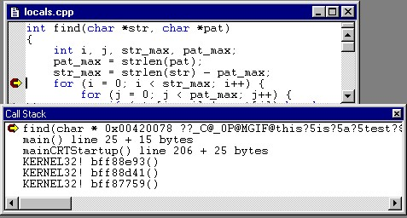
6.1.3.2 Stack Allocation(8/10)
201001V1.1

Slide 31
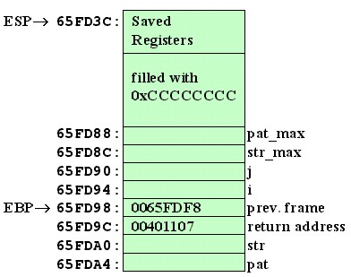
6.1.3.2 Stack Allocation(9/10)
Local Variables on Stack
201001V1.1

Slide 32
6.1.3.2 Stack Allocation(10/10)
Problem of returning local variable
  Never return the address of a local variable
  This can be changed at any time since it’s on stack.
int* ptr_to_zero() {
int i = 0;
return &i;
}
201001V1.1

Slide 33
6.1.3 Dynamic Allocation
6.1.3.1 Dynamic Memory Allocation Concept
6.1.3.2 Stack Allocation
6.1.3.3 Heap Allocation
201001V1.1

Slide 34
6.1.3.3 Heap Allocation(1/15)
Allocated and deallocated memory at arbitrary times.
The heap is just a chunk of memory
It’s usually large.
  programs use to store what kind of data?
  main() {
char* myChar = malloc(512);
    // will return a pointer with memory size of 512 bytes
    ……
  }
201001V1.1

Slide 35
6.1.3.3 Heap Allocation(2/15)
To grab memory, we have to use malloc(size):“memory allocation”
void* malloc (size_t size);
  Takes as a parameter the number of bytes to take from the heap
  Returns a pointer to the memory that was just allocated
  int *parr = (int *)malloc(n*sizeof(int)) will return an integer pointer with n x 4 bytes(space for holding n integers).
201001V1.1

Slide 36
6.1.3.3 Heap Allocation(3/15)
To free memory, we use free
void free (void *ptr);
  It releases memory we aren’t using anymore
  Takes a pointer to the memory to be released
  Must have been allocated with malloc()
  Should set pointer to NULL when done
201001V1.1

Slide 37
6.1.3.3 Heap Allocation(4/15)
We requested memory and released it!!!
int main() {
int *myInt = (int*) malloc(sizeof(int));
*myInt = 5;
free(myInt); //use free() to release memory
myInt = NULL;
return 0; }
201001V1.1

Slide 38
6.1.3.3 Heap Allocation(5/15)
Two ways to get an int
  1. On the Stack:
  2. On the Heap:
int main() {
int myInt; // declare an int on the stack
myInt = 5; // set the memory to five
return 0; }
int main() {
int *myInt ；//4 bytes from stack for pointer
myInt= malloc(sizeof(int)); // allocate 4 bytes from heap for where pointer points at
*myInt = 5; // set the memory to five
free(myInt); myInt = NULL;
return 0; }
201001V1.1

Slide 39
6.1.3.3 Heap Allocation(6/15)
Stack vs. Heap
  Both are sources from which memory is allocated
  Stack is automatic (implicit)
    Created when memory is “in scope”
    Destroyed when memory is “out of scope”
  Heap is manual (explicit)
    Created upon request
    Destroyed upon request
    Note the pointer holdingthe heap address has its own scope.
      int *parr = (int *)malloc(n*sizeof(int));
201001V1.1
Notes:
虽然动态分配的内存可以在程序退出或释放前一直存活，但其生存期和作用域受指向它的指针限制。比如指针为全局的，那么该分配的内存一直可以使用，如果指针为局部的，且在函数退出后该指针不会将地址传递给其它可以继续生存的变量，那么就必须在该函数退出时释放全局变量，否则指针的死亡将宣告内存泄露，因为无人知晓该内存区域的地址。

Slide 40
6.1.3.3 Heap Allocation(7/15)
Do not
  free() memory on the stack
  Lose track of malloc()’d memory
  free() the same memory twice
int main() {
int myInt;
free(&myInt); //very bad
return 0;
}
int main() {
int *myInt = malloc(sizeof(int));
myInt = 0;
//how can you free it now?
return 0;
}
int main() {
int *A = malloc(sizeof(int));
int *B = A;
free(A);
free(B); //very bad
return 0;
}
memory leak
201001V1.1

Slide 41
6.1.3.3 Heap Allocation(8/15)
Review: local arrays
Problem: Size determined at compile time. We must explicitly declare the exact size.
But c99 supports declare a variable-length array
int main() {
int array[5]; // static array of size 5
for(int i = 0; i < 5; i++)
array[i] = 0; // initialize the array to 0
return 0;
}
201001V1.1

Slide 42
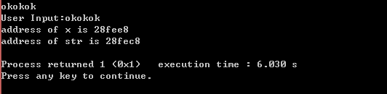
6.1.3.3 Heap Allocation(9/15)
//not work in VS2012, But work in CodeBlocks
int main()
{
int z = 1;
int x = z*10;
char str[x];//variable-length array
scanf("%s",str);
printf("User Input:%s\n",str);
printf("address of x is %x\n",&x);
printf("address of str is %x\n",str);
return 1;
}
201001V1.1

Slide 43
6.1.3.3 Heap Allocation(10/15)
dynamic array
  use malloc to allocate enough space for the array at run-time
#include <malloc.h>
int main() {
int n = rand() % 100; // random number between 0 and 99
int *array = malloc(n * sizeof(int));
// allocate array of size ‘n’ using malloc
for(int i = 0; i < n; i++)
array[i] = 0;
free(array); // make sure to free the array!
array = NULL;
return 0;
}
201001V1.1

Slide 44
6.1.3.3 Heap Allocation(11/15)
MSDN calloc
  Allocates an array in memory with elements initialized to 0.
  void *calloc( size_t num, size_t size );
/* CALLOC.C: This program uses calloc to allocate space for
* 40 long integers. It initializes each element to zero. */
#include <stdio.h>
#include <malloc.h>
void main( void ) {
long* buffer;
buffer = (long*) calloc( 40,sizeof( long ) );
if( buffer != NULL )
printf( "Allocated 40 long integers\n" );
else
printf( "Can't allocate memory\n" );
free( buffer ); buffer = NULL;
}
201001V1.1

Slide 45
6.1.3.3 Heap Allocation(12/15)
MSDN realloc
  Reallocate memory blocks.
  void *realloc( void *memblock, size_t size );
/* REALLOC.C: This program allocates a block of memory for
* buffer and then uses _msize to display the size of that block.
* Next, it uses realloc to expand the amount of memory used
* by buffer and then calls _msize again to display the new
* amount of memory allocated to buffer. */
201001V1.1
Notes:
realloc() 会将 ptr 所指向的内存块的大小修改为 size，并将新的内存指针返回。
设之前内存块的大小为 n，如果 size < n，那么截取的内容不会发生变化，如果 size > n，那么新分配的内存不会被初始化。

Slide 46
6.1.3.3 Heap Allocation(13/15)
#include <stdio.h>
#include <malloc.h>
#include <stdlib.h>
void main( void ) {
long* buffer;
size_t size;
if( (buffer = (long *)malloc( 1000 * sizeof( long ) )) == NULL )
exit( 1 );
size = _msize( buffer ); //sizeof(buffer) return 4 in 32-bit system
printf( "Size of block after malloc of 1000 longs: %u\n", size );
/* Reallocate and show new size: */
if( (buffer = realloc( buffer, size + (1000 * sizeof( long )) )) == NULL )
exit( 1 );
size = _msize( buffer );
printf( "Size of block after realloc of 1000 more longs: %u\n", size );
free( buffer ); buffer = NULL;
exit( 0 );
}
Size of block after malloc of 1000 longs: 4000
Size of block after realloc of 1000 more longs: 8000
201001V1.1
Notes:
Sizeof(buffer) is 4, _msize(buffer) is bytes allocated

Slide 47
6.1.3.3 Heap Allocation(14/15)
MSDN free
  Deallocates or frees a memory block.
  void free( void *memblock );
201001V1.1

Slide 48
6.1.3.3 Heap Allocation(15/15)
We can also use malloc to allocate space on the heap for a struct
typedef struct foo {
int value;
int array[10];
} foo_t;
int main() {
foo_t *fooStruct = (foo_t*) malloc(sizeof(foo_t));
fooStruct->value = 5;
for(int i = 0; i < 10; i++) fooStruct->array[i] = 0;
free(fooStruct); // free the struct.
fooStruct = NULL;
return 0;
}
201001V1.1

Slide 49
6.1 Several Uses of Memory
6.1.1 Memory Management
6.1.2 Static Allocation
6.1.3 Dynamic Allocation
6.1.4 Memory Allocation Algorithms
  CSAPP9.9
6.1.5 Program Memory Layout
201001V1.1

Slide 50
6.1.4 Memory Allocation Algorithms(1/6)
Difficulties of memory allocation
  malloc() will have to allocate the memory that has not been used before.
There must be a method to determine which memory blocks can be used.
201001V1.1

Slide 51
6.1.4 Memory Allocation Algorithms(2/6)
Memory allocation algorithms
  First fit (the first block in the list that meets the requirement )
  Best fit (the block that perfectly meets the requirements
  Worst fit( the largest one in the list)
201001V1.1

Slide 52
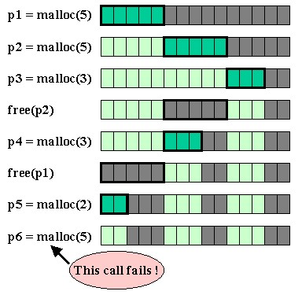
6.1.4 Memory Allocation Algorithms(3/6)
Fragmentation
Although it has memory
201001V1.1

Slide 53

6.1.4 Memory Allocation Algorithms(4/6)
Example of First fit
I need 20K bytes
15K
25K
20K
45K
free blocks
201001V1.1

Slide 54
6.1.4 Memory Allocation Algorithms(5/6)
Example of Best fit
I need 20K bytes
15K
25K
20K
45K
free blocks
201001V1.1

Slide 55
6.1.4 Memory Allocation Algorithms(6/6)
Example of Worst fit
I need 20K bytes
15K
25K
20K
45K
free blocks
201001V1.1

Slide 56
6.1 Several Uses of Memory
6.1.1 Memory Management
6.1.2 Static Allocation
6.1.3 Dynamic Allocation
6.1.4 Memory Allocation Algorithms
6.1.5 Program Memory Layout
201001V1.1

Slide 57
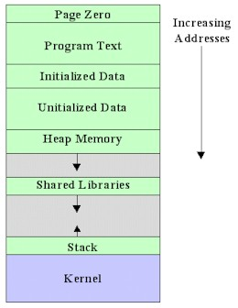
6.1.5 Program Memory Layout(1/2)
address zero is reserved and made unreadable to catch the common bug of trying to use a NULL pointer to access data
Machine code instruction
dynamically linked shared libraries
in some systems, the operating system or operating system kernel becomes part of an application's memory during system calls.
201001V1.1

Slide 58
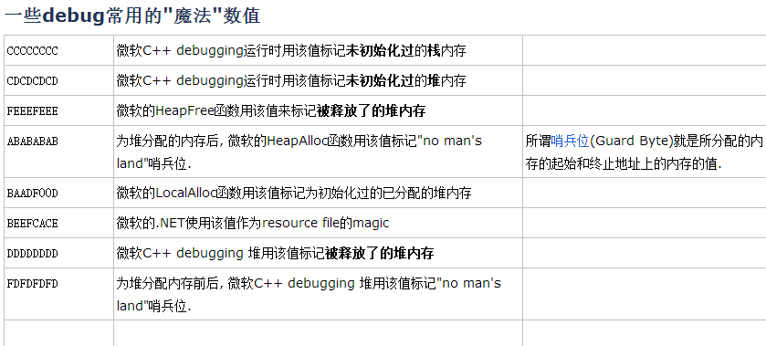
6.1.5 Program Memory Layout(2/2)
201001V1.1

Slide 59
Summary
Static allocation (char[8]) and dynamic memory (malloc())
Static declaration, like global variable (static int i)
Stack memory – a temporary memory for subroutine
Heap: is a large block of data
malloc(sie_t size) to return a pointer pointing to the memory block
free(ptr), remember to free memory
Fragmentation: memory is available but is not continuous for use
201001V1.1

