Slide 1



System Level Programming
Unit 12 Cache and Cache-Aware Programming
李靓 (Li Jing) lijing712@scu.edu.cn
School of Computer Science / Software Engineering

Slide 2
Cache and Cache-Aware Programming
12.0 Introduction
12.1 Cache types according to implementation
12.2 Writing caching friendly code and cache-aware optimization

Slide 3
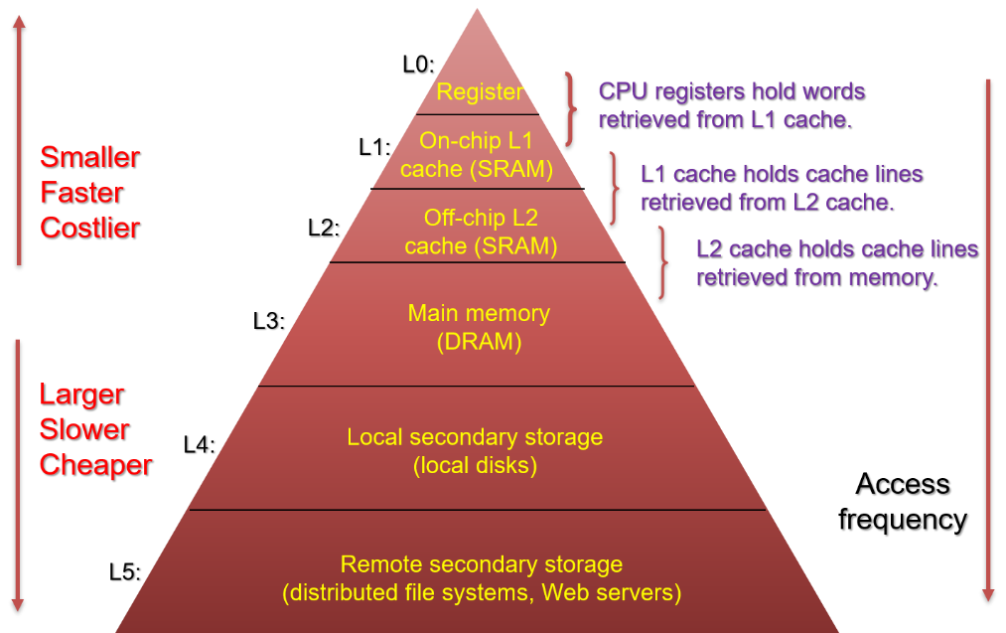
12.0 Introduction

Slide 4
12.0 Introduction
Examples of caching in memory hierarchy
Cache Type
What is Cached?
Where is it Cached?
Latency (cycles)
Managed By
Registers
4-8 bytes words
CPU core
0
Compiler
TLB
Address translations
On-Chip TLB
0
Hardware
MMU
L1 cache
64-byte blocks
On-Chip L1
4
Hardware
L2 cache
64-byte blocks
On-Chip L2
10
Hardware
Virtual Memory
4-KB pages
Main memory
100
Hardware + OS
Buffer cache
Parts of files
Main memory
100
OS
Disk cache
Disk sectors
Disk controller
100,000
Disk firmware
Network buffer cache
Parts of files
Local disk
10,000,000
NFS client
Browser cache
Web pages
Local disk
10,000,000
Web browser
Web cache
Web pages
Remote server disks
1,000,000,000
Web proxy server

Slide 5

12.0 Introduction
Level k
Miss rate
H = No.Miss / No.Ref
Cold miss
Conflict miss (Thrash)
Capacity miss
Hit rate
1 – H
Hit time $T_{hit}$
Miss penalty $T_{miss}$
Spatial locality
Temporal locality
8
4
9
14
10
3
4
10
0
1
2
3
4
4
5
6
7
8
9
10
10
11
12
13
14
15
Level k+1

Slide 6
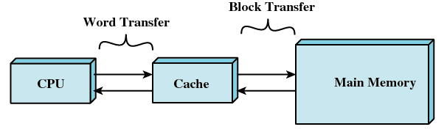
12.0 Introduction
What cache means?
Broad sense: level k and level k+1
Cache | Memory | Disk | Server
Narrow sense: small, fast memory between the CPU registers and the main memory
Cache - SRAM
Managed by hardware logic

Slide 7
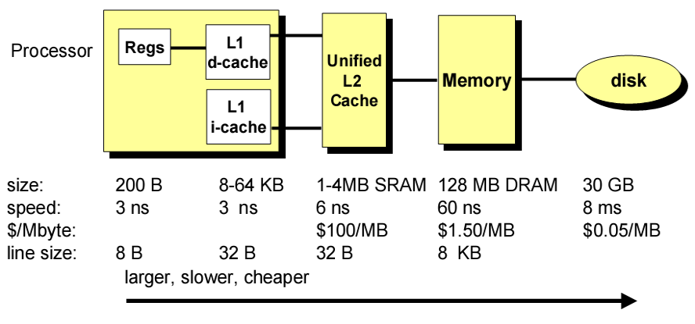
Concluding observations
Intel Pentium III Cache

Slide 8
12.0 Introduction
Basic policy that should be concerned
Cache size
Block size
Miss or hit
Pre-fetch or demand fetch
Placement
Replacement
FIFO, LRU, LFU
Write/update
Write through 直写
Write back 写回
cache
4
9
14
3
0
1
2
3
4
5
6
7
8
9
10
11
12
13
14
15
memory

Slide 9

12.0 Introduction
Many kinds of cache
By level – L1, L2, …
By content – data, instruction
By on chip or not
By implementation – Organization

Slide 10
Cache and Cache-Aware Programming
12.0 Introduction
12.1 Cache types according to implementation
12.2 Writing caching friendly code and cach-aware optimization

Slide 11
12.1 Cache types according to implementation
12.1.0 Introduction
12.1.1 Direct Mapped Cache
12.2.2 Fully Associative Cache
12.1.3 Set Associative Cache
12.1.4 Other Related Issues
12.1.5 An Example of Using Multi-level Cache

Slide 12
12.1.0 Introduction
Where can a block be placed in a cache?
Direct mapped (直接映射): Each block has only one place it can appear in the cache.
Set associative (组相联): A block can be placed in a restricted set of places. (2-way, 4-way, 8-way, etc.)
Fully associative (全相联): A block can be placed anywhere in the cache.

Slide 13
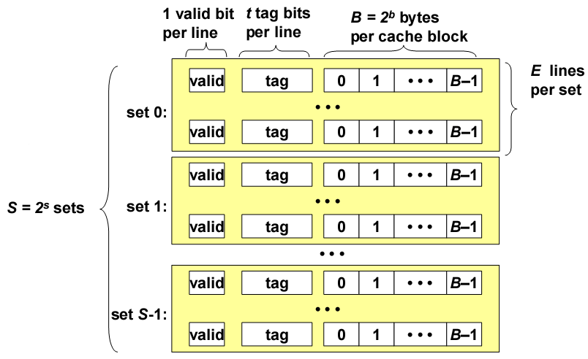
12.1.0 Introduction
Generic cache memory organization

Slide 14
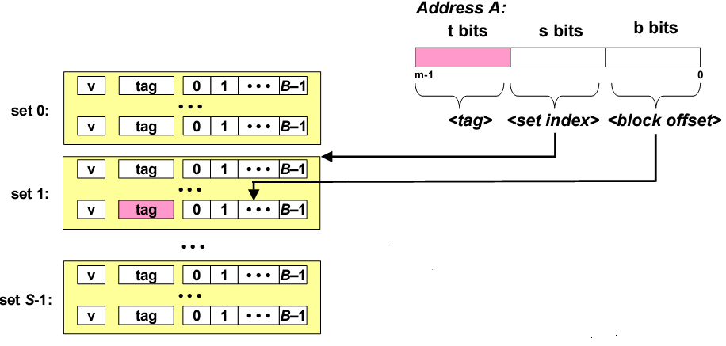
12.1.0 Introduction
Address
Process:
s bits -> t bits -> b bits
组选择+行匹配+字提取

Slide 15
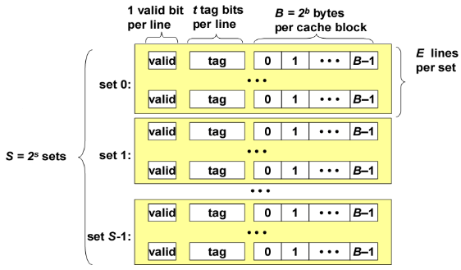
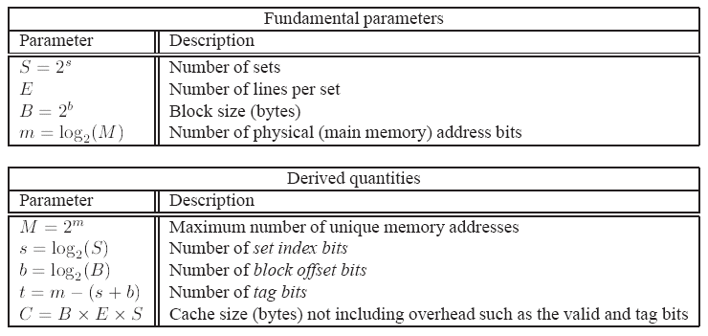
12.1.0 Introduction

Slide 16
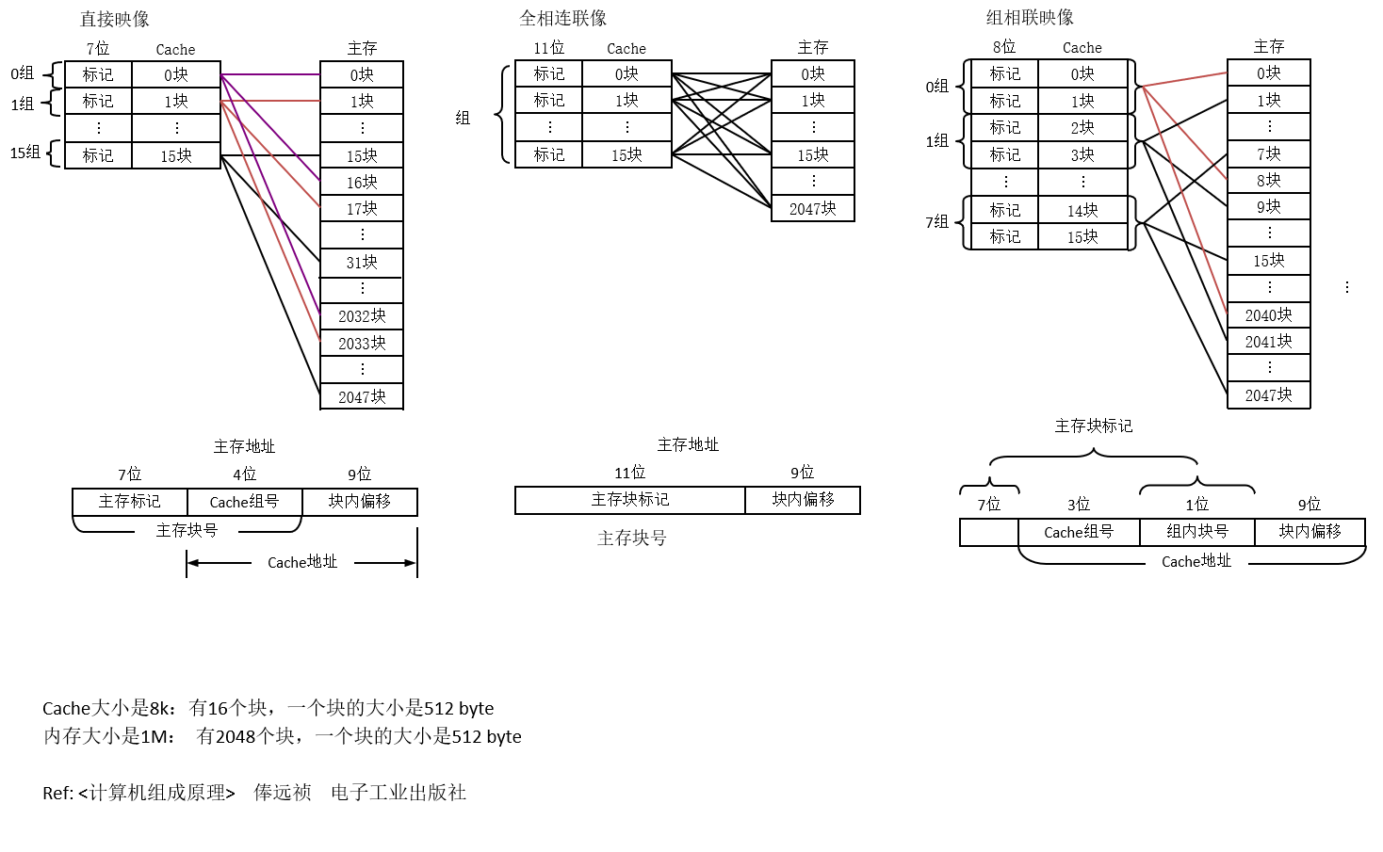
12.1.0 Introduction

Slide 17
12.1 Cache types according to implementation
12.1.0 Introduction
12.1.1 Direct Mapped Cache
12.2.2 Fully Associative Cache
12.1.3 Set Associative Cache
12.1.4 Other Related Issues
12.1.5 An Example of Using Multi-level Cache

Slide 18
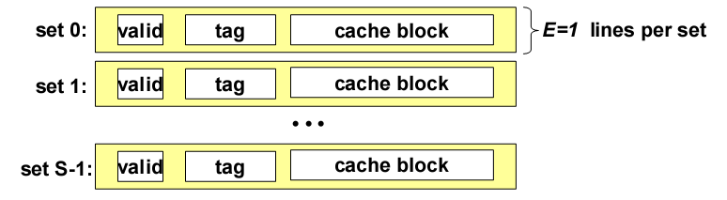
12.1.1 Direct Mapped Cache
Organization
Characterized by exactly one line per set

Slide 19
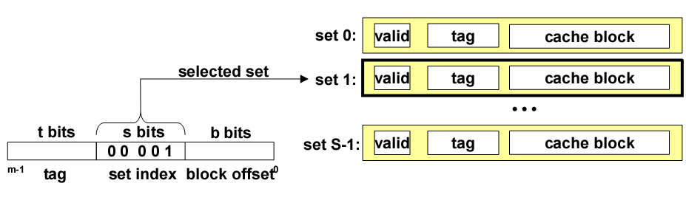
12.1.1 Direct Mapped Cache
Addressing direct mapped cache
Set index

Slide 20
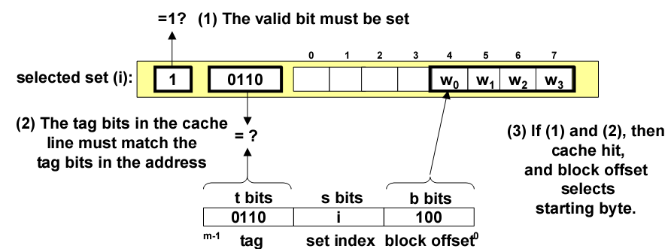
12.1.1 Direct Mapped Cache
Addressing direct mapped cache
Line matching - find valid line
Word selection

Slide 21
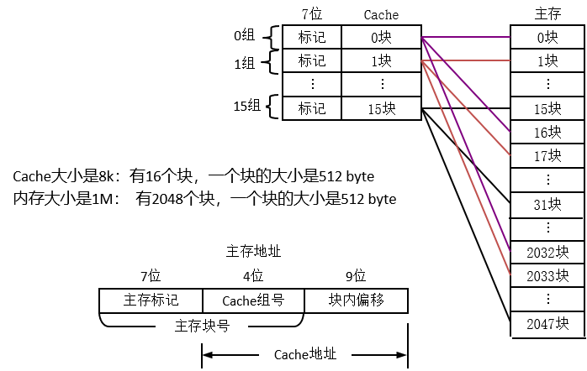
12.1.1 Direct Mapped Cache

Slide 22
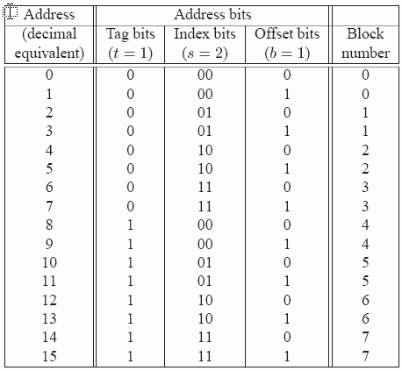
12.1.1 Direct Mapped Cache
Example: 4-bit address for direct-mapped cache
Cache set size = ?
Size of the cache line = ?
The Cache set size: N = 2^{s} = 4
The size of the cache line: L = 2 ^{b} = 2 byte

Slide 23
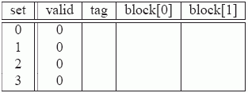
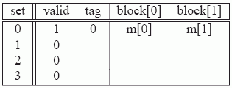
12.1.1 Direct Mapped Cache
Example: 4-bit address for direct-mapped cache
t=1
s=2
b=1
x
xx
x
Initially, the cache is empty (i.e., each valid bit is 0).
Read word at address 0 [0000].
Cache miss
Read word at address 1 [0001].
Cache hit
Read word at address 13 [1101].
Cache miss

Slide 24
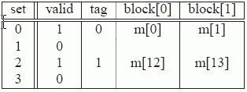
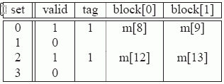
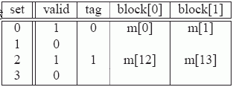
12.1.1 Direct Mapped Cache
Example: 4-bit address for direct-mapped cache
Read word at address 8 [1000].
Cache miss
Read word at address 0 [0000].
Cache miss

Slide 25
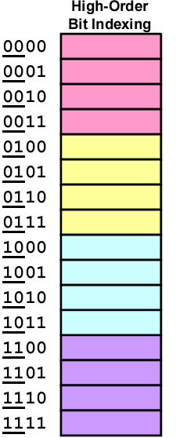
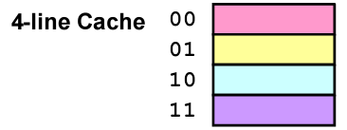
12.1.1 Direct Mapped Cache
Why use middle bits as set index?
High-order bit indexing
Adjacent memory lines
map to same cache entry
Poor use of spatial locality
4-set cache

Slide 26
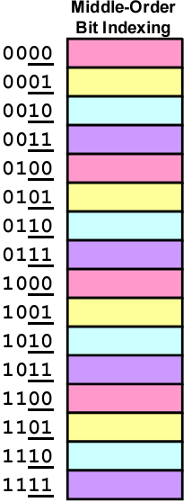
12.1.1 Direct Mapped Cache
Why use middle bits as set index?
Middle-order bit indexing
Consecutive memory lines
map to different cache lines
Hold C-byte region of address
space in cache at one time
4-set cache

Slide 27
12.1 Cache types according to implementation
12.1.0 Introduction
12.1.1 Direct Mapped Cache
12.2.2 Fully Associative Cache
12.1.3 Set Associative Cache
12.1.4 Other Related Issues
12.1.5 An Example of Using Multi-level Cache

Slide 28
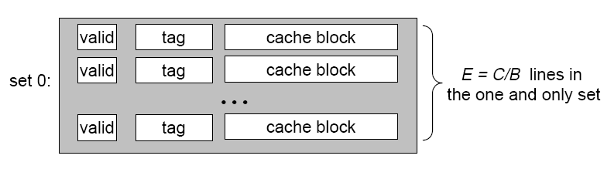
12.2.2 Fully Associative Cache
Organization
Characterized by only one set
C = cache size
B = block size

Slide 29
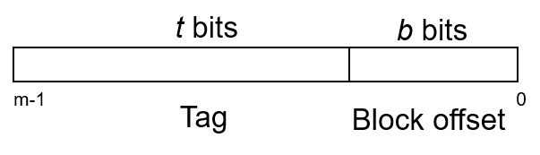
12.2.2 Fully Associative Cache
Accessing fully associative caches
Set selection (No need)
The entire cache is one set, so by default set 0 is always selected

Slide 30
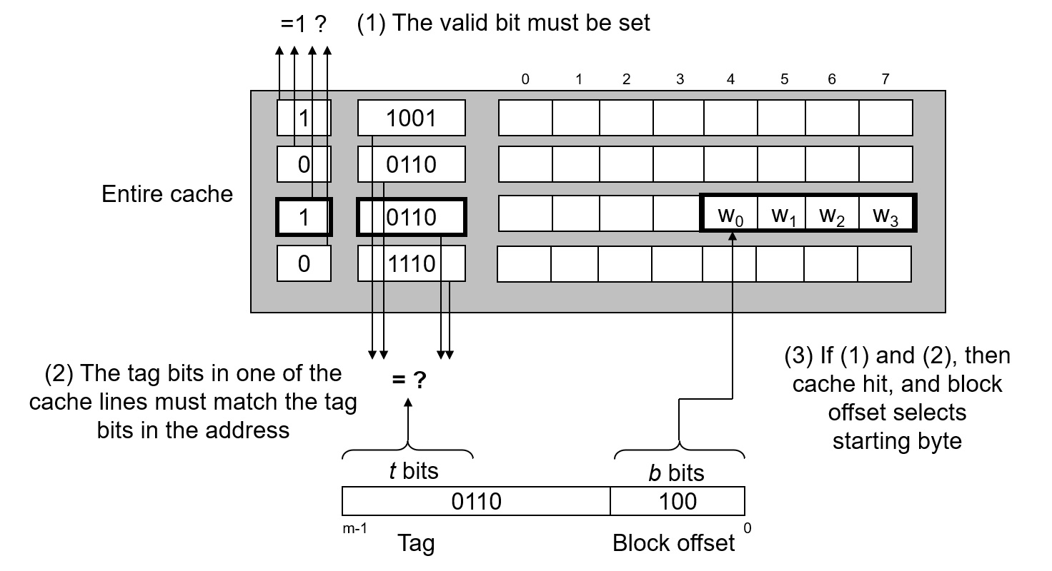
12.2.2 Fully Associative Cache
Accessing fully associative caches
Line matching
Word selection

Slide 31
12.2.2 Fully Associative Cache
全相连联像
11位
Cache
主存
标记
0块
0块
标记
1块
1块
…
…
…
标记
15块
15块
…
2047块
Cache大小是8k：有16个块，一个块的大小是512 byte
内存大小是1M： 有2048个块，一个块的大小是512 byte
主存地址
11位
9位
主存块标记
块内偏移
主存块号

Slide 32
12.1 Cache types according to implementation
12.1.0 Introduction
12.1.1 Direct Mapped Cache
12.2.2 Fully Associative Cache
12.1.3 Set Associative Cache
12.1.4 Other Related Issues
12.1.5 An Example of Using Multi-level Cache

Slide 33
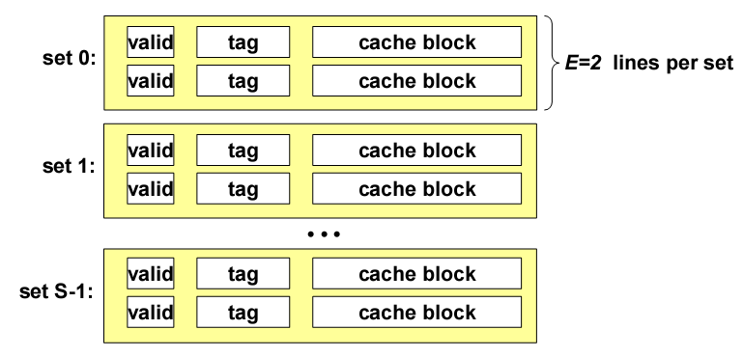
12.1.3 Set Associative Cache
Organization
Characterized by more than one line per set

Slide 34
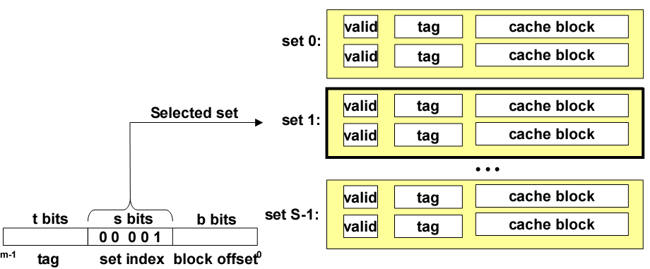
12.1.3 Set Associative Cache
Accessing set associative caches
Set selection

Slide 35
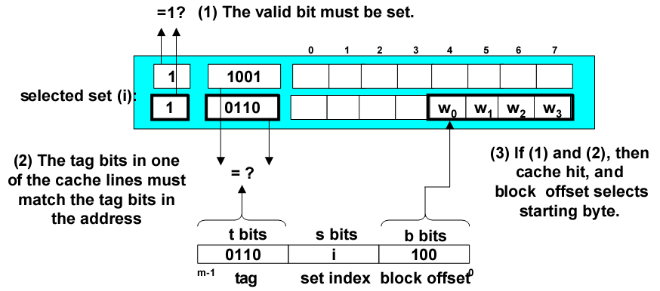
12.1.3 Set Associative Cache
Accessing set associative caches
Line matching
Word selection

Slide 36
12.1.3 Set Associative Cache
8位
Cache
主存
标记
0块
0块
0组
标记
1块
1块
标记
2块
…
1组
7块
标记
3块
…
…
8块
标记
14块
9块
7组
…
标记
15块
15块
Cache大小是8k：有16个块，一个块的大小是512 byte
内存大小是1M： 有2048个块，一个块的大小是512 byte
…
…
2040块
2041块
主存块标记
…
2047块
7位
3位
1位
9位
Cache组号
组内块号
块内偏移
Cache地址

Slide 37
12.1 Cache types according to implementation
12.1.0 Introduction
12.1.1 Direct Mapped Cache
12.2.2 Fully Associative Cache
12.1.3 Set Associative Cache
12.1.4 Other Related Issues
12.1.5 An Example of Using Multi-level Cache

Slide 38
12.1.4 Other Related Issues
CSAPP 6.4.5: Issues with writes
Write through VS Write back
Write allocate VS Not write allocate
CSAPP 6.4.7: Performance impact of cache parameters
Cache size
Block size
Association
Writing strategy
cache
4
9
14
3
0
1
2
3
4
5
6
7
8
9
10
11
12
13
14
15
memory

Slide 39
12.1.4 Other Related Issues
CSAPP 6.4.6: Instruction caches and unified caches
Intel Core i7 Cache

Slide 40
12.1 Cache types according to implementation
12.1.0 Introduction
12.1.1 Direct Mapped Cache
12.2.2 Fully Associative Cache
12.1.3 Set Associative Cache
12.1.4 Other Related Issues
12.1.5 An Example of Using Multi-level Cache

Slide 41
12.1.5 An Example of Using Multi-level Cache
Example code
/* Assumes n is a power of two */
void merge_sort (int * data, int n) {
int half = n >> 1;
if (n == 1) return;
merge_sort(data, half);
merge_sort(data + half, half);
merge(data, data + half, half);
}

Slide 42
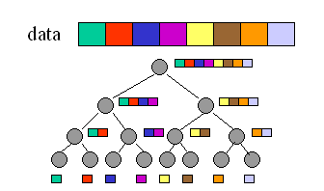
12.1.5 An Example of Using Multi-level Cache
Data using example, showing by figure
Memory access: 32 times

Slide 43
12.1.5 An Example of Using Multi-level Cache
Assuming that
The caches are fully associative
LRU is used for replacement
The access times for each level of cache
L1 cache (T1)
L2 cache (T2)
L3 cache (T3)
Memory (Tm)

Slide 44
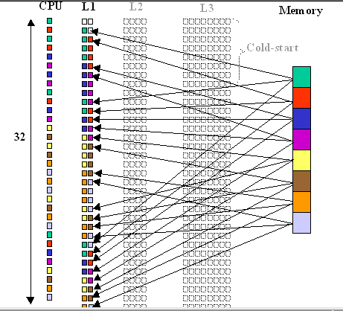

12.1.5 An Example of Using Multi-level Cache

Slide 45
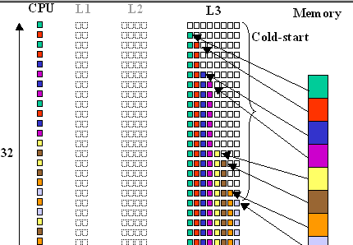

12.1.5 An Example of Using Multi-level Cache

Slide 46
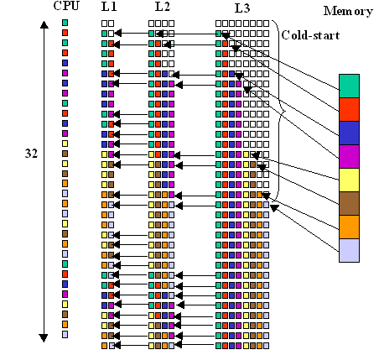
12.1.5 An Example of Using Multi-level Cache

Slide 47
12.1.5 An Example of Using Multi-level Cache
Assume
T1 = 2 ns, T2 = 4 ns, T3 = 6 ns, Tm = 60 ns
Access time:
for the one small L1 cache case
Execution Time = (32-24)*T1 + 24* Tm = 1456 ns
for the one large L3 cache case
Execution Time = (32-8)*T3 + 8*Tm = 624 ns
for the three-cache case
Execution Time = (32-24)*T1 + (24-16)*T2 + (16-8)*T3 + 8*Tm = 574 ns

Slide 48
Cache and Cache-Aware Programming
12.0 Introduction
12.1 Cache types according to implementation
12.2 Writing caching friendly code and cache-aware optimization

Slide 49
12.2 Writing caching friendly code and cache-aware optimization
12.2.0 Introduction
12.2.1 Case1: Instruction cache overflow
12.2.2 Case2: Cache Collisions
12.2.3 Case3: Insufficient spatial locality
12.2.4 Case4: Insufficient temporal locality

Slide 50
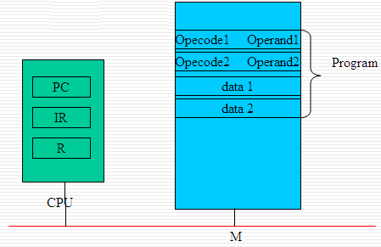
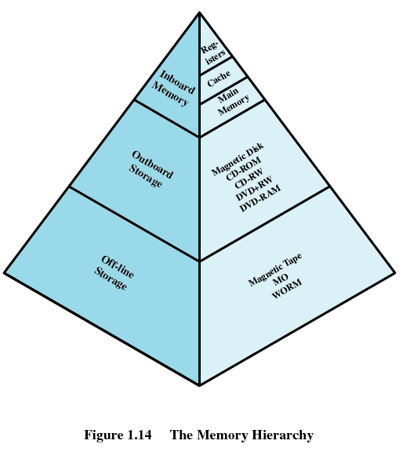
12.2 Writing caching friendly code and cache-aware optimization
CPU+MEMORY in CS

Slide 51
12.2 Writing caching friendly code and cache-aware optimization
Notice
Increase the locality of a program
Efficiency V.S. Locality
E.g. Loops
Perform differently on different computers

Slide 52
12.2 Writing caching friendly code and cach-aware optimization
12.2.0 Introduction
12.2.1 Case1: Instruction cache overflow
12.2.2 Case2: Cache Collisions
12.2.3 Case3: Insufficient spatial locality
12.2.4 Case4: Insufficient temporal locality

Slide 53
12.2.1 Case1: Instruction cache overflow
A program involving 3 complicated operations
Bad temporal locality for big loop body
If instructions in loop body overflow L1 instruction cache
for (i = 0; i < MAX; i++)
{
<Complicated operation on A[i]>
<Complicated operation on B[i]>
<Complicated operation on C[i]>
}

Slide 54
12.2.1 Case1: Instruction cache overflow
for (i = 0; i < MAX; i++)
{
<Complicated operation on A[i]>
}
for (i = 0; i < MAX; i++)
{
<Complicated operation on B[i]>
}
for (i = 0; i < MAX; i++)
{
<Complicated operation on C[i]>
}

Slide 55
12.2 Writing caching friendly code and cache-aware optimization
12.2.0 Introduction
12.2.1 Case1: Instruction cache overflow
12.2.2 Case2: Cache Collisions
12.2.3 Case3: Insufficient spatial locality
12.2.4 Case4: Insufficient temporal locality

Slide 56
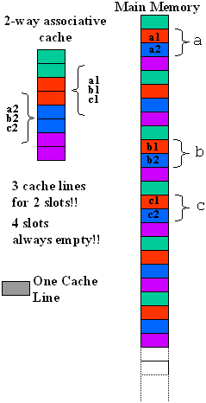
12.2.2 Case2: Cache Collisions
Cache collision [conflict miss]
int a[N];
<other stuff...>
int b[N];
<other stuff...>
int c[N];
for (i = 0; i < N; i++) {
c[i] = a[i] + b[i];
}

Slide 57
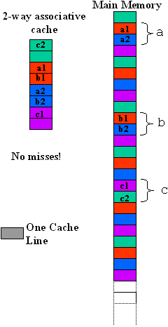
12.2.2 Case2: Cache Collisions
#define CACHELINESIZE <Cache line size of system>
#define COFFSET ((2 * CACHELINESIZE) / sizeof(int))
int a[N];
<other stuff...>
int b[N];
<other stuff...>
int c[N + COFFSET];
for (i = 0; i < N; i++) {
c[i + COFFSET] = a[i] + b[i];
}

Slide 58
12.2 Writing caching friendly code and cache-aware optimization
12.2.0 Introduction
12.2.1 Case1: Instruction cache overflow
12.2.2 Case2: Cache Collisions
12.2.3 Case3: Insufficient spatial locality
12.2.4 Case4: Insufficient temporal locality

Slide 59
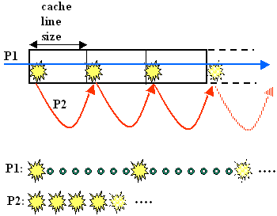
12.2.3 Case3: Insufficient spatial locality
Linear array
32 bytes
Cache line
size
int i;
int sum=0;
int data[ARRAY_SIZE]; // 4 bytes
for (i = 0; i < ARRAY_SIZE; i += stride)
sum += data[i];
P1: 7/8
P2: all miss

Slide 60
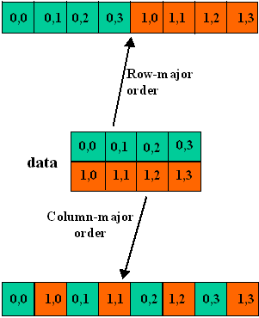
12.2.3 Case3: Insufficient spatial locality
Two-dimensional array
C arrays allocated in row-major order
Row-major order
Data
Column-major order

Slide 61

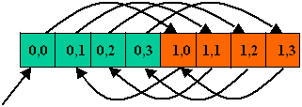
12.2.3 Case3: Insufficient spatial locality
Two-dimensional array – focus on inner loop
int data[M][N];
for (i = 0; i < M; i++) { //row
for (j = 0 ; j < N; j++) { // col
sum += data[ i ] [ j ];
}
}
int data[M][N];
for (j = 0 ; j < N; j++) { // col
for (i = 0; i < M; i++) { // row
sum += data[ i ] [ j ];
}
}

Slide 62
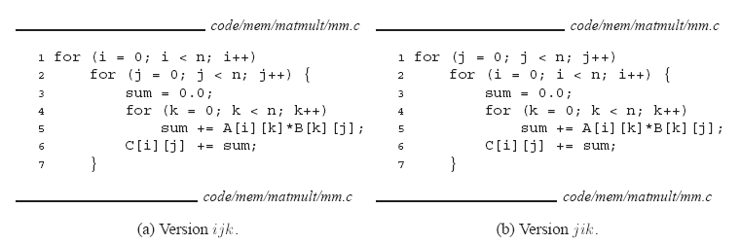

12.2.3 Case3: Insufficient spatial locality
Matrix multiply AB $\left[\begin{matrix}c_{11} & c_{12} \\ c_{21} & c_{22}\end{matrix}\right]=\left[\begin{matrix}a_{11} & a_{12} \\ a_{21} & a_{22}\end{matrix}\right]$ $\left[\begin{matrix}b_{11} & b_{12} \\ b_{21} & b_{22}\end{matrix}\right]$

Slide 63

12.2.3 Case3: Insufficient spatial locality
Matrix multiply AC $\left[\begin{matrix}c_{11} & c_{12} \\ c_{21} & c_{22}\end{matrix}\right]=\left[\begin{matrix}a_{11} & a_{12} \\ a_{21} & a_{22}\end{matrix}\right]$ $\left[\begin{matrix}b_{11} & b_{12} \\ b_{21} & b_{22}\end{matrix}\right]$

Slide 64

12.2.3 Case3: Insufficient spatial locality
Matrix multiply BC $\left[\begin{matrix}c_{11} & c_{12} \\ c_{21} & c_{22}\end{matrix}\right]=\left[\begin{matrix}a_{11} & a_{12} \\ a_{21} & a_{22}\end{matrix}\right]$ $\left[\begin{matrix}b_{11} & b_{12} \\ b_{21} & b_{22}\end{matrix}\right]$

Slide 65
12.2.3 Case3: Insufficient spatial locality
Matrix multiply - Assume
Data type: double
Line size = 32B (big enough for 64b words)
N is large enough (1/N is approximate to 0)
 | Loads / iter | Stores / iter | A-miss / iter | B-miss / iter | C-miss / iter | Total-miss / iter
ijk&jik (AB) | 2 | 0 | 0.25 | 1.00 | 0.00 | 1.25
jki&kji (AC) | 2 | 1 | 1.00 | 0.00 | 1.00 | 2.00
kij&ikj (BC) | 2 | 1 | 0.00 | 0.25 | 0.25 | 0.50

Slide 66
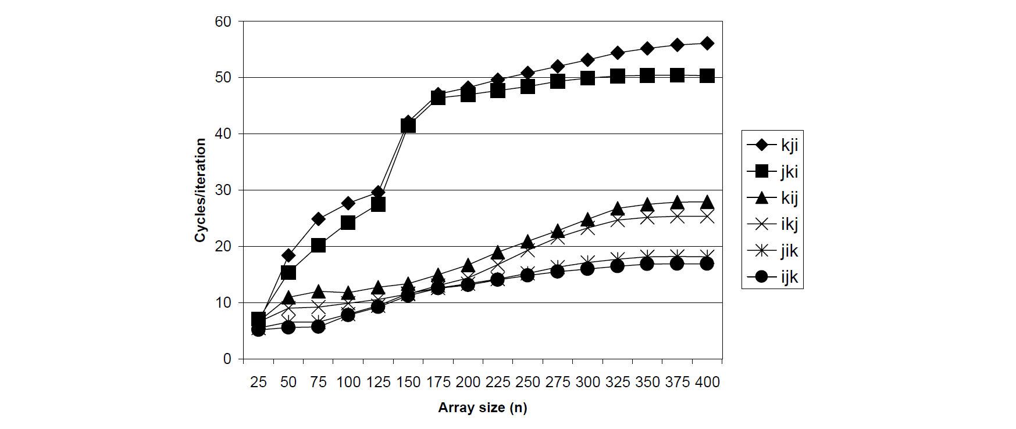
12.2.3 Case3: Insufficient spatial locality
Matrix multiply – Pentium III Xeon
AC
BC
AB

Slide 67
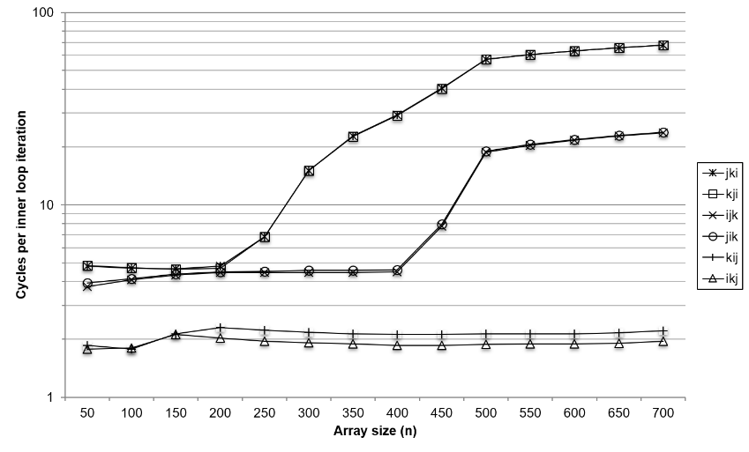
12.2.3 Case3: Insufficient spatial locality
Matrix multiply – Core i7
AC
AB
BC

Slide 68
12.2 Writing caching friendly code and cache-aware optimization
12.2.0 Introduction
12.2.1 Case1: Instruction cache overflow
12.2.2 Case2: Cache Collisions
12.2.3 Case3: Insufficient spatial locality
12.2.4 Case4: Insufficient temporal locality

Slide 69

12.2.4 Case4: Insufficient temporal locality
When we can do nothing to spatial locality
int original[M][N];
int transposed[N][M];
for (i = 0; i < M; i++) {
for (j = 0; j < N; j++) {
transposed[i][j] = original[j][i];
}
}

Slide 70
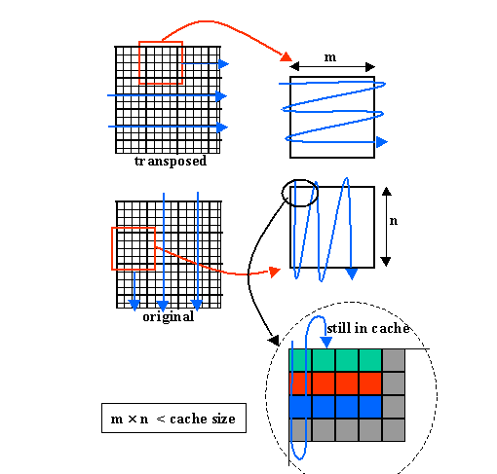
12.2.4 Case4: Insufficient temporal locality
Idea – blocking for hit ratio improvement

Slide 71
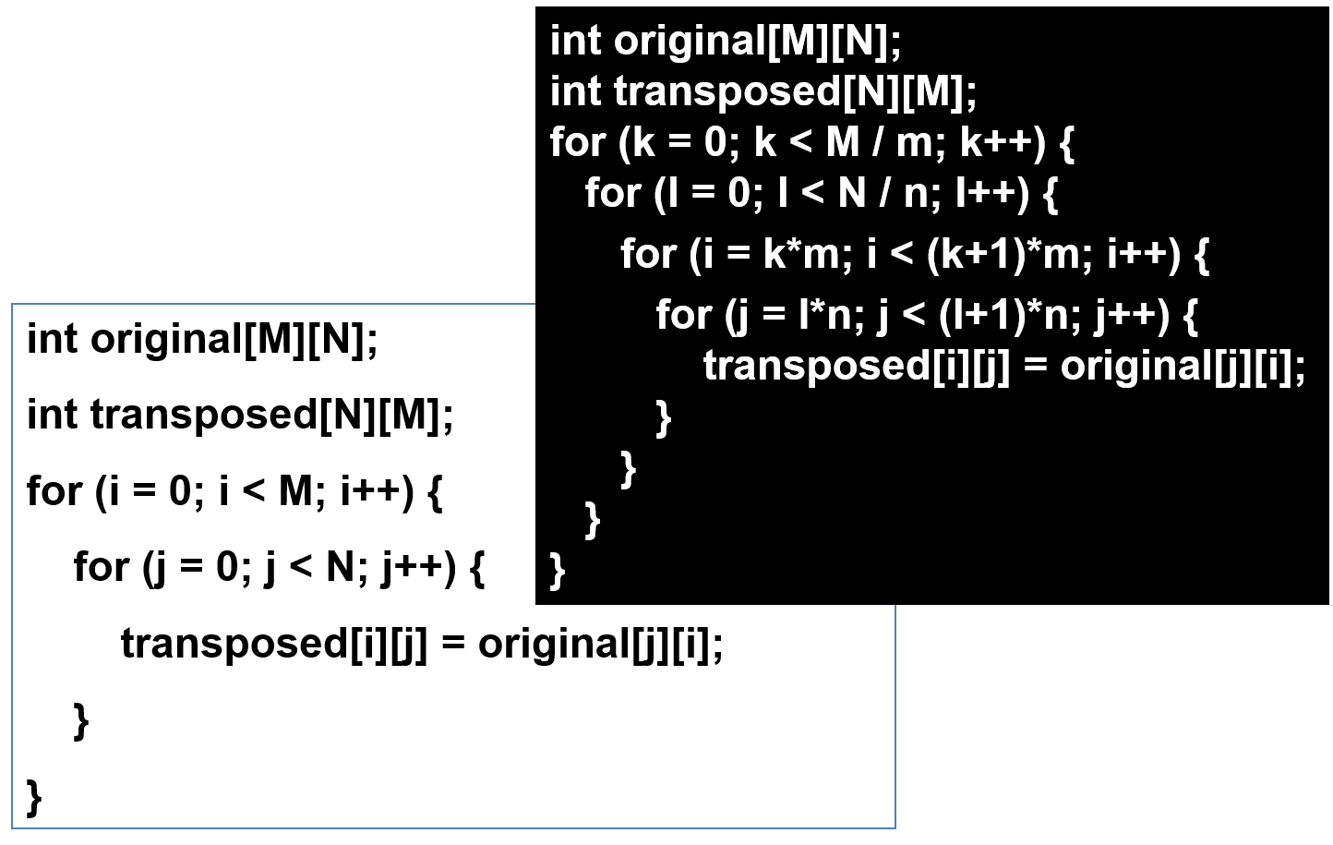
12.2.4 Case4: Insufficient temporal locality

Slide 72
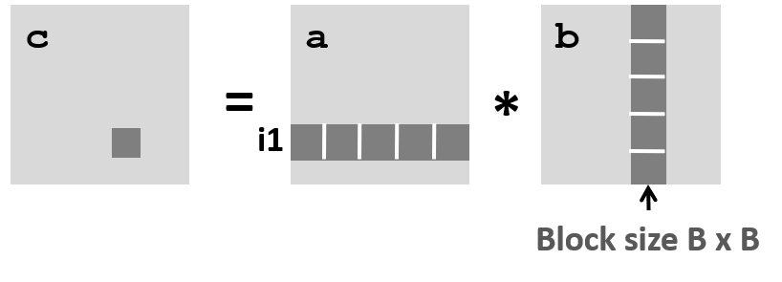

12.2.4 Case4: Insufficient temporal locality
Another example of matrix multiply
For 8*8 matrix multiply, we could partition each matrix into four 4*4 submatrices
$\left[\begin{matrix}c_{11} & c_{12} \\ c_{21} & c_{22}\end{matrix}\right]=\left[\begin{matrix}a_{11} & a_{12} \\ a_{21} & a_{22}\end{matrix}\right]$ $\left[\begin{matrix}b_{11} & b_{12} \\ b_{21} & b_{22}\end{matrix}\right]$

Slide 73
12.2.4 Case4: Insufficient temporal locality
Another example of matrix multiply

Slide 74
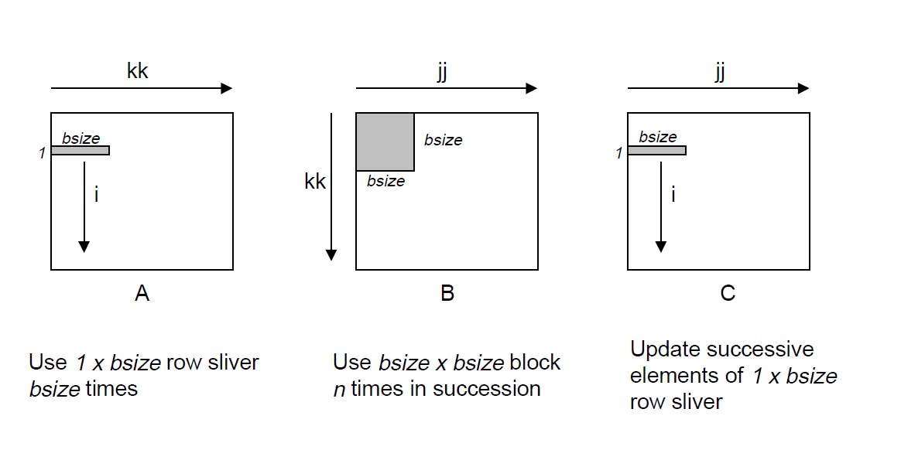
12.2.4 Case4: Insufficient temporal locality
Locality

Slide 75

12.2.4 Case4: Insufficient temporal locality
Performance

