Slide 1
System Level Programming
Software College of SCU
四川大学软件学院 左航

Slide 2
Unit 6. Memory Layout and Allocation
6.1 Several Uses of Memory
6.2 Memory Bugs
6.3 Garbage Collection
201001V1.1

Slide 3
6.2 Memory Bugs
//memory use and related errors
6.2.1 Review of Pointers in C
6.2.2 Making and Using Bad References
6.2.3 Overwriting Memory
6.2.4 Twice free
6.2.5 Memory Leaks
//tools to detect related errors
6.2.6 Exterminating Memory Bugs
201001V1.1

Slide 4
6.2 Memory Bugs
//memory use and related errors
6.2.1 Review of Pointers in C
6.2.2 Making and Using Bad References
6.2.3 Overwriting Memory
6.2.4 Twice free
6.2.5 Memory Leaks
//tools to detect related errors
6.2.6 Exterminating Memory Bugs
201001V1.1

Slide 5
6.2.1 Review of Pointers in C(1/4)
Here, var occupies 4 bytes, *var_pt also occupies 4 bytes
// take the address of a variable
int var; // declare the variable
int *var_ptr; // declare the pointer
var_ptr = &var; // take the address of var
*var_ptr = 4; // stores 3 into var
// access variable pointed to by var_ptr
if (var == *var_ptr)
printf("ok\n");
201001V1.1

Slide 6
6.2.1 Review of Pointers in C(2/4)
Memory Allocation on the Heap
// allocate an integer with malloc
// the result must be coerced into an (int *):
var_ptr = (int *) malloc(sizeof(int));
*var_ptr = 4;
// free the memory
free(var_ptr);
var_ptr = NULL;
201001V1.1

Slide 7
6.2.1 Review of Pointers in C(3/4)
Pointers and integers can be added
  pointer +- n //means n elements away
double *ptr = x;
// point to first element in x
for (int i = 0; i < n; i++) {
*ptr++ *= y;
} //* ++ same priority, so first *ptr *=y then ptr++
201001V1.1

Slide 8
6.2.1 Review of Pointers in C(4/4)
// declare a structure
typedef struct {
int int_field;
double dbl_field;
} my_struct_type;
// allocate a structure on the heap
my_struct_type* s;
s = (my_struct_type*) malloc(sizeof(my_struct_type));
// initialize fields of s
s->int_field = 0;
s->dbl_field = 0.0;
// access s in another way:
(*s).int_field = 0; // equivalent to s->int_field = 0;
201001V1.1

Slide 9
6.2 Memory Bugs
//memory use and related errors
6.2.1 Review of Pointers in C
6.2.2 Making and Using Bad References
6.2.3 Overwriting Memory
6.2.4 Twice free
6.2.5 Memory Leaks
//tools to detect related errors
6.2.6 Exterminating Memory Bugs
201001V1.1

Slide 10
6.2.2 Making and Using Bad References(1/8)
The pointer is not pointing to the right location or is not properly initialized.
It might cause the program to crash.
Here, *p is not pointing to int a[].
To solve it, p = a;
Set pointers to NULL if do not know the correct initial value.
int sum(int a[], int n)
{
int* p;
int sum = 0;
for (int i = 0; i < n; i++)
sum += *p++;
}
201001V1.1

Slide 11
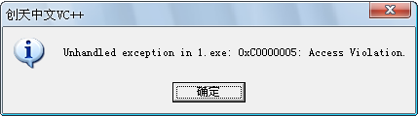
6.2.2 Making and Using Bad References(2/8)
void GetMemory (char* p, int num) {
p = (char *) malloc(sizeof(char) * num);
}
void main (void) {
char *str = NULL;
GetMemory(str, 100);
strcpy(str, "hello");
}
str
…
…
P=NULL
P=0X0012cd00
201001V1.1

Slide 12
6.2.2 Making and Using Bad References(3/8)
Solve the problem: Using Pointer’s Pointer to Correct
Using Return Value to Pass Dynamically Allocated Memory
char *GetMemory2(int num) {
char *p = (char *) malloc(sizeof(char) * num);
return p;
}
str = GetMemory2(100);
  GetMemory(&str, 100);
  void GetMemory (char** p, int num) {
  *p = (char *) malloc(sizeof(char) * num);
  }
201001V1.1
Notes:
用指向指针的指针申请动态内存

Slide 13
6.2.2 Making and Using Bad References(4/8)
  void release_foo(int * p) {
  free(p);
  p = NULL;
  }
  int * pointer;
  //.... 分配给pointer内存
  int bar() {
  release_foo(pointer);
  return 0;
  }
//correct
  int bar() {
  release_foo(pointer);
  //
  pointer = NULL;
  return 0;
  }
Dangle Pointer
201001V1.1
Notes:
“野指针”不是NULL指针，是指向“垃圾”内存的指针。人们一般不会错用NULL指针，因为用if语句很容易判断。
但是“野指针”是很危险的，if语句对它不起作用。
“野指针”的成因主要有两种：
（1）指针变量没有被初始化。任何指针变量刚被创建时不会自动成为NULL指针，它的缺省值是随机的，它会乱指一气。所以，指针变量在创建的同时应当被初始化，要么将指针设置为NULL，要么让它指向合法的内存。例如
char *p = NULL;
char *str = (char *) malloc(100);
（2）指针p被free或者delete之后，没有置为NULL，让人误以为p是个合法的指针。
（3）指针操作超越了变量的作用范围。这种情况让人防不胜防，示例程序如下：
class A
{
public:
void Func(void){ cout << “Func of class A” << endl; }
};
void Test(void)
{
A *p;
{
A a;
p = &a; // 注意 a 的生命期
}
p->Func(); // p是“野指针”
}
函数Test在执行语句p->Func()时，对象a已经消失，而p是指向a的，所以p就成了“野指针”。但奇怪的是我运行这个程序时居然没有出错，这可能与编译器有关。

Slide 14
6.2.2 Making and Using Bad References(5/8)
Referencing Nonexistent Variables
  Forgetting that local variables disappear when a function returns
  Here, it might return any value once the activation record is removed.
  不要用return语句返回指向“栈内存”的指针
int* ptr = ptr_to_zero() ;
*prt = -1;
//warning in complile
//but on error when execution, both debug and release version.
int* ptr_to_zero() {
int i = 0;
return &i;
}
201001V1.1
Notes:
Vs2017下编译报警告

Slide 15

6.2.2 Making and Using Bad References(6/8)
Return Pointer to Stack Memory
  char *GetString(void){
  char p[ ] = "hello world";
  return p;
  // 编译器将提出警告
  }
  void main (void) {
  char *str = NULL;
  str = GetString();
  // str 的内容是垃圾
  cout<< str << endl;
  }
WRONG!!
201001V1.1
Notes:
执行str = GetString语句后str不再是NULL指针，但是str的内容不是“hello world”而是垃圾。原因在于，cout会创建栈帧因此原来的数据区域会被重新改写。
文件夹下mem-leak project内有测试代码

Slide 16
6.2.2 Making and Using Bad References(7/8)
Another GetString
  运行虽然不会出错，但是函数GetString的设计概念却是错误的。因为GetString内的“hello world”是常量字符串，位于静态存储区，它在程序生命期内恒定不变。无论什么时候调用GetString，它返回的始终是同一个“只读”的内存块。
C99下的写法，消除了以前存在的隐患
const char *GetString(void) {
const char *p = "hello world";
return p;
}
void main(void) {
const char *str = NULL;
str = GetString();
cout << str << endl;
}
char *GetString(void){
char *p = "hello world";
return p;
}
void main (void){
char *str = NULL;
str = GetString();
cout<< str << endl;
}
201001V1.1
Notes:
不加const,用 char*p在c99标准下无法通过编译
注意区别此页和前一页的地址的不同，此页地址为有效地址，它指向只读数据区的常量；
前一页指向一个废弃的stack地址

Slide 17
6.2.2 Making and Using Bad References(8/8)
Dereferencing bad pointers
  Note that you should supply the address rather than the variable, Use &i; instead of i
  It is important in your exam.
int i;
double d;
// wrong!!!
scanf("%d %lf", i, d);
// here is the correct call:
scanf("%d %lf", &i, &d);
201001V1.1

Slide 18
6.2 Memory Bugs
//memory use and related errors
6.2.1 Review of Pointers in C
6.2.2 Making and Using Bad References
6.2.3 Overwriting Memory
6.2.4 Twice free
6.2.5 Memory Leaks
//tools to detect related errors
6.2.6 Exterminating Memory Bugs
201001V1.1

Slide 19
6.2.3 Overwriting Memory(1/6)
off-by-one errors
  Here, i will be incremented from 0 to array_size, not array_size – 1;
  The solution is: i < array_size not i <= array_size
  #define array_size 100
  int* a = (int *) malloc(sizeof(int) * array_size);
  for (int i = 0; i <= array_size; i++)
  a[i] = 0;
  How to detect access violation?
201001V1.1

Slide 20
6.2.3 Overwriting Memory(2/6)
Overwriting Memory - buffer overruns
  Allocating the (possibly) wrong sized object
Here, the memory allocated is 100 bytes, not 400 bytes and a[] is defined as array pointer
The solution is:
int *a = (int *) malloc( array_size* sizeof(int));
#define array_size 100
int *a = (int *) malloc(array_size);
a[99] = 0; // this overwrites memory beyond the block
201001V1.1

Slide 21
6.2.3 Overwriting Memory(3/6)
Overwriting Memory
  Not checking the max string size
Basis for classic buffer overflow attacks
  1988 Internet worm
  Modern attacks on Web servers
char s[8];
int i;
gets(s); /* reads “123456789” from stdin */
fgets(buff, sizeof(buff), stdin);//安全
201001V1.1

Slide 22
6.2.3 Overwriting Memory(4/6)
String must be terminated by 0x00;
The solution is:
char *new_s = (char *) malloc(len + 1);
char *heapify_string(char *s) {
int len = strlen(s);
char *new_s = (char *) malloc(len);
if(new_s) strcpy(new_s, s);
return new_s;
}
201001V1.1

Slide 23
6.2.3 Overwriting Memory(5/6)
Operator precedence
  Note that *a– – will decrement the pointer not the value.
  We should use (*a)-- to refer to the decrement of value
// decrement a if a is greater than zero:
void dec_positive(int* a){
*a--; // decrement the integer： (*a)--
if (*a < 0) *a = 0; // make sure a is positive
//compare *a to 0
}
201001V1.1

Slide 24
6.2 Memory Bugs
//memory use and related errors
6.2.1 Review of Pointers in C
6.2.2 Making and Using Bad References
6.2.3 Overwriting Memory
6.2.4 Twice free
6.2.5 Memory Leaks
//tools to detect related errors
6.2.6 Exterminating Memory Bugs
201001V1.1

Slide 25
6.2.4 Twice free(1/2)
void my_write(int* x) {
... use x ...
free(x);
}
int* x = (int*) malloc(sizeof(int) * N); ...
my_read(x); ...
my_write(x);
free(x); //oops, x is freed in my_write()!
quiz
It means the memory pointer was freed twice.
Here, it free the memory in the routine my_write(), but it is freed in the main ( explanation on page 13)
201001V1.1

Slide 26
6.2.4 Twice free(2/2)
Referencing Freed Blocks, Evil!
x = malloc(N*sizeof(int));
<manipulate x>
free(x);
...
y = malloc(M*sizeof(int));
for (i=0; i<M; i++)
y[i] = x[i]++;
201001V1.1

Slide 27
6.2 Memory Bugs
//memory use and related errors
6.2.1 Review of Pointers in C
6.2.2 Making and Using Bad References
6.2.3 Overwriting Memory
6.2.4 Twice free
6.2.5 Memory Leaks
//tools to detect related errors
6.2.6 Exterminating Memory Bugs
201001V1.1
Notes:
http://blog.csdn.net/whf727/article/details/6171471 堆的管理类话题

Slide 28
6.2.5 Memory Leaks(1/4)
Slow,
long-term memory killer!
The memory that is on longer used is not returned to the memory pool.
The result is that the system will run out of memory.
  Operating systems and Web servers are examples of programs that run for a long time and must be to deallocate memory when it becomes free.
The failure to deallocate (free) a block of memory when it is no longer needed is often called a memory leak
Exceptions, errors, and various forms of throw and catch are commonly associated with memory leaks.
201001V1.1
Notes:
try 是预备在哪里处异常
catch 当出现自定义异常捕捉
throw 异常处理方法
如下的try-catch代码对是做错误捕获用的，
在有可能出现导致程序崩溃性错误的代码段里使用可以正确、安全的对错误进行处理。
try{
// 代码
}catch(e){
// 错误处理
}
而throw是“手动”制造一个异常使程序崩溃或触发上级的错误处理机制。

Slide 29
6.2.5 Memory Leaks(2/4)
Example of Memory Leak
foo() {
int* x = malloc ( N * sizeof (int) );
...
return;
}
201001V1.1

Slide 30
6.2.5 Memory Leaks(3/4)
void my_function(char *msg)
{ // allocate space for a string
char *full_msg = (char *) malloc(strlen(msg) + 100);
strcpy(full_msg, “ error was encountered: ");
strcat(full_msg, msg);
if (!display(full_msg)) return;
free(full_msg); }
If it is true in the “if”, it will not execute to free(full_msg)
The memory leak occurs by error or unusual returns skipping the code that was intended to free memory.
201001V1.1

Slide 31
6.2.5 Memory Leaks(4/4)
Freeing only part of a data structure.
A Person structure was allocated and freed, but the fields of the Person structure, name and address, were allocated but not freed.
  typedef struct {
  char *name;
  int age;
  char *address;
  int phone;
  } Person;
  void my_function() {
  Person *p = (Person *) malloc(sizeof(Person));
  p->name = (char *) malloc(M); ...
  p->address = (char *) malloc(N); ...
  free(p); // what about name and address?
  }
201001V1.1

Slide 32
6.2 Memory Bugs
//memory use and related errors
6.2.1 Review of Pointers in C
6.2.2 Making and Using Bad References
6.2.3 Overwriting Memory
6.2.4 Twice free
6.2.5 Memory Leaks
//tools to detect related errors
6.2.6 Exterminating Memory Bugs
201001V1.1

Slide 33
6.2.6 Exterminating Memory Bugs
6.2.6.1 Introduction
6.2.6.2 Debugging malloc Lab
6.2.6.3 Runtime Error Detection
6.2.6.4 Debug Heap Management with VC
201001V1.1

Slide 34
6.2.6.1 Introduction(1/3)
Memory related errors:
  1/Memory leak
  2/Overwriting Memory
  3/Abuse dangle/wild pointer
201001V1.1
Notes:
Dangle pointer, 指包含了已经消亡的局部变量地址，或已经释放的堆地址
Wild pointer，指未初始化的指针，这时其初始值可能是任何不可测的值

Slide 35
6.2.6.1 Introduction(2/3)
In our last lab, we try to detect the following memory related errors by adding extra information.
  Error #1: Writing past the beginning of the user's block (through the fence)
  Error #2: Writing past the end of the user's block (through the fence)
  Error #3: Corrupting the header information
  Error #4: Attempting to free an unallocated or already-freed block
  Error #5: Memory leak detection (user can use ALLOCATEDSIZE to check for leaks at the end of the program)
2
3
1
201001V1.1

Slide 36
6.2.6.1 Introduction(3/3)
The extra information may include:
  The file name and line number where the allocation occurred.
  The status: whether the block is allocated or free.
  Padding(填充) before and after the block.
    This padding is filled with a known value such as "0xdeadbeef" so that if memory is overwritten near the boundaries of the block, the changes to the known values can easily be detected.
  Links to other blocks.
    These enable allocated blocks to be scanned and checked.
  An allocation sequence number.
    This helps to identify blocks.
How to detect accessing by dangle/wild pointer?
What kind of extra information can help?
201001V1.1

Slide 37
6.2.6 Exterminating Memory Bugs
6.2.6.1 Introduction
6.2.6.2 Debugging malloc Lab
6.2.6.3 Runtime Error Detection
6.2.6.4 Debug Heap Management with VC
201001V1.1

Slide 38
6.2.6.2 Debugging malloc(1/6)
Wrapper around conventional malloc
Detects memory bugs when deallocating(extra infor. added in malloc)
  memory overwrites that corrupt heap structures
  some instances freeing blocks multiple times
  memory leaks
201001V1.1

Slide 39
6.2.6.2 Debugging malloc(2/6)
#define malloc(size) my_malloc(size, __FILE__, __LINE__)
#define free(p) my_free(p, __FILE__, __LINE__)
#ifdef DEBUG
#include <my_malloc.h>
#endif
#define DEBUG
main() {
...
p = malloc(128);
...
free(p);
...
}
201001V1.1
Notes:
#ifdef DEBUG #endif 这是条件编译，即如果有#define DEBUG这这两个函数会编译，否则忽略， 当你用debug生成时（相对于release）开发环境则自动的加上这个宏定义，这两个函数有效。

Slide 40
6.2.6.2 Debugging malloc(3/6)
__FILE and __LINE__
  __FILE__和__LINE__都是编译器定义的宏。
  当碰到__FILE__时，编译器会把__FILE__替换成 一个字符串，这个字符串就是当前在编译的文件的路径名。
  当碰到__LINE__时，编译器会把__LINE__替换成一个数字，这个数字就是当前这行代码 的行号。
201001V1.1

Slide 41
6.2.6.2 Debugging malloc(4/6)
void *my_malloc(int size, char *file, int line) {
<prologue code>//前期代码
p = malloc(...);
<epilogue code>//后期代码
return q;
}
void my_free(void *p, char *file, int line) {
<prologue code>
free(p);
<epilogue code>
}
201001V1.1

Slide 42
6.2.6.2 Debugging malloc(5/6)
block size
block ID
file name (of allocation)
line number (of allocation)
header
checksum (of previous fields)
ptr to next allocated block
ptr to prev allocated block
guard bytes (fence)
Block requested by application
(payload)
application block
guard bytes (fence)
footer
201001V1.1

Slide 43
6.2.6.2 Debugging malloc(6/6)
my_malloc(size):
  p = malloc(size + sizeof(header) + sizeof(footer));
  add p to list of allocated blocks
  initialize fence to 0xdeadbeef
  return pointer to application block
my_free(p):
  already free (line # = 0xfeeefeeefeeefeee)?
  checksum OK?
  guard bytes OK?
  line # = 0x 0xfeeefeeefeeefeee;
  free(p - sizeof(hdr));
Leaking ?
201001V1.1
Notes:
0xfeeefeeefeeefeee 已释放空间的填充字符,

Slide 44
6.2.6 Exterminating Memory Bugs
6.2.6.1 Introduction
6.2.6.2 Debugging malloc
6.2.6.3 Runtime Error Detection
6.2.6.4 Debug Heap Management with VC
201001V1.1

Slide 45
6.2.6.3 Runtime Error Detection(1/1)
Atom, Purify, Insure++(运行时调试工具)
  powerful debugging and analysis technique
  rewrites text section of executable object file
  can detect all errors as debugging malloc
  can also check each individual reference at runtime
    bad pointers
    overwriting
201001V1.1

Slide 46
6.2.6 Exterminating Memory Bugs
6.2.6.1 Introduction
6.2.6.2 Debugging malloc
6.2.6.3 Runtime Error Detection
6.2.6.4 Debug Heap Management with VC
201001V1.1
Notes:
来自 https://msdn.microsoft.com/zh-cn/library/974tc9t1(v=vs.120).aspx

Slide 47
6.2.6.4 Debug Heap Management with VC
Inside CRT(C RunTime Lib ) : Debug Heap Management with Visual C++
  1. Memory Management Function (Review)
  2. 0xCDs or 0xDDs in memory
  3. _CrtMemBlockHeader
  4. _crtDbgFlag
201001V1.1

Slide 48
1. Memory Management Function (Review)(1/6)
malloc
  C/C++ function that allocates a block of memory from the heap.
  The implementation of the C++ operator new is based on malloc.
free
  C/C++ function that frees an allocated block.
  The implementation of C++ operator delete is based on free.
201001V1.1

Slide 49
1. Memory Management Function (Review)(2/6)
_heap_alloc_dbg
  void *_malloc_dbg( size_t size, int blockType, const char *filename, int linenumber ); 最终调用下图函数
  Allocates a block of memory in the heap with additional space for a debugging header and overwrite buffers (debug version only).
void * __cdecl _heap_alloc_dbg(
size_t nSize,
int nBlockUse,
const char * szFileName,
int nLine
)
201001V1.1
Notes:
malloc_dbg不是ANSI C的标准库函数，它是VC标准库提供的malloc的调试版，与相关函数配套能帮助开发者抓各种内存错误。
_cdecl 是C Declaration的缩写，表示C语言默认的函数调用方法：所有参数从右到左依次入栈，这些参数由调用者清除，称为手动清栈。被调用函数不需要求调用者传递多少参数，调用者传递过多或者过少的参数，甚至完全不同的参数都不会产生编译阶段的错误。

Slide 50
1. Memory Management Function (Review)(3/6)
_free_dbg
  void _free_dbg( void *userData, int blockType );
  Debug version of free; only available in the debug versions of the run-time libraries.
  Both free and _free_dbg free a memory block in the base heap, but _free_dbg accomodates two debugging features:
    blockType(CLIENT_BLOCK/_NORMAL_BLOCK/ _IGNORE_BLOCK)
    the ability to keep freed blocks in the heap’s linked list to simulate low memory conditions and a block type parameter to free specific allocation types.
201001V1.1

Slide 51
1. Memory Management Function (Review)(4/6)
normal block（普通块）：由你的程序分配的内存
client block（客户块）：特殊类型的内存块，专门用于 MFC 程序中需要析构函数的对象。MFC new 操作视具体情况既可以为所创建的对象建立普通块，也可以为之建立客户块。
CRT block（CRT 块）：是由 C RunTime Library 供自己使用而分配的内存块。由 CRT 库自己来管理这些内存的分配与释放，我们一般不会在内存泄漏报告中发现 CRT 内存泄漏，除非程序发生了严重的错误（例如 CRT 库崩溃）。
201001V1.1

Slide 52
1. Memory Management Function (Review)(5/6)
除了上述的类型外，还有下面这两种类型的内存块，它们不会出现在内存泄漏报告中：
free block（空闲块）：已经被释放(free)的内存块。
Ignore block（忽略块）：这是程序员显式声明过不要在内存泄漏报告中出现的内存块。(slides pp.78)
201001V1.1

Slide 53
1. Memory Management Function (Review)(6/6)
HeapAlloc
  Win32 API allocates a block of memory from a heap.
  The allocated memory is not movable.
HeapFree
  Win32 API frees a memory block allocated from a heap by the HeapAlloc or HeapReAlloc function.
201001V1.1
Notes:
C下面层层调用后，也是到void * __cdecl _heap_alloc (size_t size)，由它再调用heapalloc: return HeapAlloc(_crtheap, 0, size ? size : 1); heapalloc 在vs下由malloc跟踪到此return指令便不能再跟踪下去
在c++里使用堆内存分配是使用HeapAlloc函数来实现的，也就是实现new操作符分配内存时会调这个函数。

Slide 54
6.2.6.4 Debug Heap Management with VC
Inside CRT : Debug Heap Management with Visual C++
  1. Memory Management Function (Review)
  2. 0xCDs or 0xDDs in heap memory
  3. _CrtMemBlockHeader
  4. _crtDbgFlag
201001V1.1

Slide 55
2. 0xCDs or 0xDDs in memory(1/5)
This is the result of the work Microsoft has put in to detect memory corruption and leaks in the Win32 platform.
How to detect accessing by dangle/wild pointer?
What kind of extra information can help?
0xCD | Clean Memory | Allocated memory via malloc or new but never written by the application.
0xDD | Dead Memory | Memory that has been released with delete or free. It is used to detect writing through dangling pointers.
201001V1.1

Slide 56
2. 0xCDs or 0xDDs in memory(2/5)
0xFD | Fence | Memory Also known as "no mans land." This is used to wrap the allocated memory (like surrounding it with fences) and is used to detect indexing arrays out of bounds.
0xAB | (Allocated Block?) | Memory allocated by LocalAlloc().
0xBAADF00D | Bad Food Memory | allocated by LocalAlloc() with LMEM_FIXED, but not yet written to.
201001V1.1
Notes:
GlobalAlloc是一个Windows API函数。该函数从堆中分配一定数目的字节数。Win32内存管理器并不提供相互分开的局部和全局堆。提供这个函数只是为了与16位的Windows相兼容。简称全局堆分配。
Win32 下不区分 localalloc 和 globalalloc

Slide 57
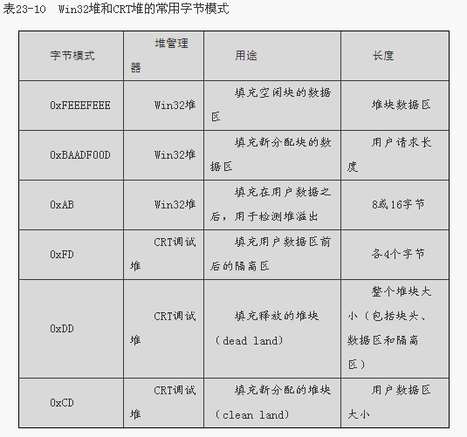
201001V1.1

Slide 58
2. 0xCDs or 0xDDs in memory(3/5)
// DBGHEAP.C
static unsigned char _bNoMansLandFill = 0xFD;
/* fill no-man's land with this */
static unsigned char _bDeadLandFill = 0xDD;
/* fill free objects with this */
static unsigned char _bCleanLandFill = 0xCD;
/* fill new objects with this */
201001V1.1

Slide 59
2. 0xCDs or 0xDDs in memory(4/5)
#include <stdlib.h>
#include <malloc.h>
int main(int argc, char* argv[]) {
char* buffer = (char*)malloc(12);
free(buffer);
buffer = NULL;
return 0;
}
201001V1.1

Slide 60
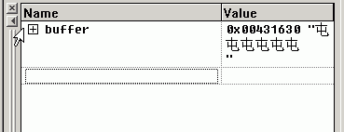
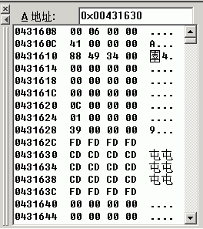
2. 0xCDs or 0xDDs in memory(5/5)
Examine Heap Memory
201001V1.1

Slide 61
6.2.6.4 Debug Heap Management with VC
Inside CRT : Debug Heap Management with Visual C++
  1. Memory Management Function (Review)
  2. 0xCDs or 0xDDs in heap memory
  3. _CrtMemBlockHeader
  4. _crtDbgFlag
201001V1.1

Slide 62
3. _CrtMemBlockHeader(1/15)
For each allocated block, the CRT keeps information in a structure called _CrtMemBlockHeader, which is declared in DBGINT.H
For the previous example, 12 bytes are dynamically allocated, but the CRT allocates more than that by wrapping the allocated block with bookkeeping information.
201001V1.1

Slide 63
3. _CrtMemBlockHeader(2/15)
  #define nNoMansLandSize 4
  typedef struct _CrtMemBlockHeader {
    struct _CrtMemBlockHeader * pBlockHeaderNext;
    struct _CrtMemBlockHeader * pBlockHeaderPrev;
    char * szFileName;
    int nLine;
    size_t nDataSize;
    int nBlockUse;
    long lRequest;
    unsigned char gap[nNoMansLandSize];
    /* followed by:
    unsigned char data[nDataSize];
    unsigned char anotherGap[nNoMansLandSize]; */
  } _CrtMemBlockHeader;
201001V1.1
Notes:
该结构体定义于：DBGINT.H VC的include目录下
https://msdn.microsoft.com/zh-cn/library/974tc9t1(v=vs.120).aspx

Slide 64
3. _CrtMemBlockHeader(3/15)
  #define nNoMansLandSize 4
  typedef struct _CrtMemBlockHeader {
    struct _CrtMemBlockHeader * pBlockHeaderNext;
    struct _CrtMemBlockHeader * pBlockHeaderPrev;
    char * szFileName;
    int nLine;
    size_t nDataSize;
    int nBlockUse;
    long lRequest;
    unsigned char gap[nNoMansLandSize];
    /* followed by:
    * unsigned char data[nDataSize];
    * unsigned char anotherGap[nNoMansLandSize]; */
  } _CrtMemBlockHeader;
pBlockHeaderNext: A pointer to the next block
allocated, but next means the previous
allocated block.
201001V1.1

Slide 65
3. _CrtMemBlockHeader(4/15)
  #define nNoMansLandSize 4
  typedef struct _CrtMemBlockHeader {
    struct _CrtMemBlockHeader * pBlockHeaderNext;
    struct _CrtMemBlockHeader * pBlockHeaderPrev;
    char * szFileName;
    int nLine;
    size_t nDataSize;
    int nBlockUse;
    long lRequest;
    unsigned char gap[nNoMansLandSize];
    /* followed by:
    * unsigned char data[nDataSize];
    * unsigned char anotherGap[nNoMansLandSize]; */
  } _CrtMemBlockHeader;
pBlockHeaderPrev: A pointer to the previous
block allocated; this means the block that
was allocated after the current block.
201001V1.1

Slide 66
3. _CrtMemBlockHeader(5/15)
  #define nNoMansLandSize 4
  typedef struct _CrtMemBlockHeader {
    struct _CrtMemBlockHeader * pBlockHeaderNext;
    struct _CrtMemBlockHeader * pBlockHeaderPrev;
    char * szFileName;
    int nLine;
    size_t nDataSize;
    int nBlockUse;
    long lRequest;
    unsigned char gap[nNoMansLandSize];
    /* followed by:
    * unsigned char data[nDataSize];
    * unsigned char anotherGap[nNoMansLandSize]; */
  } _CrtMemBlockHeader;
szFileName: A pointer to the name of the
file in which the call to malloc was made, if known.
nLine: The line in the source file indicated by
szFileName at which the call to malloc was
made, if known.
201001V1.1

Slide 67
3. _CrtMemBlockHeader(6/15)
  #define nNoMansLandSize 4
  typedef struct _CrtMemBlockHeader {
    struct _CrtMemBlockHeader * pBlockHeaderNext;
    struct _CrtMemBlockHeader * pBlockHeaderPrev;
    char * szFileName;
    int nLine;
    size_t nDataSize;
    int nBlockUse;
    long lRequest;
    unsigned char gap[nNoMansLandSize];
    /* followed by:
    * unsigned char data[nDataSize];
    * unsigned char anotherGap[nNoMansLandSize]; */
  } _CrtMemBlockHeader;
nDataSize: Number of bytes requested
201001V1.1

Slide 68
3. _CrtMemBlockHeader(7/15)
  #define nNoMansLandSize 4
  typedef struct _CrtMemBlockHeader {
    struct _CrtMemBlockHeader * pBlockHeaderNext;
    struct _CrtMemBlockHeader * pBlockHeaderPrev;
    char * szFileName;
    int nLine;
    size_t nDataSize;
    int nBlockUse;
    long lRequest;
    unsigned char gap[nNoMansLandSize];
    /* followed by:
    * unsigned char data[nDataSize];
    * unsigned char anotherGap[nNoMansLandSize]; */
  } _CrtMemBlockHeader;
nBlockUse
0 - Freed block, but not released back to the Win32 heap
(slides pp.78)
1 - Normal block (allocated with new/malloc)
2 - CRT blocks, allocated by CRT for its own use
201001V1.1

Slide 69
3. _CrtMemBlockHeader(8/15)
  #define nNoMansLandSize 4
  typedef struct _CrtMemBlockHeader {
    struct _CrtMemBlockHeader * pBlockHeaderNext;
    struct _CrtMemBlockHeader * pBlockHeaderPrev;
    char * szFileName;
    int nLine;
    size_t nDataSize;
    int nBlockUse;
    long lRequest;
    unsigned char gap[nNoMansLandSize];
    /* followed by:
    * unsigned char data[nDataSize];
    * unsigned char anotherGap[nNoMansLandSize]; */
  } _CrtMemBlockHeader;
lRequest: Counter incremented with each
Allocation. CrtMemBlockHeader
201001V1.1
Notes:
第几个分配的内存块，
在dbugheap.c中定义了static long _lRequestCurr = 1; /* Current request number */
每次分配后会++，然后赋值给当前分配的块的iRequest.

Slide 70
3. _CrtMemBlockHeader(9/15)
  #define nNoMansLandSize 4
  typedef struct _CrtMemBlockHeader {
    struct _CrtMemBlockHeader * pBlockHeaderNext;
    struct _CrtMemBlockHeader * pBlockHeaderPrev;
    char * szFileName;
    int nLine;
    size_t nDataSize;
    int nBlockUse;
    long lRequest;
    unsigned char gap[nNoMansLandSize];
    /* followed by:
    * unsigned char data[nDataSize];
    * unsigned char anotherGap[nNoMansLandSize]; */
  } _CrtMemBlockHeader;
gap: A zone of 4 bytes (in the current implementation)
filled with 0xFD, fencing the data block, of nDataSize
bytes. Another block filled with 0xFD of the same size
follows the data.
201001V1.1

Slide 71
3. _CrtMemBlockHeader(10/15)
When request 12 bytes to be allocated on the heap, malloc() will call HeapAlloc(), requesting 36 more bytes.
blockSize = sizeof(_CrtMemBlockHeader) + nSize + nNoMansLandSize; (followed by…)
malloc requests space for the 12 bytes we need (nSize), plus 32(4*8) bytes for the _CrtMemBlockHeader structure and another nNoMansLandSize bytes (4 bytes) to fence the data zone and close the gap. 32+12 (aligned by dword in condition) +4
Then, malloc() fills the _CrtMemBlockHeader block with information and initializes the data block with 0xCD and no mans land with 0xFD.
201001V1.1
Notes:
Extra infor. Takes:
Each Pointer takes 4 bytes, other variable takes 6*4bytes
Totall 4*9=36

Slide 72
3. _CrtMemBlockHeader(11/15)
201001V1.1

Slide 73
3. _CrtMemBlockHeader(12/15)
Free Memory
  When you call delete/free, the CRT will set the block it requested from HeapAlloc() to 0xDD, indicating this is a free zone.
  If flag _CRTDBG_DELAY_FREE_MEM_DF is set, 0xDD will be used to fulfill the freed heap block; otherwise 0xFEEE will be used.
201001V1.1
Notes:
=_CRTDBG_DELAY_FREE_MEM_DF

Slide 74
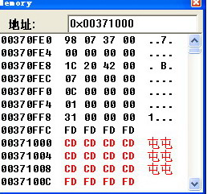
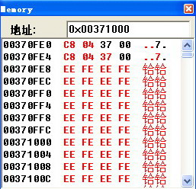
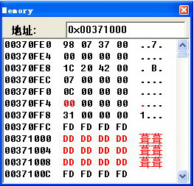
3. _CrtMemBlockHeader(13/15)
_CRTDBG_DELAY_FREE_MEM_DF is NOT set
_CRTDBG_DELAY_FREE_MEM_DF is set
201001V1.1

Slide 75
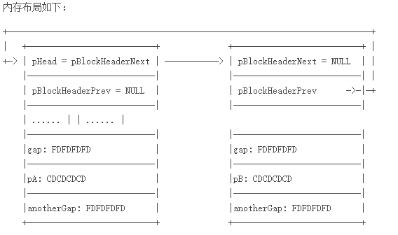
3. _CrtMemBlockHeader(14/15)
#include <stdio.h>
#include <windows.h>
void main()
{
char *pb;
int * pa;
pb = (char *)malloc(9);
pa = (int *)malloc(12);
free(pb);
free(pa);
}
201001V1.1

Slide 76
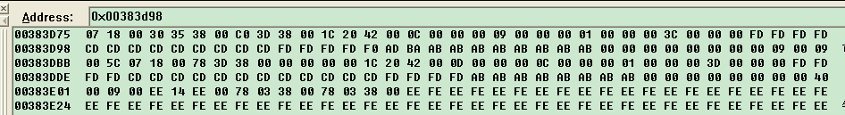

3. _CrtMemBlockHeader(15/15)
00383d78：当前块起始地址
next
prev
地址00383dc0
是next的值
201001V1.1

Slide 77
6.2.6.4 Debug Heap Management with VC
Inside CRT : Debug Heap Management with Visual C++
  1. Memory Management Function (Review)
  2. 0xCDs or 0xDDs in heap memory
  3. _CrtMemBlockHeader
  4. _crtDbgFlag
201001V1.1

Slide 78
4. _crtDbgFlag(1/15)
Retrieves and/or modifies the state of the _crtDbgFlag flag to control the allocation behavior of the debug heap manager (debug version only).
int _CrtSetDbgFlag( int newFlag );
newFlag: New state for the _crtDbgFlag
201001V1.1

Slide 79
4. _crtDbgFlag(2/15)
_crtDbgFlag’s bit fields(位域)
位域 | default | 说明
_CRTDBG_ALLOC_MEM_DF | On | 打开调试分配。当该位为 off 时，分配仍链接在一起，但它们的块类型为 _IGNORE_BLOCK 。
_CRTDBG_DELAY_FREE_MEM_DF | Off | 防止实际释放内存，与模拟内存不足情况相同。当该位为 on 时，已释放块保留在调试堆的链接列表中，但标记为 _FREE_BLOCK ，并用特殊字节值填充0XDD。
_CRTDBG_CHECK_ALWAYS_DF | Off | 导致每次分配和释放时均调用 _CrtCheckMemory 。这将减慢执行，但可快速捕捉错误。
_CRTDBG_CHECK_CRT_DF | Off | 导致将标记为 _CRT_BLOCK 类型的块包括在泄漏检测和状态差异操作中。当该位为 off 时，在这些操作期间将忽略由运行时库内部使用的内存。
_CRTDBG_LEAK_CHECK_DF | Off | 导致在程序退出时通过调用 _CrtDumpMemoryLeaks 来执行泄漏检查。如果应用程序未能释放其所分配的所有内存，将生成错误报告。
201001V1.1

Slide 80
4. _crtDbgFlag(3/15)
Set one or more _crtDbgFlag bit field, and create new state for the flag
  1. Call _CrtSetDbgFlag with newFlag equal to _CRTDBG_REPORT_FLAG to obtain the current _crtDbgFlag state and store the returned value in a temporary variable.
// Get the current state of the flag
// and store it in a temporary variable
int tmpFlag =
_CrtSetDbgFlag( _CRTDBG_REPORT_FLAG );
201001V1.1

Slide 81
4. _crtDbgFlag(4/15)
Set one or more _crtDbgFlag bit field, and create new state for the flag
  2. Turn on any bits by OR-ing the temporary variable with the corresponding bitmasks
// Turn On (OR) - Keep freed memory blocks in the
// heap’s linked list and mark them as freed
tmpFlag |= _CRTDBG_DELAY_FREE_MEM_DF;
201001V1.1

Slide 82
4. _crtDbgFlag(5/15)
Set one or more _crtDbgFlag bit field, and create new state for the flag
  3. Turn off the other bits by AND-ing the variable with a bitwise NOT of the appropriate bitmasks.
// Turn Off (AND) - prevent _CrtCheckMemory from
// being called at every allocation request
tmpFlag &= ~_CRTDBG_CHECK_ALWAYS_DF;
201001V1.1

Slide 83
4. _crtDbgFlag(6/15)
Set one or more _crtDbgFlag bit field, and create new state for the flag
  4. Call _CrtSetDbgFlag with newFlag equal to the value stored in the temporary variable to set the new state for _crtDbgFlag.
// Set the new state for the flag _CrtSetDbgFlag( tmpFlag );
201001V1.1

Slide 84
4. _crtDbgFlag(7/15)
#define _CRTDBG_MAP_ALLOC//which file and line cause leak
#include <stdlib.h>
#include <malloc.h>
#include <crtdbg.h>
int main(int argc, char* argv[]) {
int tmpFlag = _CrtSetDbgFlag( _CRTDBG_REPORT_FLAG );
tmpFlag |= _CRTDBG_DELAY_FREE_MEM_DF;
_CrtSetDbgFlag( tmpFlag );
char* buffer = (char*)malloc(12);
free(buffer);
buffer = NULL;
return 0;
}
201001V1.1
Notes:
#define _CRTDBG_MAP_ALLOC 如果取消该宏定义，则_EILE_,_LINE_的内容不填入动态分配块的头里面，里面的值
就为0，0

Slide 85
4. _crtDbgFlag(8/15)
You can avoid giving back the block to the Win32 heap by using the CRTDBG_DELAY_FREE_MEM_DF flag to _CrtSetDbgFlag().
It prevents memory from actually being freed.
When CRTDBG_DELAY_FREE_MEM_DF flag is on, freed blocks are kept in the debug heap's linked list but are marked as _FREE_BLOCK.
  通常，所释放的块将从列表中移除。为了检查是否仍在向已释放的内存写入数据，或为了模拟内存不足情况，可以选择在链接列表上保留已释放块。
  This is useful if you want to detect dangling pointers errors, which can be done by verifying if the freed block is written with 0xDD pattern or something else.
201001V1.1

Slide 86
The following code is taken from:
  File: C:\Microsoft Visual Studio\VC98\CRT\SRC\DBGHEAP.C
  Function: __cdecl _free_dbg()
To illustrate how the two-way linked list is modified when delete a node from it.
201001V1.1

Slide 87
4. _crtDbgFlag(9/15)
/* optionally reclaim memory */
if (!(_crtDbgFlag & _CRTDBG_DELAY_FREE_MEM_DF)) {
/* remove from the linked list, not delay */
if (pHead -> pBlockHeaderNext) {
pHead -> pBlockHeaderNext -> pBlockHeaderPrev =
pHead -> pBlockHeaderPrev;
}
else {
_ASSERTE(_pLastBlock == pHead);
_pLastBlock = pHead -> pBlockHeaderPrev;
}
201001V1.1

Slide 88
4. _crtDbgFlag(10/15)
if (pHead->pBlockHeaderPrev) {
pHead -> pBlockHeaderPrev -> pBlockHeaderNext =
pHead->pBlockHeaderNext;
}
else {
_ASSERTE(_pFirstBlock == pHead);
_pFirstBlock = pHead->pBlockHeaderNext;
}
201001V1.1

Slide 89
4. _crtDbgFlag(11/15)
/* fill the entire block including header with dead-land-fill */
memset ( pHead, _bDeadLandFill,
sizeof( _CrtMemBlockHeader) +
pHead->nDataSize + nNoMansLandSize );
_free_base(pHead);
}
201001V1.1

Slide 90
4. _crtDbgFlag(12/15)
else {
pHead -> nBlockUse = _FREE_BLOCK;
/* keep memory around as dead space */
memset ( pbData(pHead),
_bDeadLandFill,
pHead -> nDataSize);
}
}
201001V1.1
Notes:
不删除块，所以不用修改链表指针，仅仅做填充

Slide 91
4. _crtDbgFlag(13/15)
#define _CRTDBG_MAP_ALLOC //which file and line cause leak
#include <stdio.h>
#include <malloc.h>
#include <crtdbg.h>
int main(int argc, char* argv[]) {
//不影响mem leak detect
//int tmpFlag = _CrtSetDbgFlag( _CRTDBG_REPORT_FLAG );
// tmpFlag |= _CRTDBG_LEAK_CHECK_DF;
// _CrtSetDbgFlag( tmpFlag );
char* buffer = (char*)malloc(12);
// free(buffer);
// buffer = NULL;
_CrtDumpMemoryLeaks();
return 0; }
201001V1.1

Slide 92
//功能同上页
#define _CRTDBG_MAP_ALLOC
#include <stdlib.h>
#include <malloc.h>
#include <crtdbg.h>
int main(int argc, char* argv[]) {
//auto invoke _CrtDumpMemoryLeaks() by set flag
int tmpFlag = _CrtSetDbgFlag( _CRTDBG_REPORT_FLAG );
tmpFlag |= _CRTDBG_LEAK_CHECK_DF ;
_CrtSetDbgFlag( tmpFlag );
char* buffer = (char*)malloc(12);
// free(buffer);
// buffer = NULL;
// _CrtDumpMemoryLeaks();
return 0;
}
201001V1.1

Slide 93
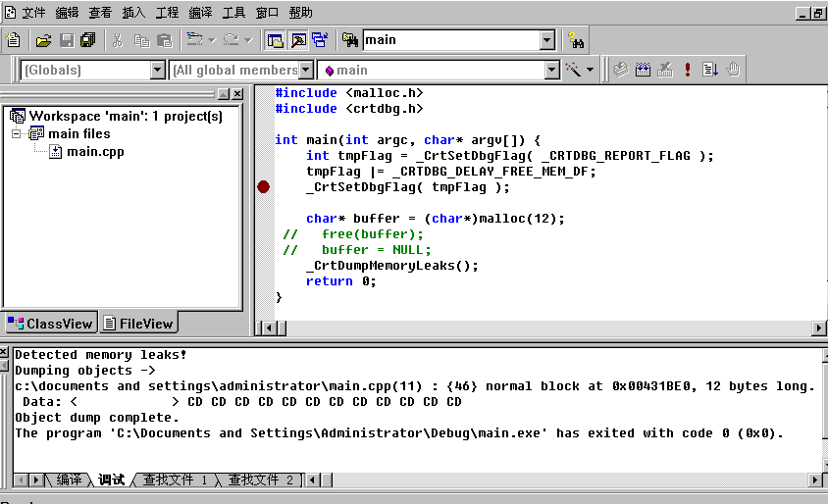
4. _crtDbgFlag(14/15)
The program will output the following message on VC debug mode:
201001V1.1

Slide 94
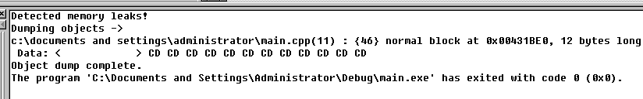
4. _crtDbgFlag(15/15)
c:\documents and settings\administrator\main.cpp(11)显示分配泄漏内存的文件名，以及文件名后括号中的数字表示发生泄漏的代码行号
{xx}：花括弧内的数字是内存分配序号，本文例子中是 {46} ；
block：内存块的类型，本文例子中是：normal block；
用十六进制格式表示的内存位置，如：at 0x00431BE0 等；
以字节为单位表示的内存块的大小，如：12 bytes long；
前 16 字节的内容（也是用十六进制格式表示），如：Data: <CD>
201001V1.1
Notes:
泄露字节大于16时，只显示前 16 字节的内容,此处因为只有12字节所以全部显示

Slide 95
Summery
Implementation Issues
  How much memory for allocation?
  How do we know how much memory to free just given a pointer?
  How do we keep track of the free blocks?
201001V1.1

