Slide 1



System Level Programming
Unit 11 Memory Operation and Performance
李靓 (Li Jing) lijing712@scu.edu.cn
School of Computer Science / Software Engineering

Slide 2
Memory Operation and Performance
11.0 Review
11.1 Memory Technology [CSAPP 6.1]
11.2 Memory Hierarchies [CSAPP 6.3]
11.3 Locality [CSAPP 6.2]
11.4 Memory Mountain Lab [CSAPP 6.6]

Slide 3
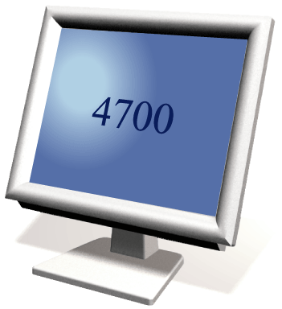

11.0 Review
The module of CS that have been using until now
Memory
Step 1. Fetch instruction
Step 4. Store results
Processor
ALU
Control Unit
Step 3. Execute instruction
Step 2. Decode instruction

Slide 4
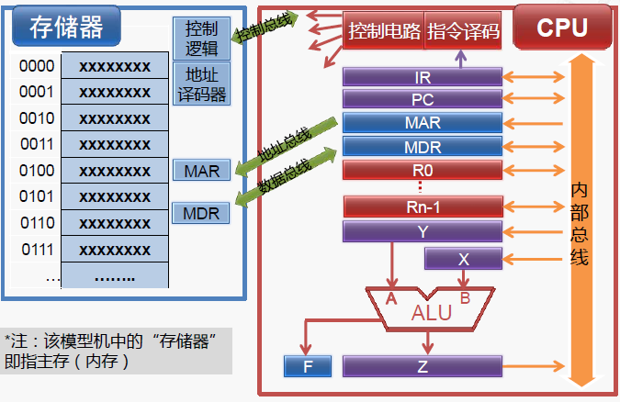
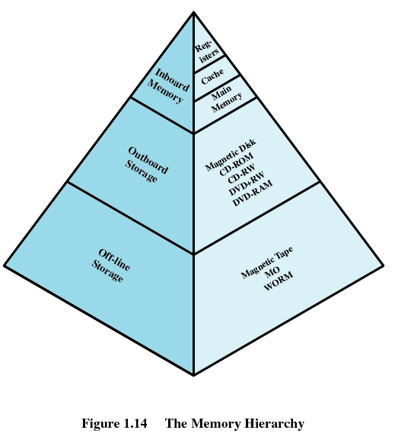
11.0 Review
The module of CS that have been using until now
Memory
Control logic
Control bus
Control circuit
Instruction decoder
Address decoder
Address bus
Data bus
BUS

Slide 5
Memory Operation and Performance
11.0 Review
11.1 Memory Technology [CSAPP 6.1]
11.2 Memory Hierarchies [CSAPP 6.3]
11.3 Locality [CSAPP 6.2]
11.4 Memory Mountain Lab [CSAPP 6.6]

Slide 6
11.1 Memory Technology
11.1.1 Random-Access Memory (RAM)
11.1.2 Read only Memory (ROM)
11.1.3 Disk Storage
11.1.4 SSD/Flash
11.1.5 Storage Technology Trends

Slide 7
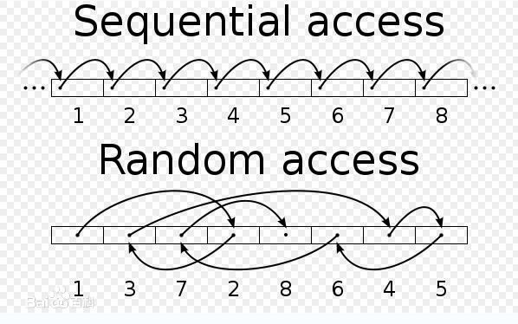
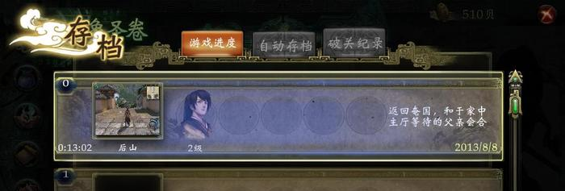
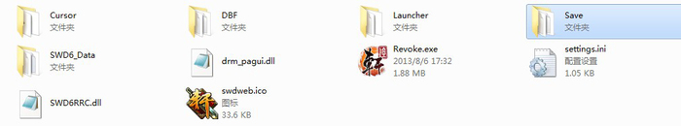
11.1.1 Random-Access Memory (RAM)
Random-Access Memory (RAM)
Random-Access
Volatile (易失性)

Slide 8
11.1.1 Random-Access Memory (RAM)
RAM comes in two varieties
SRAM (Static RAM)
DRAM (Dynamic RAM)
 | Tran. per bit | Access time | Needs refresh? | Sensitive? | Cost | Applications
SRAM | 6 | 1X | No | No | 100X | Cache memories
DRAM | 1 | 10X | Yes | Yes | 1X | Main memories Frame buffers

Slide 9
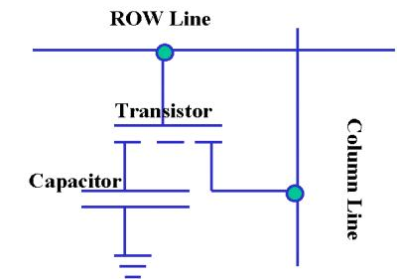
11.1.1 Random-Access Memory (RAM)
DRAM (Dynamic RAM)
Each cell stores one bit
Transistor (晶体管) + Capacitor (电容) [1T1C]
Refreshed every 10-100 ms
Word line
Bit line

Slide 10
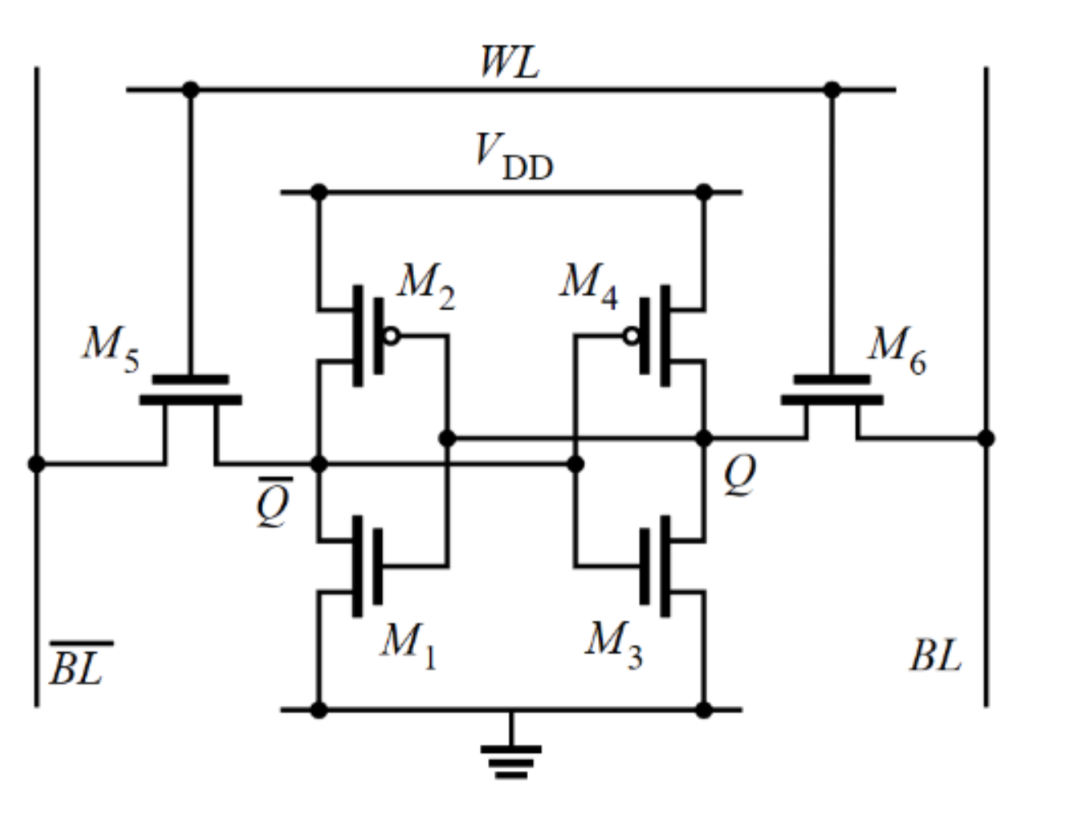
11.1.1 Random-Access Memory (RAM)
SRAM (Static RAM)
Each cell stores one bit
6-transistor circuit

Slide 11
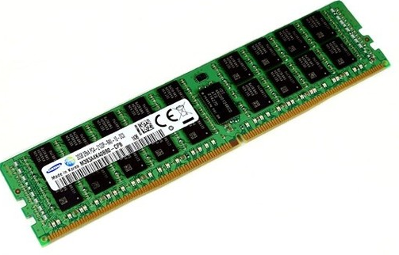

11.1.1 Random-Access Memory (RAM)
Key features - outside
Traditionally packaged as a chip
Multiple RAM chips form a memory
SIMM (Single Inline Memory Module) 单列直插内存模块
DIMM (Dual Inline Memory Module) 双列直插内存模块

Slide 12
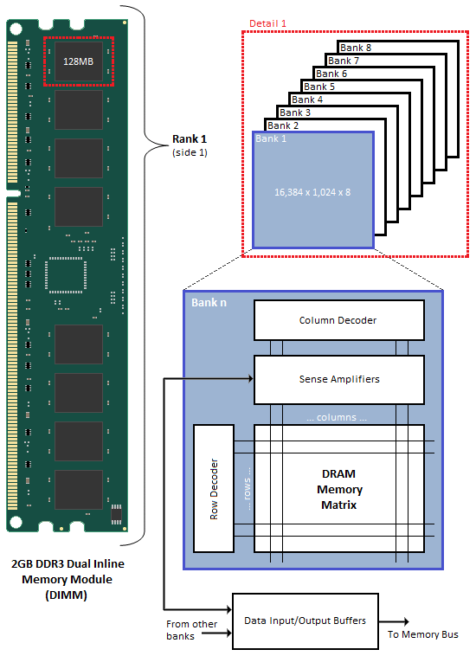
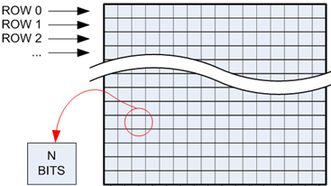
11.1.1 Random-Access Memory (RAM)
Key features – inside
Cell
Supercell
Module
8 bits Supercell

Slide 13
11.1.1 Random-Access Memory (RAM)
Multiple Cells -> Supercell
16 x 8 DRAM chip
cols
0
1
2
3
Memory
controller
2 bits
/
0
addr
1
rows
2
supercell
(2,1)
(to/from CPU)
3
8 bits
/
data
Internal row buffer

Slide 14
11.1.1 Random-Access Memory (RAM)
Step 1(a): Row Access Strobe (RAS) selects row 2.
Step 1(b): Row 2 copied from DRAM array to row buffer.
16 x 8 DRAM chip
Cols
Memory
controller
RAS = 2
0
1
2
3
2 bits
/
0
addr
1
Rows
2
8 bits
/
3
data
Internal row buffer

Slide 15
11.1.1 Random-Access Memory (RAM)
Step 2(a): Column Access Strobe (CAS) selects column 1.
Step 2(b): Supercell (2,1) copied form buffer to data lines, and eventually back to CPU.
Cols
Memory
controller
CAS = 1
0
1
2
3
2 bits
/
0
addr
To CPU
1
Rows
2
supercell
(2,1)
3
8 bits
/
data
supercell
(2,1)
Internal row buffer

Slide 16
11.1.1 Random-Access Memory (RAM)
Multiple Supercells -> Module
addr (row = i, col = j)
: supercell (i,j)
DRAM 0
64 MB
memory module
consisting of
eight 8Mx8 DRAMs
DRAM 7
bits
56-63
bits
48-55
bits
40-47
bits
32-39
bits
24-31
bits
16-23
bits
8-15
bits
0-7
63
63
56
56
55
55
48
48
47
47
40
40
39
39
32
32
31
31
24
24
23
23
16
16
15
15
8
8
7
7
0
0
Memory
controller
64-bit word main memory address A
64-bit word

Slide 17
11.1.1 Random-Access Memory (RAM)
CPU access RAM via traditional BUS structure
A collection of parallel wires that carry address, data, and control signals.
Typically shared by multiple devices.
CPU chip
Register file
ALU
System bus
Memory bus
Main
memory
Bus interface
I/O
bridge

Slide 18
11.1.1 Random-Access Memory (RAM)
What can the memory controller do?
Address to RAS and CAS
Control the transactions of memory
Buffer
CPU chip
Register file
A memory controller inside
ALU
System bus
Memory bus
Main
memory
Bus interface
I/O
bridge

Slide 19
11.1.1 Random-Access Memory (RAM)
Memory read transaction
Load operation
Register file
mov eax, [A]
ALU
%eax
Main memory
I/O bridge
A
0
Bus interface
A
x

Slide 20
11.1.1 Random-Access Memory (RAM)
Memory read transaction (1)
CPU places address A on the bus
Register file
mov eax, [A]
ALU
%eax
Main memory
I/O bridge
A
0
Bus interface
A
x

Slide 21
11.1.1 Random-Access Memory (RAM)
Memory read transaction (2)
Main memory read A from the bus, retrieves word x, and places it on the bus
Register file
mov eax, [A]
ALU
%eax
Main memory
I/O bridge
x
0
Bus interface
A
x

Slide 22
11.1.1 Random-Access Memory (RAM)
Memory read transaction (3)
CPU read word x from the bus and copies it to register eax
Register file
mov eax, [A]
ALU
%eax
x
Main memory
I/O bridge
0
Bus interface
A
x

Slide 23
11.1.1 Random-Access Memory (RAM)
Memory write transaction
Store operation
Register file
mov [A], eax
ALU
%eax
Main memory
I/O bridge
A
0
Bus interface
A
x

Slide 24
11.1.1 Random-Access Memory (RAM)
Memory write transaction (1)
CPU places address A on bus. Main memory reads it and waits for corresponding data
Register file
mov [A], eax
ALU
%eax
y
Main memory
I/O bridge
0
A
Bus interface
A

Slide 25
11.1.1 Random-Access Memory (RAM)
Memory write transaction (2)
CPU places data y on the bus
Register file
mov [A], eax
ALU
%eax
y
Main memory
I/O bridge
0
y
Bus interface
A

Slide 26
11.1.1 Random-Access Memory (RAM)
Memory write transaction (3)
Main memory read data y from the bus and stores it at address A
Register file
mov [A], eax
ALU
%eax
y
main memory
I/O bridge
0
Bus interface
A
y

Slide 27
11.1.1 Random-Access Memory (RAM)
Enhanced DRAMs
FPM DRAM
快页模式
EDO DRAM
扩展数据输出
SDRAM
同步DRAM
RDRAM
Rambus DRAM
DDR SDRAM
双倍速率SDRAM
DDR2/DDR3 SDRAM

Slide 28
11.1 Memory Technology
11.1.1 Random-Access Memory (RAM)
11.1.2 Read only Memory (ROM)
11.1.3 Disk Storage
11.1.4 SSD/Flash
11.1.5 Storage Technology Trends

Slide 29
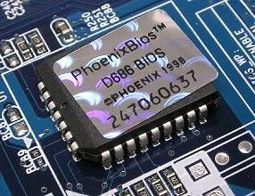
11.2 Read only Memory (ROM)
Read Only Memory (ROM) – key features
Nonvolatile (非易失性)
Read only
Types
PROM (可编程)
EPROM (可擦除可编程)
EEPROM (电可擦除可编程)
Flash (U disk, cell phone, digital camera…)

Slide 30
11.2 Read only Memory (ROM)
Firmware
Program stored in ROM
Boot time code such as BIOS
Graphics card BIOS
Disk controller
Wireless network card

Slide 31
11.1 Memory Technology
11.1.1 Random-Access Memory (RAM)
11.1.2 Read only Memory (ROM)
11.1.3 Disk Storage
11.1.4 SSD/Flash
11.1.5 Storage Technology Trends

Slide 32
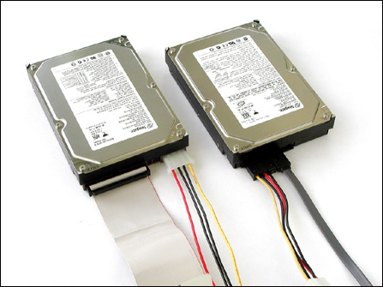
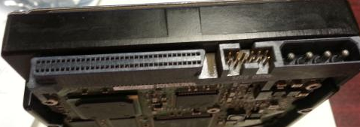
11.1.3 Disk Storage
Disk
Hard disk
IDE/SATA
SCSI
C:或D: 1TB、2TB

Slide 33
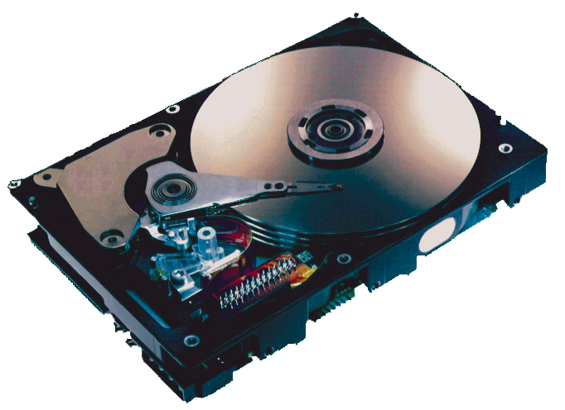
11.1.3 Disk Storage
What’s inside a disk driver
Arm 机械手臂
Spindle 主轴
Platters 盘片
Main control chip
主控芯片
(including a
processor
and memory!)
Connector
外部接口

Slide 34
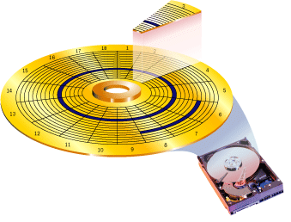
11.1.3 Disk Storage
Inside static
Platters | Surfaces | Tracks | Sectors | Gaps
扇区 Sector
track k
gaps
磁道 Track
面 Surface
sectors
面 Surface

Slide 35
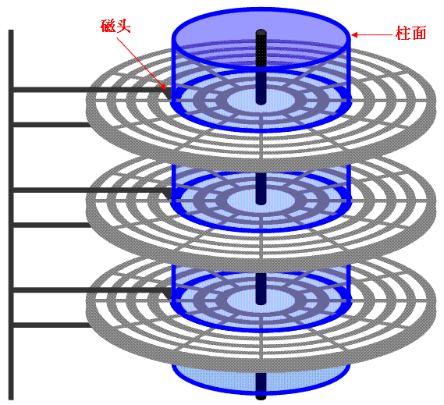
11.1.3 Disk Storage
Inside static
Head 磁头
Cylinder 柱面
Surface 0
Platter 0
Surface 1
Surface 2
Platter 1
Surface 3
Surface 4
Platter 2
Surface 5

Slide 36
11.1.3 Disk Storage
Capacity (容量) is the maximum number of bits that can be stored
Usually in GB (GigaBytes), TB (TeraByte )
Related factors
Recording density (bits/inch segment of a track)
Track density (tracks/inch radial segment)
Areal density (bits/in2) Product of the above

Slide 37
11.1.3 Disk Storage
Modern disks
Recording zones
Average number of sectors/tracks when computing capacity
…
Spindle
Capacity = (# bytes/sector) x (avg. # sectors/track) x
(# tracks/surface) x (# surfaces/platter) x
(# platters/disk)

Slide 38
11.1.3 Disk Storage
Example
512 bytes/sector
300 sectors/track (on average)
20,000 tracks/surface
2 surfaces/platter
5 platters/disk
Capacity = 512 x 300 x 20000 x 2 x 5
= 30,720,000,000
= 30.72 GB

Slide 39
11.1.3 Disk Storage
Disk operation
The disk surface
spins at a fixed
rotational rate
spindle
spindle
spindle
spindle
spindle

Slide 40
11.1.3 Disk Storage
Disk access - Read
About to read blue sector

Slide 41
11.1.3 Disk Storage
Disk access - Read
After BLUE read
After reading blue sector

Slide 42
11.1.3 Disk Storage
Disk access - Read
After BLUE read
Red request scheduled next

Slide 43
11.1.3 Disk Storage
Disk access - Seek
After BLUE read
Seek for RED
Seek to red’s track

Slide 44
11.1.3 Disk Storage
Disk access – Rotational latency
After BLUE read
Seek for RED
Rotational latency
Wait for red sector to rotate around

Slide 45
11.1.3 Disk Storage
Disk access - Read
After BLUE read
Seek for RED
Rotational latency
After RED read
Complete read of red

Slide 46
11.1.3 Disk Storage
Disk access – Service time component
After BLUE read
Seek for RED
Rotational latency
After RED read
Data transfer
Seek
Rotational
latency
Data transfer

Slide 47
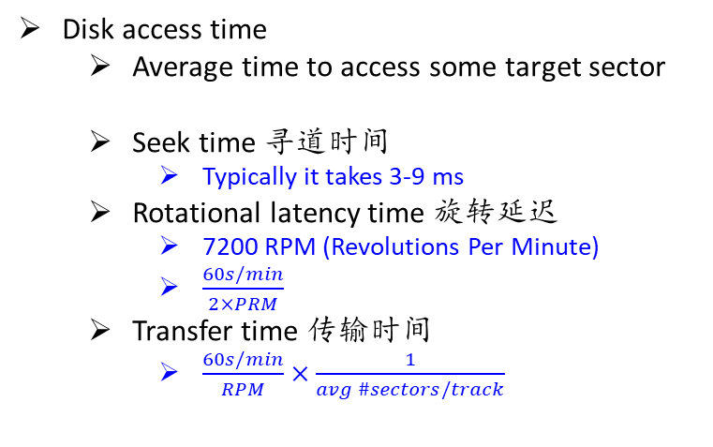
11.1.3 Disk Storage
Disk access time
Average time to access some target sector
Seek time 寻道时间
Typically it takes 3-9 ms
Rotational latency time 旋转延迟
7200 RPM (Revolutions Per Minute)
$\frac{60s/min}{2×PRM}$
Transfer time 传输时间
$\frac{60s/min}{RPM}×\frac{1}{avg \#sectors/track}⁡$
$$T_{access} =T_{avg_seek}+T_{avg_rotation}+T_{avg_transfer}$$

Slide 48
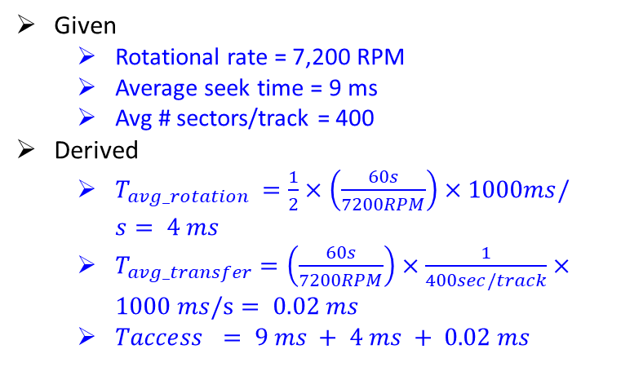
11.1.3 Disk Storage
Given
Rotational rate = 7,200 RPM
Average seek time = 9 ms
Avg # sectors/track = 400
Derived
$T_{avg_rotation} =\frac{1}{2}×\left(\frac{60s}{7200RPM}\right)×1000ms/s⁡= 4 ms$
$T_{avg_transfer}=\left(\frac{60s}{7200RPM}\right)×\frac{1}{400sec/track}×1000 ms/s⁡= 0.02 ms$
$Taccess = 9 ms + 4 ms + 0.02 ms$

Slide 49
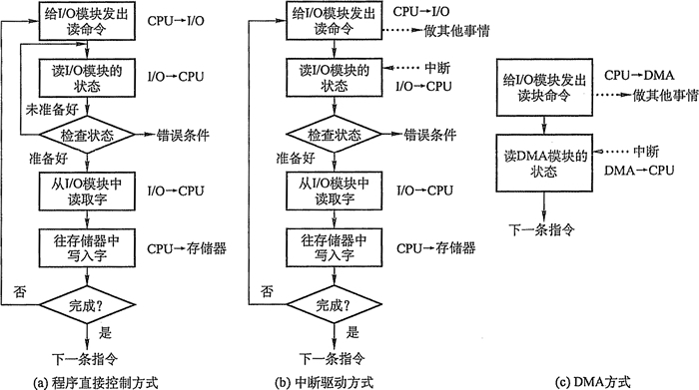
11.1.3 Disk Storage
CPU access disk
Bus and I/O ports
DMA and interrupt

Slide 50
11.1.3 Disk Storage
CPU chip
Register file
Load from disk to memory
ALU
System bus
Memory bus
Main
memory
Bus interface
I/O
bridge
I/O bus
Expansion slots for
other devices such
as network adapters.
USB
controller
Graphics
adapter
Disk
controller
Mouse
Keyboard
Monitor
Disk

Slide 51
11.1.3 Disk Storage
CPU chip
Command = logical block number + destination memory address to a port (address) associated with disk controller.
Register file
ALU
Main
memory
Bus interface
I/O bus
USB
controller
Graphics
adapter
Disk
controller
mouse
keyboard
Monitor
Disk

Slide 52
11.1.3 Disk Storage
CPU chip
Disk controller reads the sector and performs a direct memory access (DMA) transfer into main memory.
Register file
ALU
Main
memory
Bus interface
I/O bus
USB
controller
Graphics
adapter
Disk
controller
Mouse
Keyboard
Monitor
Disk

Slide 53
11.1.3 Disk Storage
CPU chip
When the DMA transfer completes, the disk controller notifies the CPU with an interrupt (i.e., asserts a special “interrupt” pin on the CPU)
Register file
ALU
Main
memory
Bus interface
I/O bus
USB
controller
Graphics
adapter
Disk
controller
Mouse
Keyboard
Monitor
Disk

Slide 54
11.1.3 Disk Storage
Logical disk blocks in modern disks
An abstract of the complex sector geometry
A sequence of b-sized logical blocks (0,1,2,…)
Mapping 映射
Maintained by disk controller
Logical block (0,1,2,…) -> (surface, track, sector)
Allows controller to set aside spare cylinder for each zone
“formatted capacity” and “maximum capacity”

Slide 55
11.1.3 Disk Storage
What can disk controller do?
Logical blocks -> physical blocks of CHS
Control operations on the disk
Buffer
Interrupt

Slide 56
11.1 Memory Technology
11.1.1 Random-Access Memory (RAM)
11. 1.2 Read only Memory (ROM)
11.1.3 Disk Storage
11.1.4 SSD/Flash
11.1.5 Storage Technology Trends

Slide 57
11.1.4 SSD/Flash
Solid State Disks (SSDs)
I/O bus
Requests to read and
write logical disk blocks
Solid State Disk (SSD)
Flash
translation layer
Flash memory
Block 0
…
…
Block B-1
…
Page 0
Page 1
Page P-1
Page 0
Page 1
Page P-1
Pages: 4KB, 8KB, or 16KB | Blocks: 32, 64, 129 or 256
Data read/written in units of pages.
Page written only when its block been erased
A block wears out after about 100,000 repeated writes

Slide 58
11.1.4 SSD/Flash
SSD performance characteristics
Sequential access faster than random access
Why are random writes so slow?
Sequential read tput 550 MB/s Sequential write tput 470 MB/s
Random read tput 365 MB/s Random write tput 303 MB/s
Avg seq read time 50 us Avg seq write time 60 us
Pages cannot be overwritten when modifying a page
Erasing a block triggered by GC takes a long time (~1 ms)

Slide 59
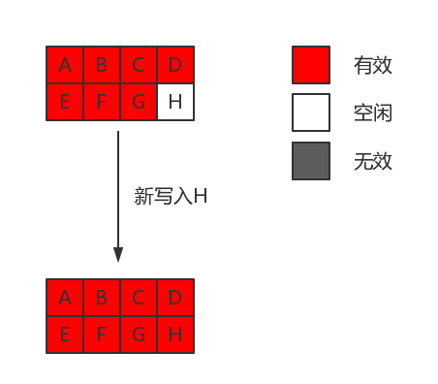
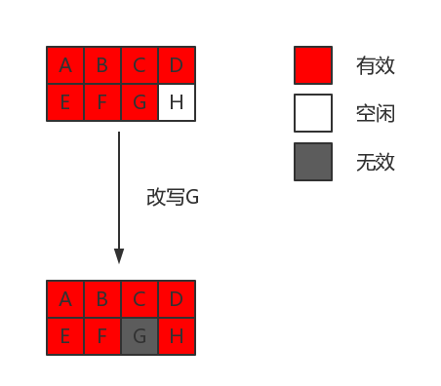
11.1.4 SSD/Flash
Random writes
Write page H
Modify page G

Slide 60
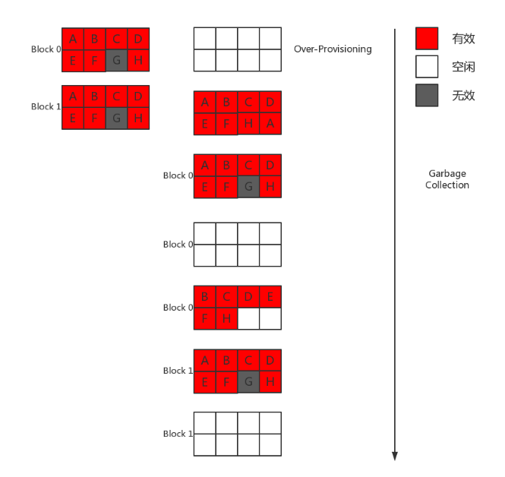
11.1.4 SSD/Flash
Random writes
Garbage collection

Slide 61
11.1.4 SSD/Flash
SSD tradeoffs V.S. Rotating disks
Advantages
No arm -> Faster, less power, more rugged
Disadvantages
The potential to ware out
About 30 times more expensive per byte in 2015
Applications
Smart phones, laptops
Desktops and servers

Slide 62
11.1 Memory Technology
11.1.1 Random-Access Memory (RAM)
11. 1.2 Read only Memory (ROM)
11.1.3 Disk Storage
11.1.4 SSD/Flash
11.1.5 Storage Technology Trends

Slide 63
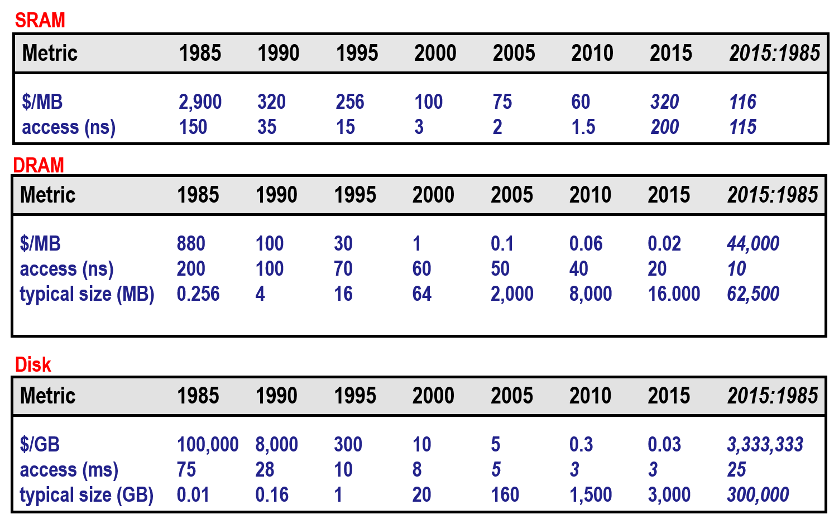
11.1.5 Storage Technology Trends
Storage trends

Slide 64
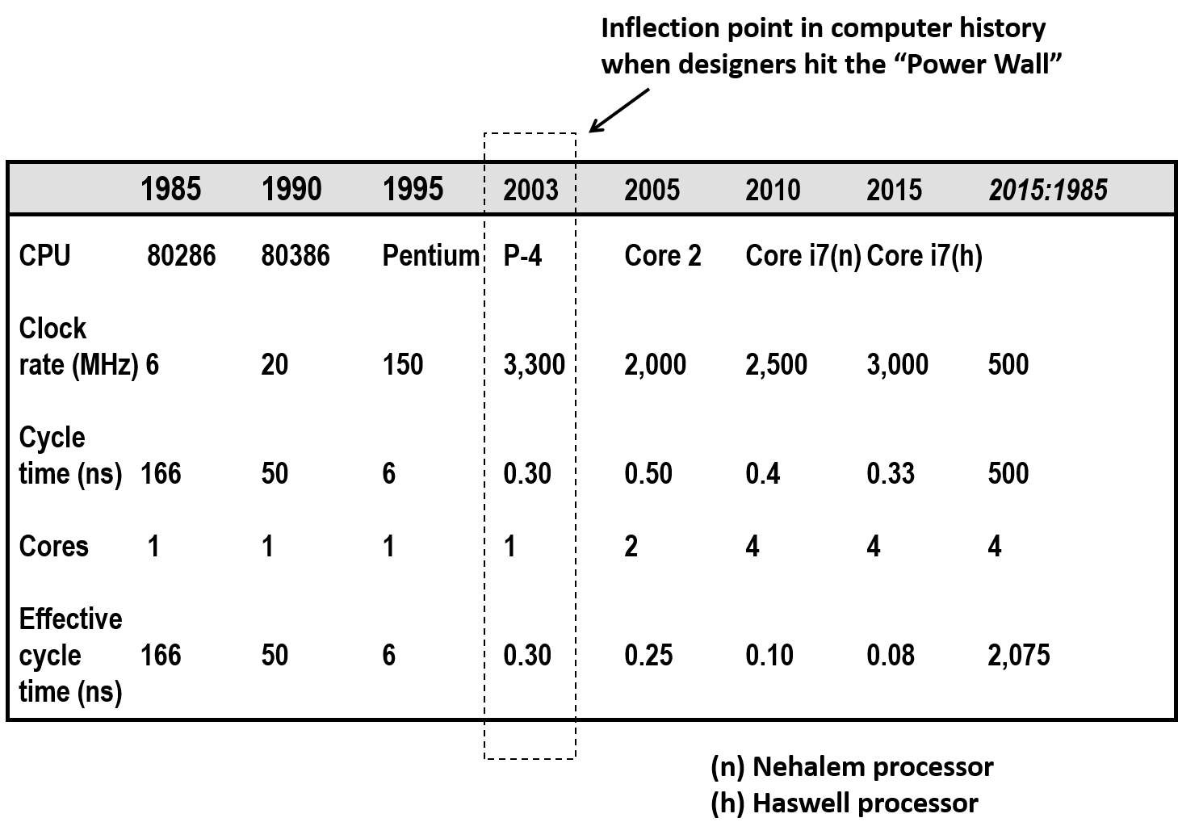
11.1.5 Storage Technology Trends
CPU clock rate

Slide 65
11.1.5 Storage Technology Trends
The CPU-MEMORY gap
Disk
SSD
DRAM
SRAM
CPU

Slide 66
Memory Operation and Performance
11.0 Review
11.1 Memory Technology [CSAPP 6.1]
11.2 Memory Hierarchies [CSAPP 6.3]
11.3 Locality [CSAPP 6.2]
11.4 Memory Mountain Lab [CSAPP 6.6]

Slide 67
11.2 Memory Hierarchies
Design constraints of a computer’s memory
Balance among (Speed, Price, Capacity)
Faster access time but smaller capacity
Greater capacity but more expensive per bit
Smaller cost per bit but slower access speed
Trade off – To use them all in hierarchy
How many | How fast | How much
Capacity | Speed | Price
Larger | Faster (= CPU) | Lower

Slide 68
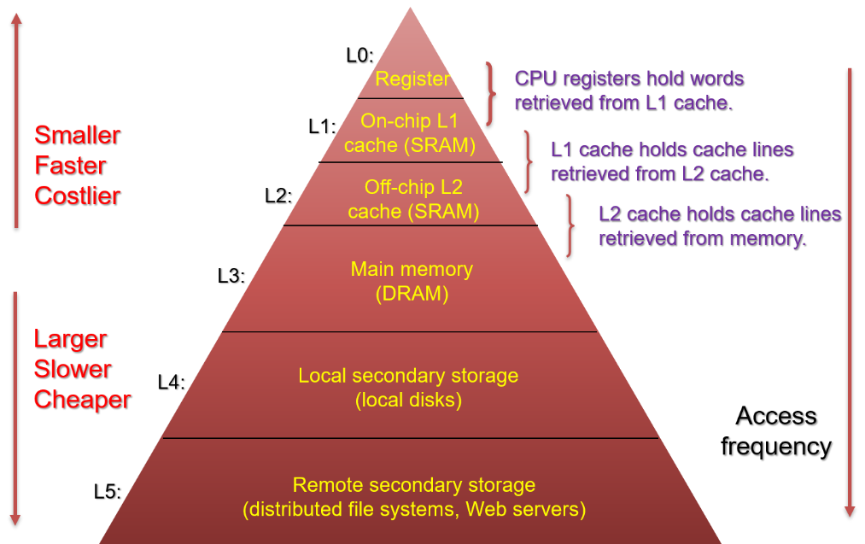
11.2 Memory Hierarchies

Slide 69
11.2 Memory Hierarchies
Why do memory hierarchies work?
Programs tend to access data at level k more often than they access data at level k+1
Storage at level k+1 can be slower, thus larger and cheaper per bit
Fundamental idea
Level k serves as a cache for level k+1
Level k+1 serves as a backup for level k

Slide 70
11.2 Memory Hierarchies
8
Level k
4
9
14
10
3
Data is copied in block-sized transfer units
4
10
0
1
2
3
Level k+1
4
4
5
6
7
8
9
10
10
11
12
13
14
15

Slide 71
11.2 Memory Hierarchies
Cache hit
Request: 14
Data in block b is needed
Block b is in cache:
Hit!
Cache
8
9
14
3
14
Memory
0
1
2
3
4
5
6
7
8
9
10
11
12
13
14
15

Slide 72
11.2 Memory Hierarchies
Catch miss
Request: 12
Data in block b is needed
Block b is not in cache:
Miss!
Cache
8
9
14
3
12
Block b is fetched from
memory
12
Request: 12
Block b is stored in cache
Placement policy: determines where b goes
Replacement policy: determines which block gets evicted (victim)
Memory
0
1
2
3
4
5
6
7
8
9
10
11
12
12
13
14
15

Slide 73
11.2 Memory Hierarchies
Types of cache misses
Code (compulsory) miss
When cache is empty
Capacity miss
When active cache blocks is larger than cache
Conflict miss
Cache limit blocks at level k+1 to a small subset of the block positions at level k
i mod 4
Reference blocks 0,2,0,2,0,2,…

Slide 74
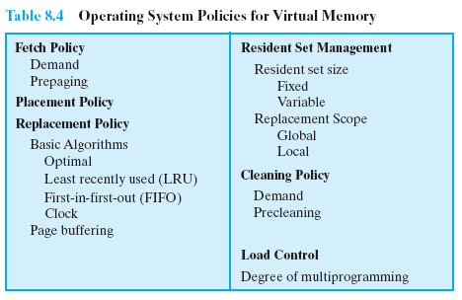
11.2 Memory Hierarchies
Policy, related to transfer between two levels

Slide 75
11.2 Memory Hierarchies
Examples of caching in memory hierarchy
Cache Type
What is Cached?
Where is it Cached?
Latency (cycles)
Managed By
Registers
4-8 bytes words
CPU core
0
Compiler
TLB
Address translations
On-Chip TLB
0
Hardware MMU
L1 cache
64-byte blocks
On-Chip L1
4
Hardware
L2 cache
64-byte blocks
On-Chip L2
10
Hardware
Virtual Memory
4-KB pages
Main memory
100
Hardware + OS
Buffer cache
Parts of files
Main memory
100
OS
Disk cache
Disk sectors
Disk controller
100,000
Disk firmware
Network buffer cache
Parts of files
Local disk
10,000,000
NFS client
Browser cache
Web pages
Local disk
10,000,000
Web browser
Web cache
Web pages
Remote server disks
1,000,000,000
Web proxy server

Slide 76
Memory Operation and Performance
11.0 Review
11.1 Memory Technology [CSAPP 6.1]
11.2 Memory Hierarchies [CSAPP 6.3]
11.3 Locality [CSAPP 6.2]
11.4 Memory Mountain Lab [CSAPP 6.6]

Slide 77
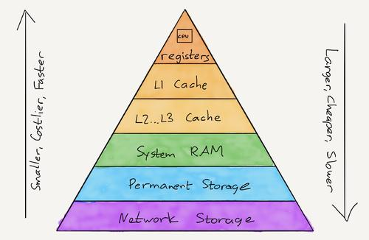
11.3 Locality
Transferring block between levels cost time
Have the data already in fast memory by the time CPU actually requests it
How to fulfill this goal?

Slide 78
11.3 Locality
Principle of locality
Programs tend to use data and instructions with addresses near or equal to those they have used recently
Locality is an attribute of program that
Programs with good locality run faster
Locality is important to
Memory hierarchy
Hardware design
Software design (To make programs with better locality)

Slide 79
11.3 Locality
Types
Temporal locality
Recently referenced items
are likely to be referenced
again
Spatial locality
Items with nearby addresses
tend to be referenced close
together in time

Slide 80
11.3 Locality
Example
Assume
MAX = 2
Starting address for instructions is FRAG
Local variable sum and i are at addresses STACKPTR+X and STACKPTR+X+4
Global variable array is at address ARRAY
sum = 0;
for (i = 0; i < MAX; i++)
sum += array[i];

Slide 81
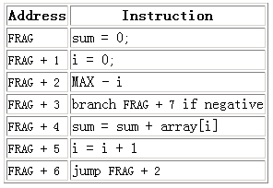
11.3 Locality
sum = 0;
for (i = 0; i < MAX; i++)
sum += array[i];

Slide 82
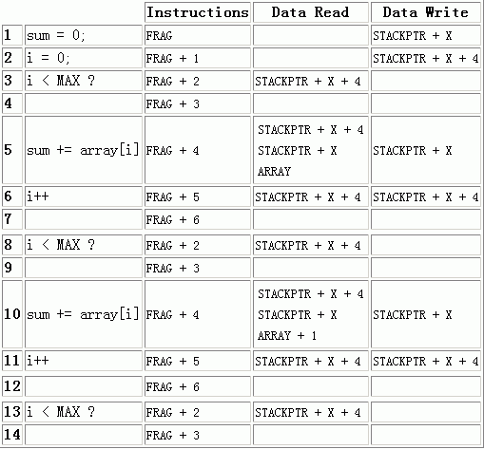
11.3 Locality

Slide 83
11.3 Locality

Slide 84
11.3 Locality

Slide 85
11.3 Locality

Slide 86
11.3 Locality

Slide 87
11.3 Locality
Conclusion
sum = 0;
for (i = 0; i < MAX; i++)
sum += array[i];
Data references
- Reference array elements array[i] in succession.
- Reference variable sum each iteration.
Instruction references
- Reference instructions in sequence.
- Cycle through loop repeatedly.
Spatial locality
Temporal locality
Spatial locality
Temporal locality

Slide 88
11.3 Locality
Repeatedly reference the same variable enjoy good temporal locality
Stride-k reference patterns enjoy good spatial locality with smaller strides
Loops have good spatial and temporal locality with respect to instruction fetches with smaller loop body and greater number of loop iterations

Slide 89
Memory Operation and Performance
11.0 Review
11.1 Memory Technology [CSAPP 6.1]
11.2 Memory Hierarchies [CSAPP 6.3]
11.3 Locality [CSAPP 6.2]
11.4 Memory Mountain Lab [CSAPP 6.6]

Slide 90
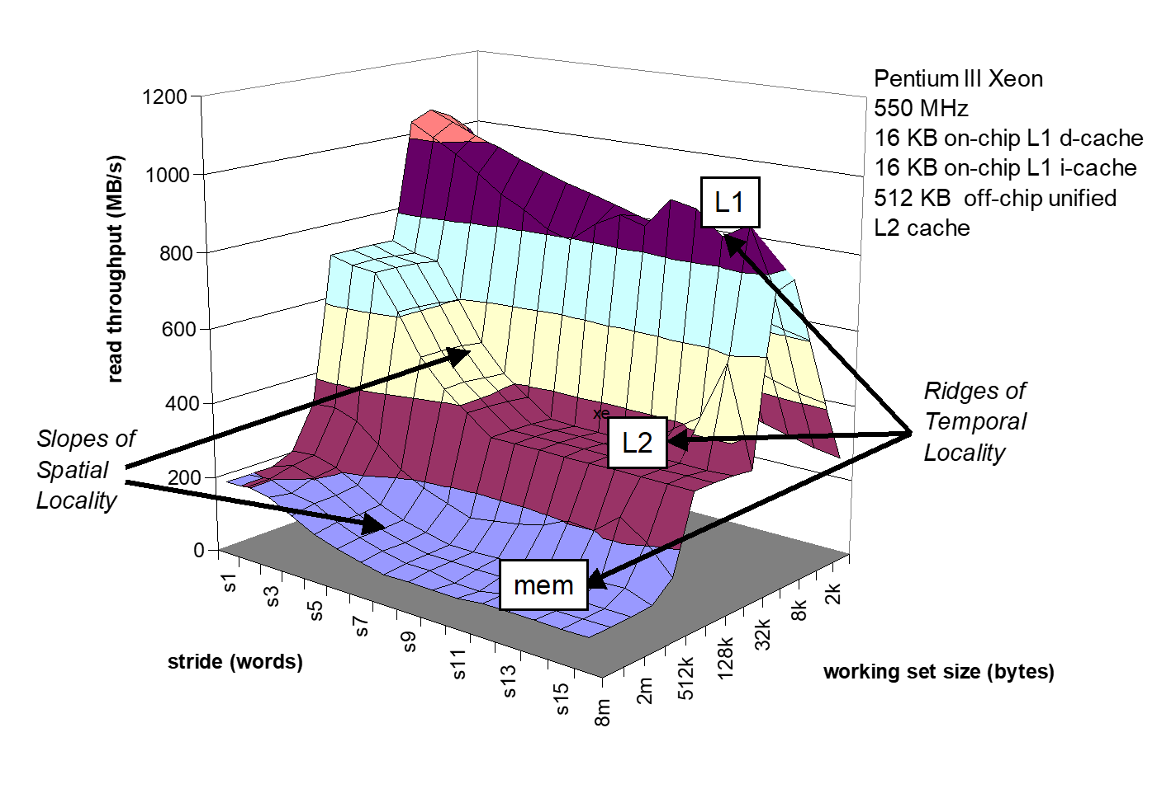
11.4 Memory Mountain Lab

Slide 91
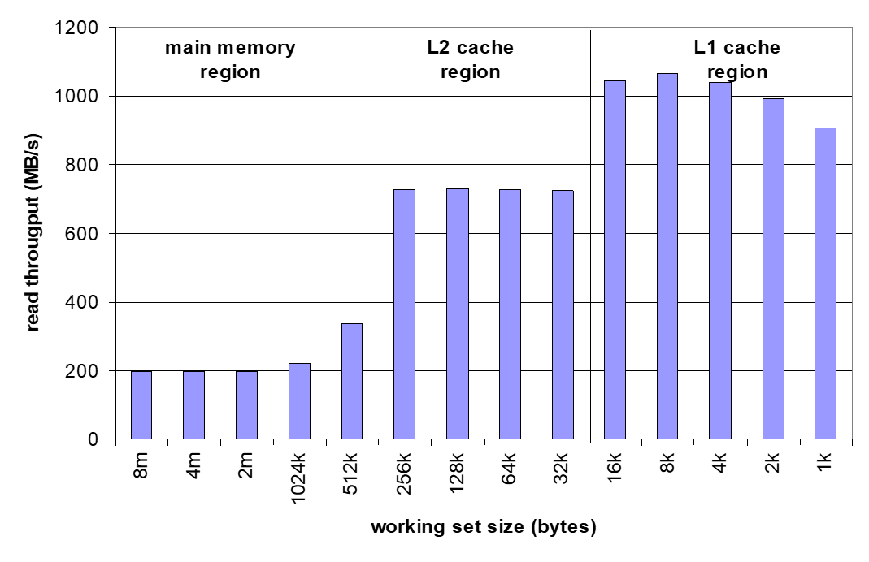
11.4 Memory Mountain Lab
Ridges of Temporal Locality: Slice through the memory mountain with stride=1

Slide 92
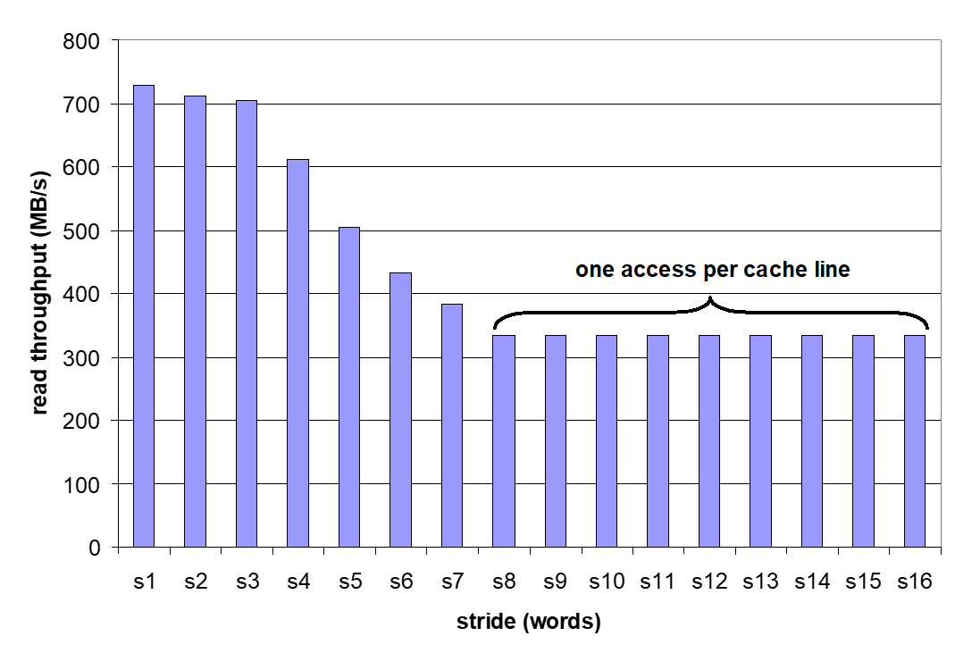
11.4 Memory Mountain Lab
A Slope of Spatial Locality: Slice through memory mountain with size=256KB

Slide 93
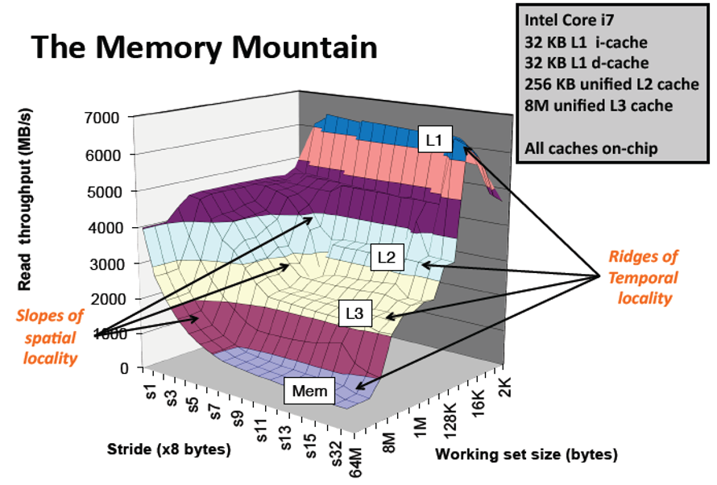
11.4 Memory Mountain Lab

