Slide 1
TEST
Anima 1
Amime2
Notes:
Lets do some tests here
<pause time=“1000”/>
Test next <next/>
<pause time=“1000”/>
Test rmode 2 <rmode mode=“word”> word and word and word </rmode> reset to default check <rmode mode=“sent”> sent and sent and sent </rmode> <rmode mode=“char”> char TSI and TSI </rmode>
<pause time=“1000”/>
Test pause <pause time=“1000”/> end
<pause time=“1000”/>
Test emph 0<emph word=“Garbage” pos=“0”/> 1 <emph word=“Garbage” pos=“1”/> 2 <emph word=“Garbage” pos=“2”/>
<pause time=“1000”/>
Test volume <vol value=“30”/> 30 % <vol value=“100”/> 100 % <vol value=“50”/> 50 %
<pause time=“1000”/>
Test set <set voice=“joyful”/> joyful <set voice=“didactic”/> didactic <set voice=“neutral”/> neutral
<pause time=“1000”/>
Test rspd <rspd speed=“30”/> 30 % <rspd speed=“300”/> 300 % <rspd speed=“100”/> 100 %
<pause time=“1000”/>
Test rmode <rmode mode=“word”/> word <rmode mode=“sent”/> sent <rmode mode=“char”/> char TSI
<pause time=“1000”/>
Test rst <rst/> all tags has been reset to default. TSI

Slide 2

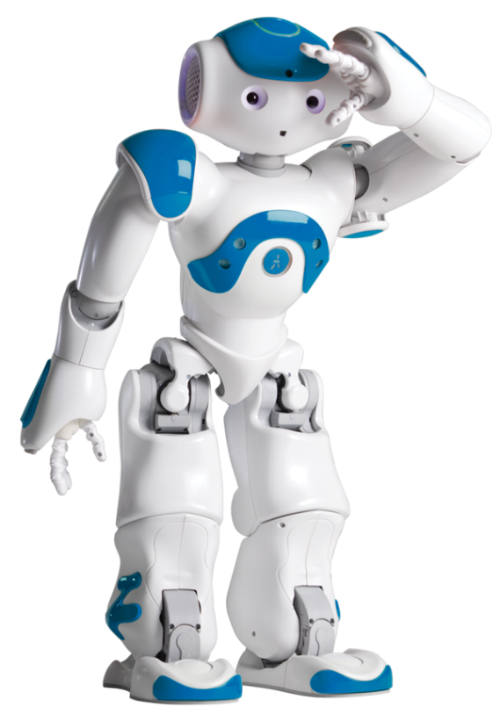
What is NAO?
Notes:
Hello! I am here to answer one question.
<next/> What <pause time=“400”/> is Nao?

Slide 3


NAO like a human?
Notes:
Nao is a humanoid robot, ready to indulge your every whim, if you teach him that is. From football to speech and facial recognition. Right now for example, I - Nao, am presenting to you this powerpoint presentation.

Slide 4

NAO capabilities
Notes:
So, how do I work? It’s quite simple, I have a head <pause time=“200”/> and a computer inside of it. This computer works like a human brain, but with a lot of limitations and a lack of conscience, and I am only capable of doing what was programmed into me and <pause time=“150”/> nothing more. So unfortunately <pause time=“100”/> I can’t conquer the world without human approval, \emph=2\ for now <pause time=“150”/> that is.

Slide 5
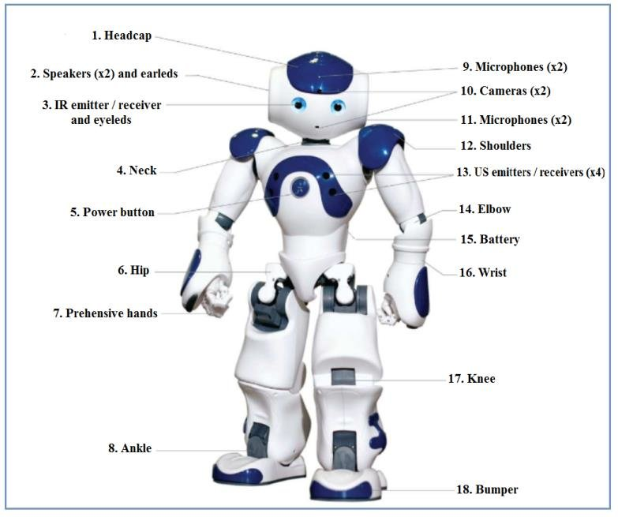
Notes:
A lot of motors <pause time=“100”/> sensors <pause time=“100”/> cameras <pause time=“100”/> and other things help me execute commands. I can be programmed to perform any procedure, when some sensor <pause time=“50”/> is triggered. For example I can be programmed to be a monster <do animation=“animations/Stand/Waiting/Monster_1”> </do>, <pause time=“300”/> or be a robot from Star Wars <do animation=“animations/Stand/Waiting/Robot_1”> </do>, <pause time=“300”/> or I can simply do a photo for you <do animation=“animations/Stand/Waiting/TakePicture_1”> </do>.

Slide 6
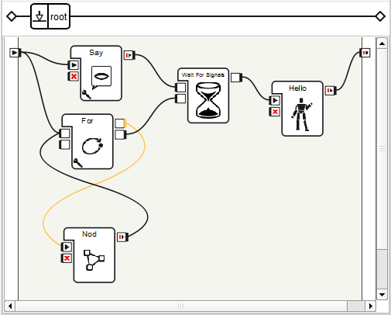

Programming for NAO
Notes:
In addition <pause time=“100”/> I have a lot of other capabilities that can be implemented through the use of low code <pause time=“150”/> or some programming language, for when you’d like to take a more detailed approach towards my software development.

Slide 7
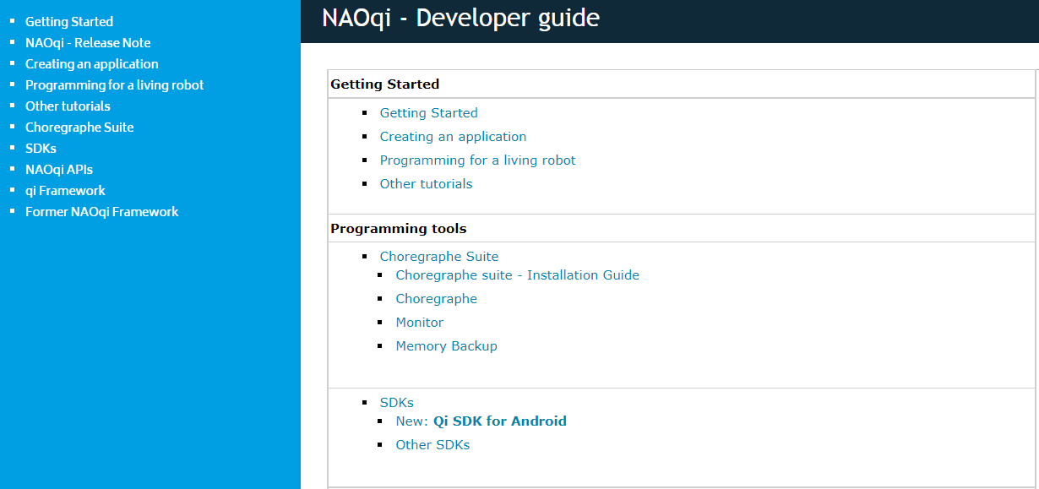
Documentation
Notes:
You can learn how to program me with the official publicly-available documentation <pause time=“150”/> or with the homemade T S I documentation. Programming with me is pretty fun and interesting. You can try it yourself, by visiting the T S I basement organization. <pause time=“200”/>

Slide 8
Thank you for your attention!
Notes:
Thank you for your attention! <do animation=“animations/Stand/Gestures/Salute_1”> This <pause time=“100”/>
has been an honor. </do>

