Slide 1

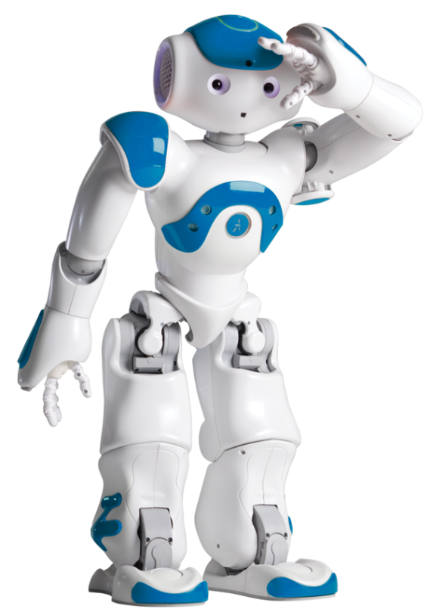
What is NAO?
Notes:
Hello! I am here to answer one question.
$event=next
$event=next
\pau=200\
$event=crash
\pau=400\
What \pau=400\ is Nao?

Slide 2


NAO like a human?
Notes:
Nao is a humanoid robot, ready to indulge your every whim, if you teach him that is. From football to speech and facial recognition. Right now for example, I - Nao, am presenting to you this powerpoint presentation.

Slide 3

NAO capabilities
Notes:
So, how do I work? It’s quite simple, I have a head \pau=200\ and a computer inside of it. This computer works like a human brain, but with a lot of limitations and a lack of conscience, and I am only capable of doing what was programmed into me and \pau=150\ nothing more. So unfortunately \pau=100\ I can’t conquer the world without human approval, \emph=2\ for now \pau=150\ that is.

Slide 4
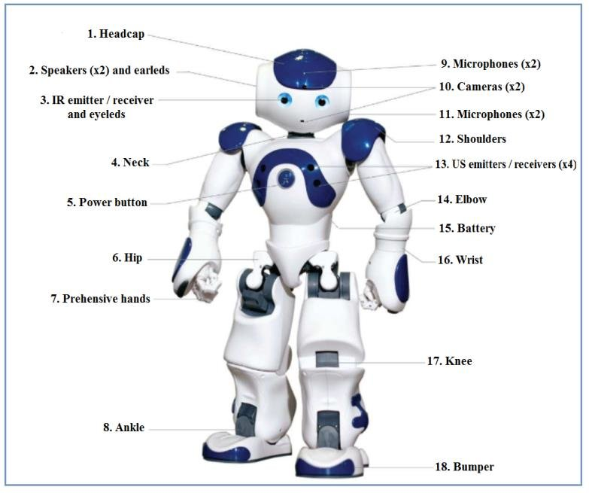
Notes:
<set animation-ns=“animations/Stand/Waiting”/>
A lot of motors \pau=100\ sensors \pau=100\ cameras \pau=100\ and other things help me execute commands. I can be programmed to perform any procedure, when some sensor \pau=50\ is triggered. For example I can be programmed to be a monster ^start(animations/Stand/Waiting/Monster_1) ^wait(animations/Stand/Waiting/Monster_1), \pau=300\ or be a robot from Star Wars ^start(animations/Stand/Waiting/Robot_1) ^wait(animations/Stand/Waiting/Robot_1), \pau=300\ or I can simply do a photo for you ^start(animations/Stand/Waiting/TakePicture_1) ^wait(animations/Stand/Waiting/TakePicture_1).

Slide 5
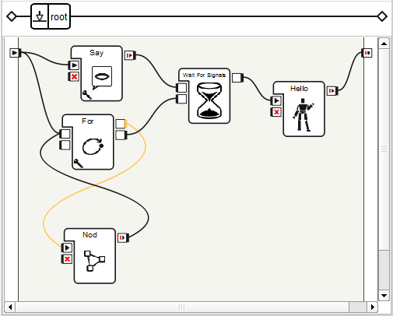

Programming for NAO
Notes:
In addition \pau=100\ I have a lot of other capabilities that can be implemented through the use of low code \pau=150\ or some programming language, for when you’d like to take a more detailed approach towards my software development.

Slide 6
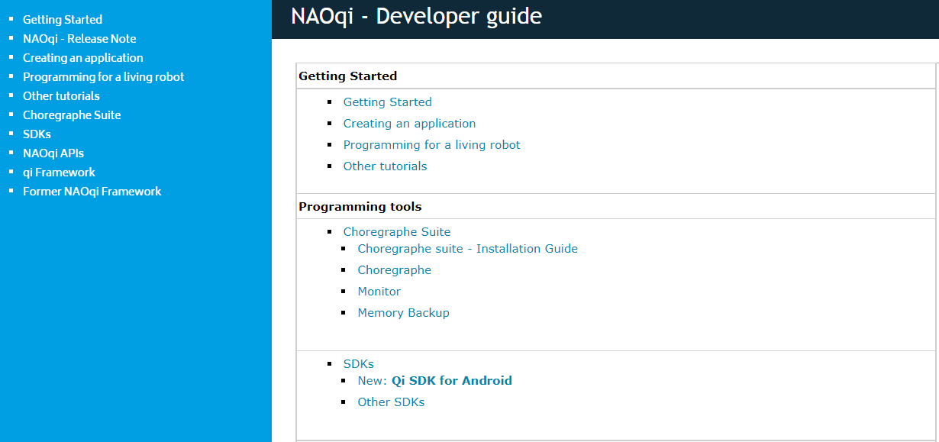
Documentation
Notes:
You can learn how to program me with the official publicly-available documentation \pau=150\ or with the homemade T S I documentation. Programming with me is pretty fun and interesting. You can try it yourself, by visiting the T S I basement organization. \pau=200\

Slide 7
Thank you for your attention!
Notes:
Thank you for your attention! ^start(animations/Stand/Gestures/Salute_1) This \pau=100\ has been an honor. ^wait(animations/Stand/Gestures/Salute_1)

