Slide 1
Cloud Native Platform Engineering
3 – VPC: Software Defined Datacenters Dr. Brian Mitchell

Slide 2
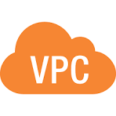



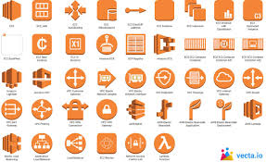
VPCs– Software Datacenter Clusters
Global AWS Services
AWS Region
AZs within a region, and datacenters within an AZ are linked together with high-speed, low latency networks
Most of AWS services are scoped to individual regions, several services are global
Not every region has every AWS service
AWS regions provide a clustered platform to enable scalable and resilient application deployment
availability zone
availability zone
datacenter
datacenter
datacenter
datacenter
datacenter
datacenter
datacenter
availability zone
Regional AWS Services
datacenter
Properly deploying scalable and resilient applications within a region requires some networking knowledge
datacenter

Slide 3
IP Addresses
Dotted Decimal
IP & Mask Notation:
192.168.1.45
255.255.128.0
192.168.1.45/17
CIDR Notation:
Subnet Mask
11111111
11111111
10000000
00000000
Network Host Split
11000000
10101000
0 0000001
00101101
Bitwise AND
Network ID
11000000
10101000
0 0000000
00000000
Network ID Dotted Decimal
192
168
0
0

Slide 4

Subnetting and “Sandboxes”
Overall network administrator will provide address ranges for a VPC. That is the overall sandbox
You can then use leading bits from the “host” part to further divide up the network
These are called Subnets
10.247.94.0/24
10.247.92.0/24
10.247.95.0/24
10.247.93.0/24
10.247.92.0/22
00001010
11110111
010111 00
00000000
10.247.92.0/22
Note that AWS reserves 5 IP addresses in every subnet for its own use. Address 0 is the network identifier, 1 is the VPC router, 2 is the DNS resolver, 3 is reserved for future use, and the highest address all bits 1 are for the broadcast address
00001010
11110111
010111 00
00000000
10.247.92.0/24
00001010
11110111
010111 01
00000000
10.247.93.0/24
00001010
11110111
010111 10
00000000
10.247.94.0/24
00001010
11110111
010111 11
00000000
10.247.95.0/24

Slide 5
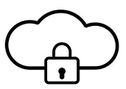

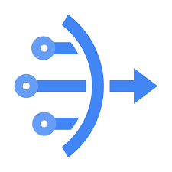
Private and Public Network Addresses
RFC 1918 Defined 3 Private (Non-Routable) address ranges
10.0.0.0/8
172.16.0.0/12
192.168.0.0/16
Any IP addresses in these ranges are considered to be non-routable on the public internet. Thus any addresses in these ranges are considered to be on a private network
NAT GATEWAY
Private IP Addresses in RFC 1918 Ranges. Internet traffic MUST BE INITIATED from the private network side
Public IP Addresses NOT in RFC 1918 Ranges, if any traffic with these addresses got to the Internet they would be dropped
Public IP Adress as Proxy for all Private IP traffic ingress and egress to internet

Slide 6
IP Assignment: How Instances Get Their Addresses
DHCP (Dynamic Host Configuration Protocol)
When an EC2 instance launches, AWS acts as a DHCP server — automatically assigning a private IP from the subnet's CIDR range. You can also assign a specific IP at launch. The private IP persists for the lifetime of the instance (even across stop/start).
Private IP Address
Public IP Address (two types)
• RFC 1918 range (10.x, 172.16.x, 192.168.x)
• Assigned by AWS DHCP at launch
• Stays assigned for instance lifetime
• Survives stop → start
• Never routable on the public internet
• Used for all internal VPC communication
Auto-Assigned Public IP
Elastic IP (EIP)
• Free
• Ephemeral — lost on stop
• Changes every restart
• Cannot be predicted
• OK for dev/test
• $0.005/hr if unused
• Persistent — survives stop
• Reassignable to any instance
• Required for stable public endpoint
• Limited: 5 per region by default
⚠ Stop an instance without an Elastic IP → it gets a new public IP on restart. Scripts or DNS records pointing at the old IP will break.
Private IPs are stable for the instance lifetime. Public IPs are ephemeral unless you use an Elastic IP — important for any public-facing resource.

Slide 7


Controlling Public (Internet Access)
AWS VPCs are Designed around the Constructs of PUBLIC and PRIVATE Subnets
AWS Internet Gateway
AWS NAT Gateway (Network Address Translation)
VPCs are Private by default. That means all subnets are private by default - No Internet Access. To gain Internet access an AWS Internet Gateway MUST be attached to the VPC. AWS Internet Gateways have no cost.
Once an Internet Gateway is attached to a VPC, private subnets still have no Internet access. To gain internet access you must deploy add routing to an AWS NAT Gateway service. NAT Gateways have costs about $0.05 per hour (~$1.20/day, ~$36.50/month)

Slide 8
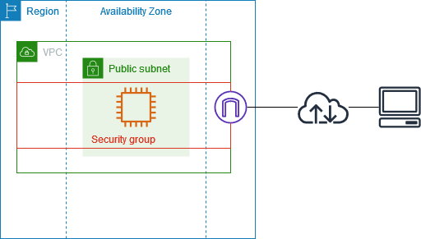
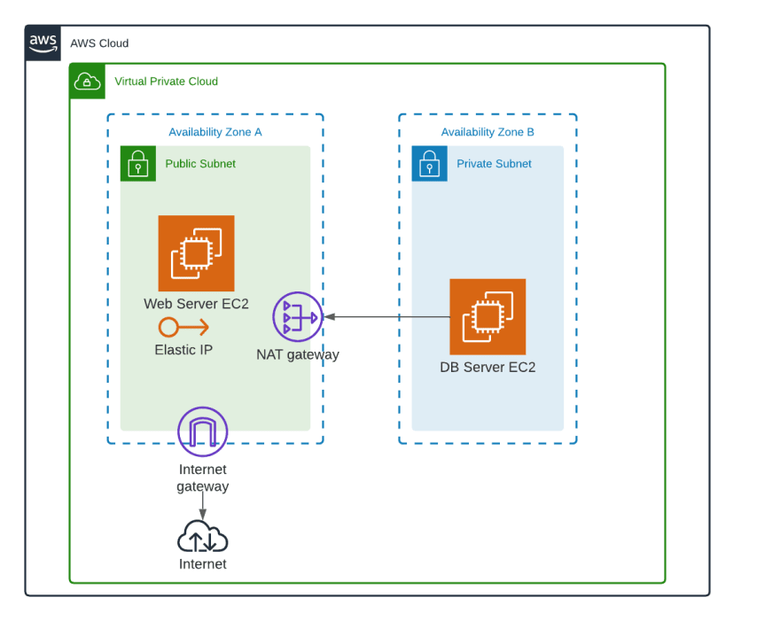
Public and Private Subnets
PUBLIC SUBNET
PRIVATE SUBNET
Must have Route Table Entry:
All resources must have private IP addresses (RFC 1918) 10.0.0.0/8, 172.16.0.0/12 192.168.0.0/16 No routes to internet gateway
Internet access only via NAT gateway in public subnet
Destination Target Status 0.0.0.0/0 ig-xxxxxxx Active
Internal Resources must have a public IP or an elastic IP assigned
Destination Target Status 0.0.0.0/0 nat-xxxxxxx Active

Slide 9

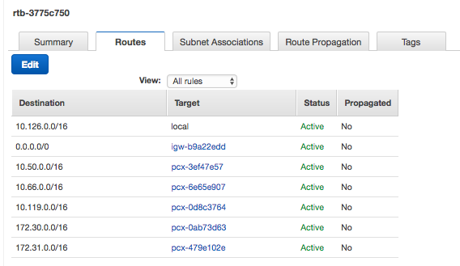
Route Tables
"A route table is a set of rules used by network devices to determine the best path for directing data packets from their source to a specific destination network."
VPCs are configured with a default route table associated with all subnets Additional Route tables can be created and associated with a VPC VPC can have MANY route tables Subnets must be associated with exactly one route table Route targets may be a network CIDR range or be an AWS resource such as an internet gateway

Slide 10
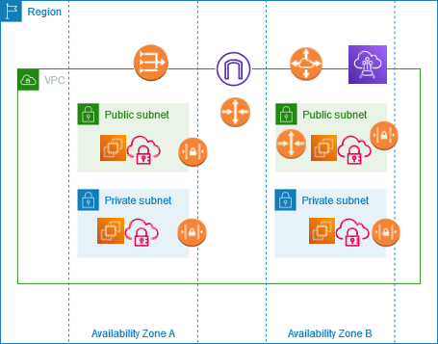
Route Tables
Routing traffic outside the VPC is managed by route tables
All VPCs have a single global route table
Individual subnets may define their own route table to override or add rules found in the global route table

Slide 11

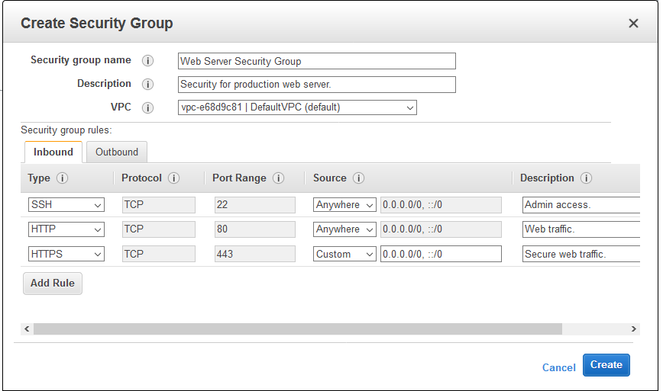
Security Groups
STATEFUL: If traffic is allowed out, return traffic is allowed in and vice versa ALLOW ONLY: Rules can be allow only, if no rules match, traffic is denied Rules match based on Protocol, Port, Port Range Source can be IP Range (CIDR) or AWS Resource (e.g., Internet Gateway)

Slide 12
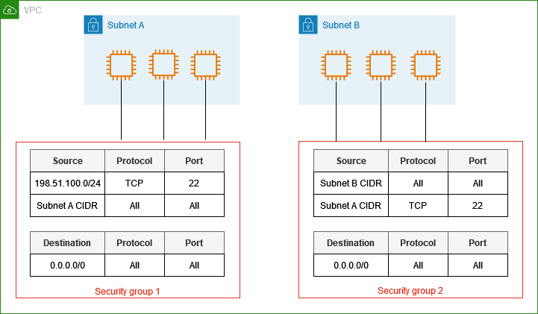
Security Groups
Security Groups are the most granular, they are applied to individual resources in a subnet. Recall NACLs are for entire subnet, and Route Tables are for the entire VPC unless a custom route table is defined for a specific subnet

Slide 13
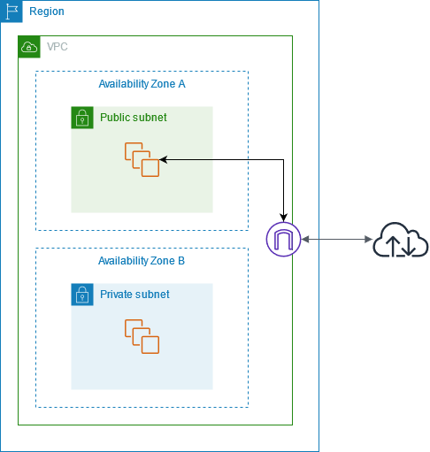
Internet Gateway
Connects to edge of VPC that enables internet access
All resources in public subnets with public IPs can send and receive data over internet
Can be restricted with things like security groups

Slide 14
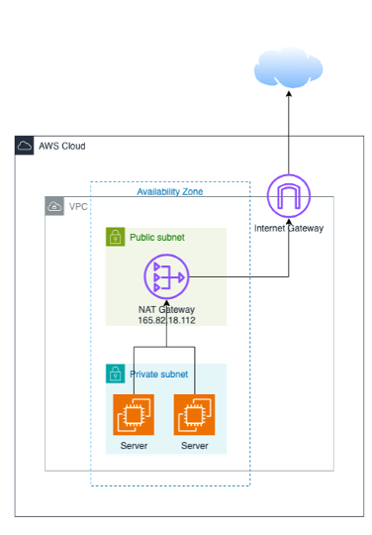

NAT Gateway
RFC 1918 Private addresses are used in a private subnet
Internet traffic targeted at NAT gateway, via NACL
NAT gateway in public subnet Proxies traffic to and from internet Internal servers not reachable from Internet

Slide 15


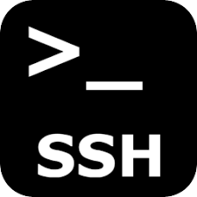


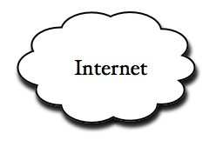
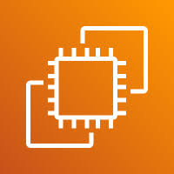
What we are going to build in Lab3 – Part 1
Your account
Custom VPC w/ Internet Gateway
AZ1
AZ2
Public Subnet
Private Subnet
Public Subnet
Private Subnet
Private Route Table
NAT GW
Elastic IP
Goal SSH into HERE
Why Nothing Here?

