Slide 1
Multimodal Sensory Biofeedback with Virtual Reality System
NTU 10-week Industrial Orientation
at ASTAR (2014)
Slides prepared by Oh SuJin

Slide 2
I. Background
Tasks assigned
- Interfacing with multiple sensors
- Logging & communication between different platforms
- Assessment
- Development of Virtual Reality to interact and engage users
- Feedback and hand gesture recognition using Arduino/wireless platform
Notes:
treat and help in the recovery of musculoskeletal disorders.

Slide 3
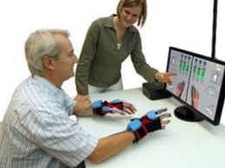
I. Background
Importance of physical therapy and rehabilitation↑
Eg) $849 billion (which is 7.7% U.S. GDP) was spent on
musculoskeletal injuries & diseases in the U.S., 2004.
Problems of traditional physical therapy
: Time-consuming, professional therapists required for every session,
often painful & boring leading to poor compliance.
Problems of existing therapy application
: Involves hassles of wearing and putting on
sensors
Eg) YouGrabber by Swiss startup YouRehab.
This enables training for bimanual reaching and
grabbing.
Notes:
treat and help in the recovery of musculoskeletal disorders.

Slide 4
HOW TO MAKE DIFFERENCE?

Slide 5
I. Background
User needs
: A simple, invisible NUI system for better user experience
Can be achieved by interfacing multiple sensors
Leap Motion + Kinect
Leap Motion
:Motion Tracking
Data
For evaluation
Kinect
:Face Tracking/
Speech Recognition
AcceleGlove
:Additional Hand/
Finger Data
Notes:
treat and help in the recovery of musculoskeletal disorders.

Slide 6
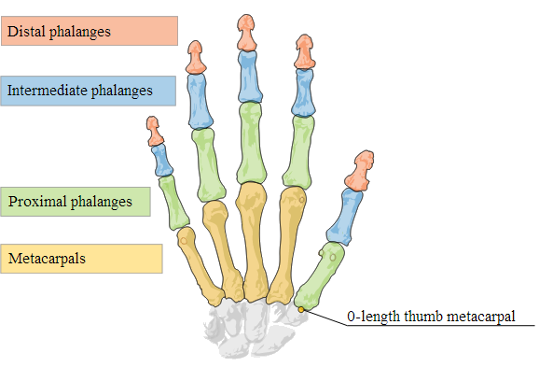
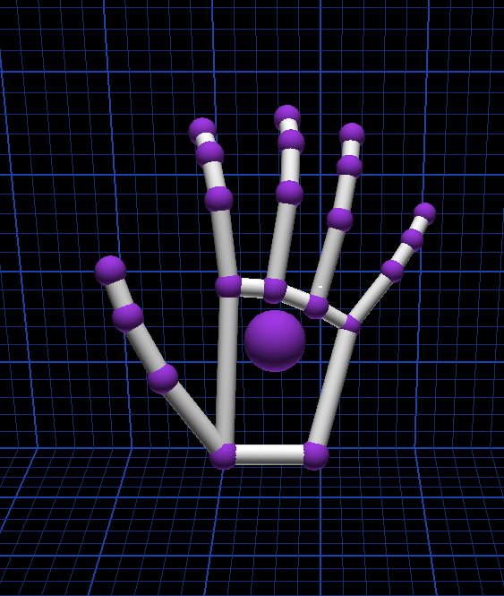
II. Literature Study
Leap Motion
Has two monochromatic IR cameras and three infrared LEDs
Leap Motion controller software is then synthesizing 3D position data by comparing the 2D frames generated by the two cameras.
- Capture finger tip position and velocity
- XYZ vector position of each 4 finger bones of all five fingers.
- Grab & Pinch strength (0~1)
Gesture (swipe/circle/screen tap/key tap) recognition

Slide 7
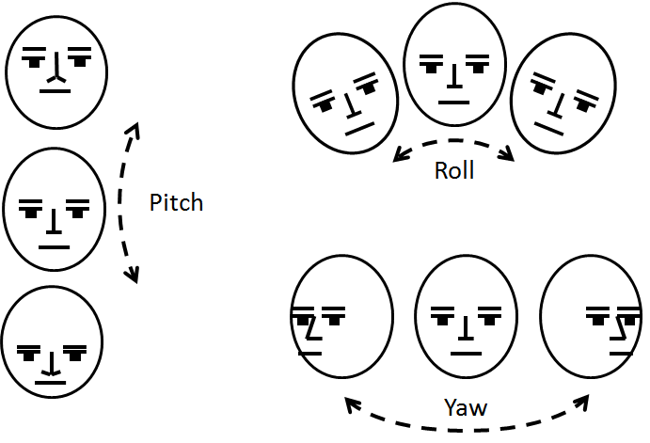
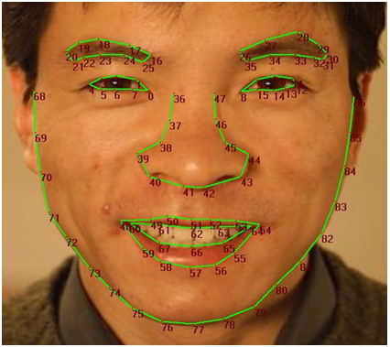
II. Literature Study
Kinect
Speech Recognition (NUI)
Face Tracking (Emotion/Concentration level)
Notes:
Application might involve body parts other than hand. For instance face → analyzing one’s emotion/one’s concentration level (is one looking at the monitor now?)
Speech recognition →minimize mouse & keyboard input →NUI (invisible user interface)

Slide 8
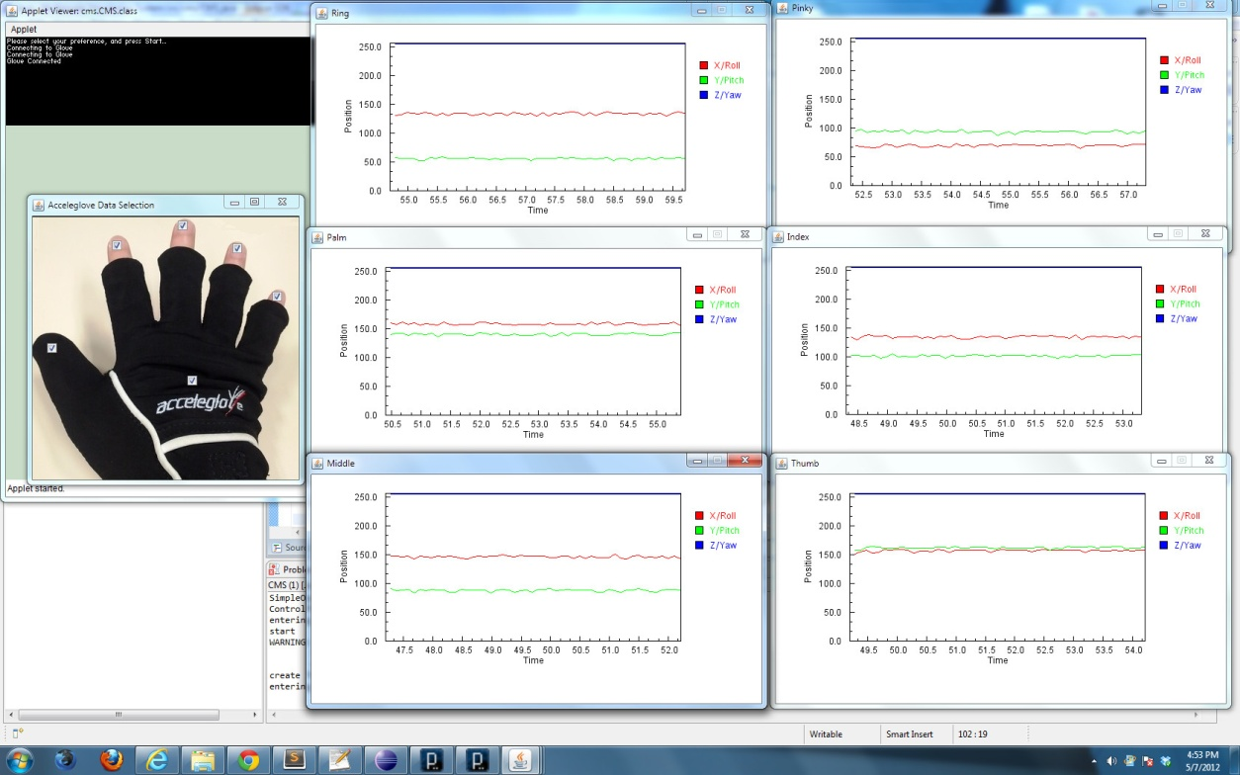
II. Literature Study
AcceleGlove
Captures and produce hand and finger position
Library of predefined gesture is required for gesture detection
Data from all the sensor can be collected based on the
axis X, Y and Z.
Notes:
Application might involve body parts other than hand. For instance face → analyzing one’s emotion/one’s concentration level (is one looking at the monitor now?)
Speech recognition →minimize mouse & keyboard input →NUI (invisible user interface)

Slide 9
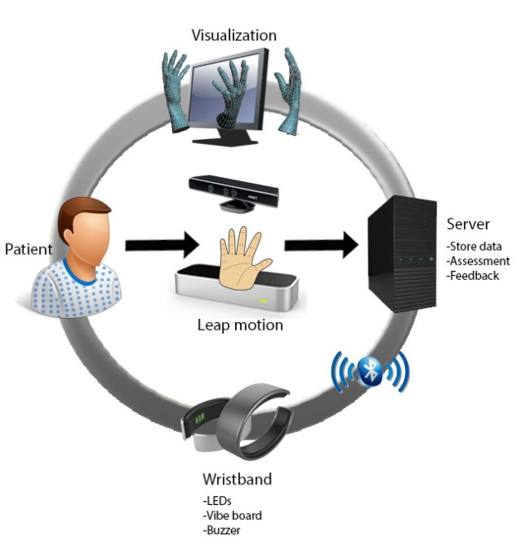
III. Proposed Solution
What is iFarm
: A Multimodal Assistive Finger Rehab System
Overview & Objective of iFarm
: To design a multimodal sensors-
controlled biofeedback wristband
for hand rehab exercise with 3D
visualization

Slide 10
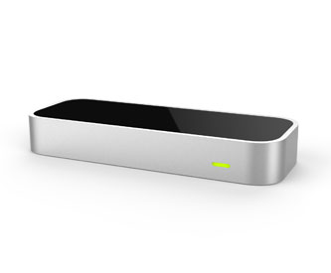
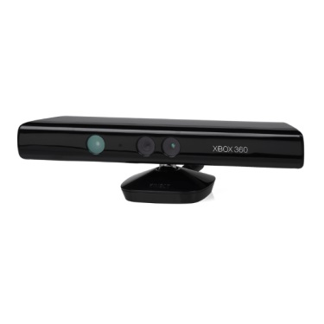
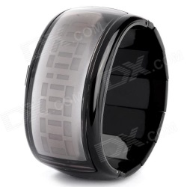
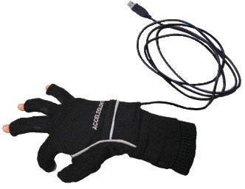
IV. iFarm Design & Integration
System Architecture
JSON formatted hand data via
WebSocket
Multimodal
sensors
Unity
Send data
via native interface
Event occurred
Notify the Unity
Java/
Processing
Actuators
Assistive sensor
Event occurred
Notify the Arduino
Notes:
System architecture
demo

Slide 11
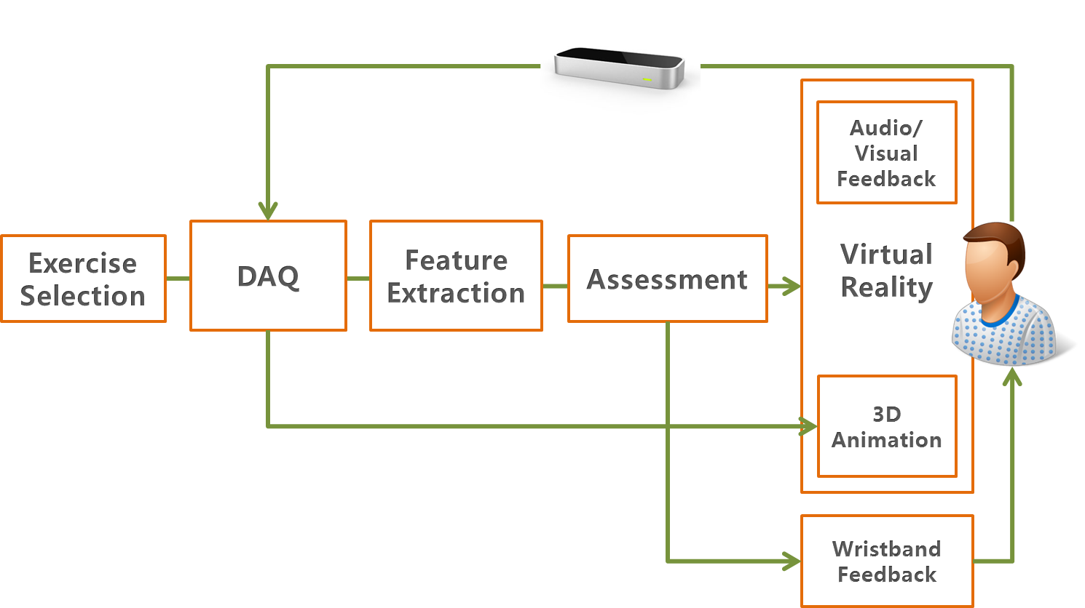
IV. iFarm Design & Integration
Application Flow

Slide 12
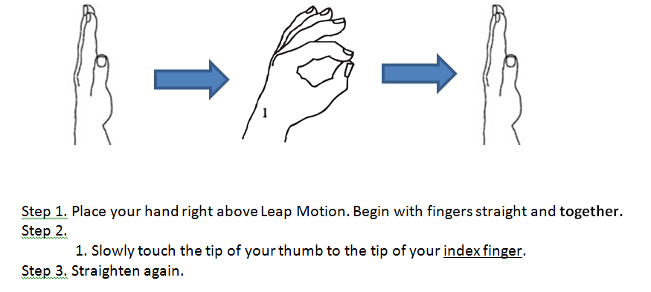
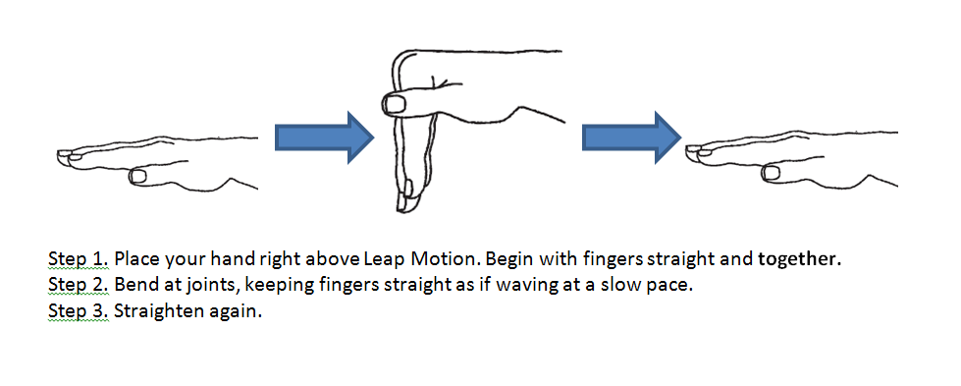
V. Approach to Finger Movement Assessment
Types of exercise
Activities of daily living (ADL)
: Daily activities such as cooking and brushing teeth will be visually
simulated by Unity
2. Traditional hand rehab exercises
: Grabbing, stretching, moving objects, Etc

Slide 13
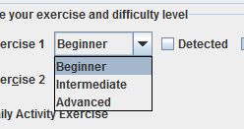
V. Approach to Finger Movement Assessment
Speed limit for exercise
: Finger/hand speed limit can be adjusted for each session to control
the difficulty level
- Beginner (slowest)
- Intermediate
- Advanced (fastest)

Slide 14
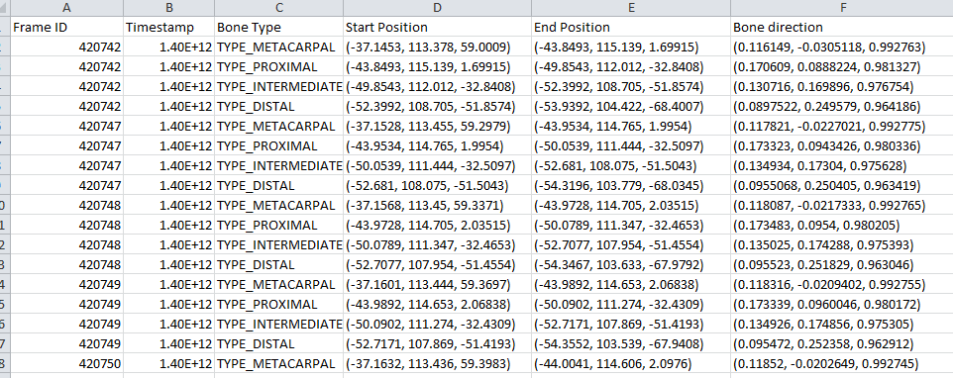
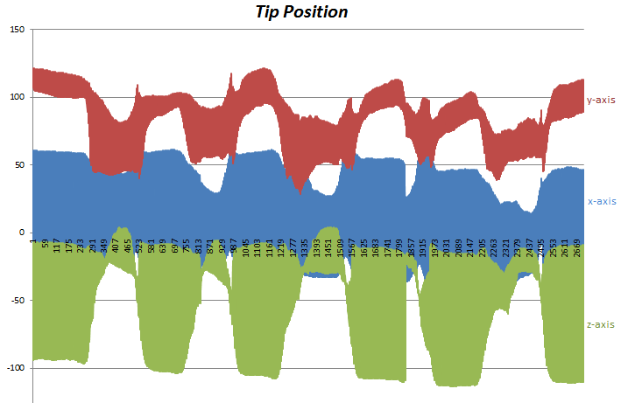
VI. Experiment and Analysis
Data assessment
- Graph plotting based on the data
obtained when each rehab exercise
is carried out
- Identify which data most explicitly
signifies the successful carry out
of position/motion of hand
Eg) Conditions for starting position of hand (original) is
1. Grab/pinch strength = 0
2. 0.8< |value of palm’s z direction and y normal vector|<1.1

Slide 15
VII. Discussion
Summary of tasks done
Data acquisition from multi-sensors
Data storage : Hand/finger data stored in .csv for each time frame for evaluation purpose
Feature Extraction: Meaningful tracking information is selected and passed to the assessment unit
Exercise assessment: If conditions are met, then~
Feedback: Respective action is triggered on
1. Simple GUI
2. Unity 3D
3. Arduino-wristband

Slide 16
VII. Discussion
Problems encountered
Attempt to use Drools (Rule Engine) as an assessment unit for iFarm, where Java constantly feeds Drools with meaningful features such as tip velocity, for each time frame.
Drools can be written in simple if-then statement
So it is easy to understand and amend the assessment criteria and rules if required in the future
However, Leap motion sends up to 300 frames of tracking data per second
Drools is not designed to handle such constant stream of data
→ Assessment is done within Java instead

Slide 17

VII. Discussion
Tasks to be done next week
Unity-Java integration using RabbitMQ, a message-oriented
middleware implementing the Advanced Message Queuing Protocol
- Bluetooth communication between the Arduino and the host computer
Future studies
- Kinect integration for more complete and precise data collection
- Accelerometer on the wristband for extra motion information

Slide 18
Outline of IO report
Background
About finger rehab: its importance, problems, user needs and technical advances
II. Literature Study & Product Survey
On exiting technologies and H/W
III. Proposed solution
Brief explanation, overview and objectives of the project
IV. iFARM Design & Development
Explain integration with unity 3D

Slide 19
Outline of IO report
V. Experimentation & Analysis
LeapMotion, AccelGolve, Kinect
VI. Methodology and approach to assessment finger
movements
2 sessions: - ADL, - Rehab exercise
Difficulty level
VII. Discussion
-Tasks completed
-Limitations & Challenges
-Future work
VIII. Conclusion

