Slide 1
Library Analysis Script Working
Contents:
Pathway used by the script
The different analysis methods of the script
  The output of each method
Packages Used in the Script
  Use of each Package
  The explanation of graphs outputted

Slide 2
Input Files
Python Script called
Makes all the sequences be in forward direction
Pathway
Read Orientation
(Biopython)
Input Files:
Reference File (Fasta)
Library Sequencing data (Fastq)
Multiple Sequence Alignment
(Muscle5)
Alignment File Outputted (aln.fasta)
Output Files:
Codon Isolated File (CSV):
  Has the given sites nucleotides
  The phred score for those site
Amino Acid (AA) converted Summary File:
  Amino acid per site
  Occurrence of that amino acid
  Protein Summary File:
    The combined protein sequence
    The occurrence of that protein sequence
    Plots (png)
Alignment Parsing
(Biopython)
Output
Summary AA Files
(CSV)
Summary
Plots
(png)
Codon Isolated File
(CSV)
Output Files

Slide 3
Script Arguments and Mode:
Alignment Through Muscle:
1. Full MSA with MUSCLE
Shell Code (Linux/Mac):
python extract_codons_qc.py extract \
-r ref_ma_gne.fa \
-i "X5DWGR #1 SAL pBK_Post POS SEL 10 mM AcK.fastq" \
-s 121,125,126,129,168,206,223 \
-o detailed_muscle_full.csv \
--aligner muscle \
--algorithm super5 \
--aligned-fasta-out aln_muscle_full.fa \
--summary-csv aa_muscle_full_summary.csv \
--plots \
--plot-dir plots_muscle_full
2) Reference-only (profile) with MUSCLE v5
Shell Code (Linux/Mac):
python extract_codons_qc.py extract \
-r ref_ma_gne.fa \
-i "X5DWGR #1 SAL pBK_Post POS SEL 10 mM AcK.fastq" \
-s 121,125,126,129,168,206,223 \
-o detailed_muscle_profile.csv \
--aligner muscle \
--profile \
--muscle-bin /usr/local/bin/muscle5 \
--aligned-fasta-out aln_muscle_profile.fa \
--summary-csv aa_muscle_profile_summary.csv \
--plots \
--plot-dir plots_muscle_profile
Can be called upon from the shell using “–help” argument

Slide 4
Script Arguments and Mode:
Alignment Through Mafft: Preferred
1. Full MSA with Mafft:
Shell Code (Linux/Mac):
python extract_codons_qc.py extract \
-r ref_ma_gne.fa \
-i "X5DWGR #1 SAL pBK_Post POS SEL 10 mM AcK.fastq" \
-s 121,125,126,129,168,206,223 \
-o detailed_mafft_full.csv \
--aligner mafft \
--aligned-fasta-out aln_mafft_full.fa \
--summary-csv aa_mafft_full_summary.csv \
--plots \
--plot-dir plots_mafft_full
2) Reference-only (profile) with Mafft
Shell Code (Linux/Mac):
python extract_codons_qc.py extract \
-r ref_ma_gne.fa \
-i "X5DWGR #1 SAL pBK_Post POS SEL 10 mM AcK.fastq" \
-s 121,125,126,129,168,206,223 \
-o detailed_mafft_profile.csv \
--aligner mafft \
--profile \
--aligned-fasta-out aln_mafft_profile.fa \
--summary-csv aa_mafft_profile_summary.csv \
--plots \
--plot-dir plots_mafft_profile
Can be called upon from the shell using “–help” argument

Slide 5
{continued}
”-” : Implies that this argument is required
“ --”: Implies that this is an optional argument
Full extraction with orientation + profile mode (aligning only to reference) + summary + plots:
python extract_codons_qc.py extract :
-r ref_ma_gne.fa \ -i ”input.fastq" :
-s 121,125,126,129,168,223 \ -o detailed_mafft_profile.csv :
--aligner mafft : Allows for the selection of the alignment software being used (mafft/ muscle)
--profile : Is calling for alignment only to the reference rather than the whole genome (Preferred)
--aligned-fasta-out aln_mafft_profile.fa :
--summary-csv aa_mafft_profile_summary.csv :
--plots \ --plot-dir plots_mafft_profile:
Calls the Python script
-r “Add the reference path”
-i “Add the input path”
-s “ The codon sites to examine/isolate”
-o “The path for the complete analysis csv
Telling the script you would like to be given the Muscle5 Alignment file
Telling the script you would like to be given a summary csv (contains amino acid sequences with count and full-protein with occurrence)
--plots: tells the script you would like to be given plots.
--plot-dir “The path for the plots to be saved”

Slide 6
Script Arguments and Mode:
{continued}
Extra commands:
Extra arguments:
. Reuse MSA to regenerate outputs:
Shell Code (Linux/Mac):
Python ./extract_codons_qc.py extract \
-r ref.fa -i "reads.fastq" -s 5,10,15 -o detailed2.csv \
--aligned-fasta aln.fa \
--summary-csv summary2.csv --plots --plot-dir plots2
'--min-quality’ : PHRED threshold for low-quality
'-a', '--algorithm’ : MUSCLE v5 algorithm (align/super5)
“--ref-start”: 1-based codon where region starts for reference
'--ref-end’ : 1-based codon where region ends for reference
. Post-process an existing detailed CSV:
Shell Code (Linux/Mac):
Python ./extract_codons_qc.py post \
--detailed-csv detailed.csv \
--summary-csv summary.csv --plots --plot-dir plots

Slide 7
Packages:
Biopython:
  Being used to perform analysis after muscle5 alignment.
  Utilized to perform the initial orientation of the fastq, which accounts for reads being forward or reverse
Muscle5:
  Performs an MSA alignment of all the sequence to the reference through clustering
  For smaller libraries (<1000 sequence) a quicker –align method can be used otherwise use –super5
Mafft:
  Performs an MSA alignment of all the sequences
  Also allows for the much faster alignment by only doing reference alignment

Slide 8
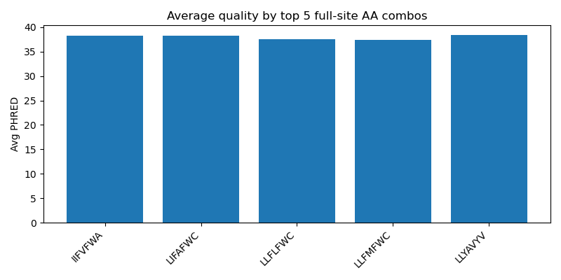
Graphs:
Optional***
Is visualizing the average quality for all the sites of the top 5 most occurring combined-full protein
The Graphs are from the Ack mini-Library analysis

Slide 9
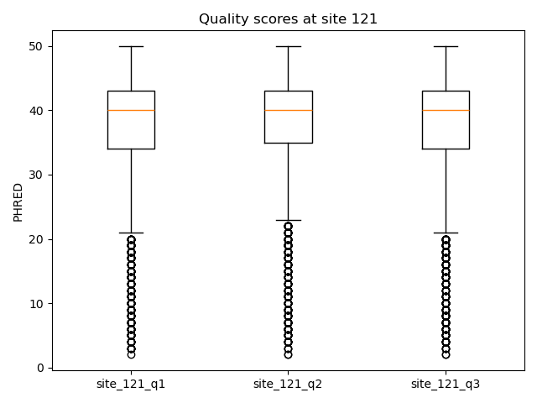
Graphs:
Optional***
Is visualizing the average quality for the particular site in the three quartile range
The Graphs are from the Ack mini-Library analysis

Slide 10
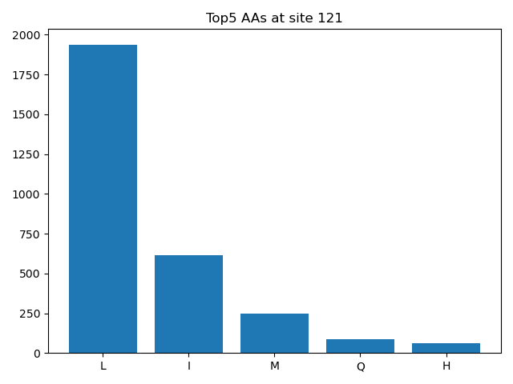
Graphs:
Optional***
Is visualizing the top 5 most occurring amino acid and their counts per site
The Graphs are from the Ack mini-Library analysis

Slide 11
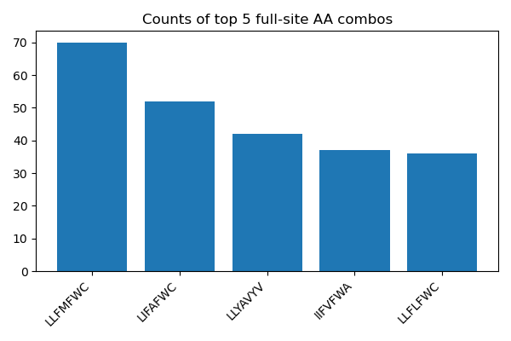
Graphs:
Optional***
Is visualizing the top 5 most occurring full-protein sequences with no missing sites for the sites and their counts per site
The Graphs are from the Ack mini-Library analysis

Slide 12
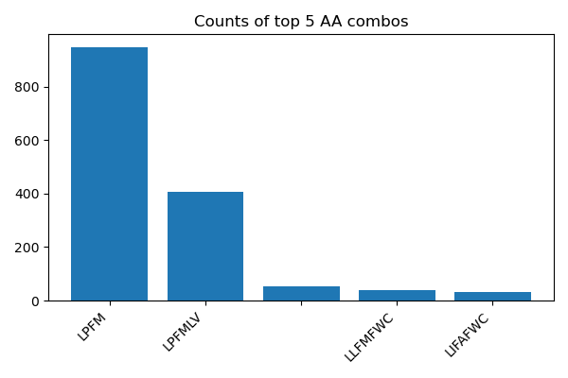
Graphs:
Optional***
Is visualizing the top 5 most occurring full-protein sequences with missing sites allowed for the sites and their counts per site
The Graphs are from the Ack mini-Library analysis

