Slide 1
Predicting Seasonal Flu Vaccination Status
BDS 472
Divy

Slide 2

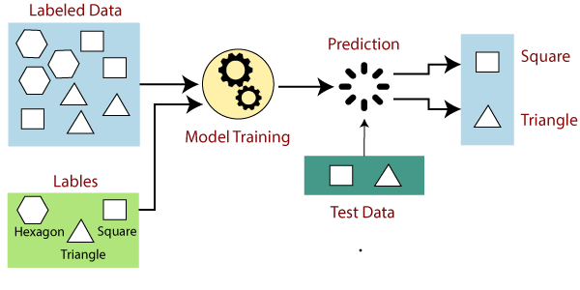
What education level is Sesame Street?
What is Machine Learning
*In Detail:
Machine learning is a branch of Artificial Intelligence that focuses on developing models and algorithms that let computers learn from data without being explicitly programmed for every task.
Vaccinated
Unvaccinated
In Summary:
ML teaches the systems to think and understand like humans by learning from the data.
www.engati.com
*https://www.geeksforgeeks.org/machine-learning/

Slide 3

The Project And Dataset
The Challenge Question:
Interests/ Possible Use:
- Can be used to advertise to individuals who are likely not to be vaccinated about vaccine awareness.
- Understand better about the factors(features) that contribute to someone being unvaccinated
Can we predict an individual Seasonal Vaccine Status based on Survey information about them containing record of demographics, opinions, and behaviors.
Dataset
Number of examples: ~26,700
Number of features: 36
Outcome variable:
Class 1: Seasonal Flu Vaccinated [~46.56%]
Class 2: Seasonal Flu Unvaccinated [~53.44%]
The Other Variable:
Class 1: H1N1 Vaccinated [~21.25%]
Class 2: H1N1 Unvaccinated [~78.75%]

Slide 4


Feature Analysis:
There are total 36 features
[ 12 categorical, 24 numerical]
Demographics & Socioeconomic:
Age Group
Education Level
Race
Sex
Income Level / Poverty Status
etc
Health & Medical Access:
Has Chronic Medical Condition
Child Under 6 Months in Household
Health Care Worker
Has Health Insurance
Doctor Recommended Flu Vaccine
etc
Behavioral Indicators:
Used Antiviral Medication
Avoided Contact with Others
Wore Face Mask
Washed Hands Frequently

Slide 5
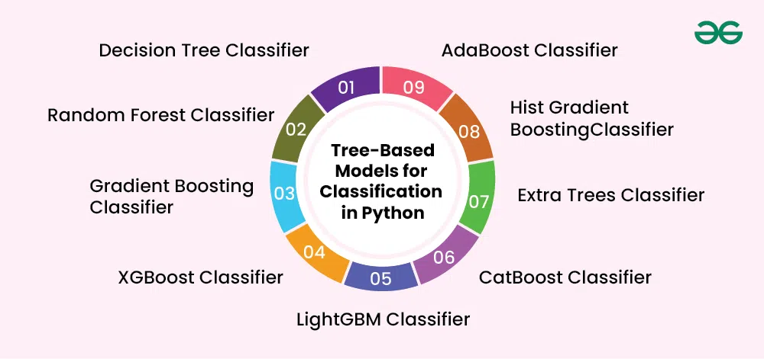
First Thoughts:
Classification Methods:
No Initial inclination towards a particular classification method.
Feature space suggests it could be better represented through a Tree based Classification.
  Multicollinearity
  Better handling of categorical data.
*Geek for Geeks
Data Wrangling / Feature Selection:
Removed column with >10000 NA’s
Removed data points after with NA’s
Feature selection with Kbest (26)
Automated selection for optimal K feature (27) for KBest
-7065
Data points: 19642
Features: 34

Slide 6
Model Performance:
Best performing:
Cross validation accuracy:
  Max Training: 82.12%
  Max Testing: 79.41
Slight Overfitting
Initial Testing:
Tested Models:
  Logistic Regression
  SVM
  Random Forest Classifier
  Gradient Boosting Classifier
  Histogram Gradient Boosting Classifier (HGBC)
  Multilayer Perceptron (MLP) classifier
RandomizedCV:
Utilizes Entropy
Tests values for Hyperparameter
Gives the best model parameter
Testing was done with 1000 iterations
Hyperparameter Optimization:
Used ”HalvingRandomizedCV” for initial testing during cross-validation
Used for the “RandomizedCV” for the best model afterwards for the testing fit
  Still HGBC the best performing after automated Kbest testing (27 features)
    Final Training: 79.93%
    Final Testing: 78.70%
HalvingRandomizedCV:
RandomizedCV but iterates
Over only the top half of the
Performing model

Slide 7
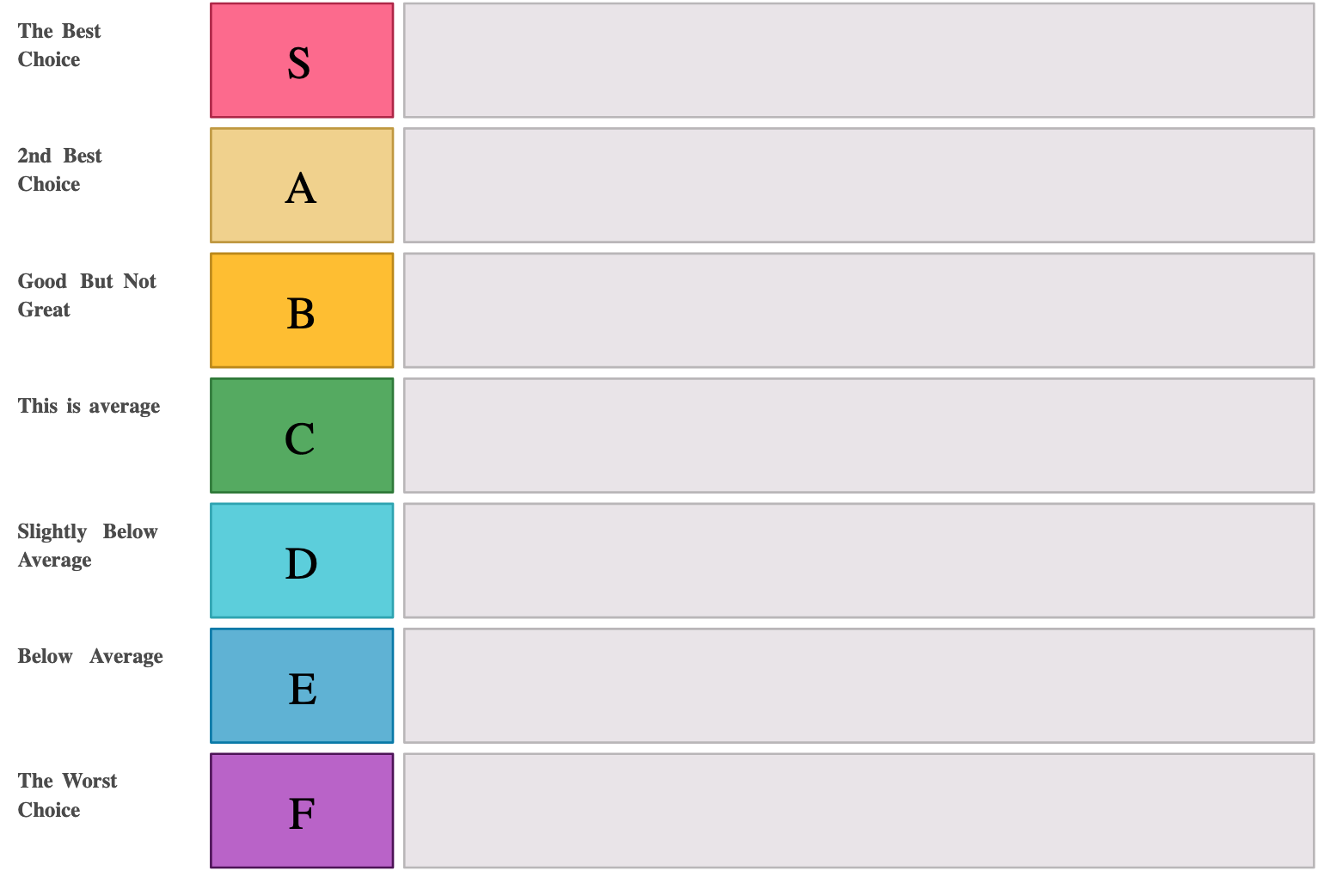
The Selected Features (27):
OrdinalEncoder+SelectKBest + HGBC
Demographics & Socioeconomic Info
Age Group
Education Level
Race/Ethnicity
Sex
Income to Poverty Ratio
Marital Status
Behavioral Measures:
Avoided Crowds or Social Contact
Used a Face Mask
Washed Hands Frequently
Avoided Large Gatherings
Stayed Mostly at Home
Avoided Touching Face
OrdinalEncoder+SelectKBest + LR
OrdinalEncoder+PCA + HGBC
OneHotEncoding+SelectKBest + HGBC
One Hot encoding+ PCA + HGBC
Medical & Health-Related Factors
Chronic Medical Condition (Yes/No)
Healthcare Worker (Yes/No)
Doctor Recommended H1N1 Vaccine
Doctor Recommended Seasonal Flu Vaccine
OneHotEncoding+PCA + LR
OneHotEncoding+PCA + SVM

Slide 8
Extra Analysis:
Confusion Matrix (27):
Train:
Testing:
Testing Accuracy
Dropped from
Actual \ Predicted | Predicted: 0 | Predicted: 1
Actual: 0 | 6672 | 1531
Actual: 1 | 1623 | 5887
Actual \ Predicted | Predicted: 0 | Predicted: 1
Actual: 0 | 1645 | 406
Actual: 1 | 431 | 1447
    78.70%
Shifted to prefer less false Positives:
Manually Changed Weights for the class
HGBC Classifier
Actual \ Predicted | Predicted: 0 | Predicted: 1
Actual: 0 | 1813 | 238
Actual: 1 | 746 | 1132
74.55%

Slide 9
Thank You!
Questions Welcome

