Slide 1
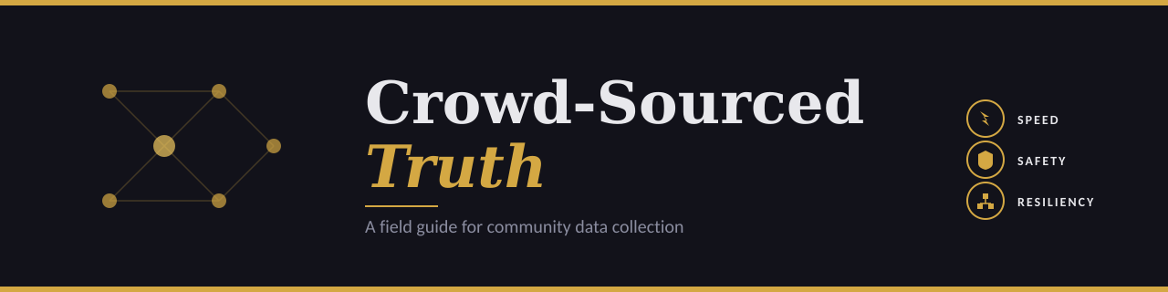
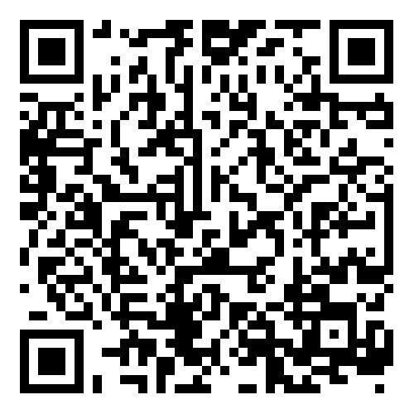
John Hogue
2026-05-15
Presentation + Materials
Notes:
Intro
skill-based volunteering
'things I wish I knew' — practitioner, not academic
Won’t be talking specifics of recent events

Slide 2
"The distance between what is said
and what is known to be true
has become an abyss."
Of all the things at risk, the loss of an objective reality
is perhaps the most dangerous.
Mon Mothma - Andor
Notes:
So when the official story doesn't match the ground truth...

Slide 3


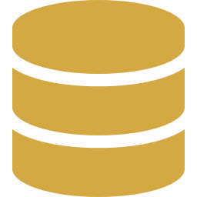

When The Official Story Doesn't Match The Ground Truth
Communities have been building their own evidence base for two decades. The pattern is consistent: when institutions fail to document what's happening, ordinary people step in.
Crowd-sourced civic data has contributed to ICC proceedings & criminal convictions.
This work has real consequences.
Kenya 2008
45,000 SMS reports of election violence mapped in 6 days
Fukushima 2011
150M+ citizen radiation readings vs. single government averages
Syria 2012-present
650K+ videos preserved after YouTube deleted 200K
Ukraine 2022-present
6.9M+ videos archived; invasion detected via Google Maps traffic
Notes:
But these efforts don't just happen. Every one lives or dies on three things.

Slide 4



The Three Pillars
Every crowd-sourced effort lives or dies on these axes
SPEED
SAFETY
RESILIENCY
How fast can you get
useful data flowing?
How do you protect
contributors & organizers?
Can the effort survive
attacks and attrition?
These pillars exist in productive tension.
Notes:
You already know how to think about tensions like this. You've been doing it your whole career.

Slide 5

Familiar Tradeoffs, Different Stakes
You already think in triangles. The skills transfer. The stakes don't.
The Scope Triangle
The Crowd Source Triangle
SDLC / Project Management
Community Data Under Pressure
SCOPE
SPEED
TIME
COST
SAFETY
RESILIENCY
Pick Two
Navigate All Three
Optimizes For Project Delivery
Optimizes For Human Outcomes & System Survival
Notes:
So what happens if you just jump in?

Slide 6

When It Goes Wrong
Syria: YouTube deletions
200K+ videos destroyed by automated content moderation. Evidence must live on infrastructure you control.
Tunisia: ISP code injection
The data is not the point.
The people are.
Government stole activist passwords through the ISP itself. The network layer is adversarial.
Haiti: SMS pleas published
Sensitive personal location data made public without consent. Good intentions don't prevent harm.
Bridgefy app (HK/Belarus)
Speed of adoption outran security vetting. Researchers could read messages and build social graphs.
Notes:
These are not cautionary tales from somewhere else. Similar things are happening right here, right now.
None of these had a clean answer. They were all trade-offs someone got wrong. Data is not the point, people are. So you want to do it right, start with asking…

Slide 7
Is Someone Already Doing This?
Duplication wastes scarce volunteer energy and fragments the data.
WHO ELSE IS ON THIS?
JOIN
COORDINATE
BUILD
An existing effort already has data, contributors, and trust. Add to it instead of fragmenting.
Adjacent efforts exist but yours fills a real gap. Share schemas, share learnings, don't compete.
Nothing covers your question. Now you're on the hook for everything: speed, safety, resiliency, exit.
Building is the last resort, not the first move.
Notes:
You've decided to help. Now what question are you actually trying to answer?

Slide 8

What Question Are You Answering?
Define the minimum viable data point to answer the question.
Vague mandates produce unusable data
Specific questions produce actionable data
"Document everything"
"What is the radiation on this street?"
"Track all the activity"
"Can this specific claim be verified?"
"Collect reports"
"Where were checkpoints active today?"
The data you don't collect can't be weaponized.
Notes:
But even with the right question, how do you collect from people who can't identify themselves?

Slide 9

Trust Without Identity
At work you authenticate users. Here you can't — and shouldn't.
HIGH VERIFICATION
HYBRID VERIFICATION
CLOSED CROWDSOURCING
Open submission, but every report passes geo/chrono checks before publication.
Vetted contributors with verified private identities and operational pseudonyms.
OPEN CROWDSOURCING
TIERED PUBLICATION
Anyone can submit. Trust comes from clustering: independent reports agreeing.
Raw layer for speed, verified layer for confidence. Reader picks the threshold.
LOW VERIFICATION
OPEN SUBMISSION
CLOSED SUBMISSION
The right model depends on the consequence of being wrong
Notes:
...Even if your contributors are trustworthy, your dataset may still lie to you.

Slide 10
Know Your Biases
You spent your career fighting biased models. This is the same problem, harder.
Geographic
Connected, populous areas dominate. Rural and infrastructure-poor regions go silent.
GROUND: Ushahidi's Kenya map underrepresented counties with thin SMS coverage.
Demographic
Digital literacy, language, and bandwidth gate participation.
GROUND: Nepal earthquake mapping — the most vulnerable communities became less visible, not more.
Survivorship
Only those who survived, escaped, or stayed online get to report.
GROUND: Syria archives are necessarily skewed toward survivors and escaped witnesses.
Reporting
Dramatic events get logged; slow patterns don't. Frequency ≠ severity.
GROUND: Hurricane Harvey social data overweighted affluent flood damage; persistent poverty was invisible.
Platform
Your submission channel selects your respondents before anyone hits submit.
GROUND: SMS reaches a different population than an iOS app or a Telegram channel.
Notes:
And that's all before someone is actively trying to break it.

Slide 11

Detecting Bad Faith & Data Poisoning
You validate every dataset at work. Here, the dataset is also the adversary.
ATTACK
DEFENSE
Bot Flooding
Rate limiting, behavioral fingerprinting
Automated submissions drown legitimate reports
False Reports
Multi-source corroboration, geographic clustering
Deliberate misinformation seeded to discredit the dataset
Weaponized Flagging
Independent archives, never trust third-party as primary
Platform moderation rules turned against you
Trust Gaming
Redundancy: multiple independent observers per event
Bots simulate normal behavior, build credit, then inject false data
AI-Generated Content
Authentication, metadata checks, human review layer
Synthetic text and images polluting submissions
Notes:
So how do you protect the people feeding that pipeline?

Slide 12

Protecting Contributors & Organizers
Privacy at work is compliance. Here, it's whether someone goes home tonight.
KNOW THE THREAT
COLLECT LESS
COMPARTMENTALIZE
State, corporate, vigilante; each has different capabilities.
Scale your defenses to actual threats.
Every unnecessary field is a future weapon.
Strip metadata at ingestion.
Reduce precision to what your analysis truly needs.
No single point of failure should endanger the whole effort.
Distribute credentials.
Pre-establish backup communication channels.
Over-securing paralyzes operations as fast as under-securing.
Notes:
Signal with disappearing messages is the baseline, not the ceiling
Even if you do all of that, one thing will still catch you off guard. The mosaic effect.

Slide 13
The Mosaic Effect
Individually harmless data points become dangerous when combined.
87%
Real-world examples:
Strava heatmap exposed military bases, patrol routes, and 18,599 French military personnel across 100 bases
NYC taxi data was reverse-engineered to identify Muslim drivers via prayer time correlations
Netflix Prize data de-anonymized through correlation with public IMDb reviews
of Americans uniquely identifiable
from just 3 data points:
ZIP + birthdate + gender
Design for the assumption that your adversary has access to datasets you don't know about.
Notes:
But where does the data actually live?

Slide 14
Control Your Infrastructure
"We are writing our memories not in our own book but in a third party's book. We don't have control of it."
Hadi al Khatib, Syrian Archive founder, after YouTube deleted 200,000 videos of the Syrian conflict
Does your data live on infrastructure you control? Plan for the day platforms delete it.
How distributed is your architecture? Mirrors across jurisdictions resist legal takedowns.
What is your plan for internet shutdowns? (Egypt, Iran, Belarus, India have all imposed them)
How do you handle platform rules being weaponized against you?
Too distributed to fail. That’s the goal.
Notes:
But protected it for whom? Who does this data actually belong to?

Slide 15
What To Do With The Data
Who benefits from this data?
CARE Principles: Collective Benefit, Authority to Control, Responsibility, Ethics
Who controls access?
Define roles, permissions, and revocation processes before collection begins
What are your retention policies?
How long do you keep raw data? When does it get aggregated or destroyed?
The data you release cannot be un-released.
Could this data harm the people it describes?
Even well-intentioned collection can endanger vulnerable communities
Is this data creating legal obligations?
Evidence preservation, data protection laws, cross-border data transfer rules
How do you publish responsibly?
Aggregate, anonymize, delay.
Notes:
Once you release it, it cannot be unreleased. Get these right before you publish.
Eventually, every effort ends. The question is whether it ends on your terms.

Slide 16

How Does It End?
Handoff, sunset, or destruction. Sustainability is the silent killer of civic tech.
Orderly Wind-down
Mission accomplished or funding exhausted. Who inherits the data? How is community trust transferred?
Forced Shutdown
Legal action, platform takedown, or political pressure. Where does the data go? What gets preserved vs. destroyed?
Organizer Attrition
Key people leave, burn out or worse. Who has backup credentials? What's the succession plan?
Notes:
Don’t be the last person standing.
The efforts that survive aren't run by heroes. They're run by people who made themselves replaceable on purpose.
Planning your work around Speed, Safety and Resiliency matter, but there will always be trade offs.

Slide 17
Some Tradeoffs
Don't Have A Right Answer
SPEED vs RIGOR
OPENNESS vs SECURITY
How fast you need it vs. how sure you need to be
What lets allies in also lets adversaries in
DOCUMENTATION vs DANGER
DISTRIBUTION vs GOVERNANCE
Every recorded abuse potentially identifies a victim
Resilience to censorship costs you central control
These constraints are yours to set. That's the job.
Notes:
Most of these efforts don't fail for lack of passion. They fail for lack of exactly the skills you used at work this week.
There is no right answer. These are constraints for you to set. That's the job.
I'll leave you with one last thought.

Slide 18
"I have friends everywhere."
Perhaps with crowd sourced data, you can too.
Thank You

Slide 19
Take It With You
What you'll find:
[QR CODE]
This Presentation
Planning checklist
Curated list of open-source repos and tools
People and organizations to follow
Case study reading list
Academic references on verification & bias
Scan for resources
Remember: Crowd-sourced civic data has contributed to ICC proceedings, criminal convictions in Germany, Sweden, Finland, and the Netherlands, and international sanctions regimes. The Berkeley Protocol establishes that digital open-source evidence meets courtroom standards. This work has real consequences.

Slide 20

Sources & Citations (1/2)
Standards & Protocols
Berkeley Protocol on Digital Open Source Investigations (2020)
ohchr.org/...berkeley-protocol
CARE Principles for Indigenous Data Governance (Carroll et al., 2020)
datascience.codata.org/articles/dsj-2020-043
ICRC: The Mosaic Effect - Revelation Risks of Combining Data
blogs.icrc.org/.../mosaic-effect-revelation-risks
Key Case Studies
Ushahidi: From Crisis Mapping Kenya to Mapping the Globe
tavaana.org/.../ushahidi-crisis-mapping
Bellingcat: OSINT and War Crime Accountability in Ukraine
rusi.org/.../osint-war-crime-accountability-ukraine
HRW: Social Media Platforms Remove Evidence of War Crimes
hrw.org/.../video-unavailable
Syrian Archive / Mnemonic: Digital Evidence Preservation
mnemonic.org
Safecast: Citizen Radiation Monitoring
safecast.org
Additional sources referenced in this talk: Sweeney (2000) on re-identification; Freedom House Freedom on the Net reports; Strava heatmap investigations (Le Monde, 2025); Fang et al. & Miao et al. on adversarial crowdsourcing; Wiggins et al. (2011) on citizen science validation; COINTELPRO documentation; Hargittai (2020) on big data bias. Full bibliography in the downloadable resource guide.
All URLs verified April 2026. Full resource guide with additional links available via QR code.

Slide 21

Sources & Citations (2/2)
Academic Research
Starbird et al.: Misinformation in Crisis (UW)
medium.com/@katestarbird
Crowdsourcing Under Data Poisoning Attacks (Springer)
link.springer.com/.../978-3-030-49669-2_18
Spatial Biases in Crowdsourced Data (ScienceDirect)
sciencedirect.com/.../S0198971520302477
Collective InfoSec in Hong Kong Protests (USENIX)
usenix.org/.../albrecht
Tools & Resources
Bellingcat Online Investigation Toolkit
bellingcat.gitbook.io/toolkit
awesome-osint: Curated OSINT Tools List
github.com/jivoi/awesome-osint
Ushahidi Platform (GitHub)
github.com/ushahidi
SecureDrop: Whistleblower Submission System
securedrop.org
EFF Surveillance Self-Defense Guide
ssd.eff.org
All URLs verified April 2026. Full resource guide with additional links available via QR code.

