Slide 2
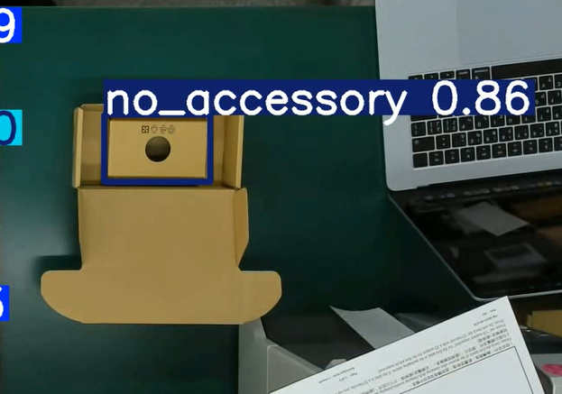
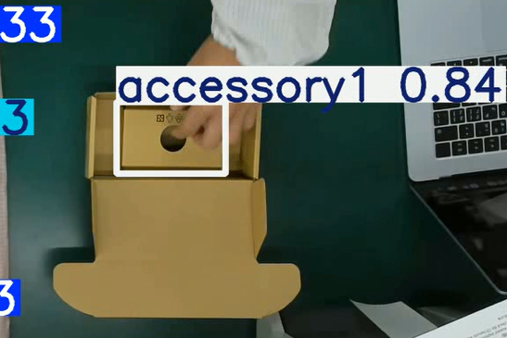
No aug
Accessory1 > 0.9
No_accessory > 0.5

Slide 3
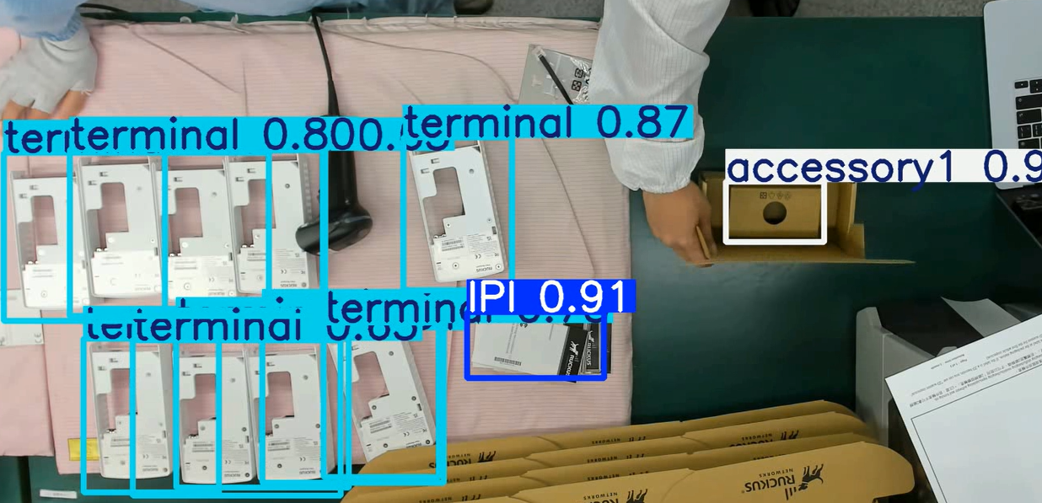
With aug
"D:\Dre\PDE_yolo_infra\runs\detect\predict29\p01_test.avi“
"D:\Dre\PDE_yolo_infra\logs\0427_11s_640_p01\yolo11s_640_0427_p01_aug.pt"
Generalize too much

