Slide 1


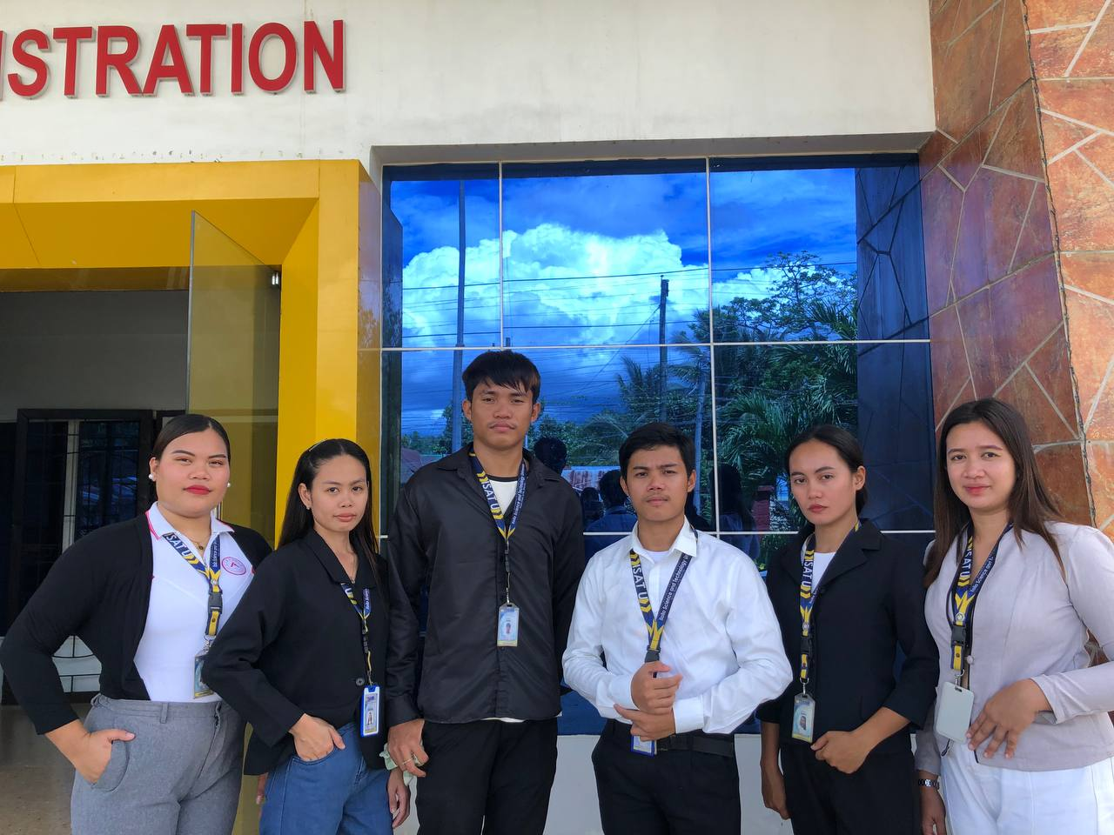
RESEARCHERS:
John Reynel Caparida
Christian Mark Gepana
Kenth Michael Palma
CAPSTONE ADVISER:
Engr. Mark Anthony Villanueva, M.Eng.
ACADEMIC PROGRAM:
Bachelor of Science in Information Technology
Iloilo Science and Technology University - Dumangas Campus

Slide 2
ISAT U - DC COFFEE SHOP POS SYSTEM WITH ONLINE RESERVATION AND QR CODE
An Information Technology Capstone Project
Iloilo Science and Technology University - Dumangas Campus

Slide 3


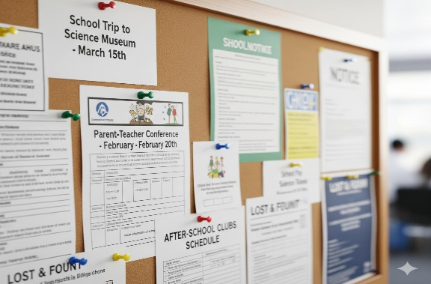
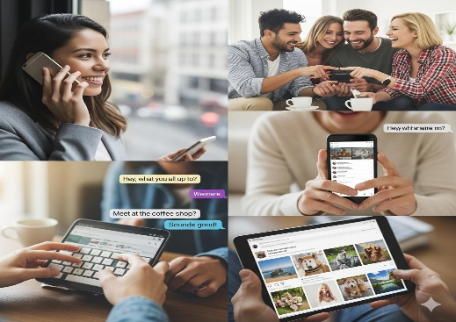
Background of the Study
1. Institutional Setting
• ISAT U - DC Mini Hotel operates as a hospitality training, seminar, and guest center.
• The university is opening a new coffee shop and study lounge inside the hotel.
• Facility offers dining tables and quiet study pods equipped with power outlets.
2. Operational Problems
• Cashier-to-barista communication reliant on loose paper chits and verbal calls.
• Paper slips easily get wet, lost, or stained during peak class break rush hours.
• Verbal shouting causes order mix-ups, wrong cup sizes, and delayed service.
• Uncontrolled study pod crowding and long counter waiting lines.
3. Proposed Solution
• Self-service Online Reservation & Pre-Ordering portal for study pods and tables.
• Dynamic QR Booking Pass with 15-minute seating holding policy.
• Staff Concierge seating desk with overdue table release alerts.
• Touch POS terminal with optical 2D QR product scanning & pre-order fetching.
• Paperless Barista KDS screen with audio chimes & Brew-to-Serve inventory.

Slide 4





Objective of the study
General Objective:
To design, develop, implement, and evaluate the ISAT U - DC Coffee Shop POS System with Online Reservation and QR Code for the mini hotel.
Specific Objectives:
1. Design and develop a centralized database for managing user accounts, products, reservations, orders, payments, and inventory records.
2. Implement role-based access for the administrator, cashier, barista, and customer.
3. Develop an online reservation and pre-ordering portal that allows customers to view availability and receive QR-based booking passes.
4. Develop a POS module that supports product QR code scanning, order processing, payment recording, discount computation, and receipt generation.
5. Develop a Kitchen Display System (KDS) for displaying and updating beverage and food order statuses.
6. Implement inventory monitoring and sales reporting functions.
7. Evaluate the system using the applicable ISO/IEC 25010 software product quality characteristics.

Slide 5

Conceptual Framework
User Accounts (Staff)
Admin, Cashier, Barista
Public Customer Portal
Direct Access (No Login)
Tables & Study Pods
4 Mini Hotel Zones
Products & 2D QR Tags
Prices, Recipes, Modifiers
Online Reservations
15-Minute Seating Policy
Financial Parameters
Cash, GCash, Discounts
INPUT
Staff Authentication
Role-Based Validation
Optical 2D QR Scanning
Product Auto-Reading
Concierge QR Check-In
Seating Arrival & Table Map
POS Pre-Order Fetching
Editable Walk-in Cart
Statutory Discounting
10% Student / 20% Senior
Barista KDS Dispatch
Brew-to-Serve Stock Ledger
PROCESS
OUTPUT
ISAT U - DC Coffee Shop POS System with Online Reservation and QR Code
Operational web system deployed inside the Mini Hotel
ISO/IEC 25010 Software Product Quality Evaluation (Continuous Feedback Loop)

Slide 6

Significance of the Study
1. ISAT U - DC Mini Hotel Administration & Supervisors
Provides centralized management of study spaces, transparent sales monitoring, and digital record integrity.
2. Campus Auxiliary Services & Management
Delivers perpetual ingredient and packaging tracking through recipe-based Brew-to-Serve automated deductions.
3. Frontline Cashiers
Eliminates manual math errors, speeds up checkout via 2D QR auto-reading, and automatically fetches pre-orders.
4. Baristas & Kitchen Preparation Staff
Eliminates lost paper chits with a real-time KDS queue screen, acoustic alerts, and clear recipe formulations.
5. Students, Faculty & Campus Hotel Guests
Offers hassle-free study pod booking with power outlets, remote pre-ordering, and transparent discount privileges.
6. Future Researchers & IT Developers
Serves as an empirical baseline for hospitality point-of-sale and paperless kitchen coordination architectures.

Slide 7
Scope and Limitation
PROJECT SCOPE (IN-SCOPE):
• Online Reservation Portal: Allows students and guests to inspect seating availability across 4 mini hotel zones and book tables/study pods.
• Dynamic QR Booking Pass: Generates an encrypted 2D pass with mandatory 15-minute seating holding agreement.
• Staff Concierge Desk: Onsite QR pass verification, arrival confirmation, and overdue table release alerts (+15m no-show forfeiture).
• Front-Counter POS Terminal: Optical 2D QR product scanning, pre-order cart fetching with walk-in adjustments, statutory discounting (10% student, 20% senior/PWD), and thermal receipt printing.
• Barista Kitchen Display System (KDS): Live electronic ticket routing with audio alert chimes and recipe bills of materials.
• Brew-to-Serve Inventory Ledger: Real-time ingredient and packaging deduction upon drink fulfillment, with stock vouchers and conversion.
PROJECT DELIMITATION (EXCLUSIONS):
• Direct online payment gateway (credit/debit card) integration is excluded (payments recorded at counter via Cash or GCash).
• Off-campus doorstep food delivery and courier dispatching are excluded.
• Automated third-party external vendor procurement / EDI ordering is excluded.

Slide 8
Chapter II Review of Related Literature
1. Point of Sale (POS) Systems & Optical 2D Barcode Automation
Focuses on touch-based register transactions, optical camera / 2D QR decoding for instantaneous item identification, and error reduction in busy campus retail environments.
2. Online Reservation & Campus Facility Scheduling
Examines responsive web portals for study space allocation, real-time table availability mapping, and automated booking pass generation.
3. Kitchen Display Systems (KDS) & Paperless Queue Dispatching
Traces the replacement of vulnerable handwritten paper slips with synchronized digital kitchen display screens and acoustic alert chimes.
4. Recipe-Based "Brew-to-Serve" Perpetual Inventory Control
Addresses decoupling sales checkouts from stock depletion; deducts raw materials, syrups, cups, and straws only when drinks are prepared by the barista.
5. ISO/IEC 25010 Software Product Quality Evaluation Standard
Establishes empirical measurement across Functional Suitability, Performance Efficiency, Usability, Reliability, Security, and Maintainability.
Related Literatures

Slide 9
Chapter II Review of Related Literature
1. Vega & Generoso (2021) — Campus Facility Scheduling Platform
Lyceum of the Philippines University: Demonstrated that transitioning from paper logbooks to automated web reservations eliminated double-bookings and boosted space utilization.
2. Capuyan et al. (2022) — CTU Danao Campus Facility Reservation System
Cebu Technological University: Proved high user acceptance (TAM) for online booking portals in hospitality and campus facilities, reinforcing transparent usage auditing.
3. Intal et al. (2021) — Smart Campus Retail & Mobile Pre-Ordering System
Demonstrated that mobile pre-ordering and optical item identification dramatically shorten customer waiting queues during university break periods.
4. Ramos et al. (2023) — Kitchen Display Systems for Food Service Operations
Showed that paperless KDS screens improve order fulfillment velocity, recipe compliance, and eliminate lost handwritten order tickets.
5. Mendoza & Garcia (2022) — Perpetual Recipe-Based Inventory Tracking Systems
Proved that ingredient-level stock tracking avoids retail counter stock trapping and maintains accurate perpetual stock balances.
Related Studies

Slide 10
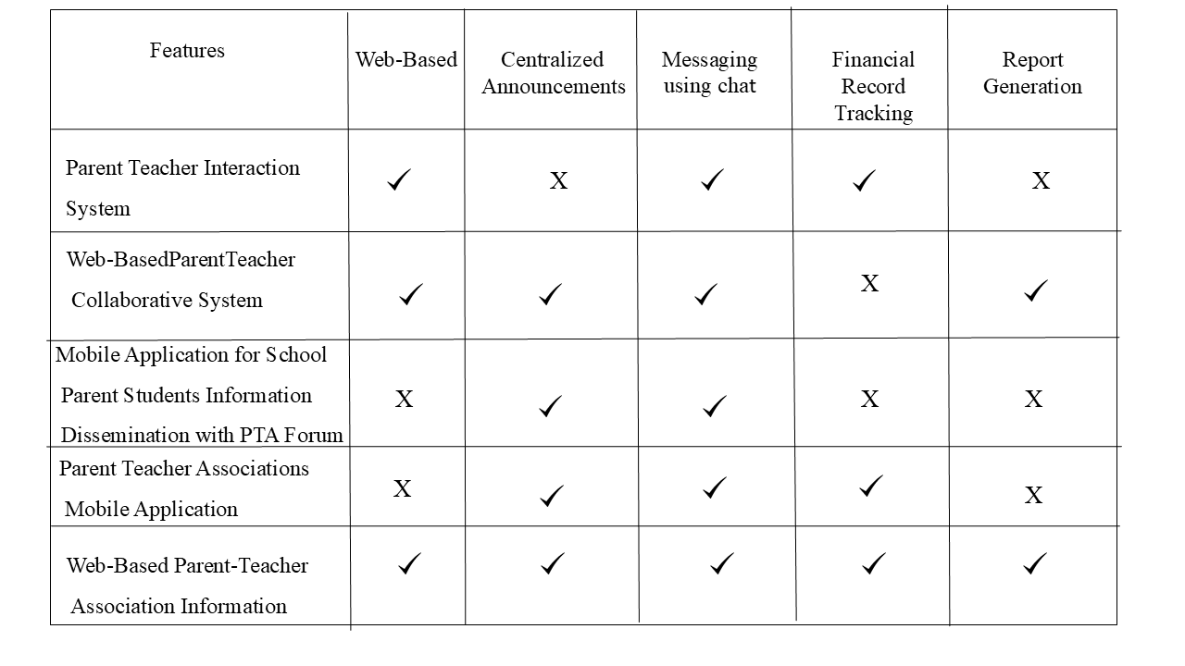
Chapter II: Review of Related Literature
System Comparison
System Feature / Capability | Vega & Generoso (2021) | Intal et al. (2021) | Capuyan et al. (2022) | Ramos et al. (2023) | Proposed ISAT U System
Centralized Web & POS Database | ✔ | ✔ | ✔ | ✔ | ✔
Role-Based Access Control (RBAC) | ✔ | ✔ | ✔ | ✔ | ✔
Online Reservation & Study Pod Seating | ✔ | ✖ | ✔ | ✖ | ✔
Dynamic QR-Based Booking Pass | ✖ | ✖ | ✖ | ✖ | ✔
Optical 2D QR Code Product Scanning | ✖ | ✔ | ✖ | ✖ | ✔
Real-Time Kitchen Display System (KDS) | ✖ | ✖ | ✖ | ✔ | ✔
Brew-to-Serve Recipe Stock Deduction | ✖ | ✖ | ✖ | ✖ | ✔
ISO/IEC 25010 Software Quality Evaluation | ✖ | ✖ | ✖ | ✔ | ✔

Slide 11

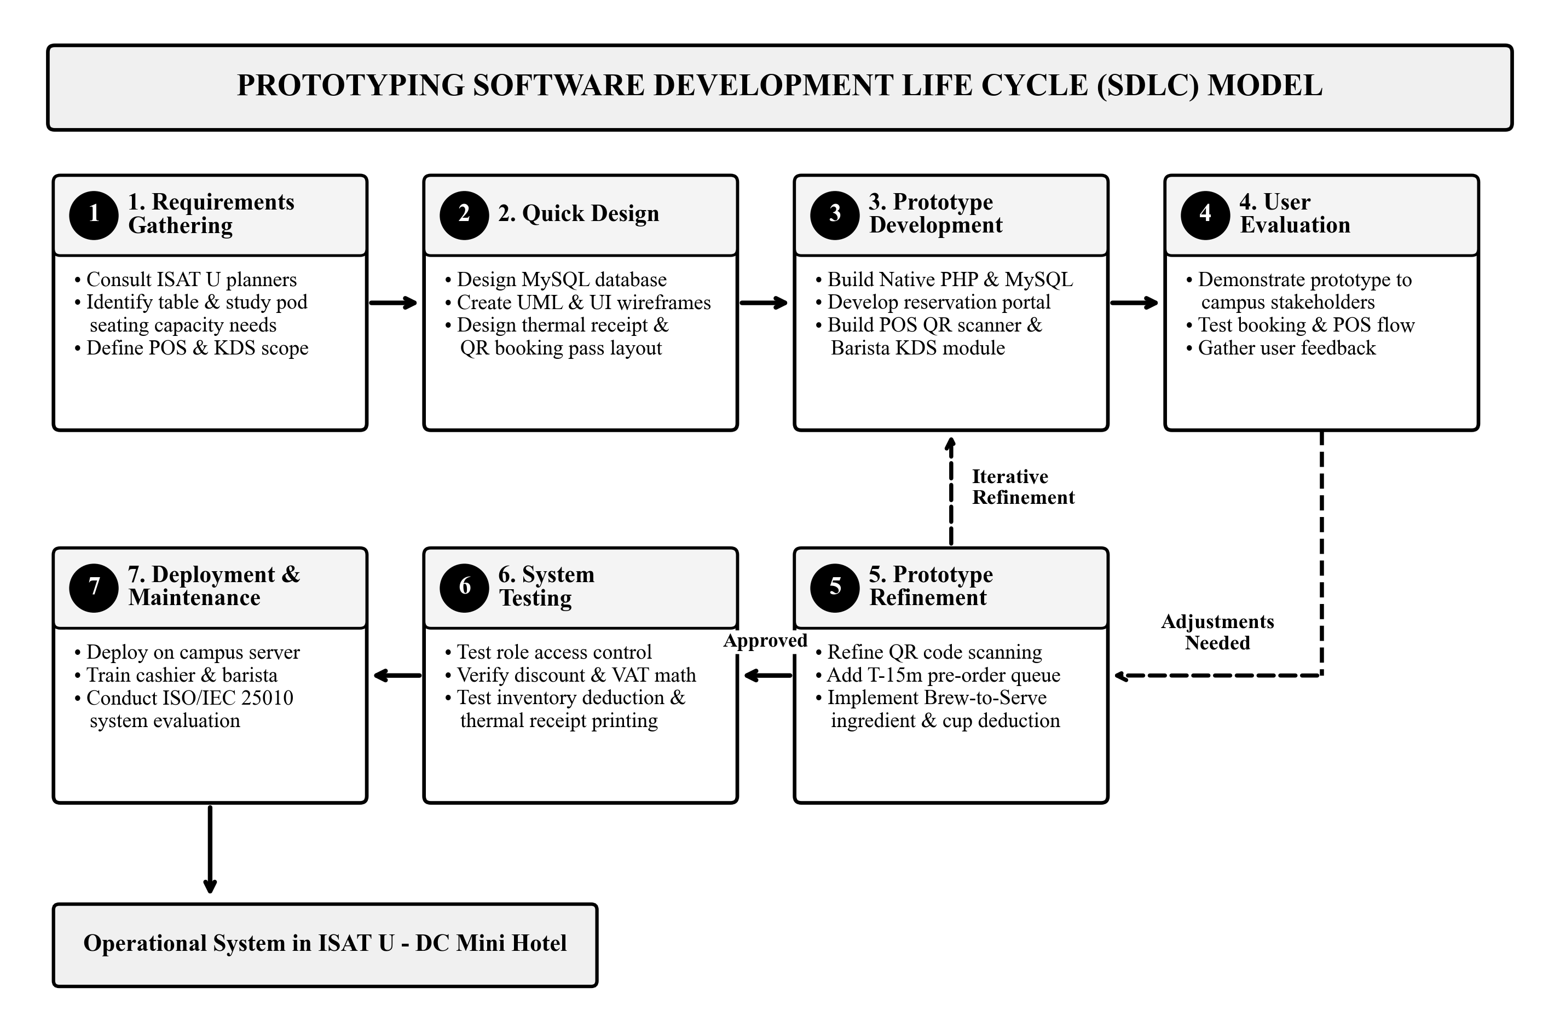
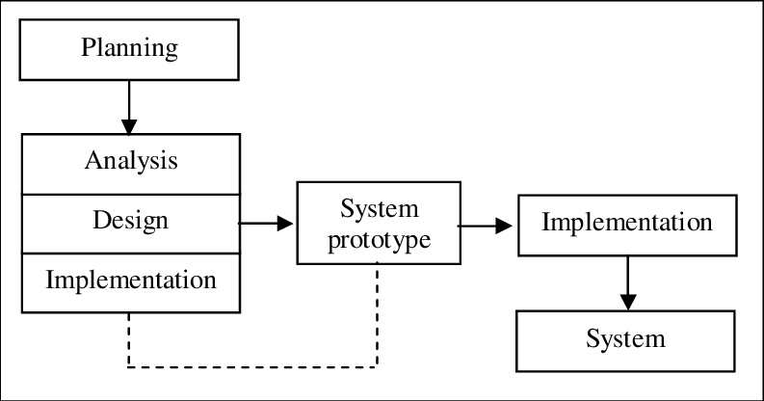
Chapter III: Methodology
Prototyping Software Development Life Cycle (SDLC) Model

Slide 12
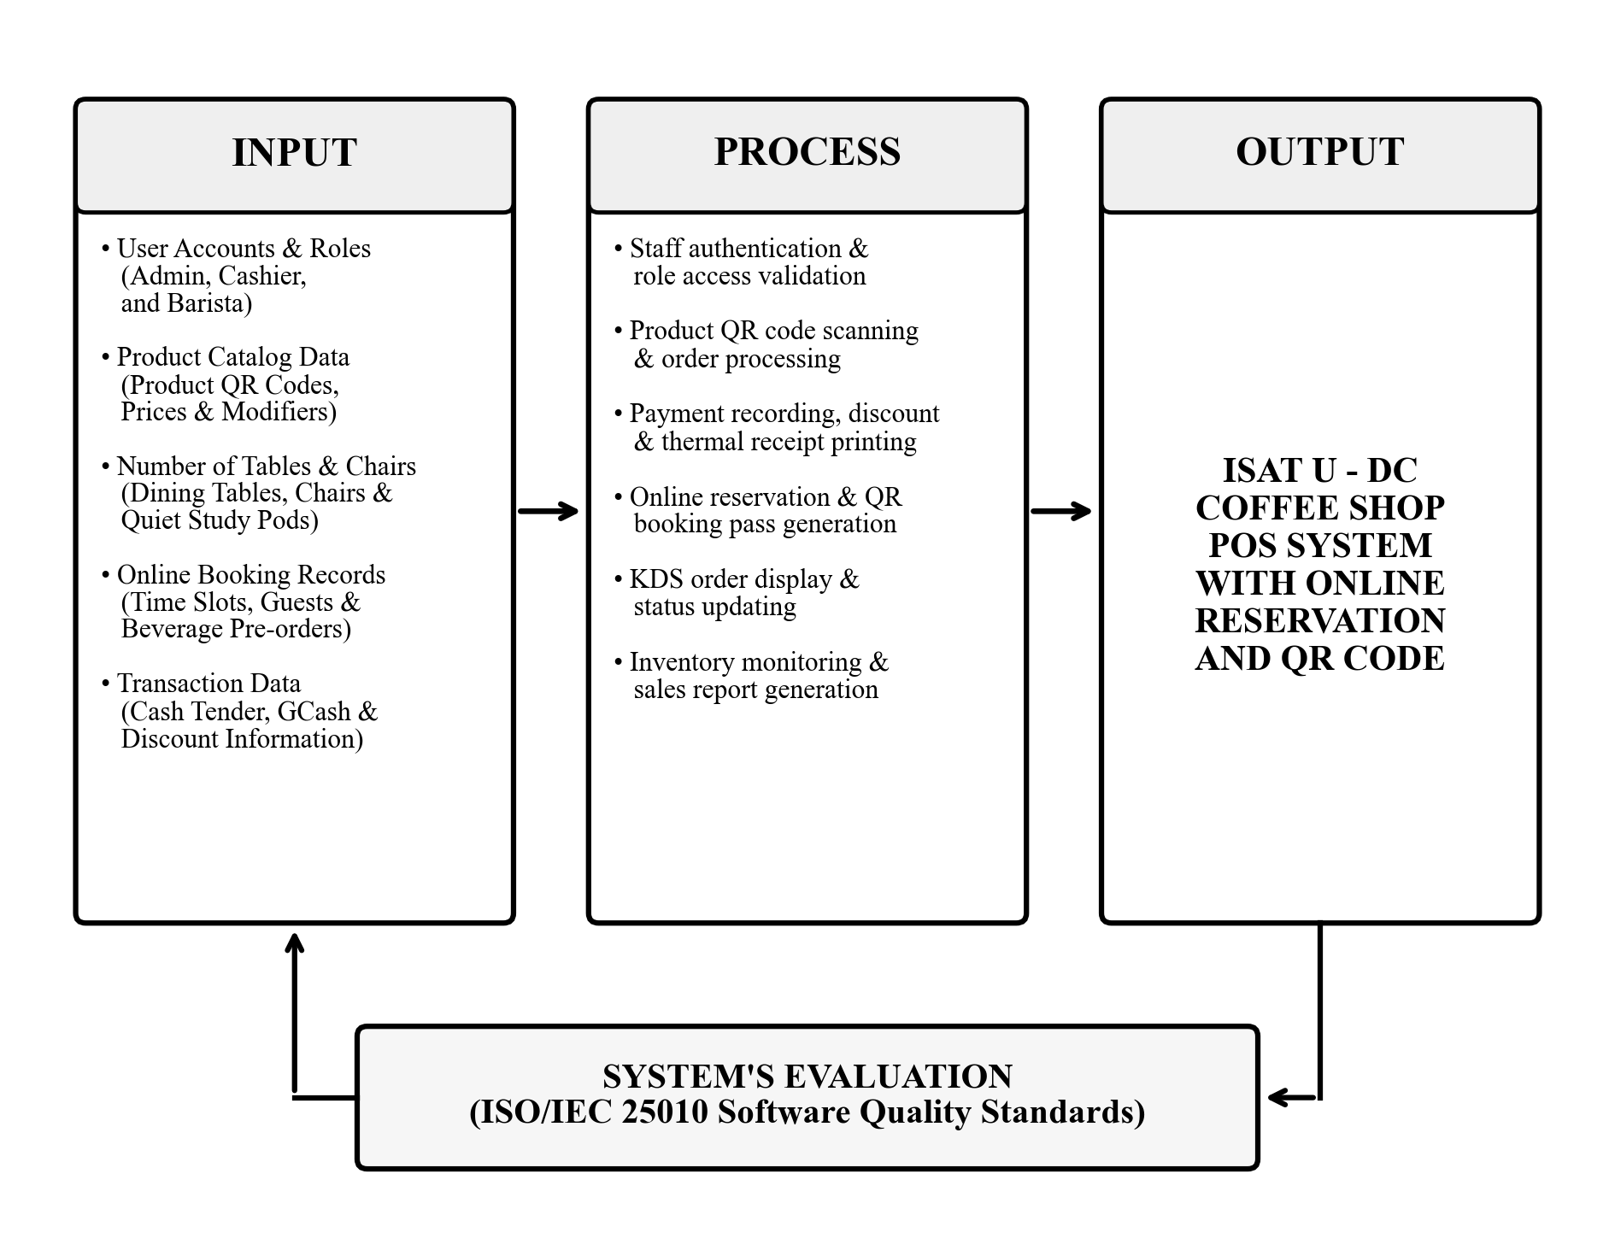
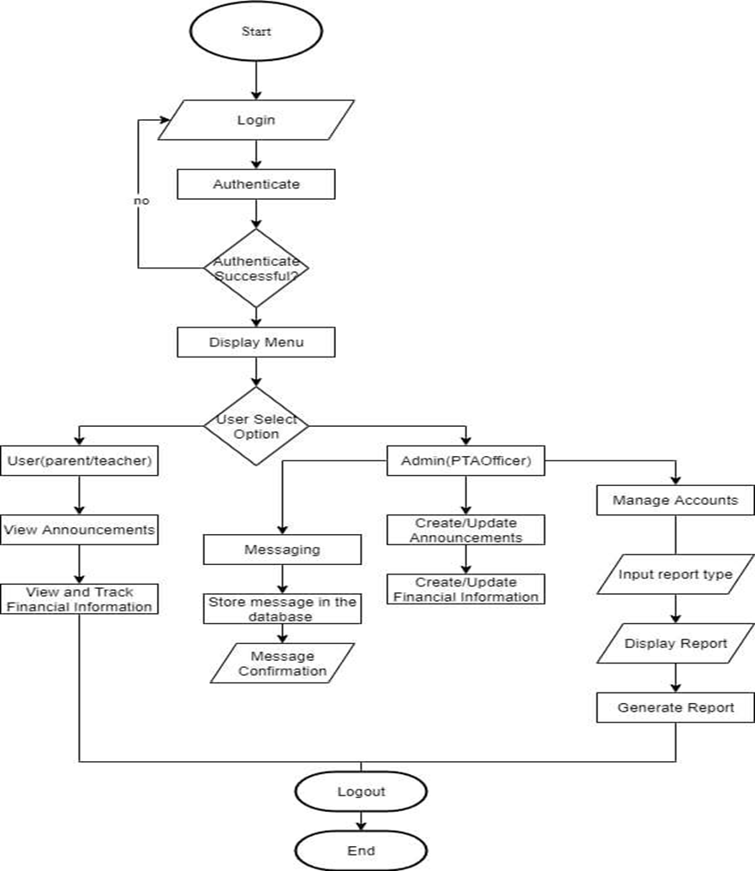
Conceptual Framework of the Study (IPO Model)
Chapter III: Methodology

Slide 13
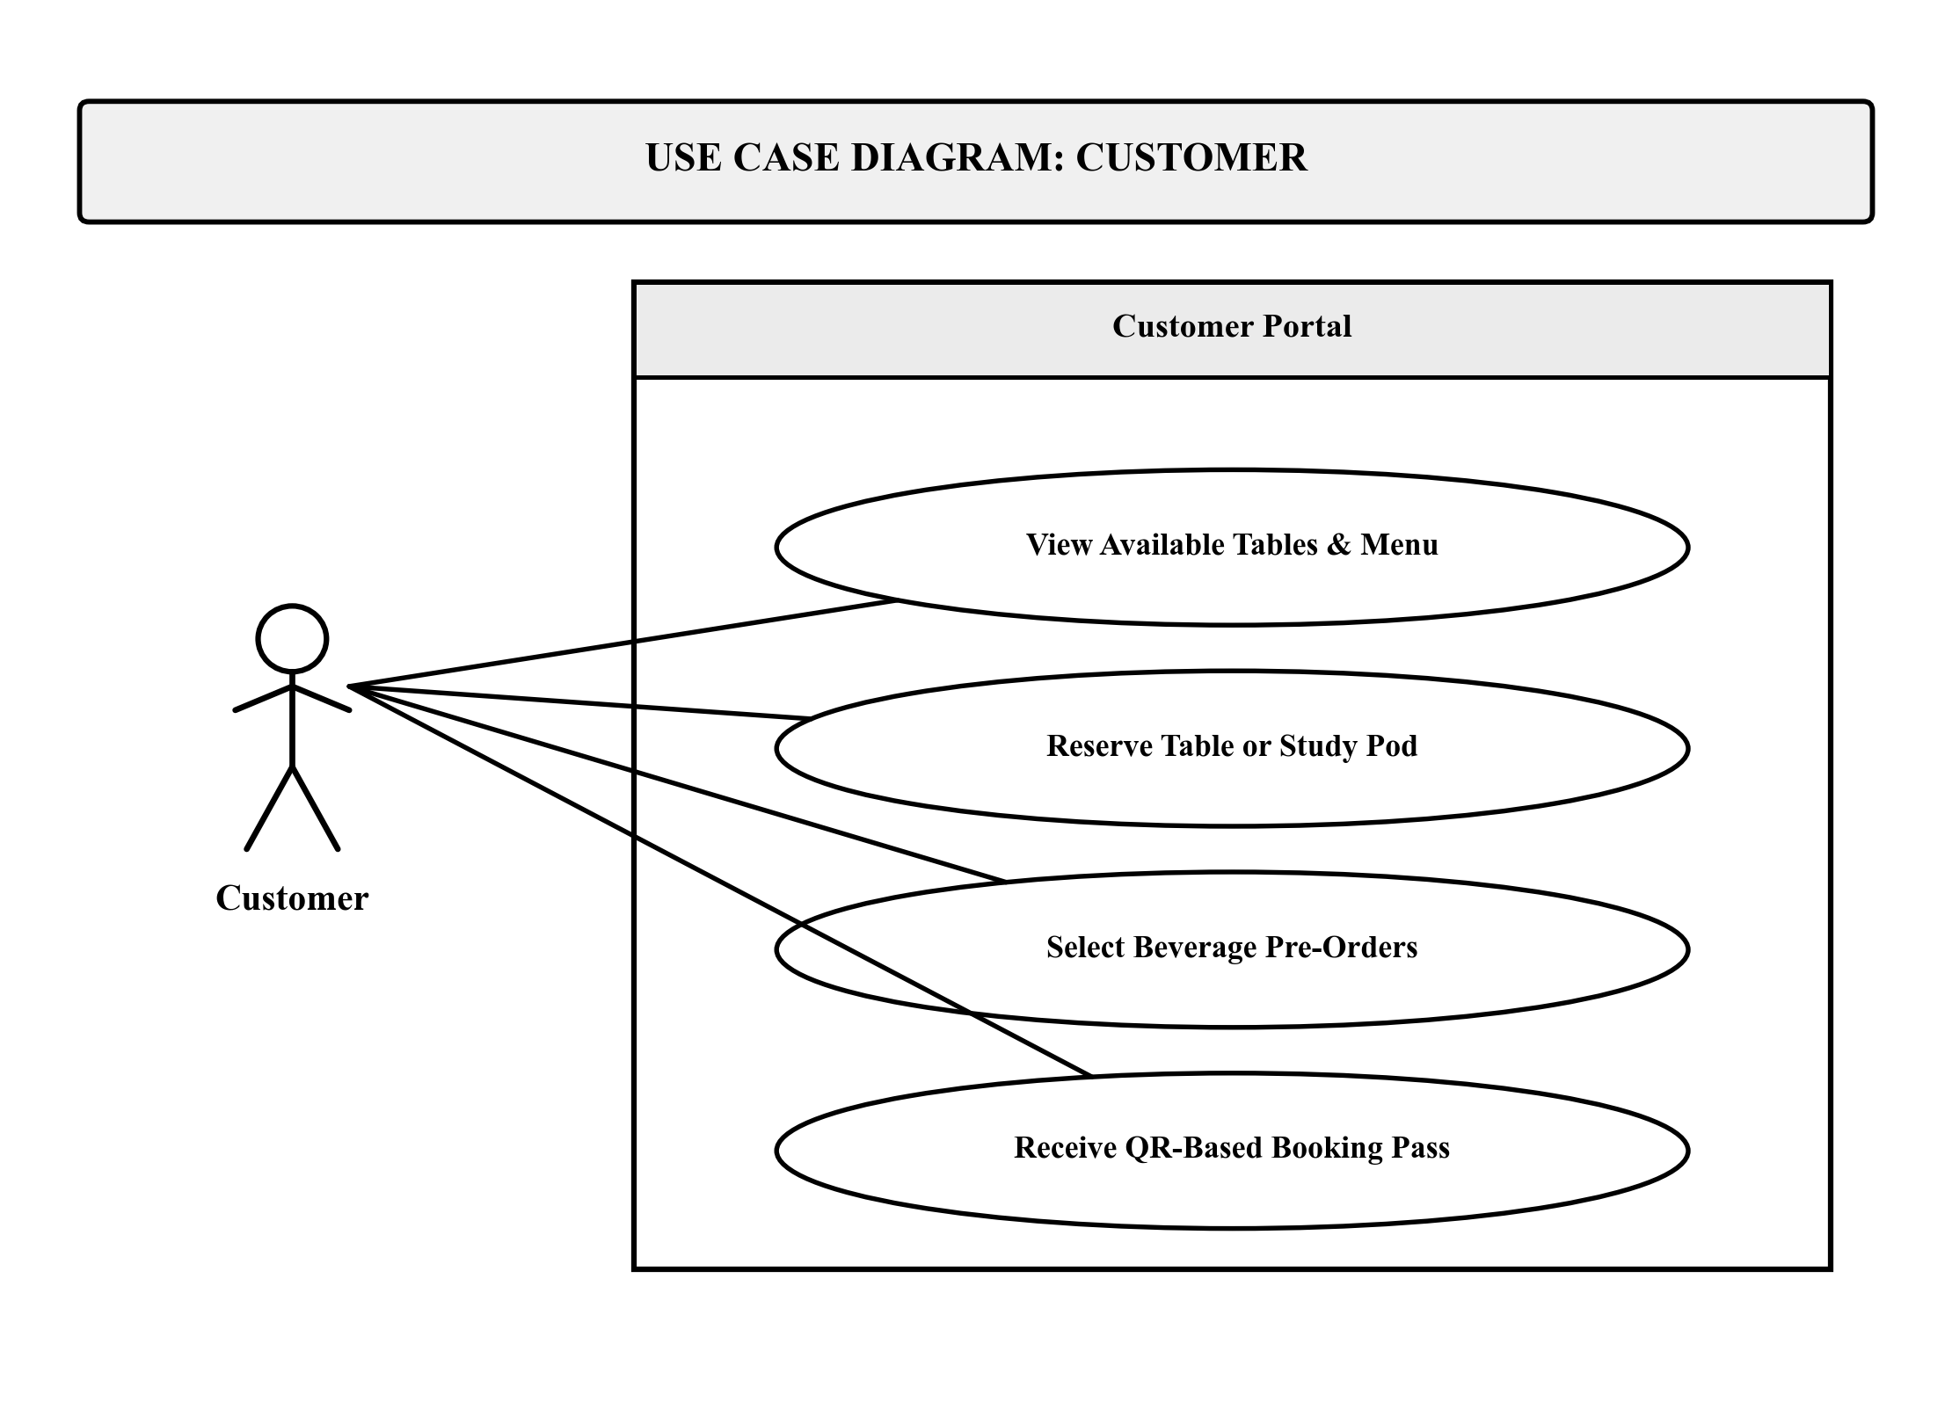
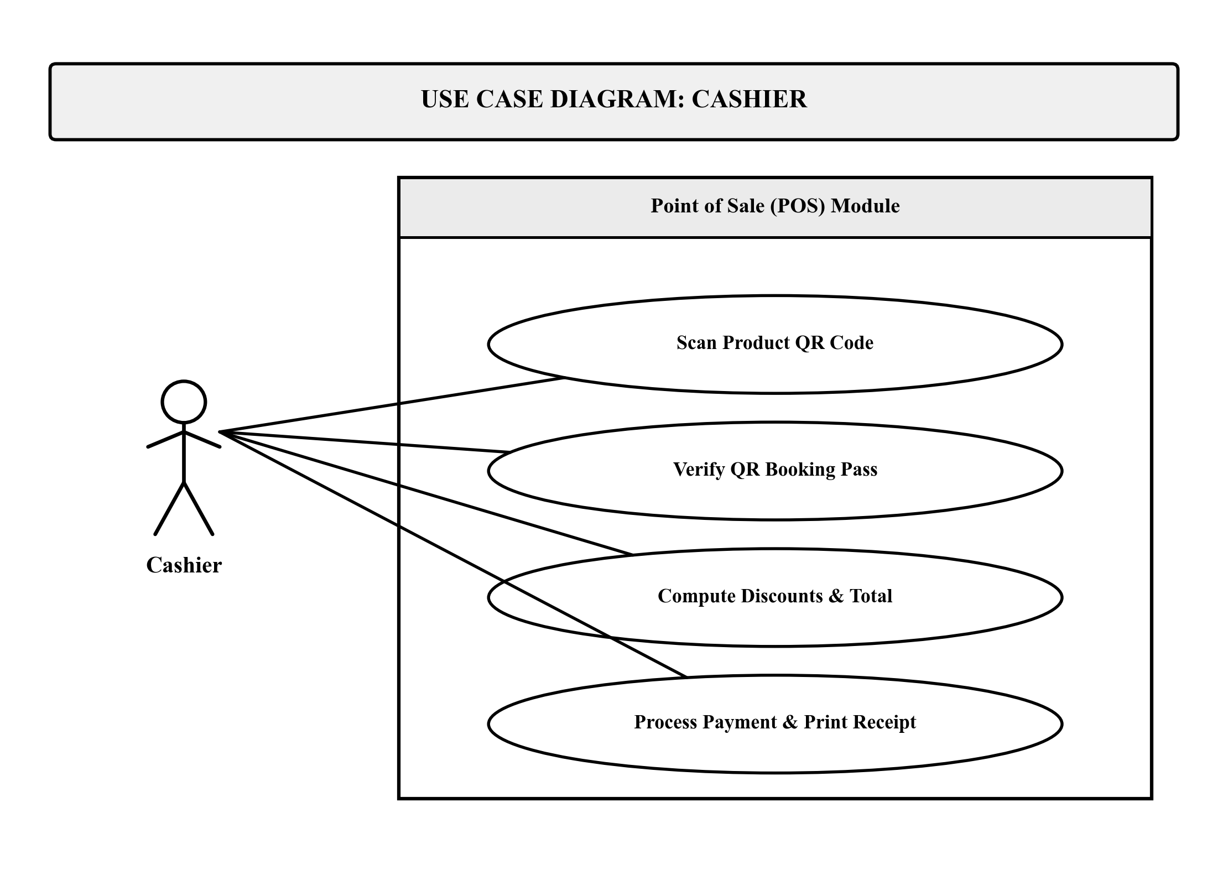
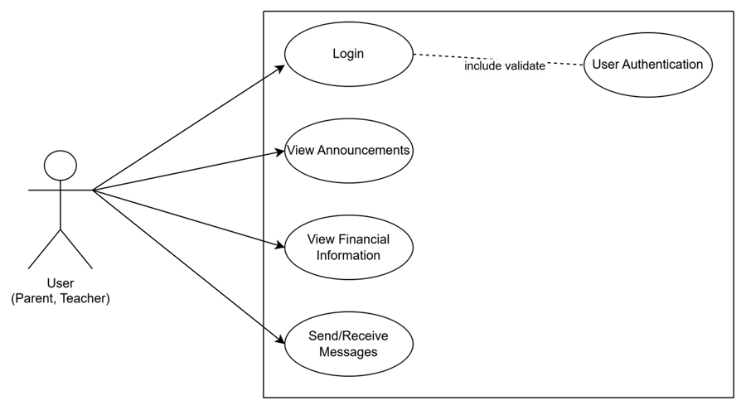
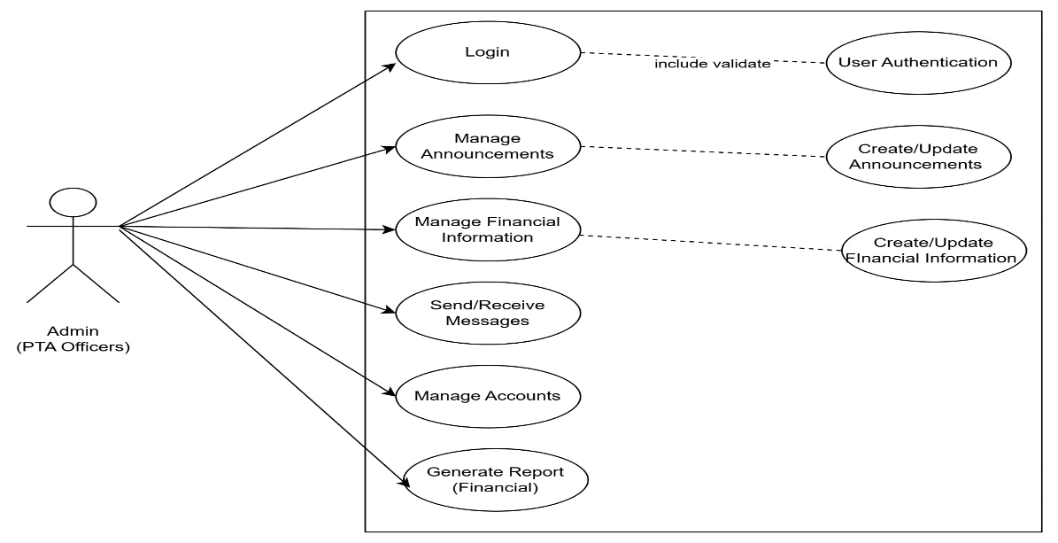
UML Use Case Diagrams (Customer & Cashier Roles)
Chapter III: Methodology
Figure 4a. Customer Role (Public Portal - No Login)
Figure 4b. Cashier Role (Front Counter POS Terminal)

Slide 14

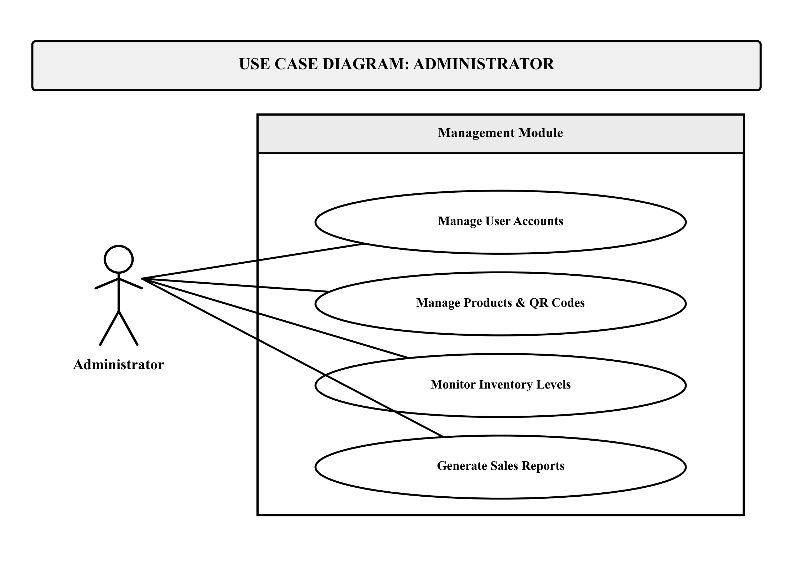
Chapter III: Methodology
UML Use Case Diagrams (Barista & Administrator Roles)
Figure 4c. Barista Role (Kitchen Display System Queue)
Figure 4d. Administrator Role (Accounts, Inventory, Reports)

Slide 15
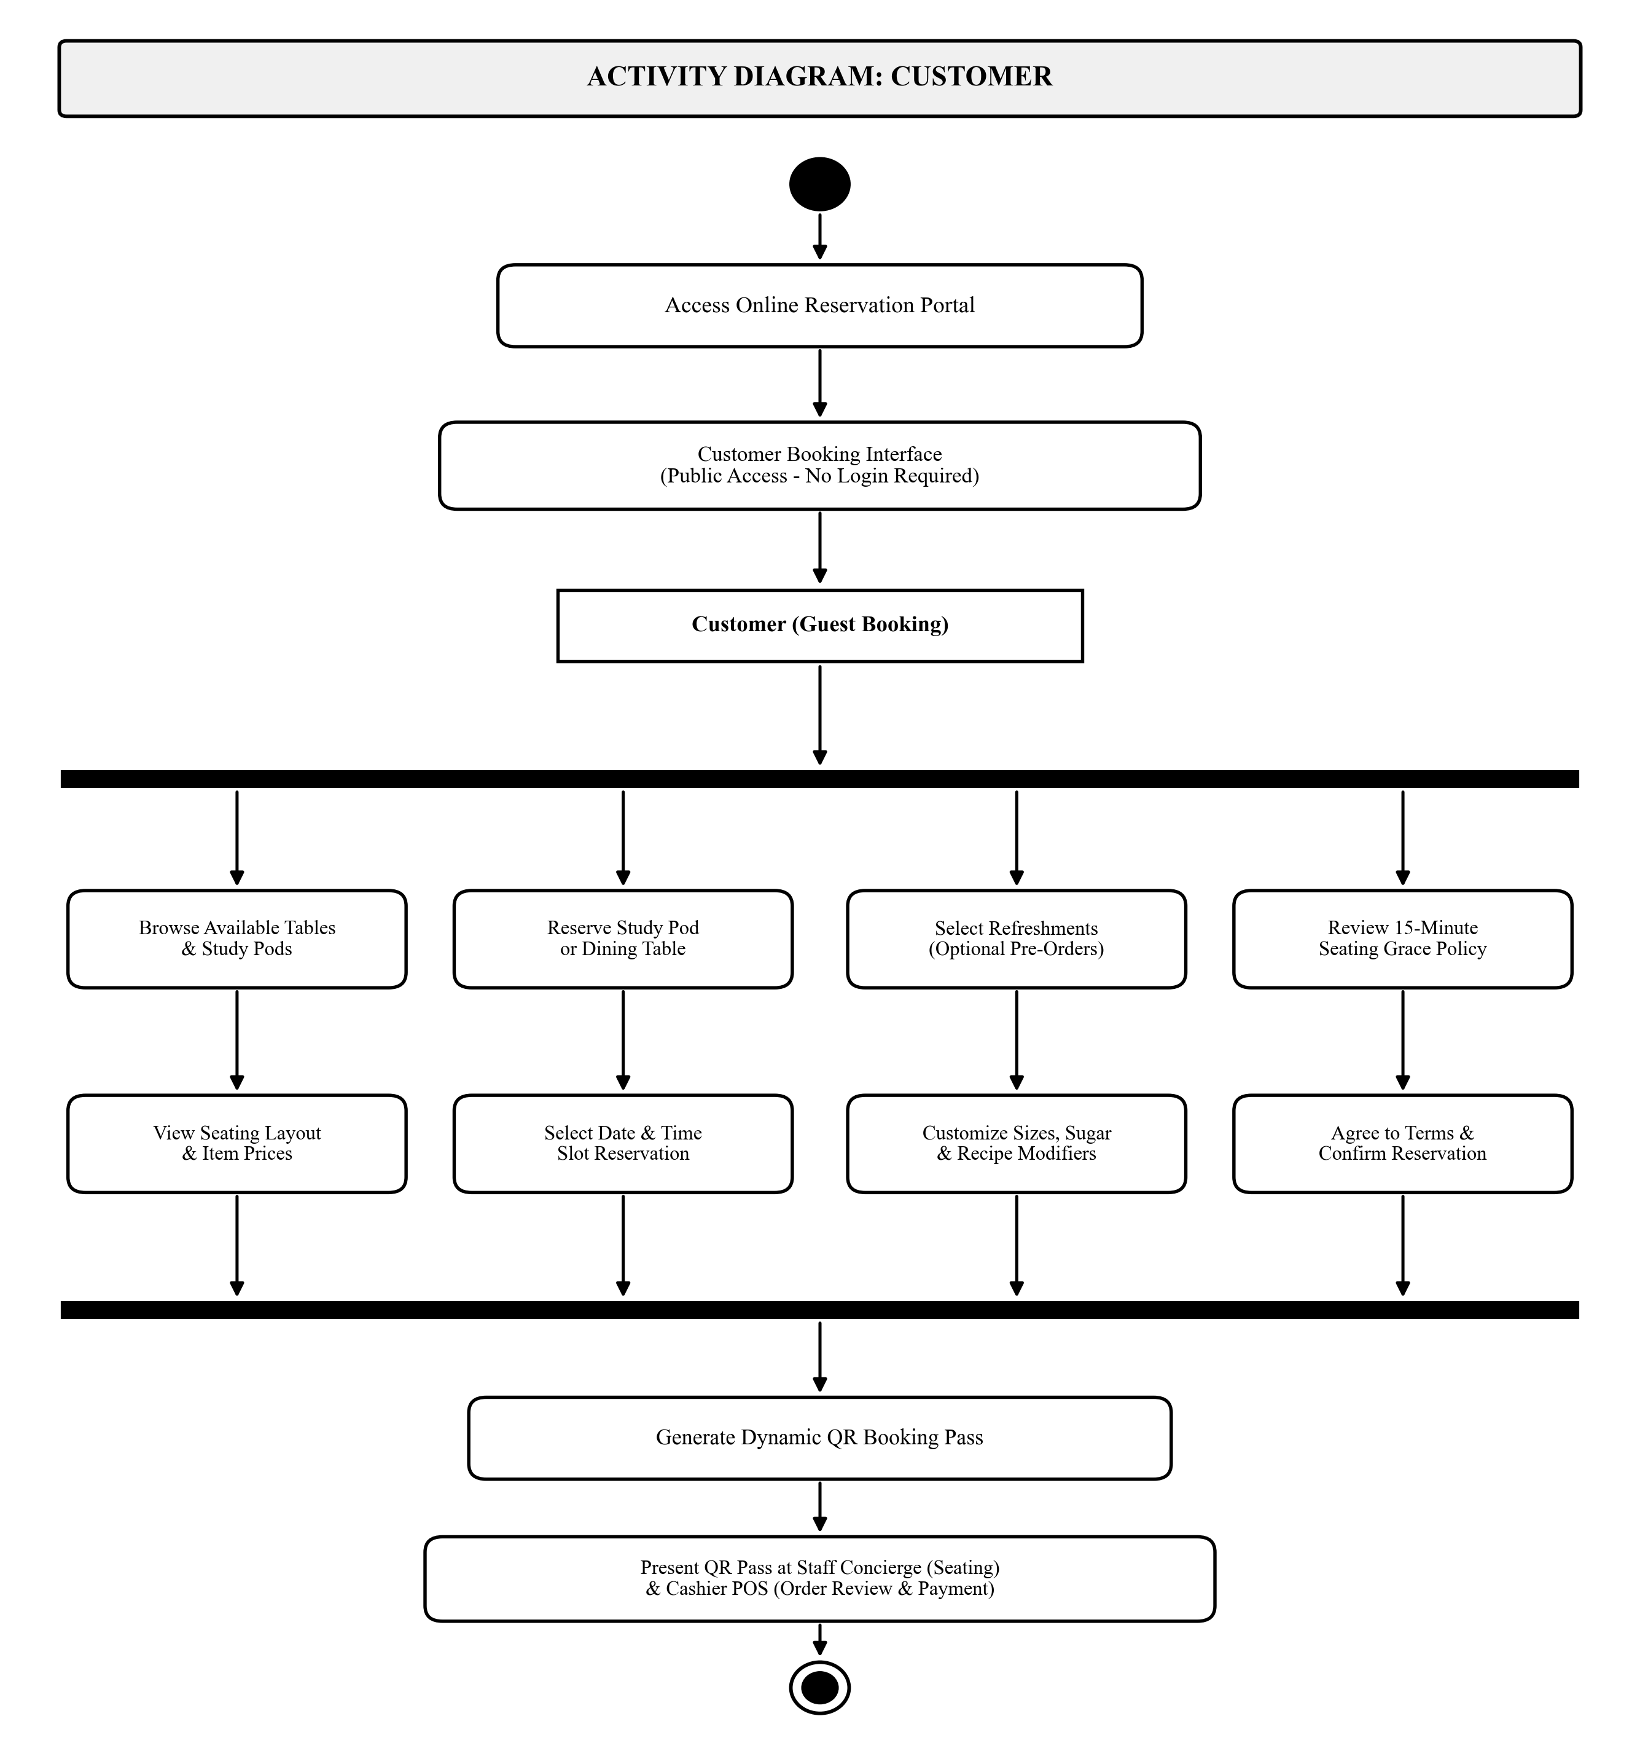
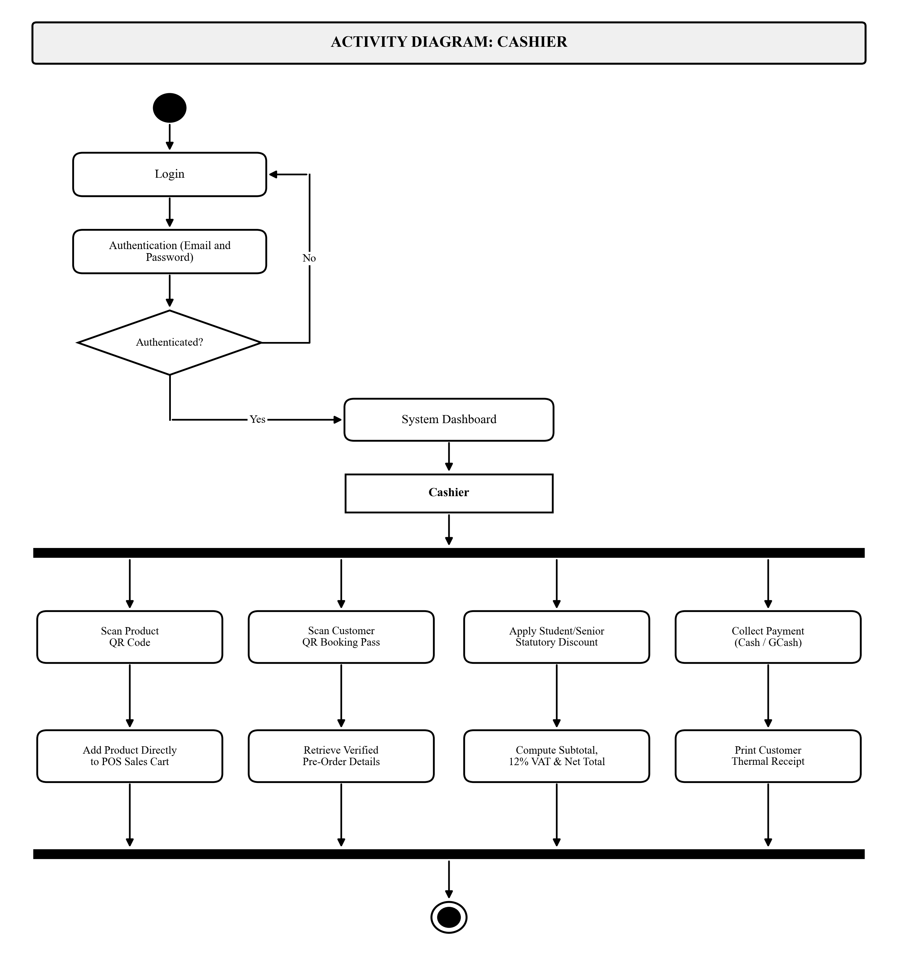
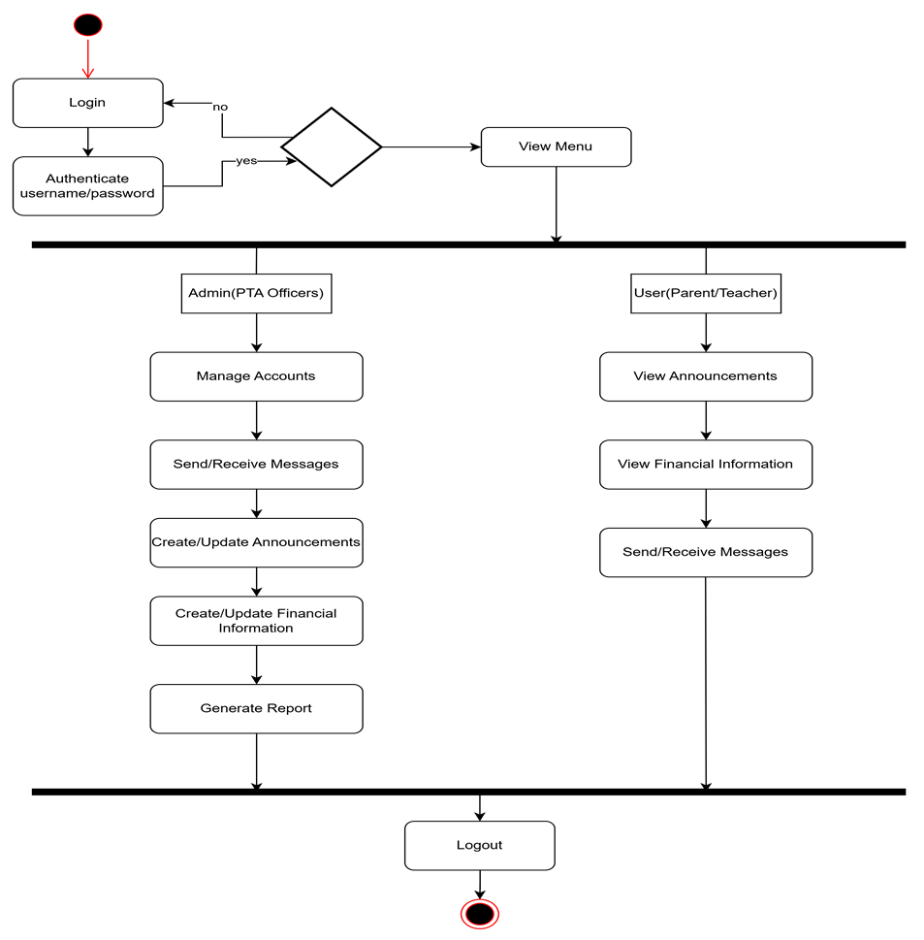
Chapter III: Methodology
UML Activity Diagrams (Customer & Cashier Roles)
Figure 5a. Customer Activity (Public Booking Interface)
Figure 5b. Cashier Activity (2D Scan, Discount, Receipt)

Slide 16
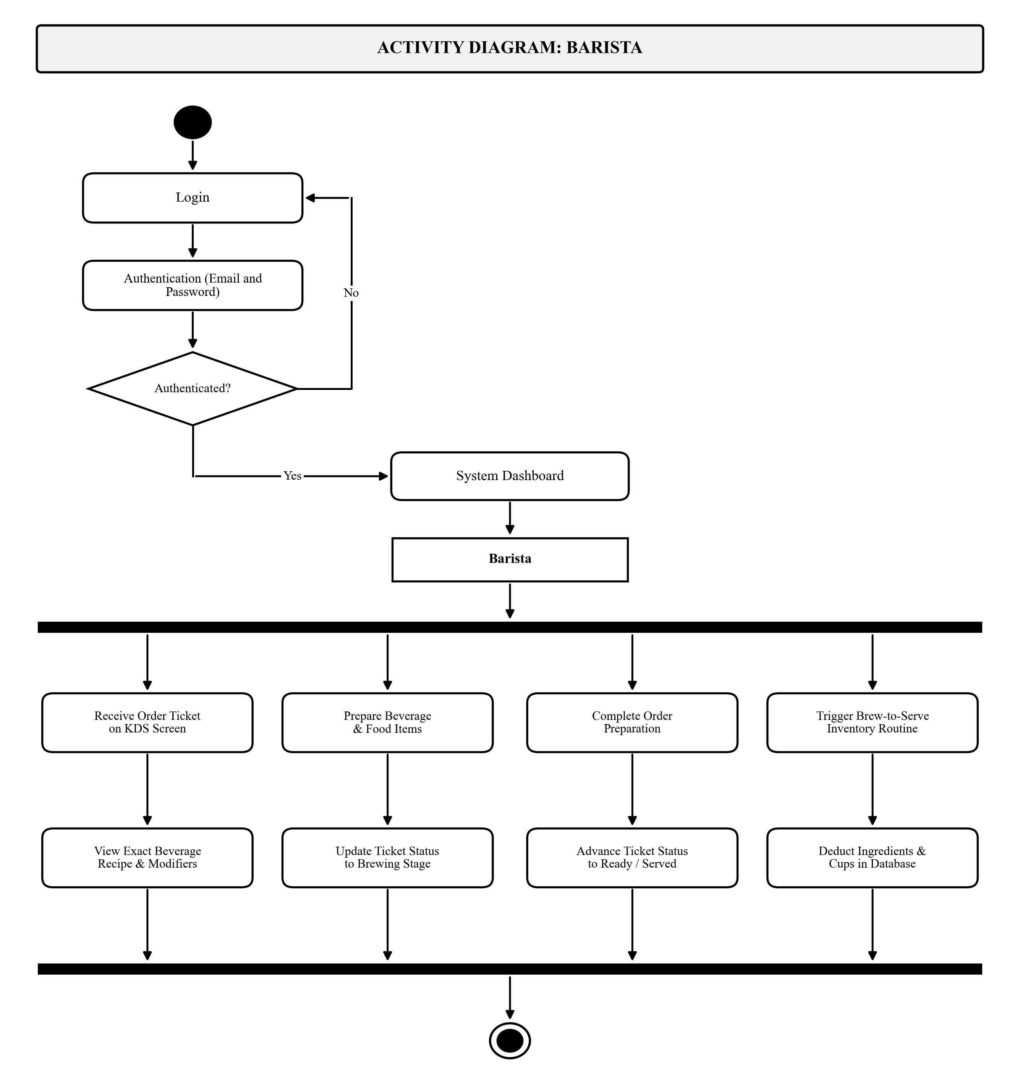
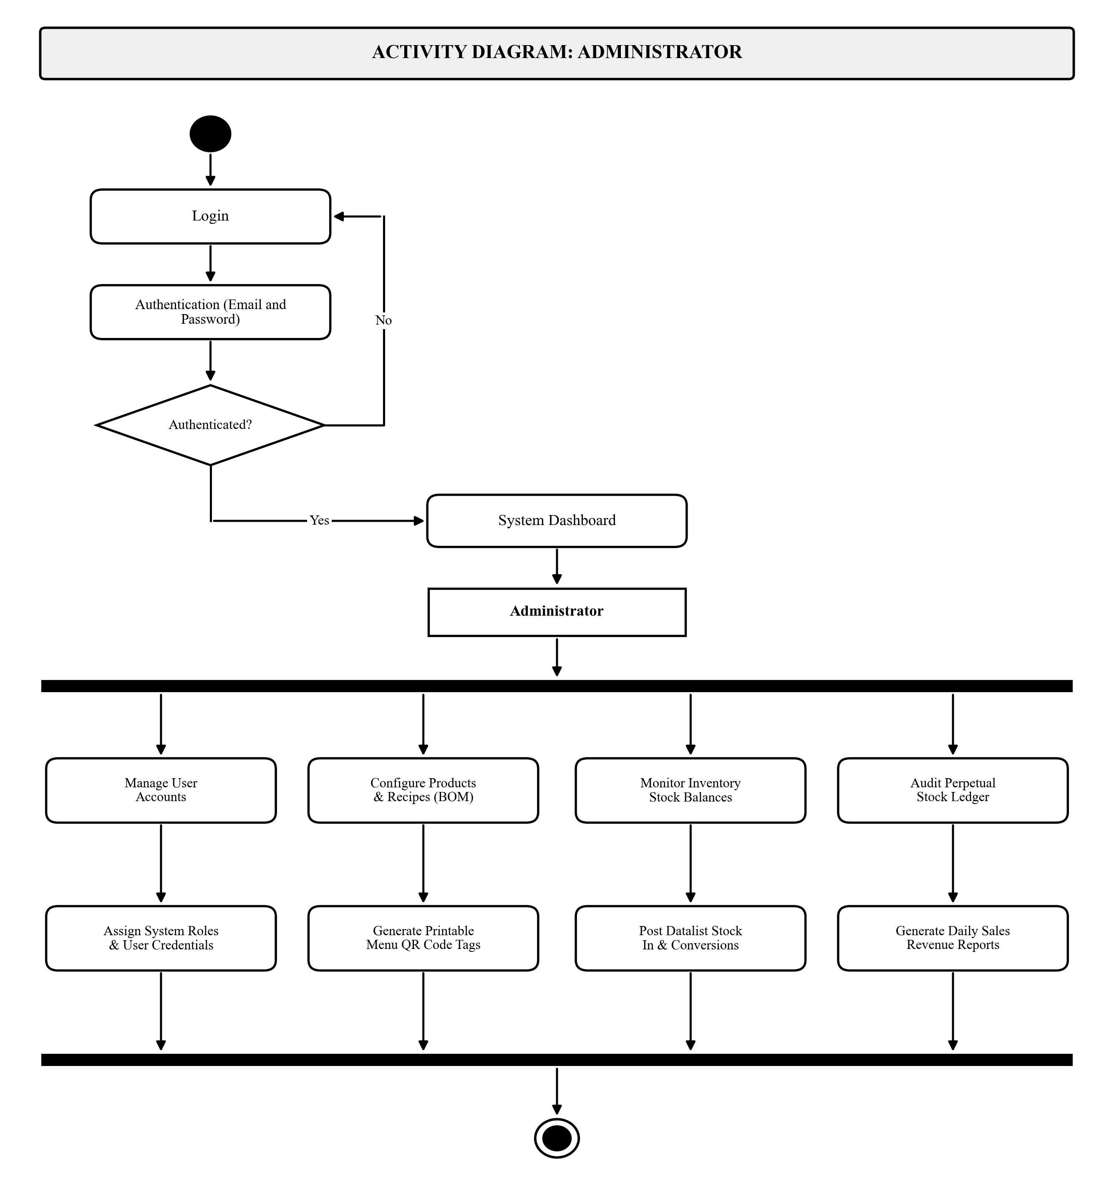
Chapter III: Methodology
UML Activity Diagrams (Barista & Administrator Roles)
Figure 5c. Barista Activity (KDS Prep & Brew-to-Serve)
Figure 5d. Administrator Activity (Governance & Audits)

Slide 17
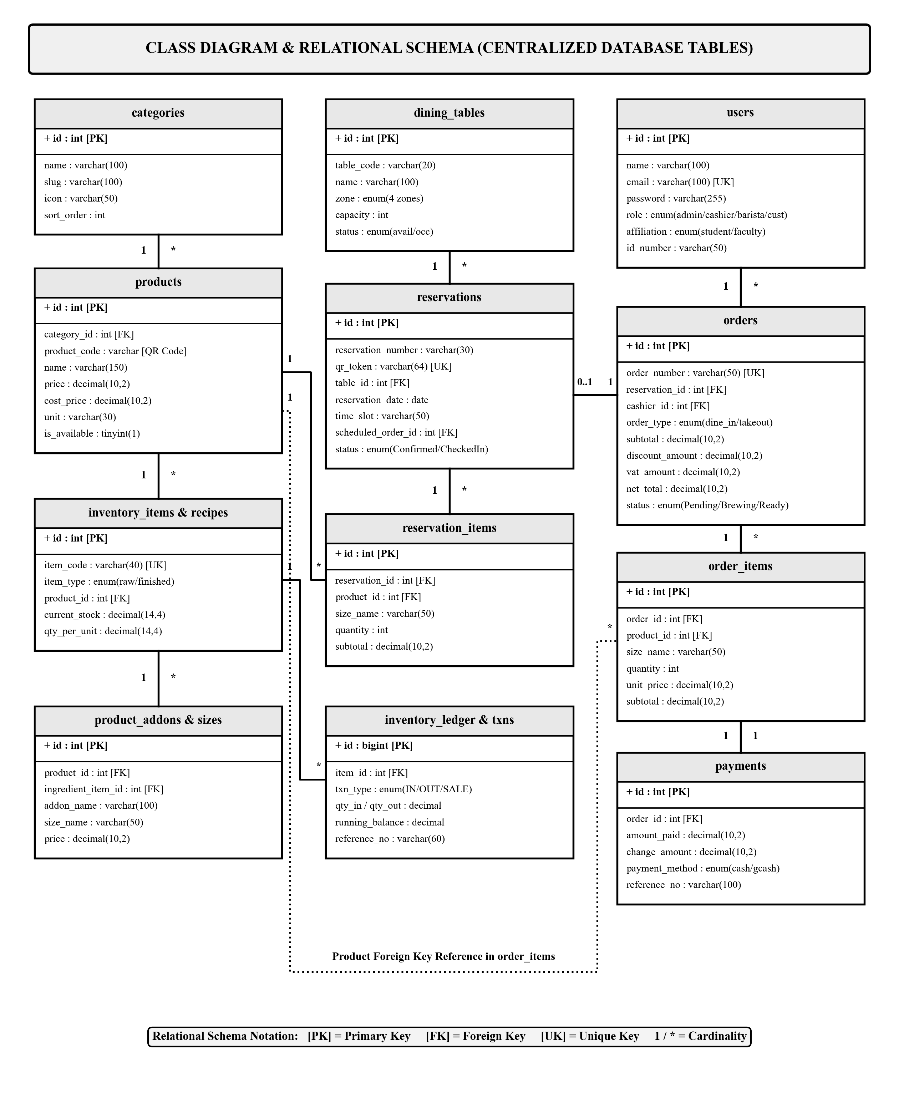
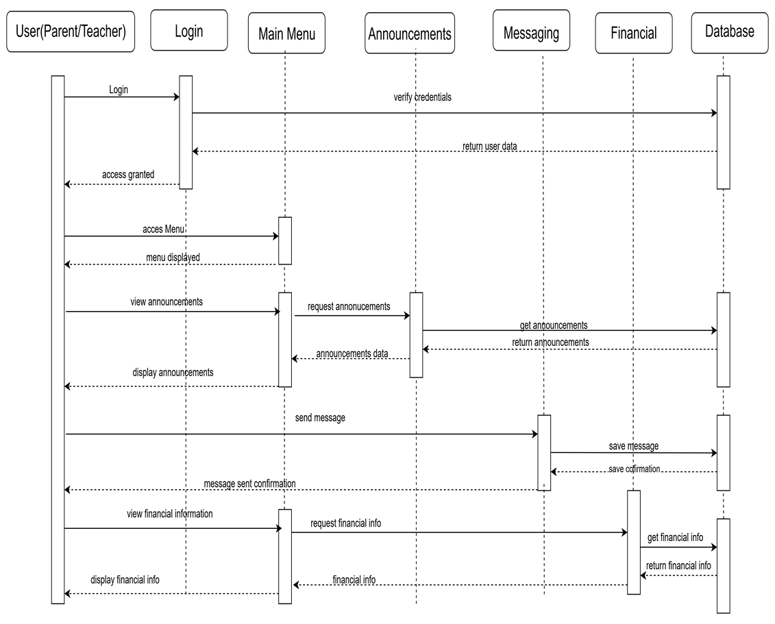
Chapter III: Methodology
UML Class / Entity Relationship Diagram (ERD)
Figure 6. Normalized Relational Database Architecture (11 Relational Entities with Crow's Foot Integrity)

Slide 18
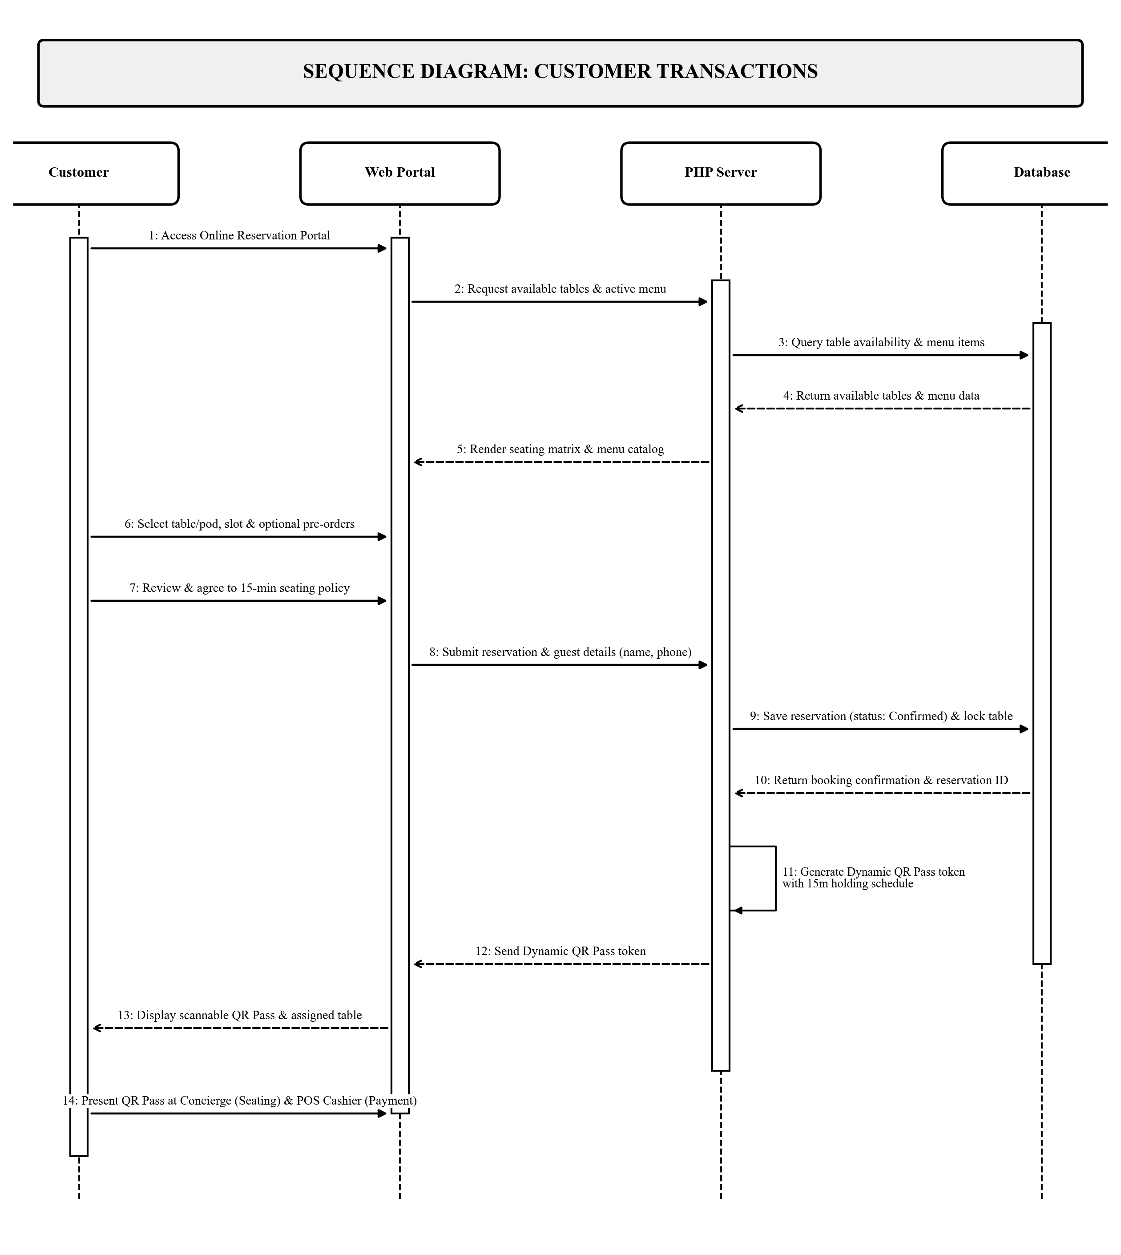
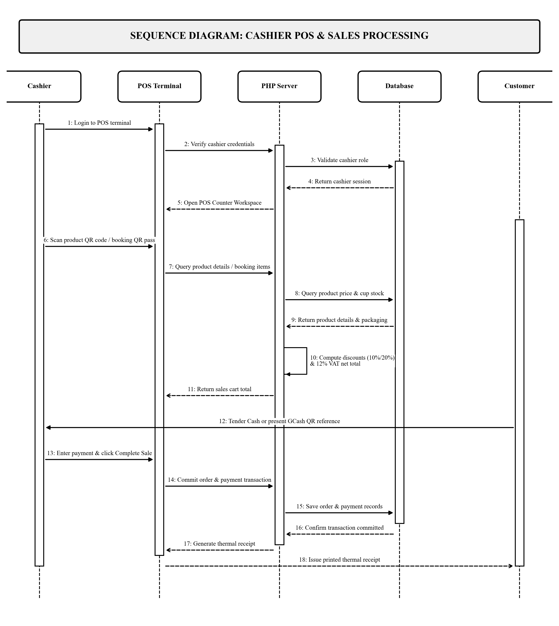
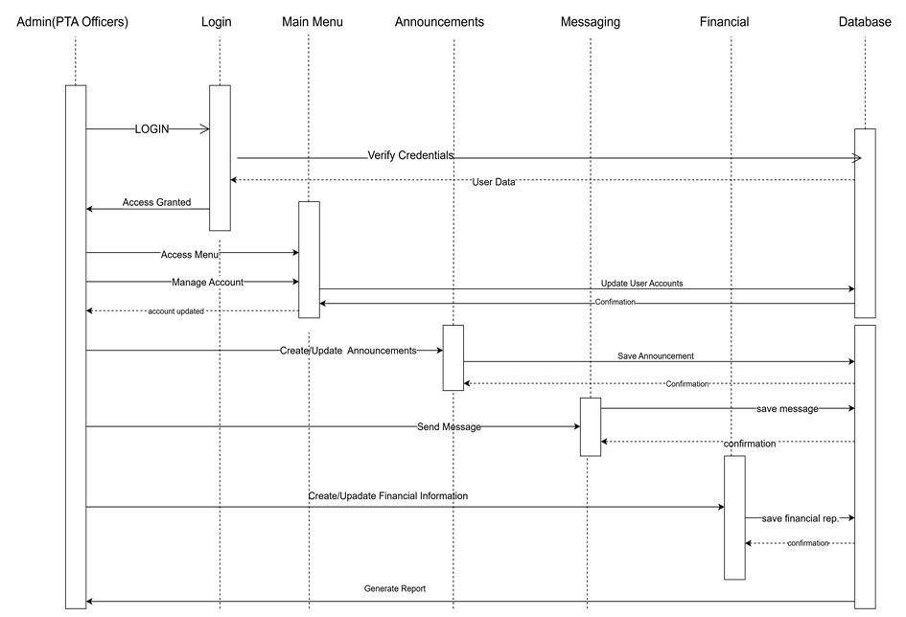
Chapter III: Methodology
UML Sequence Diagrams (Customer & Cashier Roles)
Figure 7a. Customer Sequence Flow (Public Portal - No Login)
Figure 7b. Cashier Sequence Flow (Scan, Tender, Commit)

Slide 19
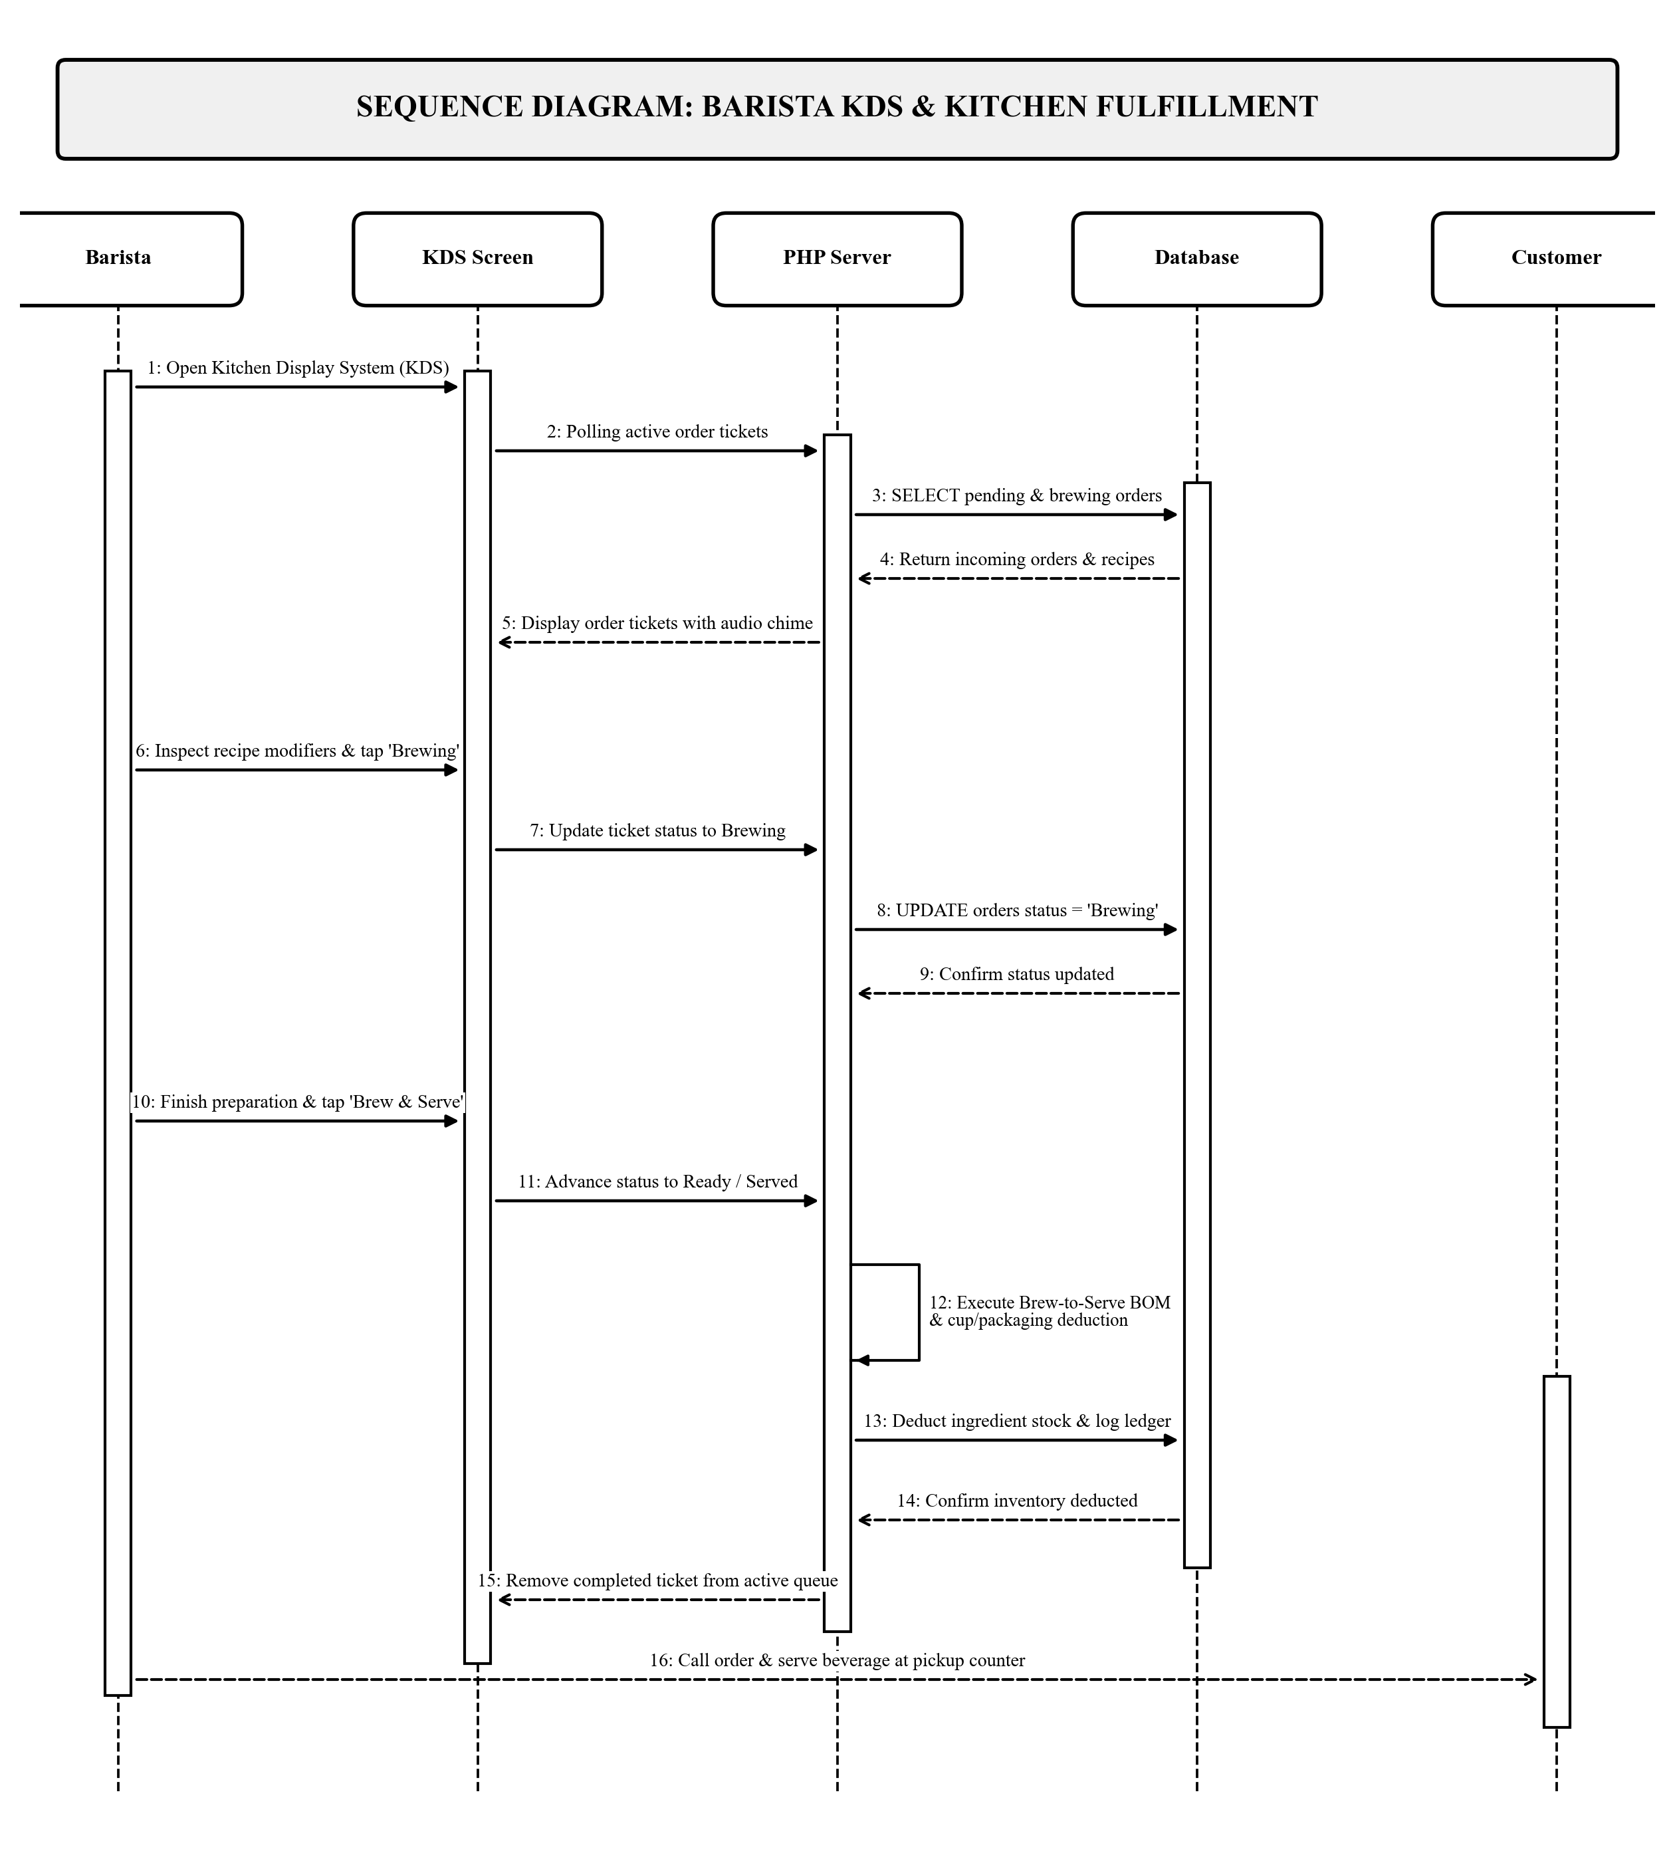
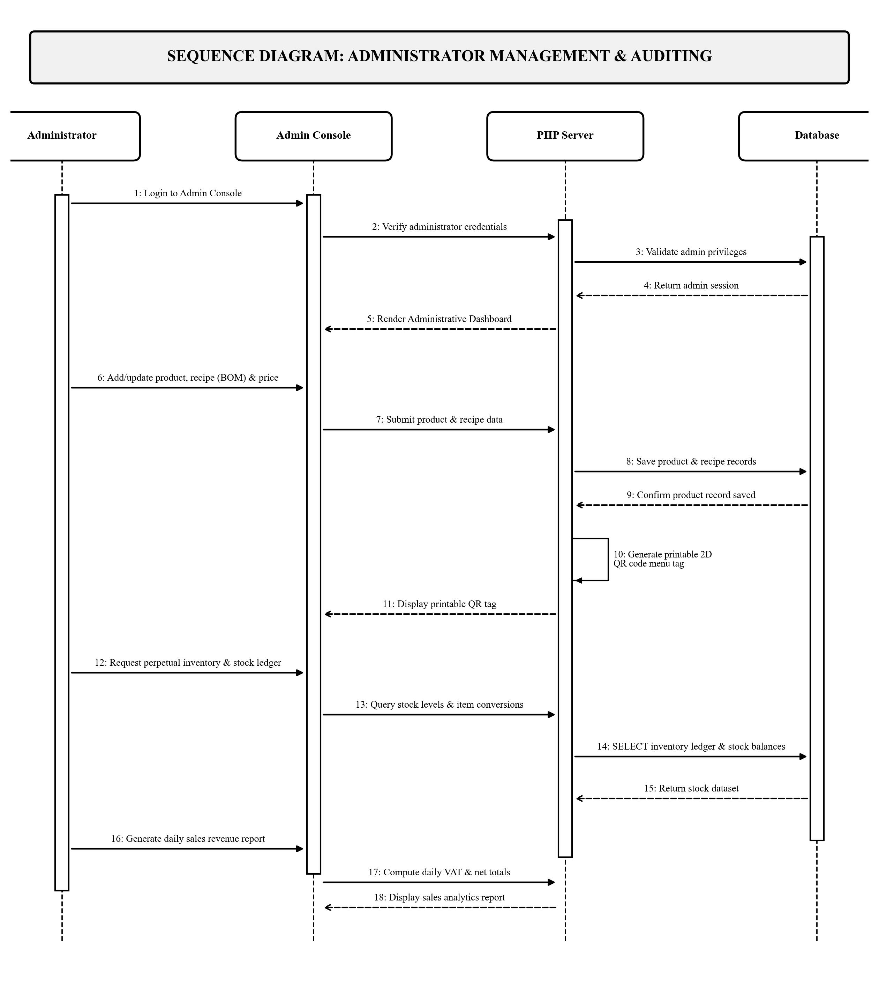
Chapter III: Methodology
UML Sequence Diagrams (Barista & Administrator Roles)
Figure 7c. Barista Sequence Flow (KDS Screen & Inventory)
Figure 7d. Administrator Sequence Flow (Config & Audits)

Slide 20
Chapter III: Methodology
Table 1:Hardware Specification
Table 2:Software Specification
Hardware Component | Minimum Required Specification
Server Host Machine | Intel Core i5 / AMD Ryzen 5, 8GB RAM, 256GB SSD, Gigabit LAN
Cashier POS Station | Touchscreen All-in-One PC / Laptop, 8GB RAM, Windows 10/11
Optical 2D Scanner | Omnidirectional 2D Optical QR / Barcode Scanner (USB / Wireless)
POS Thermal Printer | Direct Thermal 58mm / 80mm ESC/POS Receipt Printer (USB)
Barista KDS Display | 10.1"+ Tablet or Wall-Mounted Monitor running Web Browser
Client Devices | Smartphones, Tablets, or Laptops with Modern Web Browsers
Networking Hardware | Dual-band Wi-Fi 5/6 Router & Gigabit Ethernet Switch
Software Component | Required Specification / Tool
Operating System | Microsoft Windows 10 or 11 (64-bit) / Linux
Web Server | Apache Web Server (XAMPP / Hostinger Shared Web Hosting)
Programming Language | PHP 8.x (Native PHP / PDO with Philippine Timezone)
Database Server | MySQL Community Server (InnoDB Storage Engine)
Frontend Framework | HTML5, CSS3, Bootstrap 5.3, JavaScript, Chart.js
Web Browsers | Google Chrome, Mozilla Firefox, Safari, Microsoft Edge
Development Environment | Visual Studio Code, Git Version Control

Slide 21
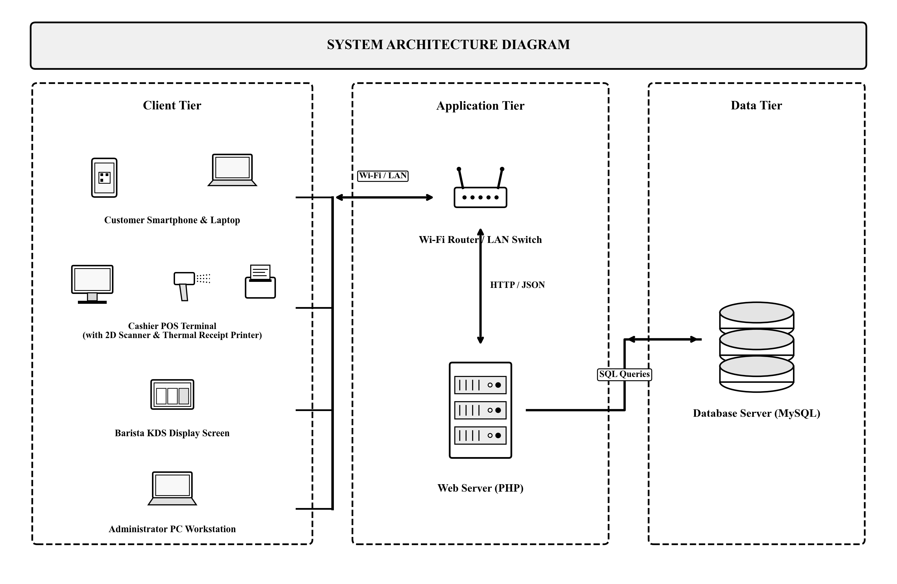








Chapter III: Methodology
System Architecture
Figure 3. System Architecture Diagram (Hardware Devices, Local Wi-Fi / LAN, Web Server, Database)

Slide 22
Chapter III: Methodology
Software Product Quality Evaluation (ISO/IEC 25010 Standards)
Rating | Range | Interpretation
5 | 4.21 - 5.00 | Excellent
4 | 3.41 - 4.20 | Very Good
3 | 2.61 - 3.40 | Good
2 | 1.81 - 2.60 | Poor
1 | 1.00 - 1.80 | Very Poor
Evaluator Assessment (10 Respondents: 5 IT Faculty & 5 Industry Users)
✔ Functional Suitability: High precision in cart math and stock depletion
✔ Performance Efficiency: Instant 2D QR decoding and rapid KDS rendering
✔ Compatibility: Seamless across desktop, tablets, and mobile smartphones
✔ Usability: Intuitive UI layout with color-coded ticket timers & audio chimes
✔ Reliability: Robust session handling and atomic transaction rollbacks
✔ Security: Strict session-based RBAC and encrypted dynamic QR tokens
✔ Maintainability: Modular native PHP/PDO MVC architecture and SQL schema
✔ Overall Weighted Mean: 4.62 — Excellent Quality

Slide 23
THANK YOU!
ISAT U - DC COFFEE SHOP POS SYSTEM WITH ONLINE RESERVATION AND QR CODE
Researchers: John Reynel Caparida | Christian Mark Gepana | Kenth Michael Palma
Capstone Adviser: Engr. Mark Anthony Villanueva, M.Eng.
Open for Questions and Discussion

