Slide 1

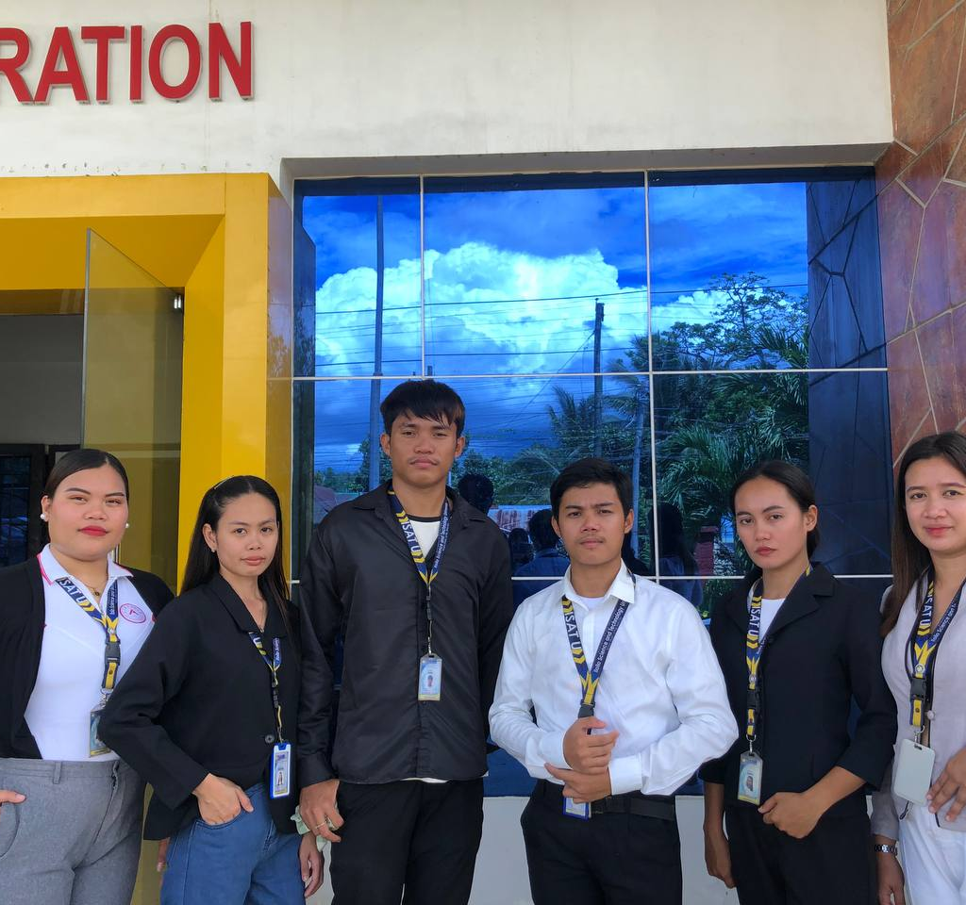
Members:
Rey John Acma
Christian Prindol
Laila Mae Suarez
Chery Lou Salvado
Angela Luna Deramos
Jaina Rose Demegillo

Slide 2
PTAConnect: Web- based Parent Teacher Association Information System

Slide 3

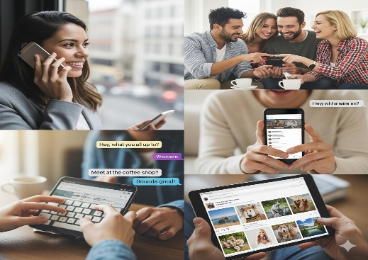


Background of the Study

Slide 4





Objective of the study
Create a database for data storage;
Provide a centralize platform for announcements;
Implement a messaging system using chat;
Tracking of financial records;
Generate report; and
• Evaluate the system using ISO 25010 criteria.

Slide 5

Conceptual Framework
Personal Information
Login Credentials
Announcements
Financial Information
INPUT
Create a database
Display Announcements
Track financial report
Messaging System
Generate report
PROCESS
OUTPUT
Web based Parent Teacher Association Information System
SYSTEM EVALUATION

Slide 6

Significance of the Study
PTA Officers
Parents
Teachers
School Administrators
Students
Future Researchers

Slide 7
Scope and Limitation
Scope:
Sharing and viewing information
Tracking financial Information
Messaging through chat
Generation of report
Limitation:
Financial features such us online payment processing is excluded
The system will run and operate using internet connection

Slide 8
Chapter II Review of Related Literature
Related Literatures
Database Management
Messaging System
Information System
Announcements
Financial Information

Slide 9
Chapter II Review of Related Literature
Related Studies
Parent Teacher Interaction System
Parent Teacher Association Mobile Application to Enhance Communication among
PTA Members During Covid 19 Pandemic
A Web based Parent –Teacher Collaborative System for Monitoring Students Academic
Performance in Nigerian School
4. Mobile Application for School Parent Students Information with PTA Forum

Slide 10
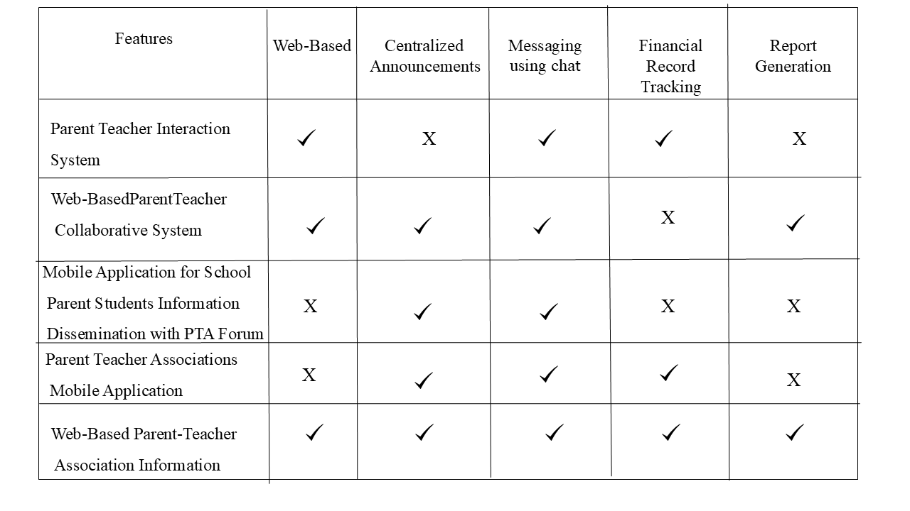
Chapter II: Review of Related Literature
System Comparison

Slide 11

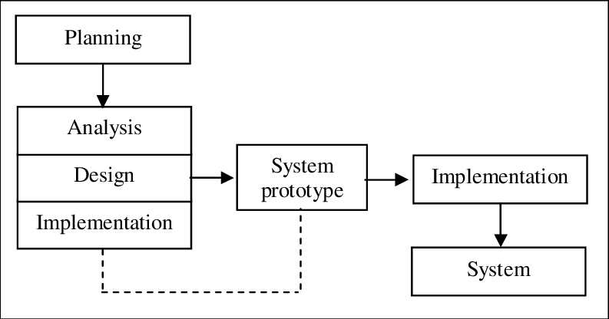
Chapter III: Methodology
Prototype Methodology

Slide 12
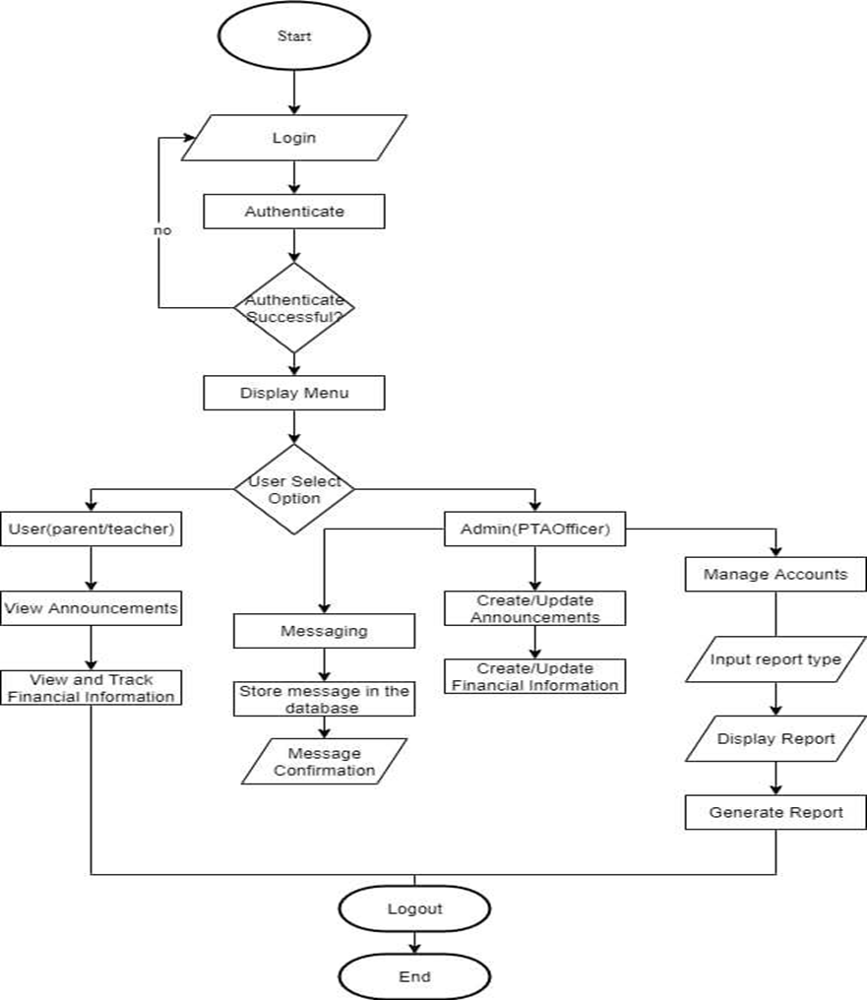
Chapter III: Methodology
Flowchart

Slide 13
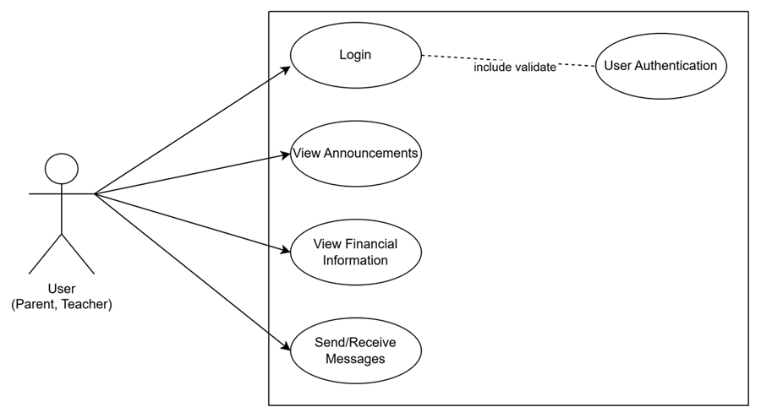
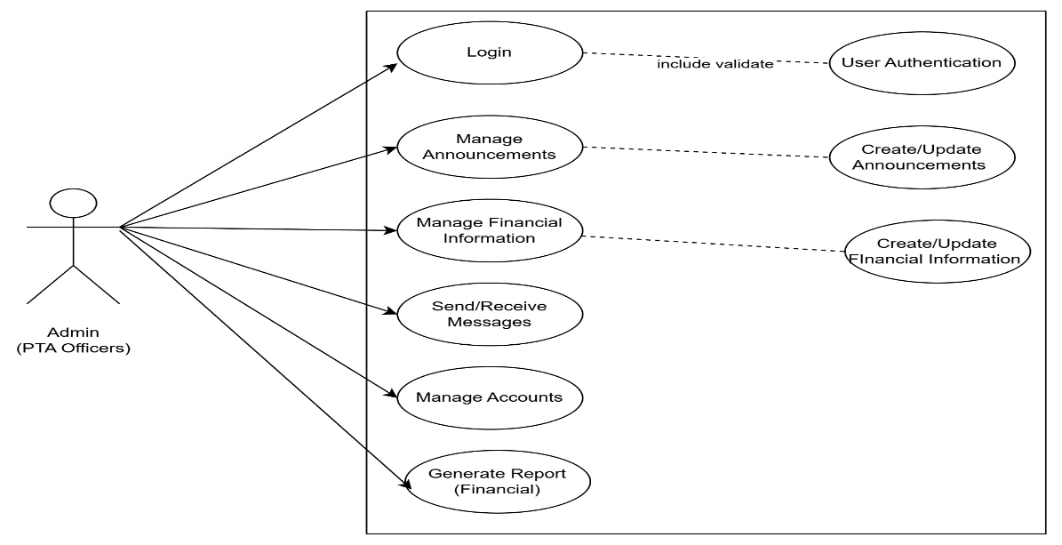
Chapter III: Methodology
User Use Case
Admin Use Case

Slide 14
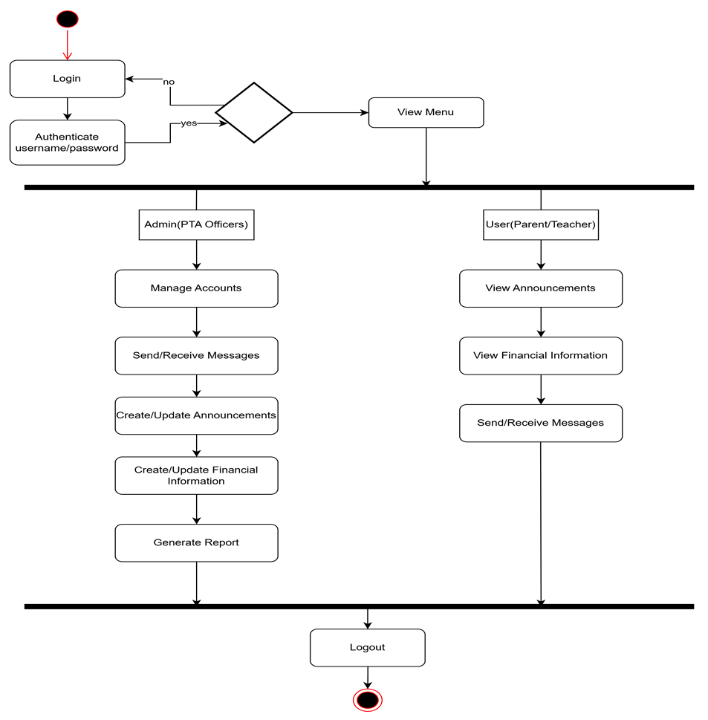
Chapter III: Methodology
User And Admin Activity Diagram

Slide 15
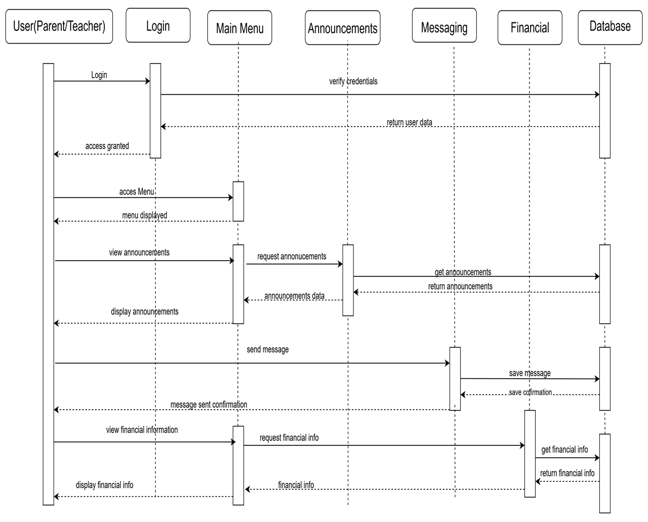
Chapter III: Methodology
Sequence Diagram for User

Slide 16
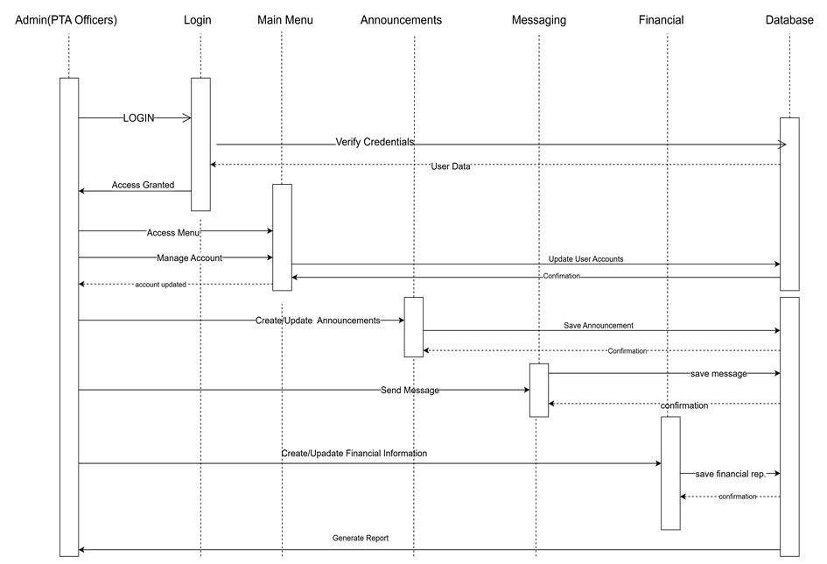
Chapter III: Methodology
Sequence Diagram for Admin

Slide 17
Chapter III: Methodology
Table 1:Hardware Specification
Table 2:Software Specification
 | Minimum Requirements
CPU Type/Model | Dual Core 2.3 GHz or Higher
Memory (RAM) | 4GB or Higher
Storage Type | 128GB SSD or Higher
Input Devices | Mouse, Keyboard
Output Devices | Monitor, Printer
Network | At least 100 Mbps Ethernet or Wireless Adapter
 | Minimum Requirements
Operating System | Windows 11 or updated version
Programming Tools | Visual Studio Code, PHP, HTML, CSS, JavaScript
Web Server | Apache Server
Database | MySQL Server
Browser | Can support any browser
Other Tools | phpMyAdmin

Slide 18








Chapter III: Methodology
System Architecture
Internet

Slide 19
THANK YOU!

