Slide 1



ILOILO SCIENCE AND TECHNOLOGY UNIVERSITY • DUMANGAS CAMPUS
Bachelor of Science in Information Technology | Capstone Pre-Oral Defense
PHARMATRACK
Sales and Inventory Management System with Demand Forecasting for Xyra Andrea Pharmacy
[Proponent Name 1]
BSIT Student
Researcher
[Proponent Name 2]
BSIT Student
Researcher
[Proponent Name 3]
BSIT Student
Researcher
CAPSTONE ADVISER: [Adviser Name] | Bachelor of Science in Information Technology | ISAT U – Dumangas Campus
ISAT U – DUMANGAS CAMPUS • CAPSTONE PRE-ORAL DEFENSE • CHAPTERS I–III

Slide 2
PHARMATRACK • CHAPTER I: INTRODUCTION
Background of the Study
• Current Practice: Xyra Andrea Pharmacy in Dumangas, Iloilo manages daily counter sales, stock updates, and batch expirations using manual paper notebooks, handwritten receipts, and physical shelf inspections.
• Identified Problems: Manual record-keeping causes severe stock-count discrepancies, unexpected shortages of high-demand medications, undetected shelf expirations resulting in dead stock, and a lack of real-time sales visibility for the business owner.
• Proposed Solution: PharmaTrack: an integrated web-based sales and inventory management system with an internal POS checkout module, real-time stock deduction, automated low-stock and expiry alerts (<90 days), and seasonal demand forecasting based on previous sales.
PRESENTER NOTE: Speak about context and empirical evidence from Xyra Andrea Pharmacy in Dumangas, Iloilo; avoid reading full paragraphs.
CAPSTONE PRE-ORAL DEFENSE • CHAPTERS I–III • ISAT U – DUMANGAS CAMPUS
2
Notes:
PRESENTER NOTE: Speak about context and empirical evidence from Xyra Andrea Pharmacy in Dumangas, Iloilo; avoid reading full paragraphs.

Slide 3
PHARMATRACK • CHAPTER I: INTRODUCTION
Objectives of the Study
GENERAL OBJECTIVE
To design, develop, and evaluate PharmaTrack, a web-based sales and inventory management system with demand forecasting for Xyra Andrea Pharmacy in Dumangas, Iloilo.
• Specific 1: POS Sales Processing: Develop a web application with an integrated Point of Sale (POS) module for counter sales and automatic real-time stock deduction.
• Specific 4: Web Sales Summaries: Provide the pharmacy owner with daily, weekly, and monthly sales summaries and inventory balances via web browser.
• Specific 2: Inventory Control: Create an inventory module to add, edit, and monitor medicine stocks, batch lots, and packaging unit conversions (boxes to pieces).
• Specific 5: Demand Forecasting: Incorporate a demand forecasting module comparing same-month historical demand from last year against current stock to calculate reorders.
• Specific 3: Automated Alert Monitoring: Build an automated alert feature notifying users when medicine stock is low or nearing expiration (<90 days).
• Specific 6: ISO/IEC 25010 Evaluation: Evaluate the system's software quality using the international ISO/IEC 25010 software quality standards.
PRESENTER NOTE: Present objectives verbatim as approved in the manuscript; do not paraphrase, merge, or omit specific items.
CAPSTONE PRE-ORAL DEFENSE • CHAPTERS I–III • ISAT U – DUMANGAS CAMPUS
3
Notes:
PRESENTER NOTE: Present objectives verbatim as approved in the manuscript; do not paraphrase, merge, or omit specific items.

Slide 4
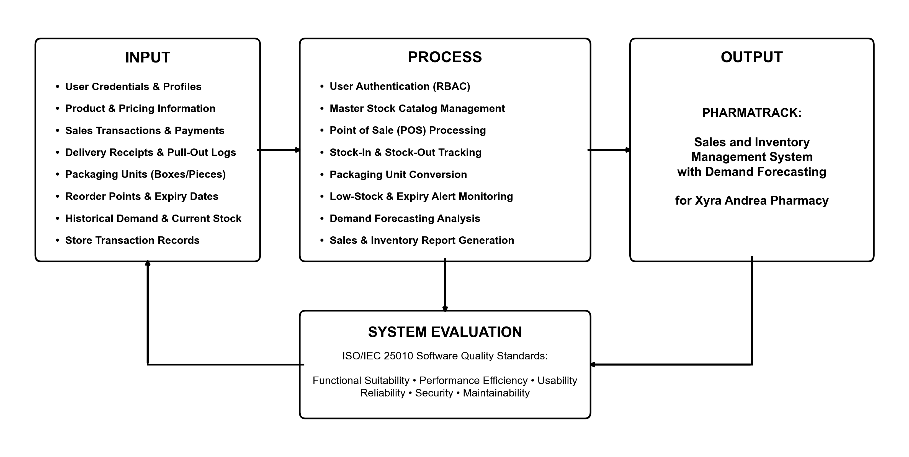
PHARMATRACK • CHAPTER I: INTRODUCTION
Conceptual Framework — Input-Process-Output (IPO)
CORE ALIGNMENT
• Unified Flow: A single central connection line channels all bulleted data inputs directly into the system processes.
• Integrated POS: POS checkout is inside the system, enabling instant atomic inventory deduction in real time.
• Forecasting Engine: Historical demand from same month last year evaluates against current stock on hand.
• Evaluation Loop: ISO/IEC 25010 feedback continuously refines system inputs and processing routines.
PRESENTER NOTE: Explain orally that a single consolidated flow connects the bulleted inputs into the core processes, resulting in the completed system output and ISO/IEC 25010 evaluation feedback.
CAPSTONE PRE-ORAL DEFENSE • CHAPTERS I–III • ISAT U – DUMANGAS CAMPUS
4
Notes:
PRESENTER NOTE: Explain orally that a single consolidated flow connects the bulleted inputs into the core processes, resulting in the completed system output and ISO/IEC 25010 evaluation feedback.

Slide 5
PHARMATRACK • CHAPTER I: INTRODUCTION
Significance of the Study
• Pharmacy Owner: Provides real-time sales visibility, automated expiry warnings, and data-driven restocking guidance from same-month sales demand to prevent overstocking and dead stock.
• Pharmacy Staff: Eliminates tedious manual receipt writing and end-of-day stock counting through a fast, integrated Point of Sale screen with automatic stock deduction and packaging unit conversion.
• Customers: Ensures faster counter transactions, reduced waiting times during peak hours, and guaranteed access to safe, unexpired, and readily available medications.
• Future Researchers: Serves as an empirical and technical reference for IT students developing localized web-based sales, batch-tracking, and demand forecasting systems for small retail drugstores.
PRESENTER NOTE: Highlight practical local benefits to suburban/rural community drugstores operating under resource constraints.
CAPSTONE PRE-ORAL DEFENSE • CHAPTERS I–III • ISAT U – DUMANGAS CAMPUS
5
Notes:
PRESENTER NOTE: Highlight practical local benefits to suburban/rural community drugstores operating under resource constraints.

Slide 6
PHARMATRACK • CHAPTER I: INTRODUCTION
Scope and Limitations of the Study
PROJECT SCOPE
• Target Entity: Xyra Andrea Pharmacy in Dumangas, Iloilo.
• User Roles: Owner/Admin (full privileges) and Staff/Cashier (restricted POS/inventory) via Role-Based Access Control (RBAC).
• Core Modules: Integrated POS cashiering, barcode lookup, FEFO batch allocation, stock-in/stock-out logging, packaging unit conversions (boxes to pieces).
• Intelligent Alerting: Automated low-stock threshold badges and batch expiry warnings (<90 days).
• Forecasting Engine: Calculates depletion risk and suggested reorders using same-month historical demand vs. current stock.
OPERATIONAL LIMITATIONS
• On-Premise Deployment: Operates locally on store desktop hardware via XAMPP (Apache/MySQL) and local LAN/localhost; no external public cloud hosting.
• Single Drugstore: Designed exclusively for a single store location; does not support multi-branch synchronization or warehouse transfers.
• Manual Payment Verification: Cashiers record Cash, GCash, and Maya tenders, but transactions are verified manually (no direct bank API/gateway integration).
• Exclusions: Excludes biometric employee timekeeping, payroll computation, and automated supplier electronic ordering.
PRESENTER NOTE: Clearly distinguish planned and implemented functionality from intentional project boundaries and constraints.
CAPSTONE PRE-ORAL DEFENSE • CHAPTERS I–III • ISAT U – DUMANGAS CAMPUS
6
Notes:
PRESENTER NOTE: Clearly distinguish planned and implemented functionality from intentional project boundaries and constraints.

Slide 7
PHARMATRACK • CHAPTER I: INTRODUCTION
Definition of Terms
“The terms are defined conceptually and operationally in Chapter I of the manuscript.”
• Alert Notification
• Barcode
• Local Database
• Dead Stock
• Demand Forecasting
• Expiration Date
• Inventory Management
• Low Stock Alert
• Owner or Admin Account
• Point of Sale (POS)
• Real-Time Update
• Restocking
• Sales Report
• Sales Transaction
• Staff or Cashier Account
• Supplier Directory
• Stock Keeping Unit (SKU)
• Stock Level
• Stock-In
• Stock-Out
• User Authentication
• Web Application
PRESENTER NOTE: List all terms defined in the manuscript in alphabetical order. Complete conceptual and operational definitions belong in the manuscript.
CAPSTONE PRE-ORAL DEFENSE • CHAPTERS I–III • ISAT U – DUMANGAS CAMPUS
7
Notes:
PRESENTER NOTE: List all terms defined in the manuscript in alphabetical order. Complete conceptual and operational definitions belong in the manuscript.

Slide 8
PHARMATRACK • CHAPTER II: LITERATURE AND STUDIES
Review of Related Literature
“What is a Point-of-Sale System and How Does It Work?” — Square (2026)
Web-based POS software running on standard browsers provides cost-effective flexibility for small retail stores, eliminating paper errors and manual receipt transfers.
“Inventory Management Practices of Small-Scale Pharmacies” — Soliveres et al. (2024)
Systematic inventory control prevents extreme outcomes—costly stockouts of vital medicines and overstocking slow-moving drugs that reach expiration.
“GS1 Barcodes: Global Standards for Retail Product Identification” — GS1 (2026)
Optical barcode scanning retrieves accurate product information in under one second, accelerating counter service and preventing medication dispensing errors.
“Guidelines on Licensing of Drugstore/Pharmacy Outlets” — FDA Philippines (2014)
Strict pharmacy regulations mandate systematic batch expiration tracking and the immediate removal of expired medicines to safeguard consumer health.
PRESENTER NOTE: Explain relevance verbally; write each source's actual title and 1-sentence key takeaway.
CAPSTONE PRE-ORAL DEFENSE • CHAPTERS I–III • ISAT U – DUMANGAS CAMPUS
8
Notes:
PRESENTER NOTE: Explain relevance verbally; write each source's actual title and 1-sentence key takeaway.

Slide 9
PHARMATRACK • CHAPTER II: LITERATURE AND STUDIES
Review of Related Studies
“Stocks Inventory Management System: A Mobile Application” — Gatpolintan et al. (2023) — ISAT U Miagao
Demonstrated that shifting from paper notebooks to role-separated digital stock tracking significantly reduced entry errors in local retail, but lacked POS and expiration monitoring.
“Development and Quality Evaluation of a Web-Based Drug Inventory System” — Budianto et al. (2026)
Achieved a 98.61% User Acceptance rating for web-based pharmacy stock control; validated the need for prominent in-app visual alert badges over browser notifications.
“Simplified Barcode-Based POS and Inventory System with Replenishment Decision” — Panganiban & Bermusa (2020)
Proved that barcode checkout cuts transaction times by >60% and automated replenishment logic based on sales velocity prevents over-purchasing.
“The Mediating Effect of Replenishment Decisions on Cloud-Based Inventory Management” — Moreno et al. (2023)
Empirical survey of 52 microbusinesses confirmed that digital inventory oversight significantly enhances record accuracy and reduces stockout frequency.
PRESENTER NOTE: Present actual reviewed study titles with key empirical contributions and identify relevance to PharmaTrack.
CAPSTONE PRE-ORAL DEFENSE • CHAPTERS I–III • ISAT U – DUMANGAS CAMPUS
9
Notes:
PRESENTER NOTE: Present actual reviewed study titles with key empirical contributions and identify relevance to PharmaTrack.

Slide 10
PHARMATRACK • CHAPTER II: LITERATURE AND STUDIES
Synthesis of Related Literature and Studies
• Shared Insights from Prior Research: Prior studies consistently demonstrate that shifting from manual paper logs to digital retail software improves inventory accuracy, eliminates calculation mistakes, speeds up cashier checkout, and empowers business owners with timely sales data.
• Identified Gap in Existing Systems: Existing solutions typically address general retail merchandise or only isolated functions. Prior drugstore systems focused on back-office stock tracking without integrated POS cashiering, or lacked batch-level expiration alerts and historical sales demand forecasting.
• PharmaTrack's Proposed Contribution: PharmaTrack bridges these gaps by combining an integrated Point of Sale (POS) module, automatic stock deduction, FEFO batch allocation, medicine expiration monitoring, packaging unit conversion, and seasonal demand forecasting into a single cohesive web application.
PRESENTER NOTE: Summarize shared insights and articulate the exact research gap that PharmaTrack addresses.
CAPSTONE PRE-ORAL DEFENSE • CHAPTERS I–III • ISAT U – DUMANGAS CAMPUS
10
Notes:
PRESENTER NOTE: Summarize shared insights and articulate the exact research gap that PharmaTrack addresses.

Slide 11
PHARMATRACK • CHAPTER II: LITERATURE AND STUDIES
Comparison of Related Studies’ Features (Table 1)
System Features / Criteria | Gatpolintan (2023) | Budianto (2026) | Panganiban (2020) | Moreno (2023) | PharmaTrack (Proposed)
Digital Sales Recording (POS) | ✓ | — | ✓ | ✓ | ✓
Automatic Stock Deduction | ✓ | ✓ | ✓ | ✓ | ✓
Medicine Expiration Alerts | — | ✓ | — | — | ✓
Barcode Product Lookup | — | — | ✓ | — | ✓
Remote Owner Access / Summary | — | — | — | ✓ | ✓
Low-Stock Automated Warnings | ✓ | ✓ | — | — | ✓
Demand Forecasting (Previous Sales) | — | — | ✓ | — | ✓
PRESENTER NOTE: Rows represent major system functions; columns show reviewed studies and PharmaTrack. Use checkmarks for confirmed presence.
CAPSTONE PRE-ORAL DEFENSE • CHAPTERS I–III • ISAT U – DUMANGAS CAMPUS
11
Notes:
PRESENTER NOTE: Rows represent major system functions; columns show reviewed studies and PharmaTrack. Use checkmarks for confirmed presence.

Slide 12
PHARMATRACK • CHAPTER III: METHODOLOGY
Project Description
• What PharmaTrack Is: PharmaTrack is an on-premise, web-based sales and inventory management system with demand forecasting engineered specifically for Xyra Andrea Pharmacy in Dumangas, Iloilo to replace manual paper logbooks.
• Owner / Admin Role: Executive administrative authority over business operations:
• Master Stock Catalog editing and retail pricing
• Supplier directory management and purchase history
• Staff user account provisioning
• Sales audits, profit summaries, and seasonal demand forecasting
• Staff / Cashier Role: Dedicated counter cashiering and inventory support:
• Built-in POS checkout with FEFO batch allocation
• Barcode scanning, discounts (Senior/PWD), and receipt printing
• Stock-In delivery logging and Stock-Out disposal records
• Packaging unit conversions (boxes to loose pieces)
• Technology Stack: PHP 8.1+ (Backend Logic) | MySQL / MariaDB (Relational Database) | HTML5, CSS3, Bootstrap 5.3, JavaScript ES6 (Frontend UI) | Apache via XAMPP Local Environment
PRESENTER NOTE: Explain what the system is, who will use it, and how POS cashiering operates natively inside the system.
CAPSTONE PRE-ORAL DEFENSE • CHAPTERS I–III • ISAT U – DUMANGAS CAMPUS
12
Notes:
PRESENTER NOTE: Explain what the system is, who will use it, and how POS cashiering operates natively inside the system.

Slide 13
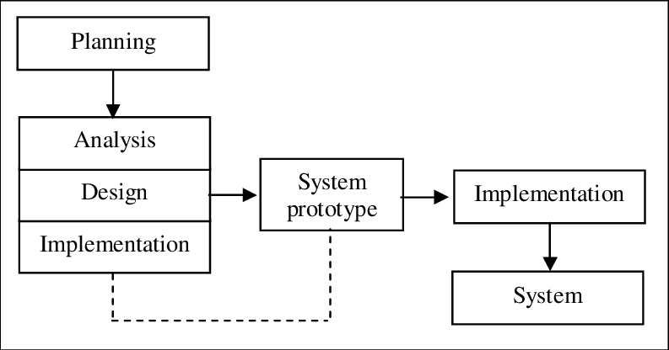
PHARMATRACK • CHAPTER III: METHODOLOGY
Project Development — Prototyping Model (Figure 2)
PROTOTYPING PHASES
• Planning & Requirements: On-site visits to Xyra Andrea Pharmacy; identified paper log bottlenecks and established project scope.
• Quick Design: Drafted wireframes, relational database schemas, and navigation flowcharts for counter sales and stock tracking.
• Prototype Development: Built functional working prototype in PHP/MySQL featuring POS cashiering and real-time inventory updates.
• User Evaluation & Refinement: Pharmacy owner and staff tested prototype; refined POS layout, unit conversion, and dashboard alerts.
• Implementation & Testing: Constructed final modules, executed unit, integration, and black box testing; conducted ISO/IEC 25010 evaluation.
PRESENTER NOTE: Explain why the Prototyping Model was chosen: continuous user feedback from drugstore personnel guided iterative refinements.
CAPSTONE PRE-ORAL DEFENSE • CHAPTERS I–III • ISAT U – DUMANGAS CAMPUS
13
Notes:
PRESENTER NOTE: Explain why the Prototyping Model was chosen: continuous user feedback from drugstore personnel guided iterative refinements.

Slide 14
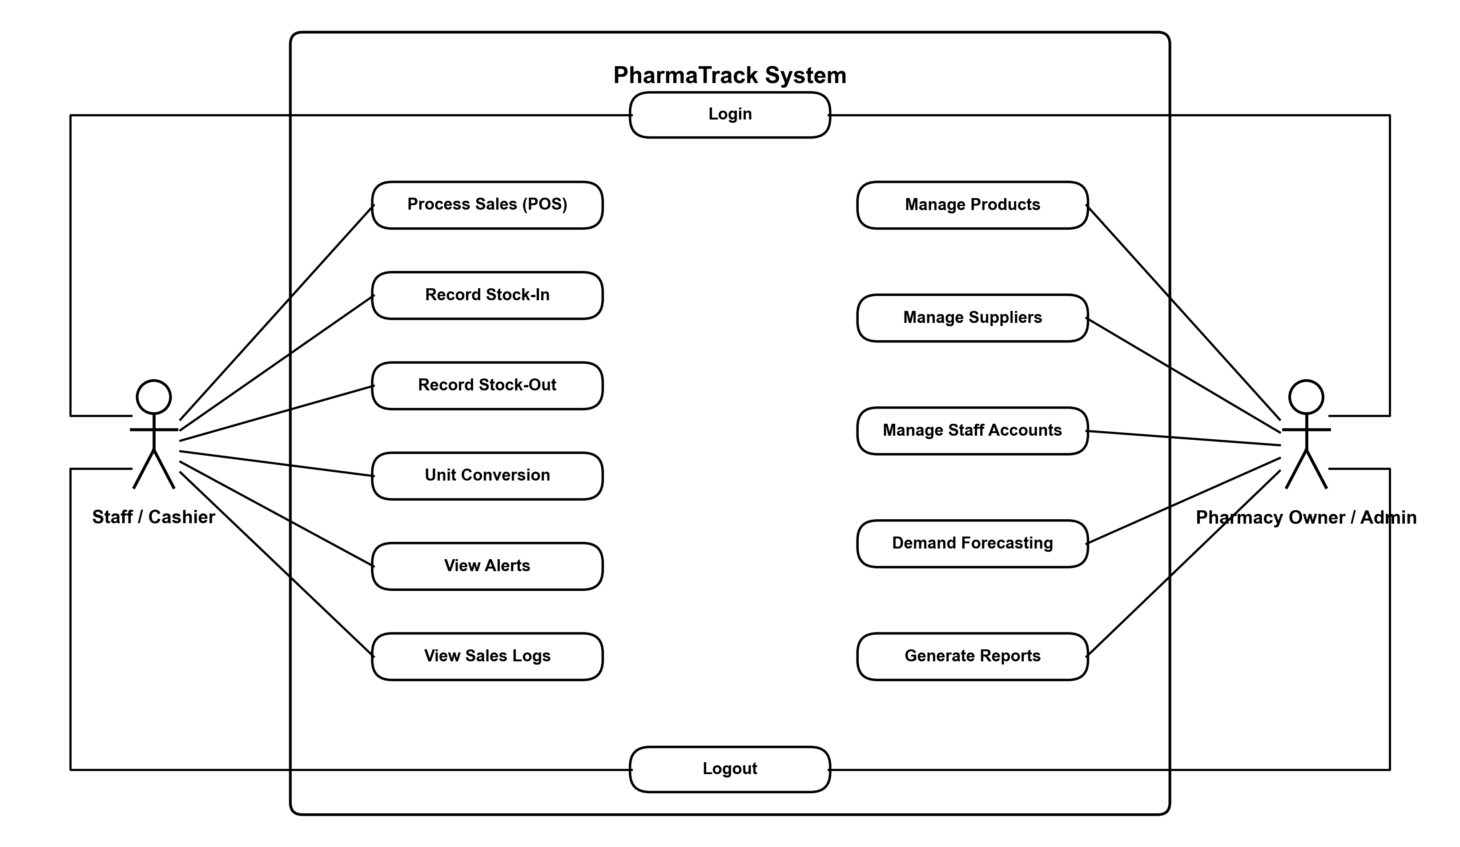
PHARMATRACK • CHAPTER III: METHODOLOGY
Use Case Diagram — Actor Functions (Figure 3)
ACTOR RESPONSIBILITIES
Staff / Cashier:
• Process Sales (POS)
• Record Stock-In
• Record Stock-Out
• Unit Conversion
• View Stock Alerts
• View Counter Logs
Owner / Admin:
• All Cashier Functions
• Manage Products & Prices
• Manage Suppliers
• Manage User Accounts
• Demand Forecasting
• Sales & Audit Reports
PRESENTER NOTE: Briefly explain actor responsibilities and how administrative privileges protect master pricing and supplier contracts.
CAPSTONE PRE-ORAL DEFENSE • CHAPTERS I–III • ISAT U – DUMANGAS CAMPUS
14
Notes:
PRESENTER NOTE: Briefly explain actor responsibilities and how administrative privileges protect master pricing and supplier contracts.

Slide 15
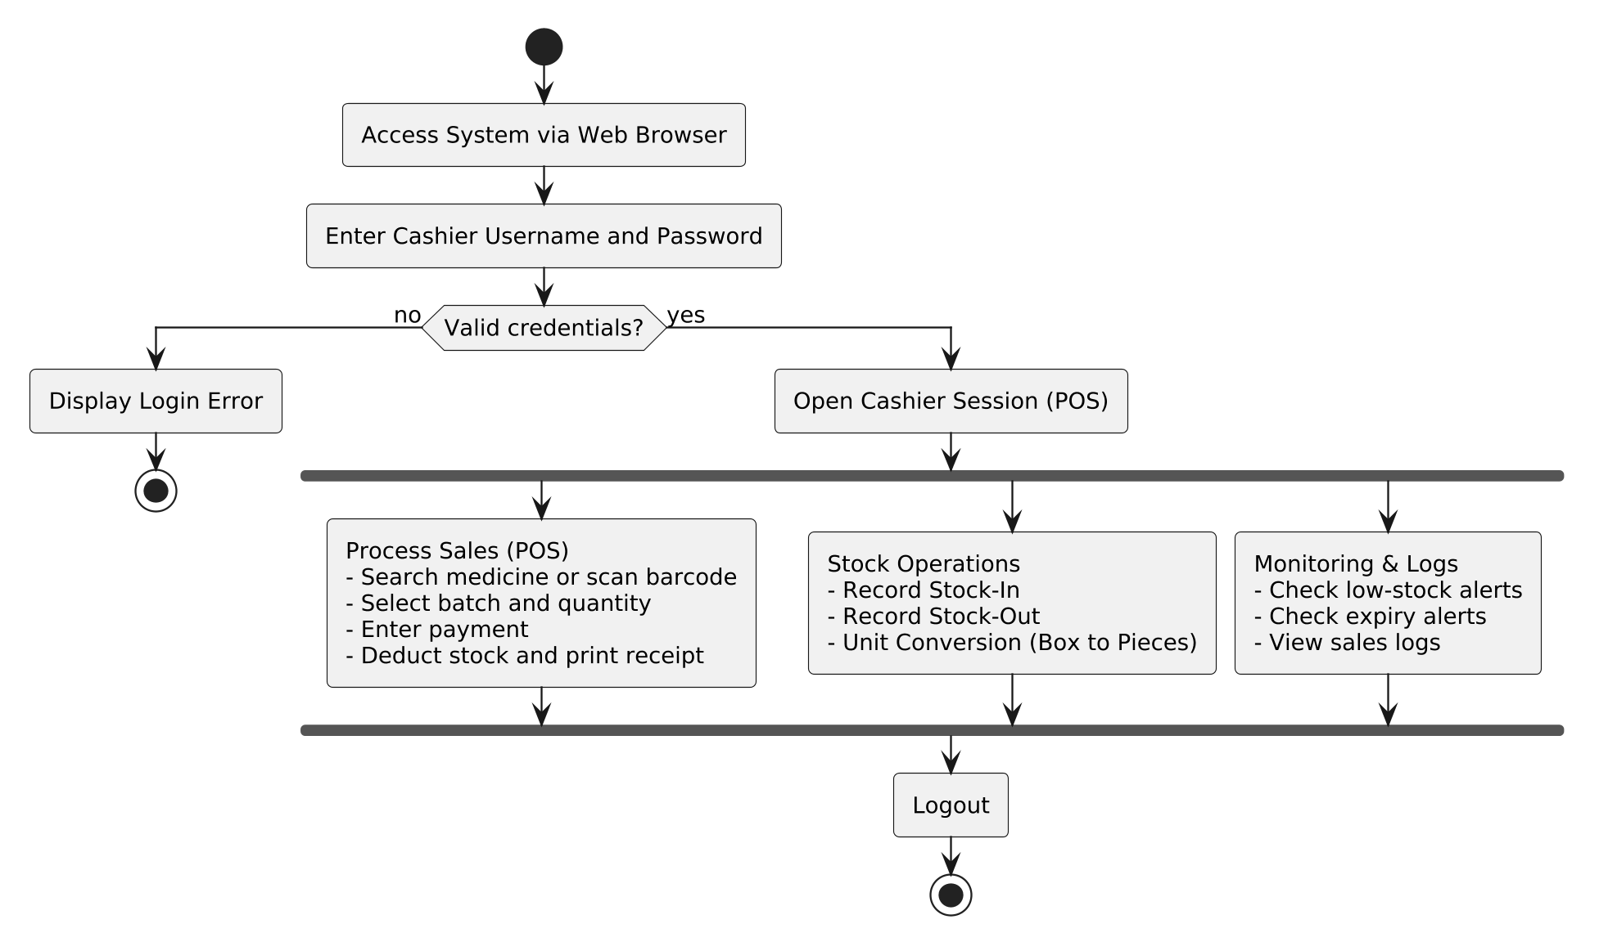
PHARMATRACK • CHAPTER III: METHODOLOGY
Activity Diagram — Staff / Cashier Workflow (Figure 4)
CASHIER WORKFLOW
• Login Authentication: Cashier submits credentials; valid authentication routes directly to the built-in POS module.
• Point of Sale (POS): Scan barcode or search name; First-Expiry First-Out (FEFO) batch priority tags; cash/GCash/Maya payment tenders.
• Atomic Deduction: Real-time stock decrement from database batch records upon checkout completion; issues thermal receipt.
• Inventory Support: Record stock-in shipments, document damaged/expired stock-out pullouts, and convert whole boxes to pieces.
PRESENTER NOTE: Emphasize that successful cashier login routes directly into the built-in POS module inside PharmaTrack.
CAPSTONE PRE-ORAL DEFENSE • CHAPTERS I–III • ISAT U – DUMANGAS CAMPUS
15
Notes:
PRESENTER NOTE: Emphasize that successful cashier login routes directly into the built-in POS module inside PharmaTrack.

Slide 16
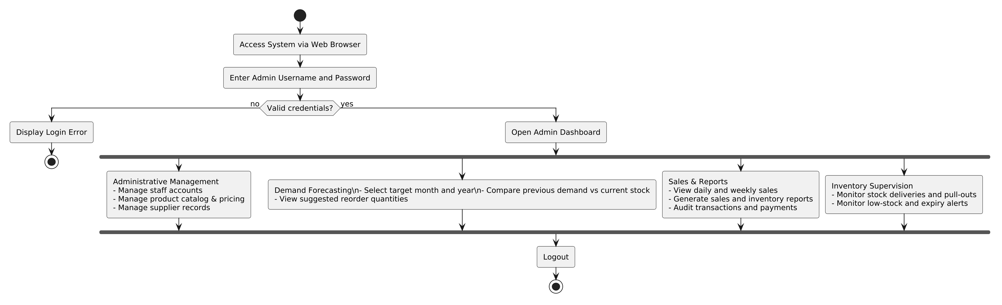
PHARMATRACK • CHAPTER III: METHODOLOGY
Activity Diagram — Owner / Admin Workflow (Figure 5)
ADMINISTRATIVE WORKFLOW
• Admin Authentication: Owner logs in; system grants complete access to the centralized Admin Dashboard.
• Demand Forecasting: Queries historical demand from same month of prior year; compares against current stock; applies 20% safety buffer to compute suggested reorders.
• Administrative Control: Manages master product catalog, classifications, selling prices, supplier contact directory, and staff accounts.
• Sales & Auditing: Audits daily gross revenue, payment tender breakdowns (Cash/GCash/Maya), and shelf low-stock/expiry alerts.
PRESENTER NOTE: Describe the 4 executive branches: Demand Forecasting, Master Catalog, Supplier Directory, and Financial Audits.
CAPSTONE PRE-ORAL DEFENSE • CHAPTERS I–III • ISAT U – DUMANGAS CAMPUS
16
Notes:
PRESENTER NOTE: Describe the 4 executive branches: Demand Forecasting, Master Catalog, Supplier Directory, and Financial Audits.

Slide 17
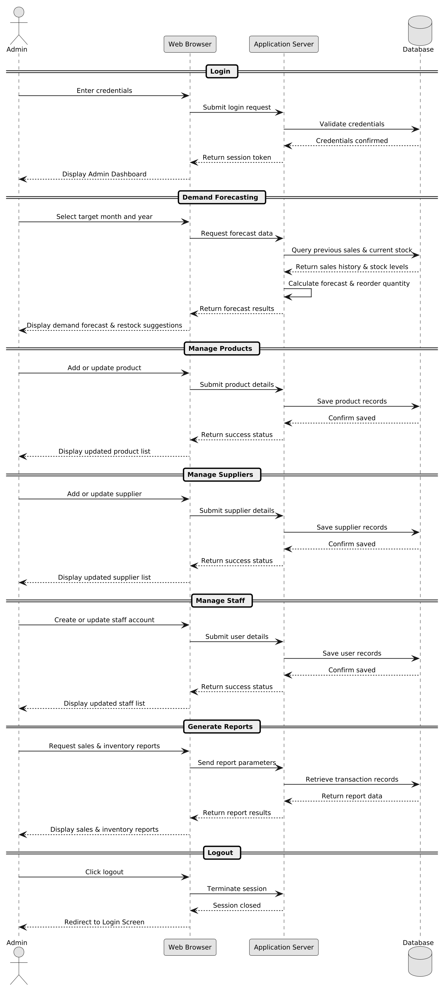
PHARMATRACK • CHAPTER III: METHODOLOGY
Sequence Diagram — Owner / Admin Workflow (Figure 6)
ADMINISTRATIVE MESSAGES
• Authentication & Access: Browser sends admin credentials; PHP server validates against MySQL users table and renders Admin Dashboard.
• Demand Forecasting: Queries historical demand for same month last year vs. current stock; returns depletion risk and reorder quantities.
• Catalog & Pricing: Commits master product additions, classifications, and retail price modifications to the database.
• Supplier Directory: Encodes distributor profiles, contact persons, and delivery references into suppliers table.
• Sales Audit & Reports: Aggregates revenue totals, gross margins, and tender distributions from sales records.
PRESENTER NOTE: Demarcated by process separators: Authentication -> Demand Forecasting -> Stock Catalog -> Suppliers -> Staff Accounts -> Audits.
CAPSTONE PRE-ORAL DEFENSE • CHAPTERS I–III • ISAT U – DUMANGAS CAMPUS
17
Notes:
PRESENTER NOTE: Demarcated by process separators: Authentication -> Demand Forecasting -> Stock Catalog -> Suppliers -> Staff Accounts -> Audits.

Slide 18
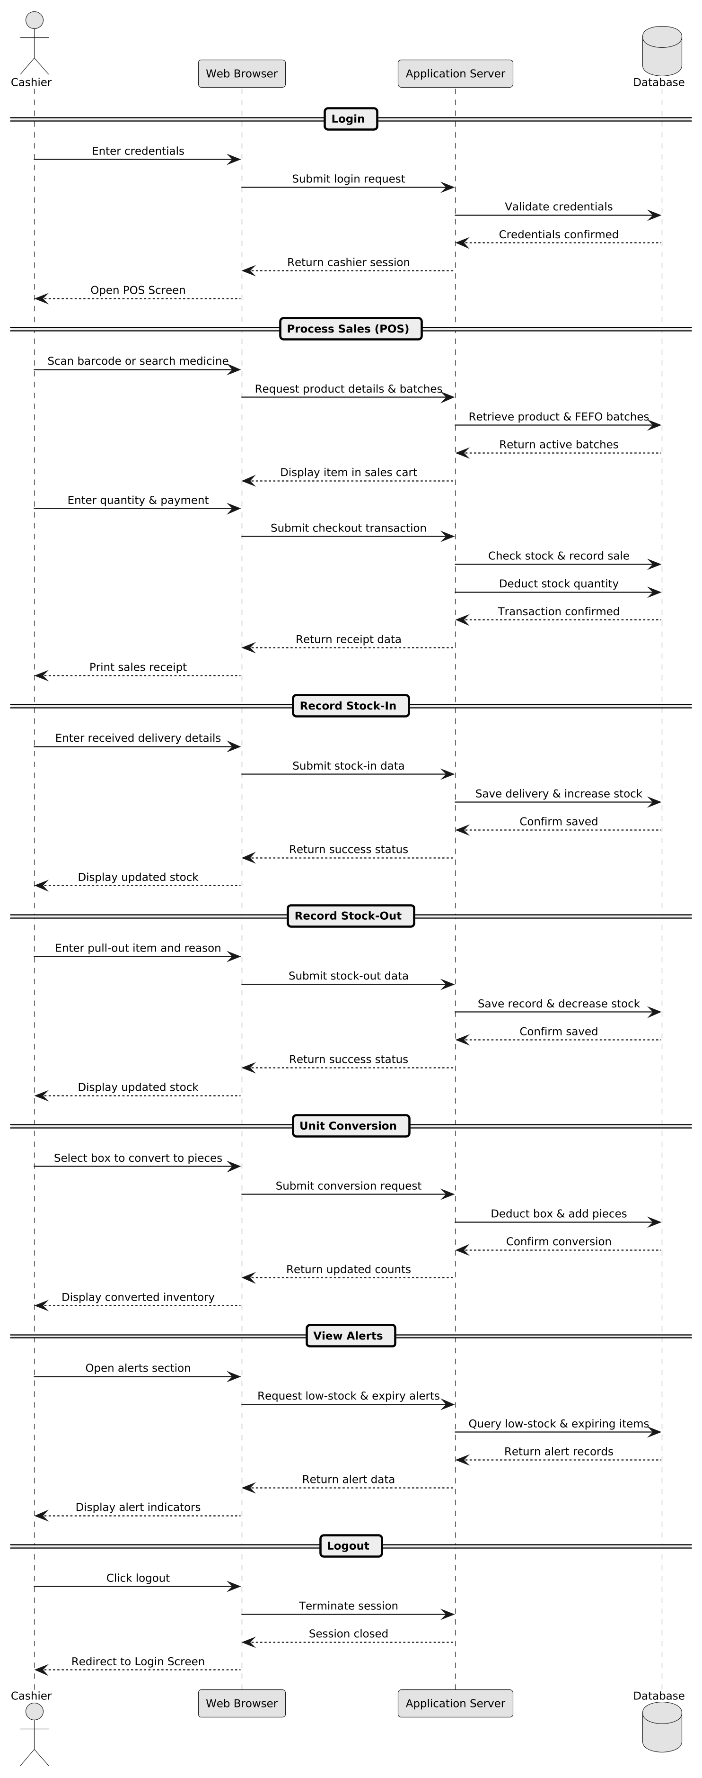
PHARMATRACK • CHAPTER III: METHODOLOGY
Sequence Diagram — Staff / Cashier Workflow (Figure 7)
CASHIERING MESSAGES
• Login -> Direct to POS: Validation confirms staff role and routes the browser natively into the built-in POS cashiering module.
• POS Atomic Checkout: Cashier submits sale; server verifies batch availability, inserts sale record, and decrements batch counts in real time.
• Stock-In Recording: Logs received delivery lots, batch numbers, supplier info, and increments inventory balances.
• Stock-Out Disposal: Records discarded or expired items with justifications, immediately updating usable stock counts.
• Packaging Unit Conversion: Converts master packaging boxes into individual dispensing pieces using defined conversion ratios.
PRESENTER NOTE: Notice: Point of Sale cashiering operates inside the system; checkout executes an atomic stock deduction in real time.
CAPSTONE PRE-ORAL DEFENSE • CHAPTERS I–III • ISAT U – DUMANGAS CAMPUS
18
Notes:
PRESENTER NOTE: Notice: Point of Sale cashiering operates inside the system; checkout executes an atomic stock deduction in real time.

Slide 19
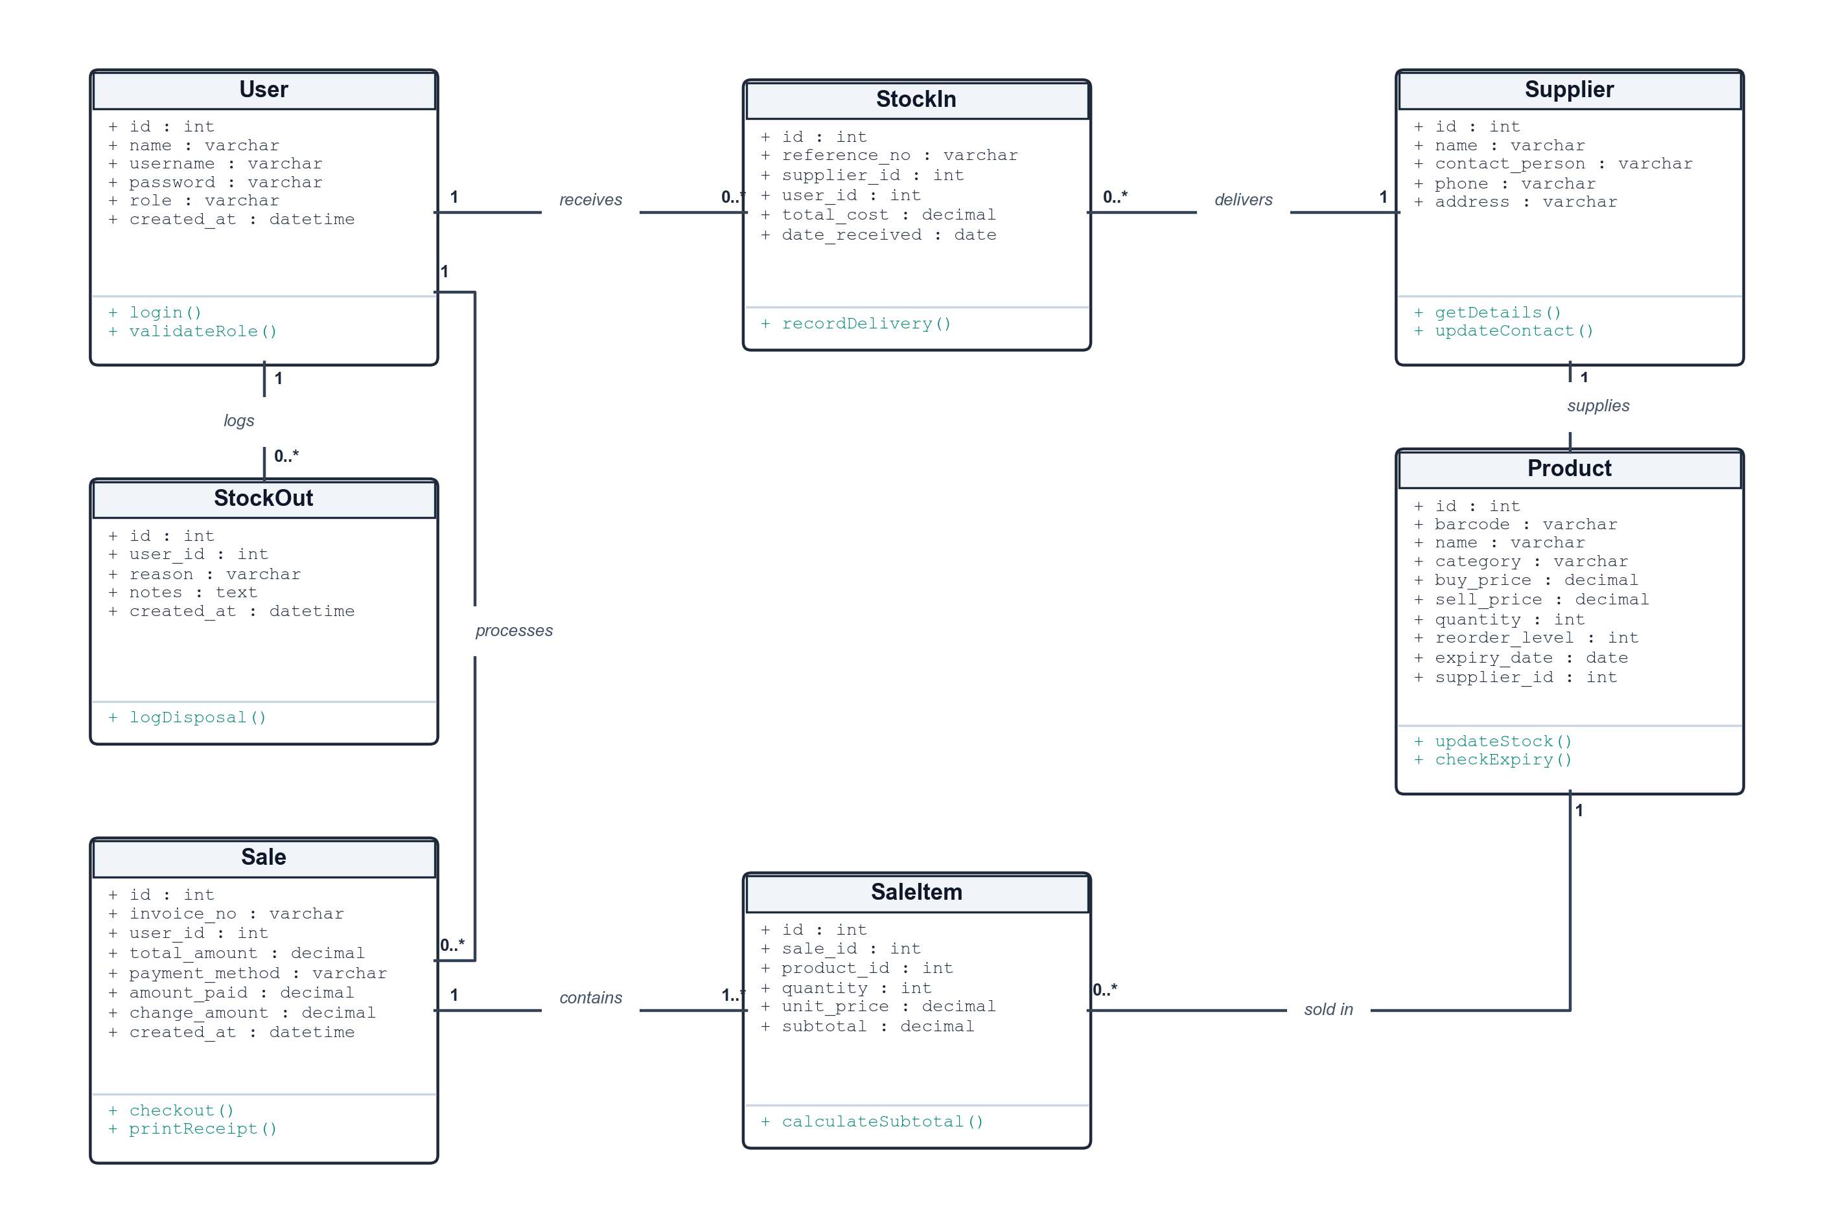
PHARMATRACK • CHAPTER III: METHODOLOGY
Class Diagram — Relational Database Architecture (Figure 8)
CORE DATABASE ENTITIES
• User: Manages user credentials, hashed passwords (bcrypt), and role permissions (Admin vs. Staff).
• Product & Batch: Tracks medicine details, barcodes, categories, retail prices, batch numbers, and expiry dates.
• Sale & SaleItem: Stores transactional receipt headers, total revenue, line items, and tender allocations.
• StockIn & StockOut: Logs delivery shipments, supplier references, and recorded item disposal justifications.
• Referential Integrity: Enforces foreign keys, preventing orphan transactions and ensuring accurate audit trails.
PRESENTER NOTE: Illustrates the 8 core relational entities: User, Product, Supplier, Sale, SaleItem, StockIn, StockOut, and Batch.
CAPSTONE PRE-ORAL DEFENSE • CHAPTERS I–III • ISAT U – DUMANGAS CAMPUS
19
Notes:
PRESENTER NOTE: Illustrates the 8 core relational entities: User, Product, Supplier, Sale, SaleItem, StockIn, StockOut, and Batch.

Slide 20
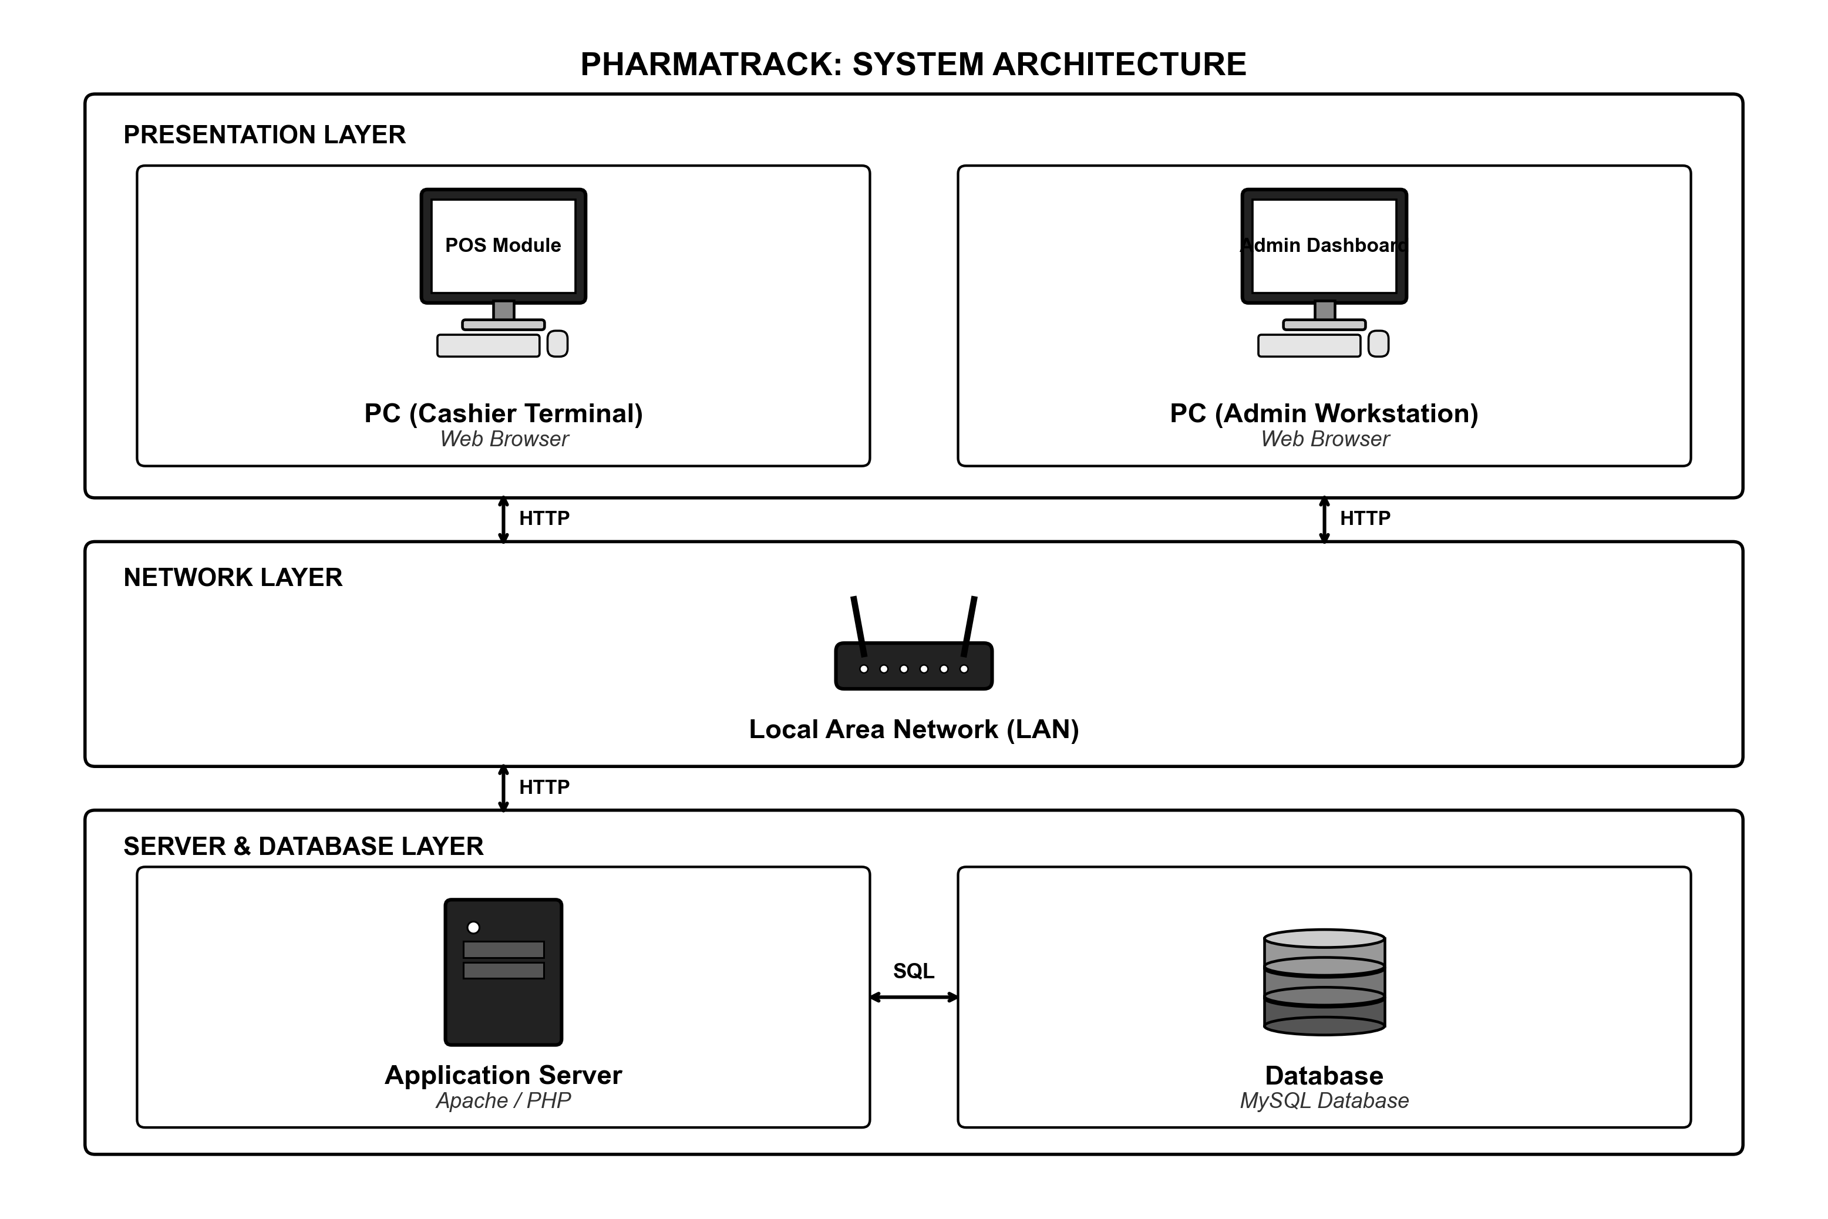
PHARMATRACK • CHAPTER III: METHODOLOGY
System Architecture — Local Deployment (Figure 9)
3-TIER ARCHITECTURE
• Client Tier: PC / Cashier Terminal (running built-in POS) and PC / Admin Workstation accessing PharmaTrack via web browsers.
• Network Infrastructure: Local Area Network (LAN) / Localhost connection inside the pharmacy; no external internet required for sales.
• Application Server: Apache Web Server and PHP backend engine executing business logic, RBAC, and demand forecasting calculations.
• Database Tier: MySQL relational database storing products, batch lot numbers, expiration dates, transactions, and user accounts.
PRESENTER NOTE: Show client PC, LAN network, Apache application server, and local MySQL database. No external cloud infrastructure required.
CAPSTONE PRE-ORAL DEFENSE • CHAPTERS I–III • ISAT U – DUMANGAS CAMPUS
20
Notes:
PRESENTER NOTE: Show client PC, LAN network, Apache application server, and local MySQL database. No external cloud infrastructure required.

Slide 21
PHARMATRACK • CHAPTER III: METHODOLOGY
Project Evaluation — ISO/IEC 25010 Quality Model
• Functional Suitability: Degree to which POS, inventory, alerts, and demand forecasting meet specified requirements.
• Maintainability: Modular PHP/MySQL codebase structured for effortless updates and future expansion.
• Usability: Ease of navigation, learnability, and operational clarity for drugstore staff and owner.
• Portability: Cross-platform compatibility across modern browsers on desktop PCs and laptops.
• Reliability: Consistent transaction processing and stock subtraction without system faults or data loss.
• Security: Role-based access control (RBAC), bcrypt password hashing, and session management.
• Performance Efficiency: Fast barcode lookup (<1s), instant cart calculations, and responsive interface.
• Compatibility: Seamless operation over local area network alongside thermal printers and barcode scanners.
PRESENTER NOTE: Name the 8 ISO/IEC 25010 characteristics; identify the 10 purposively selected evaluators (5 IT experts and 5 pharmacy domain users).
CAPSTONE PRE-ORAL DEFENSE • CHAPTERS I–III • ISAT U – DUMANGAS CAMPUS
21
Notes:
PRESENTER NOTE: Name the 8 ISO/IEC 25010 characteristics; identify the 10 purposively selected evaluators (5 IT experts and 5 pharmacy domain users).

Slide 22
PHARMATRACK • CHAPTER III: METHODOLOGY
Data Gathering Instrument and Statistical Tool
EVALUATION INSTRUMENT & RESPONDENTS
• Instrument: 24-item evaluation questionnaire adapted from ISO/IEC 25010 (3 indicators per characteristic) on a 5-point Likert scale.
• Qualitative Feedback: Open-ended recommendation section for interface comments and usability suggestions.
• Purposive Sampling: Total of 10 qualified evaluators:
• 5 IT Experts (Faculty & Software Engineers) evaluating architecture, security, and database design
• 5 Domain Users (Owner, Licensed Pharmacy Assistants, Cashiers) evaluating practical usability and counter workflows.
• Statistical Treatment: Weighted Mean formula:
Weighted Mean = (Sum of Ratings) / (Total Respondents)
FIVE-POINT LIKERT SCALE (TABLE 4)
Scale / Rating | Mean Range | Descriptive Interpretation
5 | 4.21 – 5.00 | Excellent
4 | 3.41 – 4.20 | Very Good
3 | 2.61 – 3.40 | Good
2 | 1.81 – 2.60 | Poor
1 | 1.00 – 1.80 | Very Poor
PRESENTER NOTE: Identify the 24-item ISO/IEC 25010 questionnaire, weighted mean statistical treatment, and 5-point Likert interpretation scale.
CAPSTONE PRE-ORAL DEFENSE • CHAPTERS I–III • ISAT U – DUMANGAS CAMPUS
22
Notes:
PRESENTER NOTE: Identify the 24-item ISO/IEC 25010 questionnaire, weighted mean statistical treatment, and 5-point Likert interpretation scale.

Slide 23
PHARMATRACK • CHAPTERS I–III SUMMARY
Conclusion & Readiness for Defense
• Methodological Rigor & Alignment: PharmaTrack directly addresses the real operational challenges of Xyra Andrea Pharmacy. Every specific objective is systematically fulfilled through dedicated system modules, verified by clear UML behavioral models, and grounded in published pharmaceutical retail literature.
• Operational Practicality: By integrating Point of Sale cashiering natively inside the system, enforcing atomic inventory deduction, and applying a seasonal demand forecasting formula based on previous sales, the system delivers an accessible, dependable, on-premise drugstore solution.
THANK YOU VERY MUCH!
We are now ready for the questions, comments, and recommendations of the distinguished panel.
PRESENTER NOTE: Summarize project readiness and open the floor to the distinguished panel of examiners for questions and recommendations.
CAPSTONE PRE-ORAL DEFENSE • CHAPTERS I–III • ISAT U – DUMANGAS CAMPUS
23
Notes:
PRESENTER NOTE: Summarize project readiness and open the floor to the distinguished panel of examiners for questions and recommendations.

