Slide 1
K22 support in Processor Expert within KDS may (depending upon your existing installation) require a few extra steps.
Visit:
http://www.freescale.com/tools/embedded-software-and-tools/software-development-tools/processor-expert-and-embedded-components/updates-and-patches/driver-suite-v10.4:PEXDRV_UPDATES_10_4
Download:
PExDrv v10.2 Kinetis K2xF 120MHz Service Pack (Win) Adds support for 120MHz MK21FX512, MK21FN1M0, MK22FX512, and MK22FN1M0 derivatives.
You can find additional instructions here:
http://www.freescale.com/files/soft_dev_tools/doc/support_info/PEXDRV_10-4_RN.pdf?fpsp=1.
Screen dumps are shown on the remaining pages of this file.

Slide 2
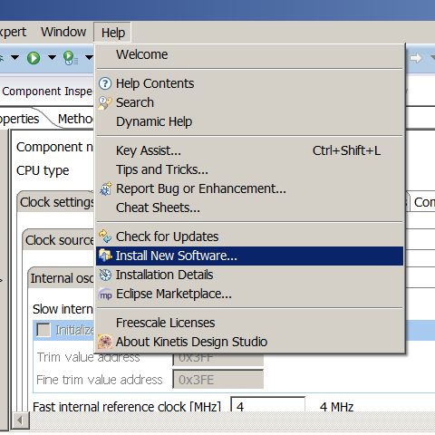
After downloading the zip file referenced on the first page,
Open KDS and: Help->Install New Software

Slide 3
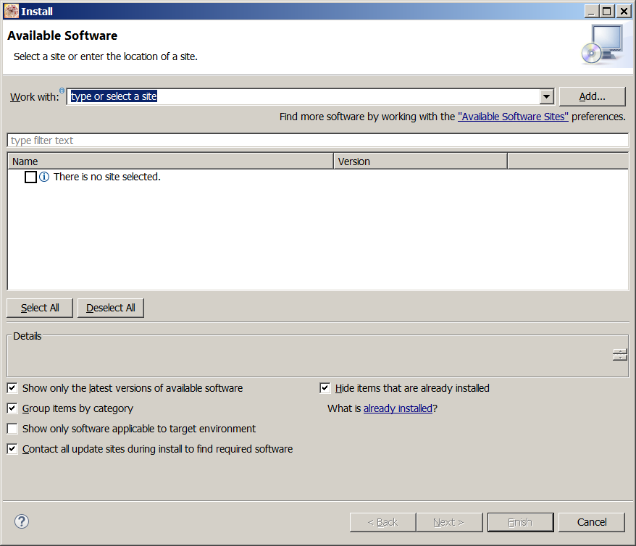
Click “Add.” to add a new repository

Slide 4
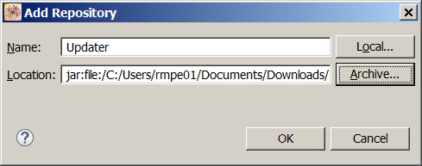
This is the zip file you downloaded earlier

Slide 5
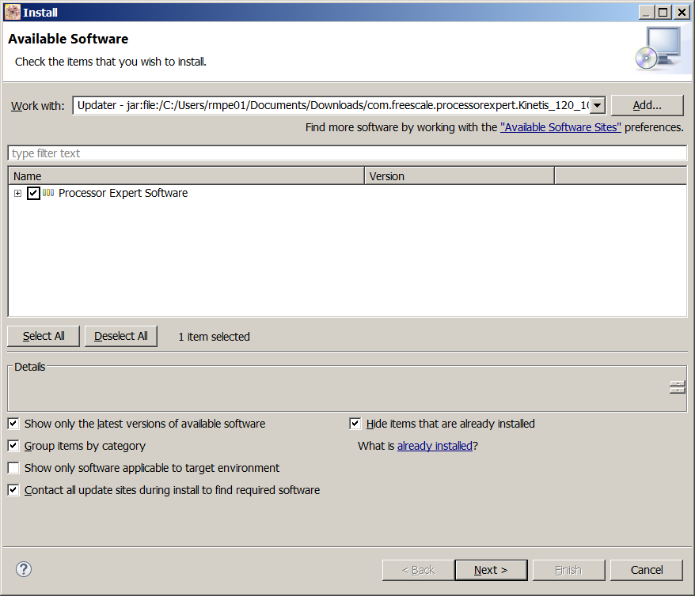
Check the checkbox

Slide 6
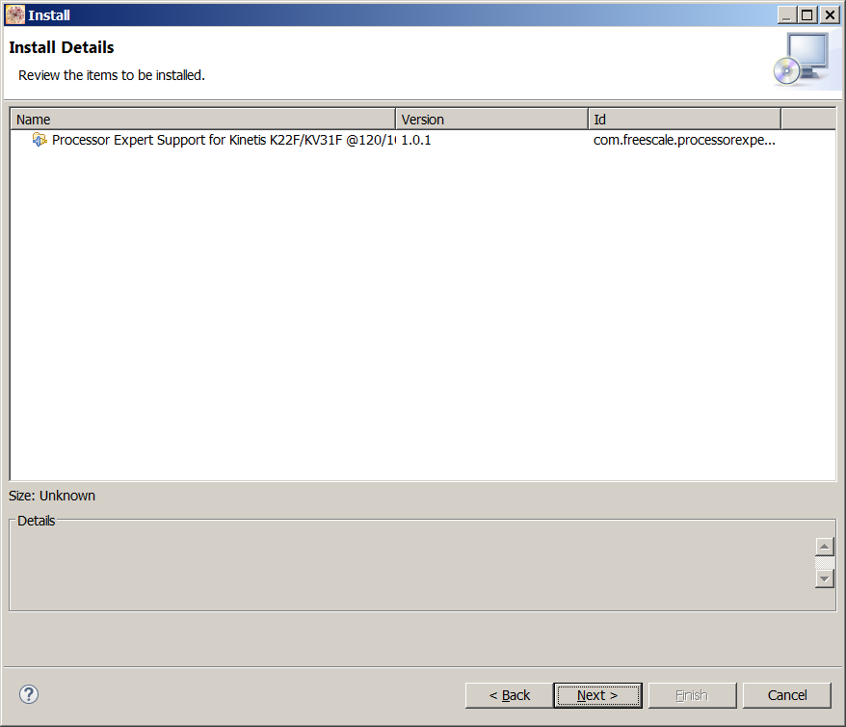
Click Next

Slide 7
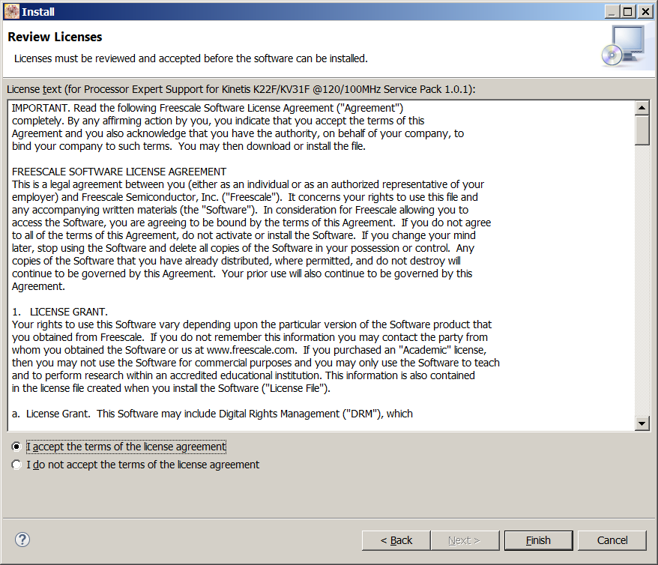
Accept the license agreement

Slide 8
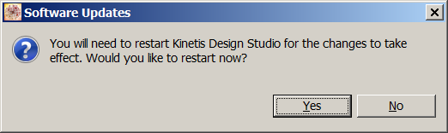
Restart KDS

