Slide 1
“Assessment method for not-so-data-poor stocks”
Fishreg brainstorm
Ernesto Jardim
(14/09/2011)

Slide 2
Setting the scene
DCF 2009 introduced the concept of “concurrent sampling” for metier related variables: sampling all or a predefined assemblage of species, simultaneously in a vessel's catches or landings (2008/949/EC, Annex, Chapter I, 1.b)
Sampling must be performed in order to evaluate the quarterly length distribution of species in the catches, and the quarterly volume of discards (B1.1.1).

Slide 3
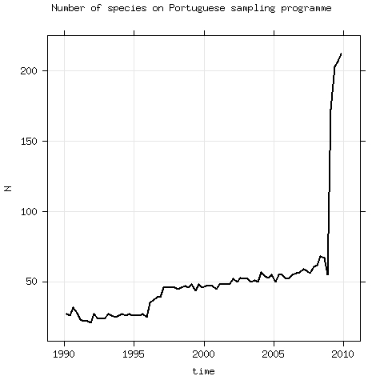
Setting the scene in numbers
In 2010 DCF costs 57m €
Biological parameters (growth & reproduction) are being collected for >250 stocks in waters where European fleets operate.
Taking PT as example, the number of species sampled on the auction market for length distributions of the landings raised from ~60 to >200 in 2009.

Slide 4
So what ? (Miles dixit)
In 2020 fisheries scientists will face the challenge of assessing >250 stocks, caught by several fleets in European EEZ, for each there are information broken by time and space on:
Source | Time | Space | Volume (L,D,C) | +Length | Effort | Index | +Length
On-auction | :-) | :-| | :-) | :-[) | :-) | :-| | :-)
On-board | :-[) | :-[) | :-) | :-[) | :-[) | :-) | :-|
Surveys | :-| | :-[) |  | :-[) |  | :-[) | :-[)
log-books | :-) | :-| | :-| |  | :-) | :-|
VMS | :-) | :-[) |  |  | :-[) | :-)
Biology will be a problem
Not sure about socio-economic information

Slide 5
Problem
These are not
data-poor stocks !!

Slide 6
Problem
No age data will be available but lots of information on exploitation and abundance will exist !!

Slide 7
Problem
It will be impossible to keep the present procedures, which require highly trained analysts working for 2 or 3 month per year, to give advice on exploitation/conservation of 1 species ...

Slide 8
Problem
Dealing with the assessment of these stocks will require a change in mindset !!

Slide 9
Solution !?
Estimate what you know,
MSE what you don't,
and keep it simple !!

Slide 10
Solution !?
Ll, Dl, Il
G(x)
La, Da, Ia
{
SCAA
+
S(x)
R(b)

Slide 11
Solution !?
SCAA
Diagnostics
Sensitivity analysis with MSE
(what's the impact on advice ?)
Ll, Dl, Il, V.
G(x)
S(x)
R(b)

Slide 12
Open issues
Multifleet
Sexual dimorphism
Space/time scale
Weighting of likelihood components
How to deal with maturity ? External parameter or integrated in the assessment method ?
...

Slide 13
Assessment for all initiative (a4a)
Vision: Assess all stocks exploited on the European EEZ
Objective: Develop a method to assess stocks that have a reduced knowledge base on biology and moderate time series on exploitation and abundance.
Tools: SCAA model embedded on MSE implemented in R/FLR

