Slide 1
Assessment for All (a4a) kick-off meeting
(29/02 – 02/03/2012, JRC, Italy)
Ernesto Jardim
Iago Mosqueira
Chato Osio

Slide 2
Setting the scene
DCF 2009 introduced the concept of “concurrent sampling” for metier related variables: sampling all or a predefined assemblage of species, simultaneously in a vessel's catches or landings (2008/949/EC, Annex, Chapter I, 1.b)
Sampling must be performed in order to evaluate the quarterly length distribution of species in the catches, and the quarterly volume of discards (B1.1.1).

Slide 3
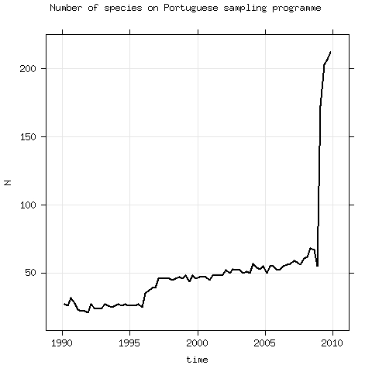
Setting the scene in numbers
In 2010 DCF costs 57m €
Biological parameters (growth & reproduction) are being collected for 250+ stocks in waters where European fleets operate.
Taking PT as example, the number of species sampled on the auction market for length distributions of the landings raised from ~60 to 200+ in 2009.

Slide 4
So what ? (Miles dixit)
European fisheries scientists will face the challenge of assessing 250+ stocks for which:

Slide 5
Setting the scene worldwide
US law requires all federal fisheries to come up with approaches for calculating annual catch limits, including appropriate buffers to account for scientific and management uncertainties (Sampson, pers.comm.).
Beddington et.al (2007) show that these intermediate data stocks that are not being scientifically assessed make up for 30% of stocks in the USA, 78% in New Zealand, 48% in Australia, 61% in the North-East Atlantic.
Roa (pers.comm.) states in Chile 65% of stocks are not assessed.

Slide 6
Problem
Dealing with the assessment of these stocks will require a change in mindset !!

Slide 7
Problem
These are not
Data-poor nor data-rich
stocks !!

Slide 8
Solution !?
Estimate what you know,
MSE what you don't,
and keep it simple !!

Slide 9
Solution !?
Ll, Dl, Il
G(x)
La, Da, Ia
{
SC@A
+
S(x)
R(b)

Slide 10
Solution !?
SC@A
Diagnostics
Sensitivity analysis with MSE
(what's the impact on advice ?)
Ll, Dl, Il, V.
G(x)
S(x)
R(b)

Slide 11
Challenges
How to set up generic HCR ?
How to set automatic stock assessment methods ?
How to consider multi-fleet in such simple method ?
How to take into account space/time effects ?
How to deal with the weighting of likelihood components in a transparent way for users ?
How to interchange information from similar stocks ?
How to consider multi-species ?
...

Slide 12
Opportunities
Stock assessment as a data generating engine
Massive data analysis
Multi* analysis
Advise for more species
Common stock assessment methodology
Comparative advise analysis
Direct input to policies like MSFD, MSP, IMP, CFP, etc
Contribute to Ecossystem Based Management
...

Slide 13
a4a initiative
The initiative aims to:
develop an assessment method targeting stocks that have a reduced knowledge base on biology and moderate time series on exploitation and abundance;
trigger the discussion about the problem of massive stock assessment.
Side objective:
capacity building

Slide 14
a4a initiative
Operational tools:
scientific meetings;
small contracts;
short term visits (Gislason, Hillary, Cadrin, ...);
participation in conferences and meetings (ICES WKLIFE & ASC & WGMG, other ?)
FLR (dev. environment, HPC, team)
Budget for 2012 supported by JRC.

Slide 15
a4a kick-off meeting
Brainstorm
Consolidate ideas
Design experiment

Slide 16
a4a kick-off meeting
Wednesday
Introduction
Identify and describe the problem (group)
Compile a set of possible solutions to the problem (group)
Thursday
Seminar to JRC on Fisheries Modelling (09:30 – 11:00)
Elaborate on advantages and disadvantages of each solution (group)
Revisit the solutions and decide which are the most promising (group)
Agree on a framework for testing: MSE, statistical analysis, simulated data, etc. (group)
Friday
Discuss implementation and testing of the best solutions (group)
Elaborate on the expected outcome (group)
Challenges and opportunities (group)
Workplan (group)

Slide 17
a4a kick-off meeting
How it will work
Solutions
Candidates
Workplan
Pros & Cons
Testing
Framework

Slide 18
a4a kick-off meeting
Leire Ibaibarriaga (AZTI, Spain)
Jose de Oliveira (CEFAS, UK)
Finlay Scott (CEFAS, UK)
Andrew Cooper (SMU, Canada)
Ruben Roa (SAU, South Arabia)
Einer Nielsen (DTU, Denmark)
Gary Carvalho (Bangor, UK)
Manuela Azevedo (IPIMAR, Portugal)
Chato Osio (JRC, EC)
Iago Mosqueira (JRC, EC)
Ernesto Jardim (JRC, EC)
Jann Martinsohn (JRC, EC)

Slide 19
a4a kick-off meeting
Expectations
Creative discussions
Consolidate ideas
Progress on designing study
Network
Step forward on cordinating with others: ICES, South Hem, tRFMOs, etc

