Slide 1


A4A
Catch Dynamics Stock Assessment Models
for Data-Moderate Fisheries

Slide 2
Catch Dynamics Models
A4A
Population dynamics stock assessment
models are vastly predominant.
Nominal effort is mostly used to fit catch rate
models to generate annual indexes of
fish abundance
Why, given that nominal effort is the single
observed cause of catch?
Fish population dynamics is sexier than fishing
operational dynamics
Fish population dynamics creates more jobs
In textbooks stock assessment is synonym with
fish population dynamics (e.g. Quinn-Deriso)
Founders such as Baranov, Beverton, Holt,
Ricker, were biologists?

Slide 3
Catch Dynamics Models
A4A
Catch Dynamics Models
Switching to discrete time steps
This is Leslie-Davies-Chapman depletion model used to do stock assessment of some squid stocks and stocks that are data-poor

Slide 4
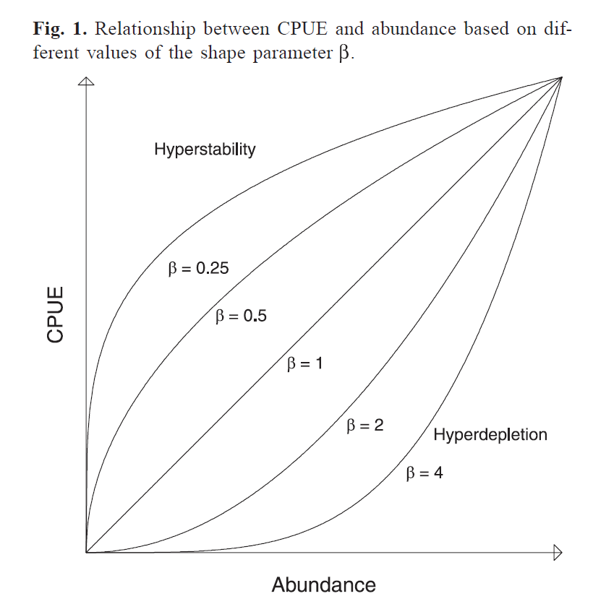
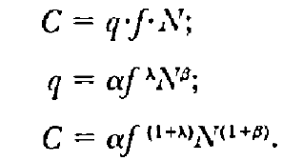
Catch Dynamics Models
A4A
Catch Dynamics Models – Process Model
Enter hyperstability/hyperdepletion, let's call it
“abundance response”
Enter gear saturability/synergy, let's call it
“effort response”
Harley, Myers,. Dunn
CJFAS 58:1761, 2001
Relax the depletion assumption, allow for replenishment
Bannerot, Austin
TAFS 112:608, 1983

Slide 5
Catch Dynamics Models
A4A
Catch Dynamics Models – Observation Model
The catch of one fleet at one time step is the result of two causes:
Nominal effort (E)
Stock abundance (N0, {Pi }),
and five constants,
A scaling parameter (k),
An effort response parameter (α),
An abundance response parameter (β),
A natural mortality parameter (M),
A stochastic response parameter (σ²)

Slide 6
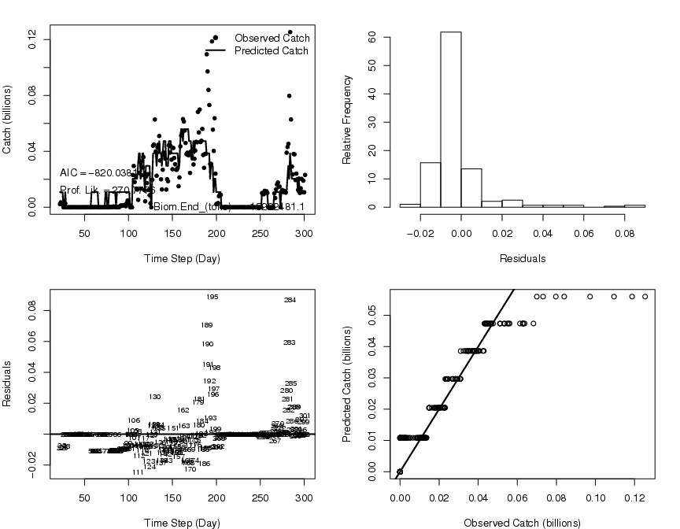
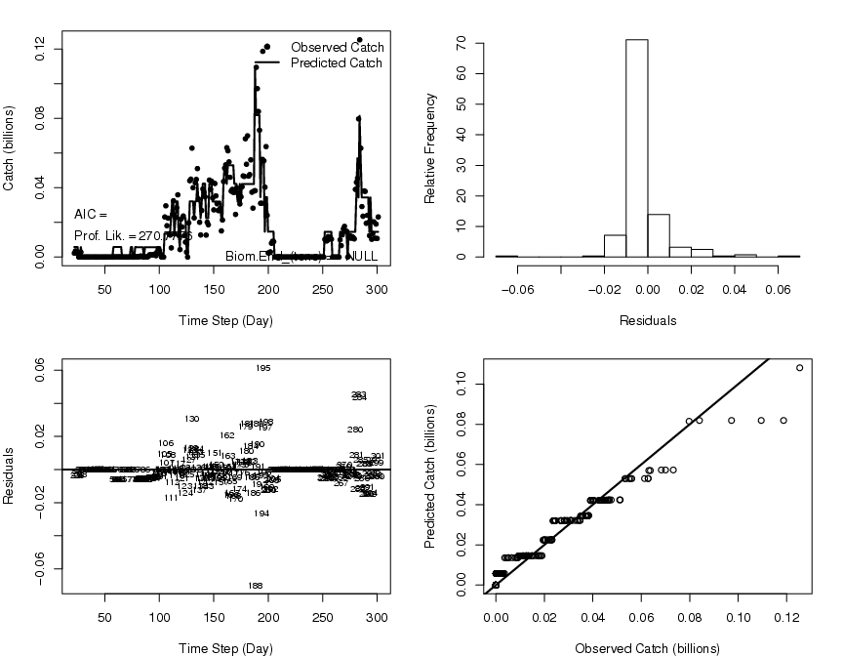
Catch Dynamics Models
A4A
Pure Depletion AIC=-820
One Perturbation at Day 189=-999

Slide 7
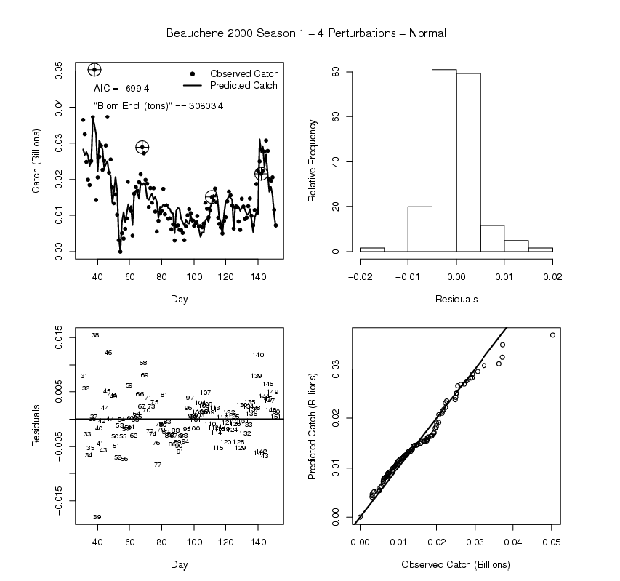
Catch Dynamics Models
A4A
2000 Loligo summer
season in the Falklands:
a case of 4-perturbations

Slide 8
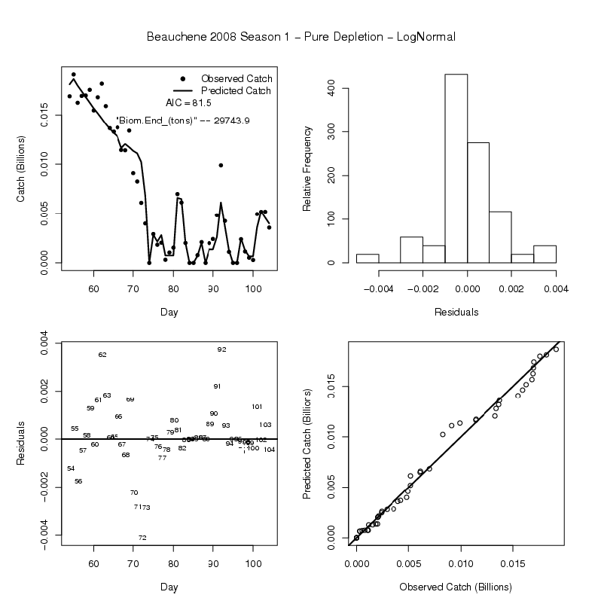
Catch Dynamics Models
A4A
2008 Loligo summer
season in the Falklands:
a case of 0-perturbations,
pure depletion

Slide 9
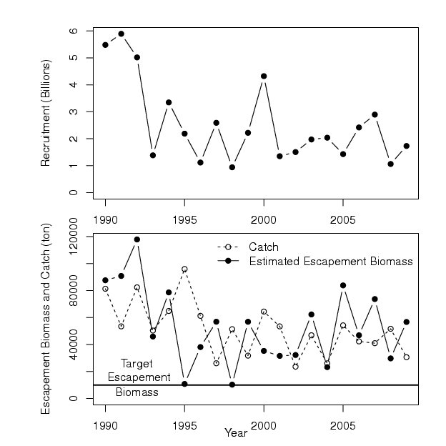
Catch Dynamics Models
A4A
Real-time management
to achieve a target

Slide 10
Catch Dynamics Models
A4A
 | Populations Dynamics Models | Catch Dynamics Models
Data aggregation | Data aggregated annually/quarterly to scale it to fish populations dynamics | Data aggregated daily or weekly because the fishing operation has a fast dynamics
Biological comprehensiveness | Very comprehensive from the fish point of view, allows estimation of fish abundance and productivity | Limited, only allows estimation of fish abundance, but not productivity.
Fishery comprehensiveness | Quite comprehensive, allows estimation of gear selectivity, catchability. | Quite comprehensive, allows estimation of gear catchability, saturability.
Cost | Very expensive, requires armies of biologists measuring fish, counting rings in bones, carrying out surveys. | Very cheap, requires observers at sea or at ports armed just with a ruler and scales.
Reaction time | Slow, the status of the stock is estimated for years past, and management measures come two or more years after the stock is estimated at risk | Fast, the stock abundance status is realized for the current season and management measures can be implemented for the current season.
Implementation of management advice | Difficult, because of their slow dynamics (the dynamics of the fish population) management tend to be framed in terms of annual TAC, but catch limits are difficult to enforce | Easy, because these models at their rapid dynamics return estimates of stock status in real time so management can be based on effort limits.
Statistical underpinnings | Integrated likelihood/Bayesianity, observed catch at age, catch at length, indices are caused by several population and fisheries processes. | Nonlinear regression/recursive models, observed catch is caused by observed fishermen effort and latent fish abundance.

Slide 11
Catch Dynamics Models
A4A
Biomass | Season | Catch
B0_1 | 1 | C_1
B0_2 | 2 | C_2
... | ... | ...
B0_S | S | C_S
'Data'
Biomass
Dynamics
Model
Hierarchical
Likelihood
Model

Slide 12
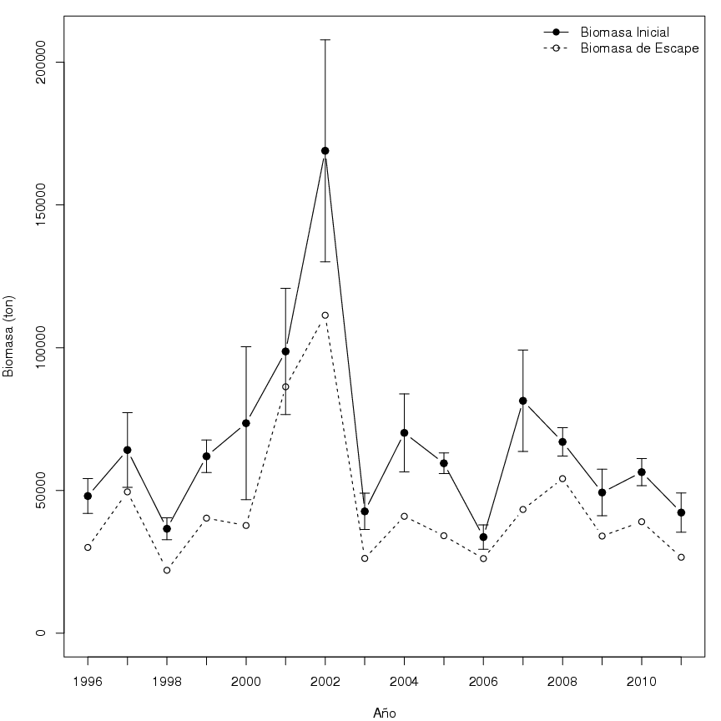
Catch Dynamics Models
A4A
Sea urchin
Fishery
In
Southern
Chile

Slide 13
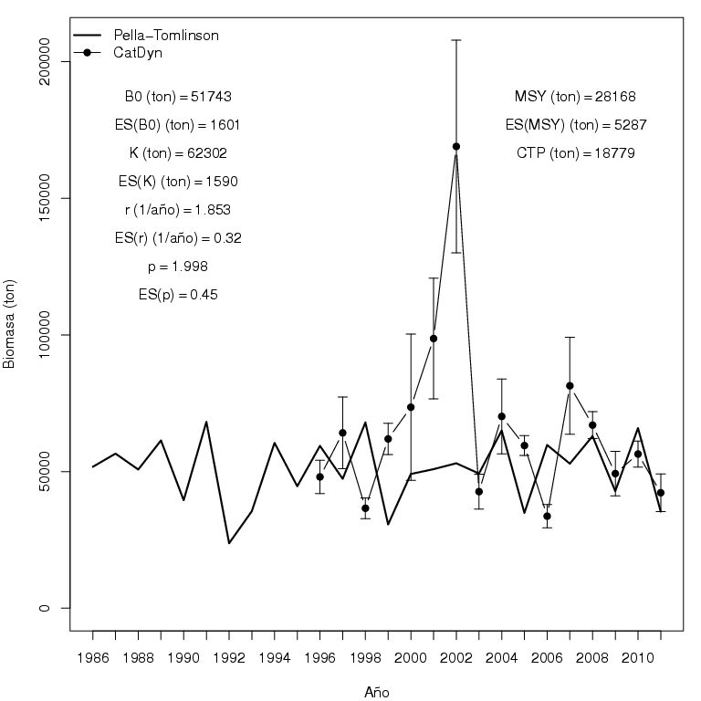
Catch Dynamics Models
A4A
Sea urchin
Fishery
In
Southern
Chile

Slide 14
Catch Dynamics Models
A4A
Implementation of catch dynamics models
CatDyn is an R package available from CRAN that allow
estimation of CDMs with 0, 1, …, 4 perturbations, additive or
multiplicative observation error, estimated or fixed natural
Mortality.
The basic data needed is high-frequency (daily or weekly) time
series of paired observations of catch in numbers and nominal
effort in a measure that is approximately exact.
If the catch is recorded in biomass, then the basic data must
also have a matching vector of mean bodymass per time step

Slide 15
Catch Dynamics Models
A4A
Way ahead/work in progress:
Write down the multi-fleet version of the model
Write down the functions to fit the multi-annual production models
to estimate productivity/MSY.
Set up simulations to test the models under perfect conditions and
under conditions where assumptions are violated
Write the models in ADMB to speed up and secure
convergence
Create a GUI to control the package from R, using PBSmodelling
and PBSadmb
Apply the model to the following list of stocks:
  Redfish fished by a Spanish fleet in the North Sea
  Blue ling fished by an Icelandic fleet in Iceland EEZ
  Hake fished by two fleets in central Chile
  Squid fished by three fleets on the Eastern coast of the USA
  Shrimps and finfish in the Persian Gulf

Slide 16
Catch Dynamics Models
A4A
Nuclei may move or
stay put; nuclei will decay
Because of natural mortality
Set up a spatially distributed stock
with RandomFields
Agents will differ in
efficiency or will be
Identical; error will be additive
or multiplicative
Harvest the stock by a group of
agents over a period of time
Introduce random pulses of abundance
increase during the harvest period
Pulses will be caused
by recruitment or agents
expanding area of opearation
Observe the harvest process in a
perfect manner or incompletely
Effort will be an exact predictor
or a random variable, raised or
not
Estimate abundance and fishing
operational parameters with catdyn
Counting the right number of
perturbations or missing a few
Calculate bias, variance, mean square
Error over many iterations

