Slide 1
Intro
What is EMP?
And potential EMP derived from mathematical models of High altitude Nuclear burst induced EMP.
Presented and prepared by
Merlyn Cousins
AKA DrForbin

Slide 2
Definition
Emp is an Electro Magnetic Pulse of short duration caused by an atomic fission or thermonuclear weapon.
Emp can also be caused by solar flares
In the case of solar flares the process is quite similar to emp generated by a blast except the origin of the charged particles are the sun.
E1 pulse;
Maxima rise time approx 5ns (.5 shakes)
Pulse width approx 40ns (4 shakes)

Slide 3
Photons
Electric and magnetic field alternating at right angles to each other.
The alternating magnetic field induces an alternating electric field. Alternating electric field induces an alternating magnetic field.
By using some quite advanced math James Clark Maxwell was able to show the wave propagated at a rate of 299,792,458m/s
An ether was not require as a media of propagation.
See Michelson–Morley experiment.
The electric and magnetic fields are in phase.

Slide 4
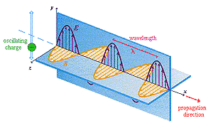
Alittle Physics (the Photon)

Slide 5
Energy of a Photon
E = hf = hc/λ. h = 6.626*10-34 Js
h is plank’s constant.
From Physicist Max Plank.

Slide 6
Compton scattering
From experiment by Arthur Holly Compton
Was meant to prove particle nature of the photon.
Photon strikes a particle imparting a portion of it’s energy to the particle causing it to scatter.
The particle moves in one direct with a portion of the photons energy and the photon move off in another with a decreased energy.
Of course energy is conserved

Slide 7
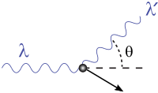
Compton scattering

Slide 8
So how does it work?
Blast occurs producing Gamma rays (High energy form of Photons)
Electrons are blown off of atoms due to the Compton effect.
The electrons then spiral down the magnetic flux lines of the earth
The acceleration of the electrons cause the electrons to emit photons
The fields (electric and magnetic) radiate out and intersect the target and create the
EMP.
Please refer to slides below showing process and absorption region.

Slide 9
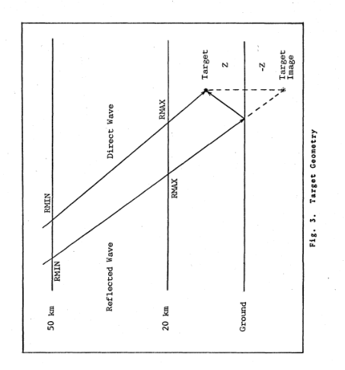
Blast production of EMP

Slide 10
Between Rmax and Rmin is the interval of integration.
The default value for the interval was 50 due to the limitations of the CDC6600 system it was ran on. This max value has been increased to 10,000. All tests were ran at 5000.
One of the many difficulties was the model diverging at the 50 iteration figure. When the value was increased to 5000 the model began to converge for all values of prompt gamma ray tonnage up to model limits of 1 Kton.

Slide 11
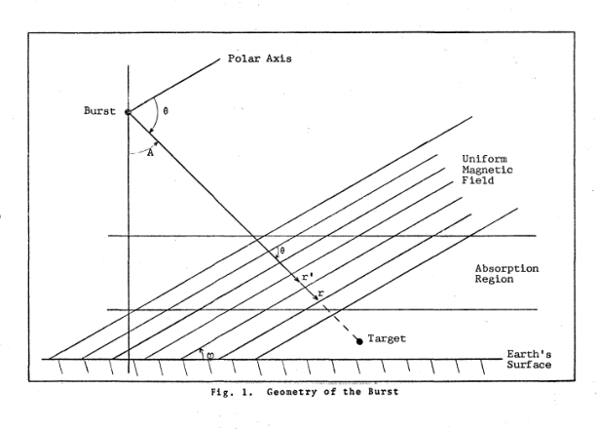
Another view with magnetic flux lines

Slide 12
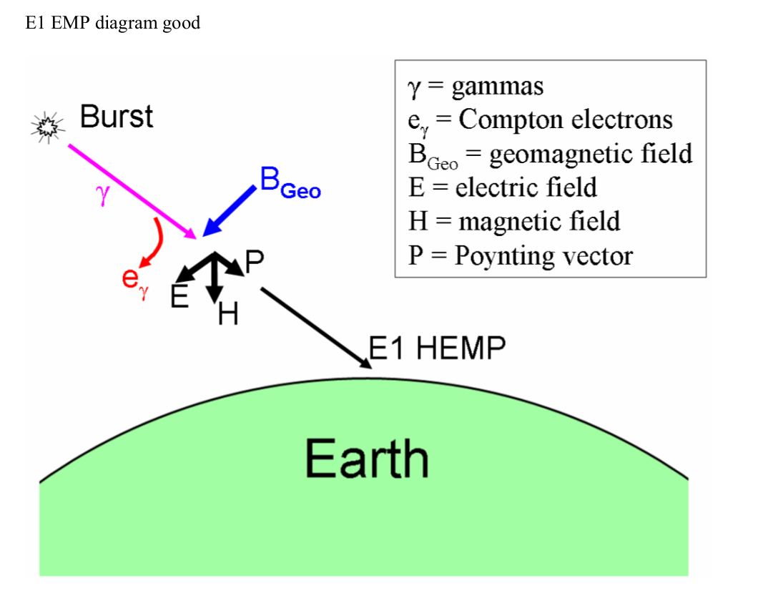
More Slides

Slide 13
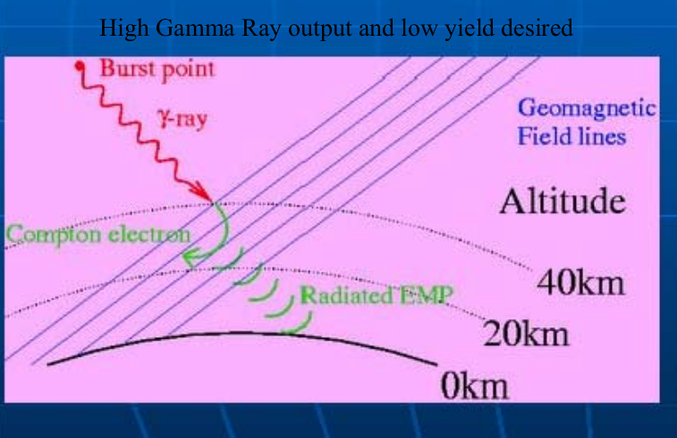
More slides

Slide 14
Notes on Blast Yield
All models use what is called Prompt gamma Yield.
This is not the Yield of the device as a totality, but represents as a general statement about .1% of the total energy of the device being converted to gamma rays. So to create 100Ktons energy of Gamma radiation yield would require a bomb of 100,000/.001=100Mton. Approx twice the size (57 Mton) of the tested Tsar Bomb. The Tsar design was suppose to have been able to produce 100Mton but was scaled back. As it stands it was the largest single man made explosion in history. The energy released was equivalent to over 1500x the combined energy released in Hiroshima and Nagasaki and 10 times ALL the bombs dropped during World War II.

Slide 15
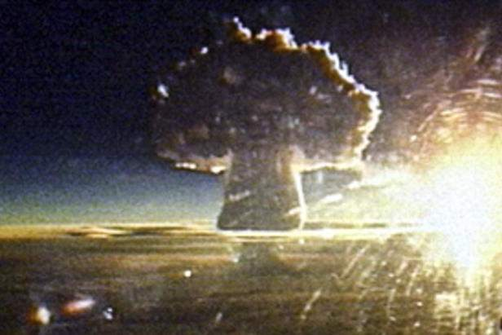

Slide 16
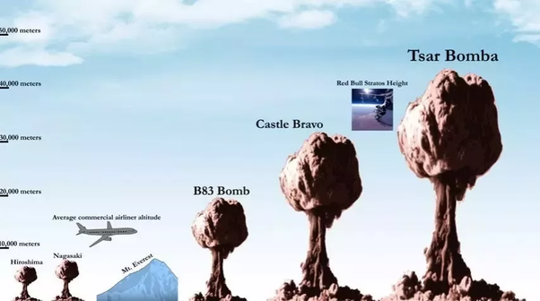

Slide 17
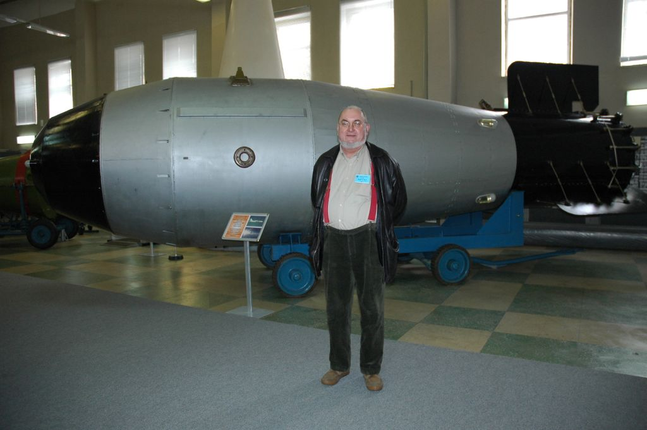

Slide 18
FOFT FUNCTION
FUNCTION FOFT(T)
C
C F(T) IS THE POMRANNING MODEL FOR TIME DEPENDENCE
C OF NUCLEAR WEAPON YIELD IN RETARDED TIME
INTEGER OUX
COMMON OUX,AP,BP,RNP,TOP
TSHAKE=1.E8*T
DENOM=(BP+AP*EXP((AP+BP)*(TSHAKE-TOP)))*RNP
FOFT=(AP+BP)*EXP(AP*(TSHAKE-TOP))/DENOM
RETURN
END

Slide 19
Meaning of variables
4 variables are defined for the time value function
Alpha, Beta, RNP, TOP Independent variable in time except RNP
Alpha-Defines the left side of the slope.
TOP- Defines the top of the pulse
Beta- Defines the right side of the slope
RNP- Scaling factor to equate integral to 1 in integration interval

Slide 20
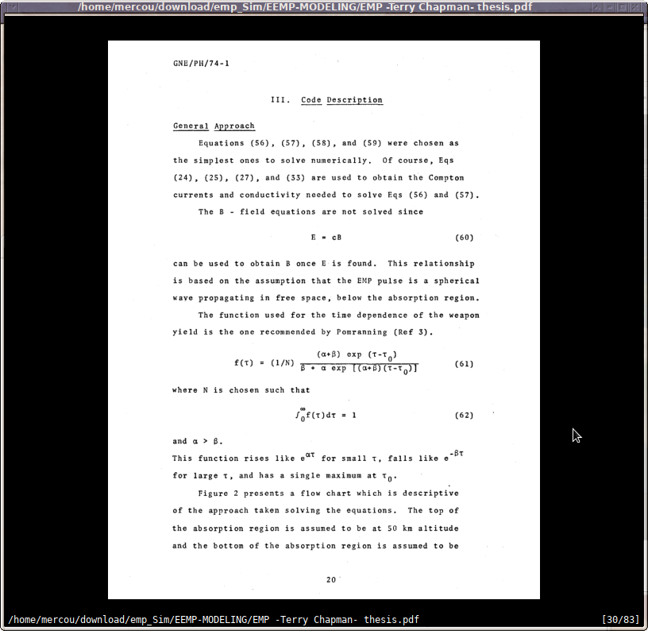
FOFT from Chapman

Slide 21

FOFT from Seiler

Slide 22
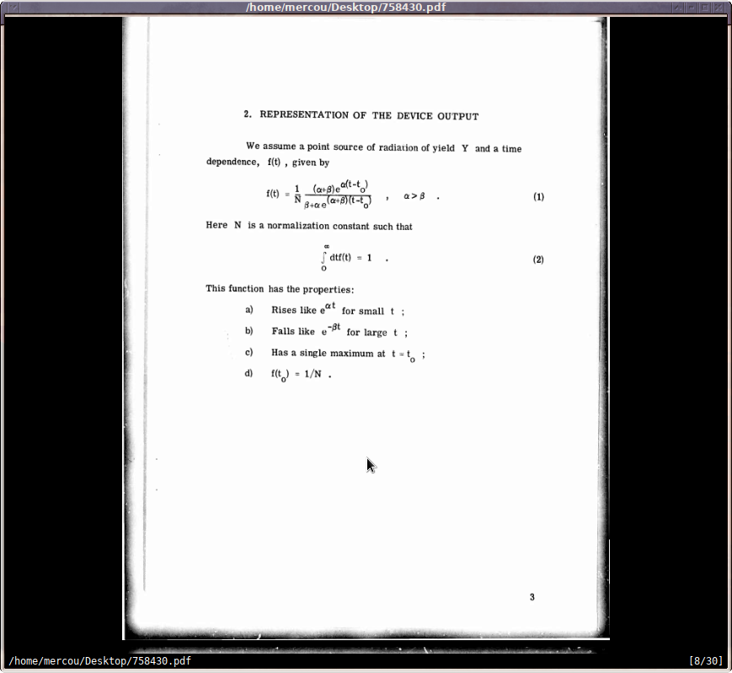
From Pomraning (Early air fireball model)

Slide 23
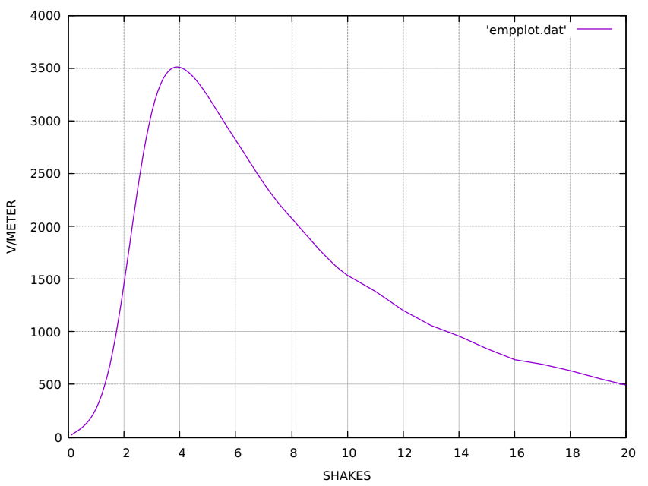
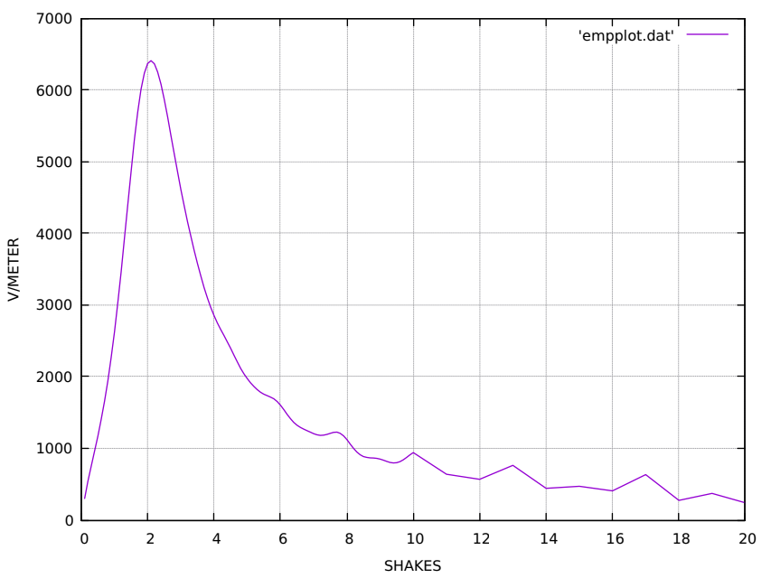
.001Ktons Yield

Slide 24
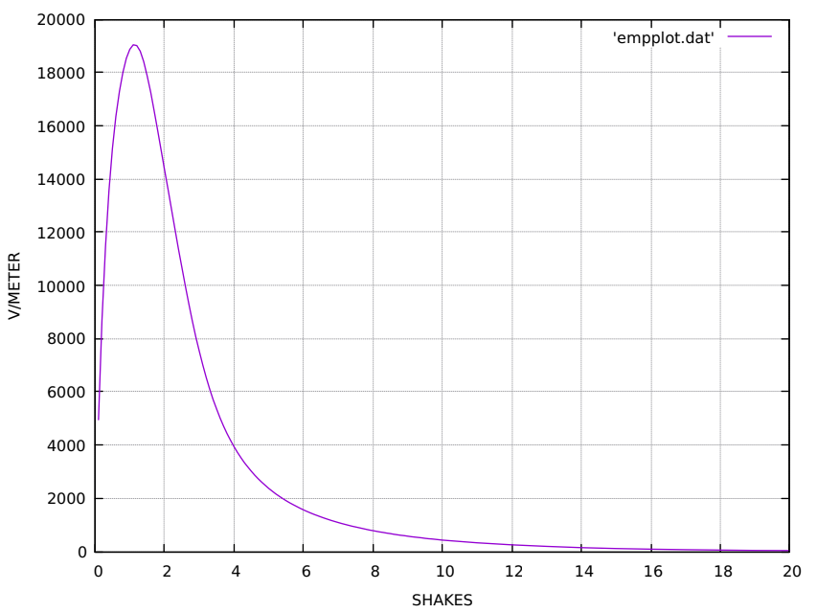
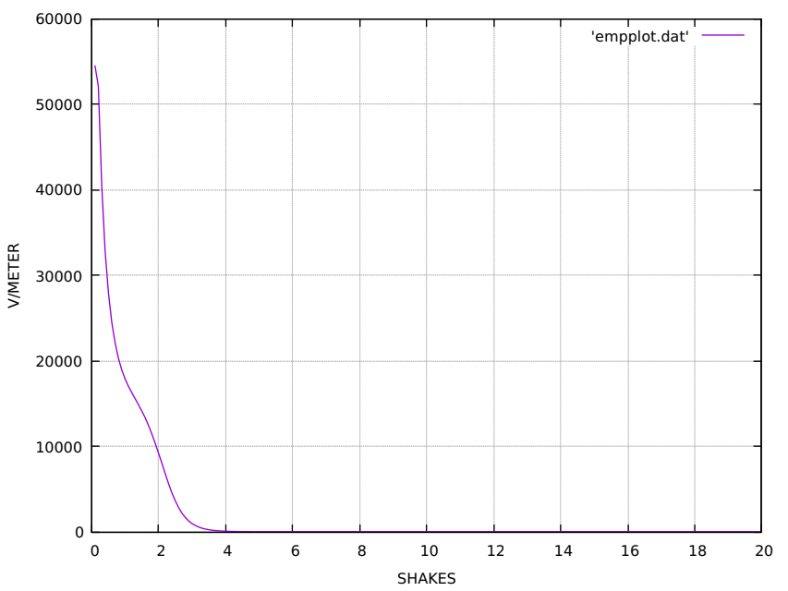
.25Ktons Yield

Slide 25
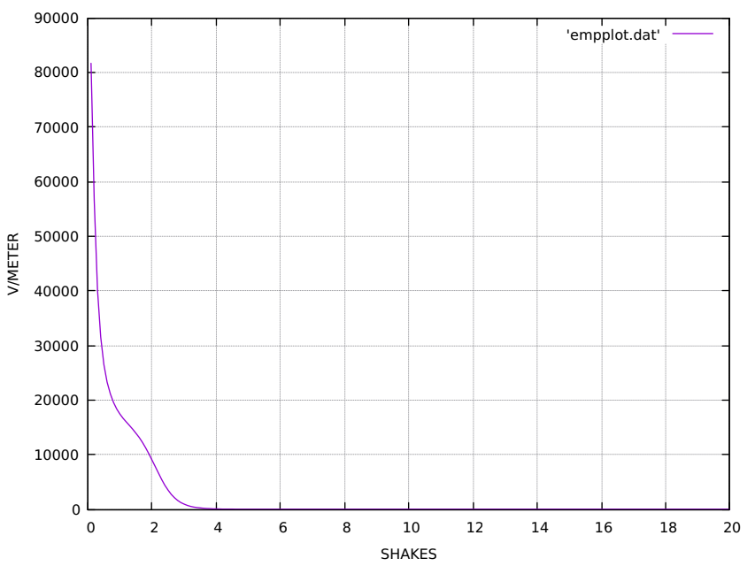
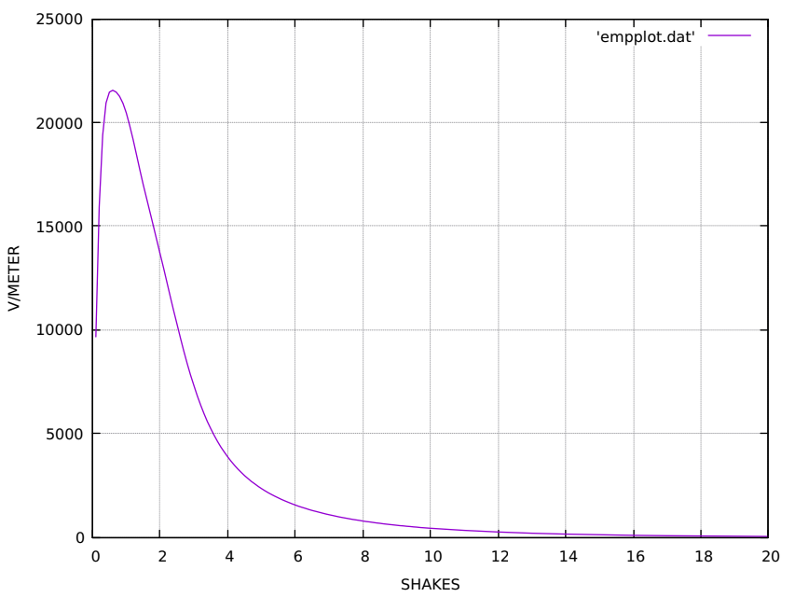
.50Ktons Yield

Slide 26
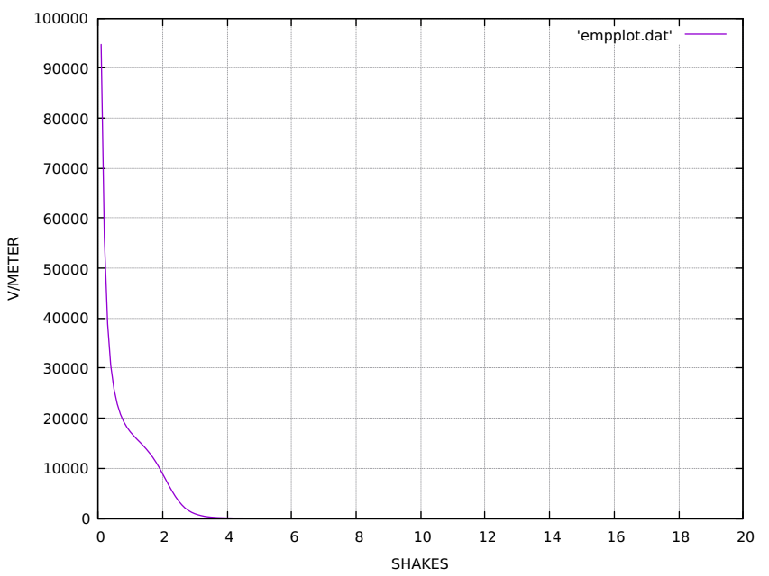

.75Ktons Yield

Slide 27
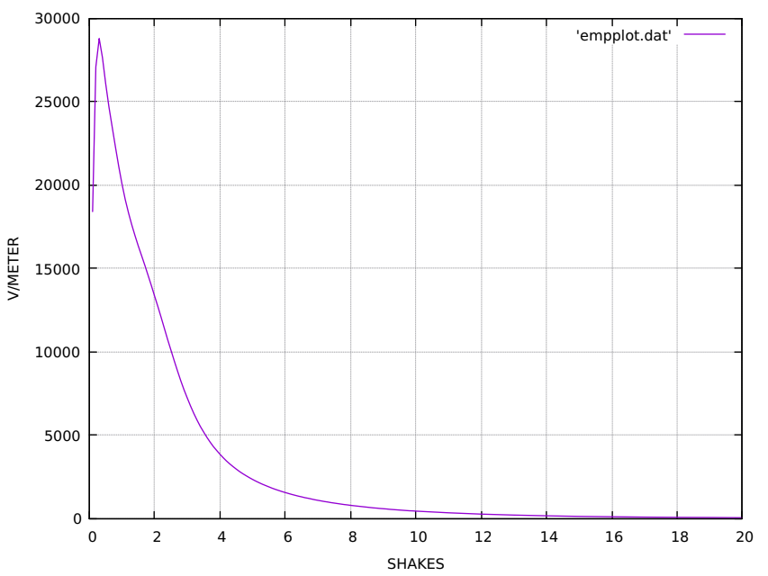
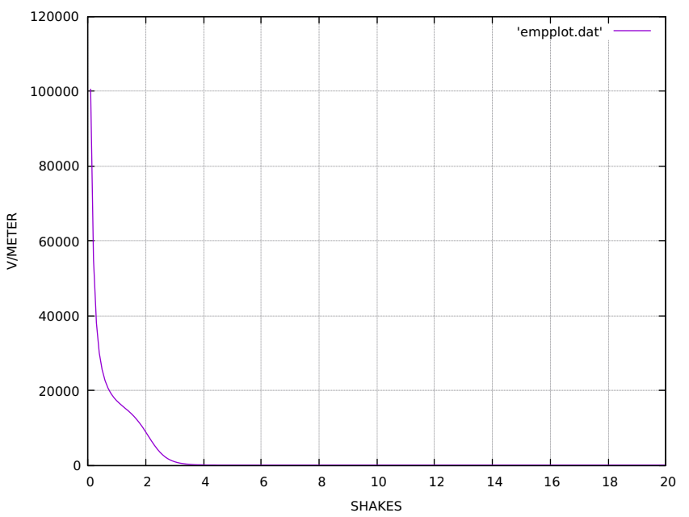
1 Ktons Yield

Slide 28
My derived constants
The following section will show my derived constants.
Methodology
Derived constants
Run for .001,.25,.50,.75,1 Ktons
Comparison

Slide 29
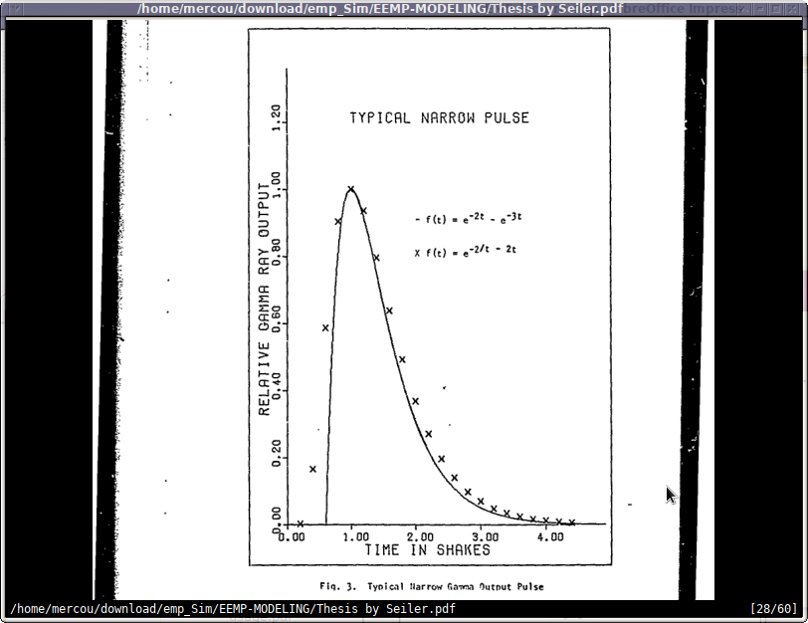
Seiler pulse gamma yield f(t)

Slide 30
The objective is to reproduce pulse as exemplified by Seiler (see previous slide) using the FOFT pulse equation shown previously.The restraints and requirements are a peak at 5ns or .5 shakes a>b and the definite integral from 0 to inf equals 1. The equation must also mimic the general shape of the pulse. Rolloff time is 40ns (4 shakes).

Slide 31
Derived constants
AP BP RPN TOP
19 .12 9 .5
Using these constants mimics Seiler pulse closely and fulfills the requirement of integration equaling 1.
Peak gamma yield is also achieved at .5 shakes into run.
See following slides to illustrate.

Slide 32
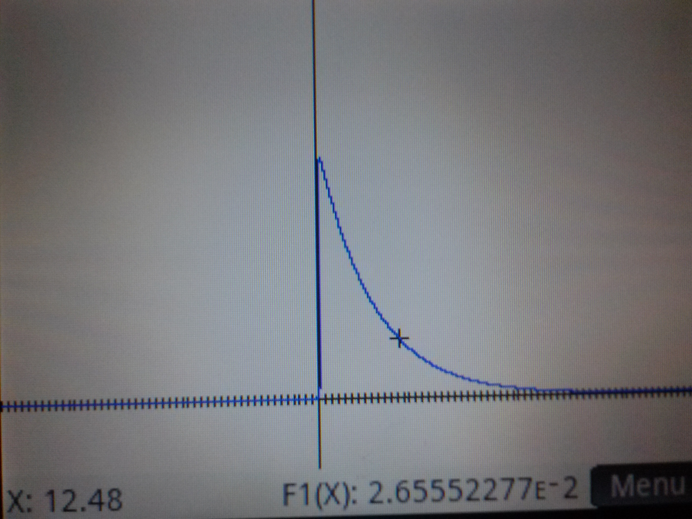

Slide 34
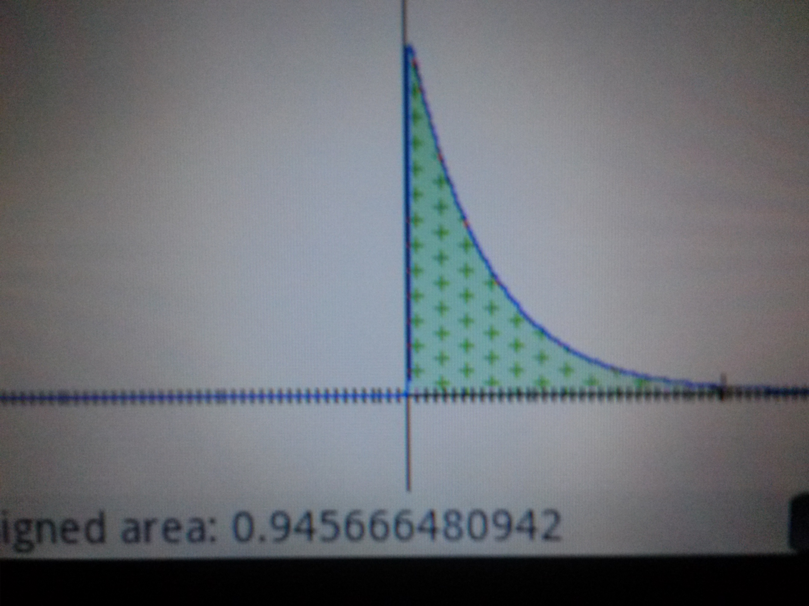

Slide 35
Once previous constants were employed an additional problem arose, namely at certain points in the calculation a NaN (NOT a NUMBER) error was encounter. After debugging it was ascertained that the problem was too small a word size. The original code was run on a CDC 6600 supercomputer which had a word size of 60bits. I therefore reasoned that the default wordsize on an intel arch was too small. Changing some variables (see source) to DOUBLE PRECISION solved the problem.

Slide 36
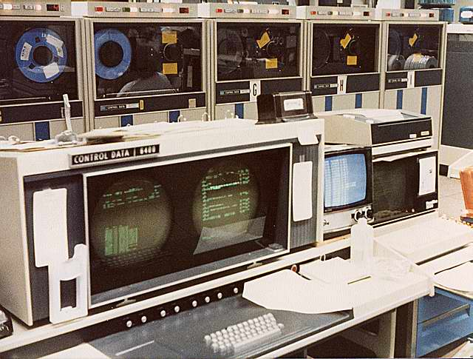

Slide 37
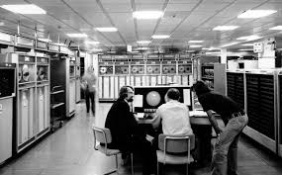

Slide 38
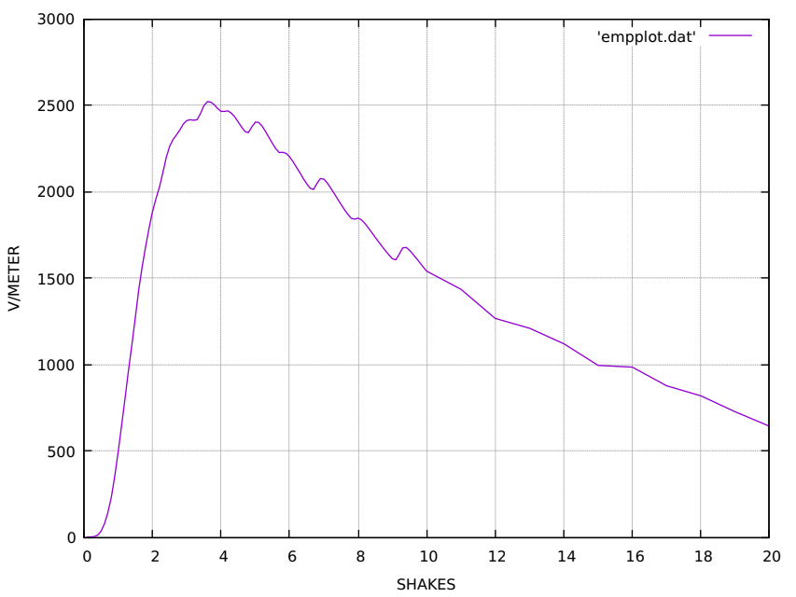
.001 Ktons

Slide 39
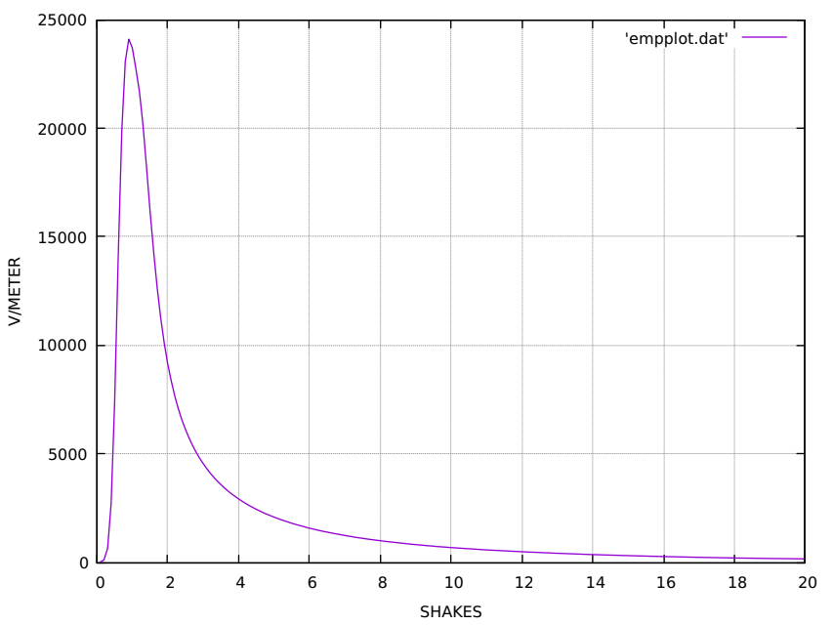
.25Ktons

Slide 40
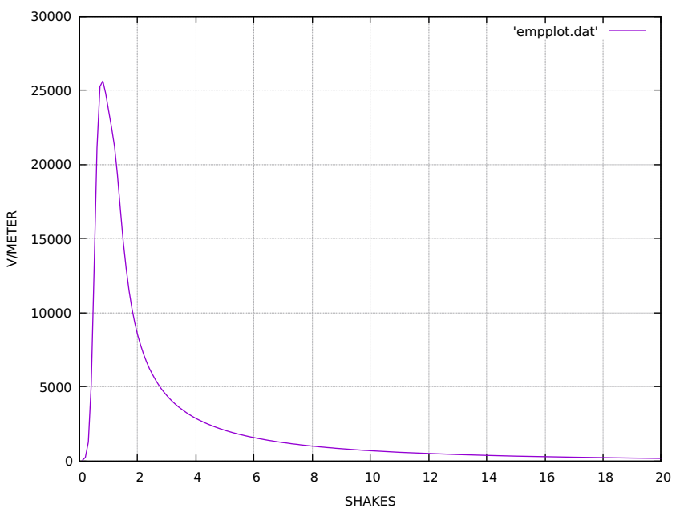
.50Ktons

Slide 41

.75Ktons

Slide 42

1Ktons

Slide 43
Notes
The accuracy of the previous mathematical runs has not been verified.
Please refer to cleaned up and amended fortran source code
https://github.com/drforbin/EEMP-MODELING
EEMP (Enhanced EMP Modeling)

Slide 44
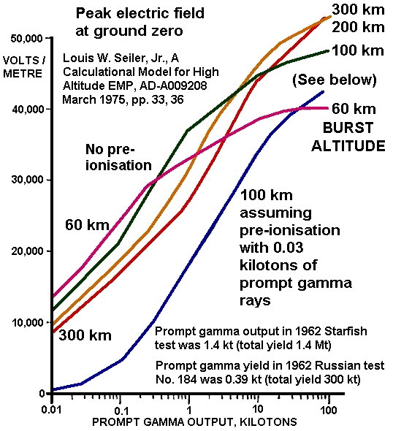
Seiler emp as F(x) of prompt gamma yield

Slide 45
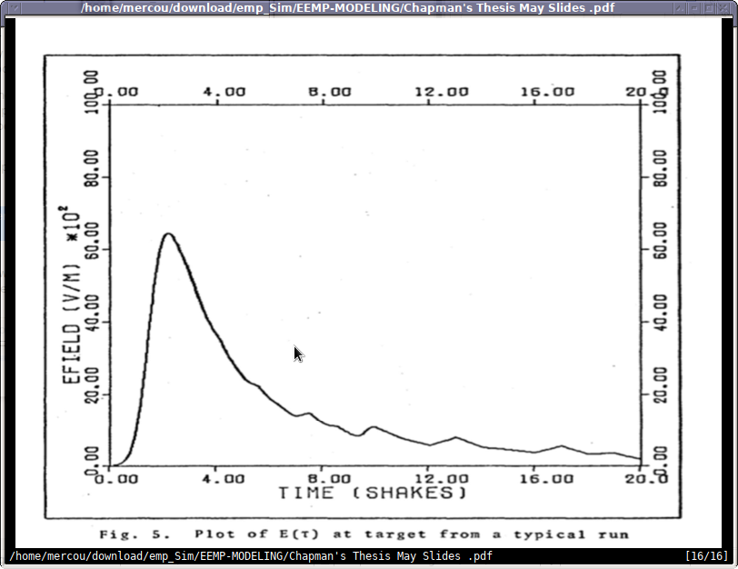
Chapman .001Ktons yield

Slide 46
Changes added functions
Following slide shows function added for plotting purposes.
Function writes txt file which can be ran through gnuplot to produce a plot.

Slide 47
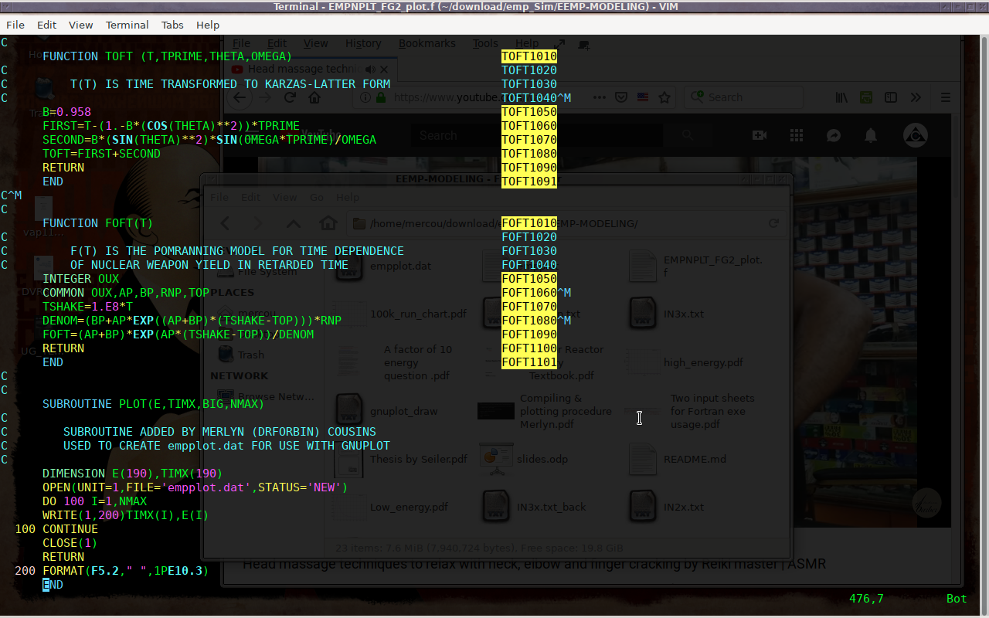
Added CALL for plotting

Slide 48
Conclusion
Based on all available data (to the presenter) the Grouse constants appear to produce figures which more closely track emp as f(x) of gamma yield. Please consider the max is slightly over 50Kv/m for a gamma yield of 100Ktons (Seiler chart). Using grouse’s constants the 1Kton emp is ~28Kv/m, ~34Kv/m for Seiler chart, and well over 100Kv/m using sunny’s constants. My constants produce a result near 27Kv/m
Grouse’s constants track the only available data more closely than does the sunny constants.
My constants are the more conservative but are the only constants which fully reproduce the Seiler gamma pulse faithfully using the Pomraning equation.

Slide 49
cont
More work has to be done to nail down exactly how these four constants interact in order that more reliable conclusions can be reached. As it stands the findings are riddled with inconsistencies.
But given both Grouse’s, My numbers and Seiler’s produce ~ a 30Kv/m EMP using a prompt gamma yield of 1Kton, which would translate into about a total weapon yield of 1000/.001=1Mton it still would pose a serious treat to unshielded electronic devices.

Slide 50
cont
In closing consider the fact that the U.S. among other nations has given up any pretense of civil defense as well as any major ground based ICMB systems opting for submarine based systems. It begs the question if expending money to harden infrastructure is really necessary or prudent. This is a question for political discussion.

Slide 51
AP BP RNP TOP
1/shakes 1/shakes shakes shakes (units)
2.2 .25 5.62603 2.23 Grouse (left chart)
1.7 2.8 1.6 1.2 Sonny (right chart)
1 SHAKE is equal to 1x10-8=10ns

Slide 52
NOTES on MAD
Slides to follow.
What is MAD?

Slide 53
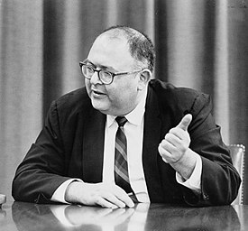
Herman Kahn.

Slide 54
Books by Herman Kahn.
‘Thinking the Unthinkable’
‘On thermonuclear war’

Slide 55
Herman Kahn Worked for the Rand Corporation
And is considered the main inspiration for Stanley Kubrick’s
classic character Doctor Strangelove.
He was one of the main theoreticians of MAD (mutually assured destruction) along with John Nash, the creator of Nash equilibrium which is a part of game theory.

Slide 56
It is the authors opinion that even though the current ‘BEST’ data available to the author suggests that peak EMP of ~27Kv/m could do substantial damage to unprotected devices it is logically invalid given the rational of MAD to care anymore about EMP than any other form of attack on infrastructure or the civilian population. In fact the very logic of MAD requires these vulnerabilities. Under MAD both the infrastructure and population are considered casualties of war to be thrown away. It is in the ability to ‘assure’ the destruction of the opponent that in game theory speak creates ‘incentives’. Incentives which according to the theory should dissuade an attack. ANY attempt to remove the assurance of destruction of either side destabilizes the game.
Thus spake Herman Kahn.

