Slide 1
WPA.
A walk down cracker lane.
Additional formatting by Phil Reason.

Slide 2
Outline
History of security in 802.11
Theory of WPA attack
PMKID attack description (thanxs to Aaron)
Live DEMO(by PHIL (the man) reason)

Slide 3
First There was WEP
WEP (Wired Equivalent Security)
  Deployed 1997
  Critical fault found in Crypto algorithm
  With 85k-100k packets collected crack is >80% probable

Slide 4
So then there was WPA
WPA (Wireless Protected Access)
  Deployed 2003
WPA2
  became Available 2004
  introduced CCMP encryption suit.
  changes in generation of MIC (Message Integrity Code)
    from md5 to sha1
WPA3 (Beyond scope)
… On to Theory ...

Slide 5
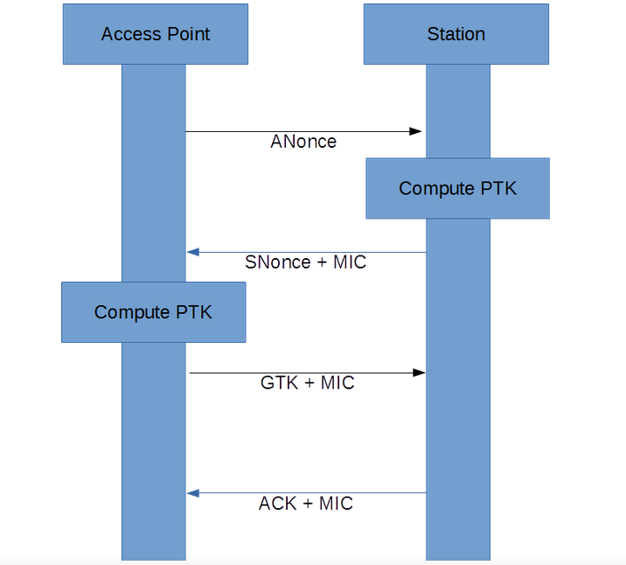
WPA Overview (the Handshake)
The 4-way Handshake
  the way WPA/WPA2 auth(s) a Station.
Lets look at a 4-way Handshake...

Slide 6
The WPA 4-way Handshake

Slide 7
WPA Overview (the Handshake)
Lets look at a Handshake:
  Interested in first two packets:
  With these we can crack WPA.
This and the SSID is all you need assuming that client successfully authenticated with the AP

Slide 8
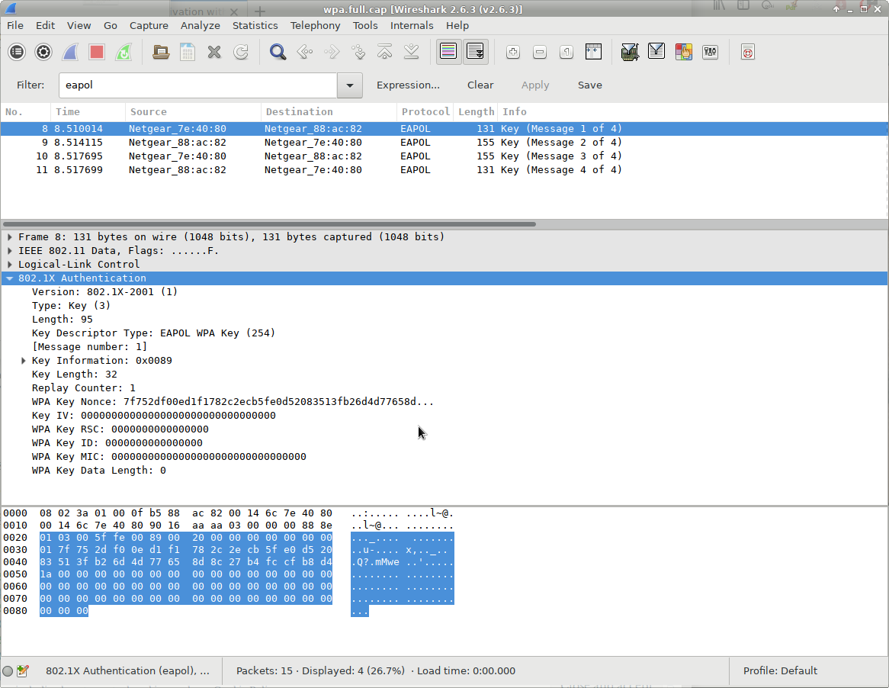
Packet 1

Slide 9
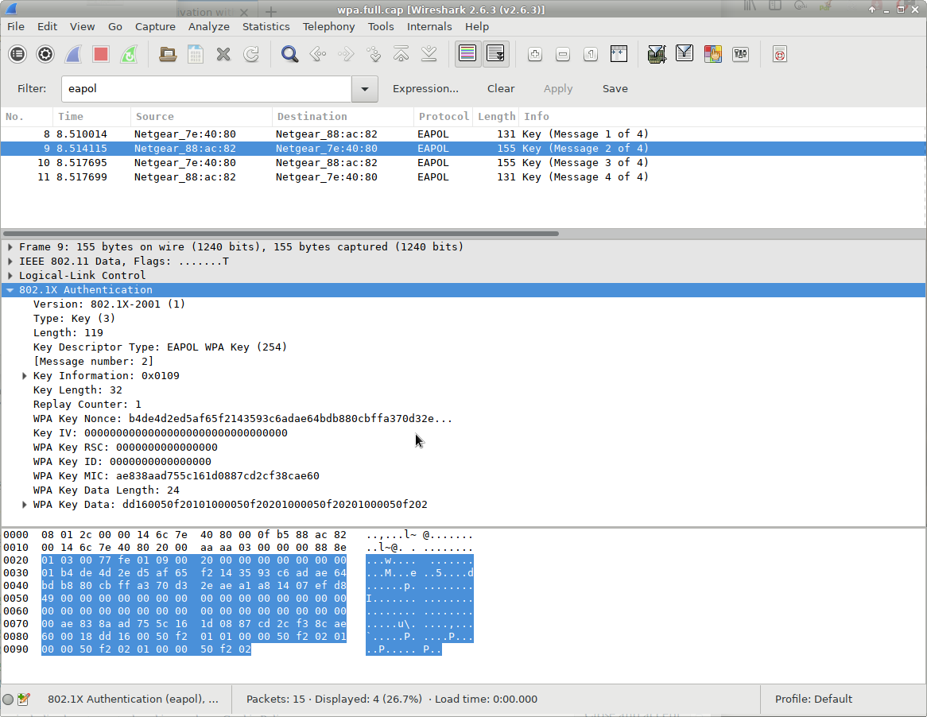
Packet 2

Slide 10
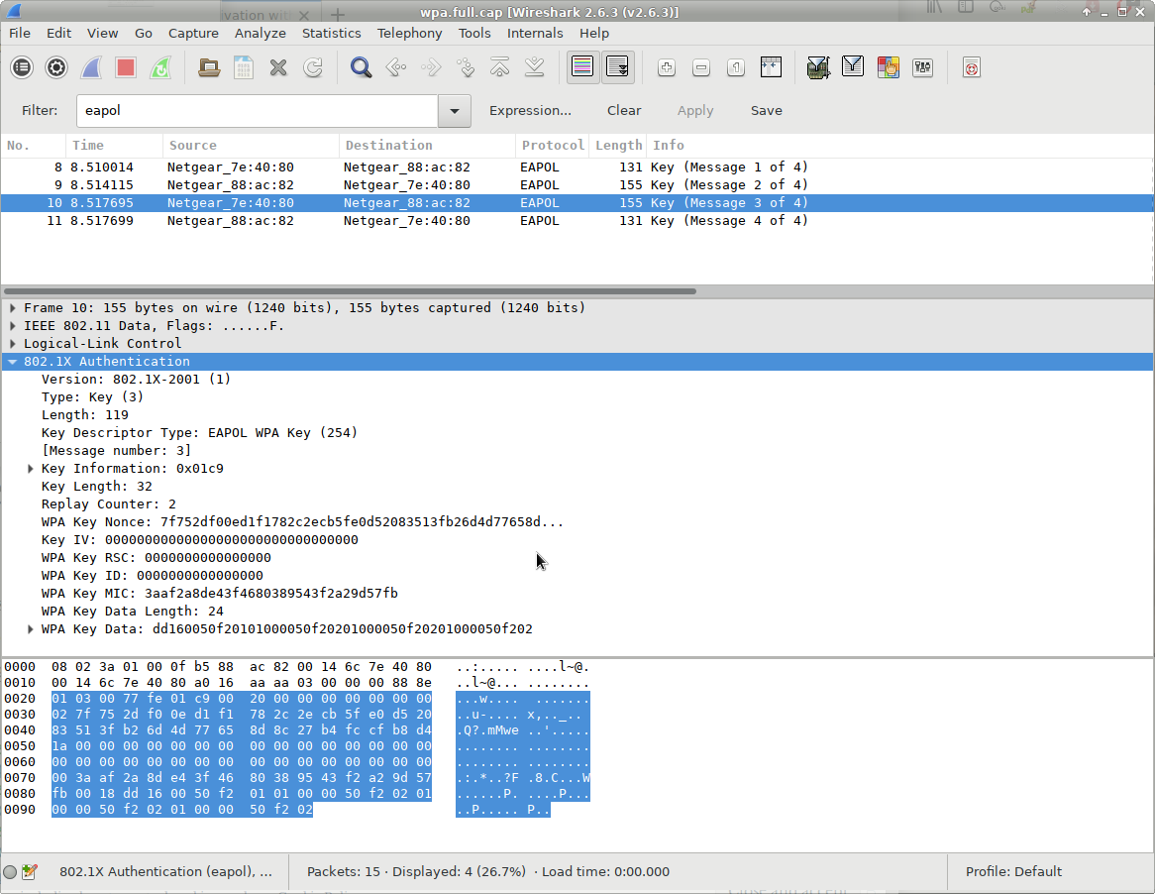
Packet 3

Slide 11
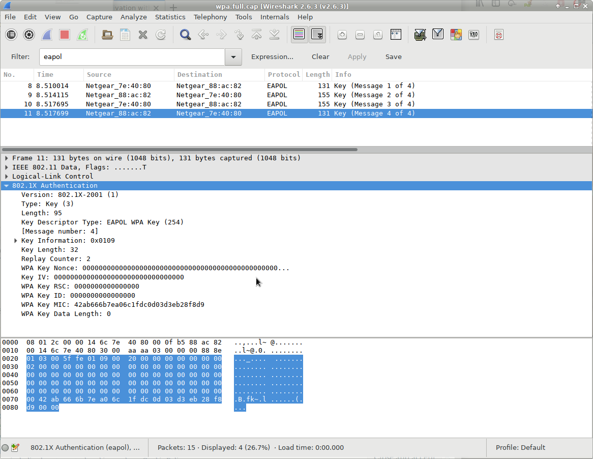
Packet 4

Slide 12
Handshake explained
ANonce – AP random number
SNonce – Station random number
MIC – Message integrity code

Slide 13
Nonce
Nonce Word
  A.K.A. “occasionalism”
  lexeme created for a single occasion to solve an immediate problem of communication.

Slide 14
Keys (So many)
PSK – Pre Shared Key
PMK – Pairwise Master Key
PTK – Pairwise Transient Key
MIC – Message Integrity Code (hash)

Slide 15
Pre Shared Key
PSK
  Not less than eight or greater than 63 characters, as required by 802.11i.
  effectively a passphase.

Slide 16
PMK (Pairwise master Key)
PMK
  #Used for computing PMK
  from hashlib import pbkdf2_hmac, sha1, md5
  #Create the pairwise master key
  pmk = pbkdf2_hmac ('sha1', psk.encode('ascii'), ssid.encode('ascii'), 4096, 32)
This takes a lot of time to generate!

Slide 17
(PTK)Pairwise Transient Key
Key segmentation fields: Total 64 Bytes (512 bits)
EAPOL-Key Confirmation Key (KCK), 16 byte
  Used to compute MIC on WPA EAPOL Key message
EAPOL-Key Encryption Key (KEK), 16 bytes
  AP uses this key to encrypt additional data sent (in the 'Key Data' field) to the client (for example, the RSN IE or the GTK)
Temporal Key (TK), 16 bytes
  Used to encrypt/decrypt Unicast data packets
Michael MIC Authenticator Tx Key, 8 bytes
  Used to compute MIC on unicast data packets transmitted by the AP
Michael MIC Authenticator Rx Key, 8 bytes
  Used to compute MIC on unicast data packets transmitted by the station
We are interested in first 16 bytes (KCK). This Key is used to produce the MIC.

Slide 18
Generating PTK(MAKEAB)
#Make parameters for the generation of the PTK
#aNonce:The aNonce from the 4-way handshake
#sNonce:The sNonce from the 4-way handshake
#apMac:The MAC address of the access point
#cliMac:The MAC address of the client
#return:(A, B)

Slide 19
Generating PTK(MAKEAB)
def MakeAB(aNonce, sNonce, apMac, cliMac):
A = b"Pairwise key expansion"
B = min(apMac, cliMac) + max(apMac, cliMac) + min(aNonce, sNonce) + max(aNonce, sNonce)
return (A, B)

Slide 20
Generating PTK(PRF)
Import hmac
#Pseudo-random function for generation of
#the pairwise transient key (PTK)
#key:The PMK
#A:b'Pairwise key expansion'
#B:The apMac, cliMac, aNonce, and sNonce concatenated
#like mac1 mac2 nonce1 nonce2
#such that mac1 < mac2 and nonce1 < nonce2
#return:The ptk

Slide 21
Generating PTK(PRF)
def PRF(key, A, B):
#Number of bytes in the PTK
nByte = 64
i = 0
R = b''
#Each iteration produces 160-bit value and 512 bits are required
while(i <= ((nByte * 8 + 159) / 160)):
hmacsha1 = hmac.new(key, A + chr(0x00).encode() + B + chr(i).encode(), sha1)
R = R + hmacsha1.digest()
i += 1
return R[0:nByte]

Slide 22
Call to Generate PTK
pmk = pbkdf2_hmac('sha1', psk.encode('ascii'), ssid.encode('ascii'), 4096, 32)
A,B = MakeAB(aNonce, sNonce, apMac, cliMac)
PTK = PRF(pmk, A, B)
Now we have our PTK (Pairwise Transient Key)
So we can now reproduce the MIC.
FORWARD!

Slide 23
Generate MIC!!!!
Import hmac
from hashlib import sha1, md5
#Compute the message integrity check for a WPA 4-way handshake
#ptk Pairwise transient key
#data: A list of 802.1x frames with the MIC field zeroed
#return: mics
def MakeMIC(ptk, data, wpa = False):
#WPA uses md5 to compute the MIC while WPA2 uses sha1
hmacFunc = md5 if wpa else sha1
#Create the MICs using HMAC-SHA1 of data and return all computed values
mics = [hmac.new(ptk[0:16], i, hmacFunc).digest() for i in data]
return mics

Slide 24
Cracking Strategy
Now we have everything to crack this AP …
Take 802.1X EAPOL (Extensible Authentication Protocol Over Lan) with MIC
cleared of sniffed packet and run it through MakeMic creating a MIC using our trial psk.
We then compare the generated MIC
if(MIC == Sniffed MIC)
  Success!;
IF they equal the PSK is correct.

Slide 25
Live demo primer
So the strategy is as follows:
Find an AP with already associated Client.
Sniff in monitor mode.
Send disassociate packets to client.
Let the client re-associate and gather packets
Then using our functions try various psk(s) until the MICS match,
or use HASHCAT or similar to emulate our algorithm
We will now be doing this using kismet, aircrack-ng, and hashcat.
Please note some GPU powered crackers can avg ~5000 kH/s
See references for picture.

Slide 26
PMKID ATTACK
Cracking using a single RSN packet:
RSN (Robust Security Network Information Element)
  obtained from the first packet.
  Not all AP(s) support this.
When they do the packet is encoded as follows:
  PMKID = HMAC-SHA1-128(PMK, "PMK Name" | MAC_AP | MAC_STA)

Slide 27
PMKID ATTACK (Cont’d)
Cracking using a single RSN packet (cont’d):
So a psk can theoretically be found by the following:
  pmk = pbkdf2_hmac('sha1', psk.encode('ascii'), ssid.encode('ascii'), 4096, 32)
  PMKID = HMAC-SHA1-128(PMK, "PMK Name" | MAC_AP | MAC_STA)
… with trials ran from a dictionary.
Advantage: No Connected Clients are Required.

Slide 28
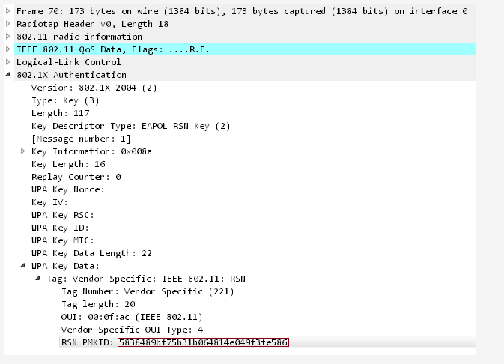
PMKID Packet

Slide 29
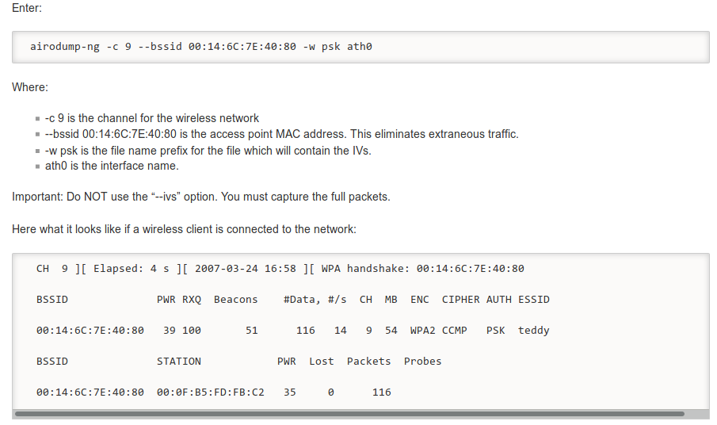
Command references (airdump-ng)

Slide 30
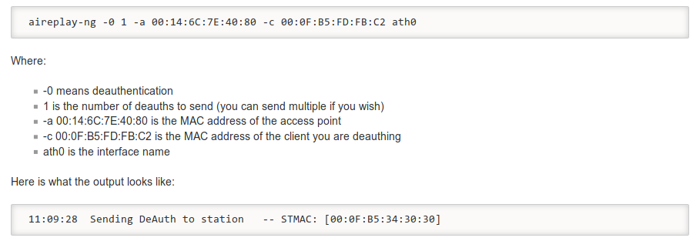
Command reference(aireplay-ng)

Slide 31
HASHCAT!
Using hashcat:
  must convert .cap file to .hccapx file.
  Ex.:
    hashcat -m 2500 capture.hccapx rockyou.txt

Slide 32
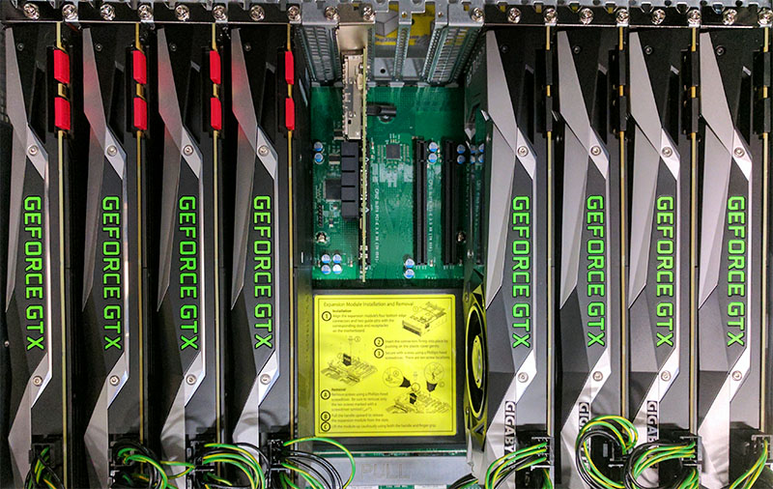
8x NVIDIA GTX 1080 Ti GPUs
AVG ~5000kH/s Build.

Slide 33

THANXS!
BYE!

